Slide 1
Exercise 1: Preparing the statistical data for
use in a GIS software
Izay Pantanilla
GIS Analyst, Health GeoLab Group, Epidemiology Department,
Mahidol-Oxford Tropical Medicine Research Unit, Faculty of Tropical Medicine,
Mahidol University, Bangkok

Slide 2
Request received for maps
Map 1
Purpose: Assist on-going malaria control and elimination activities
Audience: Province-level Malaria Surveillance Officer
Content:
Updated number of malaria cases:
By place of residence aggregated by Barangay
By place of reporting at the health facility level
Medium: A4 size map stored in a PDF file

Slide 3
Request received for maps
Map 2
Purpose: Identify geographic foci and guide foci investigations as needed
Audience: Barangay-level Malaria Surveillance Officer
Content:
Location of place of residence and possible place of infection for the 315 positive cases reported since the beginning of the year and including the new ones just reported by the RITM Hospital
Waterways and water bodies
Forests
Medium: A4 size map stored in a PDF file
Any statistical data here?
We will focus on preparing the data for the 1st map

Slide 4
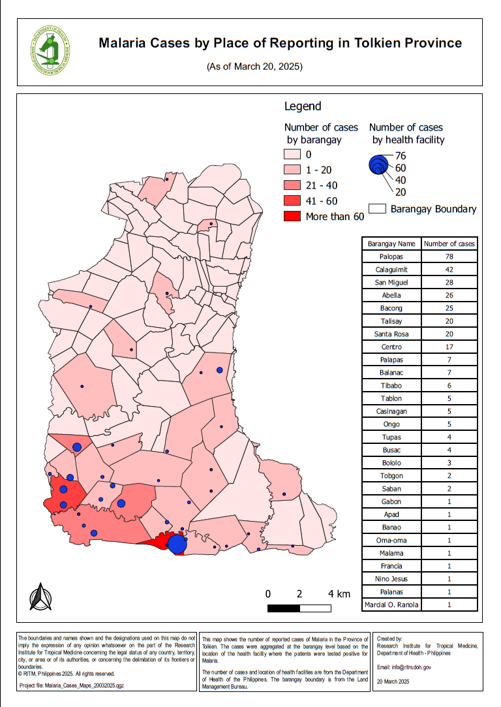
What statistical data do we need?
What kind of data do we need and how should it be organized to create the 1st map?
Excel file with the total number of cases (315+new ones) by Barangay organized in a table presenting at least 3 columns:
Barangay unique ID
Barangay name (for crosschecking)
Total number of cases until today
Excel file with the total number of cases (315+new ones) by health facility organized in a table presenting at least 3 columns:
Health facility unique ID
Health facility name (for crosschecking)
Total number of cases until today

Slide 5
What tabular data do we have?
Administrative divisions master list down to the Barangay level (PSA)
Health Facilities master list (DOH)
Malaria cases report for the 315 positive cases identified since the beginning of 2025
Answer from the ODK-based questionnaire for the new cases reported by the RITM Hospital
Data placed in the TRAINING_MATERIAL\EXERCISES\EXERCISE_1\DATA folder

Slide 6
What tabular data do we have?
Administrative divisions master list
Open the Admin_divisions_master_list_PSA_Jan2025.xlsx file in excel
Look at the structure and content of the file
How many worksheets?
What is in each worksheet?
Identify the following information across the worksheets:
The source of the data
The year of validity
The explanation of the content
Is this file organized properly to allow its use in a GIS software?

Slide 7
What tabular data do we have?
Health facilities master list
Open the Health_Facilities_master_list_DOH_Jan2025.xlsx file in Excel
Notice the similar file structure as the administrative division master list
Identity the following information across the worksheets:
The source and validity of the data
The structure of the unique identifier attached to each health facility
The geographic coordinates for each health facility
The method used to collect these coordinates and the associated level of accuracy

Slide 8
What tabular data do we have?
Malaria cases report file
Open the Malaria_Cases_Report_DOH_200325.xlsx file in excel
Look at the structure and content of the file
Search for the following information across the worksheet:
The source and validity of the data
The explanation of the content of each column
Is this file organized properly to allow using it to create the content of the first map? If not, why?
Does the list of Barangays and health facilities in this file match those in the master lists?
Are the Barangays codes and health facilities unique IDs the same between this file and the master lists?
What do you think about the unique ID attached to each case?
What do we have to do to obtain the data we need?

Slide 9
What tabular data do we have?
Answer from the ODK-based questionnaire
Open the Surveillance_results.csv file in Excel
Look at the structure and content of the file
What is missing compared to the previous files?
Is this file organized properly to allow using it to create the content of the first map? If not, why?
Does the list of Barangays and health facilities in this file match those in the master lists?
Are the Barangays codes and health facilities unique IDs the same between this file and the master lists?
Which part of this table do we need to integrate in the Malaria cases report file?
How do we use these different Excel files to create the ones we need to generate the 1st map?

Slide 10
Exercise 1 – Part 1
Integrate the new cases in the Cases Report file
Open the following files in Excel:
Malaria_Cases_Report_DOH_200325.xlsx (cases report)
Surveillance_results.csv (answers from the ODK-based questionnaire)
Save the ODK-based file under a new name and in Excel format (security in case you make a mistake)
In the copy of the ODK-based file:
Identify and highlight the columns that needs to be kept to match the structure of the cases report file
Delete the other columns

Slide 11
Exercise 1 – Part 2
Integrate the new cases in the Cases Report file
List of fields that should be in your temporary file before copying the records to the Malaria Cases Report file
Barangay code: barangay_address:residence_brgy
Barangay name: Not captured
Health facility unique ID: collection_location:hf_name
Health facility name: Not captured
Health facility type: hf_data:hf_type
Reporting date: reporting_date:date_clxn
Perform a VLOOKUP to get the Barangay names and Health facility names
Once done, integrate the new cases to the Malaria Cases Report file

Slide 12
Exercise 1 – Part 2
Integrate the new cases in the Cases Report file
Copy the new cases from the file resulting from step 3 and paste them in the cases report one (verify the total number of cases)
Add the next available unique identifier to each of the new cases
Save the case report file under a new name (with today’s date…in 2025)

Slide 13
Exercise 1 – Part 3
Create the malaria cases report file by Barangay
Open the Malaria_Cases_Report_DOH_[date].xlsx file in Excel
Use the pivot table function to generate a new table that would contain the Barangay unique identifier and the total number of cases by Barangay
Make sure that your pivot table contains all the cases from the cases report
Add the Barangay names to your table and adjust the headers to be appropriate for import in QGIS
Check that all the Barangay in your new table are in the master list and rename the worksheet «Tot_Cases_Bgy»
Save the resulting table as Tot_Cases_Bgy_[date].xlsx

Slide 14
Exercise 1 – Part 4
Create the malaria cases report file by health facility
Open the Malaria_Cases_Report_DOH_[date].xlsx file in Excel
Use the pivot table function to generate a new table that would contain the health facility unique identifier and the total number of cases by health facility
Make sure that your pivot table contains all the cases from the cases report
Add the Barangay names to your table and adjust the headers to be appropriate for import in QGIS
Check that all the health facilities in your new table are in the master list and rename the worksheet «Tot_Cases_HF»
Save the resulting table as Tot_Cases_HF_[date].xlsx

Slide 15
Exercise 1 – Conclusion
Re-organizing statistical data that are not properly organized in the first place might be very time consuming and prone to errors
Having a data catalog and metadata ensures for you to understand the data and make sure that it is appropriate for your needs
The use of a master list as the reference for data collection and sharing (unique identifier, name,…) facilitates data consistency, reduce data cleaning, and errors
Good geospatial data management practices is key to a powerful use of GIS and other geospatial technologies, and therefore thematic mapping

Slide 16
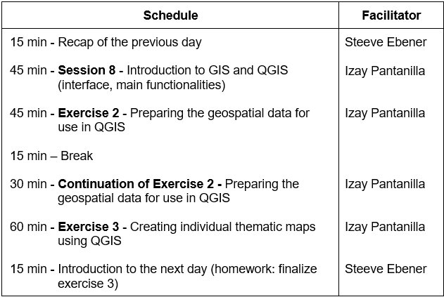
Introduction to Day 3 (October 24th, 12:00-16:00 Bangkok time)
Hands on with the use of QGIS!
Homework:
Finish exercise 1 and share the resulting file to us by email
Capture any questions you might have regarding the training in: https://bit.ly/3SR0nfB
Install QGIS 3.22 by following the instructions reported in Installing_QGIS_3-22.pptx
Capture any QGIS installation problems here: https://bit.ly/3eheHix
Go through the QGIS_Interface_Menu_Tools_27092022.pdf file

Slide 17
Q&A Sessions (October 21st, 12:00-14:00 Bangkok time)
1. Questions about the training (slides, exercises)
https://meet.google.com/rbz-wgrp-mii
Will answer the questions captured in: https://bit.ly/3SR0nfB
2. Problems installing QGIS 3.22
https://meet.google.com/yie-qhyo-yqy
Will answer the issues captured in: https://bit.ly/3eheHix

