Slide 1
INTRODUCTION TO THE MANAGEMENT AND USE OF GEOSPATIAL DATA AND TECHNOLOGIES
FOR MALARIA PROGRAMS
APMEN Online Training Series – Day 4

Slide 2
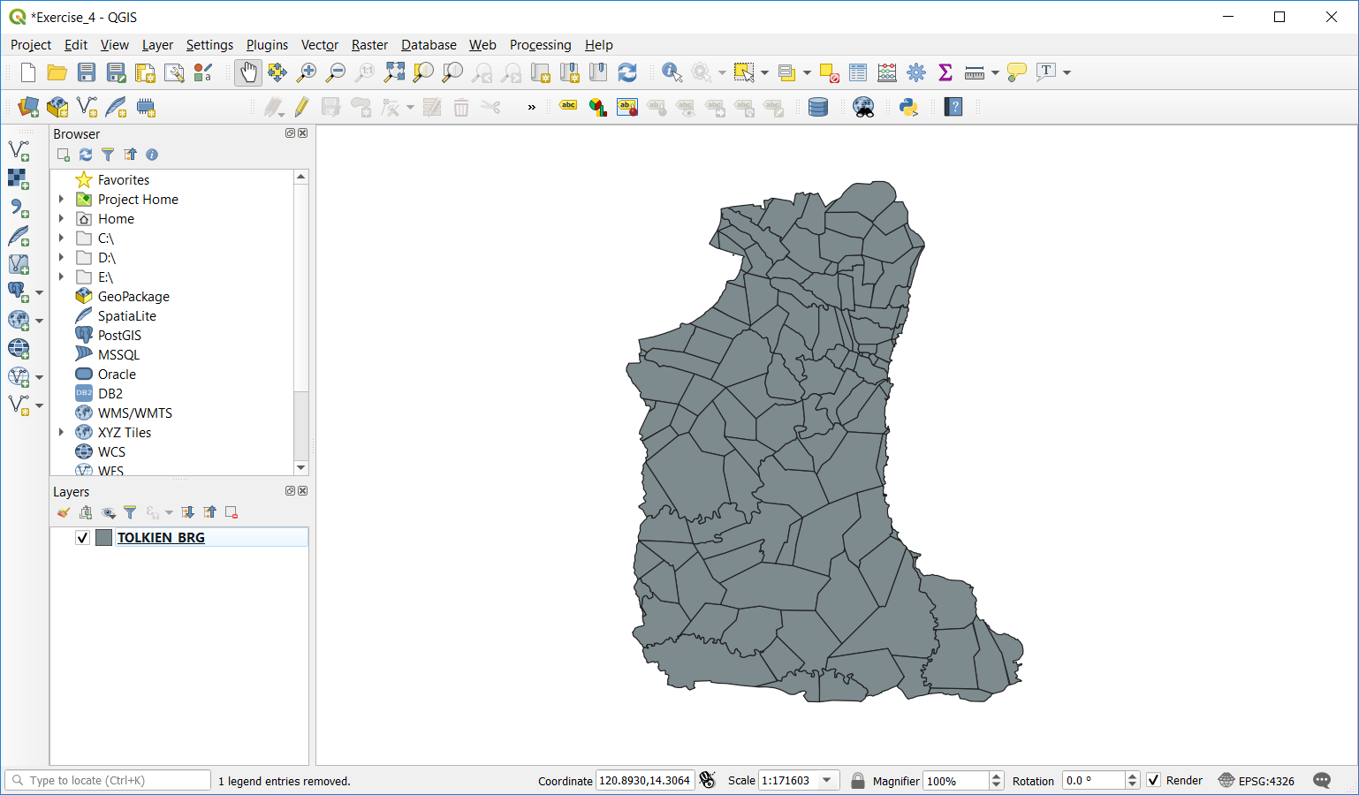
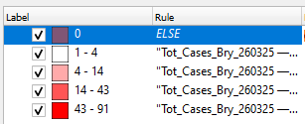
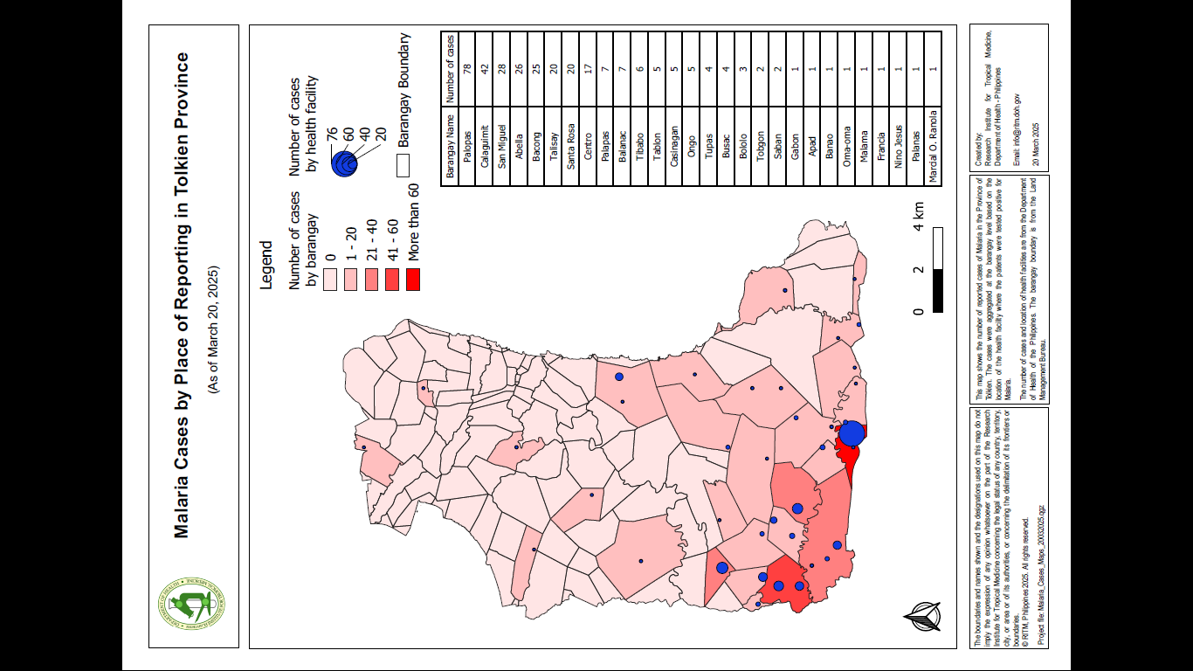
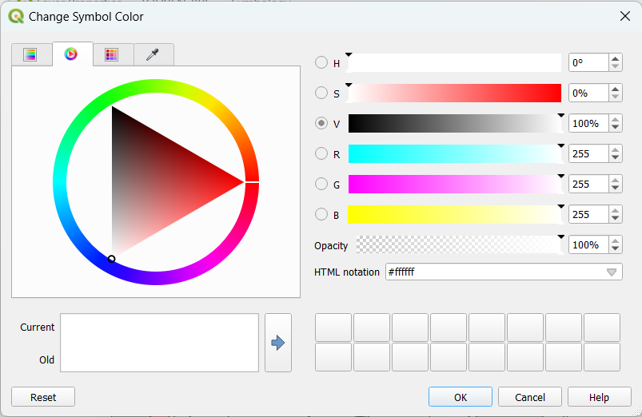
Recap of Day 4
Introduction to GIS and QGIS
Preparing the geospatial data for its use in QGIS
Creating individual thematic maps

Slide 3
Quizz
1. Please go to: https://ars.particify.de/
2. Enter code: 4739 3467
3. You should get this window:
4. Click on APMEN Day 4
5. First question

Slide 4
Day 4 (October 26th)
Repeat part of the exercises conducted during day 3
The way forward
Training evaluation form: https://bit.ly/3Fe476Z

Slide 5
Exercise 4: Preparing the thematic map
for the training certificate
Izay Pantanilla
GIS Analyst, Health GeoLab Group, Epidemiology Department,
Mahidol-Oxford Tropical Medicine Research Unit, Faculty of Tropical Medicine,
Mahidol University, Bangkok

Slide 6
Request received for maps – MAP 1
Purpose: Assist on-going malaria control and elimination activities
Audience: Province-level Malaria Surveillance Officer
Content:
Updated number of malaria cases:
By place of residence aggregated by Barangay
By place of reporting at the health facility level
Medium: A4 size map stored in a PDF file

Slide 7
What data do we need?
Geospatial data
Boundaries of the Barangay with the unique identifiers from the master list included in the attribute table
Location of the health facilities with the unique identifier from the master list included in the attribute table
Attribute data
Barangay level number of malaria cases
Health facility level number of malaria cases

Slide 8
Adding the geospatial data in QGIS
Barangay boundaries shapefile
Launch QGIS
Click the Add Vector Layer button
Browse to the location of the TRAINING_MATERIAL\EXERCISES\EXERCISE_4\DATA folder on your computer
Select the TOLKIEN_BRG.shp file and click on the Add button
Close the Data Source Manager window
The Barangay boundaries for the Province of Tolkien should appear in the map canvas of QGIS
Barangay boundaries shapefile
Click on the save icon
Browse to the folder where you want to save your QGIS project
Enter a file name and click Save

Slide 9
Adding the geospatial data in QGIS
Health facilities location shapefile
Open the Health_Facilities_master_list_DOH_Jan2025.xlsx file in Excel (located under TRAINING_MATERIAL\EXERCISES\EXERCISE_4\DATA)
Look at the fields containing the information related to the geographic coordinates of the health facilities:
How many fields do you see?
What does these fields contain?
What is the level of precision of the geographic coordinates?
Do we have geographic coordinates for the RITM Hospital?
Lat: 14.40956 Long: 121.03732
Source (method): RITM (GPS) Accuracy: High

Slide 10
Adding the geospatial data in QGIS
Health facilities location shapefile
We have to convert the content of the health facility master list into a shapefile
Save the Health_Facilities_master_list_DOH_Jan2025.xlsx as tab delimited (.txt) file
Close the Excel file.
In QGIS:
Click on the Add Delimited Text Layer button
In the window that opens:
Browse to the .txt file. Select it and click Open.
Under File Format, select Custom delimiters and check Tab
Under Geometry Definition, indicate which fields contain the longitudes and latitudes and Geometry CRS is EPSG:4326 – WGS 84
Click Add then close the Data Source Manager window.

Slide 11
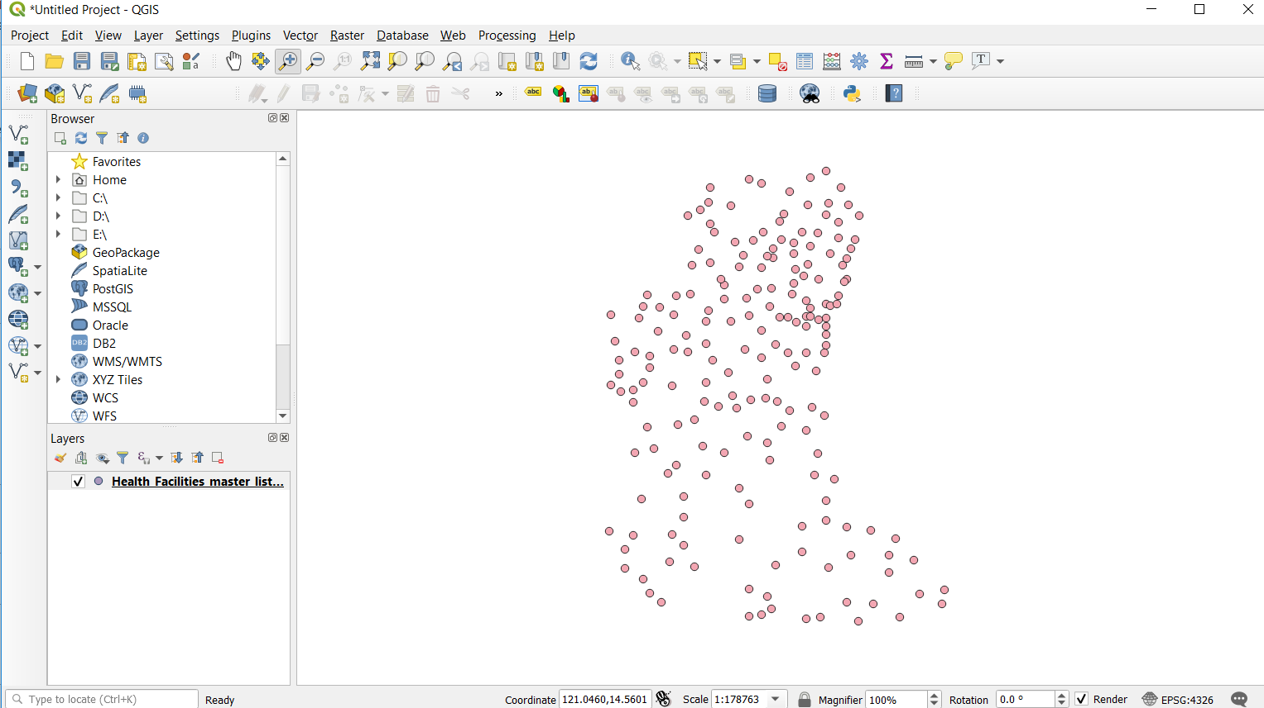
Adding the geospatial data in QGIS
Health facilities location shapefile
The locations of the health facilities included the master list should appear in the map canvas
Save the project!
!!!! The points are not yet saved in a shapefile!!!

Slide 12
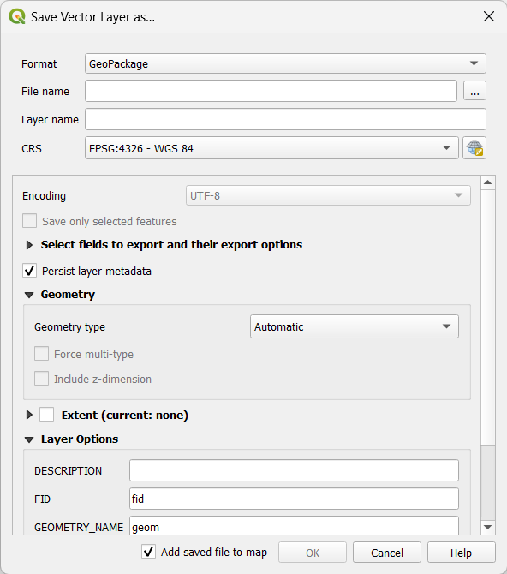
Adding the geospatial data in QGIS
Health facilities location shapefile
To do so:
Right click on the layer containing the points in the layer panel and click on Export > Save Features as…
In the Window that opens:
Select Esri Shapefile as the Format
Browse to the folder where you want to save it and give it a name (HF_Locations.shp)
Keep EPSG:4326 - WGS 84 as the CRS
Click OK.

Slide 13
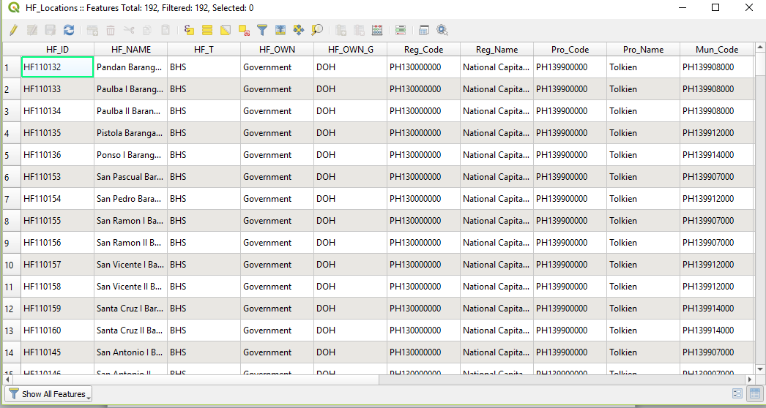
Adding the geospatial data in QGIS
Health facilities location shapefile
The new shapefile is now added to the layer panel
You can delete the temporary layer by right clicking on it and then click on Remove Layer
Once done, save the project and:
Make sure that all the points are falling within the Tolkien Province (click on the Zoom Full button for that )
Open the attribute table and check that all the content from the master list is there (192 health facilities)
Check that the health facilities are falling within the correct City and Barangay
Save the project!

Slide 14
Creating Geographic Data for Map 1
Barangay – Link with the number of malaria cases aggregated at barangay level
Click the Add Vector Layer button
Browse to the location of the EXERCISE_4\DATA folder
Select the Tot_Cases_Bgy_[date].xlsx file and click Add.
Close the Data Source Manager window.
Open the attribute table of the Excel file and Barangay boundary shapefile and compare the two tables.
Do they contain the same list of Barangays?
Is there a unique identifier in common to both tables that could be used to join them together?
Notes:
Note that the inclusion of the Administrative Division Master List in the population dataset and the shapefile make it easier to immediately link the two information. This saves time and effort .

Slide 15
Creating Geographic Data for Map 1
Barangay – Link with the number of malaria cases aggregated at barangay level
This means that we can join the content of the malaria cases table (Excel) to the attribute table of the shapefile
Right click on the shapefile name in the menu and click on Properties…
Click on Joins in the window that opens
Click on the « + » icon at the bottom of the window
In the window that opens select:
Tot_Cases_Bgy_[date] – Tot_Cases_Bgy as the Join layer
Bgy_Code as the Join field
Bgy_Code as the Target field in the shapefile
Click OK twice

Slide 16
Creating Geographic Data for Map 1
Barangay – Link with the number of malaria cases aggregated at barangay level
Re-open the attribute table of the Barangay boundaries shapefile
Notice that the content of the malaria cases table from the Excel file is now included in the shapefile attribute table (last columns)
Check that all the Barangays for which cases have been reported do present a value in the attribute table
Layer ready for thematic mapping!
Don’t forget to save your project!

Slide 17
Creating Geographic Data for Map 1
Health facility location - Link with the number of malaria cases by health facility
Click once again the Add Vector Layer button
Browse to the location of the EXERCISE_4\DATA folder
Select the Tot_Cases_HF_[date].xlsx file and click Add.
Close the Data Source Manager window.
Open the attribute table of the Excel file and Health facility shapefile and compare the two tables.
Do we have the unique identifier?
Is there a value in the TOT_CASES column for each health facility in the Excel file?
Notes:
Note that the inclusion of the Administrative Division Master List in the population dataset and the shapefile make it easier to immediately link the two information. This saves time and effort .

Slide 18
Creating Geographic Data for Map 1
Health facility location - Link with the number of malaria cases by health facility
We can join the content of the malaria cases table (Excel) to the attribute table of the shapefile
Right click on the health facility shapefile name in the menu and click on Properties…
Click on Joins in the window that opens
Click on the « + » icon at the bottom of the window
In the window that opens select:
Tot_Cases_HF_[date] – Tot_Cases_HF as the Join layer
HF_ID as the Join field
HF_ID as the Target field in the shapefile
Click OK twice
Save the project!

Slide 19
Creating Geographic Data for Map 1
Health facility location - Link with the number of malaria cases by health facility
Re-open the attribute table of the health facility shapefile
Notice that the content of the malaria cases table from the Excel file is now included in the shapefile attribute table (last columns)
Notice that there not all the health facilities have TOT_CASES value because health facilities with no reported cases (0 cases) were not included in the Excel file
Click on the header of the “Tot_Cases_HF_[date] TOT_CASES_HF_TOT_CASES” column (last column) and scroll down to check that the join worked for all the 39 facilities
Does all the health facilities for which we have malaria cases have a Latitude/ Longitude?
Layer ready for thematic mapping

Slide 20
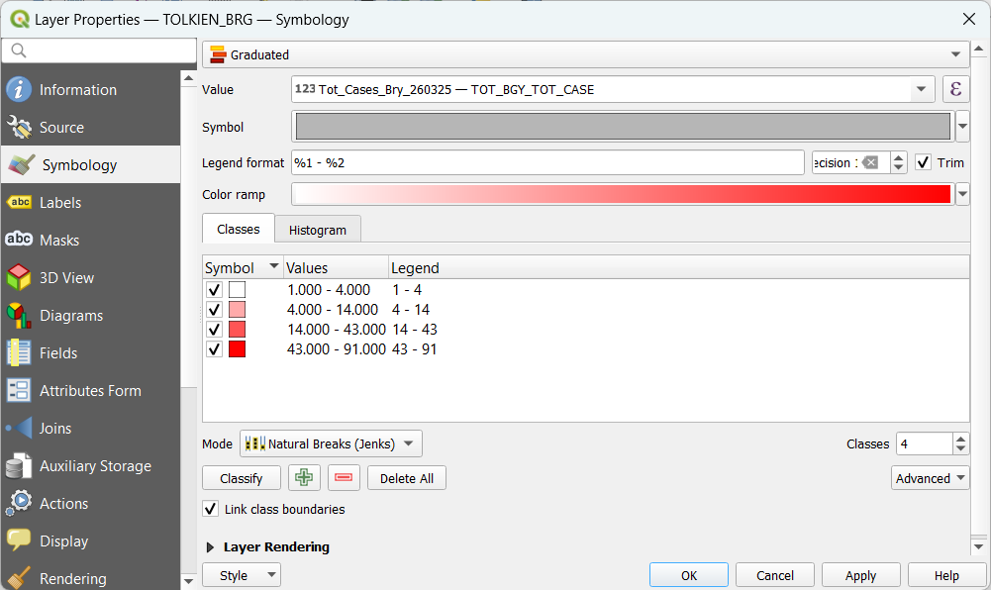
Creating thematic map – Mode of representation
Creating Graduated symbology

Slide 21
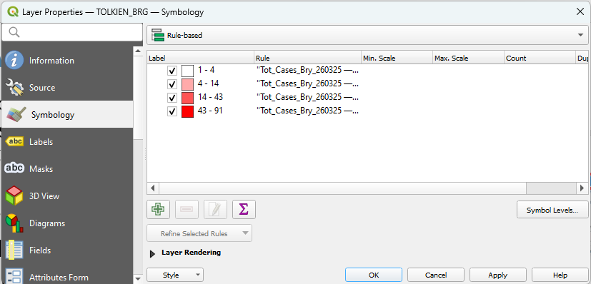
Creating thematic map – Mode of representation
Symbolizing the areas with zero cases
Finish symbolizing the areas with cases first
From the dropdown menu of the different modes or representation, choose Rule-based.
Click the Add button

Slide 22
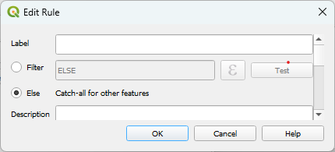
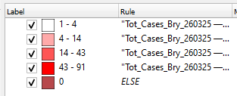
Creating thematic map – Mode of representation
In the Edit Rule window that opens, select Else then click OK.
A new symbology class will appear. Click its corresponding label field and type “0”.
Click and drag it to the top so that it appears above the other classes. Click Apply.

Slide 23
Creating thematic map – Mode of representation
Customize the fill color by right-clicking on the color square then choosing Change Color…
Choose the appropriate color for the symbol then click OK.

Slide 24
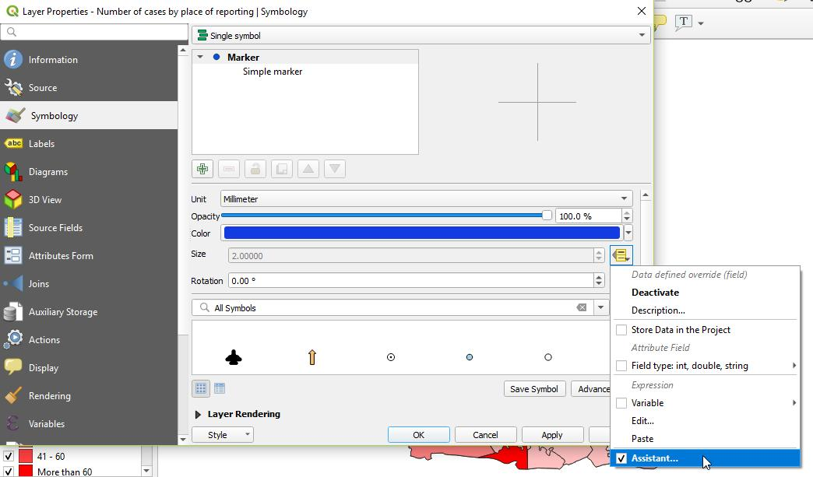
Creating thematic map – Mode of representation
To create proportional symbols:
Open the Properties window of the HF_Locations shapefile and go to the Symbology tab.
Click the dropdown menu beside the Size field and choose Assistant…

Slide 25
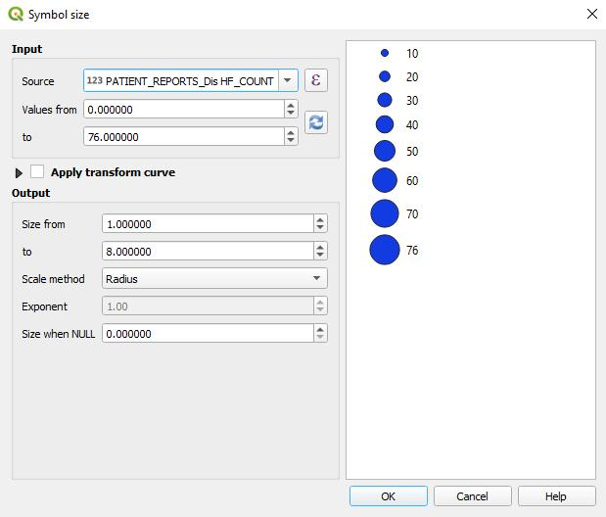
Creating thematic map – Mode of representation
In the Input section, choose the column you would like to symbolize in the Source field.
Click the Refresh button for the field values to appear.
In the Output section, put the minimum and maximum size you would like for your symbol.
In the Scale method field, choose Radius.
Click OK.
Click OK in the Layer Properties window.
If your symbols turn out to be too big or too small, you may repeat these steps to change their size

Slide 26
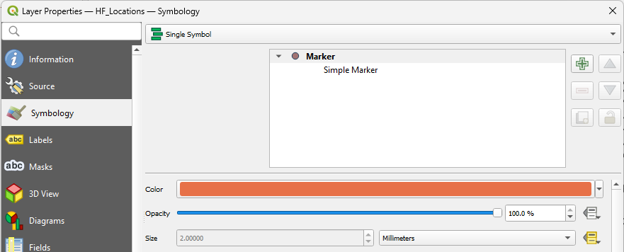
Creating thematic map – Mode of representation
Customize the fill color by clicking on the color field. The Select Color window will open.
Choose the appropriate color for the symbol then click OK.
If you would like to change the colors again, just repeat these steps.

Slide 27
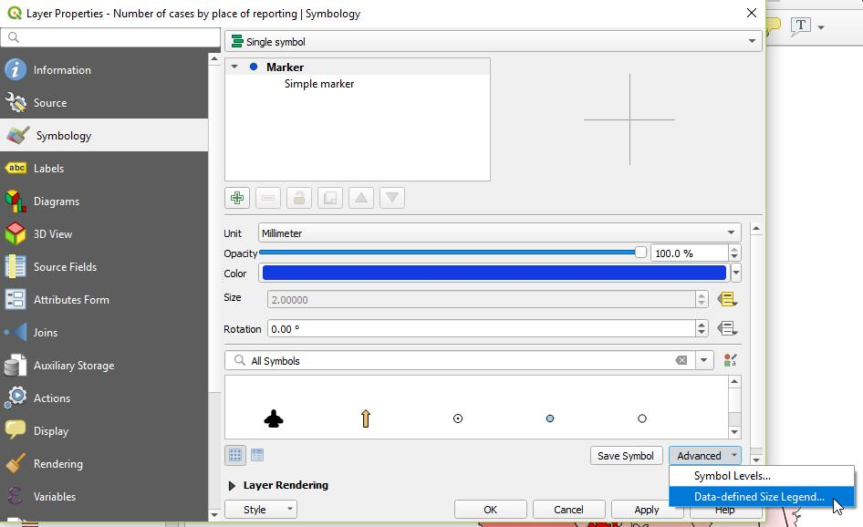
Creating thematic map – Mode of representation
To make sure that the proportional symbol appears in the map layout legend:
Click the Advanced dropdown menu and choose Data-defined Size Legend…

Slide 28
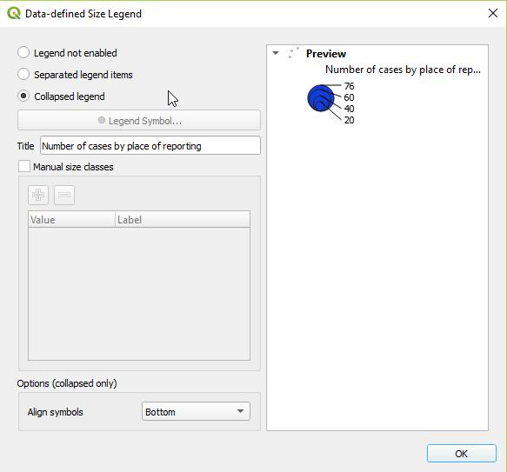
Creating thematic map – Mode of representation
Choose how you would like the symbol to appear in the legend (preferably Collapsed legend).
Type in the title of your legend item.
Click OK.
Click OK in the Layer Properties window.

Slide 29
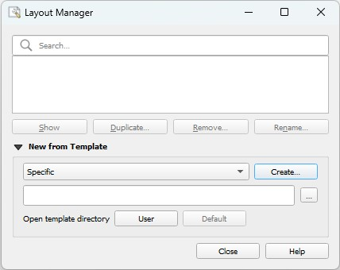
Creating thematic map – Using a map template
We have prepared an incomplete map template for you to use in this exercise. Skip steps 31-36 in Annex 3 and do the following steps instead.
To start creating the layout for your map, click Project > Layout Manager… in the main menu.
The Layout Manager window opens. To choose the template, in the New from template section dropdown list, choose Specific then click the Browse button.

Slide 30
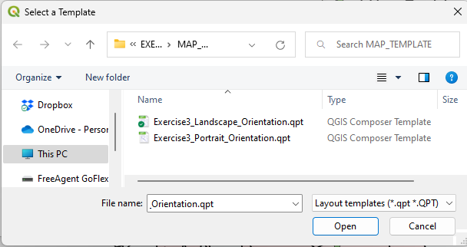
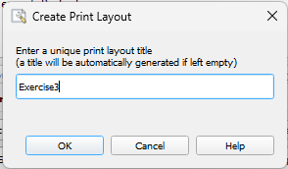
Creating thematic map – Using a map template
The Select a Template window opens. In your training materials files, go to TRAINING_MATERIAL\EXERCISES\EXERCISE_4\MAP_TEMPLATE.
Select the appropriate orientation for your map. Click Open.
Click Create then type in a unique print composer title in the field that appears. (Otherwise a title will be generated for you.) Click OK.

Slide 31
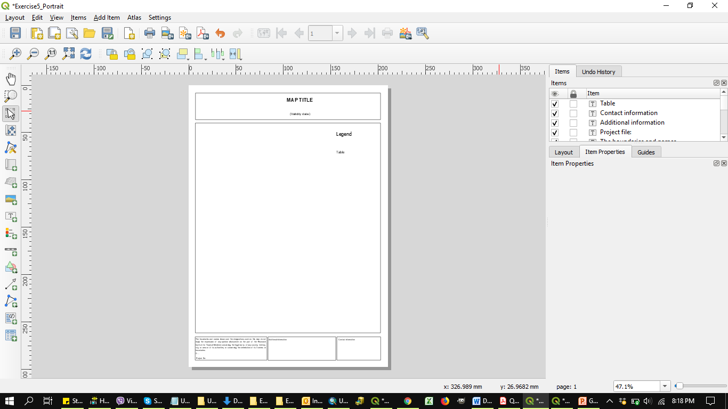
Creating thematic map – Using a map template
The map template will open in a new window.
Guide_HGLC_Part2_6_1_Annex_3
Proceed with steps 37 onward of Annex 3 to complete your map.
The APMEN logo to use is in the EXERCISES\EXERCISE_4\LOGO folder

Slide 32
Thematic map to be produced to get the training certificate
Judging criteria
Fit the purpose, audience, content, and medium
Inclusion of the key components that make a good map
Visually appealing and passing a strong message
One map per training participant
Deadline for submission by email: November 4th
Good luck !!!

