Slide 1
INTRODUCTION TO THE MANAGEMENT AND USE OF GEOSPATIAL DATA AND TECHNOLOGIES
FOR MALARIA PROGRAMS
APMEN Online Training Series

Slide 2
Objectives of the training
Strengthen Malaria programs’ technical skills and practices to manage and use geospatial data and technologies.
More specifically, the training will:
Clarify the concepts and the process behind the management and use of geospatial data and technologies in general and the creation of good thematic maps
Train participants on the use of open-source software (QGIS) to produce thematic maps
Guide NMCPs towards geo-enabling their information system to support Malaria elimination
Going beyond GIS

Slide 3
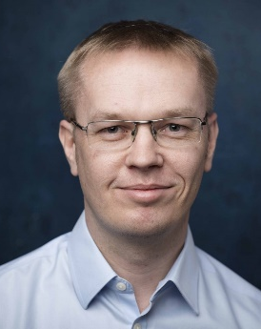

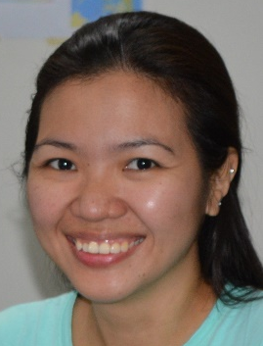
Introduction of facilitators
Dr Steeve Ebener
Izay Pantanilla
Prof Richard J Maude
Participants
27 participants
14 countries
https://bit.ly/3Cl16i7

Slide 4
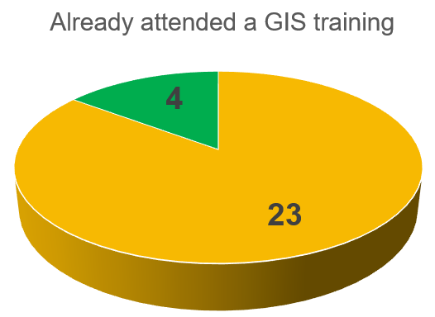
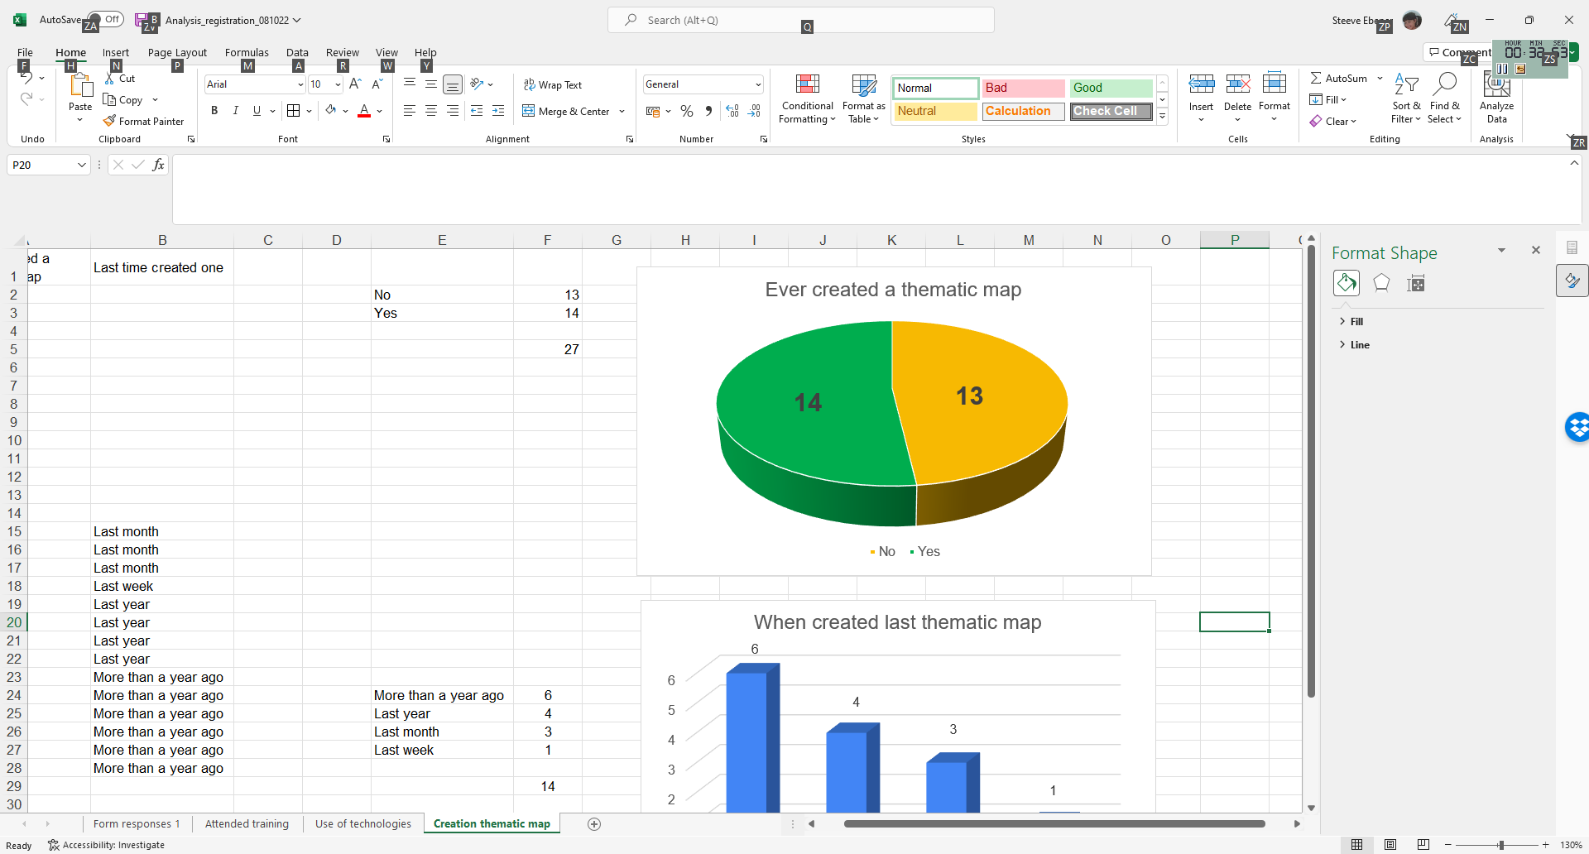
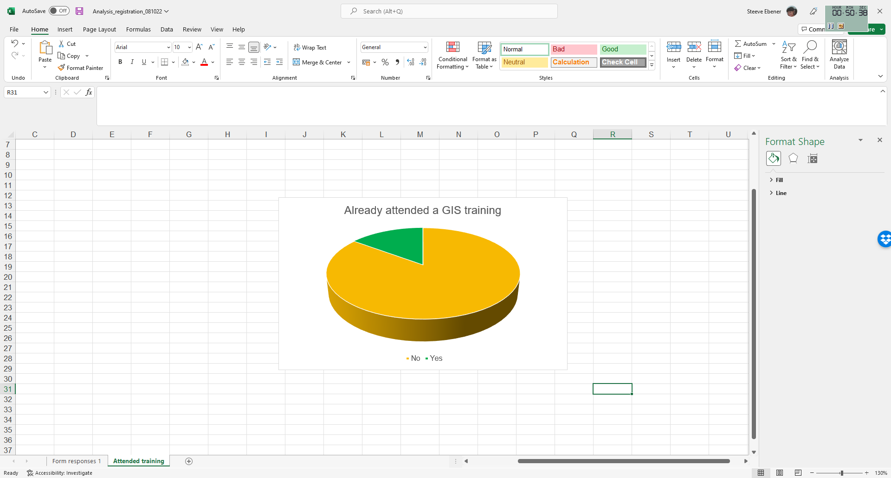
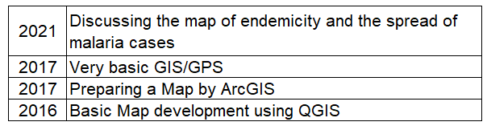
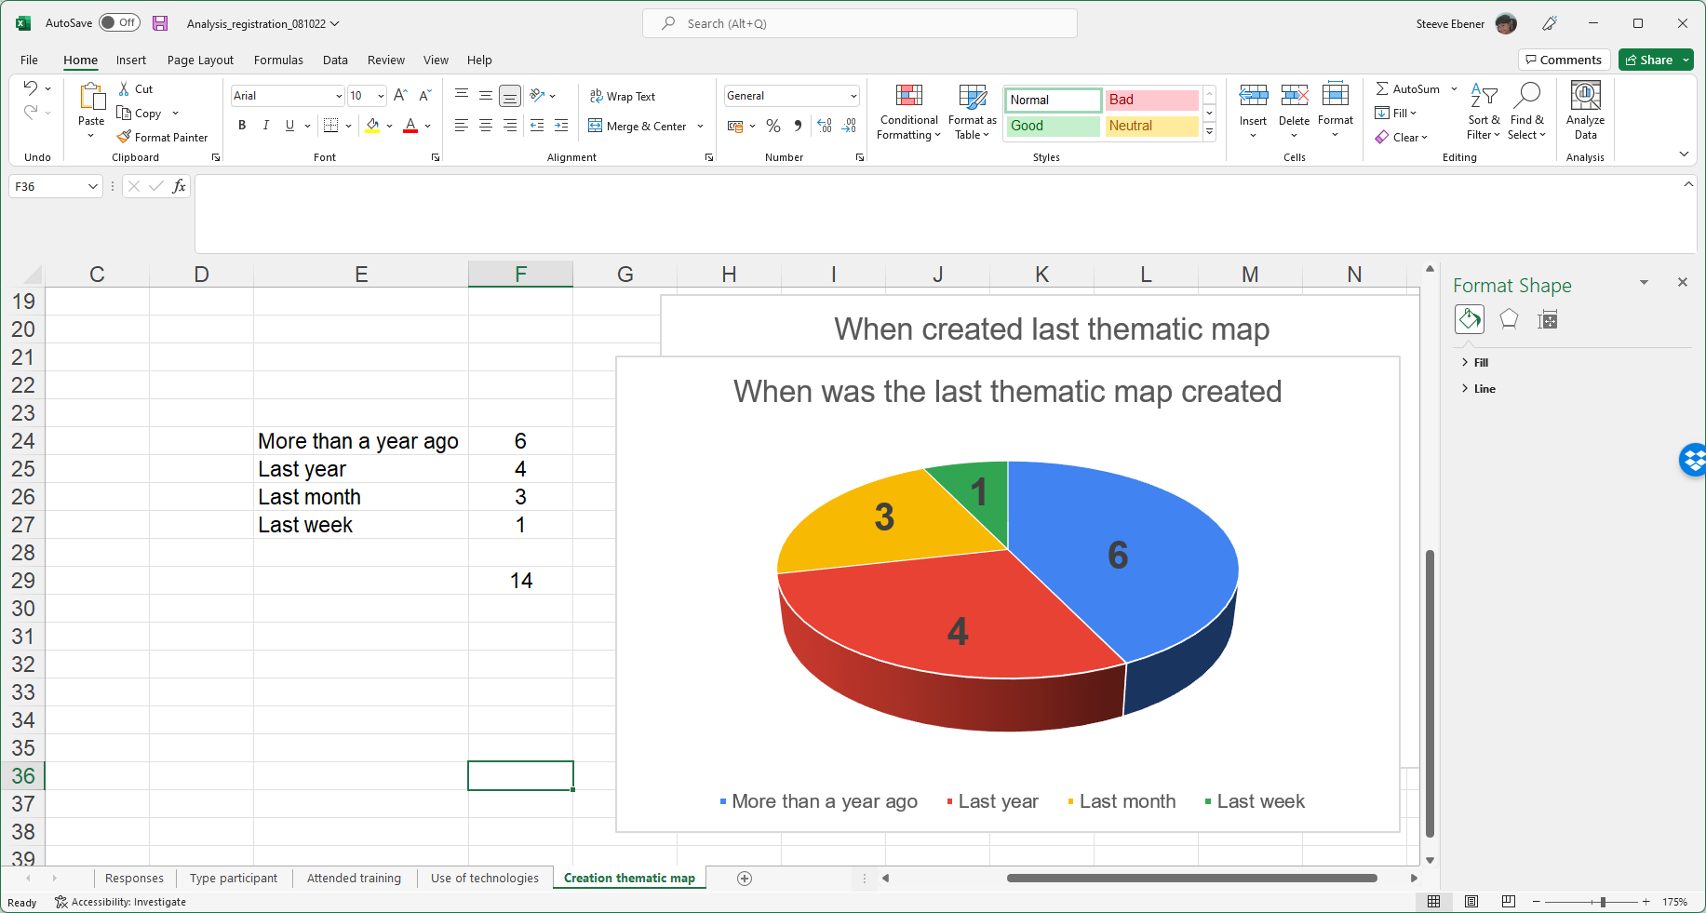
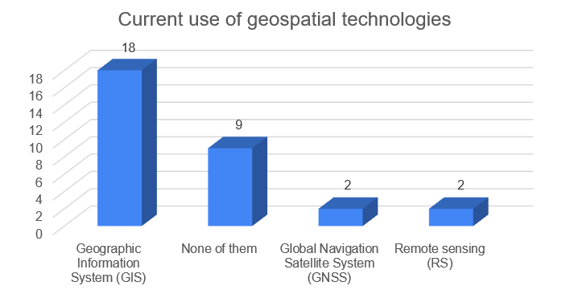
Participants profile
Large variety of profiles (public health officer, data managers, entomologist, deputy director,…)
Based on the registration form you filled:
Half of you have already created at least one thematic map while most of you did not yet have a GIS training
Most of you have not created a thematic map for quite some time
Good opportunity to learn or refresh during this training!

Slide 5
Participants expectations
“It will enhance my knowledge about the geographical areas and population who had been infected with the various diseases. This will help me provide more realistic, accurate and timely information to the health industry and other related stakeholders to provide support to reduce the spread of the disease to the areas and populations that are not affected.”
“It is of high priority that by understanding and using this software i would be able to translate information in a package that is more in detail and understandable. presenting information in thematic maps gives the reader or a person a broader view of understanding the information and relating it to an identified area of interest based on what and how information is presented.”
“I hope upon attending this training I will be able use a GIS knowledge in the field of malaria programme and I scope, I will be able to prepare better thematic map of malaria cases diagnosed.”
“I hope it will help me to design the maps to show the malaria receptivity and vulnerability density variations in different areas hence to determine the risk of malaria transmission. These maps will be very useful for decision makers to allocate resources accordingly to conduct relevant malaria activities.”
“It will be massively beneficial for our program for control and prevention of Vector Borne Diseases. Furthermore, it will also help in case response activities and identifying the hotspots in the province.”
“Better decisions will be taken in the light of quality indicators derived from the geospatial data and technologies.”
“I have no idea at present”

Slide 6
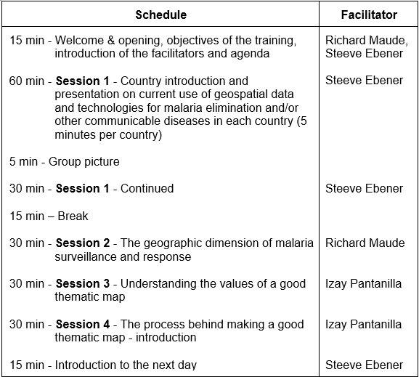
Training Agenda – Day 1 (October 17th, 12:00-16:00 Bangkok time)
Getting to know each other
Set the scene

Slide 7
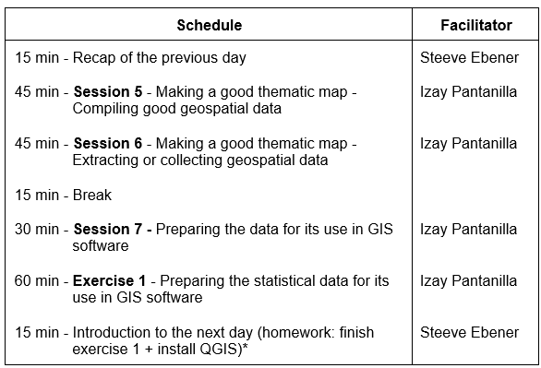
Training Agenda – Day 2 (October 19th, 12:00-16:00 Bangkok time)
The importance of data
Q&A Session (October 21st)
Two-hour session for those who have questions related to the training and/or problems installing QGIS

Slide 8
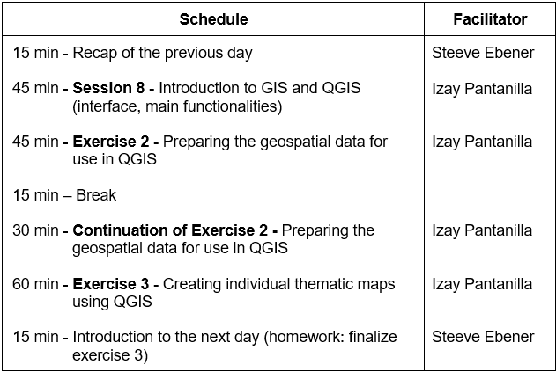
Training Agenda – Day 3 (October 24th, 12:00-16:00 Bangkok time)
Hands on with the use of QGIS!

Slide 9

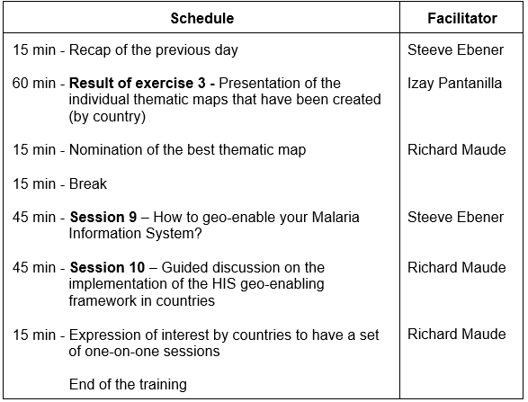
Training Agenda – Day 4 (October 26th, 12:00-16:00 Bangkok time)
Who made the best thematic map?
The way forward
After training one-on-one sessions
For the NMPs interested in discussing their specific challenges or needs when it comes to the management and use of geospatial data and technologies

Slide 10
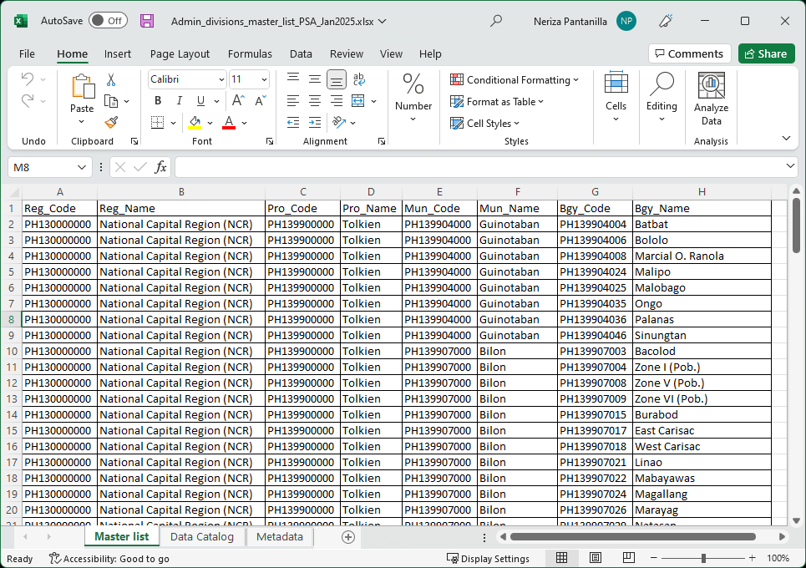
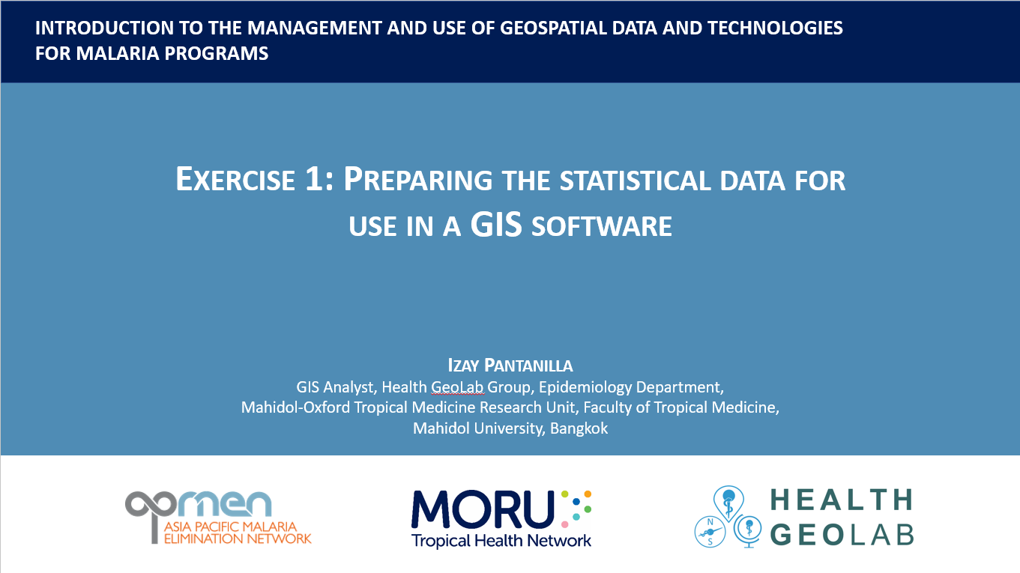
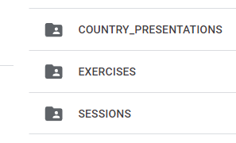
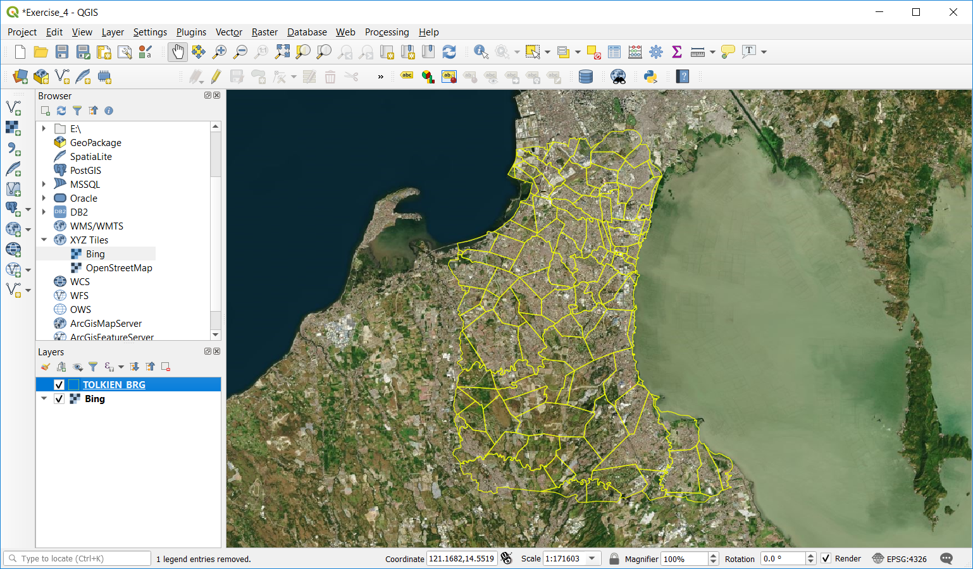
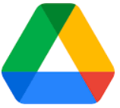
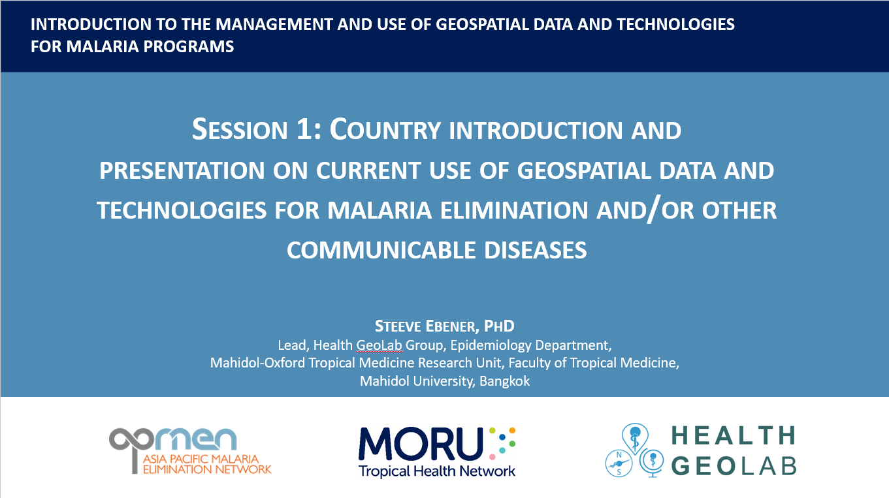
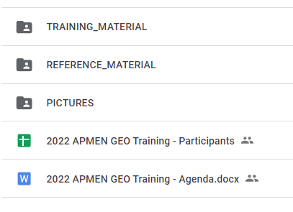
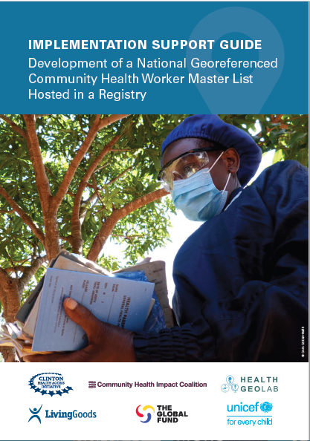

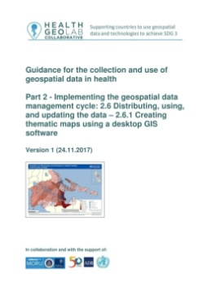
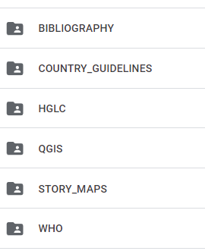
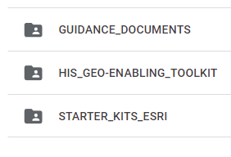
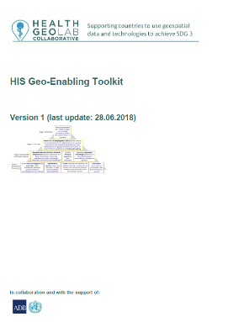
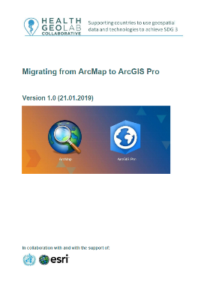
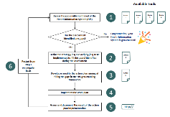


Training material
Exercises with data
When you see this icon on the slides, it means the corresponding document can be found in the Google Drive folder
(https://bit.ly/3ChSHMs)
Please download this folder on your computer!
Slides
Guidance
Toolkit
QGIS Installer
Separate link
Starter kits

Slide 11

Additional training resource
https://healthgeolab.net/resources/his-geo-enabling-course/
There are some exercise we cannot conduct online or some of you might be interested in going further than what is being presented during this training
The following image will appear when reference is made to material to look at and exercise to perform on your own from the HIS geo-enabling course:

Slide 12
Modus Operandi
Don’t hesitate to ask questions (type them in the chat, raise hand, fill the Google form (https://bit.ly/3SR0nfB), attend the Q&A session on October 21st)
Keep your microphones on mute when not speaking
Do your “homework” and look at the reference material
Master list?
Thematic mapping?
GIS ???

