Slide 1
Session 2: The Geographic Dimension of
Malaria Surveillance and Response
Prof Richard J Maude
MBChB Hons BSc DTM&H DPhil MD FRGS FRCP FRSPH
Head of Epidemiology Department,
Mahidol-Oxford Tropical Medicine Research Unit, Faculty of Tropical Medicine,
Mahidol University, Bangkok

Slide 2
Learning goals
Know which data in Health Information Systems has a geographic dimension
Understand why mapping is essential to communicable disease surveillance
Know how geography is used in the different components of malaria surveillance
Know how malaria mapping needs change as country approach elimination
Understand the roles of GIS and data dashboards

Slide 3
Cholera: from paper maps to GIS

Slide 4
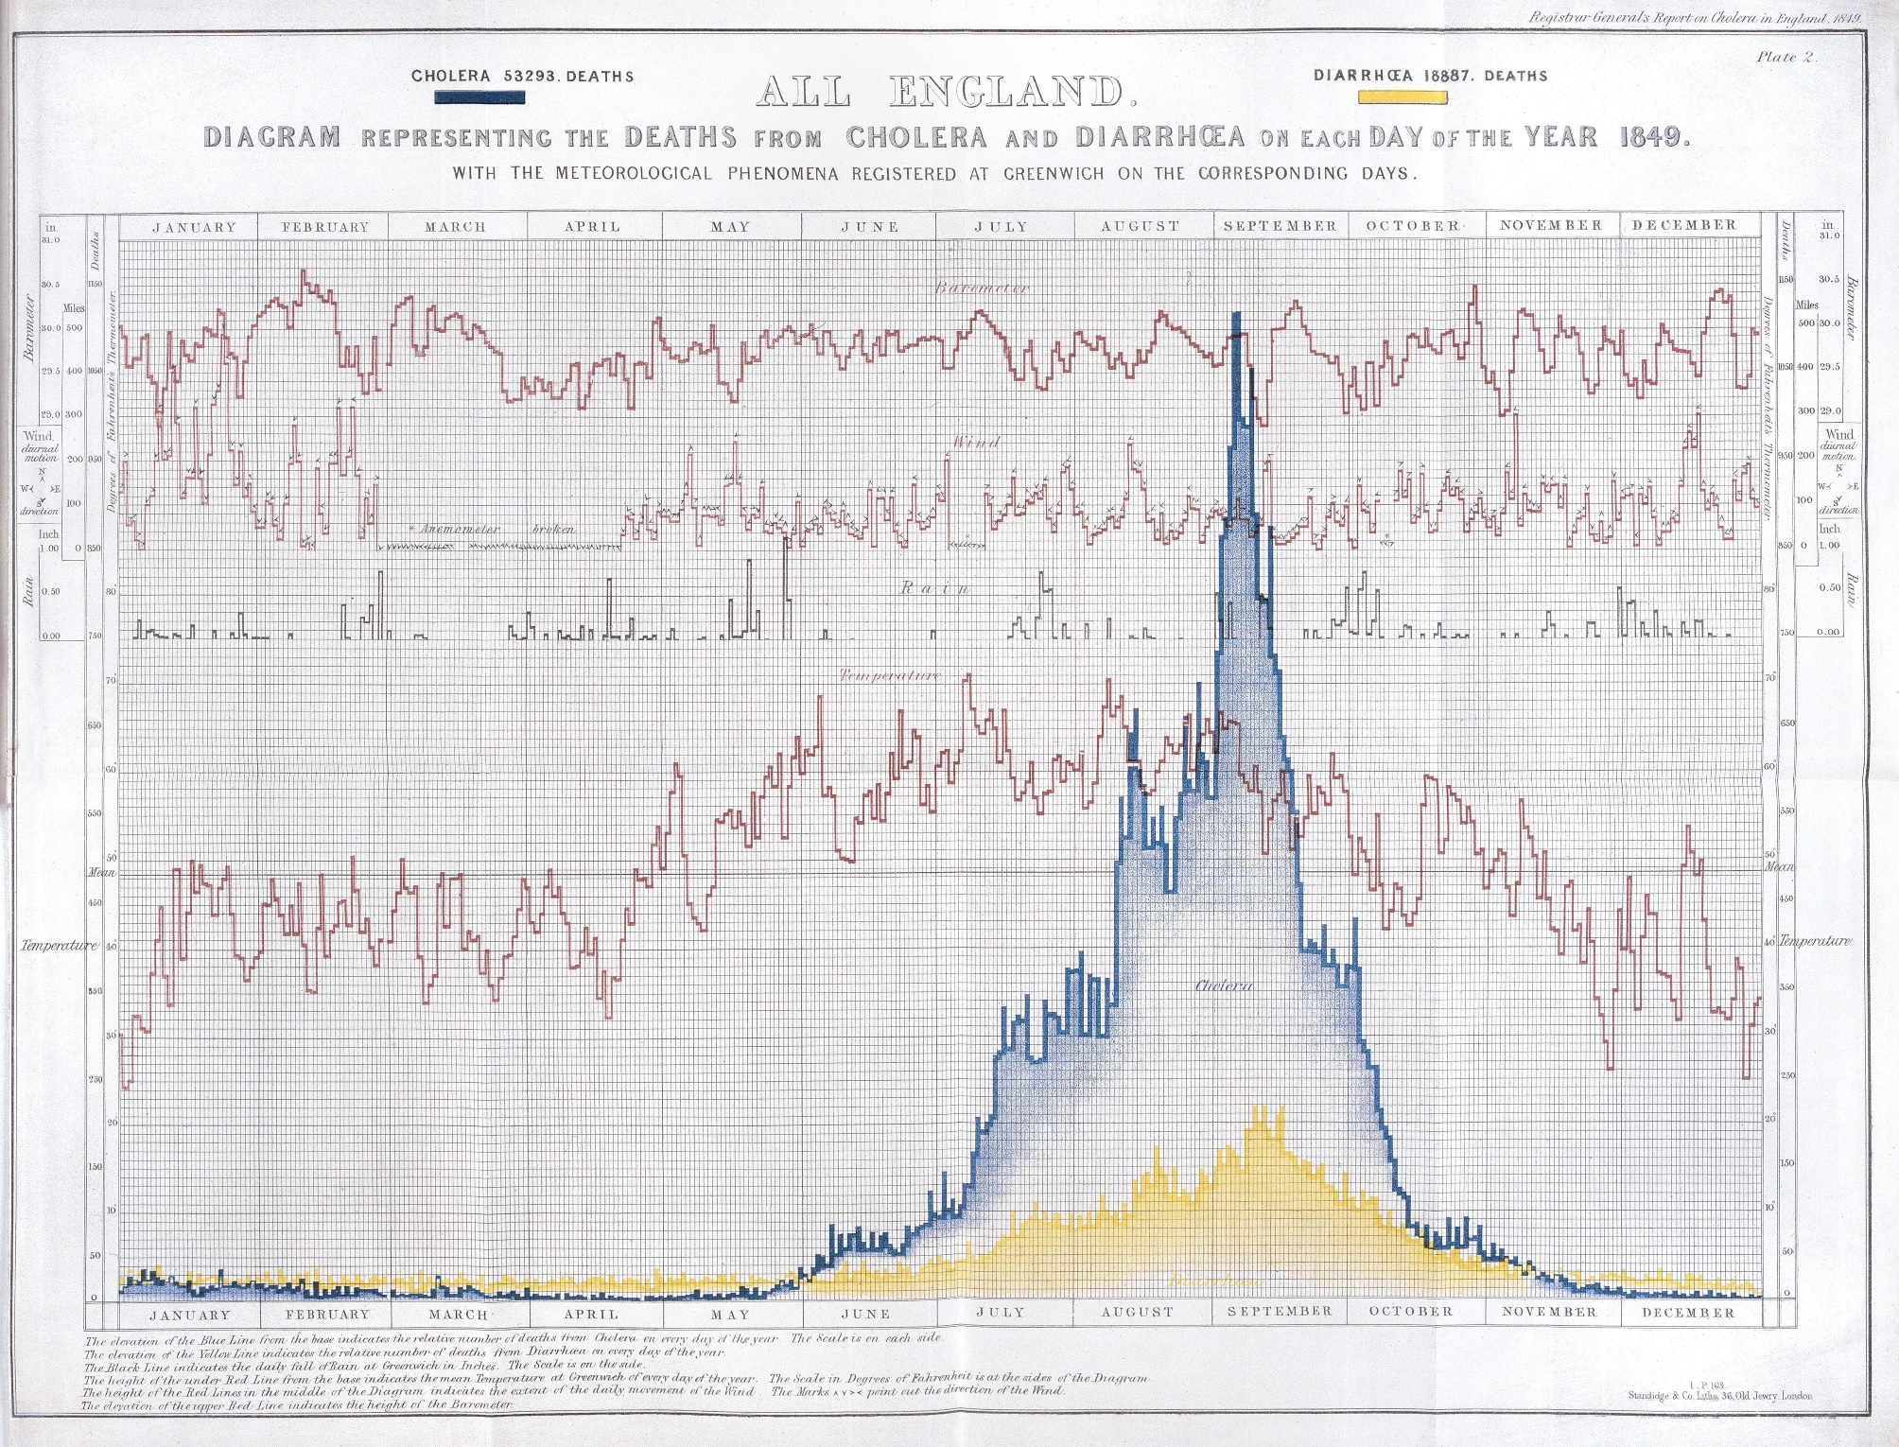
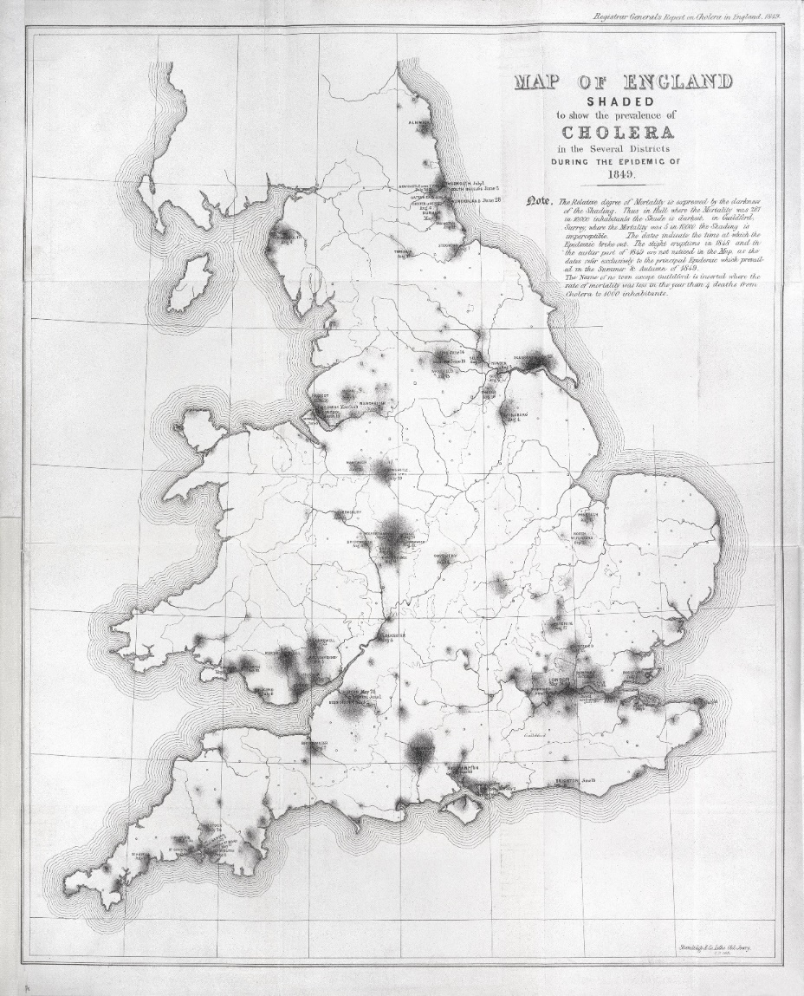
John Snow Cholera, 1854

Slide 5
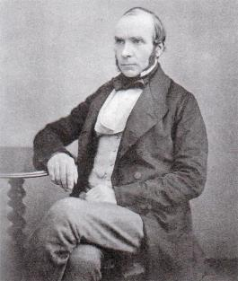
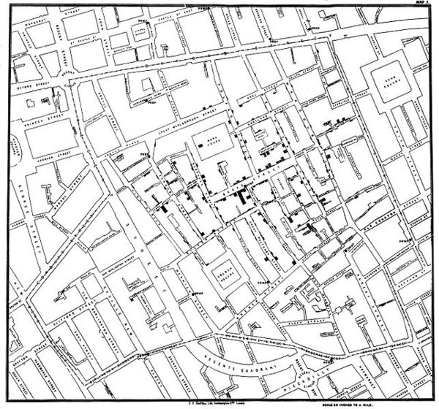
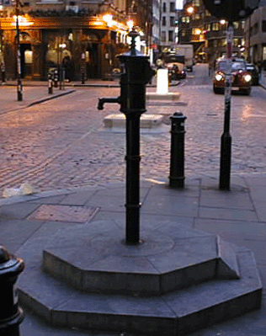
John Snow Cholera, 1854
Broad Street water pump

Slide 6
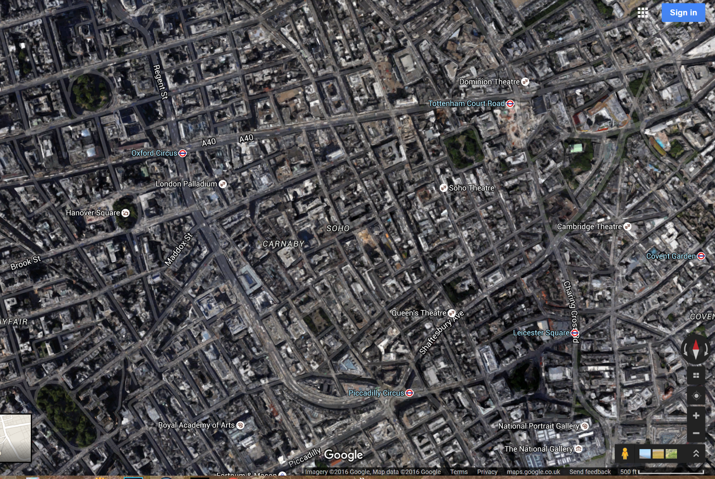
John Snow, Cholera 1854 & Google Maps
Broad Street water pump

Slide 7
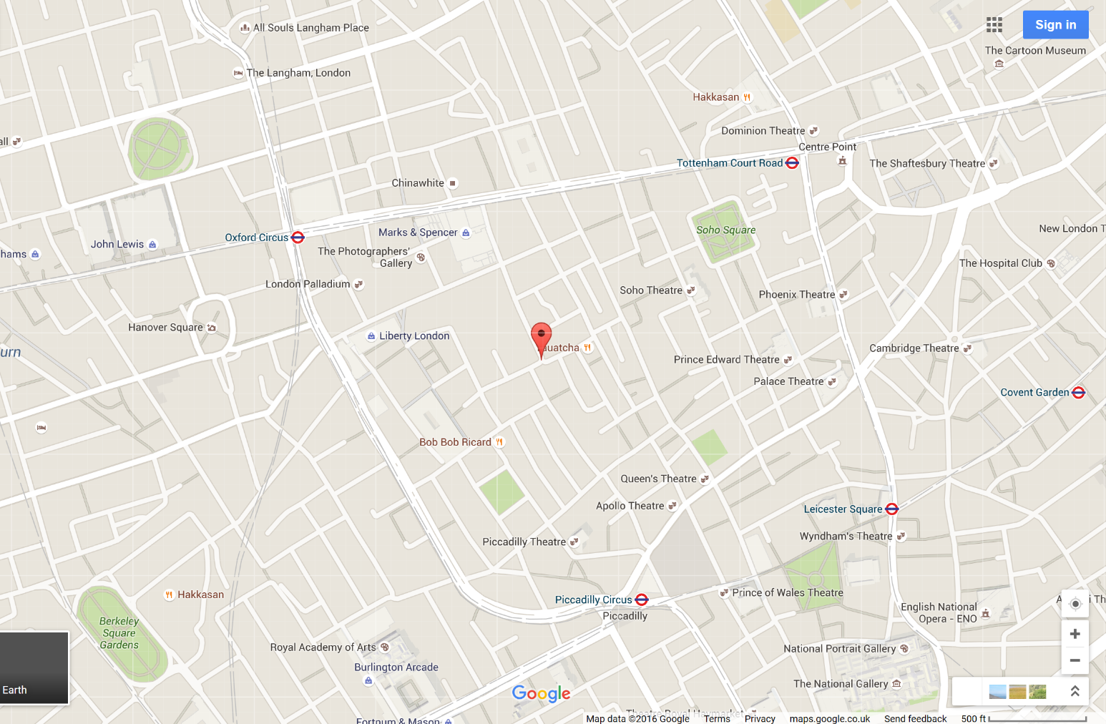
John Snow, Cholera 1854 & Google Maps
Broad Street water pump

Slide 8
John Snow, Cholera 1854 & Google Maps
Broad Street water pump

Slide 9
John Snow, Cholera 1854 & Google Maps
Broad Street water pump

Slide 10
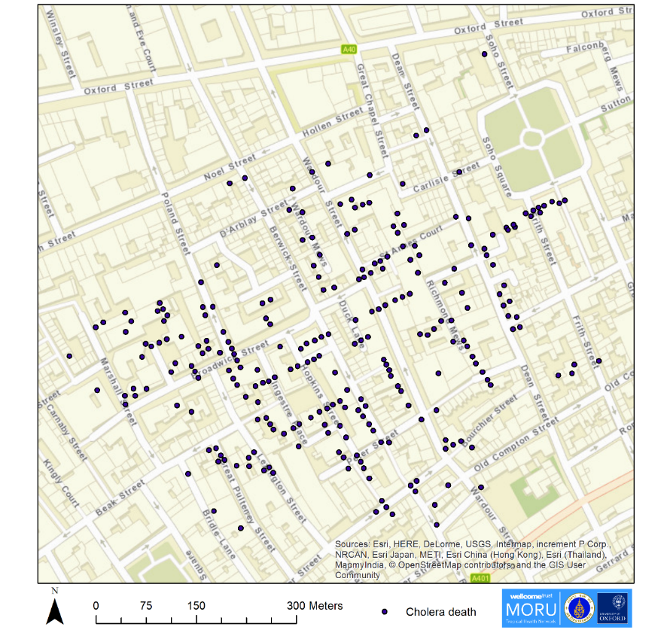
John Snow, Cholera 1854 & GIS

Slide 11
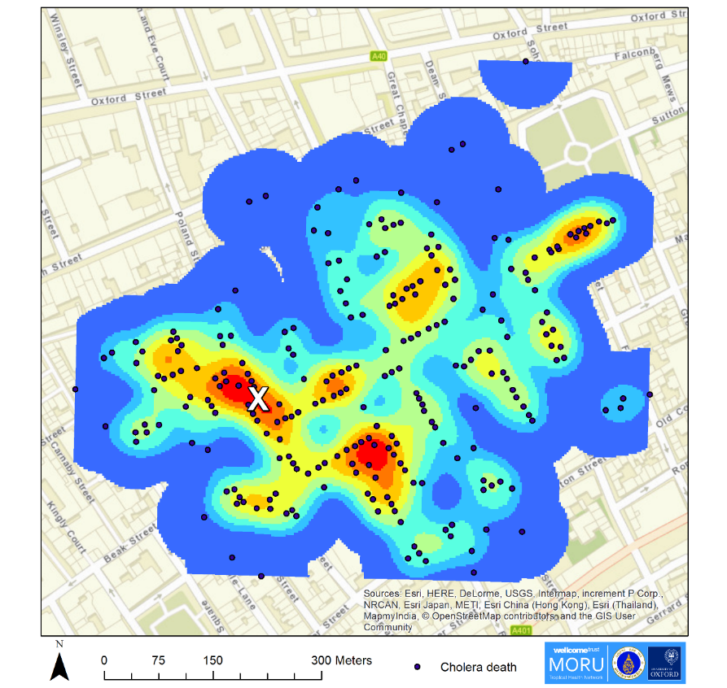
John Snow, Cholera 1854 & GIS
Kernel density plot

Slide 12
John Snow, Cholera 1854 & GIS
Broad Street water pump

Slide 13
Communicable Disease Surveillance & GIS

Slide 14
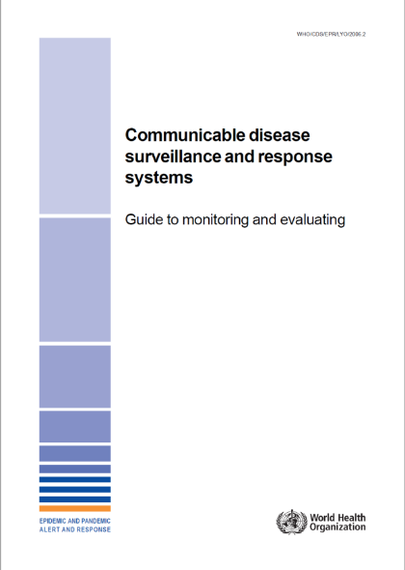
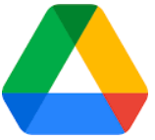
Communicable Disease Surveillance
World Health Organization
Ongoing systematic collection, analysis, and interpretation of outcome specific data for use in planning, implementing and evaluating public health policies and practices.
WHO_CDS_EPR_LYO_2006_2.pdf

Slide 15
Communicable Disease Surveillance
World Health Organization
A communicable disease surveillance system serves two key functions:
1. early warning of potential threats to public health.
2. programme monitoring functions which may be disease specific or multi-disease in nature.

Slide 16
Health Information System (HIS)
“Provides the underpinnings for decision-making” (WHO)
4 key functions:
1. Data Generation
2. Compilation
3. Analysis and synthesis
4. Communication and use
Generates health data e.g. from surveillance system
Converts data into information for health-related decision-making
Compiles data from the health sector and other relevant sectors
Analyses the data and ensures their overall quality, relevance & timeliness

Slide 17
All data in Health Information Systems has geographic and time dimensions
"everything happens somewhere”*
…“at a given time"
Geography and time should be routinely captured in a Health Information System (HIS)
BUT they are among the most poorly captured dimensions
*Tosta 2001

Slide 18
Health Information Cycle, Geography & GIS
Resource allocation
Lat/long, address
Targeting interventions
GIS
Geoenabled database
GIS
Report
GIS
Maps, tables
Dashboard
WHO 2018

Slide 19
Malaria Surveillance & Geography

Slide 20
WHO World Malaria Report 2021
Why Map Malaria?
3 main questions:
Where are the cases?
Where are the mosquitoes?
Where are people being infected?
How this is used:
Monitoring impact of control measures
Monitoring progress towards elimination
Targeting malaria control and elimination activities
  Prevention
  Access to healthcare
  Risk stratification to allocate limited resources
  Define units of intervention

Slide 21
2018
WHO Malaria SME Reference manual 2018_two page view.pdf

Slide 22
Closer to elimination -> Higher resolution reporting
Notes:
Malaria heterogeneity across the transmission continuum
As transmission decreases, malaria becomes focal, and the intensity and frequency of reporting increase. Surveillance systems evolve from reporting aggregate case data by month over large geographical areas (e.g. district) to reporting near-real-time individual case data in small areas (foci).

Slide 23
Data flow and analysis for malaria

Slide 24
Sources of malaria surveillance data
Government hospitals
Government health centres
Village health workers
Non-governmental organisations
Private healthcare providers
Shops
Pharmacies
Military
Etc.
Level of geographic detail and accuracy can vary widely
Mercado et al. Malar J. 2017.

Slide 25
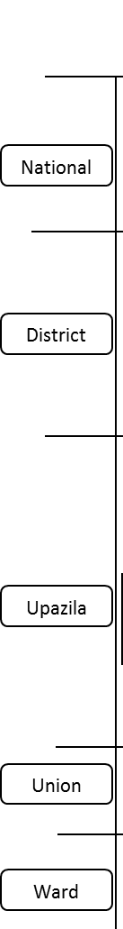
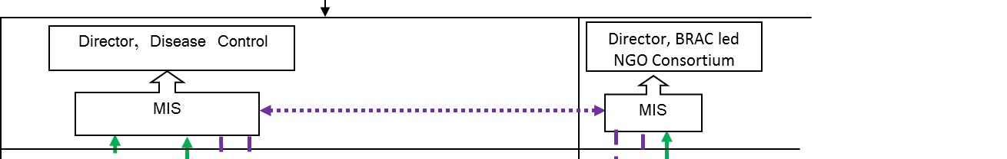
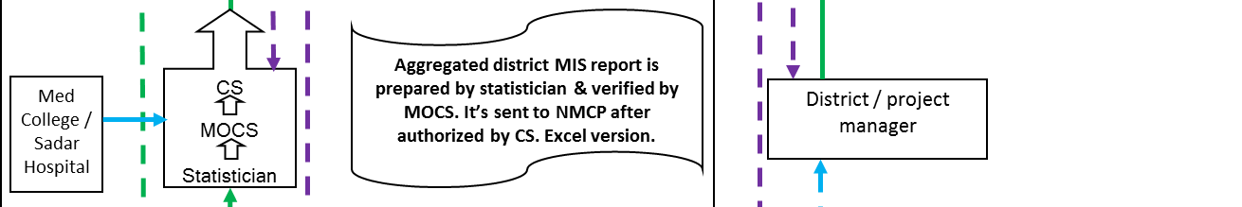
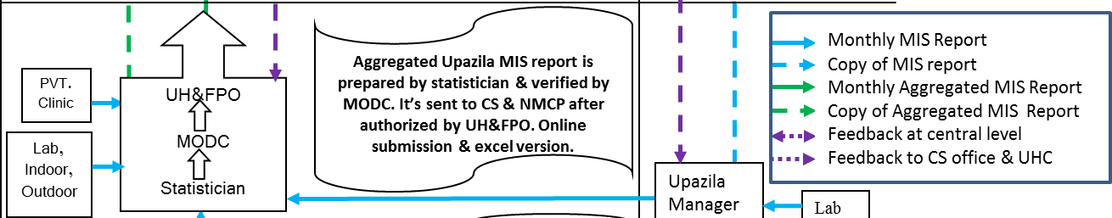

Hierarchical Reporting System
GOB
NGO
Anjan Saha, NMEP, Bangladesh.

Slide 26
Data collation: ideal vs reality
Data from multiple sources need to be combined
Ideal:
  Data available from all sources
  Standardized format/layout
  Same level of spatial aggregation using same geography
  Defined data fields common all sources
Reality:
  Data from only some sources
  Variety of formats from different organisations need to be combined manually
  Different levels of spatial aggregation using different geography
  Subset of data fields match e.g. gender, age

Slide 27
Malaria Elimination Surveillance and Geography
ACTIVITY GEOGRAPHY
CASES
Case detection
  Passive case detection (PCD): people seeking care
  Active case detection (ACD): screening in those at higher risk
    Proactive case detection (PACD)
    Reactive case detection (RACD) e.g., outbreaks
Case investigation -> classification
Focus investigation -> classification
Drug efficacy and resistance
  Location of cases:
    Residence
    Health facility
    Area e.g., district, province
  Location of possible transmission site
VECTORS
Baseline survey
Routine sentinel survey
Spot checks
Focus investigation
  Location of survey site
    Vector species distribution
    Insecticide resistance
INTERVENTIONS AND LOGISTICS
  Antimalarial stocks
  RDTs
  Diagnostic labs
  LLIN coverage
  Staff and services e.g., VHVs, clinics
  Location of health facility
  Location of supply chain e.g., warehouse, vehicle

Slide 28
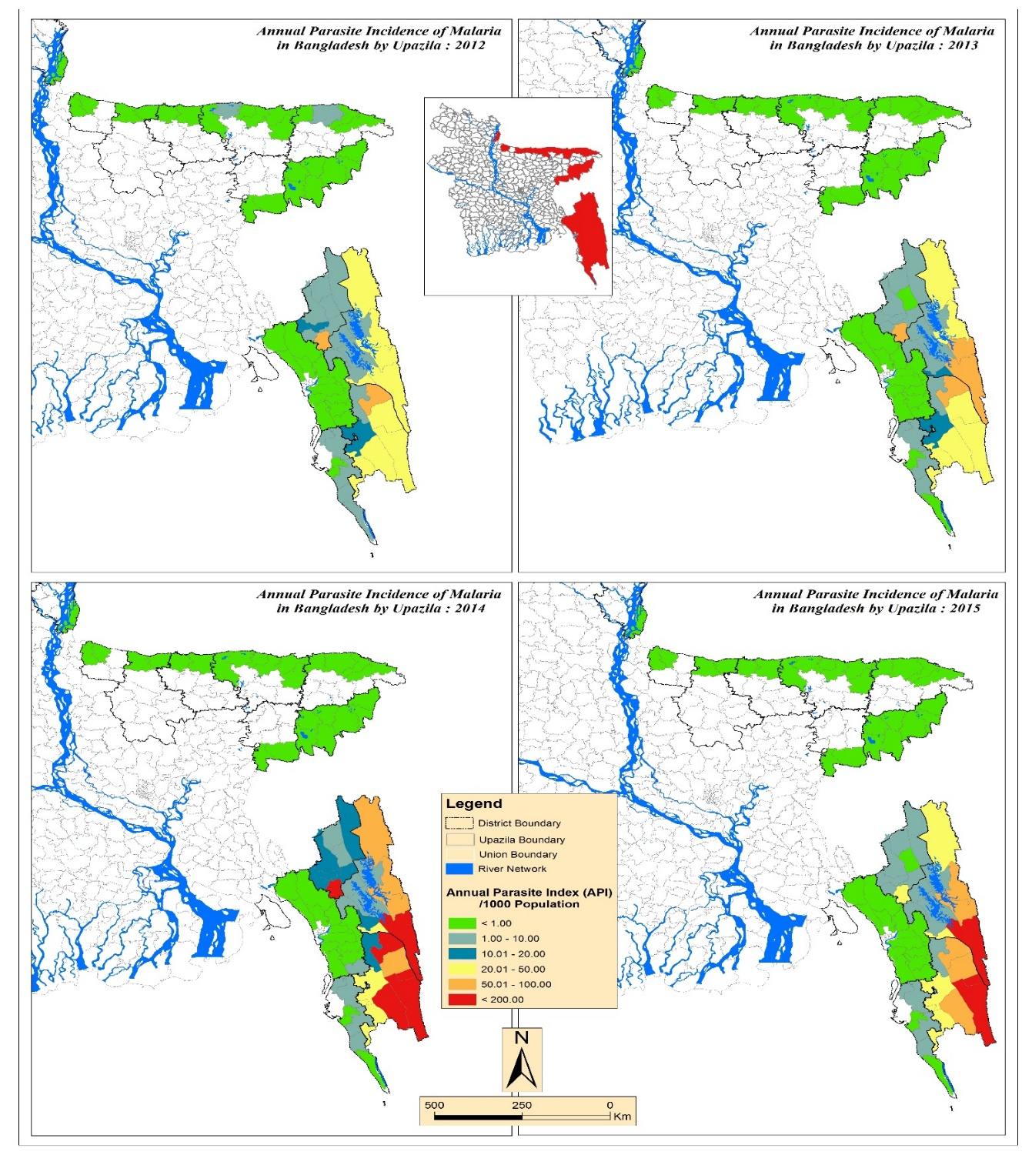
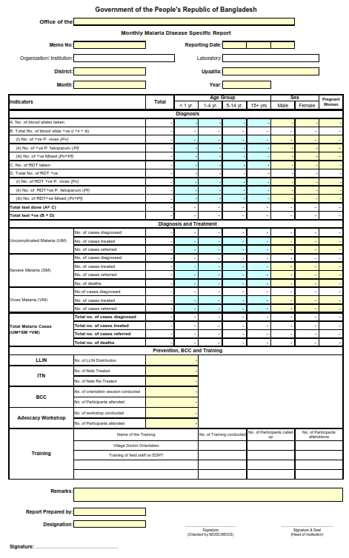
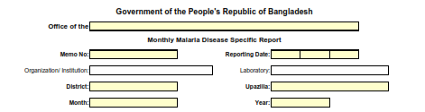
Passive Case Detection
Karim et al. ASTMH 2016.

Slide 29
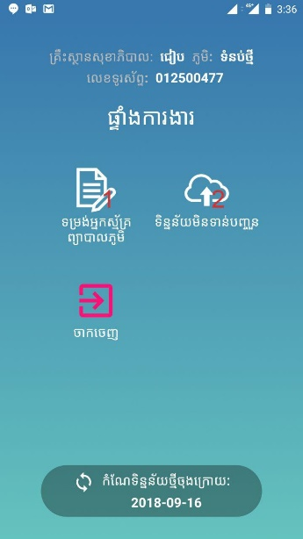
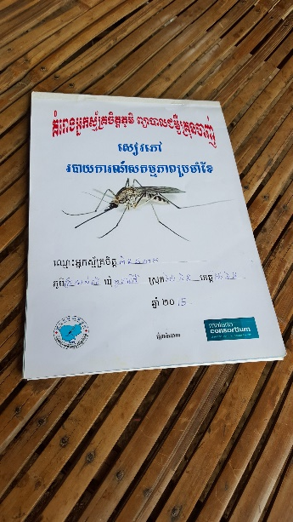
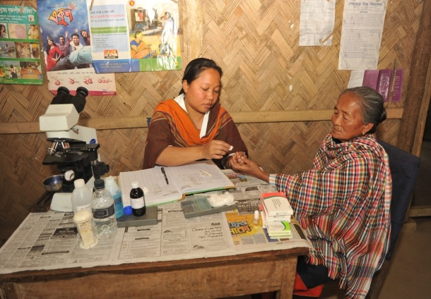
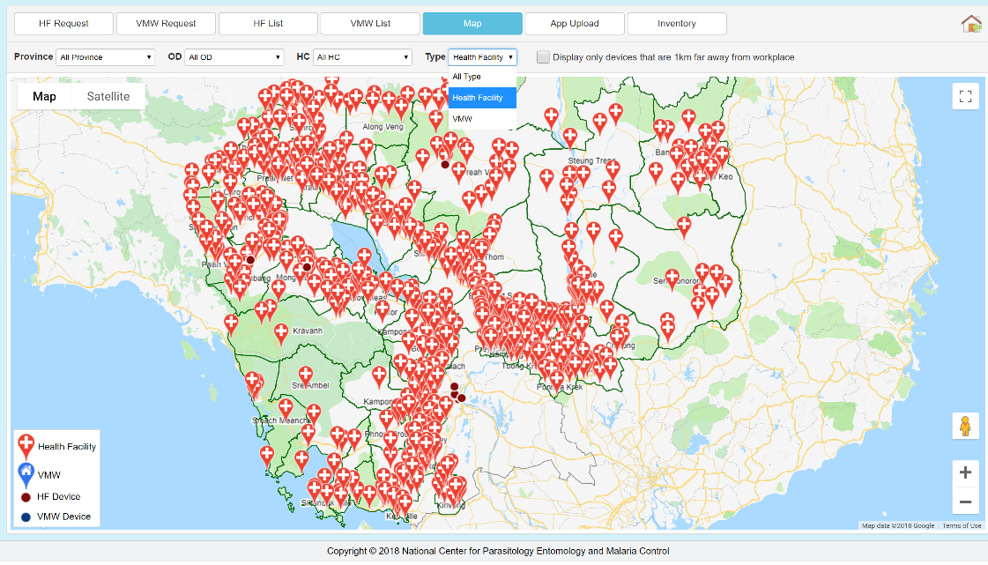
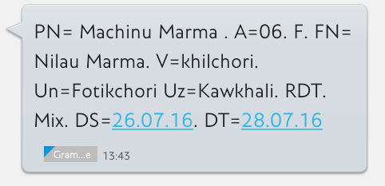
Passive Case Detection
Cambodia
Bangladesh

Slide 30
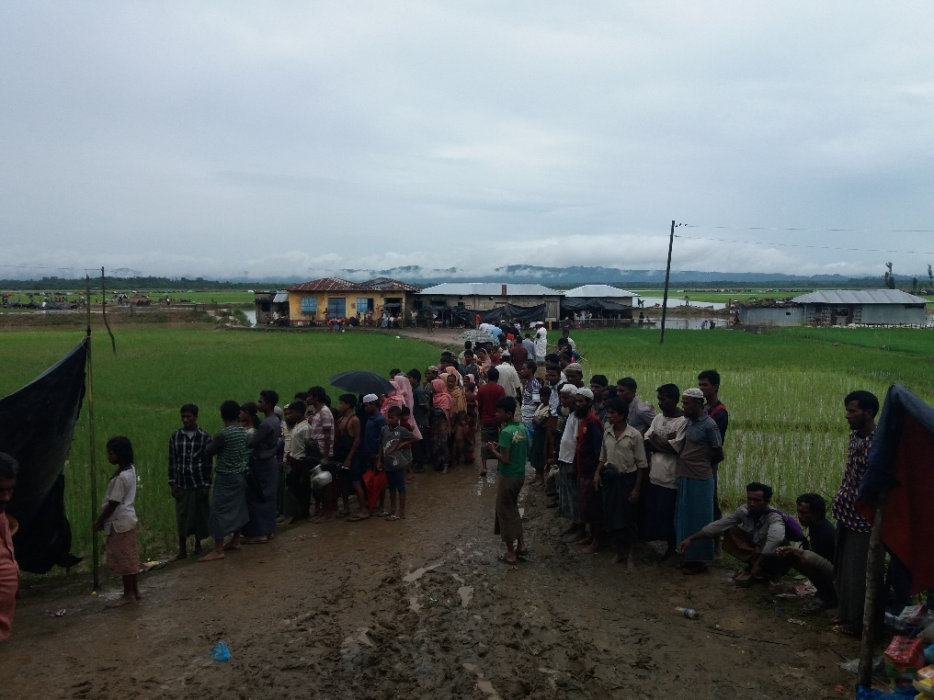
Case Investigation -> Classification
Where was the infection acquired?
Mosquito transmission
Acquired locally
  Indigenous (no link to imported case)
  Introduced (linked to proven imported case)
Acquired abroad or outside area
  Imported
Not Mosquito transmission
Induced
  Blood transfusion
  Congenital
Notes:
The collection of a detailed history of an index case at a fixed point of care (health facility or CHW) is the basis of initial case investigation. Recording of a detailed patient history is an integral part of surveillance for elimination and should be implemented at the fixed points of care even when a case will not be followed up in the community.

Slide 31

Case Investigation

Slide 32

What location information to use?
Place of diagnosis vs place of residence vs place of infection vs routes of spread
Health facility
Home Address
Travel Patterns
Travel Patterns + Pop Genetics

Slide 33
Focus Investigation -> Classification
Is there transmission in the focus?
Focus = defined, circumscribed area in a currently or formerly malarious area that contains epidemiological and ecological factors necessary for malaria transmission
≤3 years
>3 years

Slide 34
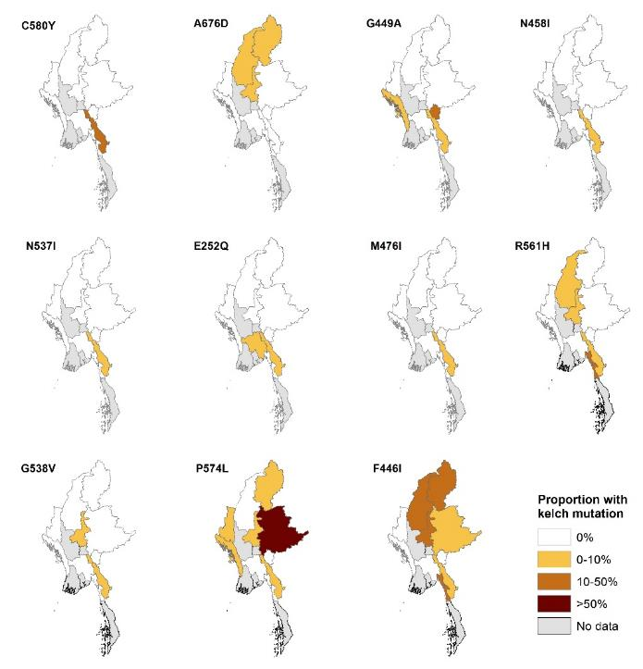
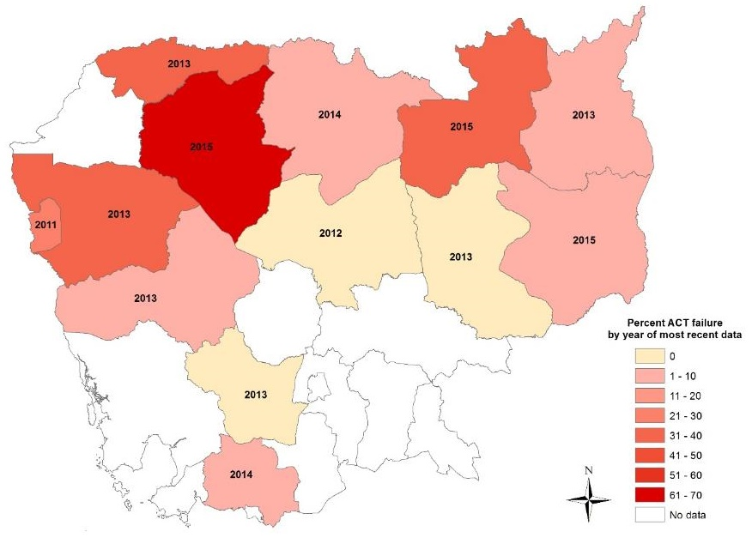
Drug efficacy and resistance
ACT treatment failure in Cambodia
Molecular markers in Myanmar

Slide 35
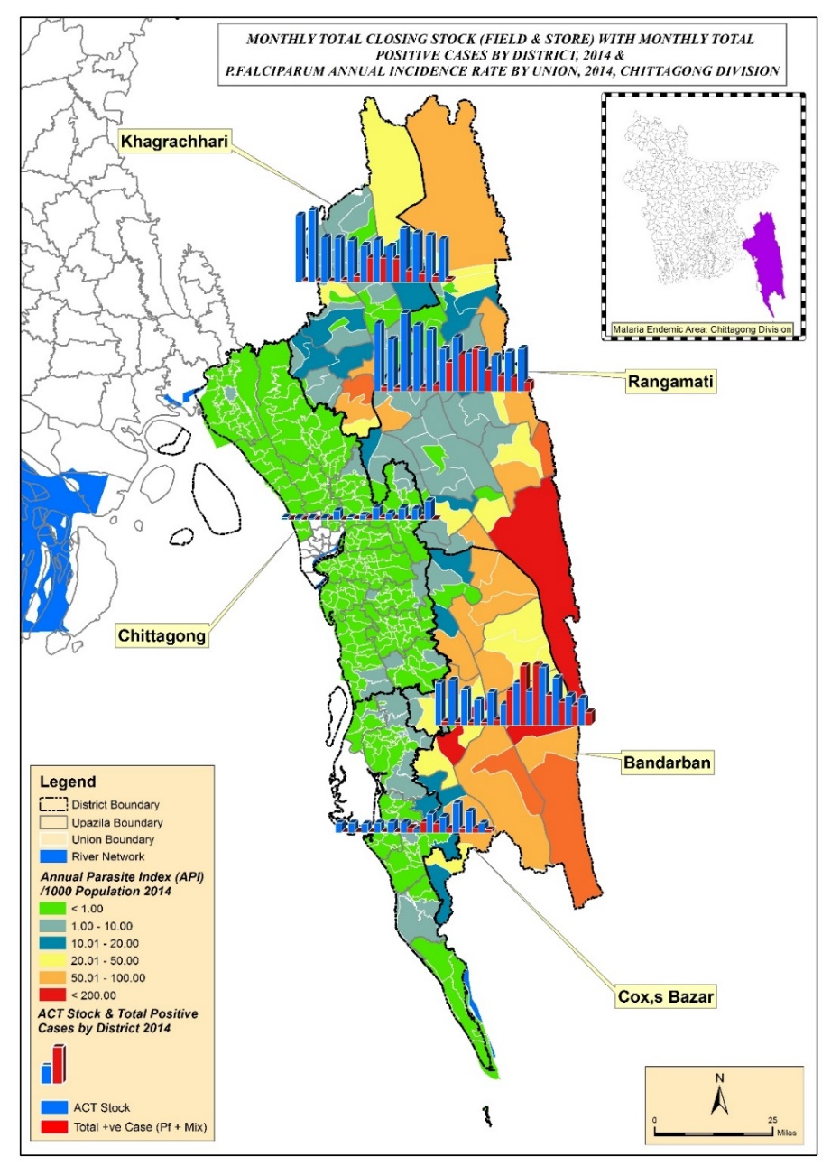
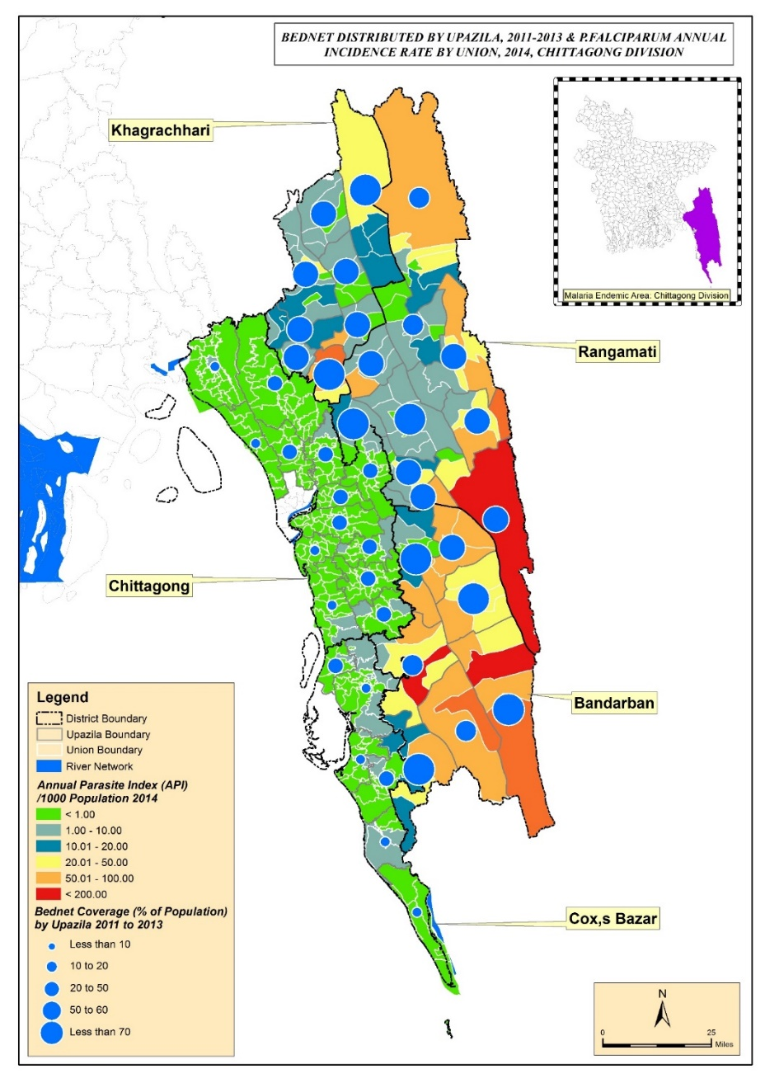
Logistics
ACT stock
LLIN distribution
Karim et al. ASTMH 2016.

Slide 36
Uses of surveillance data by an NMCP: Where maps might be needed
Internal use of NMCP – monthly/near real-time situation analysis and planning activities
Annual bulletin/report for MOH
Progress update to Global Fund
WHO World Malaria Report
NMCP/MOH Dashboard
Publications (internal/external)
Presentations
Special requests from MoH
Information sharing with collaborating organizations

Slide 37
Malaria Dashboards vs GIS
Dashboard e.g., DHIS2 | GIS e.g., QGIS, ArcGIS
User-friendly, easy to learn | More difficult to learn
Online, may be near-real-time | Online or offline, harder to update
Limited range of fixed map outputs | Potentially unlimited range of map outputs
Little or no spatial analysis | Broad range of spatial analyses
Relatively inflexible once set up | Very flexible – content, formats…
Mostly require pre-prepared geographic data | Can manage and edit geographic data
NMCPs need both!

Slide 38
Summary
All data in Health Information Systems has a geographic dimension
Mapping is essential to communicable disease surveillance for monitoring and planning service delivery
For malaria, the closer a location is to elimination, the more geographical and temporal detail is needed
GIS is an essential partner to dashboards e.g. DHIS2

Slide 39
Resources
https://www.who.int/csr/resources/publications/surveillance/WHO_CDS_EPR_LYO_2006_2/en/
https://www.who.int/malaria/publications/atoz/9789241503334/en/
https://www.dhis2.org/
https://www.arcgis.com/index.html
https://www.qgis.org/en/site/

Slide 40


Acknowledgements
Cambodia NMCP (CNM): Siv Sovannaroth
Bangladesh NMEP: Anjan Saha, MM Aktaruzzaman
MORU: Pengby Ngor, Jahirul Karim, Chris Mercado

Slide 41
Thank you and good luck!
richard@tropmedres.ac
www.tropmedres.ac/units/epidemiology

