Slide 1
Session 3: Understanding the value of
a good thematic map
Izay Pantanilla
GIS Analyst, Health GeoLab Group, Epidemiology Department,
Mahidol-Oxford Tropical Medicine Research Unit, Faculty of Tropical Medicine,
Mahidol University, Bangkok

Slide 2
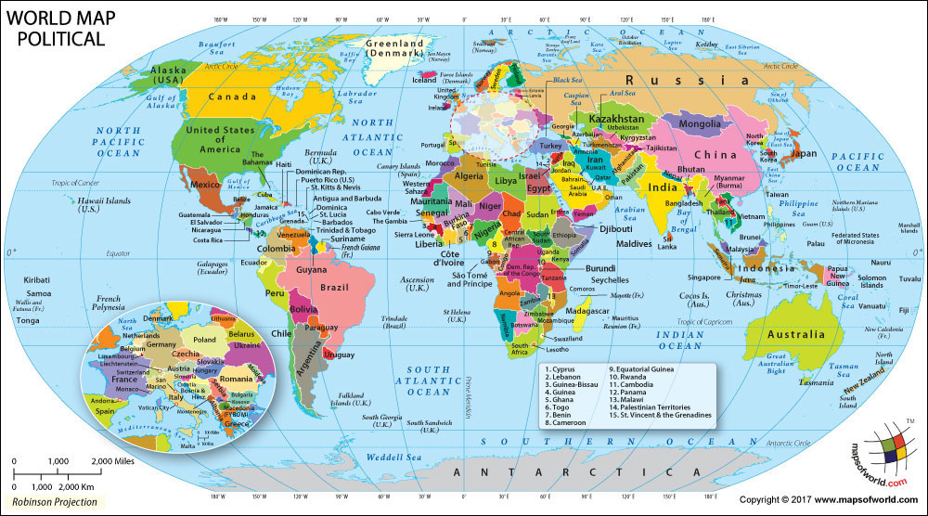
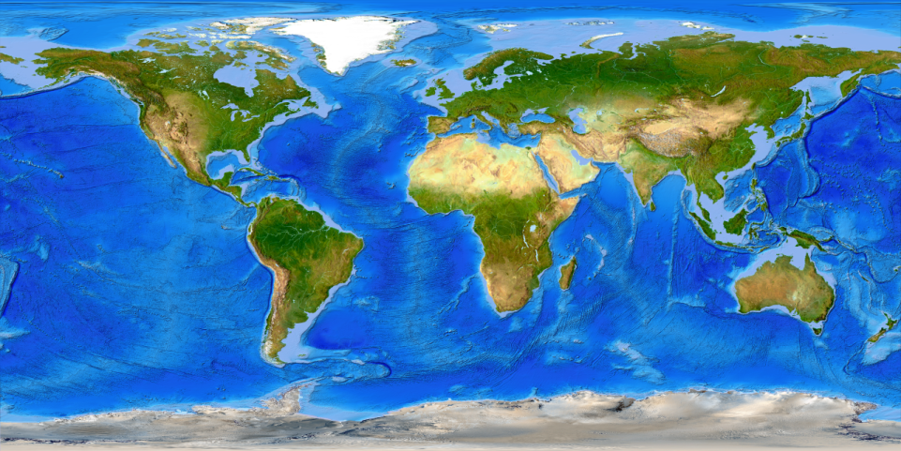
What is a map?
A drawing of the Earth's surface, or part of that surface, showing the shape and position of different countries, political borders, natural features such as rivers and mountains, and artificial features such as roads and buildings

Slide 3
Types of map
Political maps
Physical maps
Topographic maps
Climate maps
Street maps
Geological maps
Navigational maps
Thematic maps
Topic of the present session
Guide_HGLC_Part2_6_1.pdf
https://www.healthgeolab.net/DOCUMENTS/Guide_HGLC_Part2_6_1.pdf

Slide 4
Thematic Map
What is a thematic map?
A map designed to convey information about a single topic or theme, such as population density, geology, or health
What is a good thematic map?
A good thematic map easily and effectively conveys the information it contains to the reader without having to contact the person who created the map.
Easy to understand
Contains just the right amount of information to support decision making
Useful!
4

Slide 5
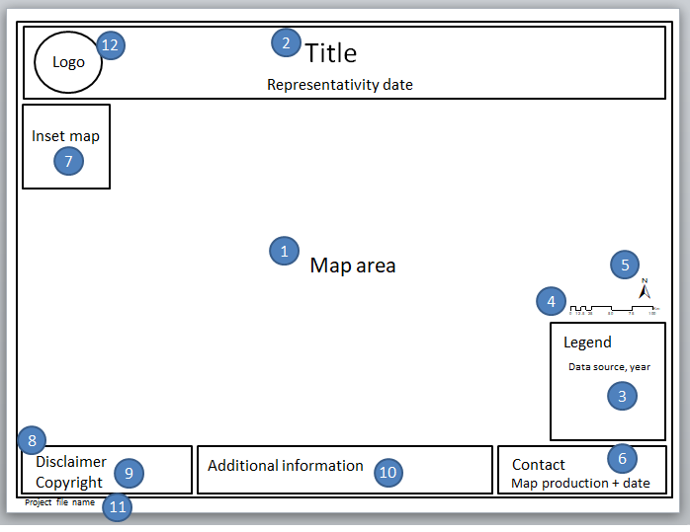
Components of a Good Thematic Map
A good thematic map should always have at least the following components:
Map area
Title
Legend
Scale bar
North arrow
Map production information
Guide_HGLC_Part2_6_1.pdf

Slide 6
Components of a Good Thematic Map
The following components, while not mandatory, are adding value to the map:
Inset map
Disclaimer
Copyright
Additional information
Project file name
Logo
It is good to create one template in portrait and one in landscape orientation that can be used each time you create a thematic map

Slide 7
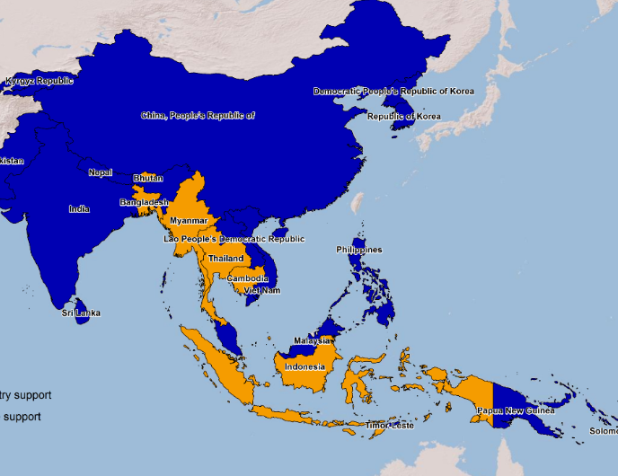
Components of a Good Thematic Map
Mandatory components
Map area – where the symbolized and labelled data is located
Title – description of the content of the map
A good practice, when it applies, is to also indicate in the title the validity date of the information represented on the map

Slide 8
Components of a Good Thematic Map
Mandatory components
Legend – indicating what the different symbols used in the map represent on the ground. The legend should also contain the source of the data and the year when it was collected if not in the title.
The source and year associated to the data may sometime be placed separately from the legend if the texts are too long (in the additional information section)

Slide 9
Components of a Good Thematic Map
Mandatory components
Scale – a map element used to graphically represent the scale of a map
North arrow – a map symbol that shows the direction of north on the map, thereby showing how the map is oriented
Map production information – stating the person and/or organization who created the map and their contact information and the date when the map was created.

Slide 10
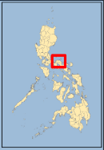
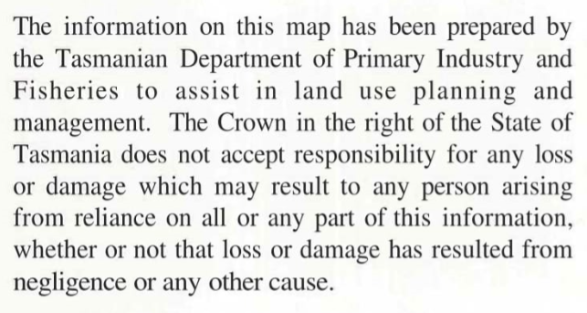
Components of a Good Thematic Map
Optional components
Inset map – showing a detailed part of the map at a larger scale, the location of the main map in the context of a larger area, or information for a related location that cannot easily fit into the same map
Disclaimer – delimiting the scope of rights and responsibility of the author regarding the content of the map.
Copyright – detailing use and distribution information of the map.

Slide 11
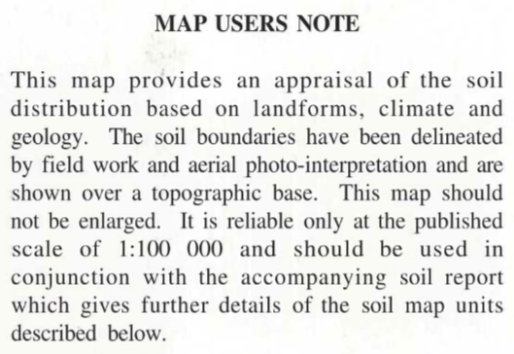
Components of a Good Thematic Map
Optional components
Additional information – that would provide further context to the map
Project file name – and its complete path to allow the GIS technician to easily find such project in case changes needs to be made
Logo – a personal or organization logo that will help make the map more recognizable as a property of and contribute to the image of the owner or organization.

Slide 12
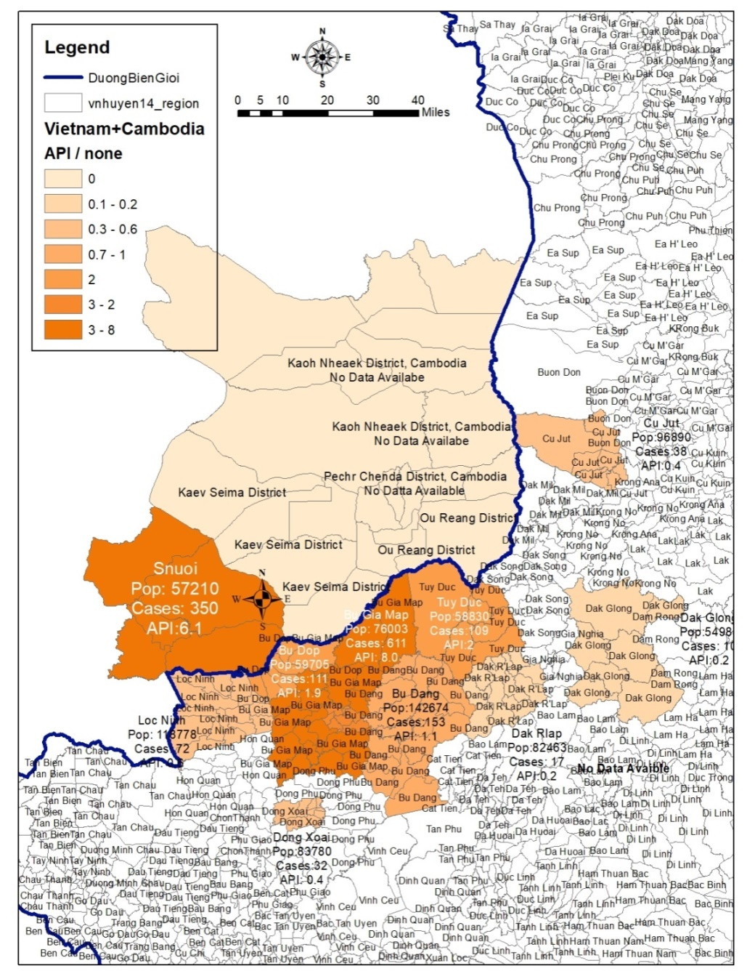
Is this a good thematic map?
What is missing?
What should/could be improved?
Does it contain the right amount of information?
Is this map useful?

Slide 13
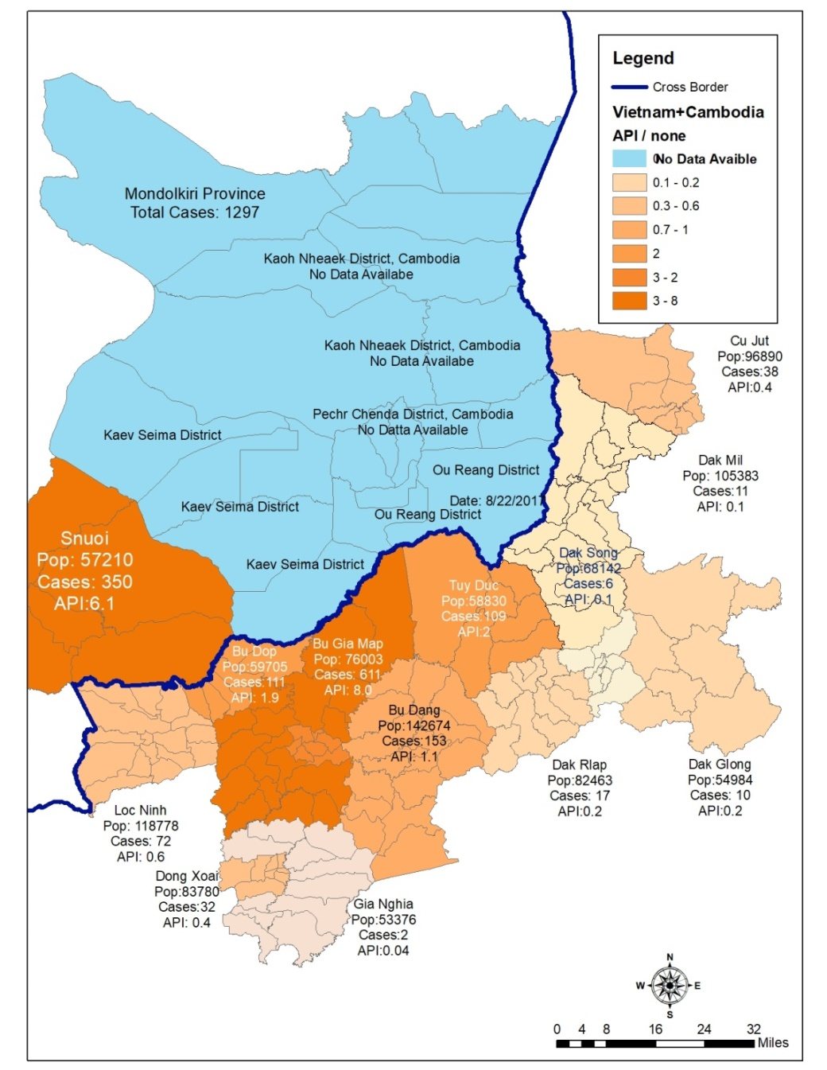
Is this a good thematic map?
What is missing?
What should/could be improved?
Does it contain the right amount of information?
Is this map useful?

Slide 14
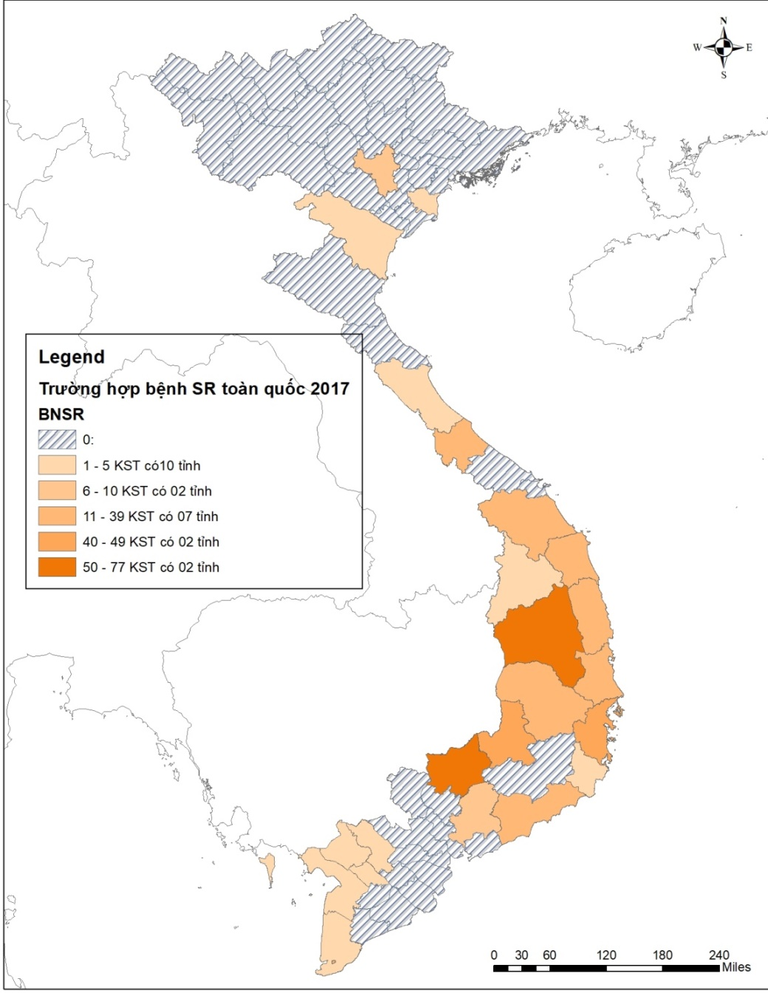
Is this a good thematic map?
What is missing?
What should/could be improved?
Does it contain the right amount of information?
Is this map useful?

Slide 15
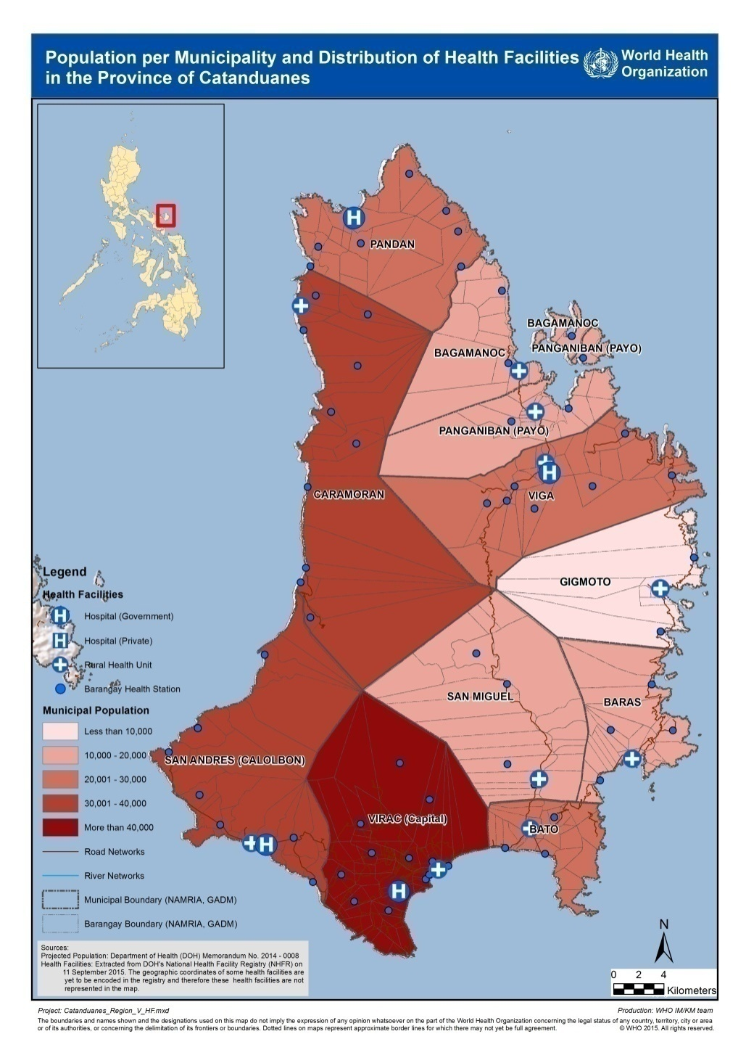
Is this a good thematic map?
What is missing?
What should/could be improved?
Does it contain the right amount of information?
Is this map useful?

Slide 16
Example of a good thematic map

