Slide 1
Session 4: The process behind making
a good thematic map –
Introduction
Izay Pantanilla
GIS Analyst, Health GeoLab Group, Epidemiology Department,
Mahidol-Oxford Tropical Medicine Research Unit, Faculty of Tropical Medicine,
Mahidol University, Bangkok

Slide 2
Key terms used in this session
Attribute data: Also statistical data; Nonspatial information about a geographic feature, usually stored in a table that can be attached to a geographic object through the use of unique identifier or ID
Geospatial data: Also referred to as spatial data; Information about the locations and shapes of geographic features and the relationships between them, usually stored as coordinates and topology.
Map: Any graphical representation of geographic or spatial information.
Thematic map: A map designed to convey information about a single topic or theme, such as population density, geology, or health

Slide 3
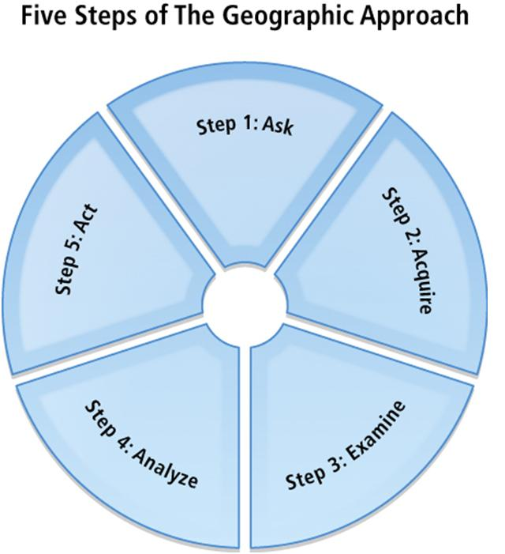
The geographic approach
Step 1: Ask
What is the problem to solve or analyze? Where is it located?
Step 2: Acquire
What data are needed to complete the analysis? Where can it be found or generated?
Step 3: Examine
Visual inspection of data, how is it organized (schema), how does it correspond to other data and physical world (topology), where is it from (metadata).
Step 4: Analyze
Way data processed and analyzed depends on results wanted
Step 5: Act
Presentation of results part of the decision making process. Via reports, maps, tables, and charts; printed/digitally – network/web.
Thematic mapping follows these steps

Slide 4
The thematic mapping process
Three main parts of the process:
Understanding the context of the map to be created
Collecting and preparing the necessary data and information
Creating the thematic map itself
Ask
Acquire
Examine
Analyze
Guide_HGLC_Part2_6_1.pdf
https://www.healthgeolab.net/DOCUMENTS/Guide_HGLC_Part2_6_1.pdf

Slide 5
The thematic mapping process
Understanding the context of the map to be created
1. Understanding the purpose
What is the map going to be used for? Is this for general information, decision making?
What is the message(s) that the map is meant to convey?
When and where will this map be used?
Who will present the map?

Slide 6
The thematic mapping process
Understanding the context of the map to be created
2. Understanding the audience
Who will be using the map?
Is this map meant for the MOH only or for the public?
Can you use technical terms/jargons or should you only use simple terms?
Is the audience familiar with the topic covered by the map?
Do your map readers know the area well?

Slide 7
The thematic mapping process
Understanding the context of the map to be created
3. Defining the content
What information needs to appear on the map to fulfil the expected purpose and reach the target audience?
Is there any particular way in which the information should be represented on the map?
What data and information needs to be collected in order to create the map
Avoid including too much information in just one map!

Slide 8
The thematic mapping process
Understanding the context of the map to be created
4. Identifying the medium
Medium = support on which the map will be stored (printed on paper, saved in a pdf or ppt file, shared online,...)
How will the map reach the audience?
What is the appropriate size for the map?
Does the audience need to zoom on the map?

Slide 9
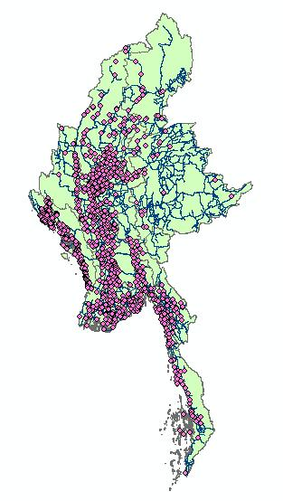
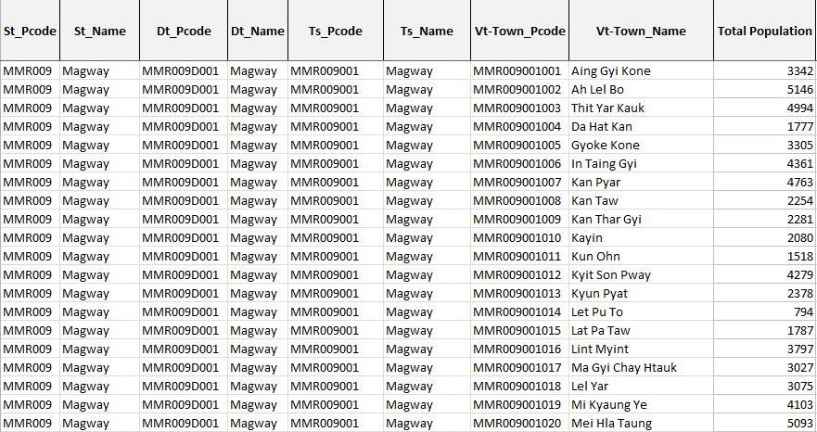
The thematic mapping process
Collecting and preparing the necessary data
Two main data types needed to create a thematic map:
Geospatial data
Attribute data
Additional data:
Other information to appear on the map
Basemap

Slide 10
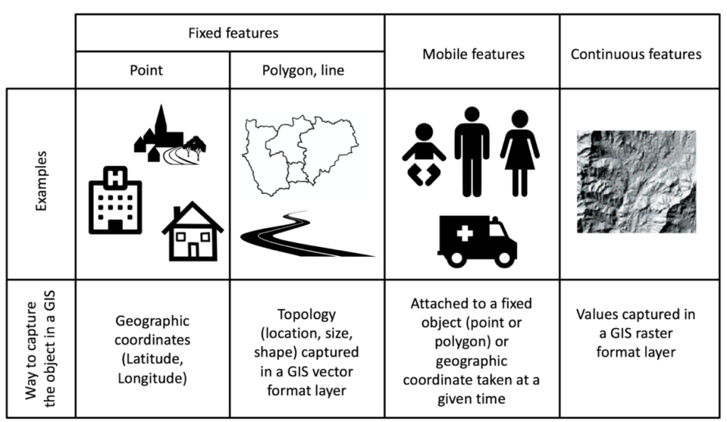
The thematic mapping process
Collecting and preparing the necessary data
Geospatial/spatial data
Information about the locations and shapes of geographic features (object) and the relationships between them, usually stored as coordinates and topology (how point, line, and polygon features share geometry).
https://www.healthgeolab.net/DOCUMENTS/Guide_HGLC_Part2_1.pdf
Guide_HGLC_Part2_1.pdf

Slide 11
The thematic mapping process
Collecting and preparing the necessary data
Attribute data
Statistical data and/or information that can be attached to a specific geographic objects (geospatial data)
Generally stored in a table (Excel file for example)
A unique identifier allows the link (join) with the corresponding object
Unique identifier

Slide 12
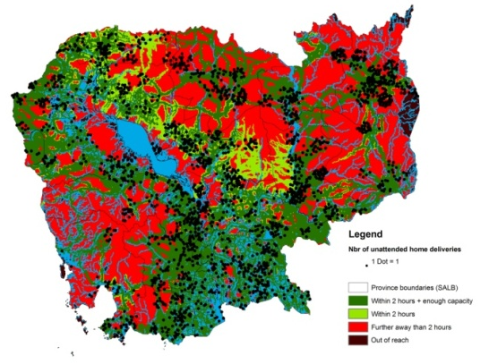
The thematic mapping process
Collecting and preparing the necessary data
Map
Geographic
objects
Unique identifier
Programmatic
attributes
Region/
State
Stats/Info
District
Stats/Info
Township
Stats/Info
Table/graph
Village track
Stats/Info
Ward
Health facility
Information
EPI community
Information
Health
program
specific
Patient
Stats/Info
Master lists

Slide 13
The thematic mapping process
The concept of master list
A unique, authoritative, complete, up-to-date, and uniquely coded list of all the active (and past active) records for a given type of geographic feature/object (e.g., health facilities, administrative divisions, villages) officially curated by the mandated agency
Key characteristics
Cover the core set of fields that would allow to uniquely identify, classify, geographically locate, and, when appropriate, contact each active record in the master list
Originate from the governmental entity officially mandated to develop and maintain such master list (unique)
Be complete and up-to-date (updating mechanism in place, validity time stamp)
Contain an official and unique identifier (ID) for each record
Make the link with other master lists in order to describe the geographical and hierarchical relationships between the objects (e.g., by including the name and unique code of administrative divisions in the health facility master list)
National-Georeferenced-Community-Health-Worker-Master-List-Hosted-in-a-Registry-2021.pdf

Slide 14
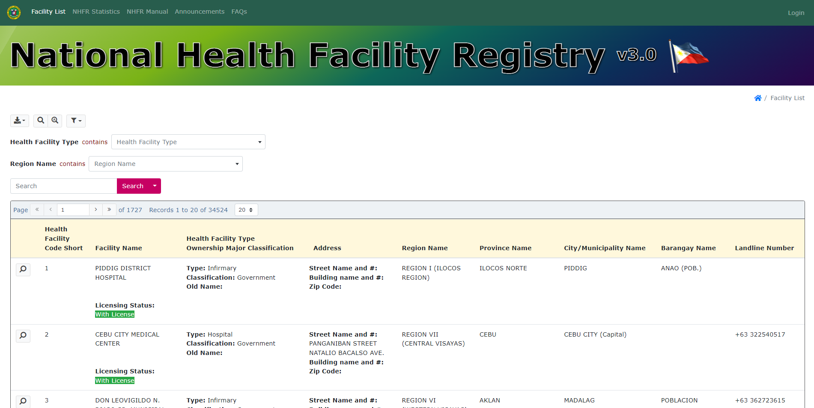
The thematic mapping process
The concept of registry
Central authority to collect, store, and distribute an up to date and standardized master list
In other words, a registry can be understood as the IT solution while the master list is itself the standardized data stored in that solution.
Example of the health facility registry of the Department of Health of the Philippines: https://nhfr.doh.gov.ph/VActivefacilitiesList

Slide 15
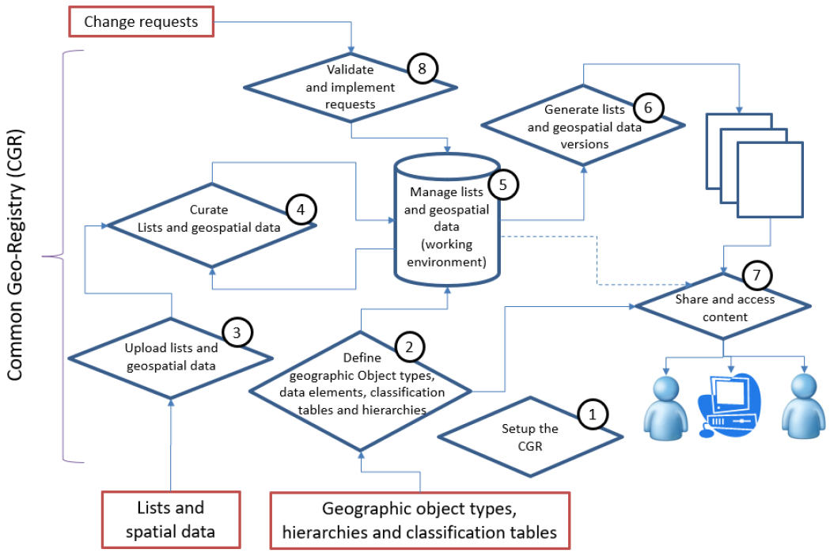
The thematic mapping process
The concept of Common Geo-Registry
IT solution that allows to store, manage, validate, update, and share multiple master lists in parallel
We will talk more about this on the last session of this training workshop
Guidance_Common_Geo-registry_Ve2.pdf

Slide 16
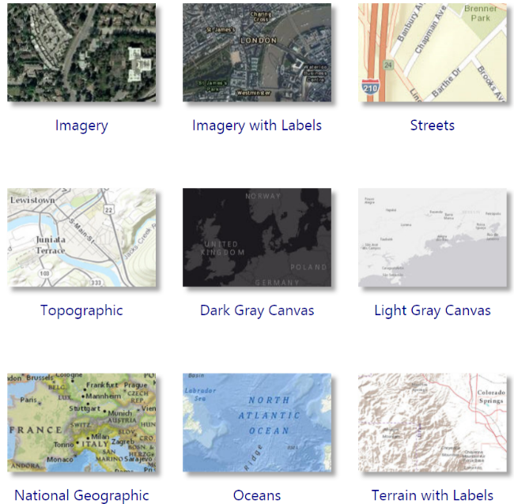
The thematic mapping process
Collecting and preparing the necessary data
Basemaps
Raster file with selection of layers combined into single raster or vector file
Used as bottom layer/background for a map
Examples:
Google Maps
ESRI via ArcGIS online
Open Street Map
Only for visualization purpose

Slide 17
The thematic mapping process
Creating the thematic map
Steps in creating a thematic map
Adding the data into the GIS software
Select the appropriate mode of representation
Fix the symbology
Add labels to the map
Choose the map orientation (or map template)
Fix the other elements of the layout
Save the final map in the appropriate format
+
Fix map elements outside the GIS software (with Adobe Illustrator for example after export)

Slide 18
The thematic mapping process
Creating the thematic map
1. Adding the data in the GIS software
Geospatial data
Attribute data
Basemap
Join the attribute data with the geospatial data using the unique identifier

Slide 19
The thematic mapping process
Creating the thematic map
2. Select the appropriate mode of representation for the content of the map
Choropleth
Proportional symbol
Isarithmic or isopleth
Chorochromatic
Dot density
Dasymetric or cartogram
Most used
Guide_HGLC_Part2_6_1.pdf
Section 4.3.3

Slide 20
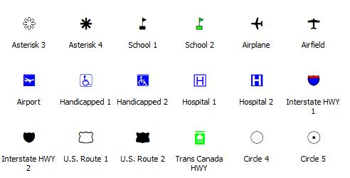
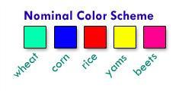
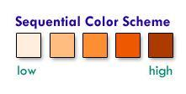
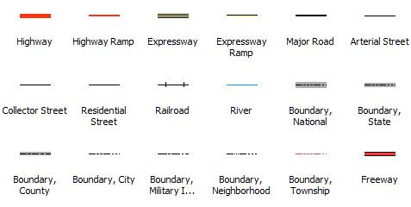
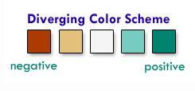
The thematic mapping process
Creating the thematic map
3. Fix the symbology
Choose the appropriate symbols and/or colors

Slide 21
The thematic mapping process
Creating the thematic map
4. Add labels to the map
In cartography, a label is a text placed on or near a map feature that describes or identifies it.
Identify the intellectual hierarchy
The ranking of importance of the different map features
Determine the visual hierarchy of map labels based on the intellectual hierarchy
The way the map labels are designed to help map readers organize geographical information

Slide 22
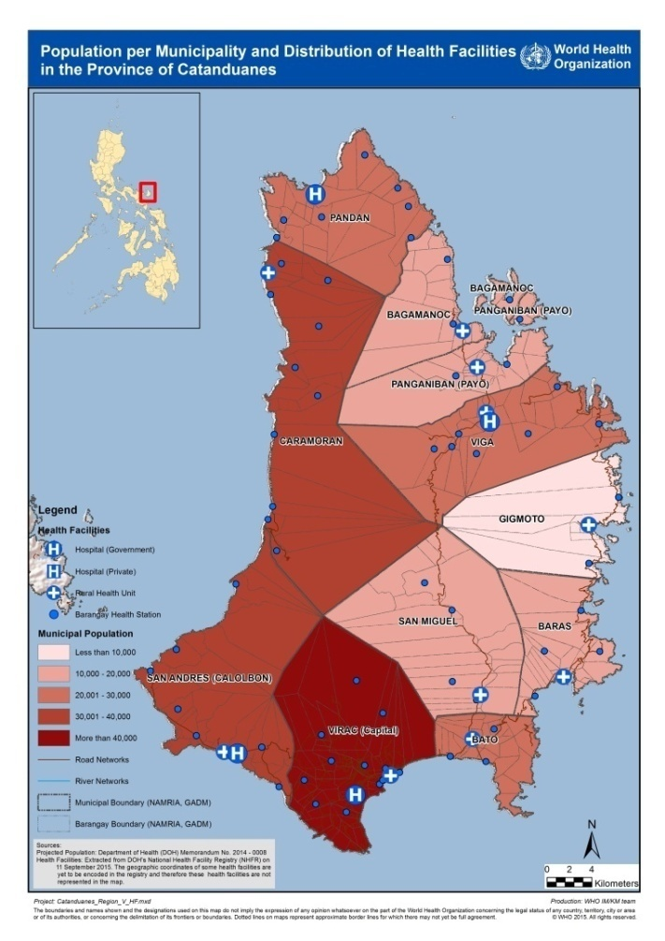
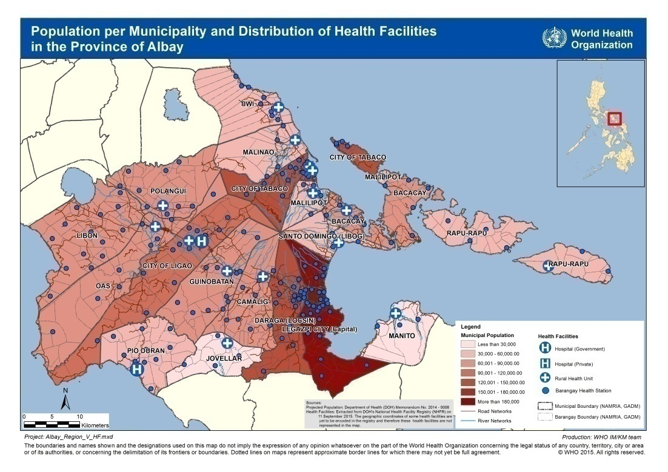
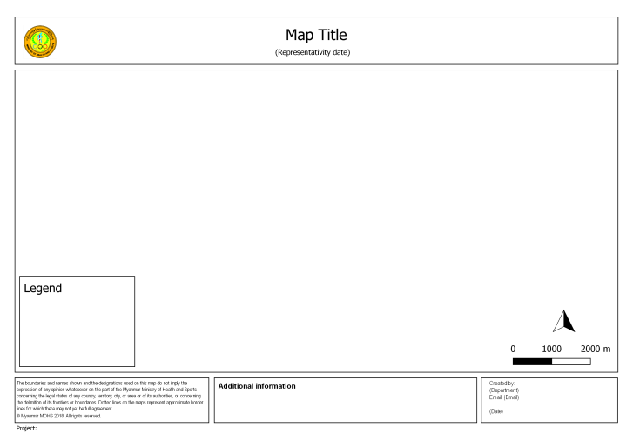
The thematic mapping process
Creating the thematic map
5. Choose the map orientation (or map template)
Portrait
Landscape
Depends mainly on the shape of the geographic area being covered

Slide 23
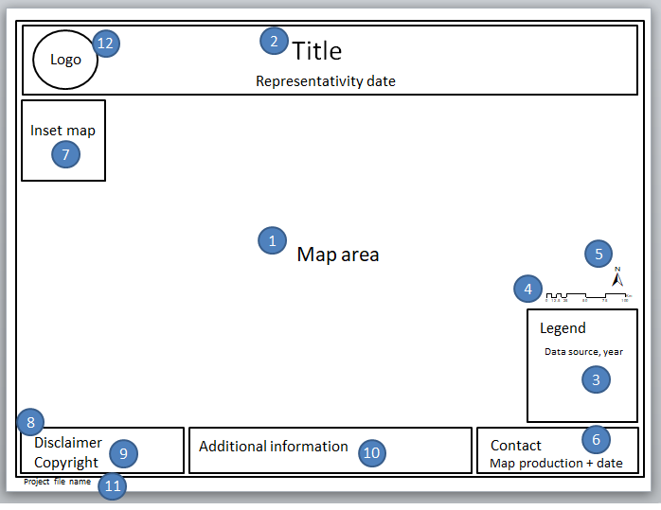
The thematic mapping process
Creating the thematic map
6. Fix the other elements of the layout
If no map template is available, make sure that all map components are present.
If using a map template:
Supply the text for the title, production date, project file name, etc.
Check that the legend and scale represent the current map
Check the overall look of your map. Ensure that it looks clean and balanced.

Slide 24
The thematic mapping process
Creating the thematic map
7. Save the final map in the appropriate format
Save the map in a file format that would best suit the end use
For use in electronic viewing wherein the map readers do not need to zoom in, the map can be saved in JPEG, BMP, or PNG file format.
Otherwise, it is best to save in PDF format.
It is advisable to save the map with at least 300 dots per inch (dpi) resolution.

Slide 25
The thematic mapping process
Creating the thematic map
Fix map elements outside the GIS software (after export)
There is sometimes the need to do minor editing after creating the final map:
Repositioning or adding labels
Adding text information
Removing unnecessary data and/or text
JPEG, BMP, and PNG MS Paint or Adobe Photoshop
PDF Adobe Photoshop or Adobe Illustrator

Slide 26
Introduction to Day 2 (October 19th, 12:00-14:00 Bangkok time)
The importance of data
No homework this time but feel free to:
Go through the slides presented today (in the Google Drive)
Consult the reference material in the Google Drive folder + collect geographic coordinates
Capture any questions you might have in the following Google form: https://bit.ly/3SR0nfB

