Slide 1


INTRODUCTION TO THE MANAGEMENT AND USE OF GEOSPATIAL DATA AND TECHNOLOGIES
FOR MALARIA PROGRAMS
APMEN Online Training Series – Day 2

Slide 2
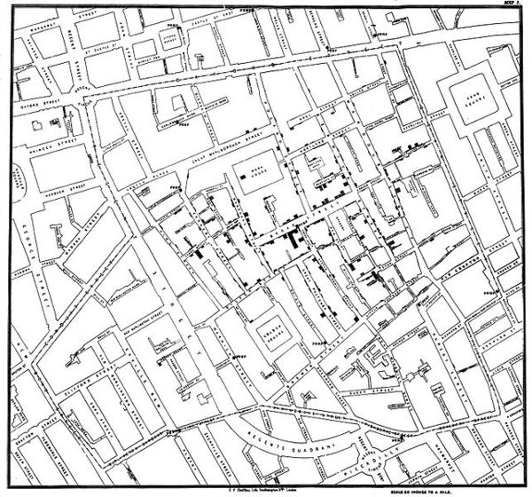
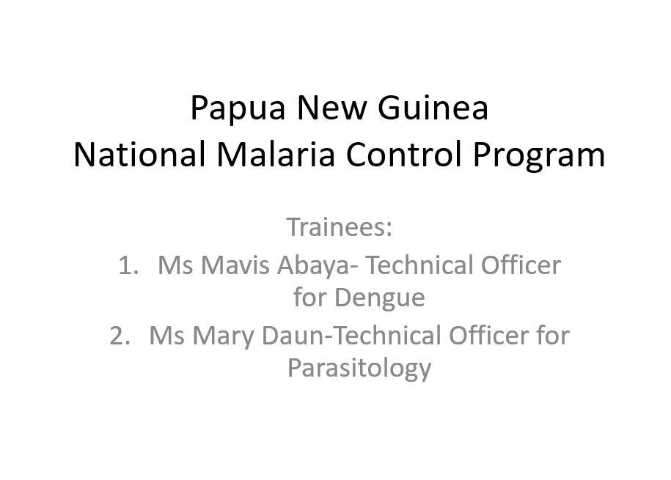
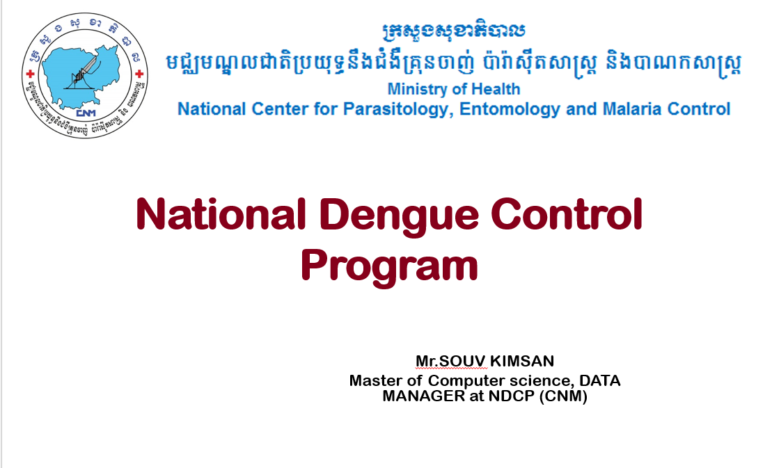
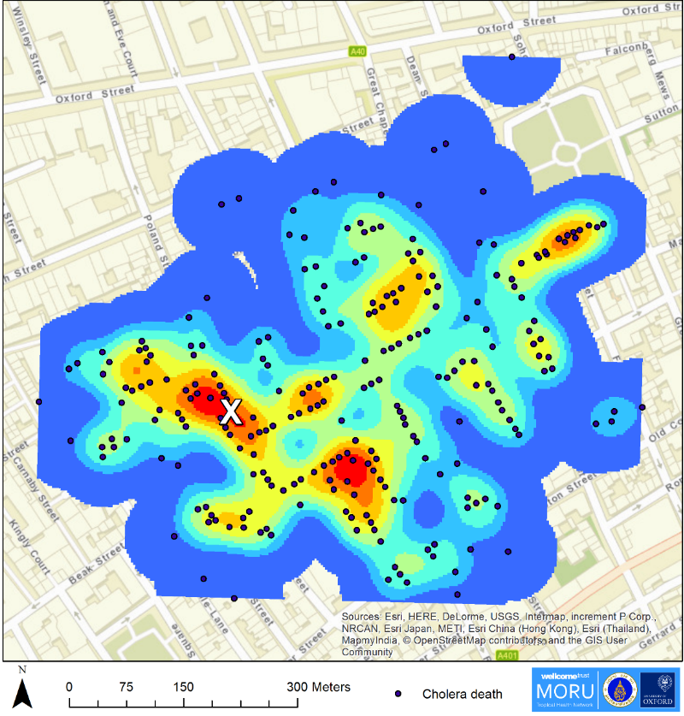
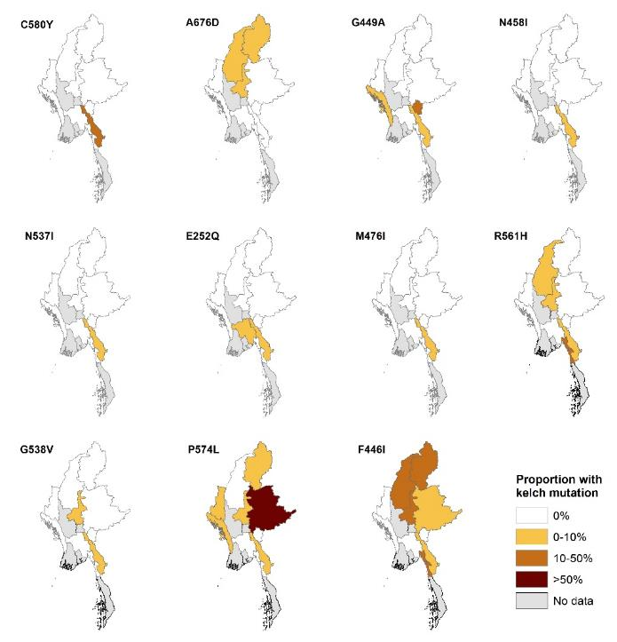
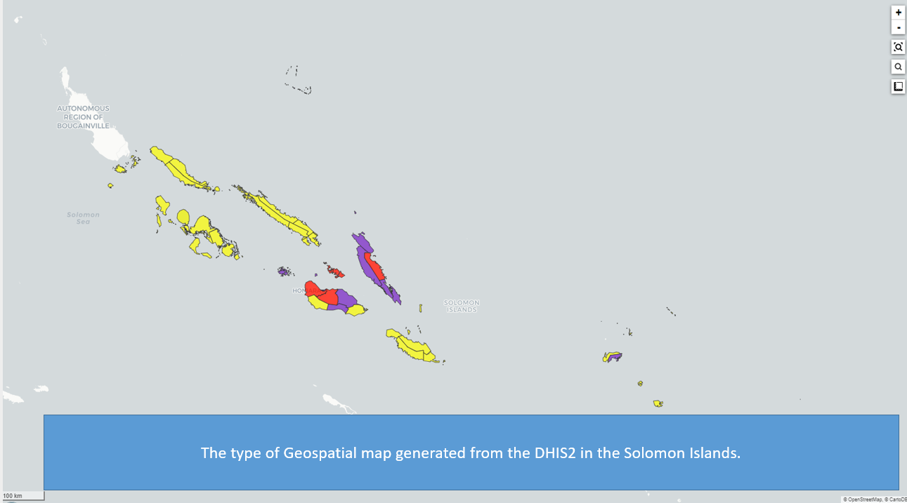
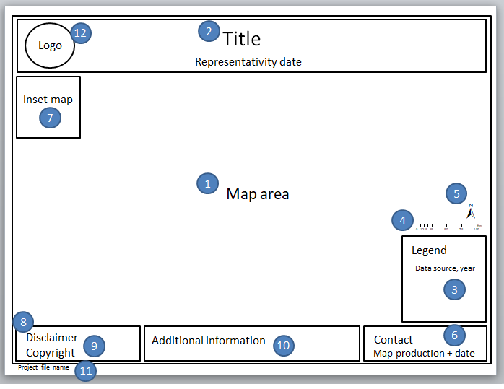
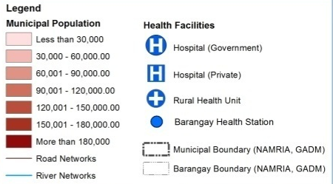
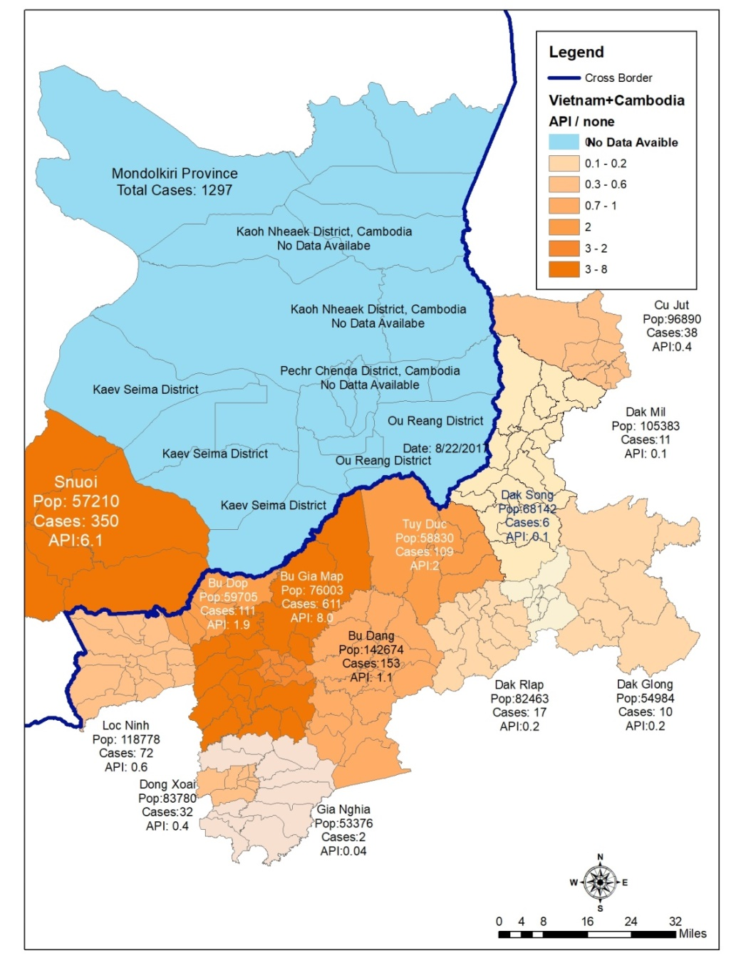
Recap of Day 1
Country presentations
Geographic dimension of malaria surveillance response
Understanding the value of
a good thematic map

Slide 3
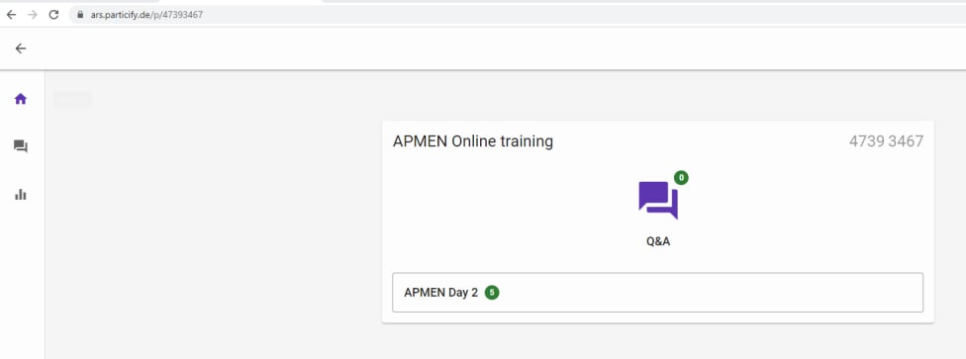
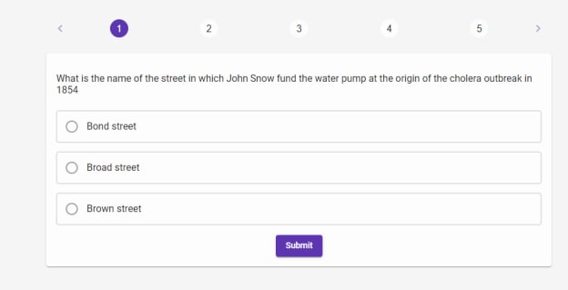
Quizz
1. Please go to: https://ars.particify.de/
2. Enter code: 4739 3467
3. You should get this window:
4. Click on APMEN Day 2
5. First question

Slide 4



Some logistic reminders
Training material
QGIS Installer
- Google Drive: https://bit.ly/3ChSHMs
- Web page: https://bit.ly/3gkWnpm
Sessions recording
Questions, Problems installing QGIS
Picture
- General questions: https://bit.ly/3SR0nfB
- QGIS Issues: https://bit.ly/3eheHix
- Type them in the chat, raise hand, attend the Q&A session on October 21st

Slide 5
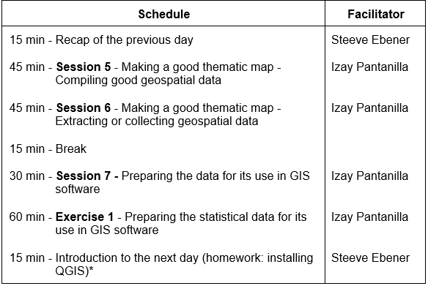
Day 2 (October 19th)
The importance of data

Slide 6
Session 5: Making a good thematic map –
Compiling good geospatial data
Izay Pantanilla
GIS Analyst, Health GeoLab Group, Epidemiology Department,
Mahidol-Oxford Tropical Medicine Research Unit, Faculty of Tropical Medicine,
Mahidol University, Bangkok

Slide 7
Key terms used in this session
Attribute data: Also statistical data; Nonspatial information about a geographic feature, usually stored in a table that can be attached to a geographic object through the use of unique identifier or ID
Basemap: Collection of GIS data and/or orthorectified imagery that form the background setting for a map. The function of the basemap is to provide background detail necessary to orient the location of the map.
Data: Facts and statistics collected for reference or analysis
Geospatial data: Also referred to as spatial data; Information about the locations and shapes of geographic features and the relationships between them, usually stored as coordinates and topology.
Map: Any graphical representation of geographic or spatial information.
Master list: A unique, authoritative, complete, up-to-date, and uniquely coded list of all the active (and past active) records for a given type of geographic feature/object (e.g., health facilities, administrative divisions, villages) officially curated by the mandated agency
Metadata: Information that describes the content, quality, condition, origin, and other characteristics of data or other pieces of data
Thematic layer: A spatial representation of analyzed geospatial data of elements of the same type (health facilities, roads, districts, etc.)

Slide 8
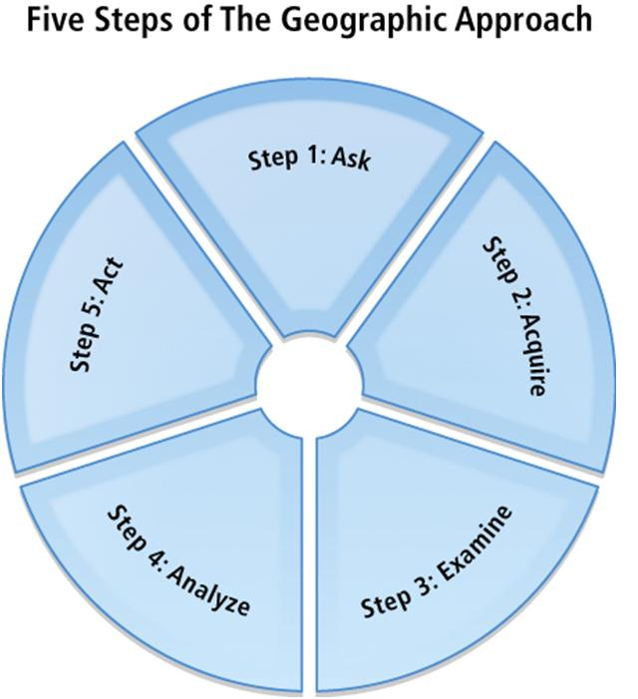
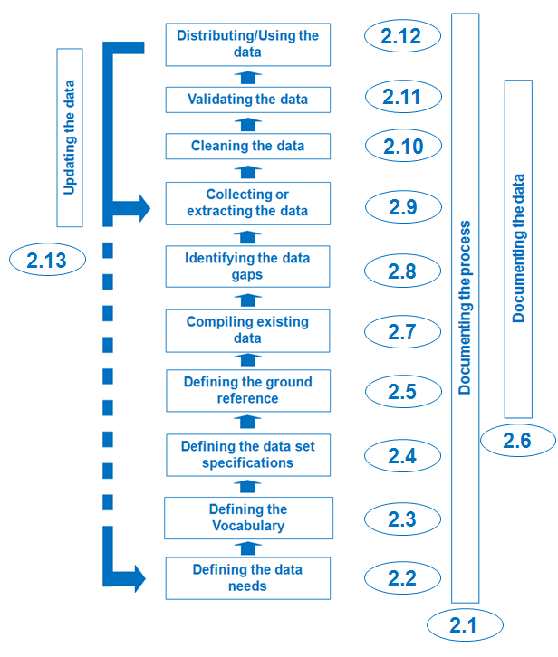
The geospatial data cycle
Geospatial data life cycle
Critical steps to create good maps!

Slide 9
Defining the vocabulary, data set specifications, and ground reference
As mentioned earlier, identifying and understanding the purpose of the map helps identify the data needs and identifying the audience helps in defining the vocabulary to be used. Before compiling the needed data, the data specification and ground reference have to be defined to ensure the quality of the data to be used.
  Defining the vocabulary
  Defining the data set specification
  Defining the ground reference
http://www.healthgeolab.net/DOCUMENTS/Guide_HGLC_Part2_2.pdf

Slide 10

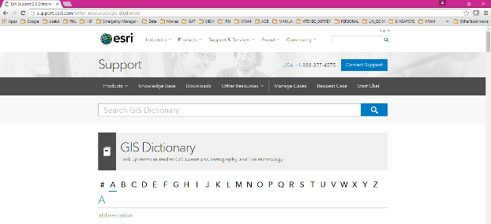
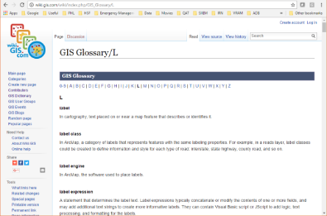
Defining the vocabulary
Defining the vocabulary ensures that all actors involve speak the same language
GIS: Esri online GIS dictionary: http://support.esri.com/other-resources/gis-dictionary
GIS: wiki.GIS.com: http://wiki.gis.com/wiki/index.php/GIS_Glossary
Also important to have a dictionary covering the concerned thematic area (Malaria, MNH,…)

Slide 11



Defining the data set specifications and ground reference
Addressing public health issues requires good quality data and good geospatial data must cover the six (6) dimensions of data quality:
Completeness: No data gap
Uniqueness: No duplicates
Timeliness: Up-to-date
Validity: Conform to the defined format, type, range,...
Accuracy: Correctness
Consistency: No difference across sources
The data set specifications and the ground reference capture the standards against which geospatial data is assessed to measure these dimensions.
Guide_HGLC_Part2_2.pdf
http://www.healthgeolab.net/DOCUMENTS/Guide_HGLC_Part2_2.pdf

Slide 12
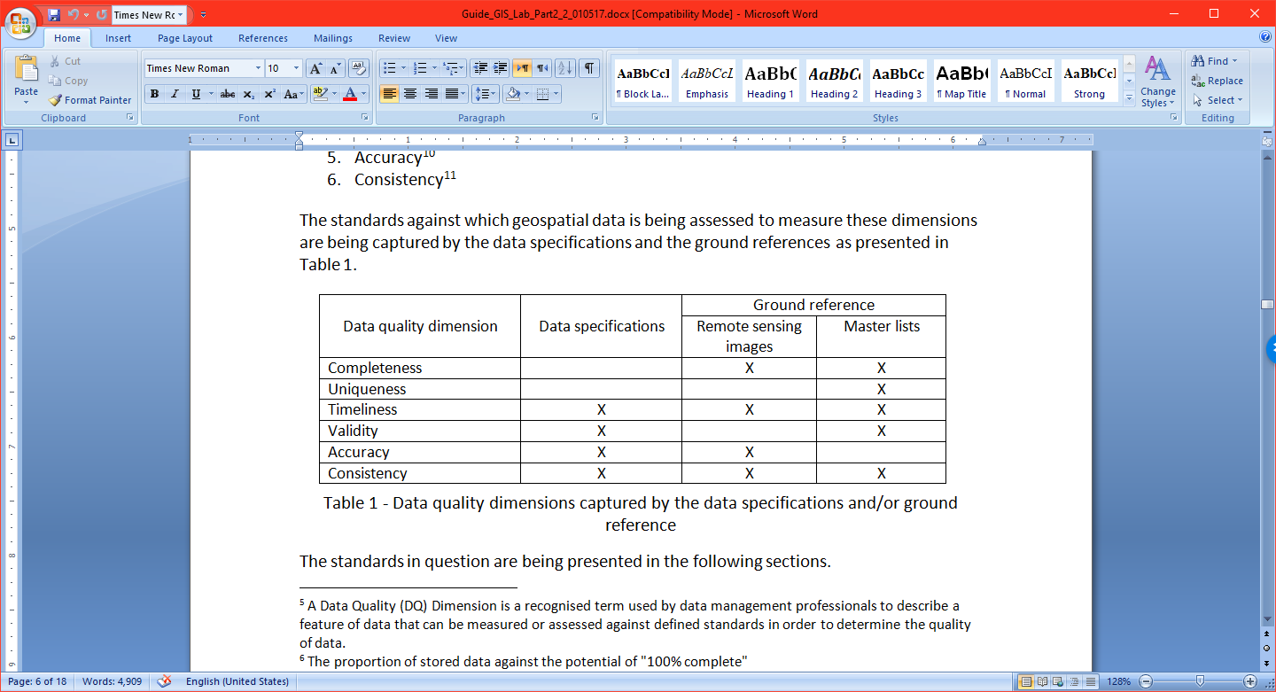
Defining the data set specifications
A geospatial data specification document contains all features a geospatial dataset should comply with in order to be considered of good quality and fulfill the original purpose and expected outcomes of the project.
The data quality dimensions¹ covered by the data set specifications are presented below:
1 A Data Quality (DQ) Dimension is a recognized term used by data management professionals to describe a feature of data that can be measured or assessed against defined standards in order to determine the quality of data.

Slide 13
Defining the data set specifications
Such document should contain at least the following information:
Validity:
  V.1 Geographic coordinate system and map projection
  V.2 Geographic extent of the area being covered
  V.3 Language(s) included in the data
  V.4 File format(s) for sharing data
  V.5 Metadata standard used to document the data
Accuracy:
  A.1 Scale (vector layers)
  A.2 Spatial resolution (raster layers)
  A.3 Positional accuracy (vector layers)
  A.4 Positional accuracy (GNSS reading)
  A.5 Positional precision (GNSS reading)
Timeliness:
  T.1 Period for which the data is being considered as relevant
Consistency

Slide 14
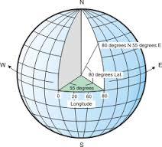
Defining the data set specifications
V.1 Geographic Coordinate System
System in which geospatial data is defined by a 3-D surface and measured in latitude and longitude.
Angular units: The unit of measure on the spherical reference system.
Prime meridian: The longitude origin of the spherical reference system.
Datum: Defines the relationship of the reference spheroid to the Earth's surface.
Spheroid: The reference spheroid for the coordinate transformation.
https://www.healthgeolab.net/DOCUMENTS/Guide_HGLC_Part2_2.pdf
http://help.arcgis.com/en/arcgisdesktop/10.0/help/index.html#/What_are_geographic_coordinate_systems/003r00000006000000/

Slide 15
Defining the data set specifications
V.1 Geographic Coordinate System
IMPORTANT: Must use the same Geographic Coordinate System on each dataset being combined on a map

Slide 16
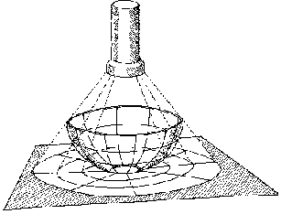
Defining the data set specifications
V.2 Projected Coordinate System
System in which geospatial data is defined by a flat 2-D surface and can be measured in units of meters and feet.
Map projection
A method by which the curved surface of the earth is portrayed on a flat surface
The systematic transformation of points on the Earth’s surface to corresponding points on a plane (flat) surface
The earth is 3D but maps need to be flat!
This requires distortion of some parts of the map.
Note: When displaying data that is using a geographic coordinate system, GIS uses a projected coordinate system. Basically, we just treat the coordinate values as if they are linear and just display the data.

Slide 17
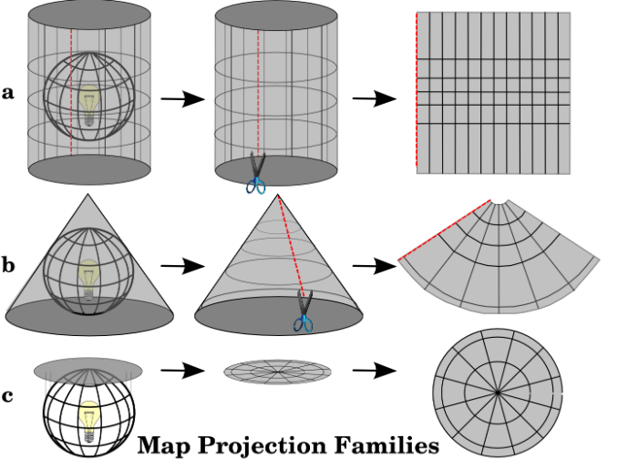
Defining the data set specifications
V.2 Map Projection – Basic projection techniques
Cylindrical
Conical
Azimuthal
https://www.healthgeolab.net/DOCUMENTS/Guide_HGLC_Part2_2.pdf
http://www.icsm.gov.au/mapping/about_projections.html#types

Slide 18
Defining the data set specifications
V.2 Map Projection – Basic projection types
Each projection preserves a particular relationship or characteristic:
Equal-Area — correctly shows the size of a feature
Conformal — correctly shows the shape of features
Equidistant — correctly shows the distance between two features
True Direction — correctly shows the compass direction between two features
A map cannot be at the same time equal-area or conformal – it can only be one or the other, or neither.
A map projection is to be chosen based on the needs
https://www.healthgeolab.net/DOCUMENTS/Guide_HGLC_Part2_2.pdf

Slide 19
Defining the data set specifications
V.2 Map Projection – Examples
Projection | Technique | Type | Description
Equirectangular | Cylindrical | Equidistant | Simplest geometry; distances along meridians are conserved. Plate carrée: special case having the equator as the standard parallel.
Lambert cylindrical equal-area | Cylindrical | Equal-area
Universal Transverse Mercator (UTM) | Cylindrical | Conformal | Divides the Earth into sixty zones, each being a six-degree band of longitude
Robinson | Pseudocylindrical | Compromise (neither equal-area nor conformal) | Used to create global maps
https://en.wikipedia.org/wiki/List_of_map_projections

Slide 20
Defining the data set specifications
V.3 Language
National versus international capacity to understand the data
V.4 Geospatial and attribute data format (most used)
Vector
  Shapefiles (actually composed of the 3 to 8 files)
  GeoJSON (QGIS)
Raster
  Georeferenced: Geotiff
  Not georeferenced: .jpeg, .png, etc.
  GRID
Tabular (attributes):
  Spreadsheets: .xls, .dbf (for point type data and when they contain the latitude and longitude)
Combined vector/raster/tabular
  Geodatabases
Recommended

Slide 21
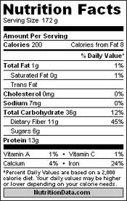
Defining the data set specifications
V.5 Metadata – Data about the data
For users to ensure that the data is appropriate for their own purpose
Should be captured as much as possible during data collection and completed before data dissemination
Applies to both geospatial and statistical data
Different standards exists (FGDC, ISO) but they first need to be converted into a metadata profile (selection of fields) before being used.

Slide 22

Defining the data set specifications
V.5 Metadata – Data about the data
A minimum metadata should cover:
  Where is the data coming from?
  When was it created/last updated?
  What is the method behind the data (scale, accuracy,..)?
  Which geographic coordinate/projection system is being used?
  Are there any use or redistribution restrictions attached to the data?
  Who can I contact if I have questions?
Guide_HGLC_Part2_5_1.pdf
https://www.healthgeolab.net/DOCUMENTS/Guide_HGLC_Part2_5_1.pdf

Slide 23
Defining the data set specifications
A.1 Scale, A.2 Resolution, A.3 & A.4 Accuracy, and A.5 Precision
Scale: The ratio or relationship between a distance or area on a map and the corresponding distance or area on the ground, commonly expressed as a fraction or ratio. A map scale of 1/100,000 or 1:100,000 means that one unit of measure on the map equals 100,000 of the same unit on the earth.
Resolution (raster format): The dimensions represented by each cell or pixel in a raster.
Accuracy: The degree to which a measured value conforms to true or accepted values. Accuracy is a measure of correctness.
Precision: The number of significant digits used to store numbers, particularly coordinate values. Precision measures exactness.
http://support.esri.com/other-resources/gis-dictionary/

Slide 24
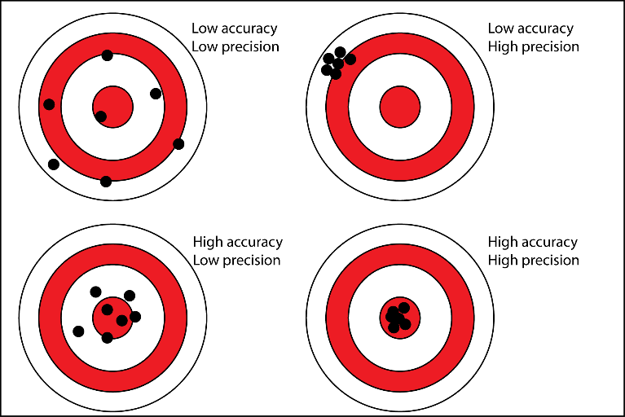
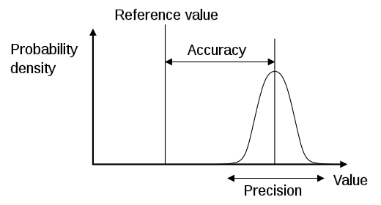
Defining the data set specifications
Accuracy and Precision (A.4 and A.5)

Slide 25
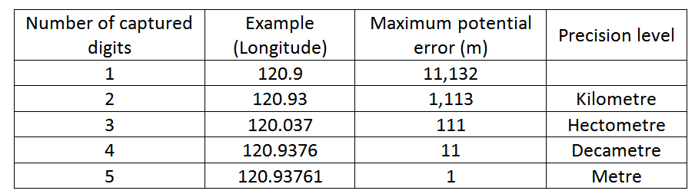
Defining the data set specifications
Precision (A.5)
At the equator: 360 º
40’075 km
1 º
͌
111’320 m
Recommended
During data collection in the field (GNSS enabled devices)
When generating or extracting vector format geospatial data (precision level of vertices)

Slide 26
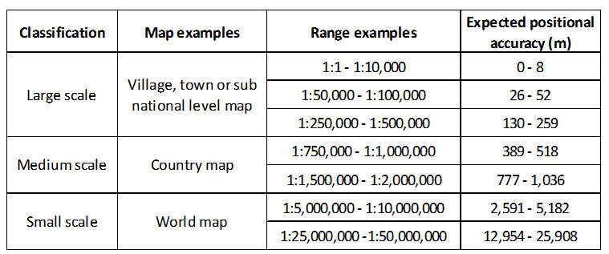
Defining the data set specifications
Scale, Accuracy, and Precision (A.1, A.3, and A.5)
United States Geological Survey mapping standards: "requirements for meeting horizontal accuracy as 90 per cent of all measurable points must be within 1/30th of an inch for maps at a scale of 1:20,000 or larger, and 1/50th of an inch for maps at scales smaller than 1:20,000."
http://www.colorado.edu/geography/gcraft/notes/error/error_f.html

Slide 27
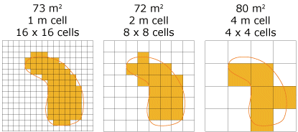
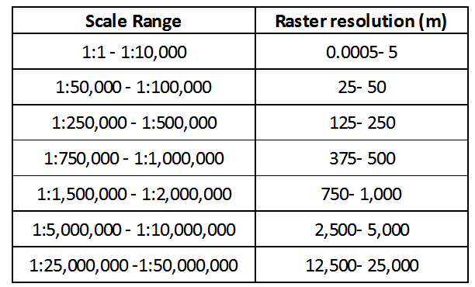
Defining the data set specifications
Scale and Resolution (A.1 and A.2)
Values are very close to those for accuracy
Tobler W. (1987): Measuring Spatial Resolution, Proceedings, Land Resources Information Systems Conference, Beijing, pp. 12-16

Slide 28
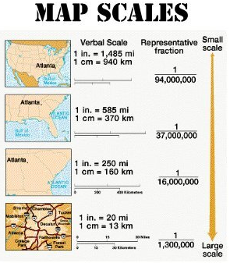
Defining the data set specifications
Scale, Accuracy, and Precision - Conclusion
PURPOSE
The purpose behind the thematic map will guide the choice of a specific scale of work.
This scale will directly influence the positional accuracy and spatial resolution that should be used when compiling, collecting, or extracting geospatial data.
The highest accuracy possible should be sought when using GNSS-enabled devices to allow for the largest use possible of the resulting data; and
A precision level down to the meter (5 digits in decimal degrees) is being recommended.

Slide 29
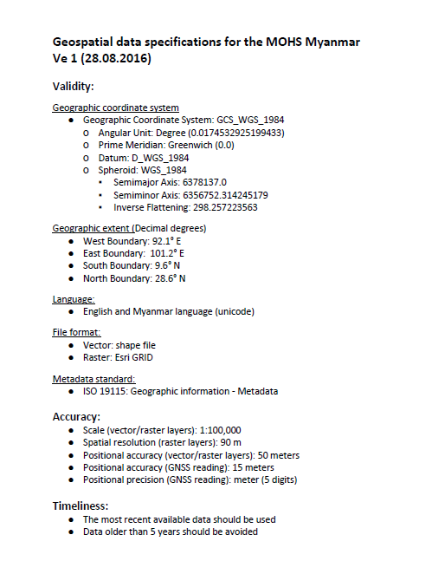
Defining the data set specifications
Summary
Defining the data specifications is key to ensuring the quality of the geospatial data and thematic maps created from it.
All the geospatial data used to create a thematic map should comply with the data specifications. For example:
  Using different geographic coordinate system will result in misaligned layers
  Inaccurate geographic coordinates will lead to health facilities falling in the sea
  Using layers from different point in time (2005, 2010, 2021) will create temporal discrepancies
Central to the creation of good thematic maps!!!
Geospatial_data_specifications_MMR_201217.pdf

Slide 30
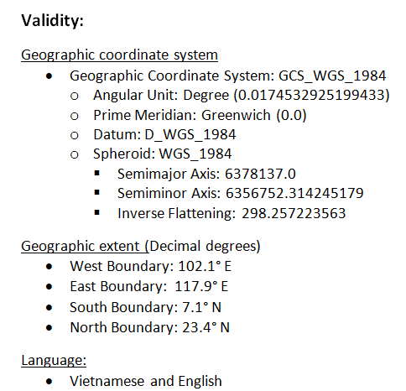
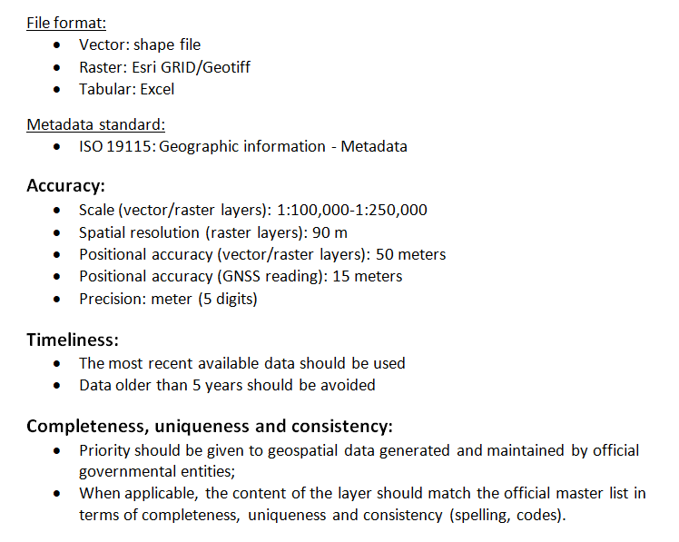
Defining the data set specifications
Example - Data specifications for MOH of Vietnam (HIS geo-enabling process)

Slide 31
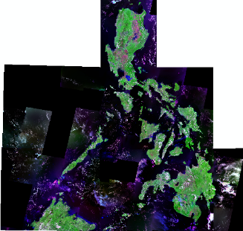
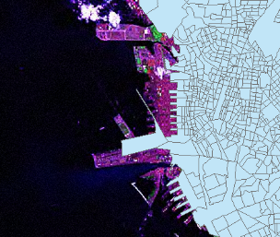
Defining the ground reference
There are two types of ground references or ground truths:
Remote sensing imagery (geospatial)
The image also has its own accuracy
Master lists (geospatial and attribute data)
890 m

Slide 32
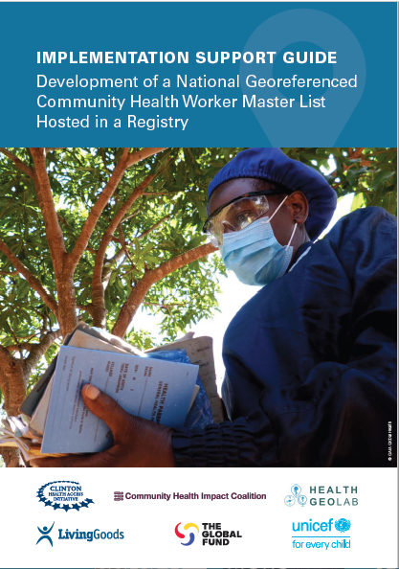
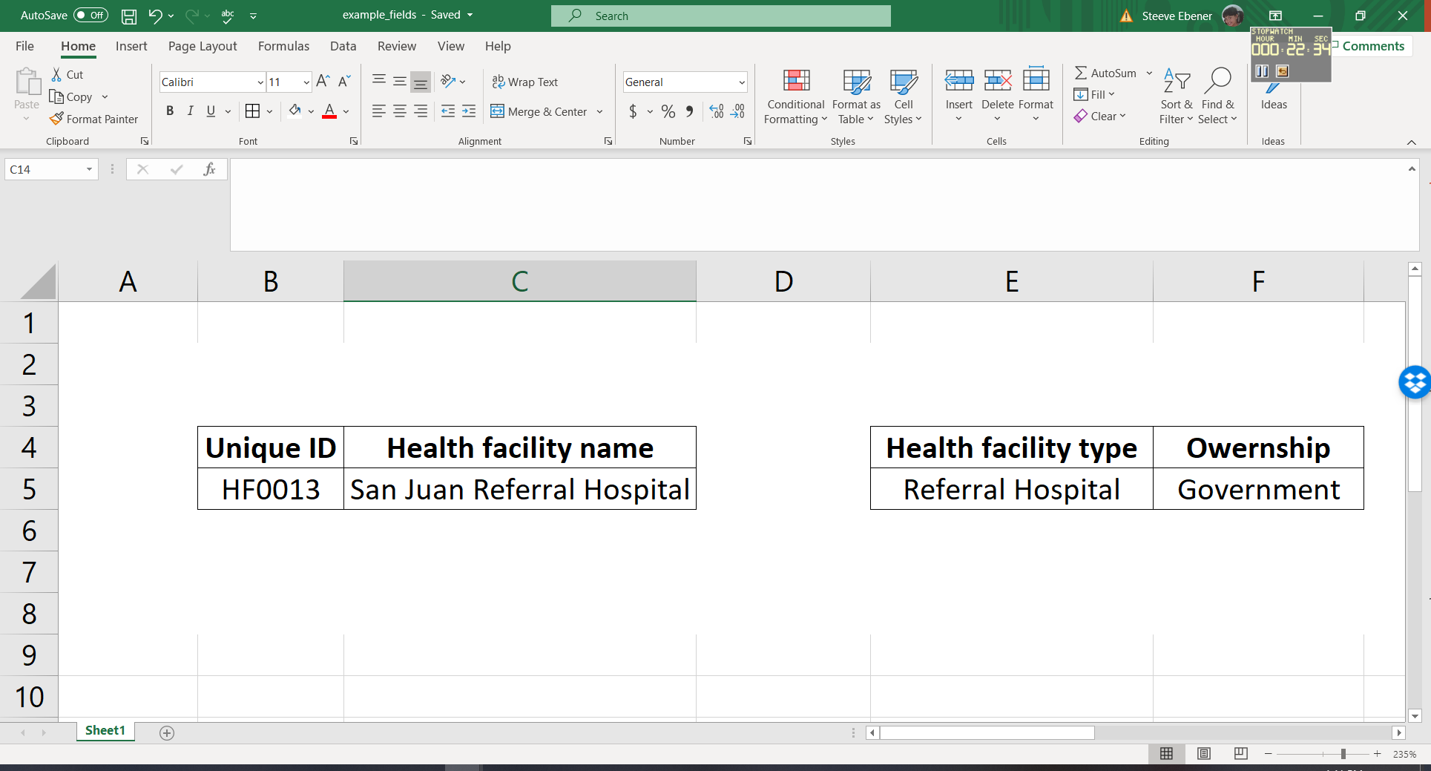
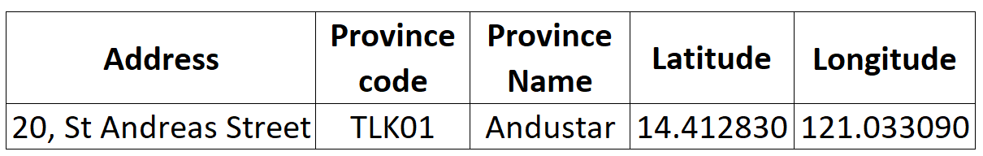
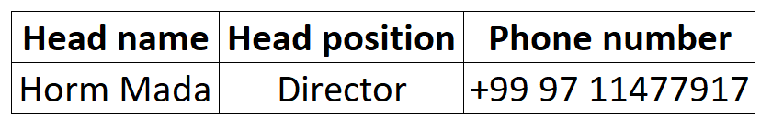
The concept of Master list
Definition: A unique, authoritative, complete, up-to-date, and uniquely coded list of all the active (and past active) records for a given type of geographic feature/object (e.g., health facilities, administrative divisions, villages) officially curated by the mandated agency.
Tabular information that allows to do the following for each of the geographic object:
Uniquely identify (unique identifier, name)
Classify (type, ownership,…)
Locate (address, administrative division, geographic coordinates)
When it applies, contact (Head name, phone number, email address,…)
Example for a health facility
National-Georeferenced-Community-Health-Worker-Master-List-Hosted-in-a-Registry-2021.pdf

Slide 33
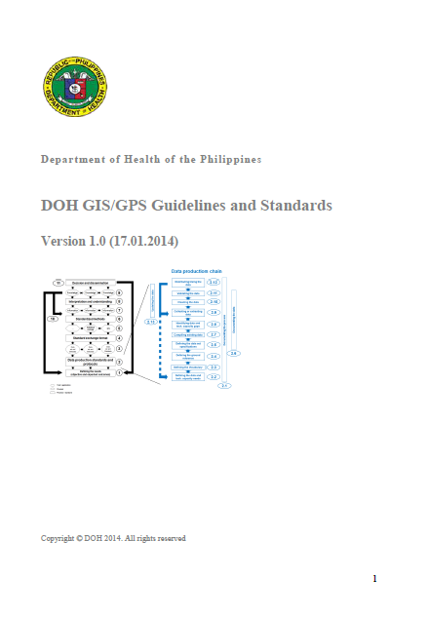


Geospatial data management guideline
It is important to capture all we covered in this session into a Geospatial data management guideline document
Philippines (2014):
Cambodia (2018):
Myanmar (2018):
DOH_GIS-GPS_ Guidelines_Standards_011714.pdf
KHM_MOH_Guidelines_2018.pdf
MMR_MOHS_Geo-Guidelines.pdf
https://healthgeolab.net/KNOW_REP/DOH_GIS-GPS_Guidelines_Standards_011714.pdf
https://www.healthgeolab.net/KNOW_REP/KHM_MOH_Guidelines_2018.pdf
https://www.healthgeolab.net/KNOW_REP/MMR_MOHS_Geo-Guidelines.pdf

Slide 34
Compiling existing data
Once the data needs have been identified and before collecting data in the field, existing data must first be compiled. The defined data specifications and ground reference will then be used as references to assess the quality of the compiled data.
Compiling existing data first prevents duplication of efforts, saves time and money, and allows identification of potential gaps.
The following must be compiled in order to have a quality dataset:
The master list for the geographic features considered in the data model
  The thematic layers containing the geospatial representation (geographic objects) for the considered geographic features
  The statistical data to be attached to these features
  Basemaps to serve as ground reference when checking the geospatial data that has been collected
  Metadata
http://www.healthgeolab.net/DOCUMENTS/Guide_HGLC_Part2_3.pdf

Slide 35
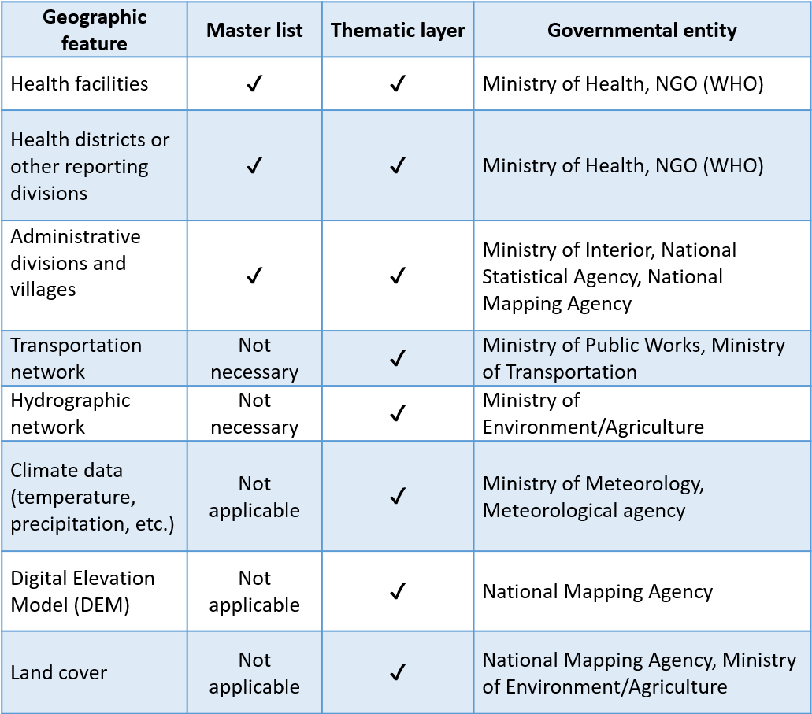
Sources of data
By definition, master lists come from the government entities which have the official mandate over the considered geographic feature(s).
The table on the right provides the list of the governmental entities generally in charge of the master list and associated thematic layer for the geographic features most often used in public health.
However, other sources can be considered for geospatial and statistical data and basemaps depending on the needs identified at the beginning of the process and their availability.
It is important to consider all these sources as they might be complementary and under different use and redistribution rights constraints.

Slide 36
Potential sources of data
Aside from governmental entities, other potential sources of local, regional, or global geospatial and statistical data are:
NGOs (UN,…) and volunteer groups (i.e., OSM): administrative boundaries, road network, hydrographic network, populated places,…
Research groups/universities: Population distribution grids, land cover
Other type of institutions: satellite images
Private sector including GIS software companies (e.g., Esri): basemap layers

Slide 37
Potential sources of data
Online free shapefiles (for download)
There are many websites for online free shapefiles. Here are some examples:
UN Second Administrative Level Boundaries: https://www.unsalb.org/
OpenStreetMap: openstreetmap.org, http://download.geofabrik.de/, openstreetmapdata.com , http://extract.bbbike.org/
Online free population data (for download)
Worldpop: www.worldpop.org.uk
GEOHIVE: http://www.geohive.ie/catalogue.html
Gridded Population of the World http://sedac.ciesin.columbia.edu/data/collection/gpw-v4
Free raster layers (for download)
Global Land Cover 30: http://www.globallandcover.com
Forest cover: https://earthenginepartners.appspot.com/science-2013-global-forest/download_v1.6.html
DEM (CGIAR): http://srtm.csi.cgiar.org/

Slide 38
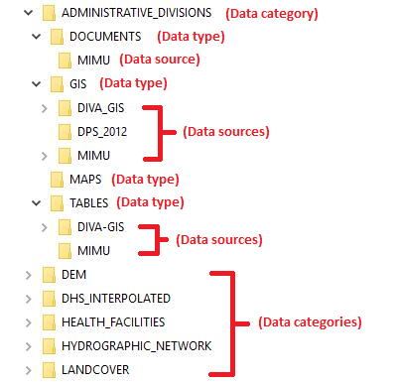
Organizing compiled data
Once the available existing data are compiled, they must then be organized on a computer in such a way that it is easy to find by you or other people.
The suggested folder organization structure is the following:
Data category
Data type
Data source

Slide 39

Assessing compiled data
The compiled and organized data must be assessed in order to identify:
If at least one source for each of the data needed at the beginning of the process has been found.
If not, make a list of data that has not been possible to find
  Which source/s is/are of the best quality according to the six (6) dimensions (Completeness, Uniqueness, Timeliness, Validity, Accuracy, Consistency):
  Comply to the defined data specifications?
  Consistent with the ground references?
If not, you might have to search for other sources or complete the identified gaps… or do with what you have
Example of geospatial data specifications document: MOHS Myanmar
Geospatial_data_specifications_MMR_201217.pdf

Slide 40
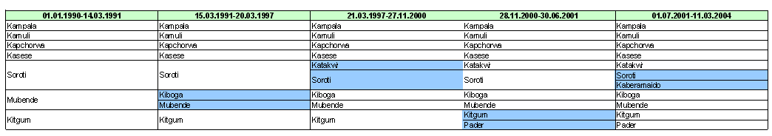
Possible issues when assessing data
Some of the issues that may persist after the assessment :
  Temporal discrepancies: Data collected at different time period and therefore corresponding to different geographies

Slide 41
Possible issues when assessing data
There are some issues that may arise after the assessment such as:
  Lack of documentation: The metadata is missing or incomplete which could lead to technical issues or inability to determine the appropriateness of the data for use
  Big gaps in authoritative data compared other sources: The gaps in authoritative data from the government might be too big compared to other sources for them be considered

Slide 42
Result of data assessment
At the end of the assessment, some or all of the compiled data:
  May not be of sufficient quality
    Do not comply to the data specification and/or not consistent with the ground references
  Has use restrictions
    Can use them but under some conditions
    Cannot even use the data
  Has sharing restriction
    Can use the data to make a map but cannot share the data to a third party
You might find that you have gaps in your data at the end of the assessment process

Slide 43
Addressing the data gaps
When you have gaps with your data, the following options should be considered:
  Look for additional sources that might have been missed during the first round of data compilation
  Identify if combining different sources of data together could help cover the gap(s)
If none of the above works, the remaining gaps should be properly documented and mentioned not only in the metadata profile but also on any maps that would be created using this data.

Slide 44
Addressing the data gaps
How do you address these remaining gaps when possible?
Session 6 - Making a good thematic map –
Extracting or collecting geospatial data

