Slide 1
Session 6: Making a good thematic map –
Extracting or collecting geospatial data
Izay Pantanilla
GIS Analyst, Health GeoLab Group, Epidemiology Department,
Mahidol-Oxford Tropical Medicine Research Unit, Faculty of Tropical Medicine,
Mahidol University, Bangkok

Slide 2
Key terms used in this session
Accuracy: The degree to which a measured value conforms to true or accepted values. Accuracy is a measure of correctness.
Basemap: Collection of GIS data and/or orthorectified imagery that form the background setting for a map. The function of the basemap is to provide background detail necessary to orient the location of the map.
Data: Facts and statistics collected for reference or analysis
Geographic data: Information describing the location and attributes of things, including their shapes and representation. Geographic data is the composite of spatial data and attribute data.
Notes:
Key terms used in this session

Slide 3
Key terms used in this session
Geographic feature: Man-made or naturally-created features of the Earth.
Geographic object: Whereas features are in the real word (mountain, river, church, etc.), geographic objects are computer representation of features
GLONASS: Acronym for Global'naya Navigatsionnaya Sputnikovaya Sistema (Global Navigation Satellite System). The Russian counterpart of the United States’ Global Positioning System.
GNSS: Acronym for Global Navigation Satellite System and is the standard generic term for satellite navigation systems that provide autonomous geo-spatial positioning with global coverage. This term includes e.g., the GPS, GLONASS, Galileo, Beidou, and other regional systems.
Notes:
Key terms used in this session

Slide 4
Key terms used in this session
GPS: Acronym for Global Positioning System. A system of radio-emitting and -receiving satellites used for determining positions on the earth. Developed and operated by the U.S. Department of Defense, the system is used in navigation, mapping, surveying, and other applications in which precise positioning is necessary.
Precision: The number of significant digits used to store numbers, particularly coordinate values. Precision measures exactness.
Scale: The ratio or relationship between a distance or area on a map and the corresponding distance or area on the ground, commonly expressed as a fraction or ratio. A map scale of 1/100,000 or 1:100,000 means that one unit of measure on the map equals 100,000 of the same unit on the earth.
Notes:
Key terms used in this session

Slide 5
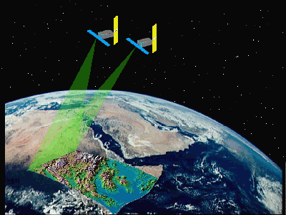
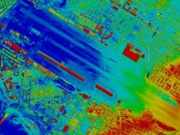
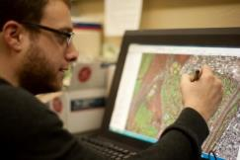
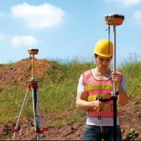

Filling identified data gaps
The data gaps identified after assessing the compiled data can be filled by creating geographic data.
Geographic data = geospatial data + attributes
  When it comes to the geospatial data (objects):
  By using remote sensors placed on a satellite or in a plane (remote sensing)
  By processing the images resulting from remote sensing (image processing)
  By extracting the geographic coordinates of point type object or the topology of line/polygon objects from 1 or 2 (digitizing)
  By collecting the geographic coordinates of places in the field using a GNSS enabled device (Surveying)
The method you will most likely be using
Notes:
Filling identified data gaps

Slide 6
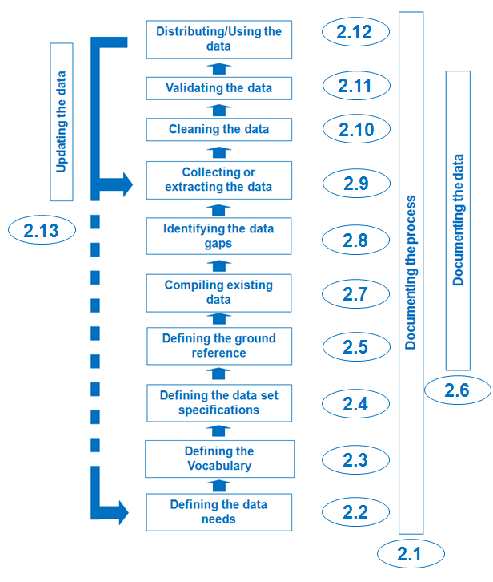
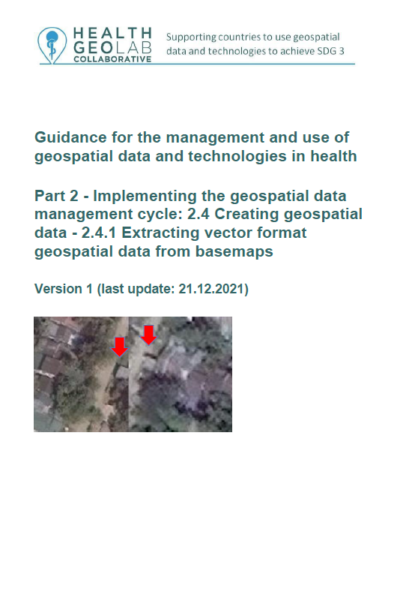
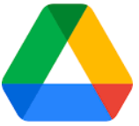
Collecting or extracting geographic data
This session focuses on one of the two methods that you will most likely use in filling the identified data gaps.
Collecting geographic data in the field
The following HGLC guidance will provide you more details regarding the extraction of vector format geospatial data from basemaps:
http://www.healthgeolab.net/DOCUMENTS/Guide_HGLC_Part2_4_1.pdf
Guide_HGLC_Part2_4_1.pdf
http://www.healthgeolab.net/DOCUMENTS/Guide_HGLC_Part2_4_2.pdf
Notes:
Collecting or extracting geographic data

Slide 7
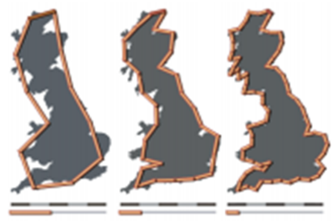
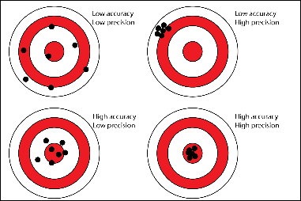
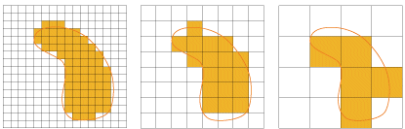
Collecting or extracting geographic data
When creating geographic data:
It is pertinent that the geographic objects comply with the defined data set specification:
Scale of work
Accuracy and precision level for vector format geospatial data
Accuracy and resolution for raster format geospatial data
Notes:
Collecting or extracting geographic data

Slide 8
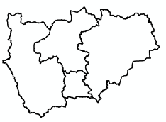
Collecting or extracting geographic data
When it comes to attribute data (statistics/information):
The attribute must be attached to its corresponding object, preferably through the use of its unique ID coming from the master list.
Geospatial data
Master list
Attributes
District ID
Stats/Info
Notes:
Collecting or extracting geographic data

Slide 9
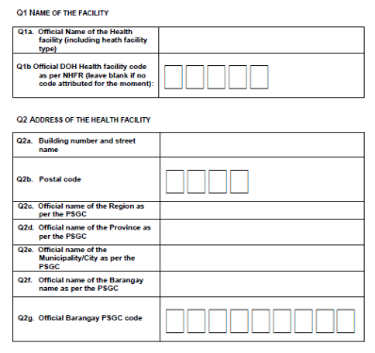
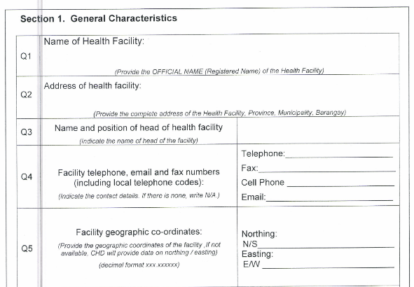
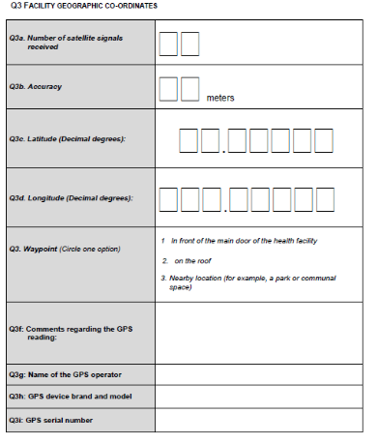
Collecting or extracting geographic data
When it comes to attribute data (statistics/information):
It is therefore key that any field survey aiming at collecting health related data contains the necessary fields to link with the corresponding master list and its unique IDs!
Notes:
Collecting or extracting geographic data

Slide 10
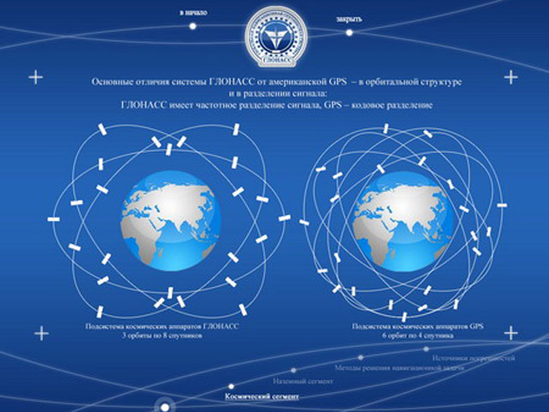
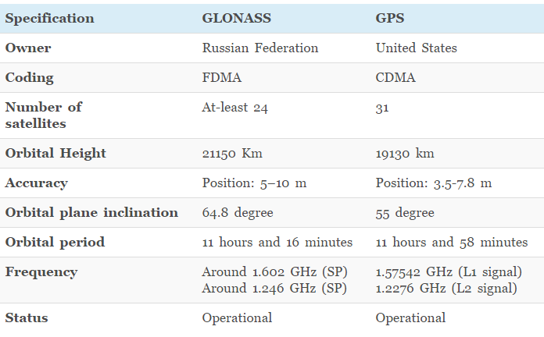


Global Navigation Satellite Systems
There are different satellite navigation systems providing autonomous geo-spatial positioning at present:
GPS, GLONASS, BeiDou, and Galileo
Notes:
Global Navigation Satellite Systems

Slide 11
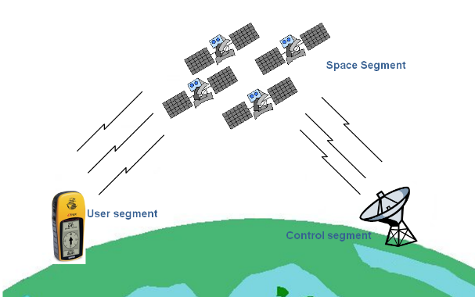
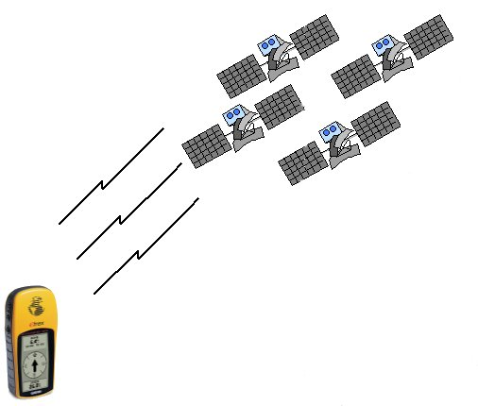


How does it work?
- Identifier
- Almanac Data
(status & orbital info to
calculate which satellites
are visible)
Don’t need internet !!!
Ephemeris Data
(precise orbital info to
calculate satellite location)
Notes:
How does it work?

Slide 12

How does it work?
If only 1 signal
?
?
?
?
?
?
?
Notes:
How does it work?

Slide 13
How does it work?
If only 2 signals
?
?
?
?
?
?
?
?
Notes:
How does it work?

Slide 14
How does it work?
If 3 signals
If 4 signals
Reason why you need at least 4 satellites signal to get a good reading
Notes:
How does it work?

Slide 15
Source of signal errors
Poor PDOP
Good PDOP
PDOP: Positional Dilution of Precision
Notes:
Source of signal errors

Slide 16
Source of signal errors
Accuracy: 69 m
Accuracy: 46 m
Accuracy: 44 m
Accuracy: 19 m
Accuracy: 14 m
Accuracy: 12 m
Accuracy: 12 m
Accuracy: 7 m
Better to have a good dispersion and looking at the accuracy measure given by the device
Notes:
Source of signal errors
With most receivers, you will be able to see the dispersion of the satellite you are getting the signal from. It is better to wait to have a good dispersion and to look at the accuracy measure given by the device before recording the location (reading).

Slide 17


Source of signal errors
Notes:
Source of signal errors

Slide 18


Source of signal error
1
2
1
2
Signal Multipath
Take the reading in the most open space possible
Notes:
Source of signal errors

Slide 19


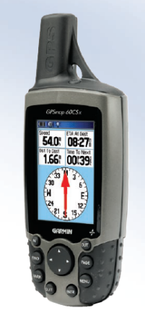
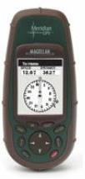


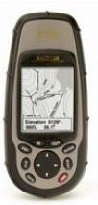
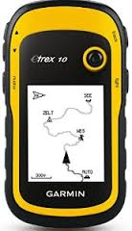
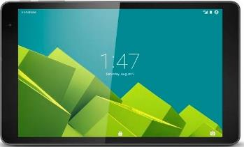
Which device to use?
Large choice / different prices!
Minimum requirements:
1. Allows to be set up as follow:
  a. Position format: hddd.ddddd
  b. Map datum: WGS84
  c. Map Spheroid WGS84
  d. Distance and speed: Metric
2. Provide a reading with at least 5 digits to reach a level of precision down to the meter
3. Display the following information:
  a. Number of received satellite signals
  b. Accuracy measure
4. Having access to both the GPS and GLONASS constellations is a plus
Notes:
Which device to use?

Slide 20

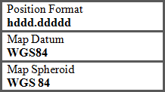
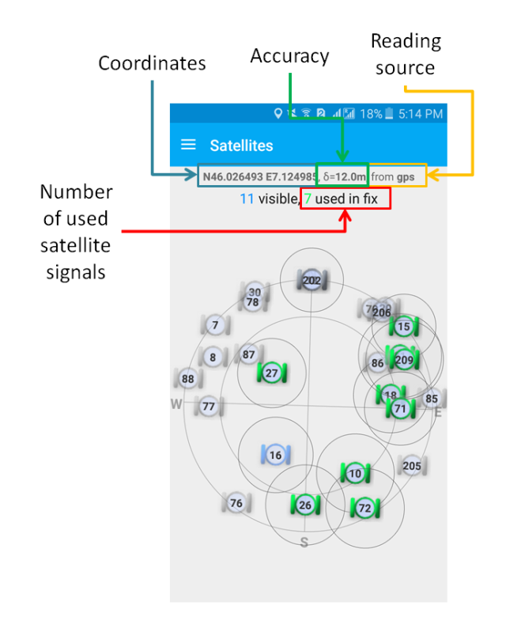
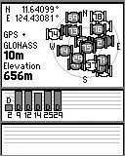
Unit Setting
Should match the data specifications
Taking a reading
Coordinates
GPS and GLONASS
on
Accuracy value
Satellite
position
Number of received satellite signals
GNSS device
Mobile phone + app
Notes:
Unit Setting

Slide 21
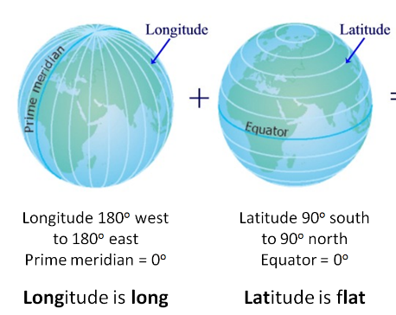
Why use latitude and longitude?
Why use latitude/longitude (Decimal degrees)?
Most comprehensive and powerful method of georeferencing
  Standard, stable, unique, infinitely fine resolution
Uses a well-defined and fixed reference frame
  Based on Greenwich (Prime) Meridian and Equator
Most used in geospatial technologies
Notes:
Why use latitude and longitude?

Slide 22
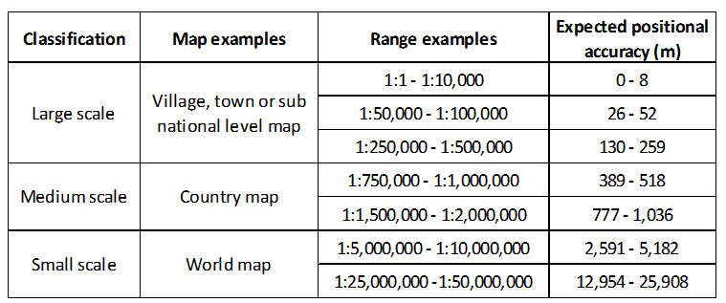
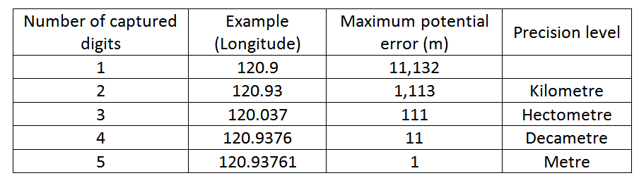
Scale, Accuracy, and Precision
15 m
Recommended
Notes:
Scale, Accuracy, and Precision

Slide 23
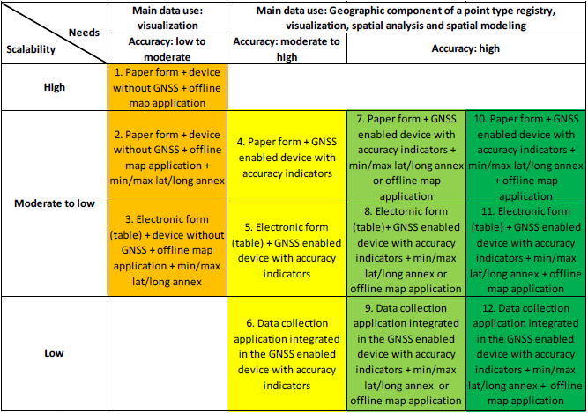
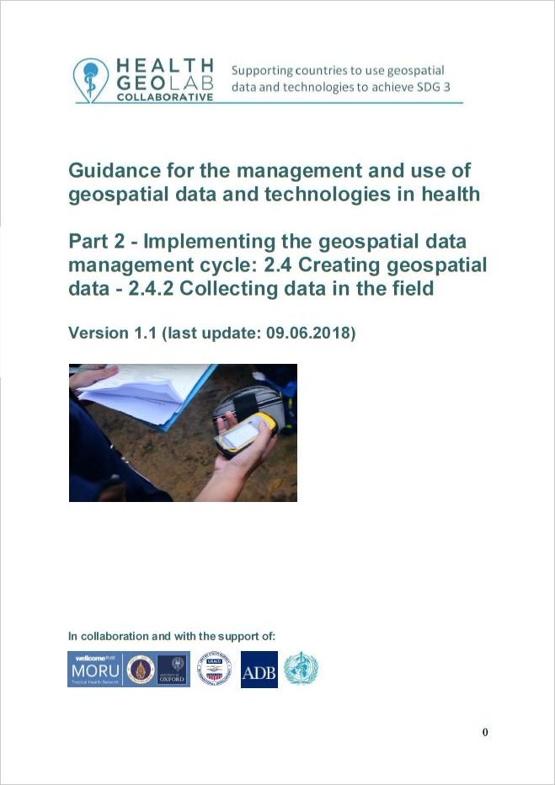
Data collection methods
Without GNSS
enabled devices
Guide_HGLC_Part2_4_2.pdf
Uses GNSS
enabled devices
https://www.healthgeolab.net/DOCUMENTS/Guide_HGLC_Part2_4_2.pdf
Notes:
Data collection methods

Slide 24
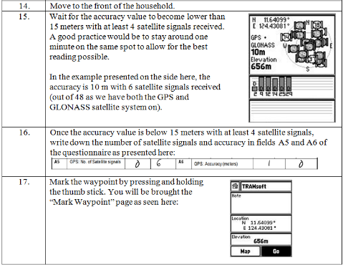
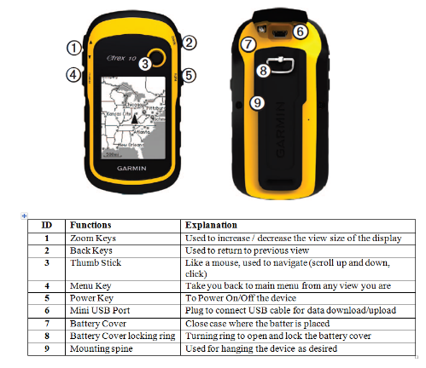
Importance of SOP and Training
It is important to have and follow Standard Operating Procedure and to train using the device.
Description of the device
How to use the device (buttons, batteries,…)
How to set it up
Step by step process to collect the reading
Guide_HGLC_Part2_4_2.pdf
Notes:
Importance of SOP and Training

Slide 25


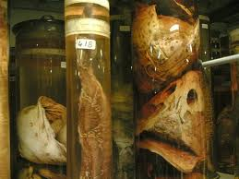
Importance of SOP and Training
When you are done with the stand-alone device
On site, between data collection points
For longer period of time
Remove the batteries from the device
Store the device in a dry place
Notes:
Importance of SOP and Training

Slide 26
Summary
To summarize:
Choose the appropriate device/method
Set the unit as per the data specifications
Use a pre-established SOP
Signal lost indoors and reflected off buildings and other nearby objects => choose an open space
Takes time to calibrate and get accurate reading – wait 1 minute to finalize coordinates
Minimum 4 satellites
Collect coordinates with 5 digits after the decimal point
Ethics of mapping households and GPS tracking !!!

Slide 27

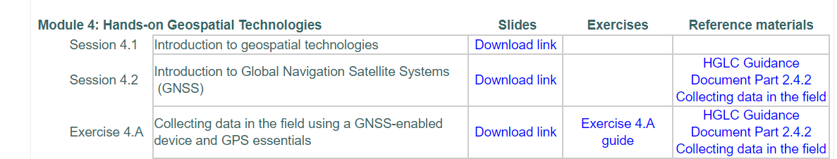
Practicing the collect of geographic coordinates in the field
We unfortunately can’t practice this during the online training
Inviting you to conduct this exercise and ask questions via the Google form if needed: https://bit.ly/3SR0nfB

