Slide 1
Session 7: Preparing the data for use in
GIS software
Izay Pantanilla
GIS Analyst, Health GeoLab Group, Epidemiology Department,
Mahidol-Oxford Tropical Medicine Research Unit, Faculty of Tropical Medicine,
Mahidol University, Bangkok

Slide 2
Key terms used in this session
Attribute data: Also statistical data. Nonspatial information about a geographic feature, usually stored in a table that can be attached to a geographic object through the use of unique identifier or ID
Data: Facts and statistics collected for reference or analysis
Geographic object: Whereas features are in the real word (mountain, river, church, etc.), geographic objects are computer representation of features
Geospatial data: Also referred to as spatial data, information about the locations and shapes of geographic features and the relationships between them, usually stored as coordinates and topology.
Notes:
Key terms used in this session

Slide 3
What is needed?
The data to be prepared depends on the types of objects to appear on the map.
Fixed objects that can be represented by:
  Points (health facility, village, school, …)
  lines or polygons to which information/statistics can be linked (admin boundaries, road, river,…)
“Mobile” objects (patients, health workers, vehicle,…)
Continuous geospatial data (Digital Elevation Model (DEM), landcover,…)
Notes:
What are the data that needs to be prepared?

Slide 4

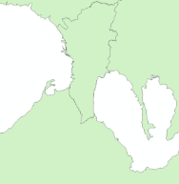
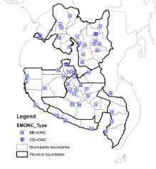
What is needed?
1. Fixed objects that can be represented by points (health facility, village, school, …)
Master list with unique identifier, admin divisions and geographic coordinates
Unique identifier included in the statistics/information table
Coordinates used to create a GIS layer (points)
Unique identifier allows joining the statistics/information with the map
Notes:
What needs to be prepared?

Slide 5

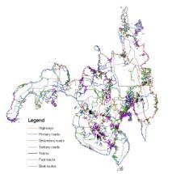
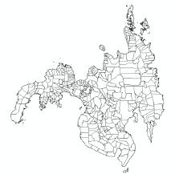
What is needed?
2. Fixed objects that can be represented by a line or polygons to which information/statistics can be linked (admin boundaries, road, river,…)
Complete, up-to-date master list
with unique identifier
+
identifier included in the attribute table of the GIS layer
identifier included in the
Statistics/information table
GIS Layer (shape file)
Identifier allows joining the statistics/information with the GIS layer
Notes:
What is needed?

Slide 6





What is needed?
3. “Mobile” objects (patients, health workers, vehicle,…)
Complete, up-to-date master list
with unique identifier and fields to capture the place of care, of residence,… through other fixed objects respective unique identifier
Village
But you might want to track some of these objects…
174000001
12034
174000000
Notes:
What is needed?

Slide 7
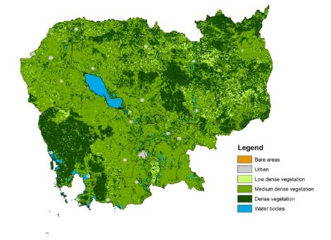
What is needed?
4. Continuous geospatial data (Digitial Elevation Model (DEM), landcover,…)
The GIS Layer
The classification if not already included in the layer itself
5. Basemaps
Nothing needed except the access to the basemap layer which is most likely going to be through internet
Notes:
What is needed?

Slide 8
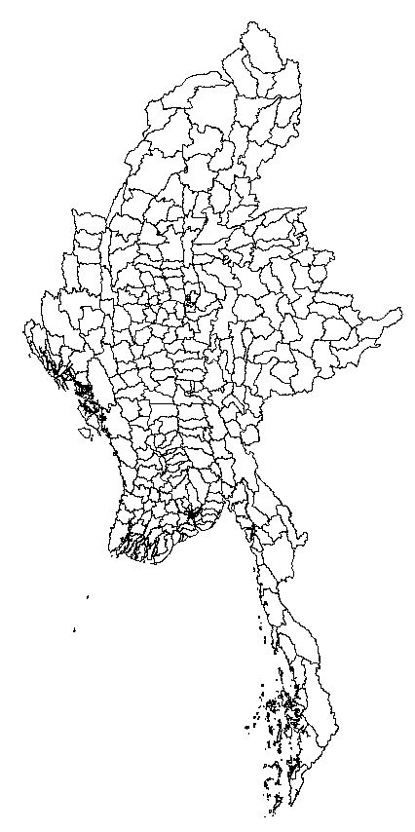
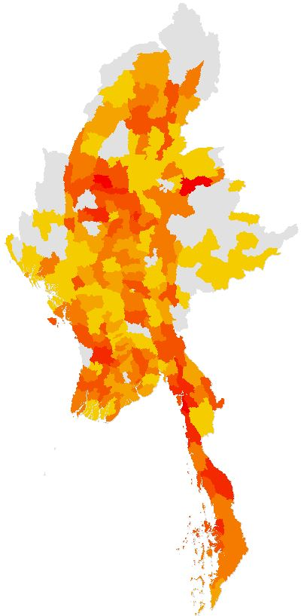
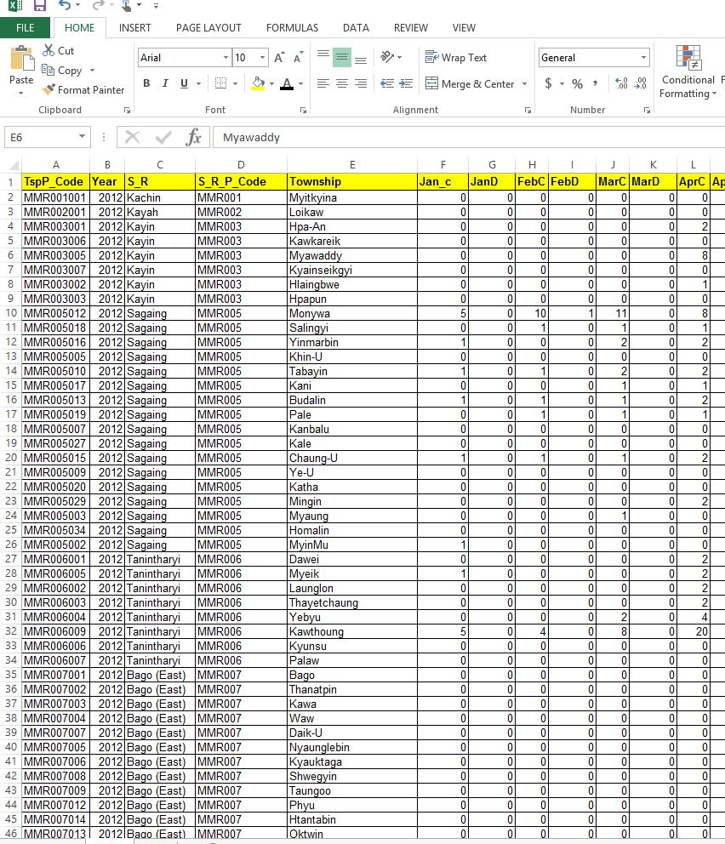
What is needed?
What you will mostly be doing is to link statistics/information to a shapefile to create a thematic map
+
The unique identifier is key!

Slide 9
Preparation of geospatial data
The preparation of geospatial data is meant to result in vector (shapefiles) or raster (GRID) format layers that present:
  The same geographic coordinate system if more than one layer to be included in the map (good practice to also use the same projected coordinate system)
  For shapefiles:
    An attribute table containing the same unique identifier as the corresponding master list
    The same geography as the one of the statistical/information data that you want to represent on the map
This will be practiced during Exercise 2
Notes:
Preparation of geospatial data

Slide 10
Preparation of statistical data
Things to avoid when preparing statistical data
Columns used for spacing
Merged cells
Information stored at the top of the table itself
Long headers
Duplicated record
Numbers displayed as text
Spaces, special characters, hyphens, or symbols in the header name
Multiple information stored in a single column
Data inconsistency between records
Notes:
Preparation of statistical data

Slide 11
Preparation of statistical data
Proper data structure
A GIS software expect:
  Well formatted data organized in rows and columns:
    One record (health facility, village,..) per row
    One statistic/information per column
  The use of the same unique identifier as in the master list, identifier that is also stored in the attribute table of the shapefile
Notes:
Preparation of statistical data

Slide 12
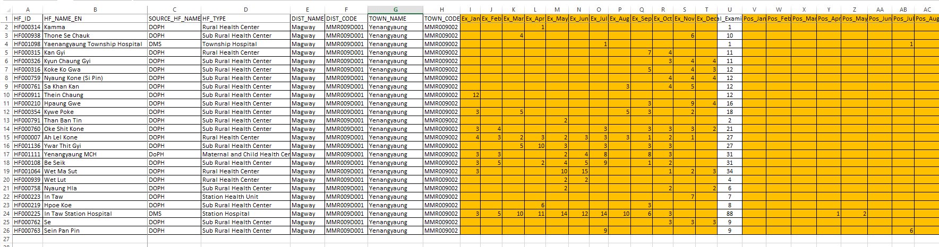
Preparation of statistical data
Proper data structure
Unique identifier from the master list
Other useful information from the master list
Statistics/information
One record (health facility) per line
One statistic/information per column
This will be practiced during Exercise 1
Notes:
Preparation of statistical data

Slide 13
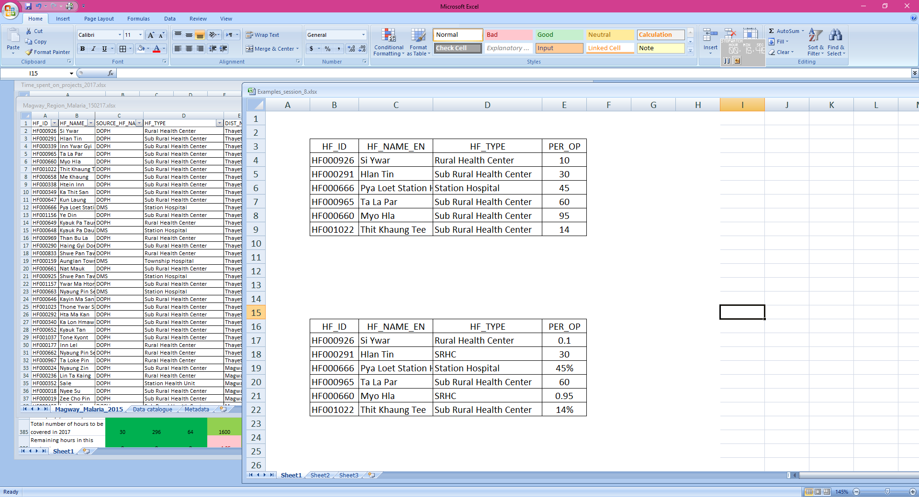


Preparation of statistical data
Data consistency between records
The way the statistics/information is captured should be consistent between records to allow for proper representation on the map:
  Names should always be spelled the same way
  Number should use the same format
Notes:
Preparation of statistical data

Slide 14
Preparation of statistical data
Preparing a good map might require for you to spend:
70% of your available time to prepare good data
  Collecting, checking, cleaning, validating, formatting, linking with other data
20% to create the map
10% to check the resulting map, make potential adjustments
A good map is made of good data!
The higher the quality of the data in the first place the more time can be spent on generating good maps
Notes:
Preparation of statistical data

Slide 15

Data confidentiality
Concerns both the statistical data /information and geospatial data
The statistical data/information should be anonymized before being linked to geospatial data
Precisely locating certain information on a map might allow locating the person in question even without mentioning its name (sex, age, marital status, job,…)
Great attention should be put on this issue
Notes:
Data confidentiality

