Slide 1


INTRODUCTION TO THE MANAGEMENT AND USE OF GEOSPATIAL DATA AND TECHNOLOGIES
FOR MALARIA PROGRAMS
APMEN Online Training Series – Day 3

Slide 2
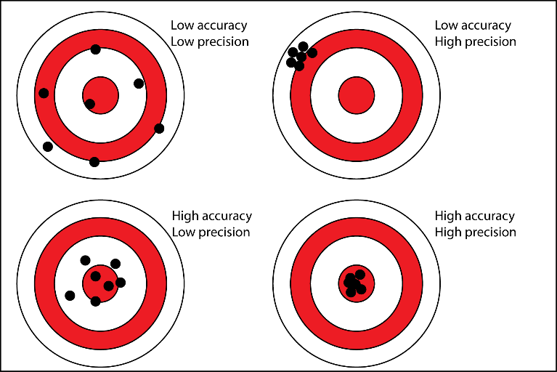
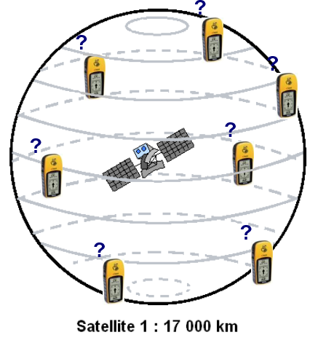
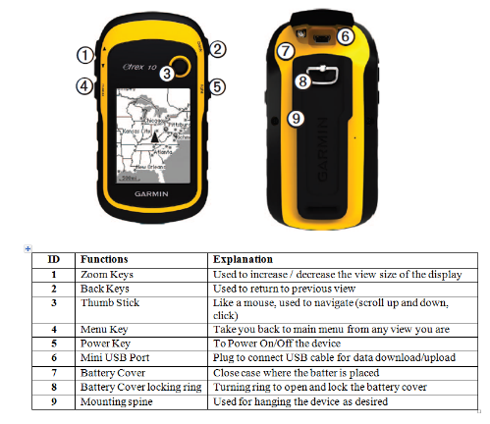
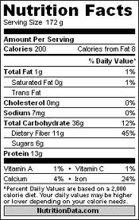
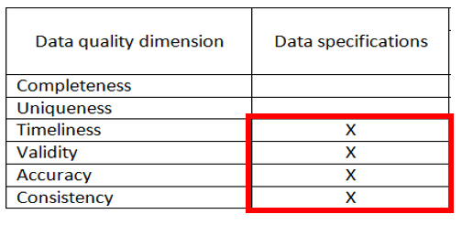
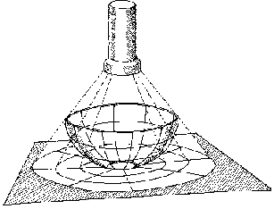
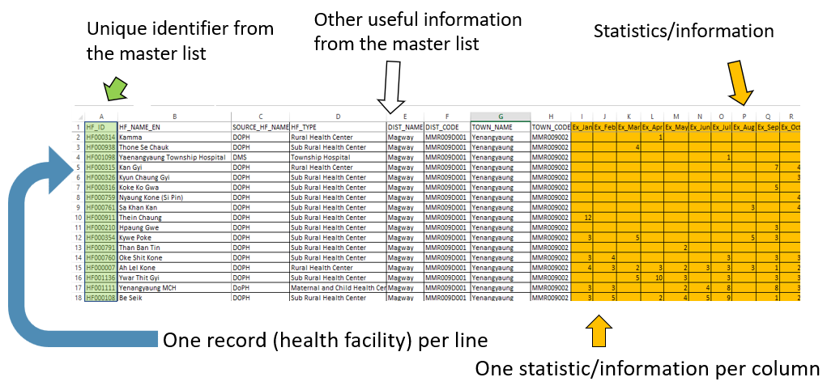
Recap of Day 2
Compiling good geospatial data
Extracting or collecting geospatial data
Preparing the data for its use in a GIS software

Slide 3
Recap of Day 2
Summary of the main issues observed for Exercise 1:
Making sure you have combined all the data you needed to create your table.
  Add the new malaria cases from the ODK-based questionnaire (Surveillance_results.csv) to the cases report file (Malaria_Cases_Report_DOH_200325.xlsx) from Exercise 1 - Parts 1 & 2.
Checking that the total number of cases included in the Pivot table is correct (330 cases)
Cleaning the resulting Pivot table for use in GIS software:
  Make sure the table starts in the first row and column (no extra rows before the table)
  Add a new column to capture the Barangay or health facility name
  Save the resulting table as a new file (Tot_Cases_Bgy_[date].xlsx or Tot_Cases_HF_[date].xlsx)

Slide 4
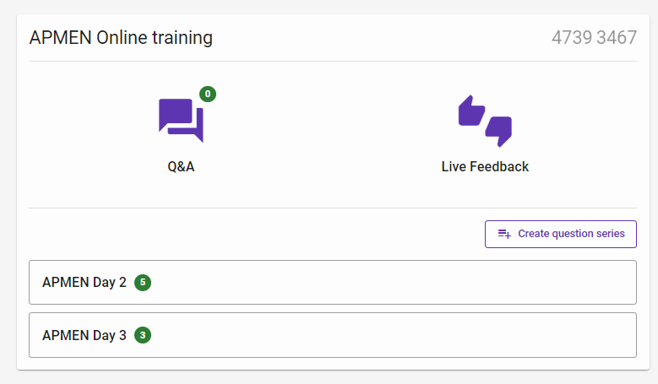
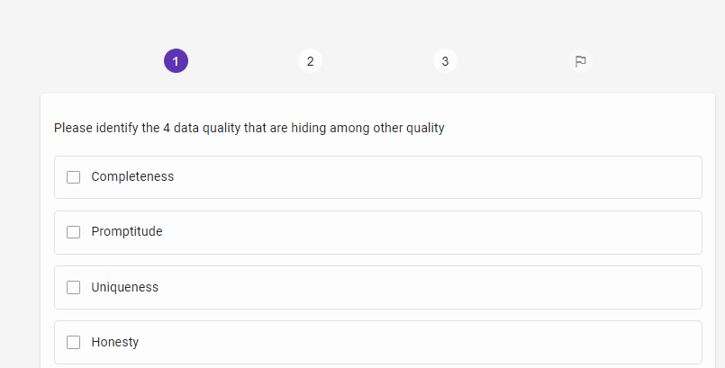
Quizz
1. Please go to: https://ars.particify.de/
2. Enter code: 4739 3467
3. You should get this window:
4. Click on APMEN Day 3
5. First question

Slide 5
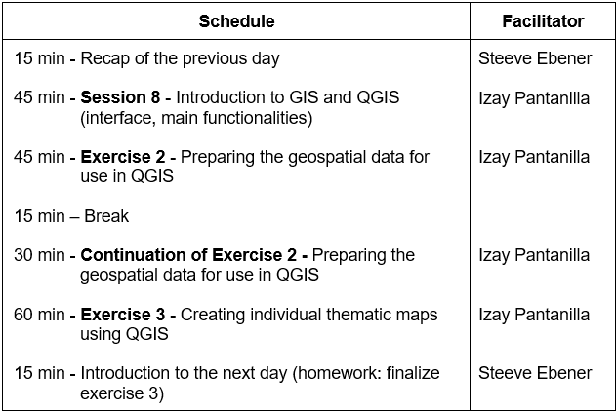
Day 3 (October 24th)
Hands on with the use of QGIS!

Slide 6
Session 8: Introduction to GIS and QGIS
Izay Pantanilla
GIS Analyst, Health GeoLab Group, Epidemiology Department,
Mahidol-Oxford Tropical Medicine Research Unit, Faculty of Tropical Medicine,
Mahidol University, Bangkok

Slide 7
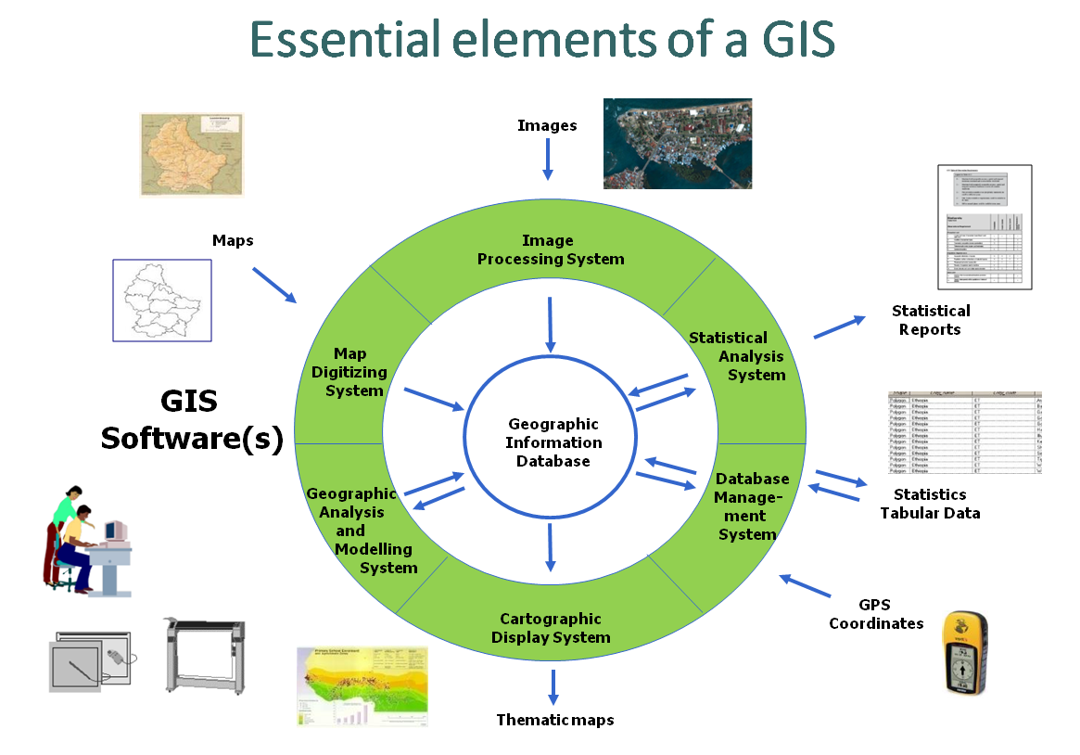
GIS - Definition
“An integrated collection of computer software and data used to view and manage information about geographic places, analyze spatial relationships, and model spatial processes.”
It is not only about software!
Data
Software
Hardware
People
Methods
Notes:
GIS - Definition

Slide 8
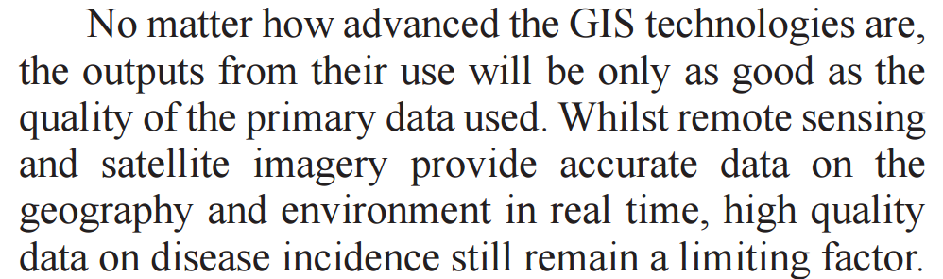

Data - The content at the center!
Essential elements of GIS
Garbage in –
Garbage out !
Need for good data management practices
Mendis K. (2009) Spatial technology & malaria control. Indian J Med Res 130, November 2009, pp 498-500
Notes:
Essential elements of GIS

Slide 9
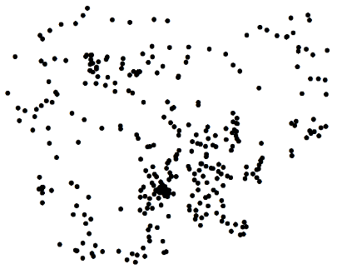
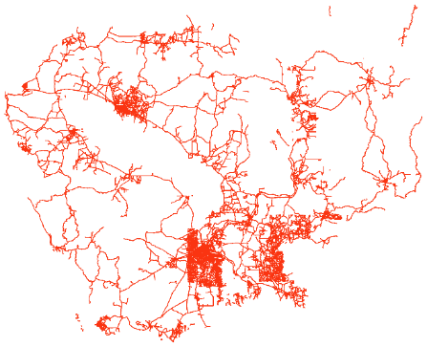
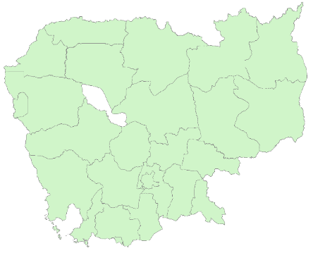
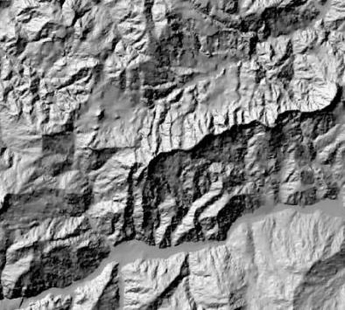
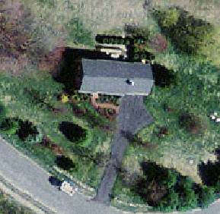

Types of Geospatial data
Vector format (shapefile)
Point
Line
Polygon
Raster format (Geotiff, GRID)

Slide 10
What can you do with GIS in public health?
Complexity
Data Quality
Nbr of users
Spatial Modelling
Spatial Analysis
Thematic Mapping
+
Creation/Management of Geospatial data
Notes:
What can you do with GIS in public health?

Slide 11
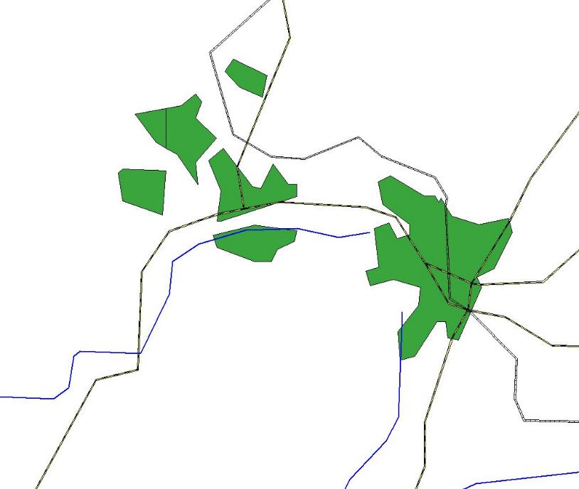

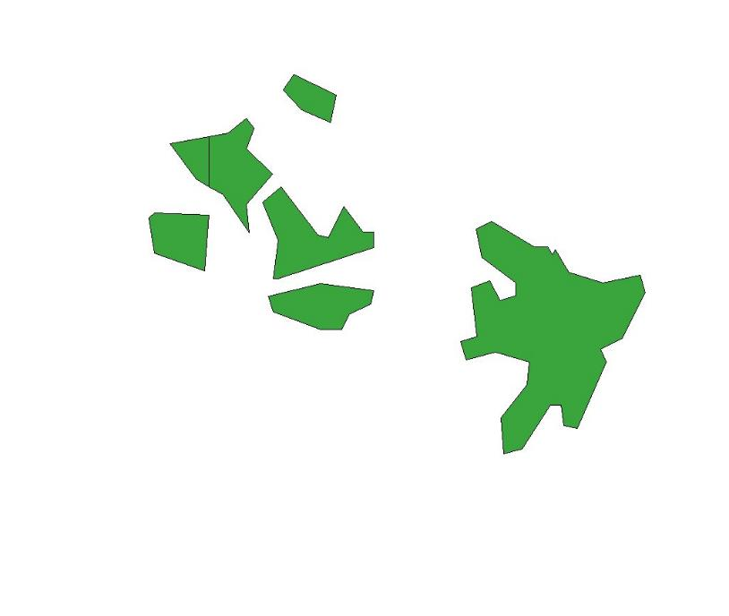

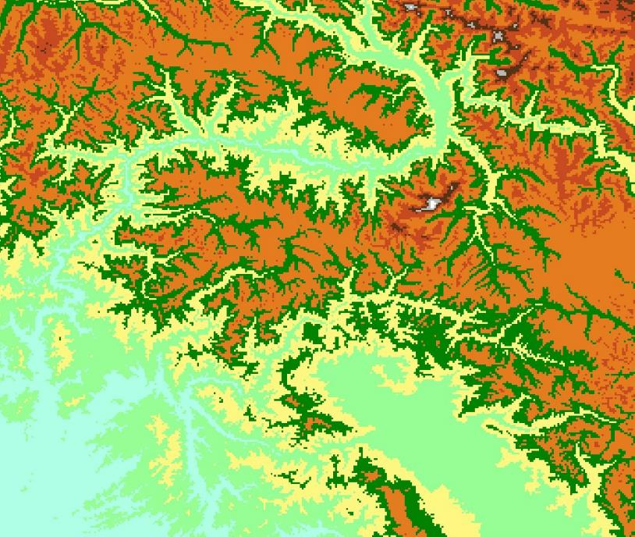

What can you do with GIS in public health?
Spatial Modelling
Spatial Analysis
1 hour
Thematic Mapping
Context/relationship
Distance
Travel time
Notes:
What can you do with GIS in public health?

Slide 12
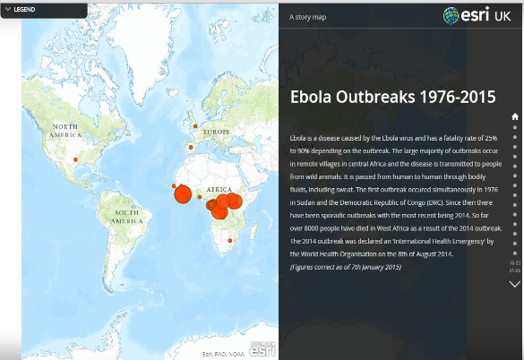
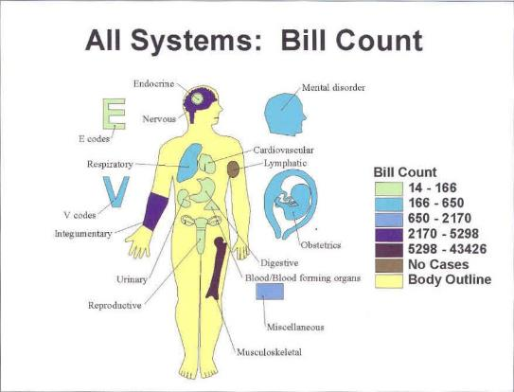
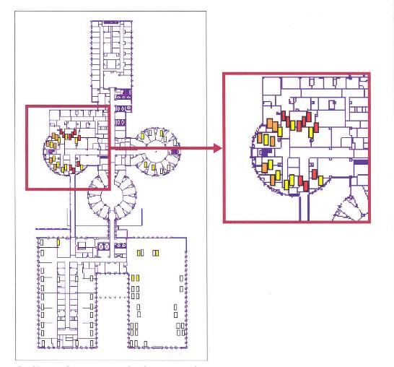
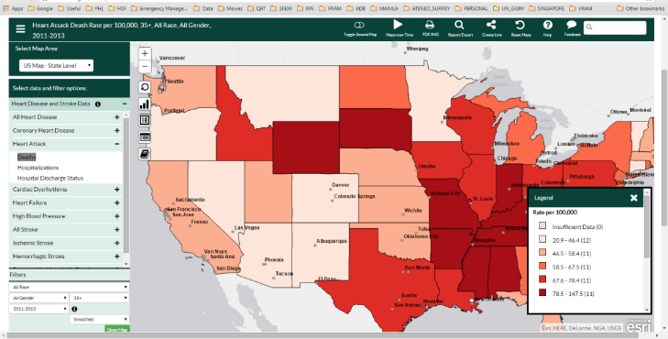
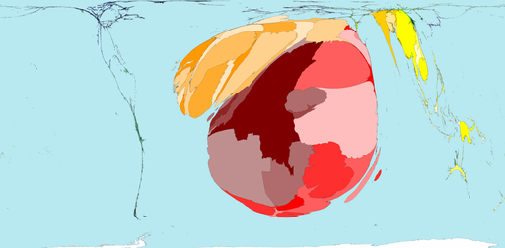
Example of application in Public Health
Thematic mapping
Story
Map
Web mapping
Hospital management
Cartogram
Notes:
Example of application in Public Health

Slide 13
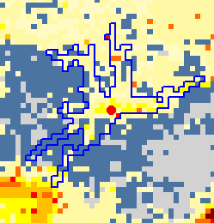
Example of application in Public Health
Spatial analysis
Location (e.g., altitude)
Distance
Travelling Time
Notes:
Example of application in Public Health

Slide 14
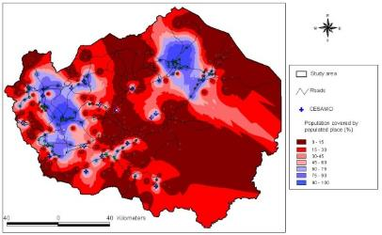
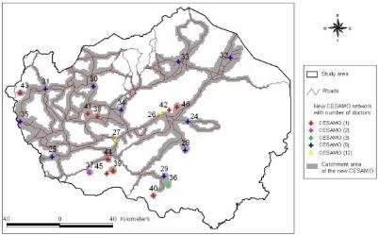
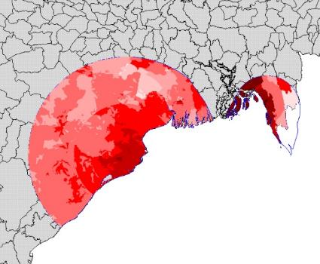
Example of application in Public Health
Spatial modelling
Physical Accessibility
Distribution of health inequalities
Poverty Mapping
Vulnerability Mapping
Link between Natural disaster (floods and hurricanes) and epidemics
Notes:
Example of application in Public Health

Slide 15


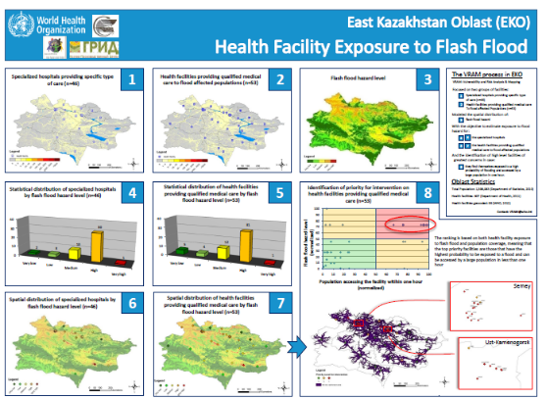
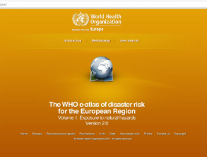
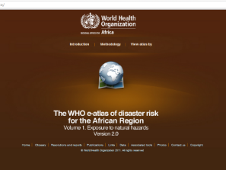
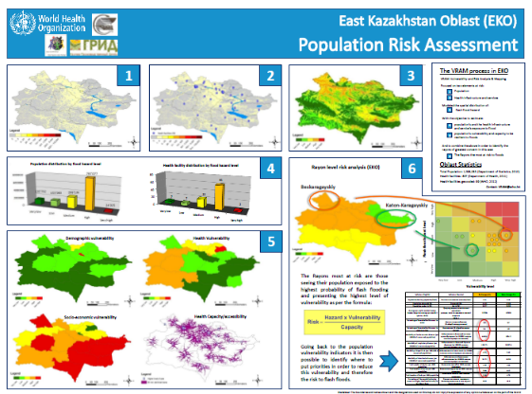
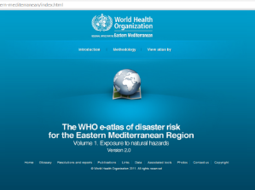
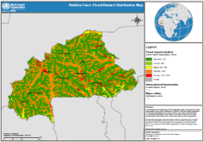
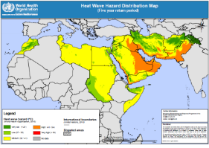
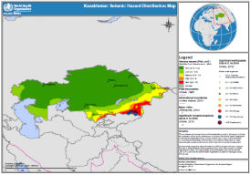
Example of application in Public Health
Spatial modelling
Hazard modelling and geographically-based risk assessment
VRAM
WHO eAtlas for Europe: http://data.euro.who.int/e-atlas/europe/
VRAM KAZ: http://www.gaia-geosystems.org/PROJECTS/VRAM/KAZ/vram_kaz_home.htm
Notes:
Example of application in Public Health

Slide 16







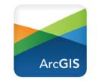
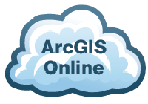
Not everything is a GIS software
Database managers with a thematic mapping interface
Statistical packages allowing to conduct geostatistical analysis
Navigation and thematic mapping applications
These are real GIS software
ArcGIS www.arcgis.com
  Most comprehensive and versatile
  Complete GIS ecosystem: maps, analyses, web apps, servers, mobile, coding in Python, integration with R…
  Proprietary and comes with a price but grant and highly discounted for the MOHs
QGIS www.qgis.org
  Good for thematic maps, limited for analyses
  Open Source
  Free
Notes:
Not everything is a GIS

Slide 17
What is QGIS?
QGIS (formerly known as Quantum GIS) is a free and open-source cross platform desktop geographic information system (GIS) application that supports viewing, editing, and analysis of geospatial data.
Version 3.22
Why are we using QGIS version 3.22?
Version 3.22 is the most stable version of QGIS at the moment which means that it has fewer bugs and less likely to crash.
Notes:
What is QGIS?

Slide 18
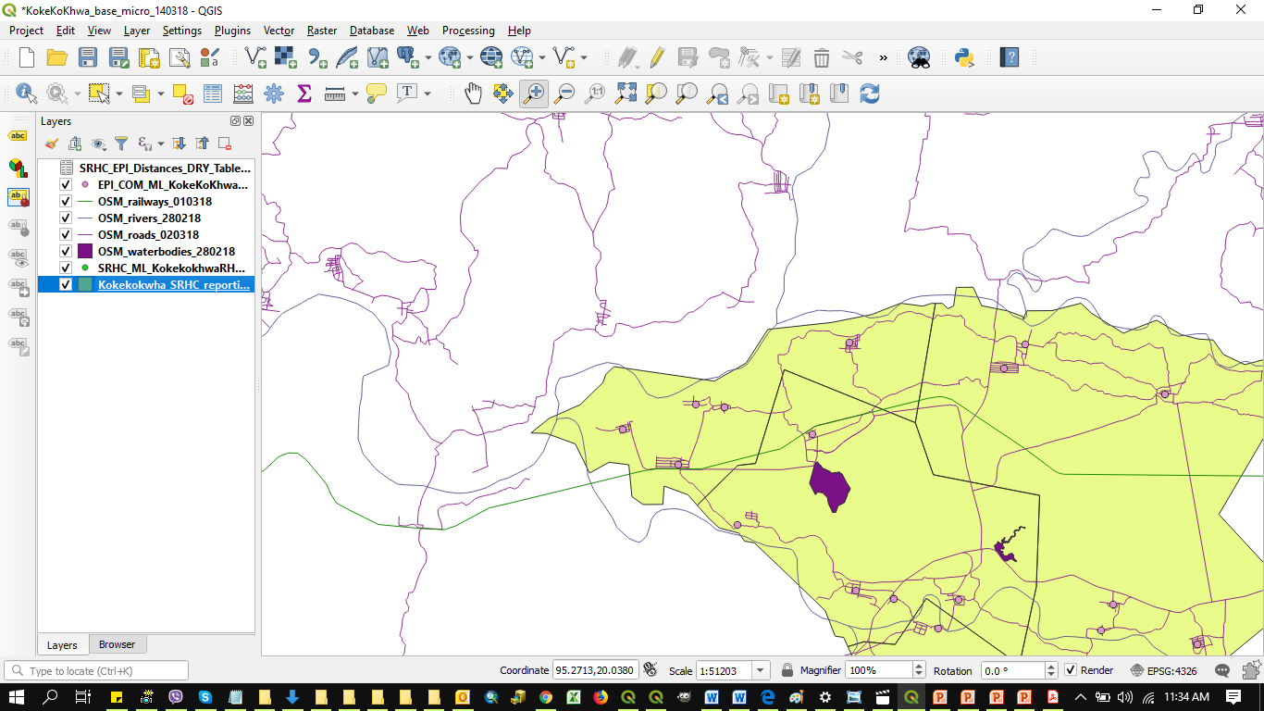
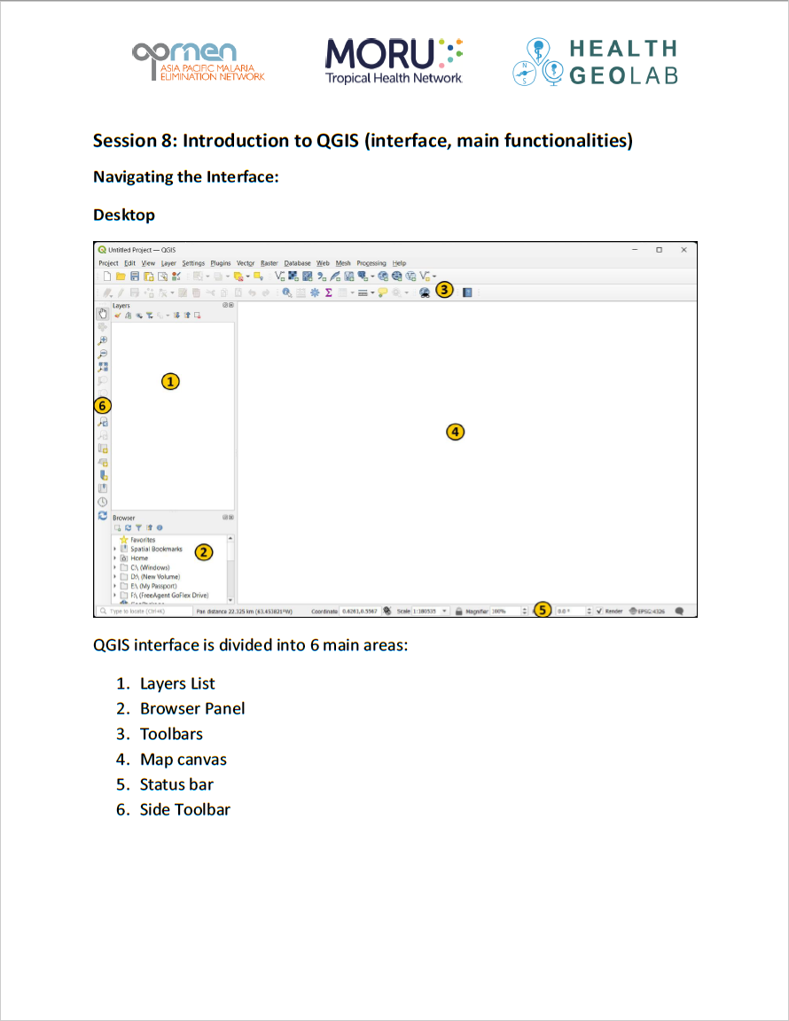
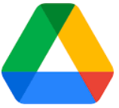
QGIS (Interface, main functionalities)
Let’s have a look together!
QGIS_Interface_Menu_Tools_27092022.pdf

