Slide 1
Session 9: How to geo-enable your
Malaria Information System?
Steeve Ebener, PhD
Lead, Health GeoLab Group, Epidemiology Department,
Mahidol-Oxford Tropical Medicine Research Unit, Faculty of Tropical Medicine,
Mahidol University, Bangkok

Slide 2
Geography central to malaria surveillance and elimination
The geographic mapping of identified positive cases down to their place of residence and infection is critical to effectively support case and foci investigation as well as monitor interventions
Knowing where Malaria services are located helps in planning interventions and filling potential gaps
Integrating geography and time across the Health Information System (HIS) allows linking vertical disease programs together and supports a more systemic approach to solving public health issues
WHO_Disease_Surveillance_Malaria_Elimination_2012_eng.pdf
2

Slide 3
Geography central to malaria surveillance and elimination
Geo-related terms (105 pages):
Mapping/map: 43 times
Global Positioning System (GPS): 12
Geographic Information System (GIS): 9
Mapping of foci has been added compared to the 2012 version
Maps used across surveillance, monitoring and evaluation
Annex 5 on geographical reconnaissance during focus investigation
Certification of elimination requires supporting maps
WHO Malaria SME Reference manual 2018_two page view.pdf
“Clear illustrative mapping, electronically or on paper, should be a routine”
Important to strengthen country’s technical capacity when it comes to the management and use of geospatial data and technologies
3

Slide 4
Using GIS-based approaches to measure physical accessibility to
Malaria services
Need to be able to combine different data and information to assess how physically accessible services are:
Target population
distribution
Patient condition
Services location
Transportation scenario
Using GIS-based approaches allows taking all the above into account when measuring physical accessibility, patient referral or the delivery of services/commodities to point of service/distribution (ITN, medicine, diagnostic material)
GIS-based
approach
Notes:
Malawi
Rwanda
Nigeria
Mexico
Kosovo
Kazakhstan
Philippines
Kashmir (Inde)
Burkina Faso
Laos
Iran
+ les pays des articles postés sur le site d'AccessMod
The analysis makes use of Accessmod, which is WHO Geographic Information System (GIS) software that works of the standard GIS ESRI ArcGIS platform but performs additional analytical functions, such as examining the capacity of each facility to deliver services, and to run scale up scenarios. These are important functions related to strategic planning and forecasting population health needs.
Accesmod allows for taking into account conjointly the location and the maximum coverage capacity of each health care provider, the geographic distribution of the population, the environment that the patient will have to cross to reach the care provider, as well as the transportation mode s/he will be using, and the capacity of each facility to provide services (i.e., up to a threshold or saturation point).
Over the years, two versions of AccessMod have been freely shared with the public (Version 3.0, released in 2008, has been downloaded more than 1'000 times from ESRI’s ArcScript web site), and Version 4.0 for ArcGIS 9.3.1 has been downloaded 466 times since its release in June 2012, also accessible from ArcGIS online). AccessMod has been used to measure physical accessibility and geographic coverage in many low- and middle income countries including Rwanda, Namibia and Sao Tomé and Principe.

Slide 5
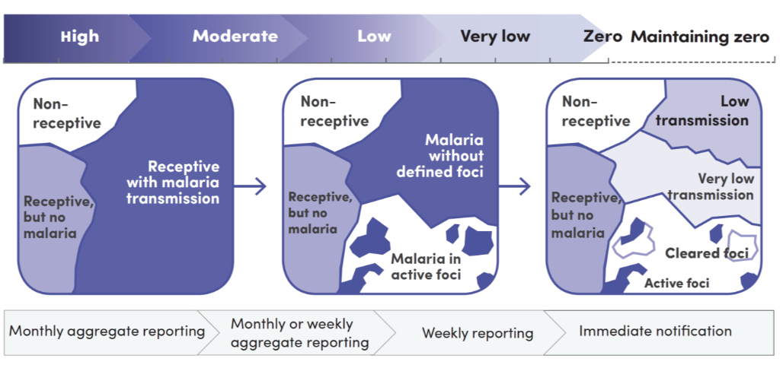
Target population along the malaria elimination continuum
Transmission
Entire population | Population groups more severely affected in areas with low and moderate transmission | Population living in active foci and residual non-active foci | Population living in residual non-active and cleared foci | Populations in areas with increased receptivity and vulnerability
Target population
Need the spatial distribution of the target population
Notes:
Malawi
Rwanda
Nigeria
Mexico
Kosovo
Kazakhstan
Philippines
Kashmir (Inde)
Burkina Faso
Laos
Iran
+ les pays des articles postés sur le site d'AccessMod
The analysis makes use of Accessmod, which is WHO Geographic Information System (GIS) software that works of the standard GIS ESRI ArcGIS platform but performs additional analytical functions, such as examining the capacity of each facility to deliver services, and to run scale up scenarios. These are important functions related to strategic planning and forecasting population health needs.
Accesmod allows for taking into account conjointly the location and the maximum coverage capacity of each health care provider, the geographic distribution of the population, the environment that the patient will have to cross to reach the care provider, as well as the transportation mode s/he will be using, and the capacity of each facility to provide services (i.e., up to a threshold or saturation point).
Over the years, two versions of AccessMod have been freely shared with the public (Version 3.0, released in 2008, has been downloaded more than 1'000 times from ESRI’s ArcScript web site), and Version 4.0 for ArcGIS 9.3.1 has been downloaded 466 times since its release in June 2012, also accessible from ArcGIS online). AccessMod has been used to measure physical accessibility and geographic coverage in many low- and middle income countries including Rwanda, Namibia and Sao Tomé and Principe.

Slide 6
Malaria services along the malaria elimination continuum
Wide range of services along the continuum for which a master list of quality including geographic location is needed in order to measure accessibility
Notes:
Malawi
Rwanda
Nigeria
Mexico
Kosovo
Kazakhstan
Philippines
Kashmir (Inde)
Burkina Faso
Laos
Iran
+ les pays des articles postés sur le site d'AccessMod
The analysis makes use of Accessmod, which is WHO Geographic Information System (GIS) software that works of the standard GIS ESRI ArcGIS platform but performs additional analytical functions, such as examining the capacity of each facility to deliver services, and to run scale up scenarios. These are important functions related to strategic planning and forecasting population health needs.
Accesmod allows for taking into account conjointly the location and the maximum coverage capacity of each health care provider, the geographic distribution of the population, the environment that the patient will have to cross to reach the care provider, as well as the transportation mode s/he will be using, and the capacity of each facility to provide services (i.e., up to a threshold or saturation point).
Over the years, two versions of AccessMod have been freely shared with the public (Version 3.0, released in 2008, has been downloaded more than 1'000 times from ESRI’s ArcScript web site), and Version 4.0 for ArcGIS 9.3.1 has been downloaded 466 times since its release in June 2012, also accessible from ArcGIS online). AccessMod has been used to measure physical accessibility and geographic coverage in many low- and middle income countries including Rwanda, Namibia and Sao Tomé and Principe.

Slide 7
Examples of accessibility-related indicators
Physical accessibility
Proportion of the target population within recommended travel time/distance to specific services/commodities by geographic entity of analysis (accessibility coverage)
Average travel time/distance to the nearest point of service/distribution against recommendations per geographic entity of analysis (accessibility analysis)
Population served within a given travel time/distance against the available service providers offering service/commodity of interest (geographic coverage)
Number and location of points of services to reach a given target population coverage (scaling up)
Percent change in travel time/distance or coverage by geographic entity of analysis after service location optimization
Referral or services/commodities delivery
Travel time/distance between the primary and secondary points of service (referral)
Proportion of the primary point of services finding themselves further away than a given travel time to the nearest referral facility
Travel time/distance between service/commodity “warehouse” and mobile points of service/distribution
Proportion of mobile points of service/distribution finding themselves further away than a given travel time from the service/commodity “warehouse”
Percent change in travel time/distance after route optimization

Slide 8
Geo-enabled HIS/MIS – The definition
An Information System that fully benefits from the power of geography, geospatial data and technologies through the proper integration of geography and time across its business processes
Geography: The study of the natural features of the Earth, such as mountains and rivers – The Science
Geospatial data: Also referred to as spatial data, information about the locations and shapes of geographic features and the relationships between them, usually stored as coordinates and topology – The Content
Geospatial technologies: Refers to equipment used in visualization, measurement, and analysis of earth's features, typically involving such systems as Global Navigation Satellite System (GNSS), Geographical Information Systems (GIS), and remote sensing (RS) – The Tools
8

Slide 9
Geo-enabled HIS/MIS – The reason
Can you think about one piece of data or information within an HIS/MIS that has neither a spatial nor a time dimension ?
"everything happens somewhere
at a given time"
Key across all the public health functions (assessment, service delivery, policy formulation,…
At the origin of modern epidemiology
9

Slide 10
Geo-enabled HIS/MIS – The benefits
Extracted from: https://www.adb.org/publications/building-capacity-geo-enabling-health-information-systems
10

Slide 11
Geo-enabled HIS/MIS – The benefits
Extracted from: https://www.adb.org/publications/building-capacity-geo-enabling-health-information-systems
11

Slide 12
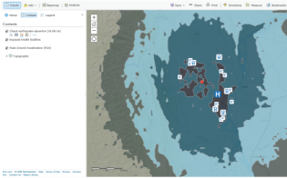
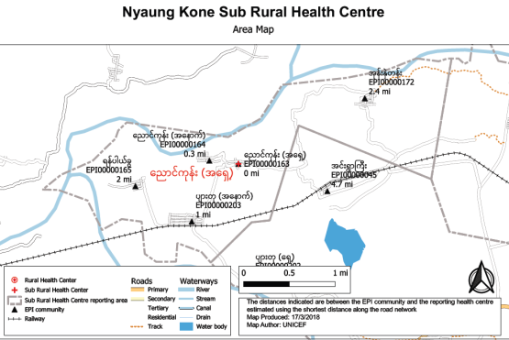
Geo-enabled HIS/MIS – The main users in Public Health
Health services planning by improving physical accessibility
Communicable disease surveillance, monitoring and elimination
Emergency management (risk identification, rapid impact assessment, response and recovery)
Improving immunization coverage (microplanning, monitoring and evaluation)
All share the same geography!
12

Slide 13
Geo-enabled HIS/MIS – The vision
Passing from this…
…to this
Each information system is using a different geography, maintaining each geography separately is not cost-effective and this situation does not allow benefiting from the power of geography, geospatial data and geospatial technologies
All the information systems use the same geography which does not only reduce duplication of efforts and cost but also allows to fully benefit from the power of geography, geospatial data and geospatial technologies
13

Slide 14
Geo-enabled HIS – The framework
9 core common assets for an HIS to be considered as geo-enabled
Examples for each in the HGLC knowledge repository
14

Slide 15
Geo-enabled HIS – The toolkit
Designed as the instrument to help countries assess their level of HIS geo-enablement and fill the identified gaps.
HIS_geo-enabling_toolkit.pdf
https://www.healthgeolab.net/DOCUMENTS/HIS_geo-enabling_toolkit.pdf
15

Slide 16
Geo-enabled HIS – The toolkit
Adaptation of the toolkit for immunization
Provide a non-technical introduction to the role of geospatial data and technologies in immunization programs; and
Propose a process-based framework to guide decision-makers and planners in strengthening the management and use of geospatial data and geospatial technologies in immunization program in countries.
Gavi_UNICEF_HGLC_GIS_Immunization_guidance_Oct2018.pdf
https://www.healthgeolab.net/KNOW_REP/Gavi_UNICEF_HGLC_GIS_Immunization_guidance_Oct2018.pdf
16

Slide 17
Geo-enabled HIS – Other recent guidance documents
GIS-and-Immunisation-Landscape_EN.pdf
Leveraging-Geospatial-Technologies.pdf
National-Georeferenced-Community-Health-Worker-Master-List-Hosted-in-a-Registry-2021.pdf
17

Slide 18
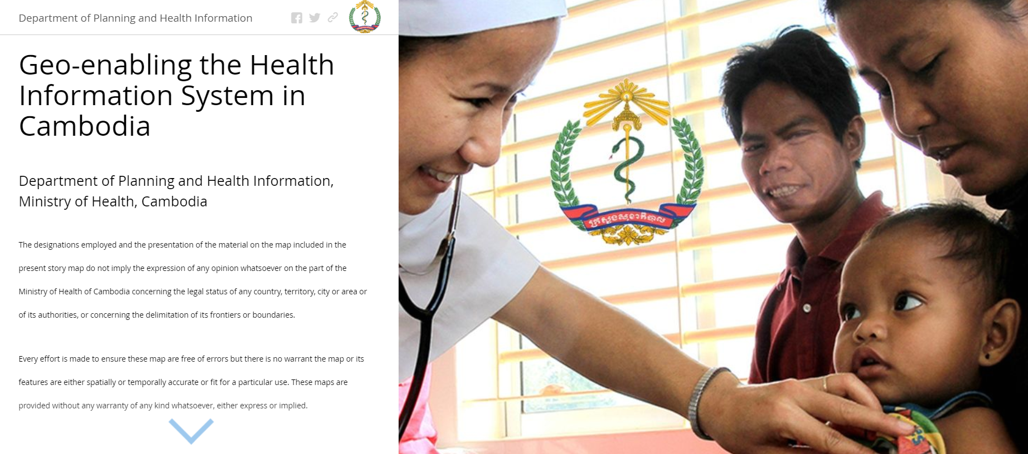
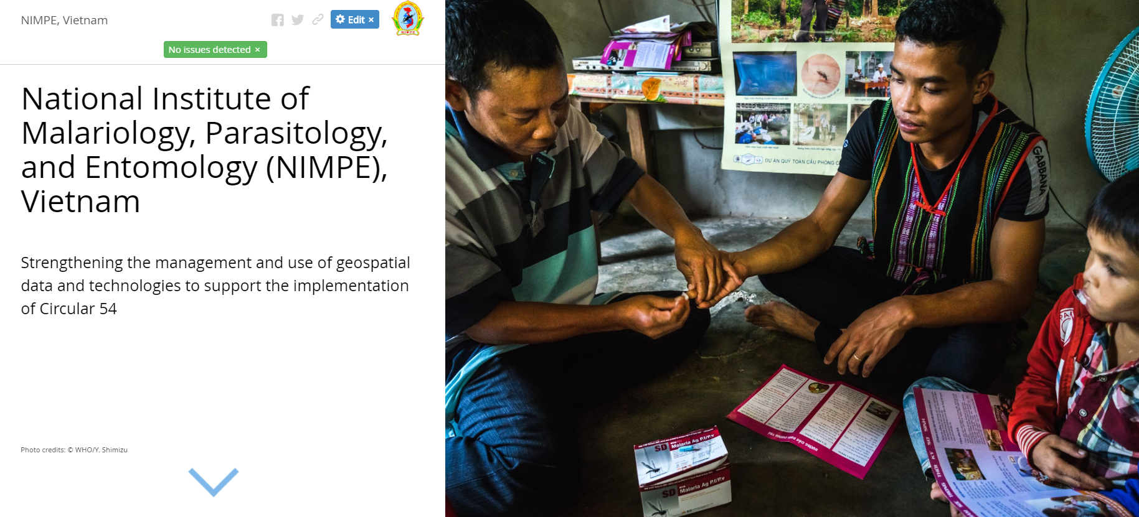
Geo-enabled HIS – Example of implementation
Myanmar (https://arcg.is/1KL18X0)
Cambodia (https://arcg.is/1CmSeL)
Vietnam (https://bit.ly/2HfVvjH)
18

Slide 19
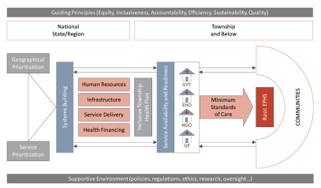
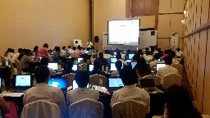
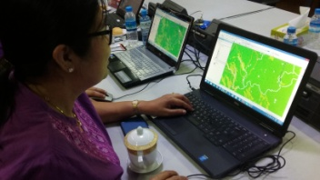
Implementation in Myanmar
National health Plan 2017-2021
HIS Geo-enabling
National roll out
Regional level
pilot project
Vision and needs
Data model and data specifications
Capacity building
Guidelines and master lists
Township level
pilot project
https://arcg.is/1KL18X0
Needs &
Gaps
Training &
Equipment
Workplan & methods
Pilot
project
Geo-enabling of the Immunization program
Could be applied to the Malaria program
19

Slide 20
Geo-enabled HIS – The implementation
Started by implementing a pilot project to strengthen this and demonstrate the benefits of the geo-enablement….
…to then support the establishment of this for long term sustainability
20

Slide 21
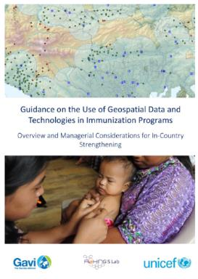
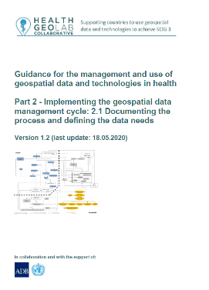
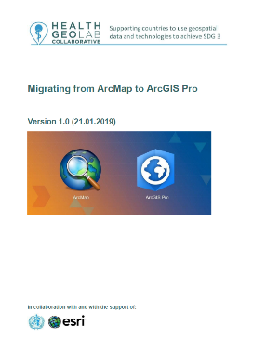
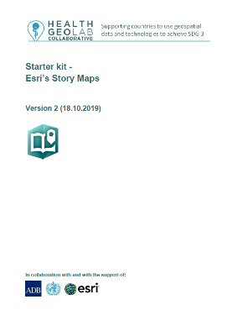
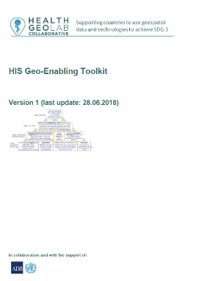
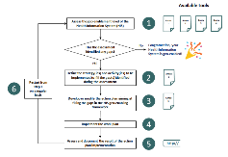
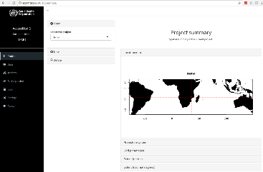
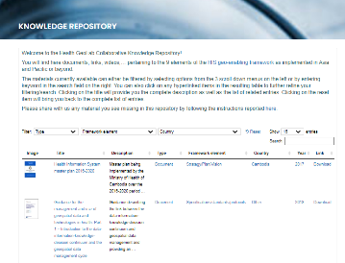
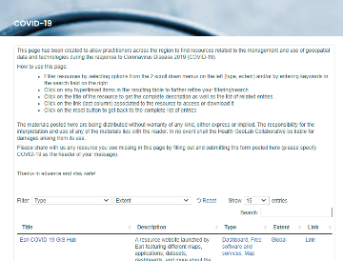
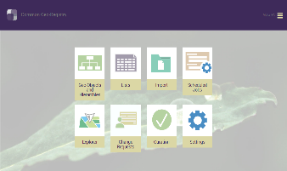
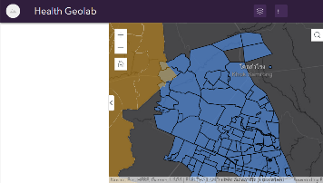
Geo-enabled HIS – Free resources
Develop and share reference material
HIS geo-enabling toolkit
Guidance
Starter kits
Developing, testing and using tools
Exchanging knowledge and experiences
AccessMod
CGR/GPR
Knowledge repository (126)
COVID-19 resources (184)
Boundaries widget
21

Slide 22
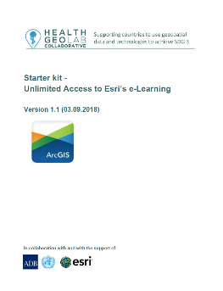
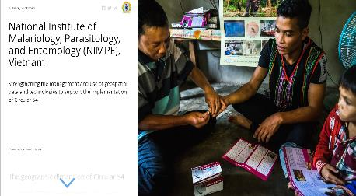
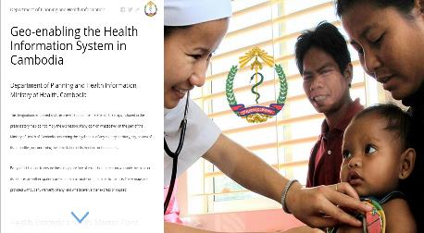
Geo-enabled HIS – Free resources
Country level and other training
Vanuatu
Cambodia
Myanmar
Vietnam
Philippines
https://healthgeolab.net/resources/workshops_trainings/
Esri e-learning resources
Documented implementations
Schools of public health
https://bit.ly/3gsLMot
Vietnam
http://bit.ly/2NqWZHA
Cambodia
https://healthgeolab.net/resources/reference-materials/
https://healthgeolab.net/resources/his-geo-enabling-course/
22

Slide 23
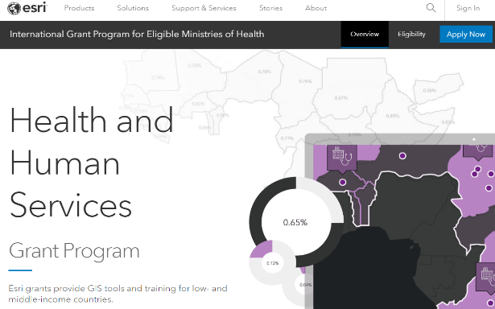
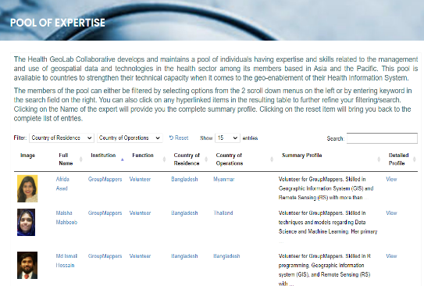
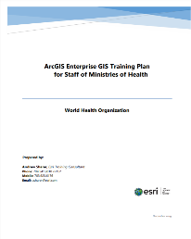
Geo-enabled HIS – Free resources
Collaborative
(19 members) - Governmental agencies, development partners, academic institutions, private sector, volunteer organizations
LinkedIn group
(241 members)
USAID
GeoCenter
www.linkedin.com/groups/10311235/
One Network (CoP)
Thai GIS Network
(more than 500 members)
Public-Private Partnership (PPP) with Esri
Pool of expertise
(24 Members and growing)
23

Slide 24
“Resilient health systems are aware. Resilient health systems have an up-to-date map of human, physical, and information assets that highlight areas of strength and vulnerability”
(Margaret E Kruk et al, 2015)
https://www.thelancet.com/action/showPdf?pii=S0140-6736%2815%2960755-3
24
Notes:
Robust, responsive and resilient health systems are “aware”. One essential component of health system “awareness” is having and using up-to-date information on the location and functionality of health system assets, including community health workers. This information is critical to health services planning, human resource management, supply chain management, emergency preparedness and response, monitoring, and evaluation – indeed spatial information and data on the functionality of health assets are critical to all aspects of health systems strengthening.

