Slide 1

Introduction to geospatial data management
and technologies for Health Programs training workshop - Timor Leste
Exercise 1: Using a smart phone and an app to collect geographic coordinates in the field

Slide 2
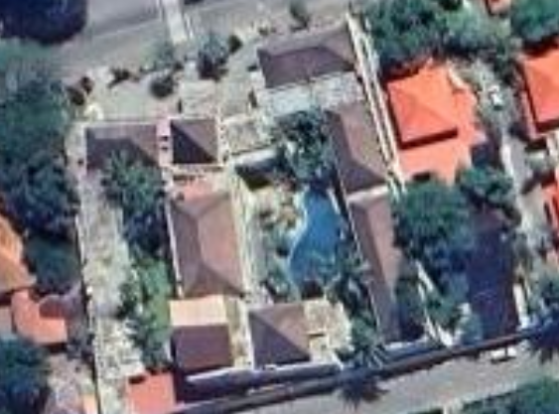
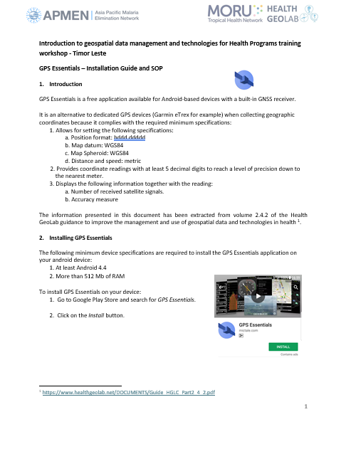
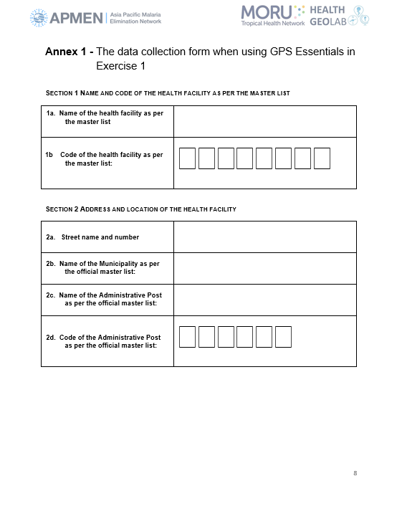

Exercise 1
You will collect the geographic coordinates here
Health facility name: Klinika Novo Turismo
Health facility code: HF190005
Street name and number: Avenue Bidau Lecidere
Municipality name: Dili
Administrative post name: Nain Feto
Administrative post code: TL0604
2

