Slide 1

Introduction to geospatial data management
and technologies for Health Programs training workshop - Timor Leste
Exercise 2: Using basic functionalities of QGIS

Slide 2
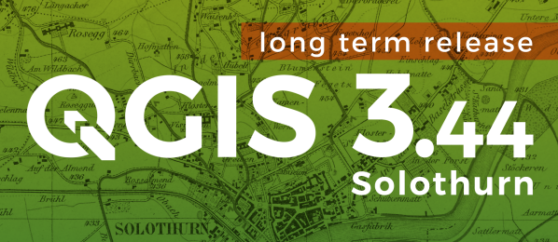
What is QGIS?
QGIS (formerly known as Quantum GIS) is a free and open-source cross platform desktop geographic information system (GIS) application that supports viewing, editing, and analysis of geospatial data.
Why are we using QGIS version 3.44?
Most recent and stable version of QGIS
2

Slide 3

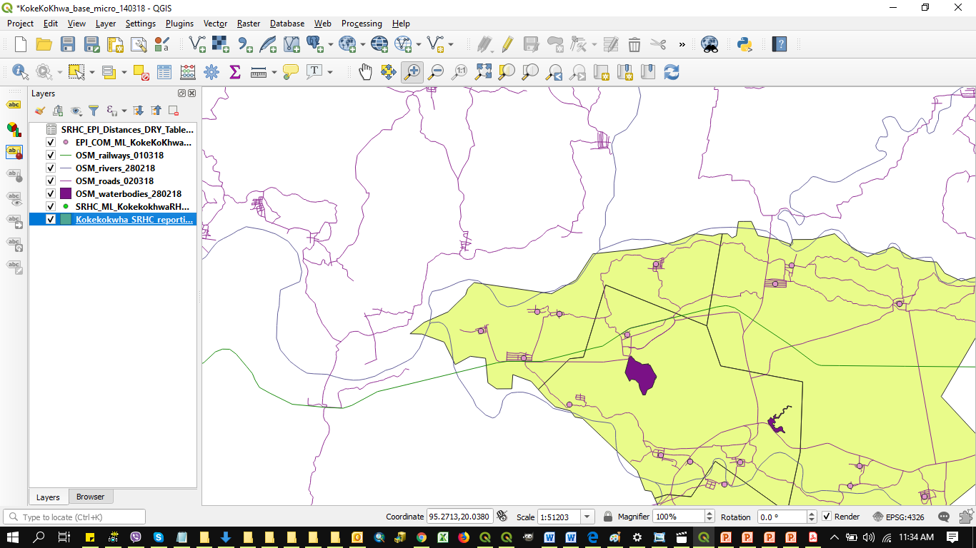
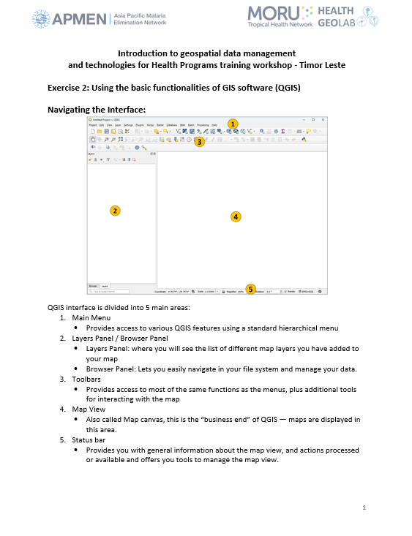

QGIS (Interface, main functionalities)?
Let’s have a look together!
QGIS_Interface_Menu_Tools_EN.pdf
3

