Slide 1

Introduction to geospatial data management
and technologies for Health Programs training workshop - Timor Leste
Exercise 3: Preparation of the statistical data for use in a GIS software (QGIS)

Slide 2
Objectives
The objectives of this exercise are to teach participants how to:
Apply the lessons learned from Session 13
Prepare statistical data for use in GIS software (QGIS)
Exercise Data
The data used in this exercise are fictitious and created only to facilitate the exercises in this course. The different geospatial objects are not related to any real location or infrastructure in the real world.
Data specifications
The data specifications to be used are also fictitious and created only to facilitate the exercises in this course.

Slide 3
Request received for a map
Purpose: Assist on-going HIV/AIDS prevention efforts
Audience: Province-level Disease Prevention and Control officer
Content:
  Number of HIV cases:
    By place of reporting at the health facility level
    By place of origin at the barangay level
Medium: A4 size map stored as PDF

Slide 4
What statistical data do we need?
What kind of data do we need and how should it be organized to create the map?
Excel file with the total number of cases by health facility organized in a table presenting at least 3 columns:
  Health facility unique ID
  Health facility name (for crosschecking)
  Total number of cases until today
Excel file with the total number of cases by Barangay organized in a table presenting at least 3 columns:
  Barangay unique ID
  Barangay name (for crosschecking)
  Total number of cases until today

Slide 5


What tabular data do we have?
Administrative divisions master list down to the Barangay level (PSA)
Health Facilities master list (DOH)
HIV cases report for the 315 positive cases identified since the beginning of 2027
Download/extract the exercise data from the TRAINING_MATERIAL/EXERCISES/EXERCISE_3 folder
On your computer, create an “EXERCISES” folder. Then, create a subfolder ”EXE_3” and place the downloaded data there for easier access.
(e.g., D:\EXERCISES\EXE_3)

Slide 6
What statistical data do we need?
Administrative divisions master list
Open the Admin_divisions_master_list_PSA_Jan2027.xlsx file in Excel
Look at the structure and content of the file
  How many worksheets?
  What is in each worksheet?
Identify the following information across the worksheets:
  The source of the data
  The year of validity
  The explanation of the content
Is this file organized properly to allow its use in a GIS software?

Slide 7
What tabular data do we have?
Health facilities master list
Open the Health_Facilities_master_list_DOH_Jan2027.xlsx file in Excel
Notice the similar file structure as with the administrative division master list
Identity the following information across the worksheets:
  The source and validity of the data
  The structure of the unique identifier attached to each health facility
  The geographic coordinates for each health facility
  The method used to collect these coordinates and the associated level of accuracy

Slide 8
What tabular data do we have?
HIV cases reports file
Open the HIV_Cases_Report_DOH_200327.xlsx file in Excel
Look at the structure and content of the file
Search for the following information across the worksheet:
  The source and validity of the data
  The explanation of the content of each column
Is this file organized properly to allow using it to create the content of the first map? If not, why?
Does the list of Barangays and health facilities in this file match those in the master lists?
Are the Barangays codes and health facilities unique IDs the same between this file and the master lists?
What do you think about the unique ID attached to each case?
What do we have to do to obtain the data we need?

Slide 9
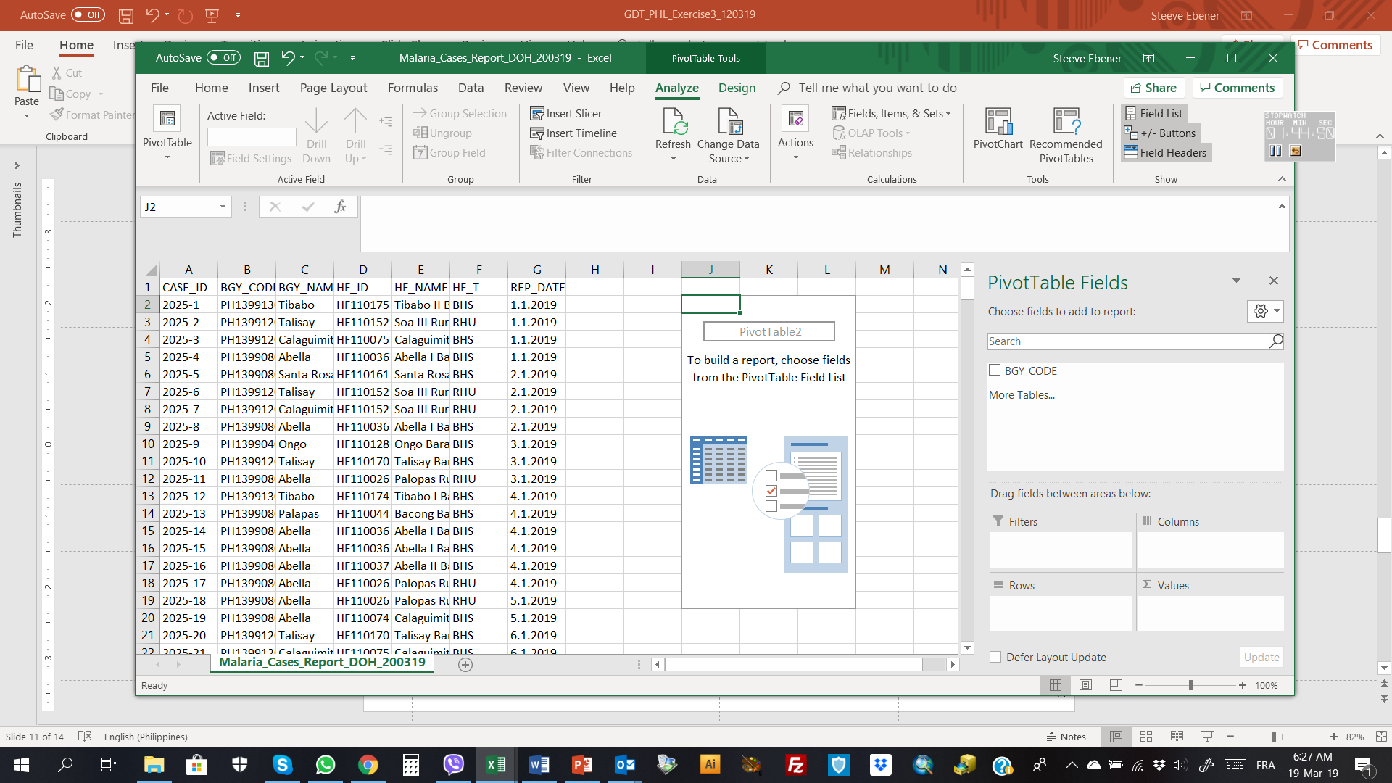
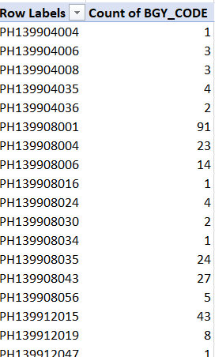
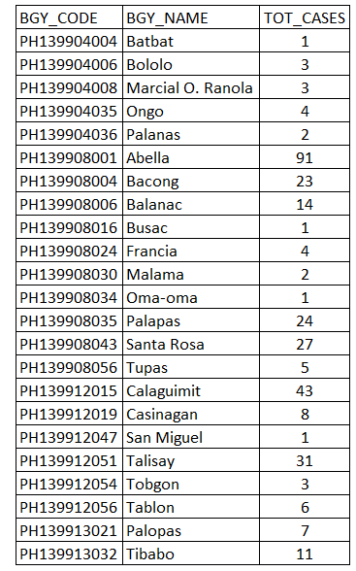
Exercise 3 – Part 1
Create the HIV cases report file by Barangay
Open the HIV_Cases_Report_DOH_200327.xlsx file in Excel
Use the pivot table function to generate a new table that would contain the Barangay unique identifier and the total number of cases by Barangay
Make sure that your pivot table contains all the cases from the cases report file
Add the Barangay names to your table and adjust the headers to be appropriate for import in QGIS
Check that all the Barangay in your new table are in the master list and rename the worksheet «Tot_Cases_Bgy»
Save the resulting table as Tot_Cases_Bgy_200327.xlsx

Slide 10
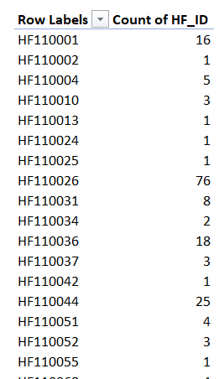
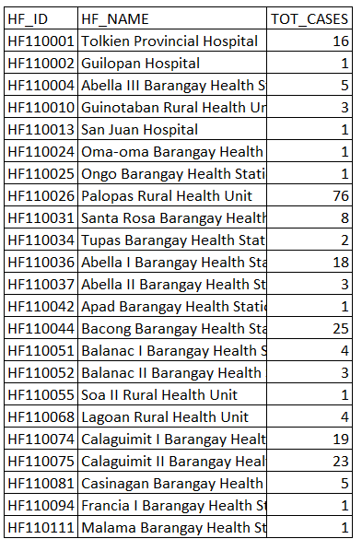
Exercise 3 – Part 2
Create the HIV cases report file by health facility
Open the HIV_Cases_Report_DOH_200327.xlsx file in Excel
Use the pivot table function to generate a new table that would contain the health facility unique identifier and the total number of cases by health facility
Make sure that your pivot table contains all the cases from the cases report file
Add the health facility names to your table and adjust the headers to be appropriate for import in QGIS
Check that all the health facilities in your new table are in the master list and rename the worksheet «Tot_Cases_HF»
Save the resulting table as Tot_Cases_HF_200327.xlsx

Slide 11
Exercise 3 – Conclusion
Re-organizing statistical data that are not properly organized in the first place might be very time consuming and prone to errors
Having a data catalog and metadata helps ensure that you to understand the data and make sure that it is appropriate for your needs
The use of a master list as the reference for data collection and sharing (unique identifier, name,…) facilitates data consistency and reduce data cleaning and errors
Good geospatial data management practice is key to a powerful use of GIS and other geospatial technologies, and therefore thematic mapping

