Slide 1

Introduction to geospatial data management
and technologies for Health Programs training workshop - Timor Leste
Exercise 4: Preparation of the geospatial data to create a thematic map in a GIS software (QGIS)

Slide 2
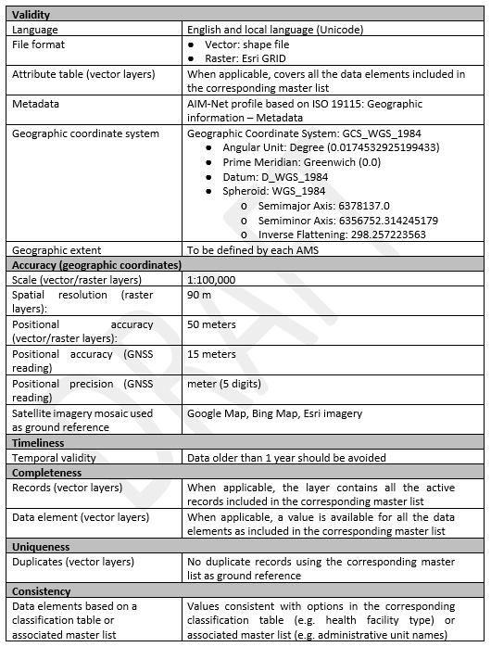
Objectives
The objectives of this exercise are to teach participants how to:
Apply the lessons learned from Session 13
Prepare geospatial data for use in GIS software (QGIS)
Exercise Data
The data used in this exercise are fictitious and created only to facilitate the exercises in this course. The different geospatial objects are not related to any real location or infrastructure in the real world.
Data specifications
The data specifications to be used are also fictitious and created only to facilitate the exercises in this course.
Geospatial data

Slide 3
Request received for a map
Purpose: Assist on-going HIV/AIDS prevention efforts
Audience: Province-level Disease Prevention and Control officer
Content:
  Number of HIV cases:
    By place of reporting at the health facility level
    By place of origin at the barangay level
Medium: A4 size map stored as PDF
What geospatial data do we need?

Slide 4

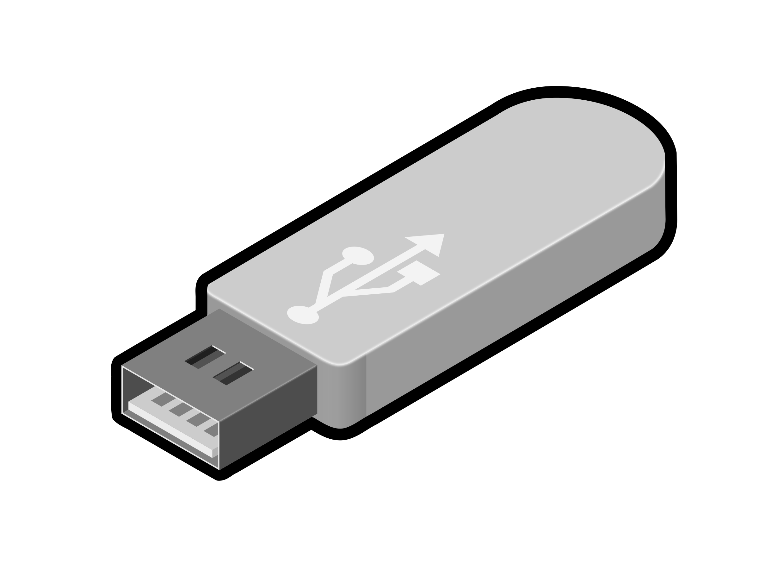
What geospatial data do we need?
For the Province of Tolkien, we need shapefiles containing:
Boundaries of the Barangay with the unique identifiers from the master list included in the attribute table
Location of the health facilities with the unique identifier from the master list included in the attribute table
What geospatial data do we have?
Barangay boundary shapefile (LMB)
Place of residence for the 315 positive cases identified since the beginning of 2027 and the new ones reported by the RITM hospital (collected with ODK)
Download/extract the exercise data from the TRAINING_MATERIAL/EXERCISES/EXERCISE_4 folder
In the “EXERCISES” folder you created in the previous exercise, create a subfolder ”EXE_4” and place the downloaded data there for easier access.
(e.g., D:\EXERCISES\EXE_4)

Slide 5
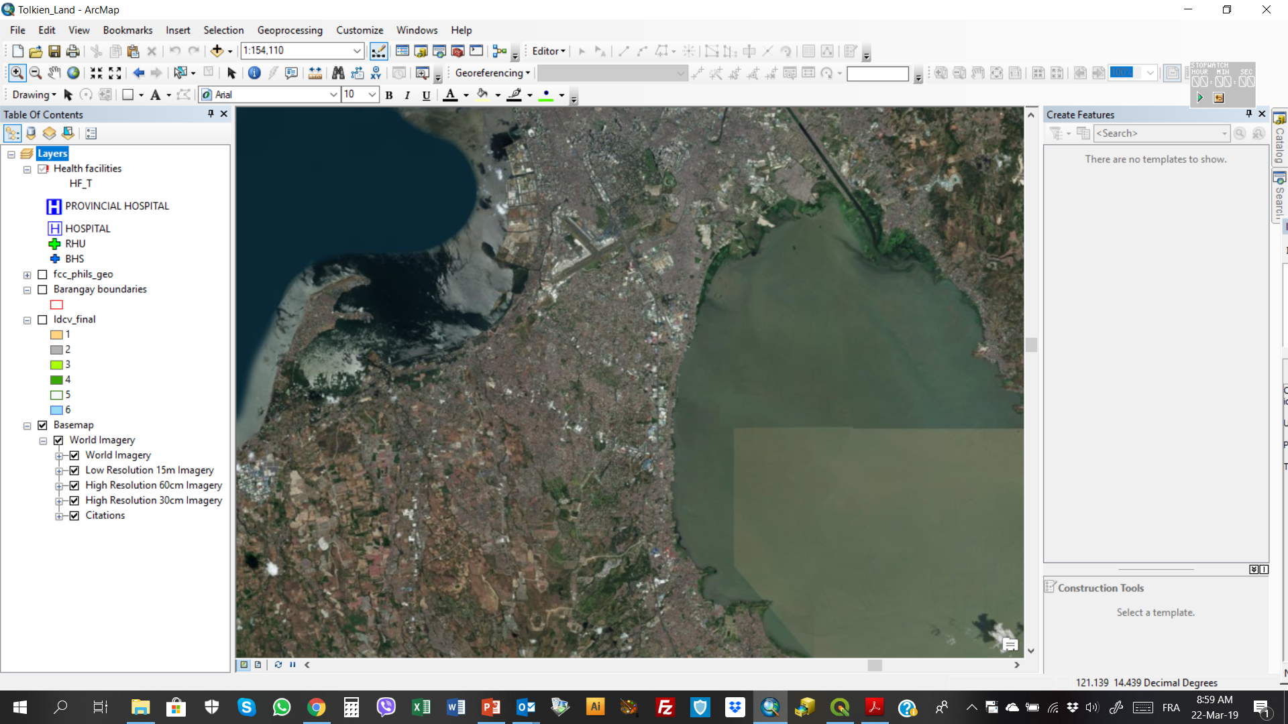
What geospatial data do we need?
Basemap
Satellite
images
Ground reference
Will be used to check the consistency, accuracy, and completeness of the geospatial data that we will be using

Slide 6
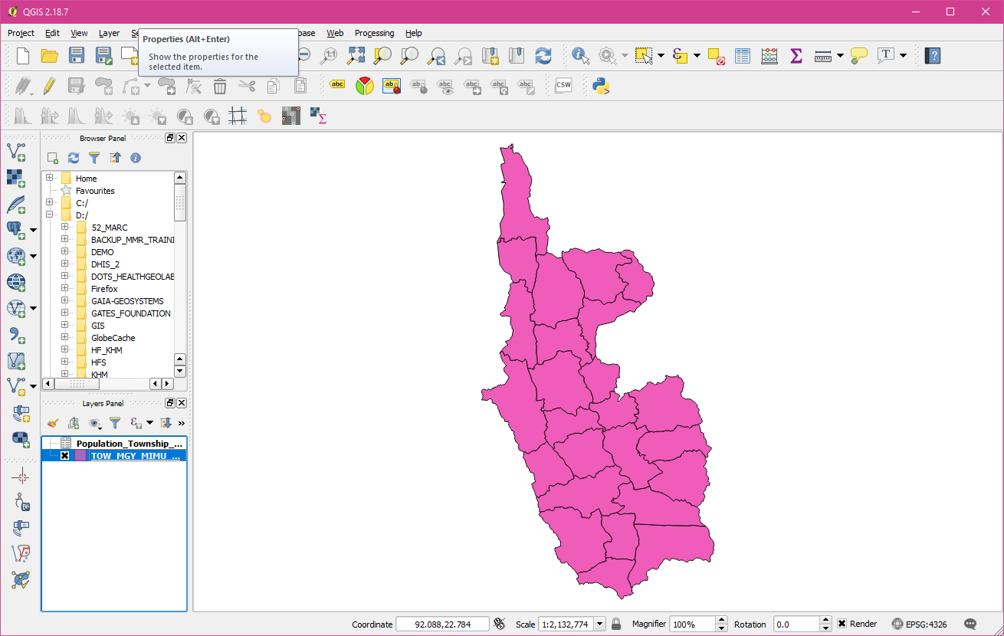
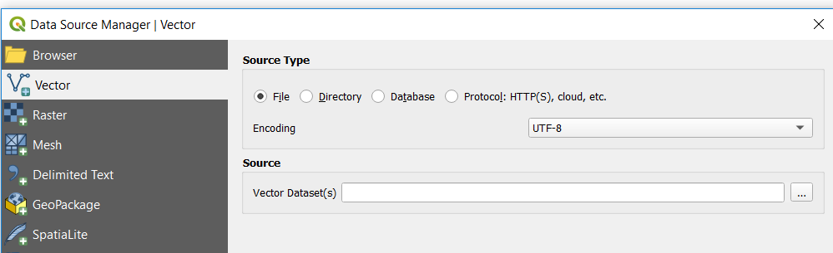

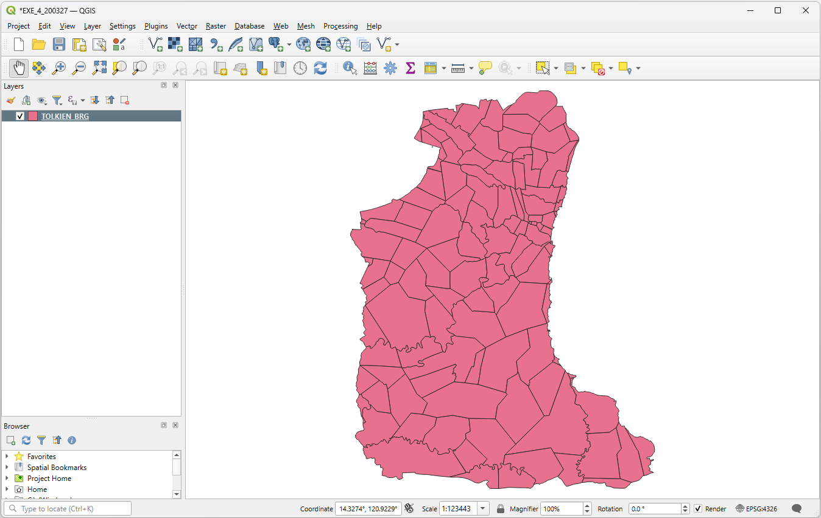
Exercise 4 – Part 1
Barangay boundary shapefile
Launch QGIS
Click on the Save button
Go to the folder where you want to save your QGIS project (D:\EXERCISES\EXE_4)
Enter a file name and click Save
Click the Add Vector Layer button
Browse to the location of the EXERCISES\EXE_4\
BARANGAY_BOUNDARIES\LMB folder on your computer
Double-click on the TOLKIEN_BRG.shp file and click the Add button
Close the Data Source Manager dialog box
The barangay boundaries for the Province of Tolkien should appear in the map canvas of QGIS. (Random color is assigned.)

Slide 7
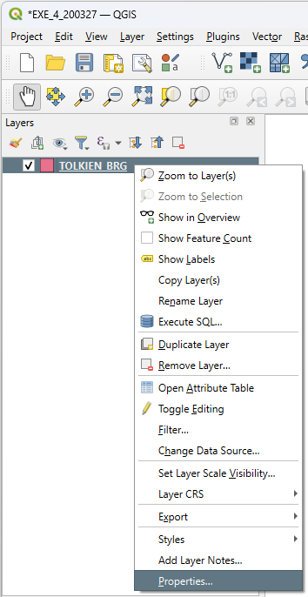

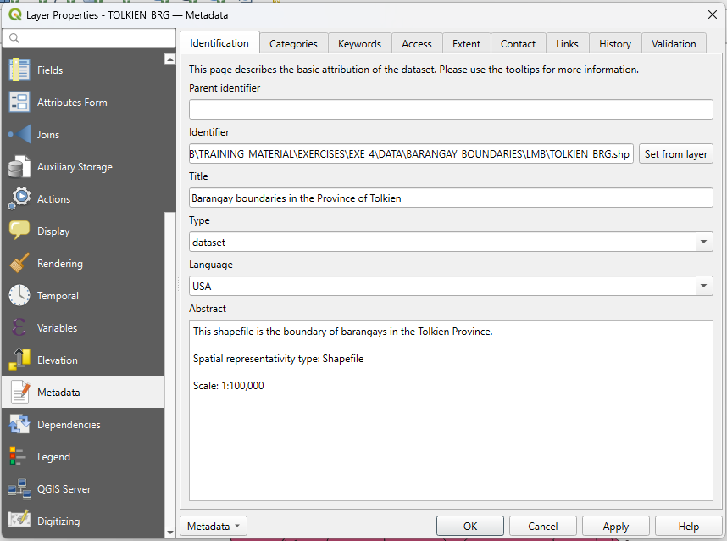
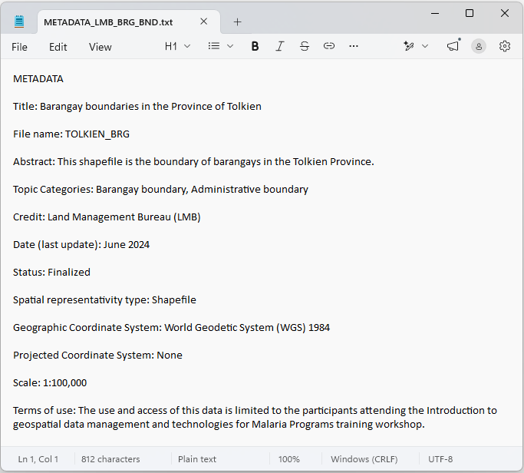
Exercise 4 – Part 1
Barangay boundary shapefile
Right-click on the barangay boundary layer and select Properties…
Select Metadata in the left-hand menu and have a look at information reported there
You can also have a look at the METADATA_LMB_BRG_BND.txt file stored in the EXERCISES\EXE_4\DATA\BARANGAY_ BOUNDARIES\LMB folder to get information about this layer

Slide 8
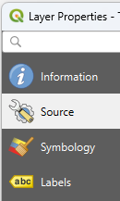

Exercise 4 – Part 1
Barangay boundary shapefile - Projection
Still in the Layer Properties dialog box, click on Source.
The information about the geographic coordinate and projection system is stored under “Assigned Coordinate Reference System”
The layer is not projected; only using a geographic coordinate system (WGS 84)
Close the Layer Properties dialog box.

Slide 9
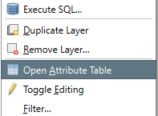

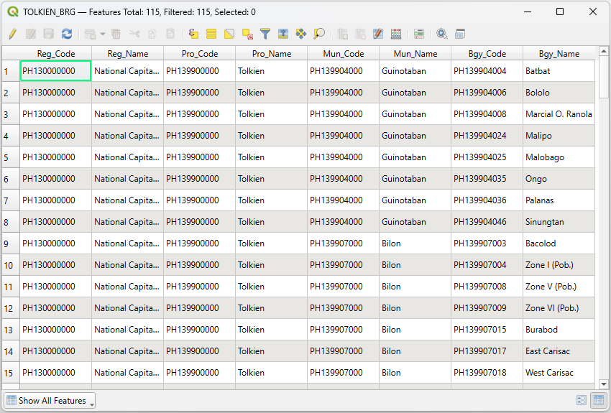
Exercise 4 – Part 1
Barangay boundary shapefile – Attribute table
Right-click on the layer
Select Open Attribute Table in the menu
Take some time to look at how the attribute table is structured (rows, columns)
Does this remind you of another table we saw in the previous exercise?
Does the content of the shapefile match the content of the master list?

Slide 10
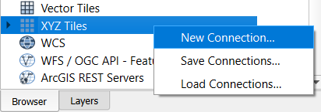
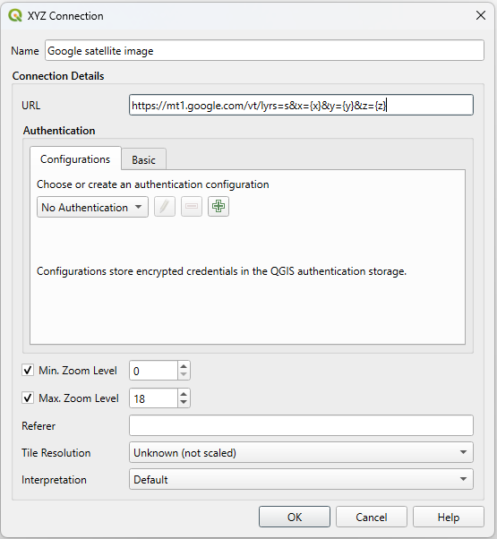
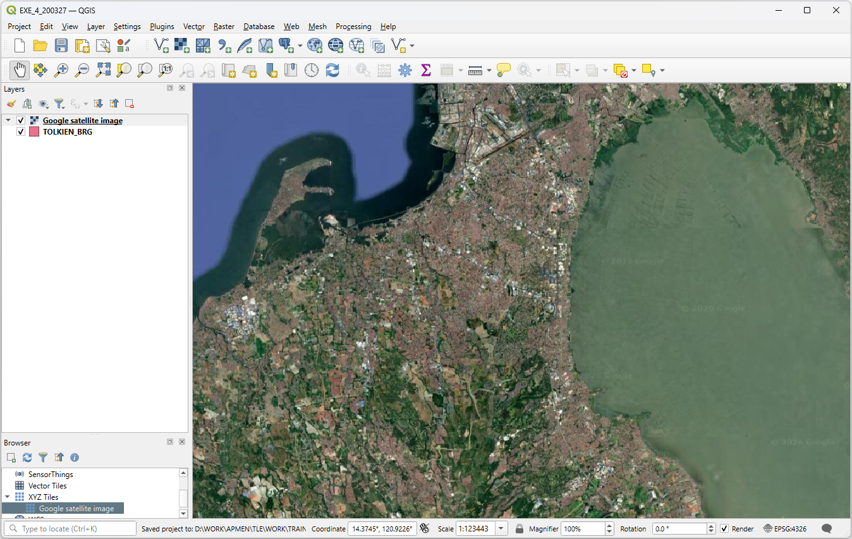
Exercise 4 – Part 1
Barangay boundary shapefile – Consistency with the satellite image used as ground reference
In the Browser Panel, scroll down and look for XYZ Tiles.
Right-click on XYZ Tiles then choose New Connection…
In the dialog box that opens:
  Indicate the name under which you want to see this layer appear in the list (e.g., Google satellite image)
  Enter the URL of the WMS you want to use (LINK_GOOGLE_SATELLITE.txt file in the EXE_4 folder)
  Do not change the other settings in the dialog box. Click OK.
  Double-click on the layer name under the XYZ Tiles
The satellite images should appear in the map canvas
Save the project!

Slide 11
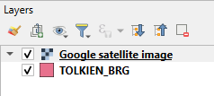

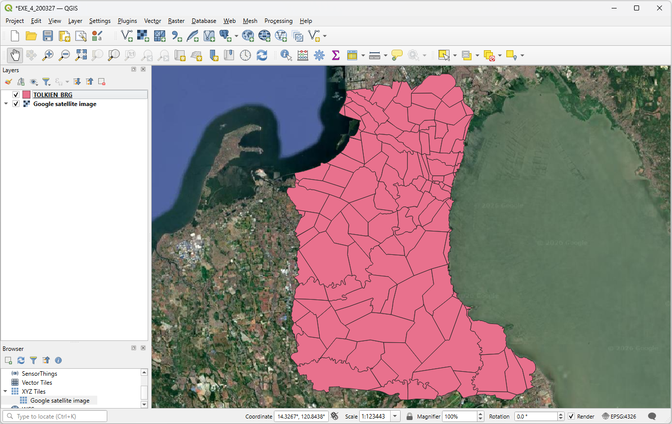
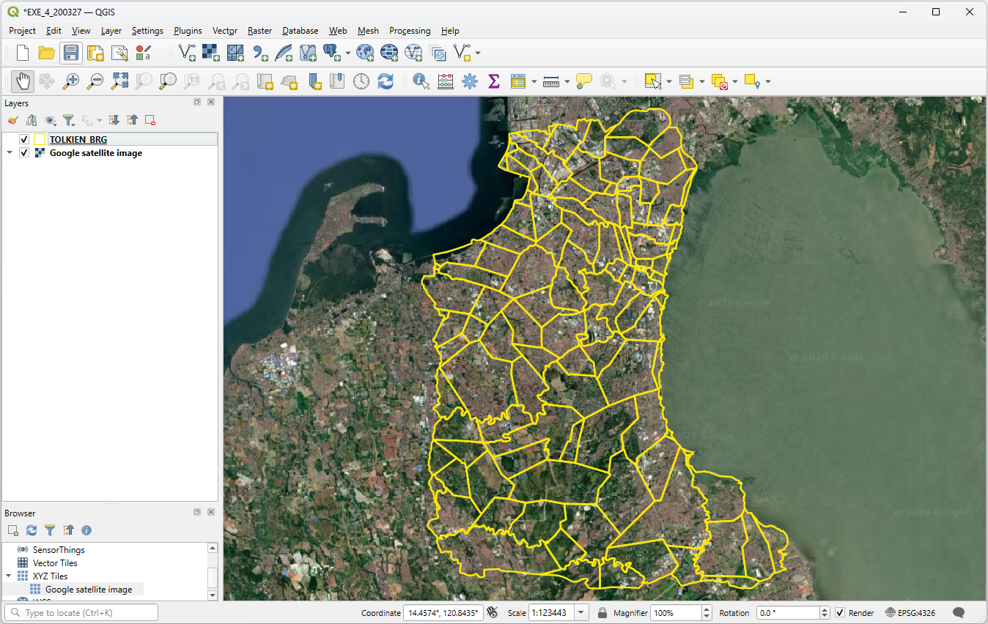
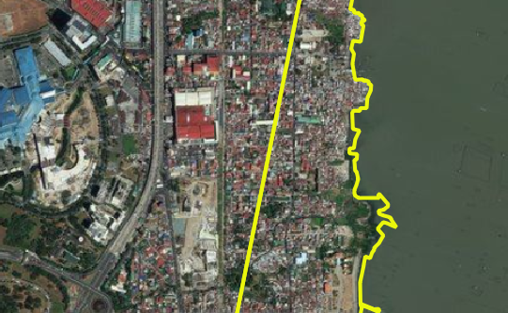
Exercise 4 – Part 1
Barangay boundary shapefile – Consistency with the satellite image used as ground reference
Move the satellite image basemap to the back of the barangay boundaries
Change the symbology of the barangay boundary layer so that we can see the satellite images through it
Zoom on some areas to visually judge the accuracy of the barangay boundaries
Uncheck the basemap and barangay boundary layer before moving to the next step
Save the project!
How well does this shape file align with the specifications for geospatial data?

Slide 12
Exercise 4 – Part 2
Health facilities location shapefile
Open the Health_Facilities_master_list_DOH_Jan2027.xlsx file in Excel (located inside EXERCISES\EXE_4)
Look at the fields containing the information related to the geographic coordinates of the health facilities:
  How many fields do you see?
  What do these fields contain?
  What is the level of accuracy of the geographic coordinates?

Slide 13
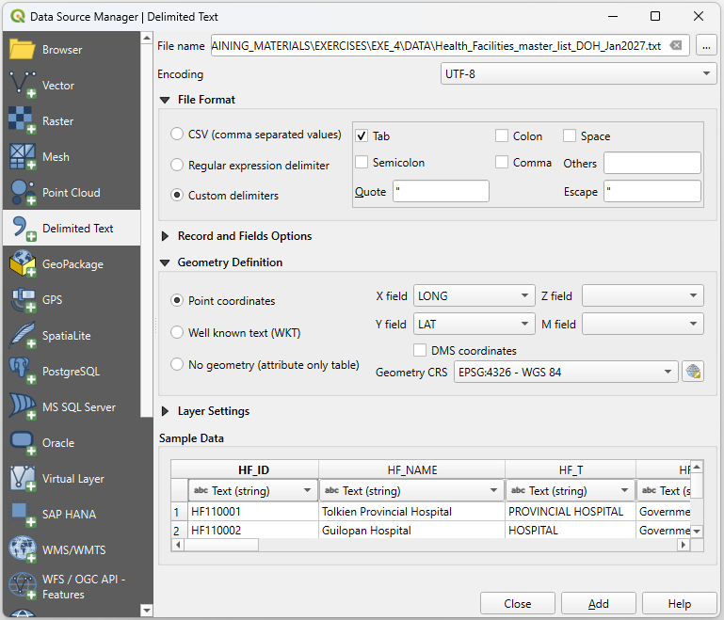

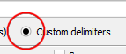
Exercise 4 – Part 2
Health facilities location shapefile
We have to convert the content of the health facility master list into a shapefile
Save the Health_Facilities_master_list_DOH_Jan2027.xlsxfile as tab delimited (.txt) file
Close Excel
In QGIS:
  Click on the Add Delimited Text Layer button
  In the dialog box that opens:
    Browse to the location of the .txt file and select it
    Select Custom delimiters under File format and check Tab
    Indicate which fields contain the longitudes and latitudes and EPSG:4326 – WGS 84 under Geometry definition
Click Add then Close.

Slide 14
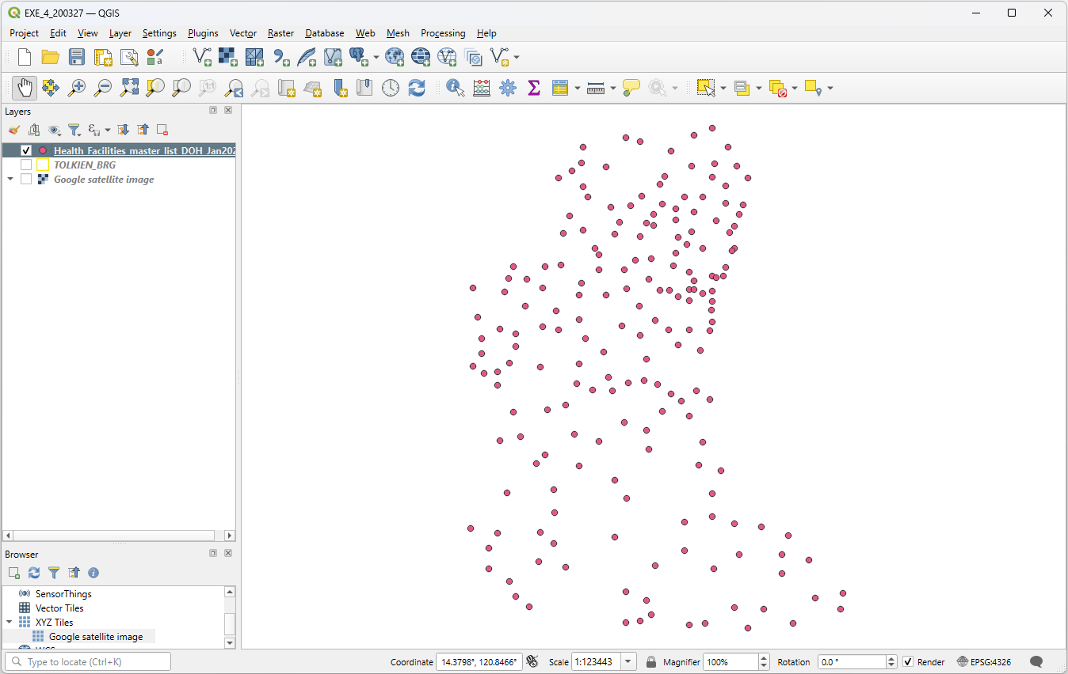
Exercise 4 – Part 2
Health facilities location shapefile
The locations of the health facilities included in the master list should appear in the map canvas
Save the project!
The points are not yet saved in a shapefile!!!

Slide 15
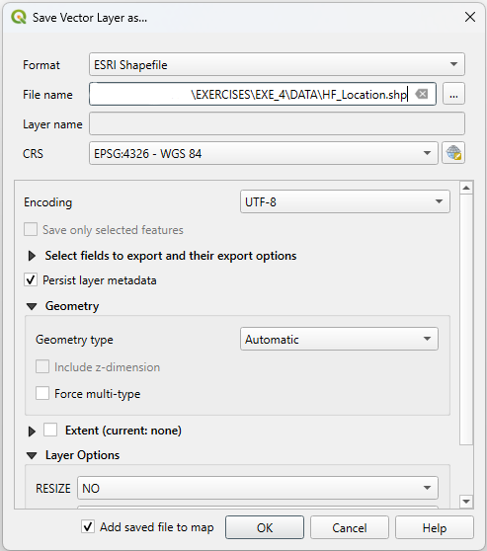
Exercise 4 – Part 2
Health facilities location shapefile
To save the points as a shapefile:
Right-click on the layer containing the points in the layer panel and click on Export > Save Features As…
In the dialog box that opens:
  Select Esri Shapefile as the Format
  Browse to the folder where you want to save it (EXERCISES/EXE_4) and give it a name (HF_Location.shp)
  Keep EPSG:4326 - WGS 84 as the CRS
Click OK

Slide 16
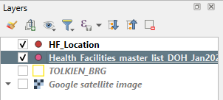
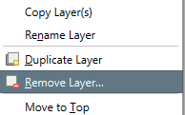
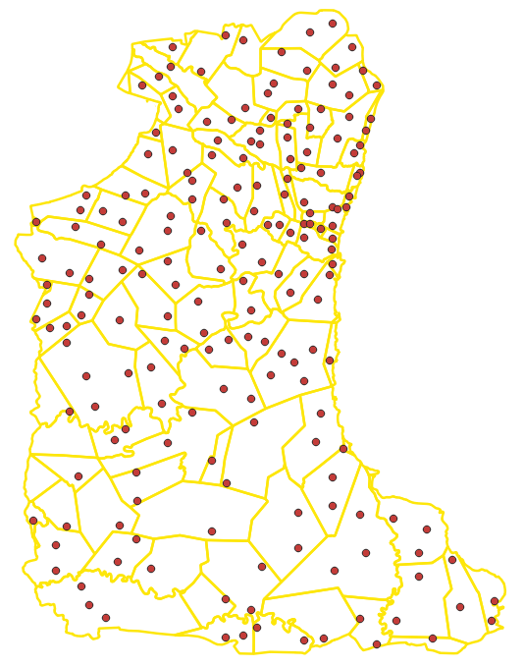
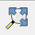
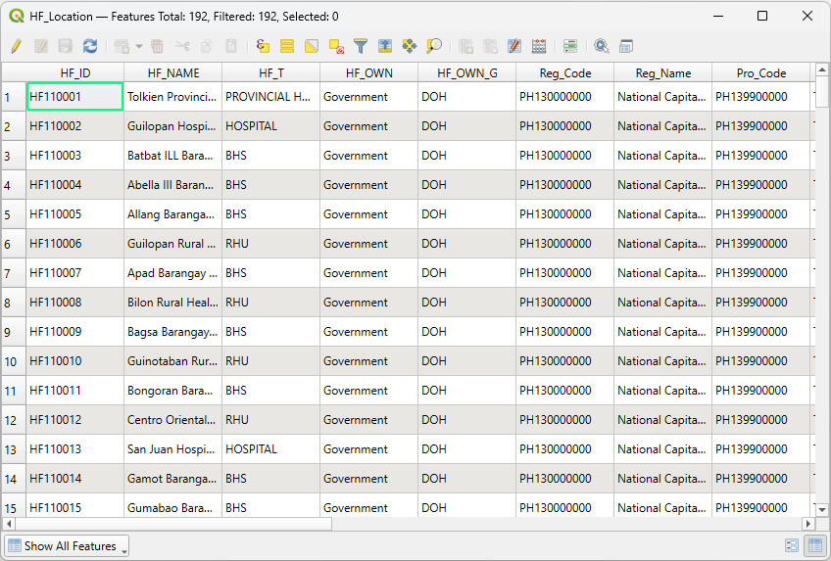
Exercise 4 – Part 2
Health facilities location shapefile
The new shapefile is now added to the Layers panel
You can delete the temporary layer by right-clicking on it and then selecting Remove Layer…
Once done, save the project and:
Make sure that all the points are falling within the Tolkien Province (click on the Zoom Full button for that )
Open the attribute table and check that all the content from the master list is there (192 health facilities)
Check that the health facilities are falling within the correct municipality and barangay
Save the project!

Slide 17
Exercise 4 – Conclusion
Geospatial data can be stored in different ways (geographic coordinates in an Excel file, shapefile, raster grid,…)
It is very important to remain very critical about the data you are using to make sure that it is of good quality and corresponds to your needs
  Metadata
  Ground reference
Always make sure that all the data you use are aligned with the corresponding data specifications (e.g., present the same datum, or even better, the same geographic coordinate system to avoid shifts between layers).

