Slide 1

Introduction to geospatial data management
and technologies for Health Programs training workshop - Timor Leste
Installation of QGIS and GNSS app

Slide 2
Installing QGIS 3.44

Slide 3


What is QGIS?
  QGIS (formerly known as Quantum GIS) is a free and open-source cross platform desktop geographic information system (GIS) application that supports viewing, editing, and analysis of geospatial data.
Version 3.44
  Why are we using QGIS version 3.44?
  Version 3.44 is the most stable version of QGIS at the moment which means that it has fewer bugs and less likely to crash.

Slide 4

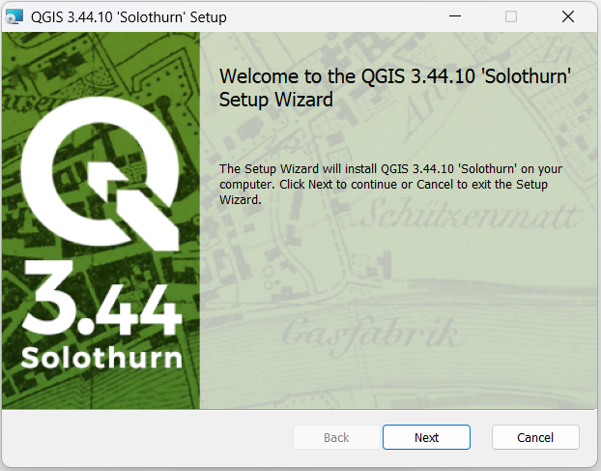
Downloading and installing QGIS 3.44
  Download the installer from the QGIS website: https://download.qgis.org/downloads/QGIS-OSGeo4W-3.44.10-1.msi
  Once downloaded, go to the location where you have saved the QGIS installer file.
  Double click on the file: QGIS-OSGeo4W-3.44.10-1.msi. This will launch the Setup Wizard.
Click Next.

Slide 5
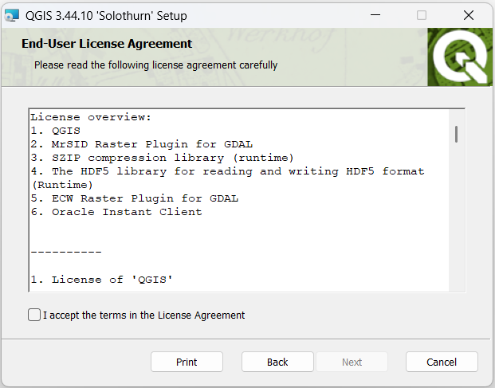
Installing QGIS
Read the license agreement and click the box to accept the terms in the License Agreement.
Click Next.

Slide 6
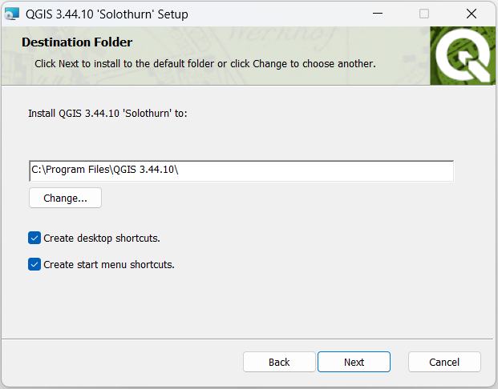
Installing QGIS
Choose the folder in which to install QGIS or accept the default folder (recommended).
Choose whether you want to create desktop and/or start menu shortcuts.
Click Next.

Slide 7
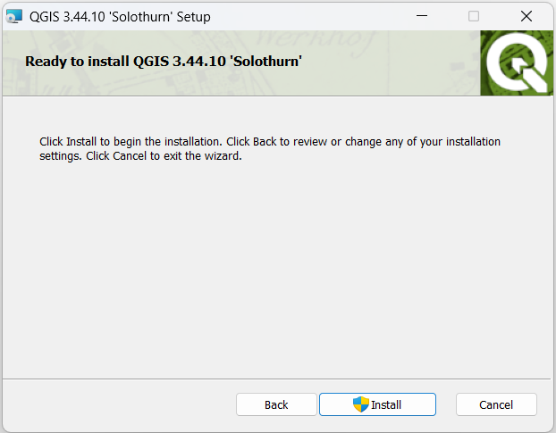
Installing QGIS
Click Install to begin the installation.
When asked if you want to allow the app to make changes to your device, click Yes.

Slide 8
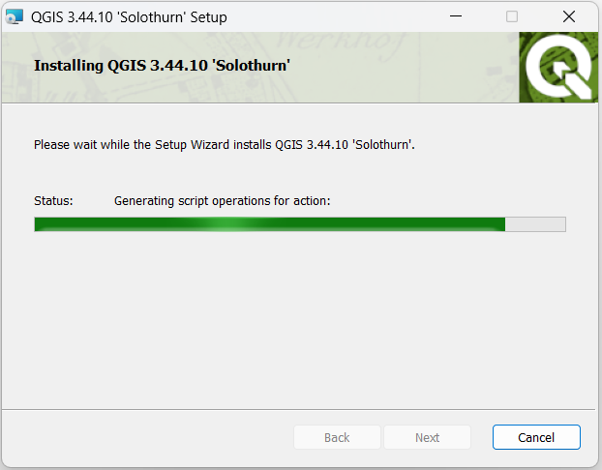
Installing QGIS
QGIS will start the installation. This may take some time depending on your computer.

Slide 9
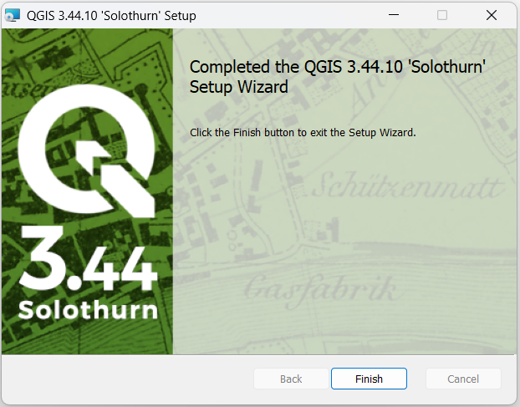
Installing QGIS
Once the installation is done, click Finish.

Slide 10

Using QGIS
To use QGIS, click on the Windows Start menu and search for QGIS Desktop 3.44.
Click QGIS Desktop 3.44 to launch QGIS.

Slide 11
Installing GPS Essentials app on an Android device and My GPS Coordinates app on an iOS device

Slide 12
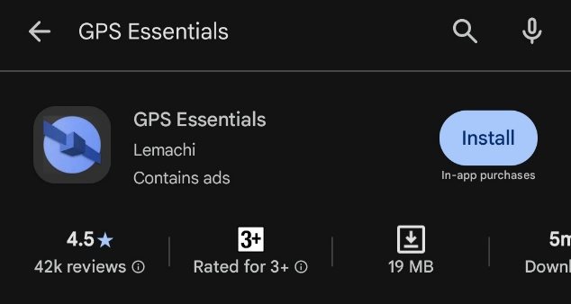
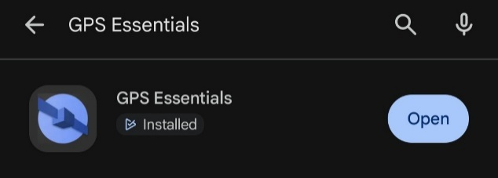
Installing GPS Essentials on an Android device
Make sure that your Android device meets the minimum specifications to install the app:
  At least Android 5.0
  At least 21 MB of free space
  More than 512 Mb of RAM
Go to Google Play Store and search for GPS Essentials.
Tap the Install button.
Once installed, tap the Open button to launch the app. Or look for and tap the GPS Essentials app icon among your device’s apps.

Slide 13
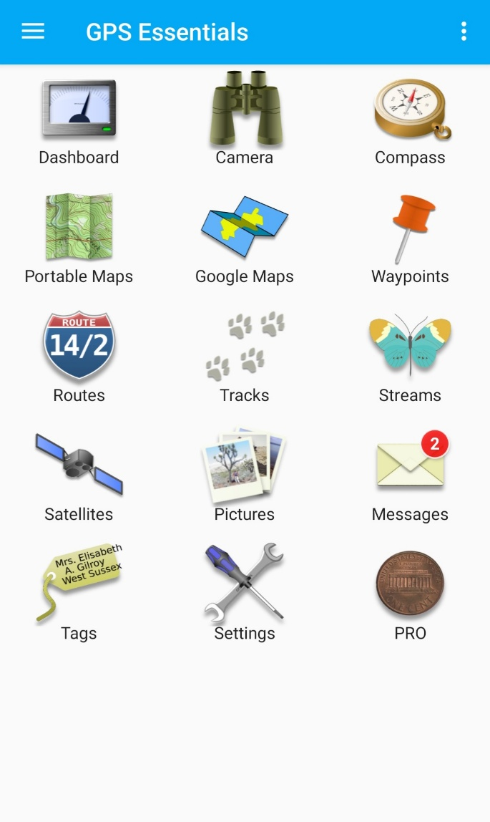
The GPS Essentials app
The main page of the GPS Essentials app looks like the image on the right.
Note: You will learn how to configure the settings of the app on Day 2. As such, you may get a warning that message that the GPS/location setting on your phone is currently disabled.

Slide 14
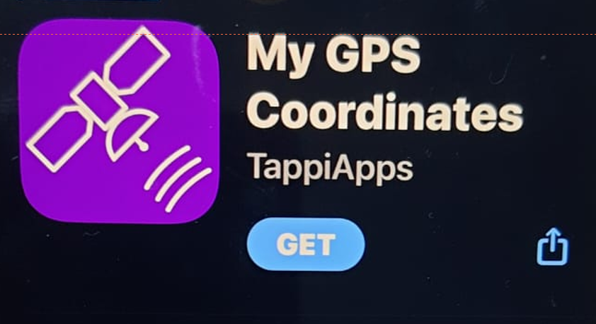

Installing My GPS Coordinates on an iOS device (iPhone/iPad)
Make sure that your iOS device meets the minimum device specifications to install the app:
  At least iOS 16.0
  At least 75.6 MB of free space
Go to the App Store and search for My GPS Coordinates.
Tap the Get button. Then tap Install.
Once installed, tap the Open button to launch the app. Or look for and tap the My GPS Coordinates app icon among your device’s apps.

Slide 15
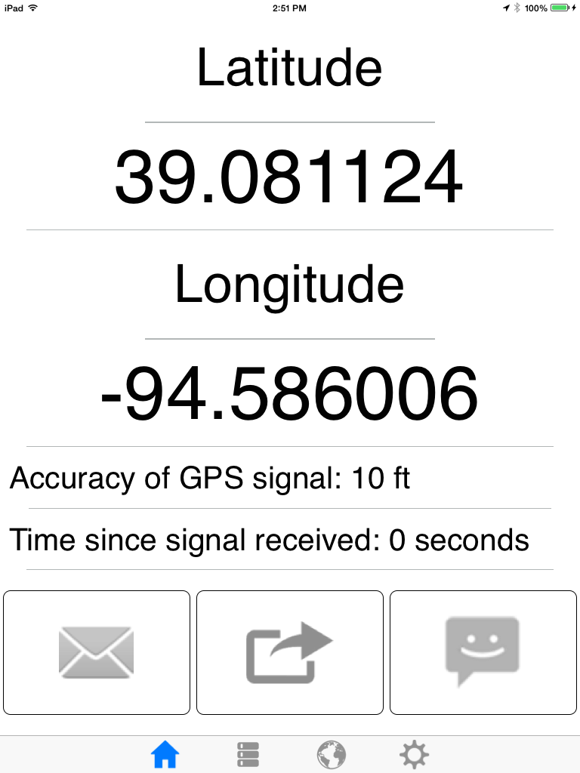
My GPS Coordinates app
The main page of the My GPS Coordinates app may look like the image on the right.

