Slide 1

Introduction to geospatial data management
and technologies for Health Programs training workshop - Timor Leste
Session 2: Examples of application of geospatial data and technologies in public health

Slide 2
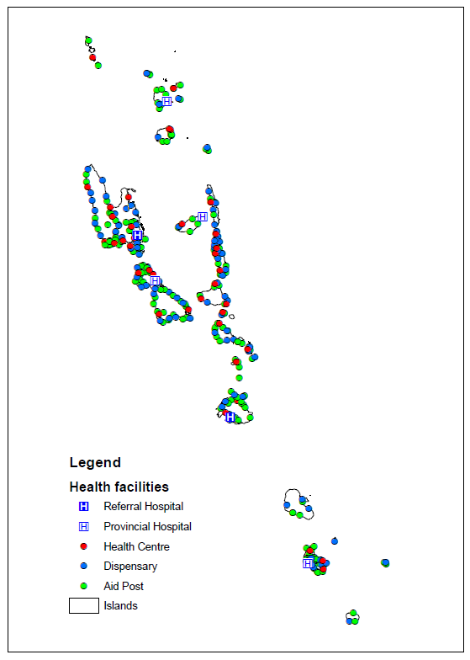
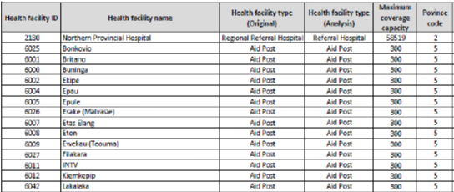
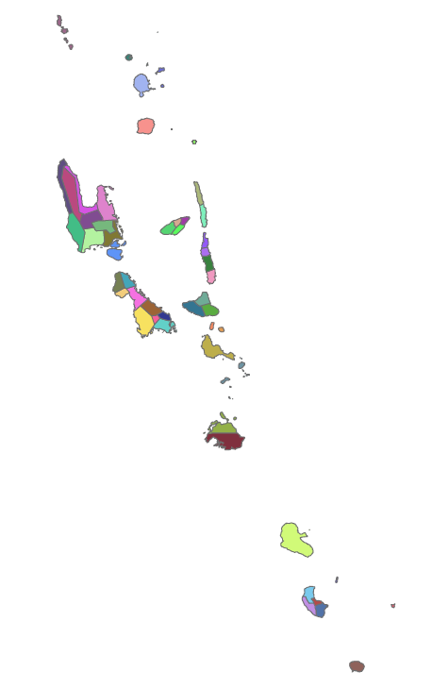
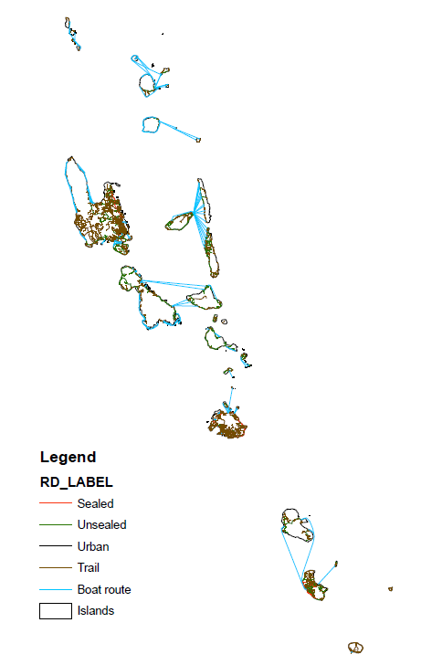
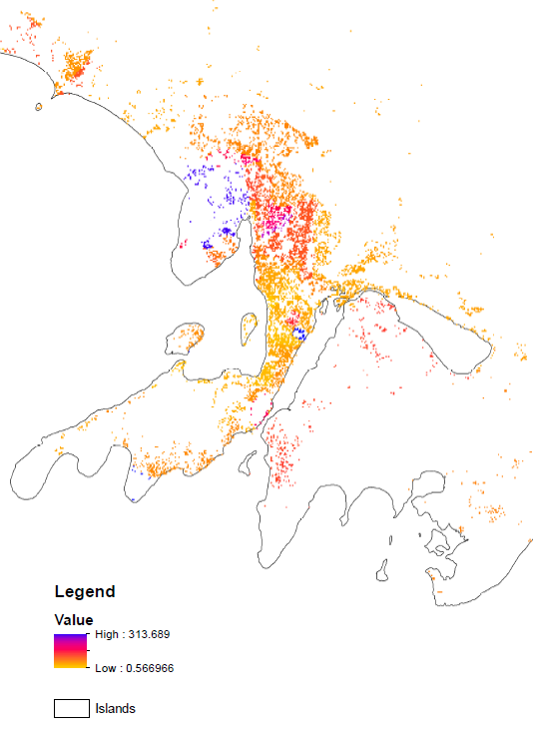
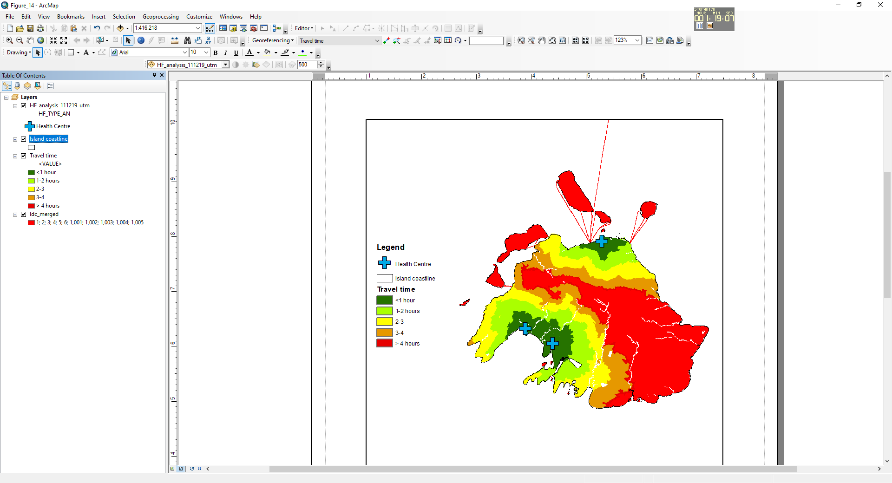
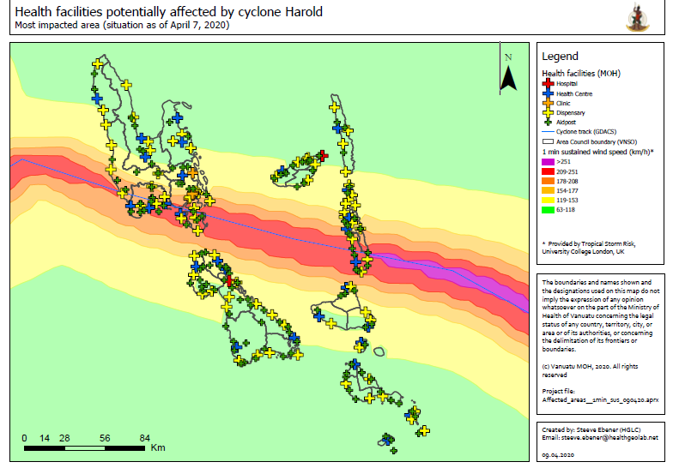
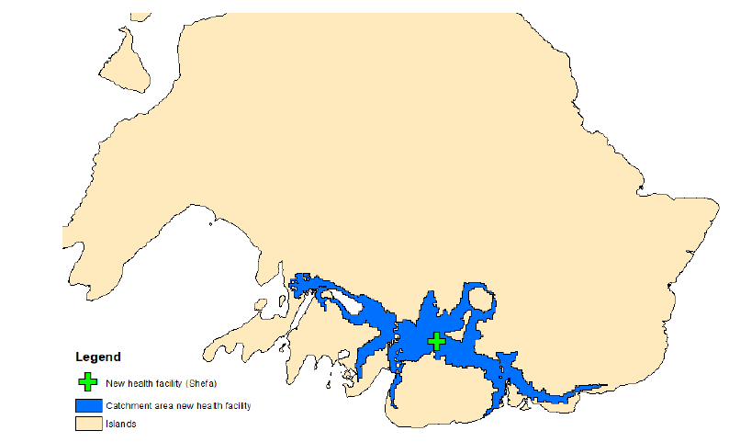
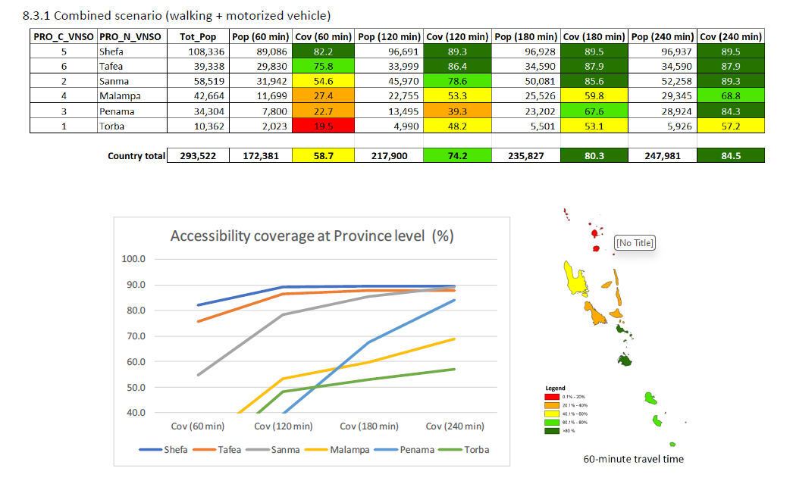
Planning - Accessibility analysis (Vanuatu)
Objective
Result
Ensure that the population has equitable geographic access to primary health care services
Administrative units
Transportation
network
Population
Outcomes and benefits
Accessibility analysis used to improve accessibility to primary health care services
Improved the availability and quality of geospatial data that can be used across programs including an updated georeferenced master list of health facilities
Baseline data and information used during the response to cyclone Harold in 2020
Improved geospatial data
Updated georeferenced health facilities master list
Reference: https://healthgeolab.net/KNOW_REP/Acc_Analysis_VUT_050224_FINAL.pdf
Accessibility analysis
Response to cyclone Harold (2020)
2

Slide 3

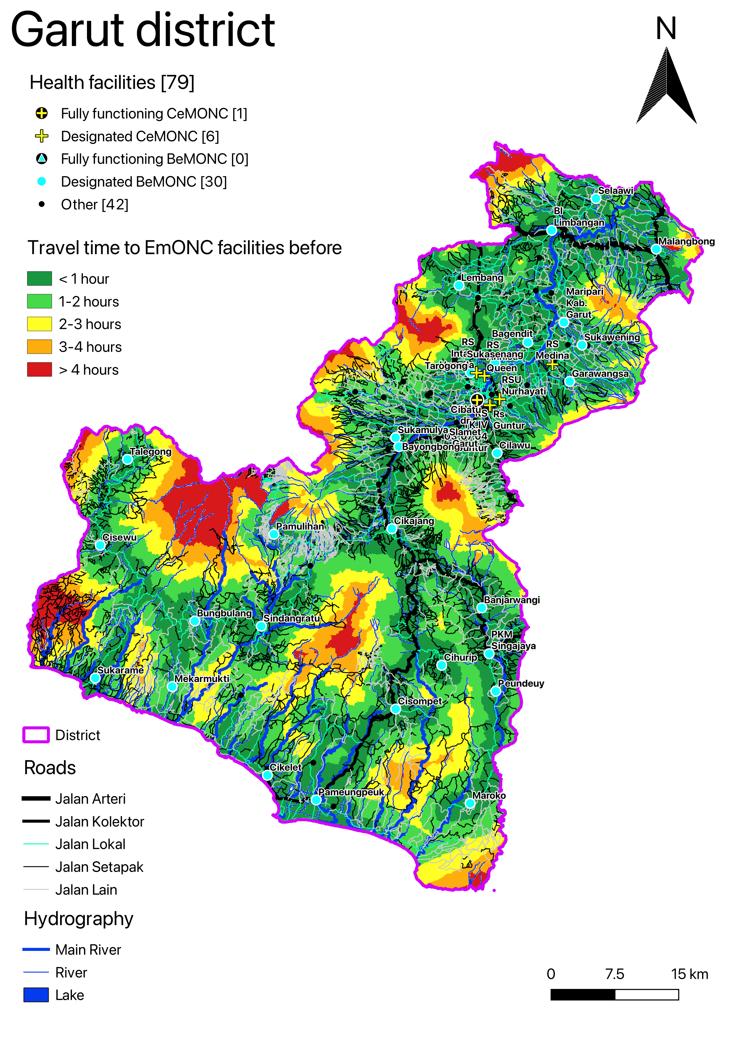


Planning - Prioritization of EmONC services (Indonesia)
Objective
Result
Prioritize health facilities to form a cost-efficient network of those providing EmONC services
Outcomes and benefits
Identification of the minimum set of EmONC facilities needed to still provide a good accessibility coverage within a given travel time
Identification of the areas where coverage remains limited and for which other strategies might need to be defined
Improved geospatial data that can be used by other programs
Reference: https://www.unfpa.org/featured-publication/implementation-manual-developing-national-network-maternity-units
Before prioritization (37 EmONC)
82.5% pop coverage in 1 hour
95% pop coverage in 2 hours
After prioritization (16 EmONC)
77% pop coverage in 1 hour
93% pop coverage in 2 hours
3

Slide 4
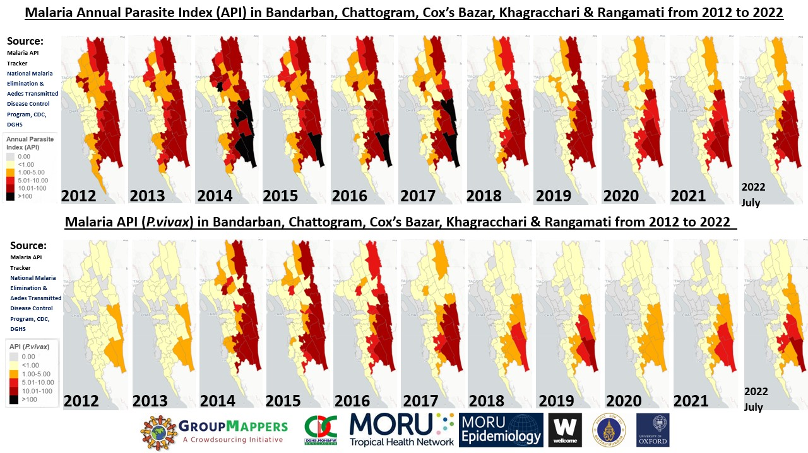
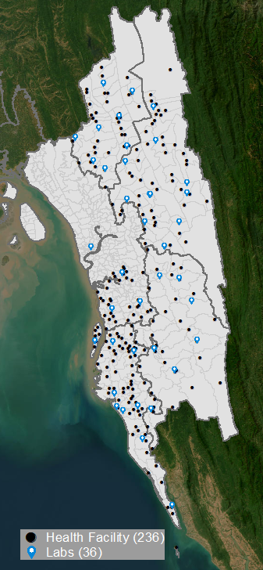
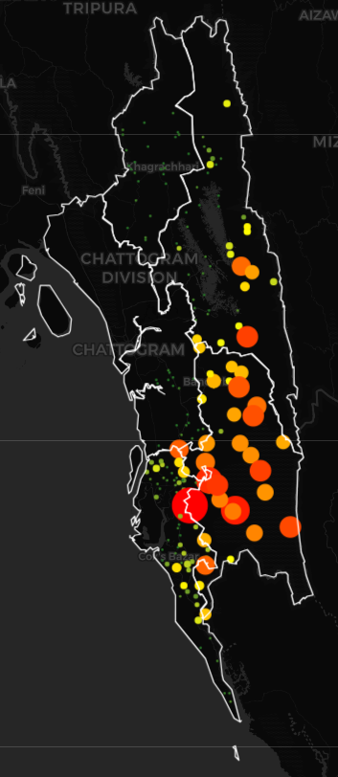
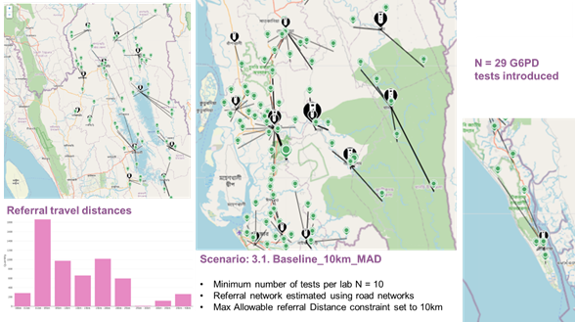



Planning - Diagnostic Network Optimization (DNO) (Bangladesh)
Objective
Introduce G6PD diagnosis​ that best uses available resources to​ optimise access to testing by P. vivax patients
Outcomes and benefits
Support the National Malaria Elimination Programme (NMEP) with the use of the OptiDx tool
Model the coverage and estimate the cost of different scenarios for introducing G6PD testing
Prepare DNO outputs that can be included into strategic and operational plans and funding proposals by NMEP
Demand
Results
4

Slide 5
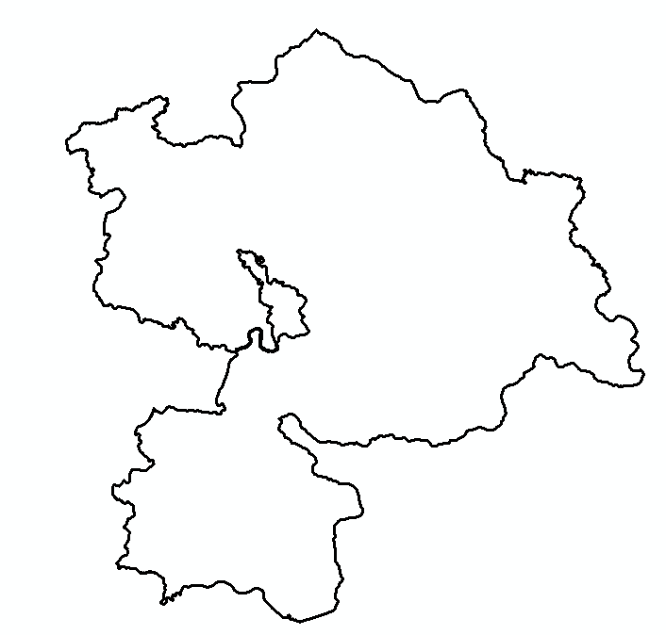
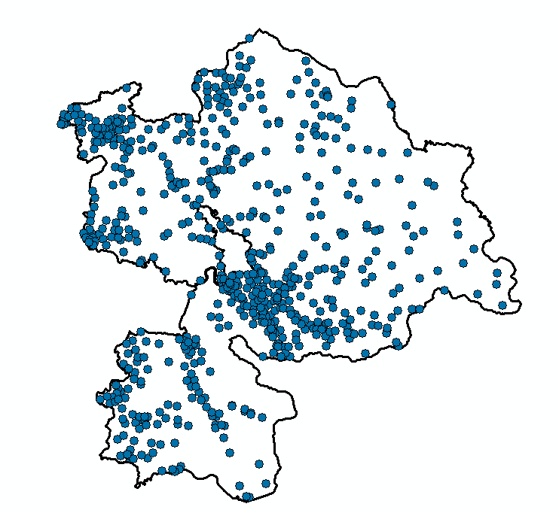
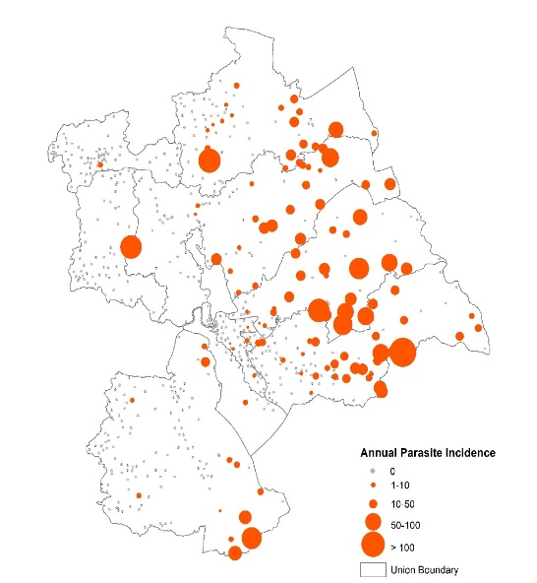
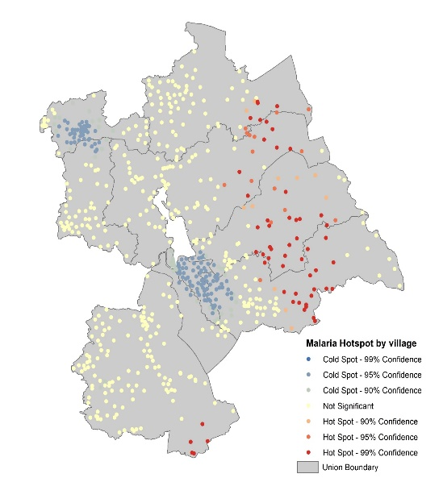

Communicable diseases - Malaria surveillance and risk mapping (Bangladesh)
Objective
Increase the granularity of malaria surveillance and risk mapping
Before 2023
Now
Outcomes and benefits
644 Settlements
Enhance malaria data by transitioning from the Upazila (sub-district) to the settlement level for fine scale malaria risk
Use of settlement level data to identify the geographic distribution of malaria hotspot
Accessibility analysis down to the settlement level to add access to malaria services in the risk estimation
Settlement level API mapping
Malaria hotspot map
Physical accessibility modeling
5

Slide 6
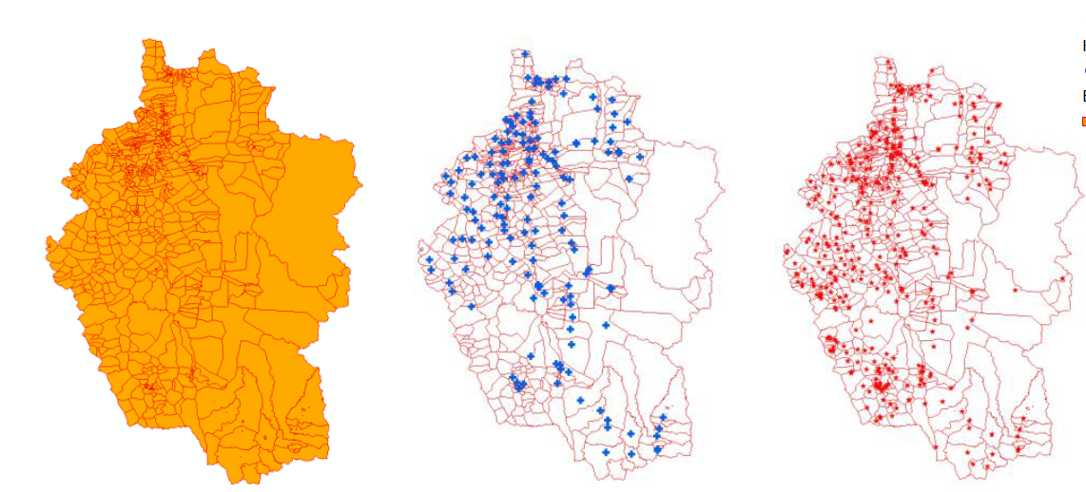
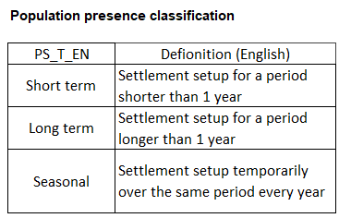
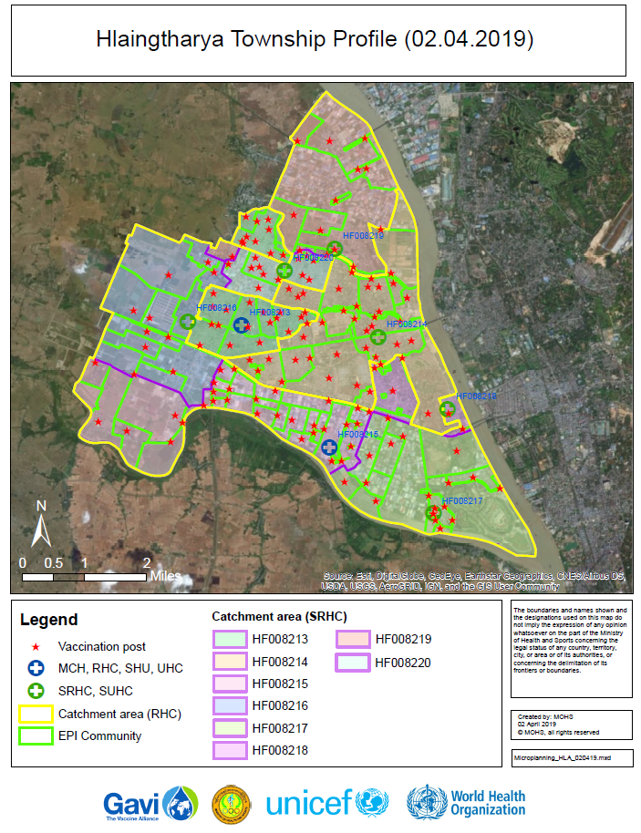

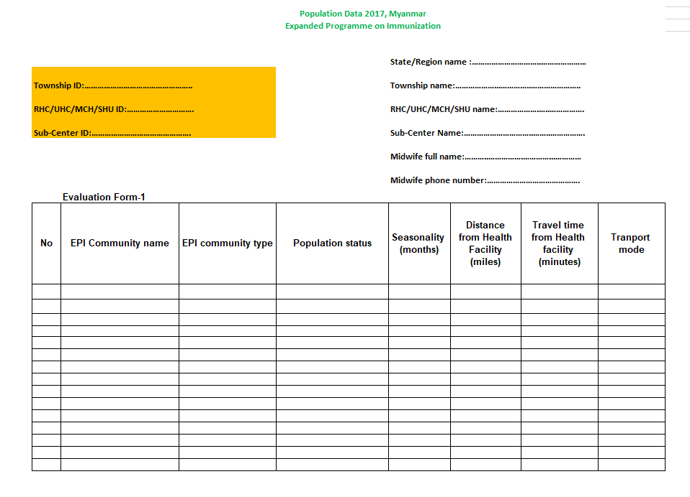
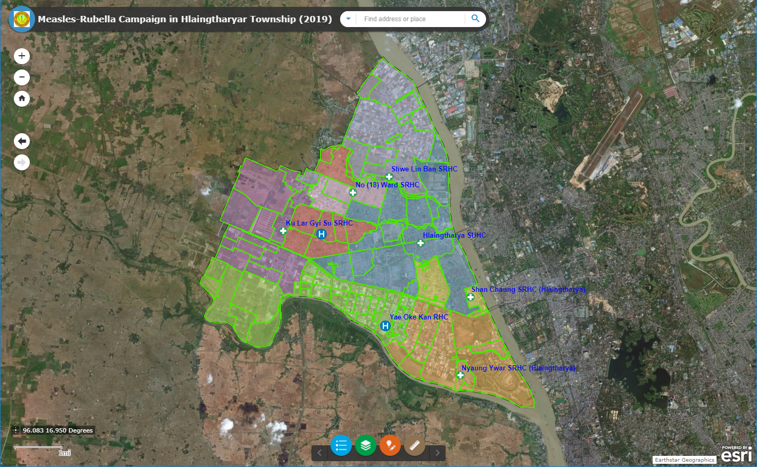
Immunization - Geo-enabled microplanning (Myanmar)
Objective
Result
Support routine immunization microplanning as well as monitoring and evaluation
Outcomes and benefits
New classification of EPI communities
Digital microplanning maps and improved routine immunization forms
Support comprehensive immunization campaigns
Updated georeferenced master list of health facilities, communities to support mutli-program implementation
New classification of EPI communities
Establish/updated/complete the master list of EPI communities, vaccination posts and health facilities with geographic extent or location
Digital microplanning maps (pdf and online)
Improved routine immunization forms
Reference: https://bit.ly/3vyUuNL
6

Slide 7
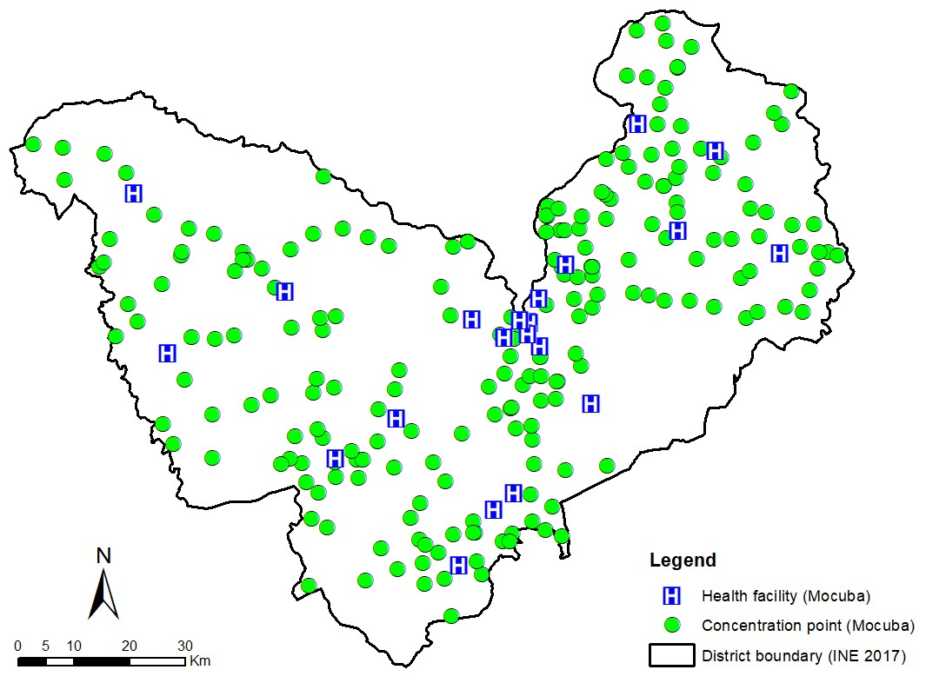
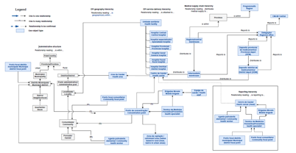
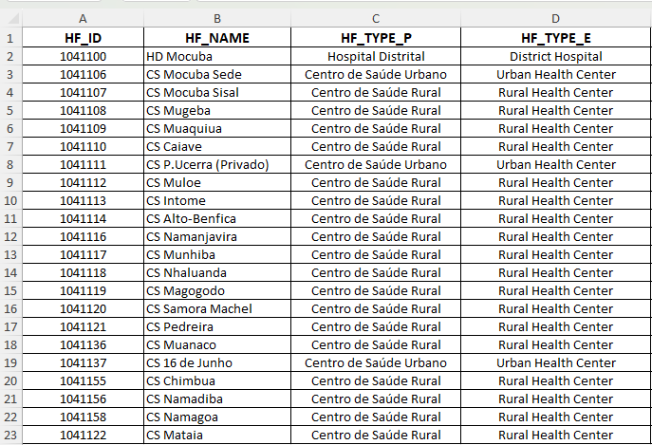
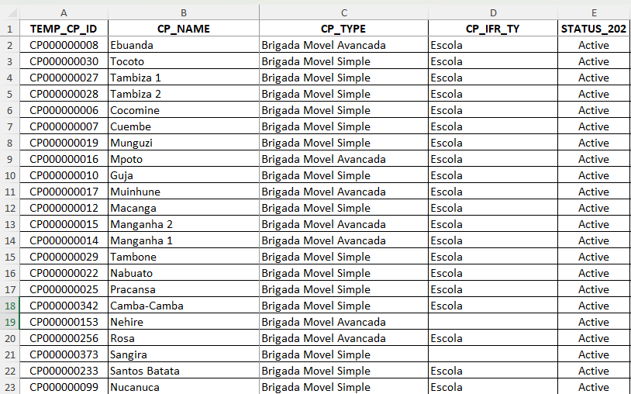
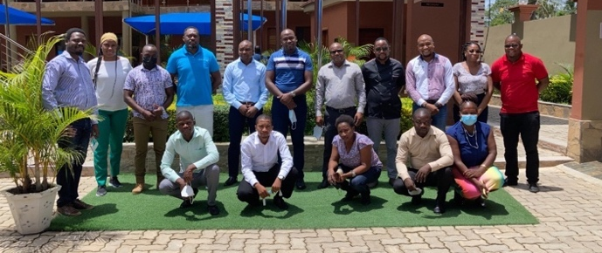
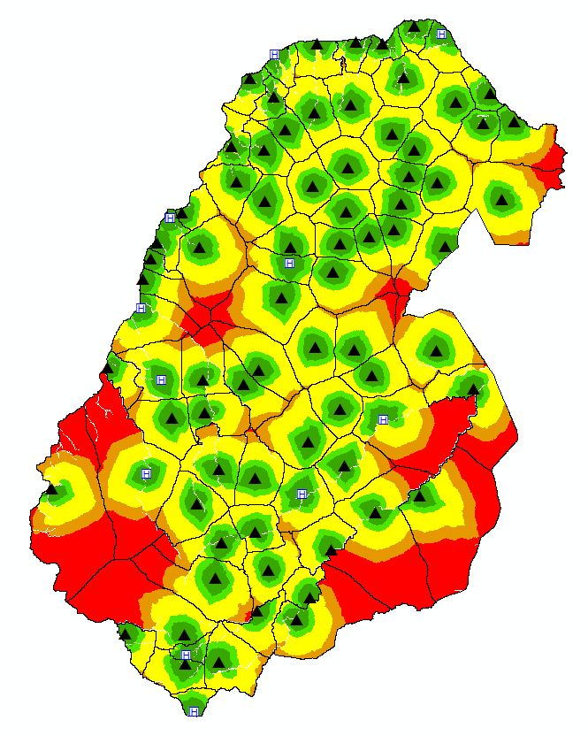
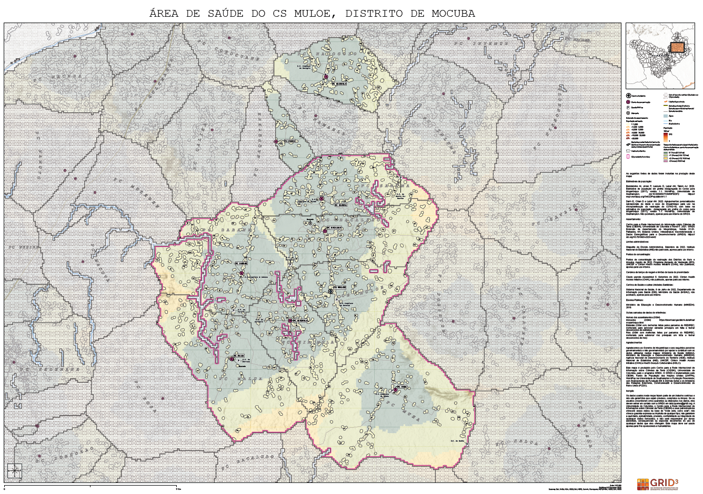
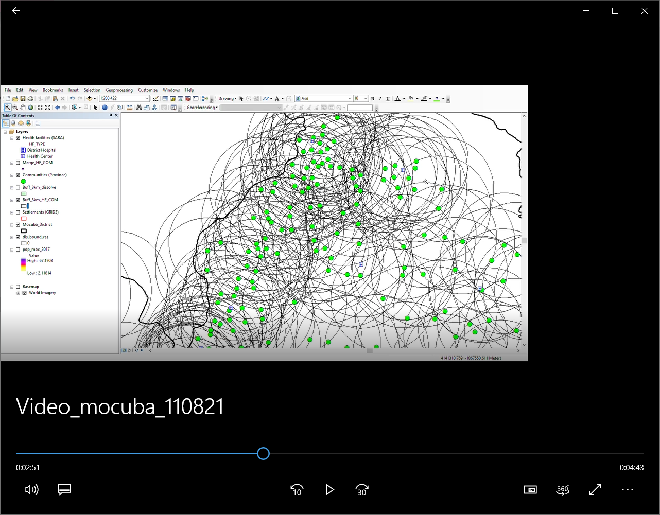
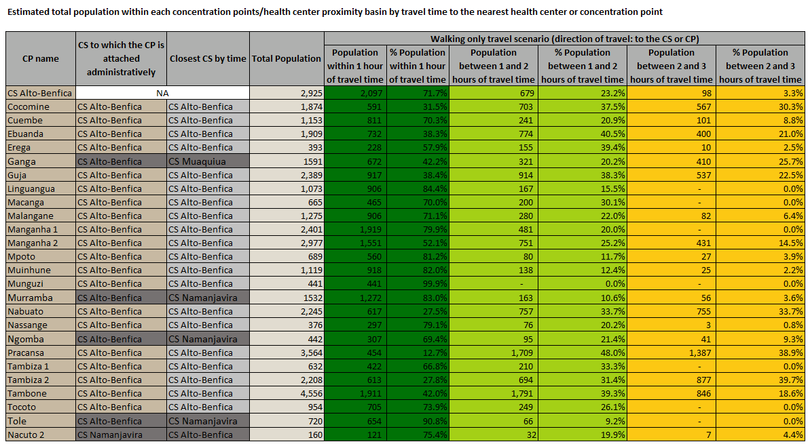
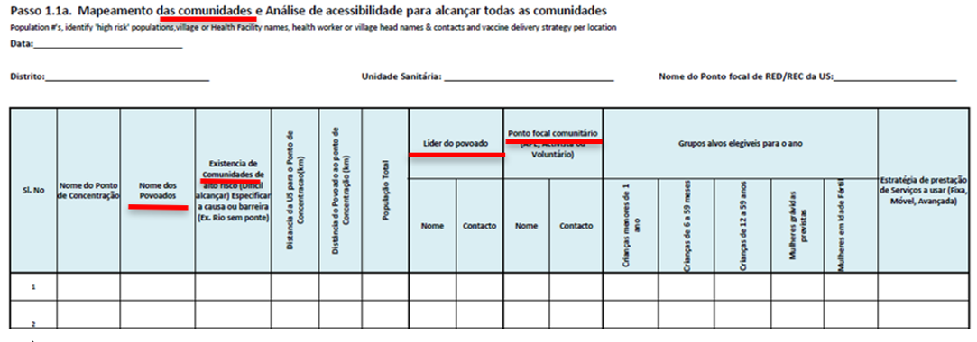
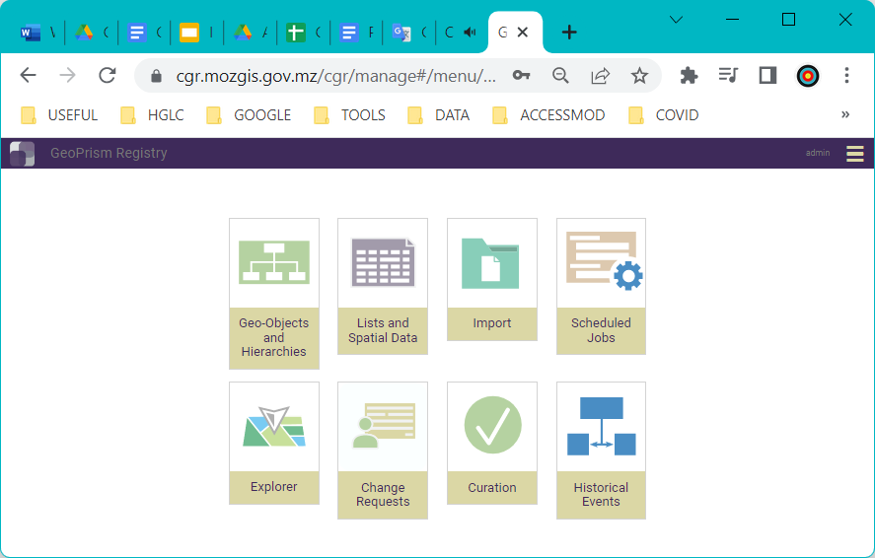
Immunization - Geo-enabled microplanning (Mozambique)
Objective
Result
Digitalize microplanning to enhance routine immunization
Outcomes and benefits
Improved understanding of the geographic context (data model and georeferenced master lists)
Improved method to estimate population coverage
Microplanning maps and population estimates for the optimization of the network of vaccination post
Adjustment of the microplanning process and forms
Improved data management practices and data storage and management platform
Immunization ecosystem data model
Georeferenced master list of health facilities and concentration points
Field data collection to collect geographic coordinates of health facilities and concentration points
Improved population coverage estimates
Microplanning maps and population estimates
Deployment of a Common Geo-Registry to host, maintain, regularly update and share master list and associated spatial data
Reference: https://tinyurl.com/537t343j
Adjusted microplanning forms
7

Slide 8
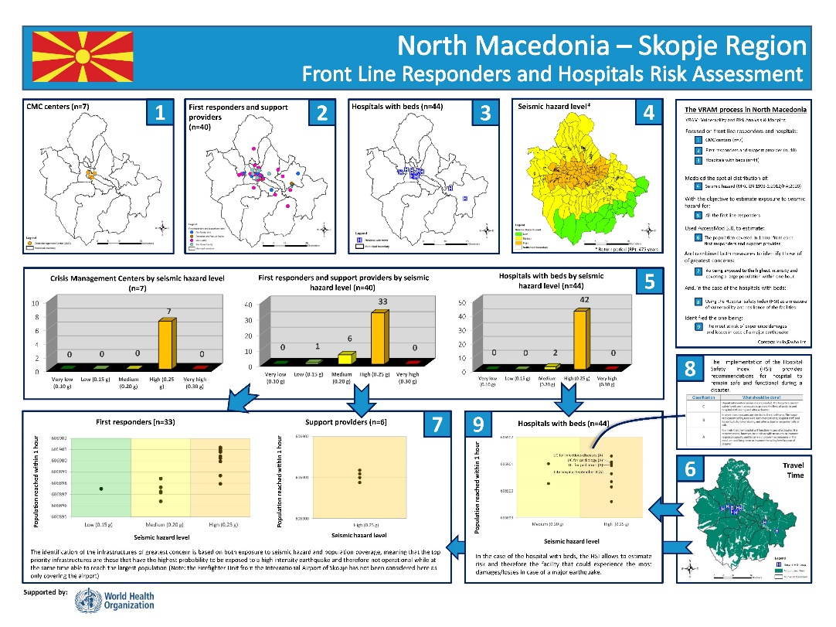
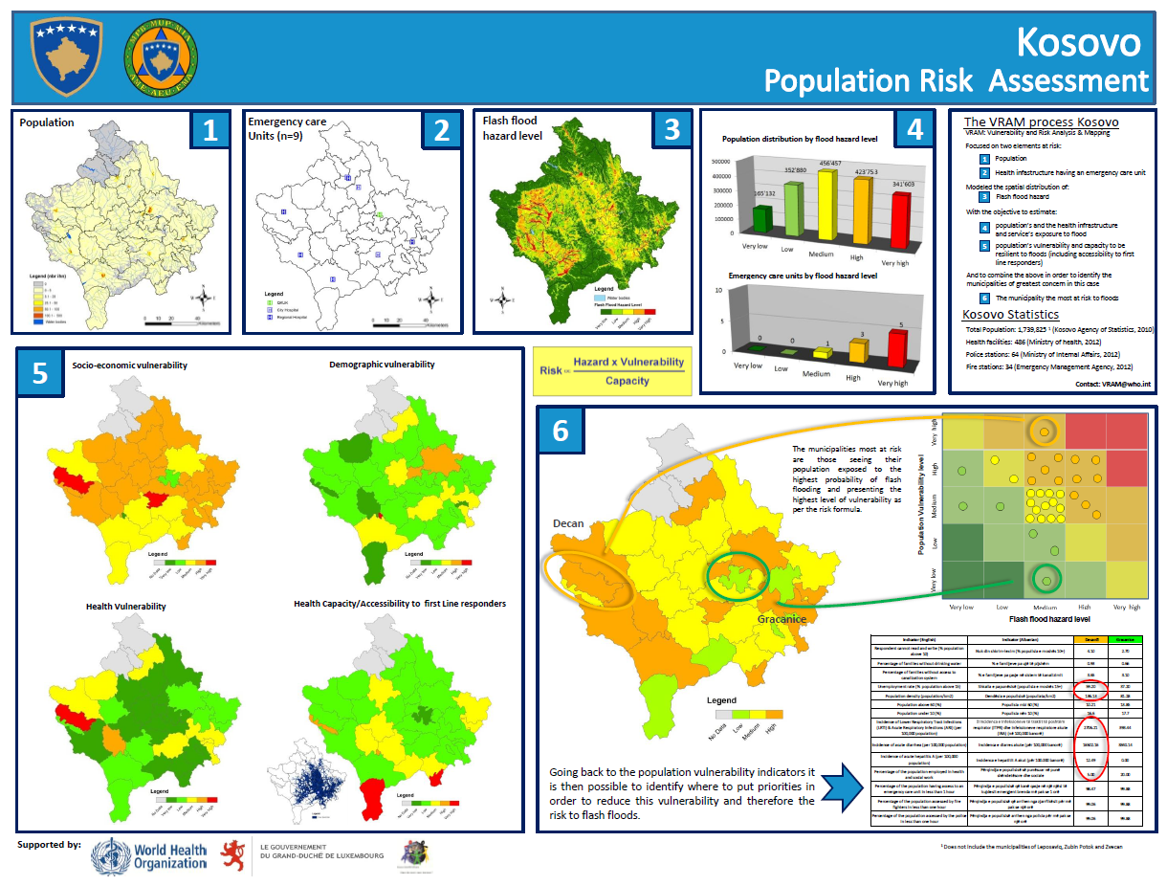
Emergency management - Vulnerability and risk analysis (North Macedonia)
Objective
Result
Support emergency preparedness of the health sector by identifying the population and infrastructures most at risk to experience losses or to be damaged during an emergency
Outcomes and benefits
Identification of the health facilities and other infrastructures that will most likely not be operational during a disaster
Identification the geographic area(s) in which the population is most at risk to experience significant losses
Support the development of the emergency preparedness and response plan
Reference: https://tinyurl.com/msafe4hj, https://tinyurl.com/2n7svyr4
8

Slide 9
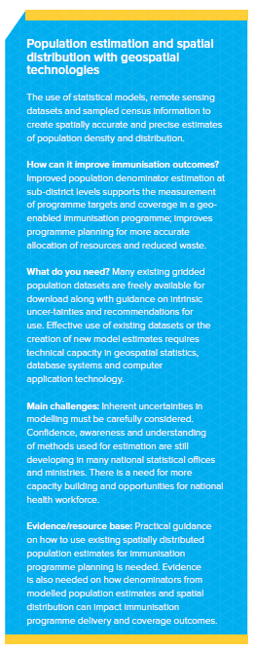
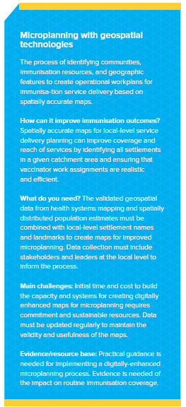
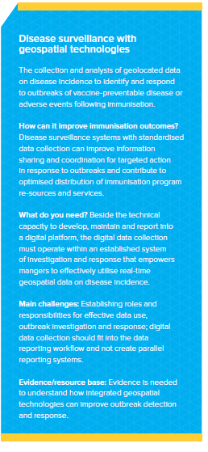
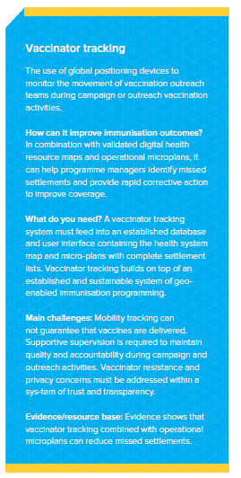
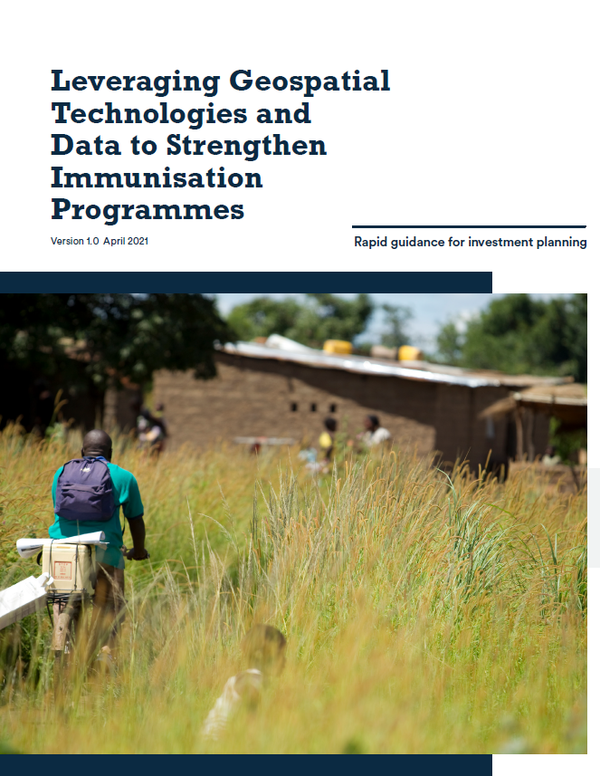
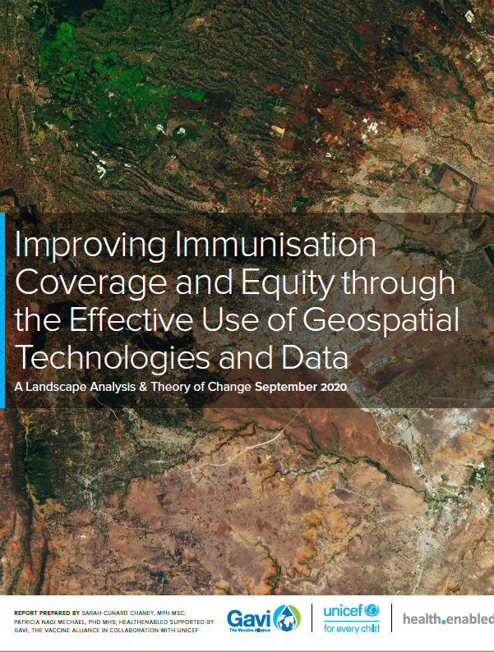
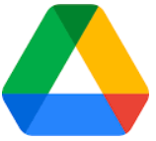
Other immunization related use case
https://healthgeolab.net//KNOW_REP/GIS-and-Immunisation-Landscape_EN.pdf
9

Slide 10
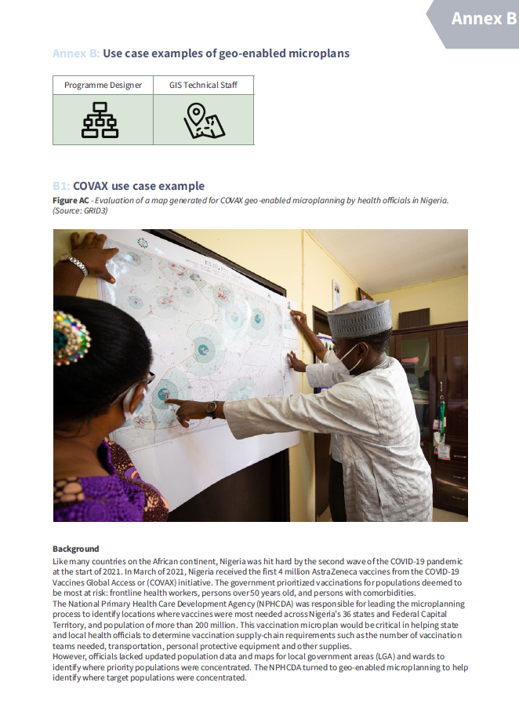
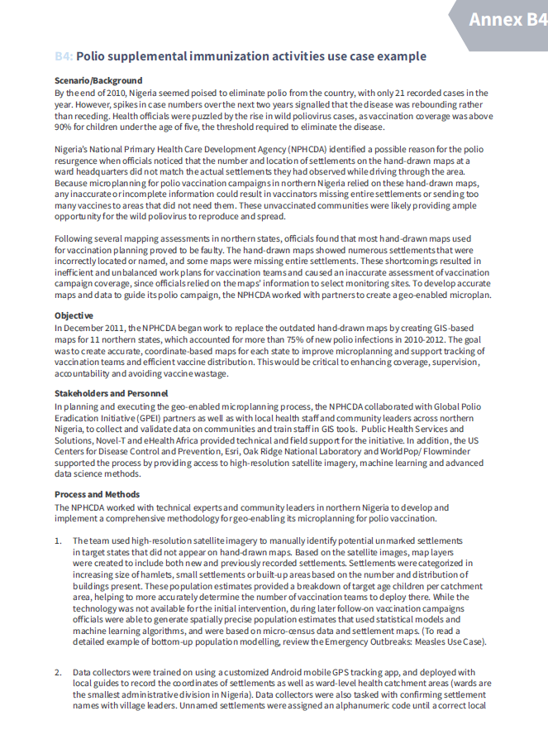

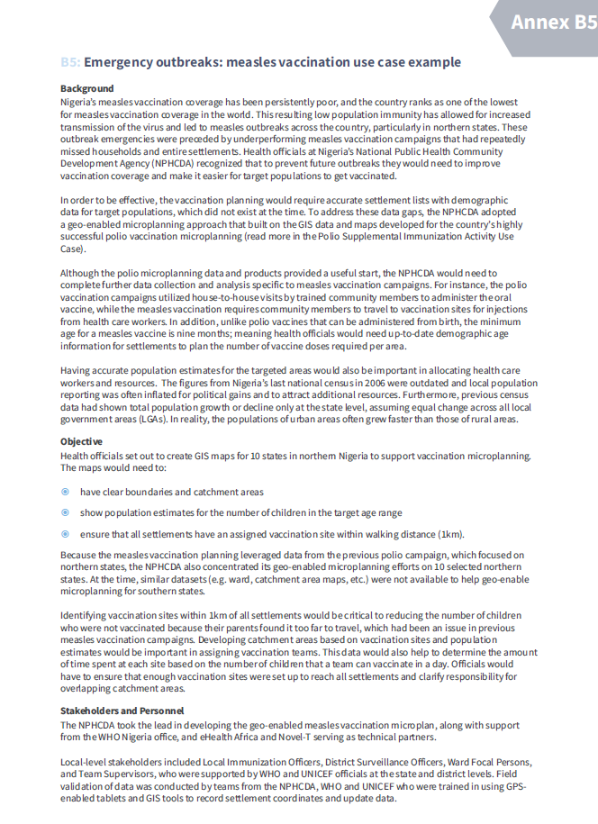
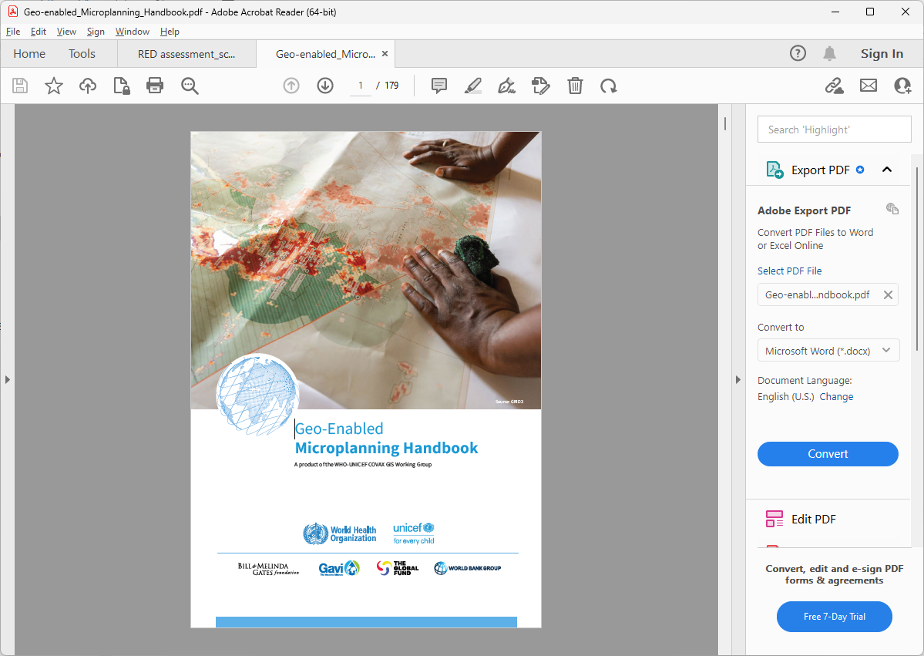
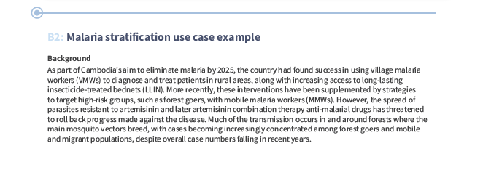
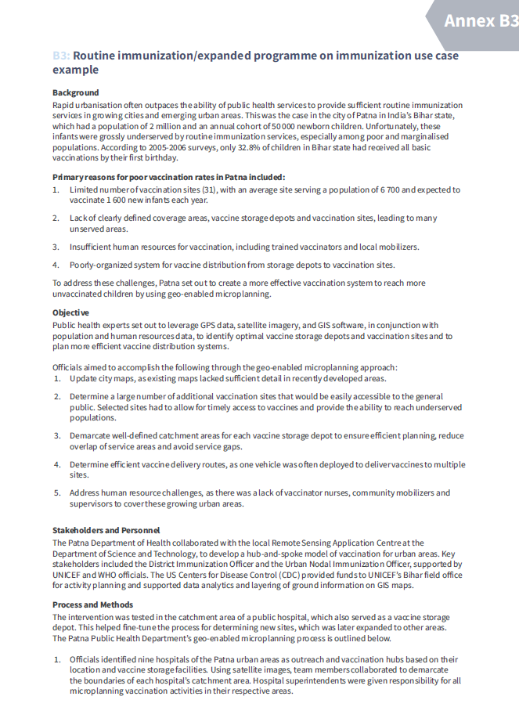
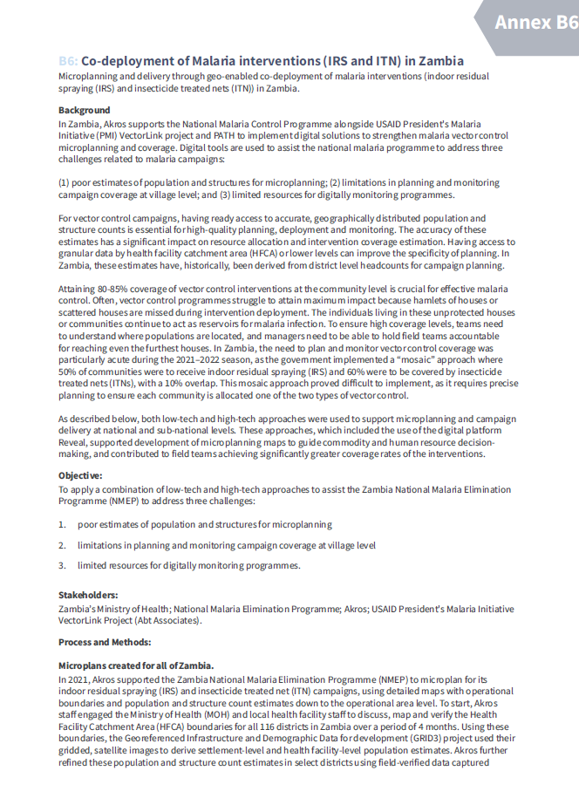

Other microplanning related use case
https://knowledge.unicef.org/resource/geo-enabled-microplanning-handbook
10

Slide 11







Other country specific use cases
Myanmar (https://arcg.is/OCHOz)
Cambodia (https://arcg.is/0uviGj)
Viet Nam (https://arcg.is/1XmLjy)
Mongolia
(https://arcg.is/1O0u4r)
11
11

