Slide 1

Introduction to geospatial data management
and technologies for Health Programs training workshop - Timor Leste
Session 3: Short introduction to the HIS geo-enabling framework and its implementation process in countries

Slide 2
A geo-enabled health information system
An Information System that fully benefits from the power of geography, geospatial data and geospatial technologies through the proper integration of the geographic and time dimensions across its business processes
Can you think about one piece of data or information within an HIS that has neither a geographic nor a time dimension?
" Everything happens somewhere
at a given time"
Properly integrating geography and time in the HIS improves geographically-based decision making and provides a more systemic and systematic approach to solving public health problems.
2
Directly applicable to any program or intervention
2

Slide 3
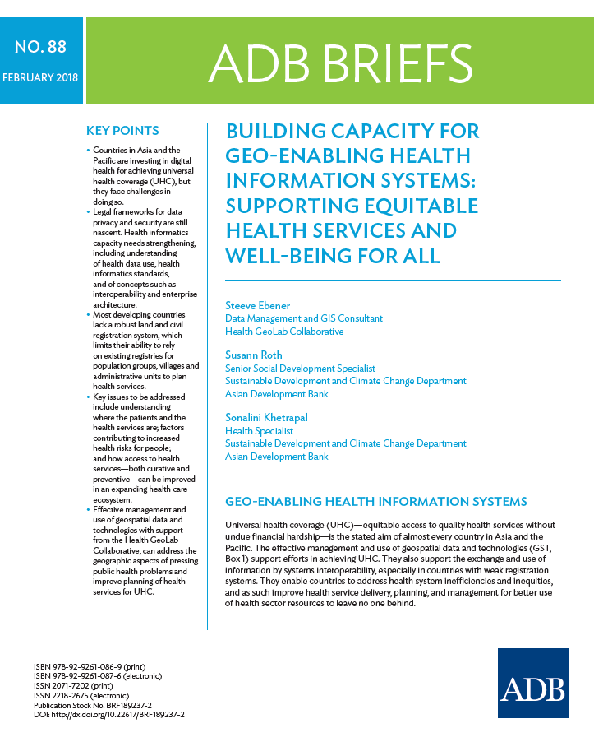
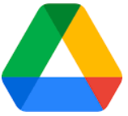
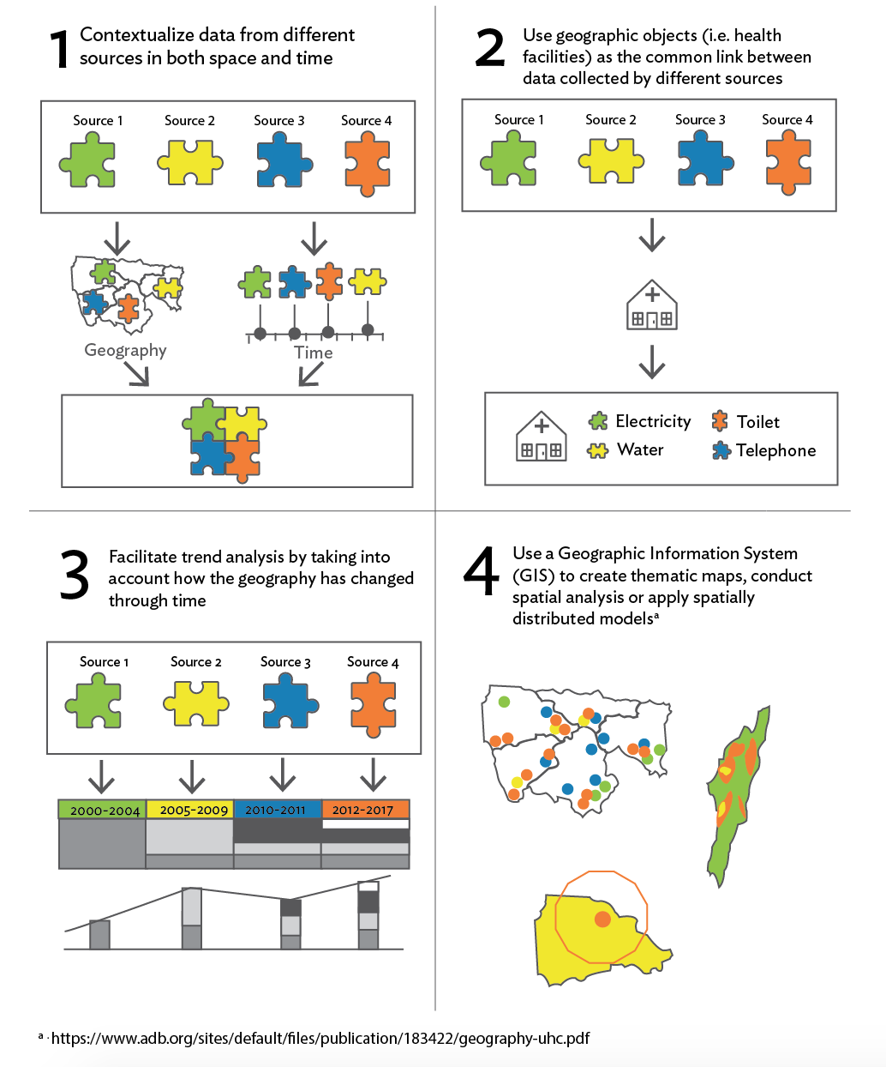
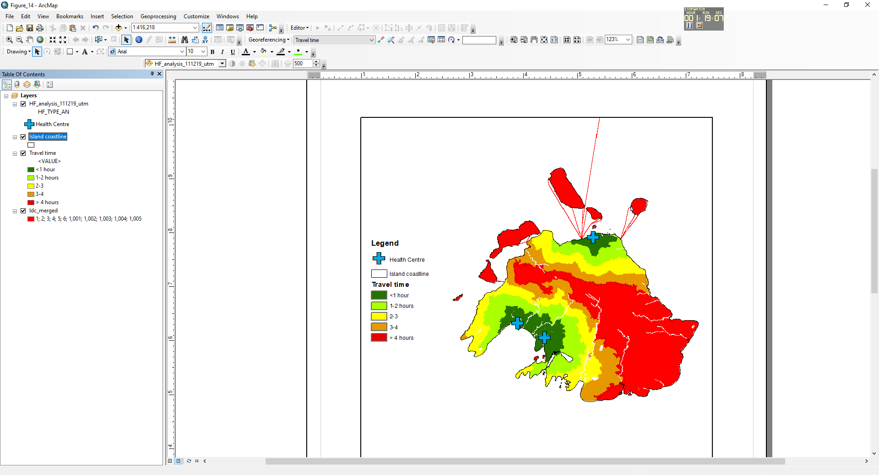
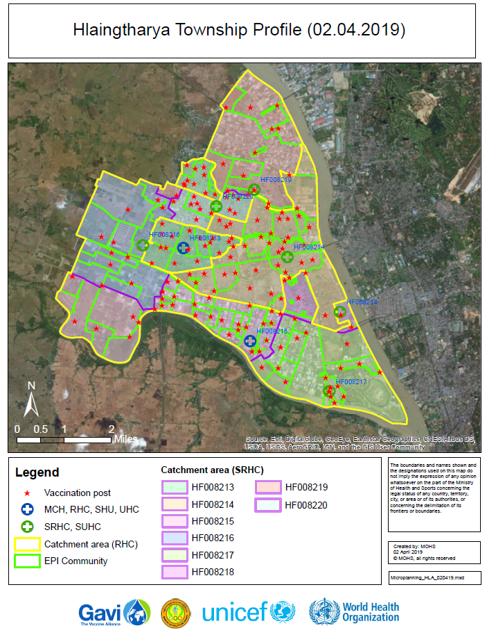
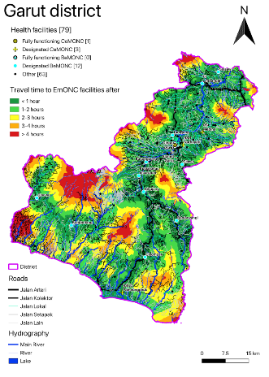
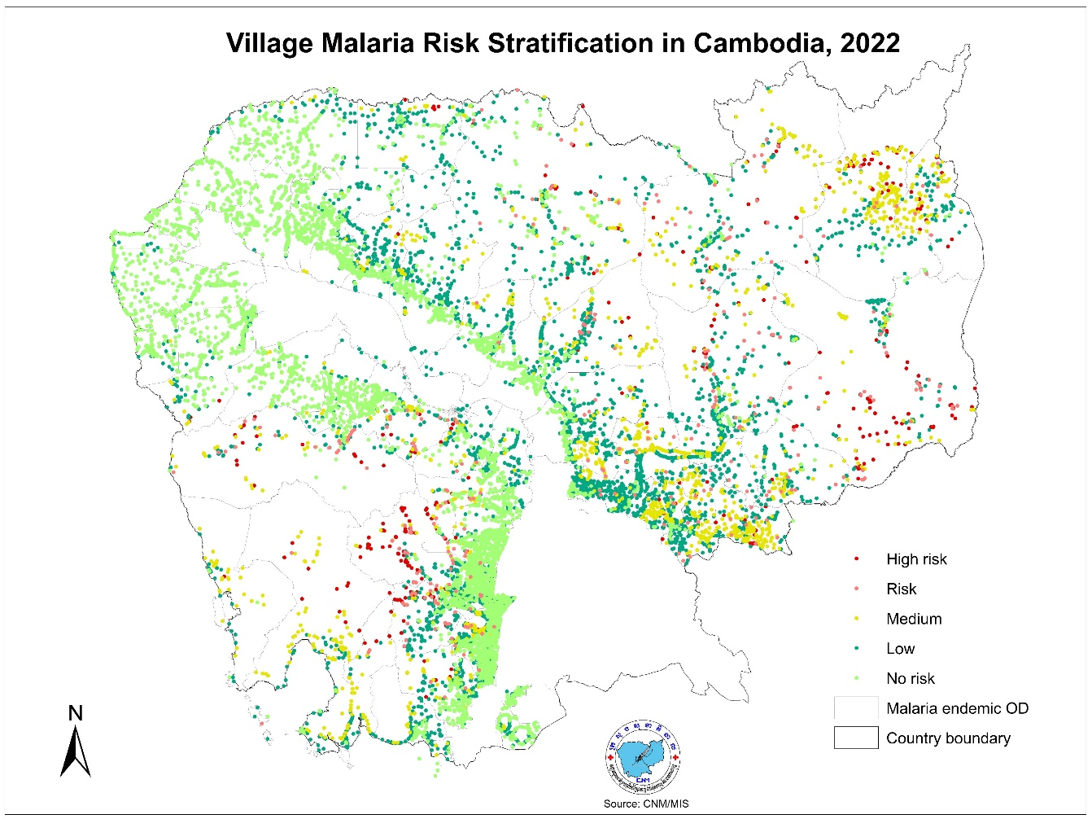
Benefits of a proper integration of the geographical and temporal dimensions in the HIS, a program or an intervention
1
Contextualize data from different sources in both space and time
Use geographic features (i.e. health facilities) as the common link between data collected by different sources
Facilitate trend analysis by taking into account how geography is evolving through time
Use a geographic information system (GIS) to create thematic maps, conduct spatial analyses, or apply spatially distributed models
How do you benefit from this in a sustainable way?
By geo-enabling the health information system, programs or interventions
¹ https://www.adb.org/publications/building-capacity-geo-enabling-health-information-systems
3

Slide 4
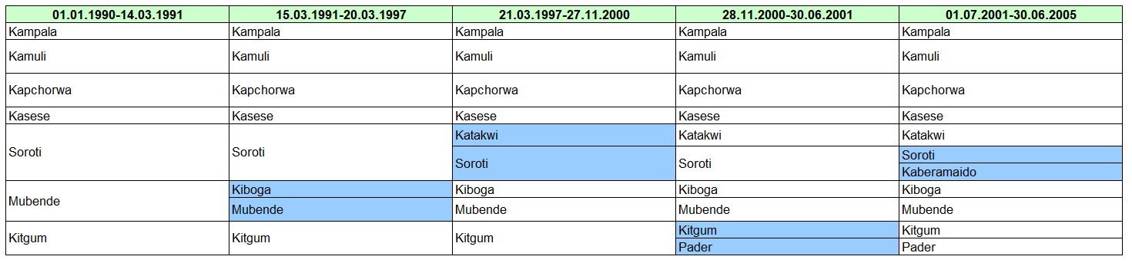
A geo-enabled health information system
  Importance of simultaneously managing the geographic and temporal dimensions
Uganda
Geography changes continuously over time and at a different “speed” depending on the geographic feature being considered
4
https://salb.un.org/en
4

Slide 5

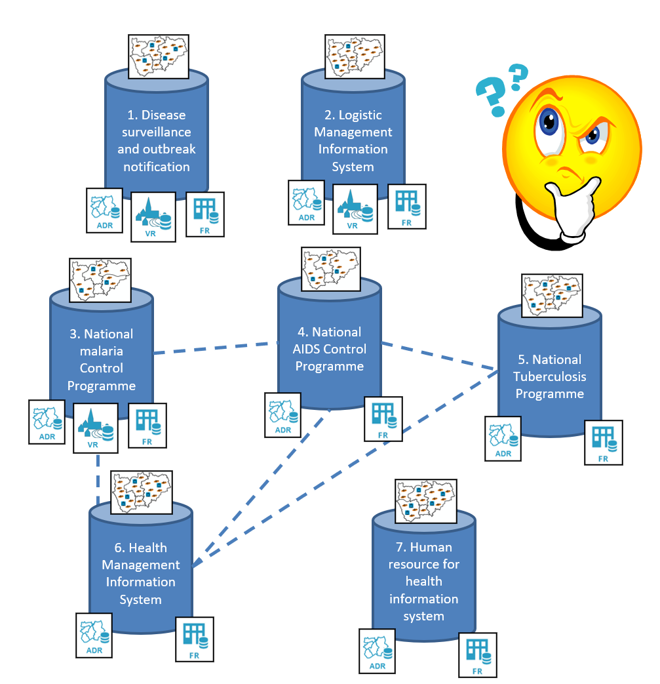
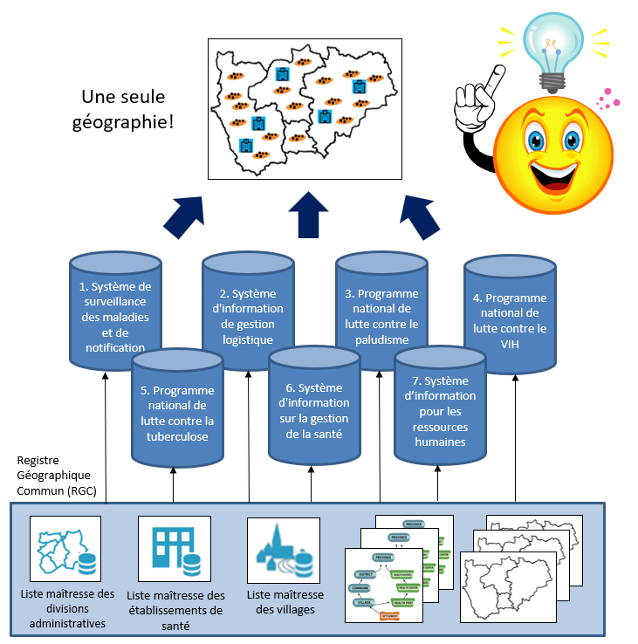
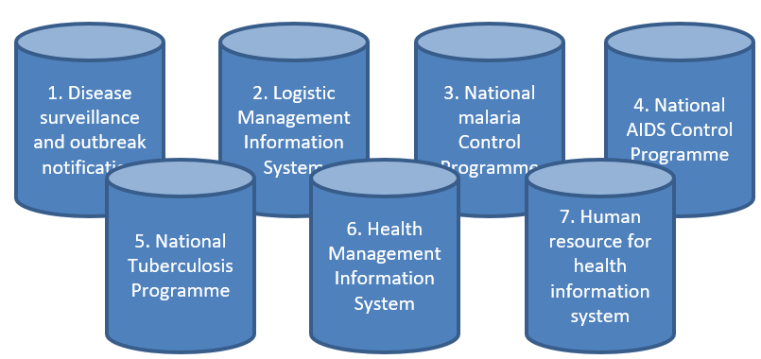
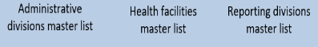
The vision behind the geo-enablement of the HIS
Passing from this …
… to this
One Geography!
Common Geo-Registry (CGR)
Each information system maintains and uses a different geography which is not cost-effective and does not allow benefiting from the power of geography, geospatial data and technologies
All information systems use the same geography over time, which not only reduces duplication of effort and costs, but also takes full advantage of the power of geography, geospatial data and technologies
5

Slide 6
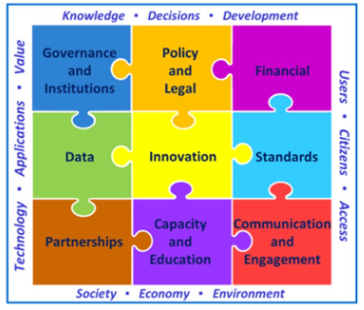
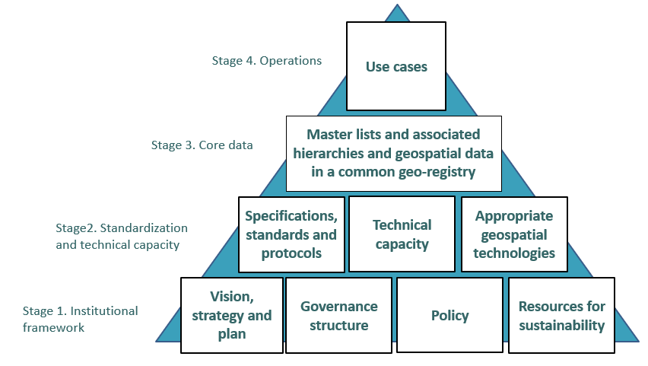
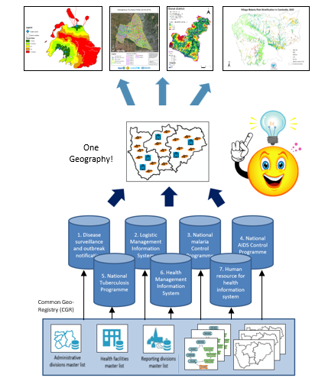
The HIS geo-enabling framework
9 elements that must be in place and sustained over the long term for a HIS, a program or an intervention to be considered geo-enabled
Aligned with the United Nations Integrated Geospatial Information Framework (UN-IGIF) – Cross sectoral framework
Each stage supports the next one towards an operational use of geography, geospatial data and technologies to support the implementation of health programs
6

Slide 7
The HIS geo-enabling framework
The place of the 5 main applications of geospatial data and technologies
Thematic mapping
Population estimation and spatial distribution
Geographic accessibility, service localization, and route optimization modeling
Georeferenced Master Lists
Navigation, tracking and geographic coordinate collection using a GNSS
Apart from the georeferenced master lists and the collection of geographic coordinates which are also key to the core data stage of the framework, all these application are enabling the use cases
7

Slide 8
The HIS geo-enabling framework
A Clear vision, strategy, and action plan for the management and use of geospatial data and technologies have been defined.
A governance structure supporting the vision, strategy, and action plan has been established.
Sufficient technical capacity has been developed to support the proper management and use of geospatial data and technologies.
Geospatial data specifications, standards, and protocols have been defined and are being implemented to ensure the availability and quality (completeness, uniqueness, timeliness, validity, accuracy, and consistency) of geographic information across the whole data lifecycle.
The master lists for the core geographic objects (health facilities, administrative divisions and villages, and reporting divisions) and their associated hierarchies and geospatial data have been developed, made accessible, and an updating mechanism put in place for each of them using a common geo-registry.
The appropriate geospatial technologies have been identified and are being used in accordance with good geospatial data management practices.
Use cases (applications) supporting health programs (communicable diseases surveillance, malaria elimination, health service coverage, disaster management, etc.) towards reaching SDG 3 are being implemented and documented.
Policies supporting and enforcing all the above as well as geospatial data accessibility have been released.
The necessary resources to ensure long term sustainability have been identified and secured.
8

Slide 9
The HIS geo-enabling framework - Origin
1
Situation in countries of the Asia-Pacific region (2017)
Has received a GIS training (mainly in data collection and thematic mapping)
Has access to a GIS software
Generates thematic maps, but spatial analysis and modelling are very limited
Important gaps for the elements guaranteeing the quality, effectiveness and long-term sustainability of data and information products
9
9
¹ Source: https://www.adb.org/publications/building-capacity-geo-enabling-health-information-systems
9

Slide 10
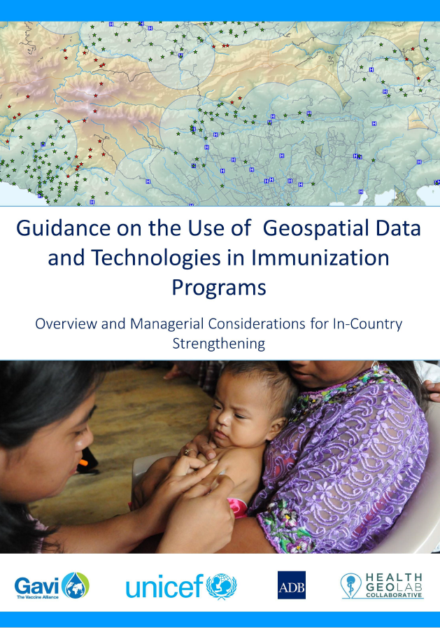


Guidelines including/based on the HIS geo-enabling framework
2018
2021
2023
Framework used by UNICEF, GAVI, WHO and the Global Fund to support the management and use of geospatial data and technologies in countries.
1 https://www.unicef.org/media/58181/file
2 https://www.gavi.org/news/document-library/leveraging-geospatial-technologies-and-data-strengthen-immunisation
3 https://drive.google.com/file/d/1jj779zww4herWOESAd9mXqVE1YfQehtH/view?usp=sharing
10

Slide 11
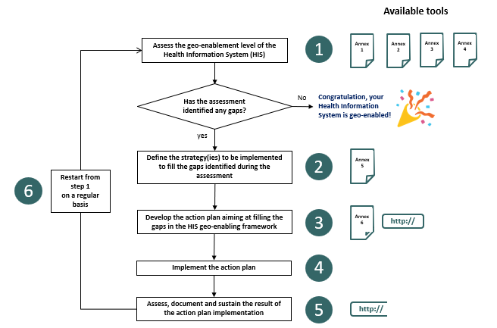
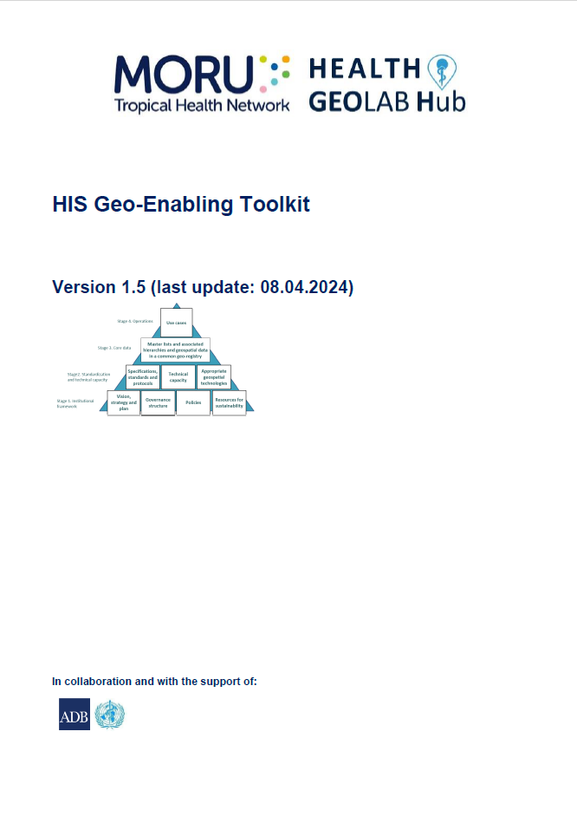
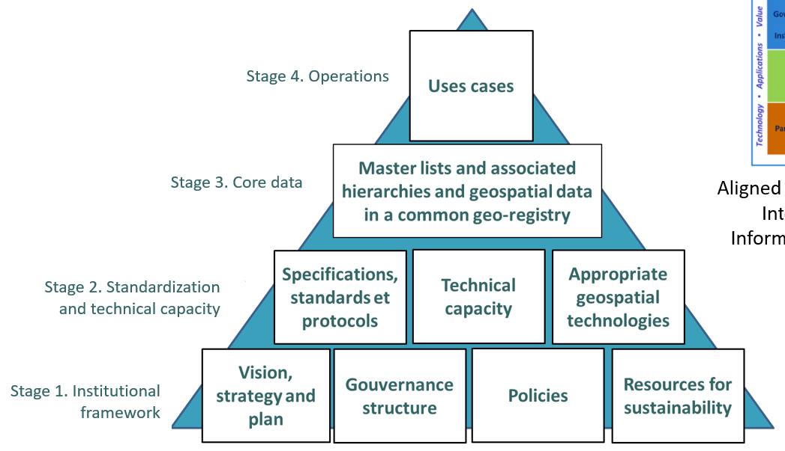
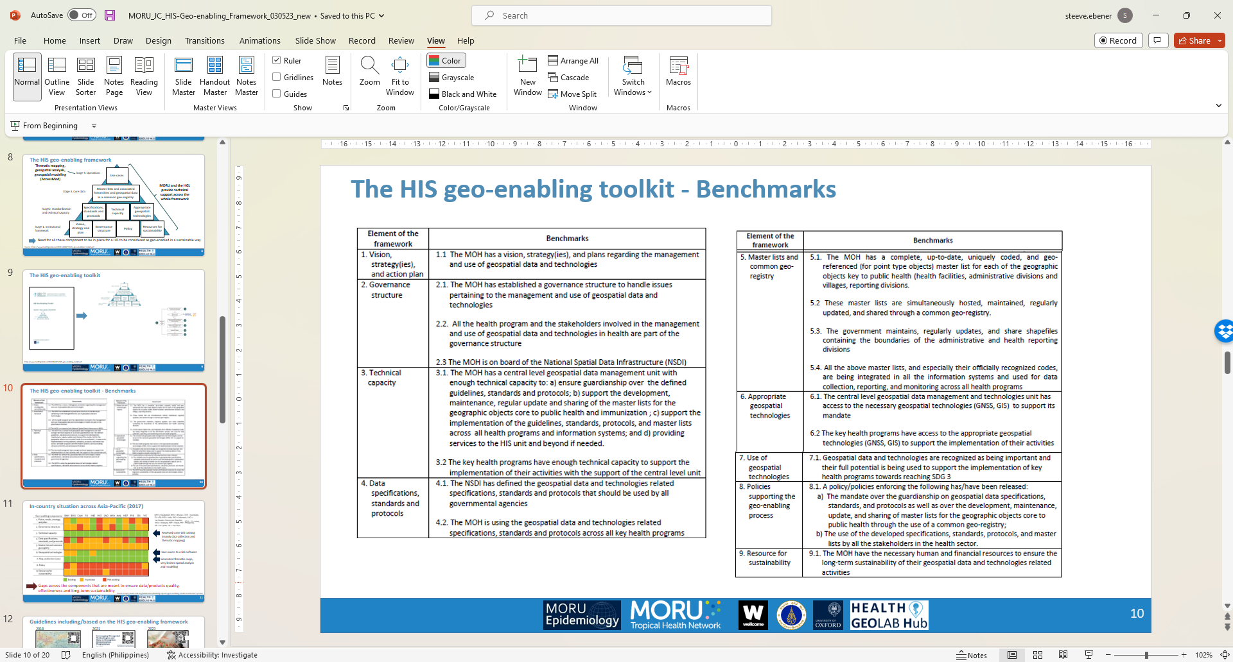
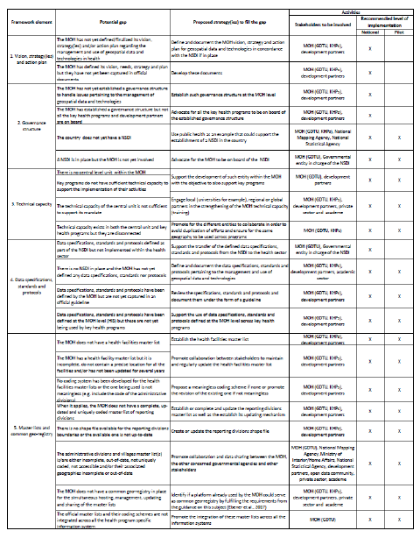
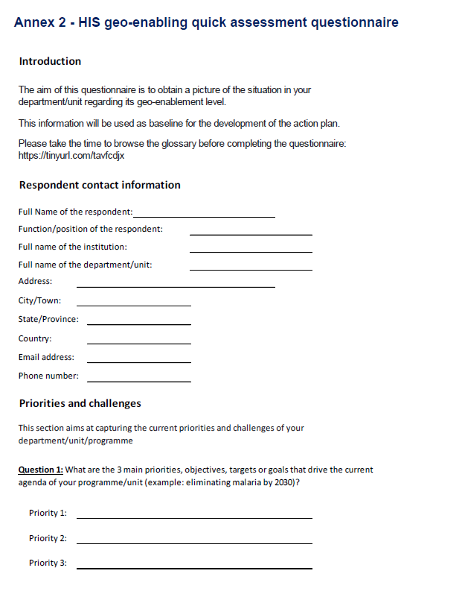
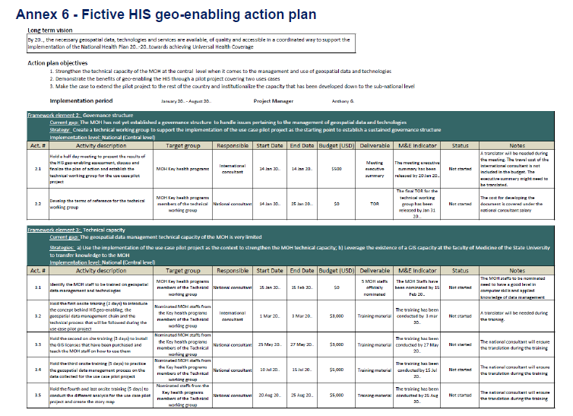
The HIS Geo-enabling toolkit
Designed to help countries assess their level of HIS geo-enabling and develop the action plan aimed at filling the identified gaps
HIS geo-enabling framework pyramid
Implementation process and associated materials
Benchmarks
HIS Geo-enabling quick assessment questionnaire
Strategies, stakeholder engagement and level of implementation to address existing gaps
Action plan template
¹ https://www.healthgeolab.net/DOCUMENTS/HIS_geo-enabling_toolkit.pdf
11

Slide 12
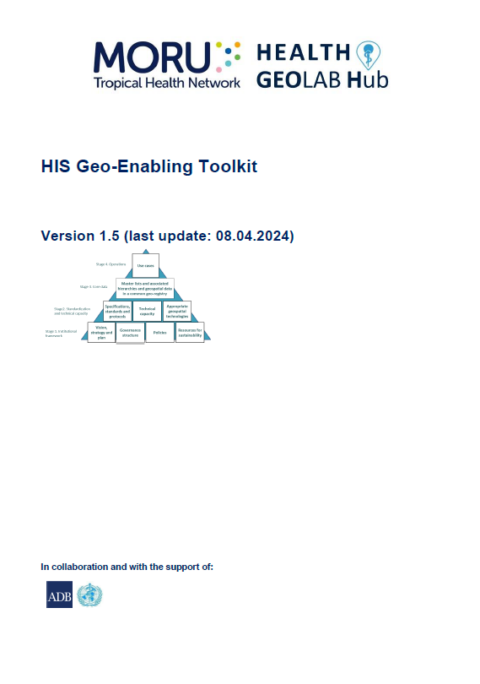
HIS Geo-enabling framework implementation process
To achieve the benchmarks of the HIS geo-enabling framework, it is necessary to follow a six-step process described in the HIS geo-enabling toolkit:
Step 1 : Assess the level of geo-enablement of the health information system
Step 2 : Define the strategy(ies) to be implemented to fill the gaps identified
during the assessment
Step 3 : Develop the action plan aiming at filling the gaps in the HIS geo-enabling framework
Step 4 : Implement the action plan
Step 5 : Assess, document and sustain the result of the action plan implementation
Step 6 : Restart from step 1 on a regular basis
http://www.healthgeolab.net/DOCUMENTS/HIS_geo-enabling_toolkit.pdf
12

Slide 13

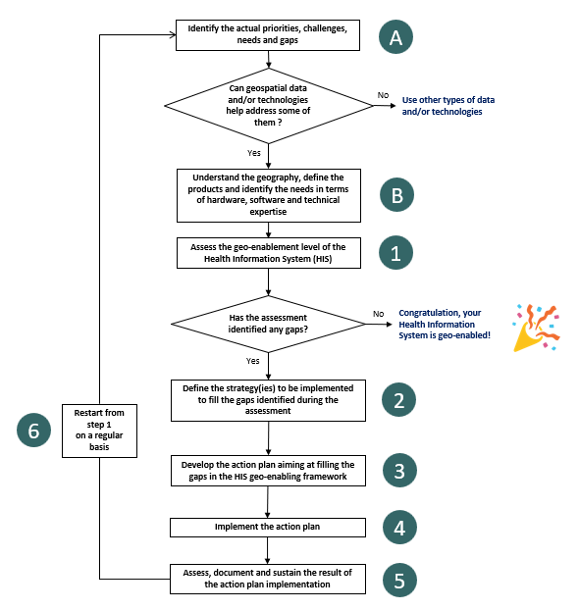

The HIS Geo-enabling toolkit – Implementation process
Geo-enabling a program or intervention
Geo-enabling the HIS
Two additional steps at the beginning of the process
Loop in both cases
UNICEF regional training workshop material
13

Slide 14







Example of in-country implementation
Myanmar (https://arcg.is/OCHOz)
Cambodia (https://arcg.is/0uviGj)
Viet Nam (https://arcg.is/1XmLjy)
Mongolia
(https://arcg.is/1O0u4r)
14
14

