Slide 1

Introduction to geospatial data management
and technologies for Health Programs training workshop - Timor Leste
Session 4: Understand the geography of a program or intervention

Slide 2
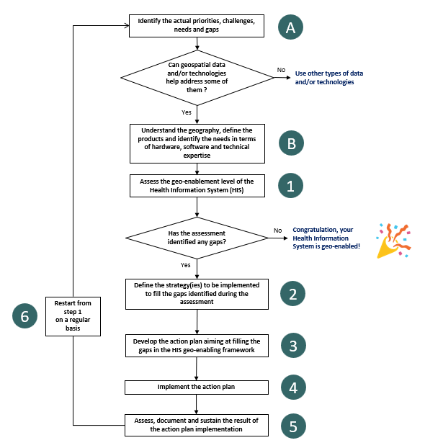
HIS Geo-enabling framework implementation process
Step B : Understand the geography, define the products and identify the needs
2

Slide 3
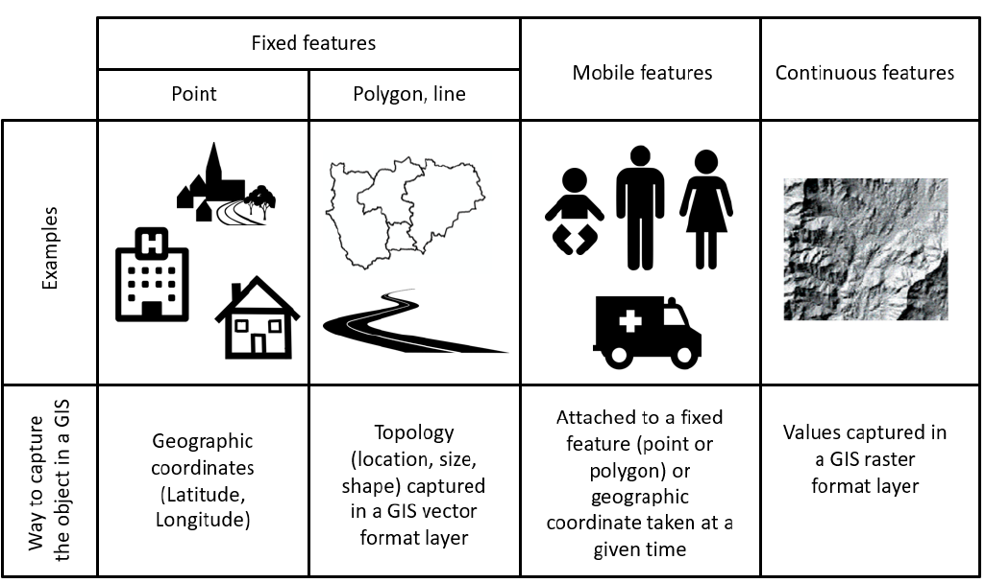
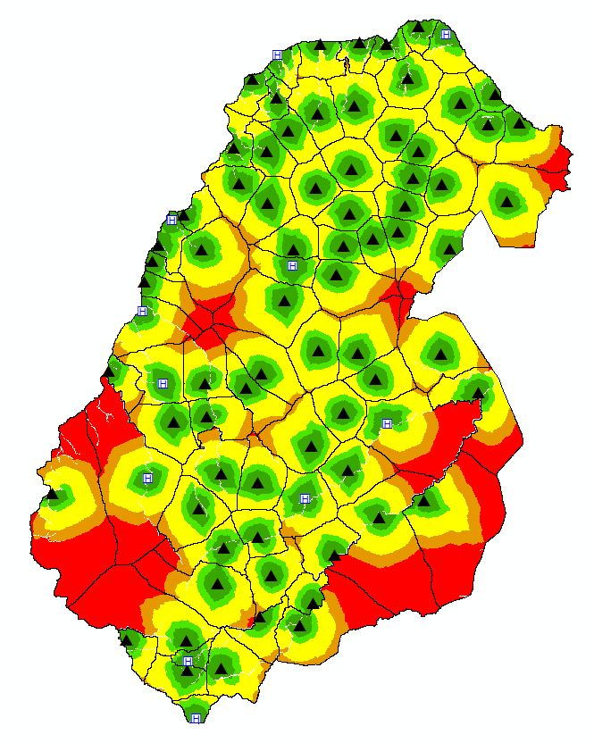
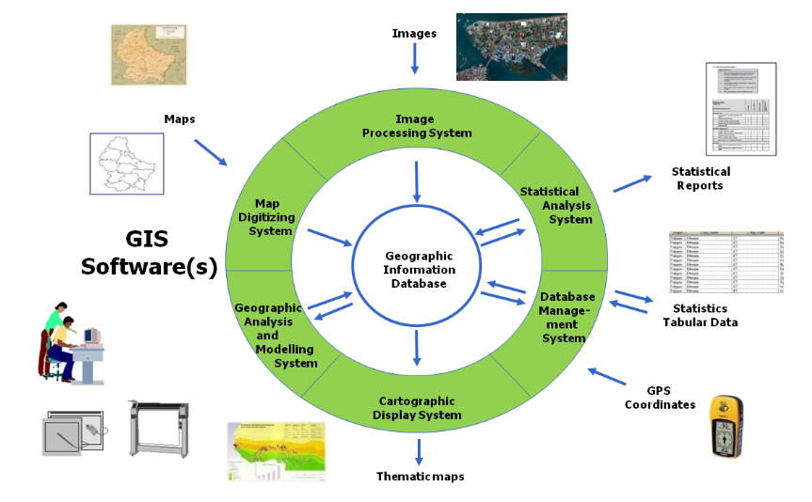
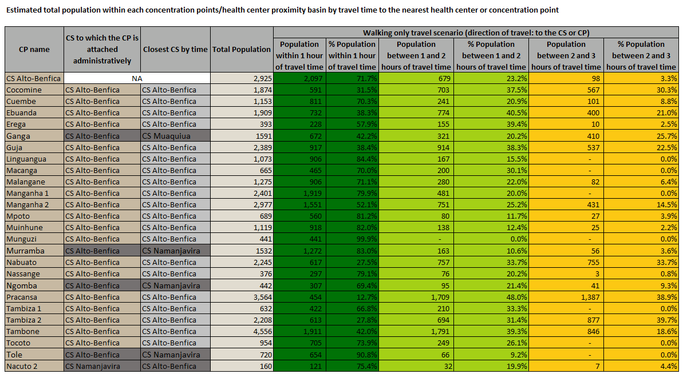
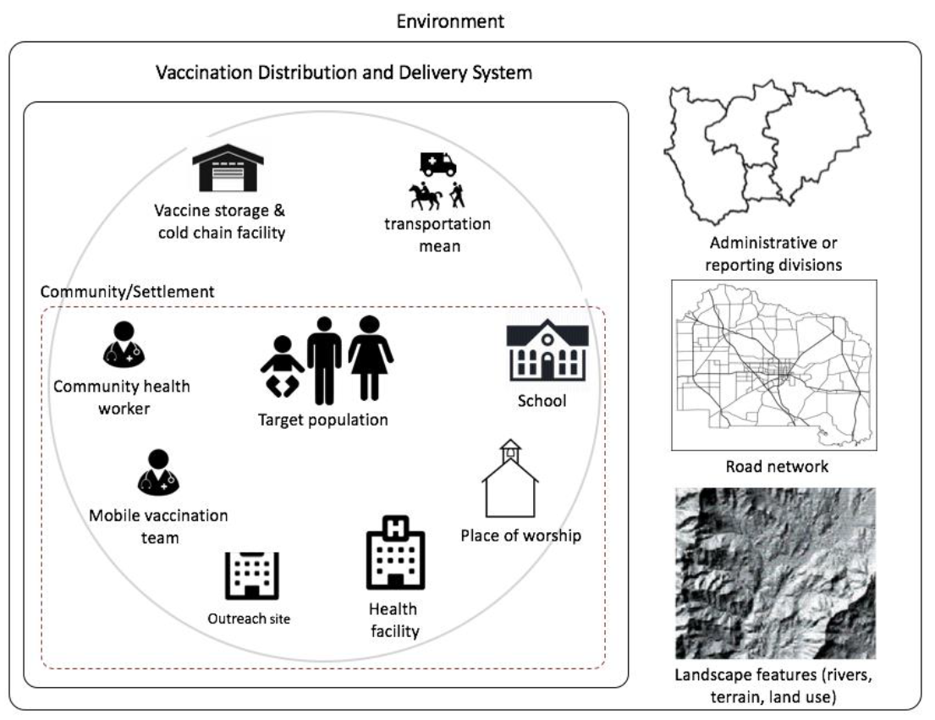
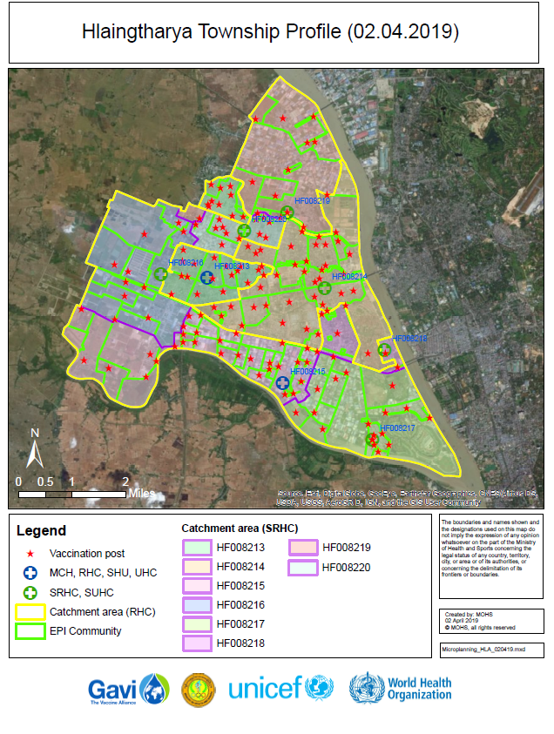
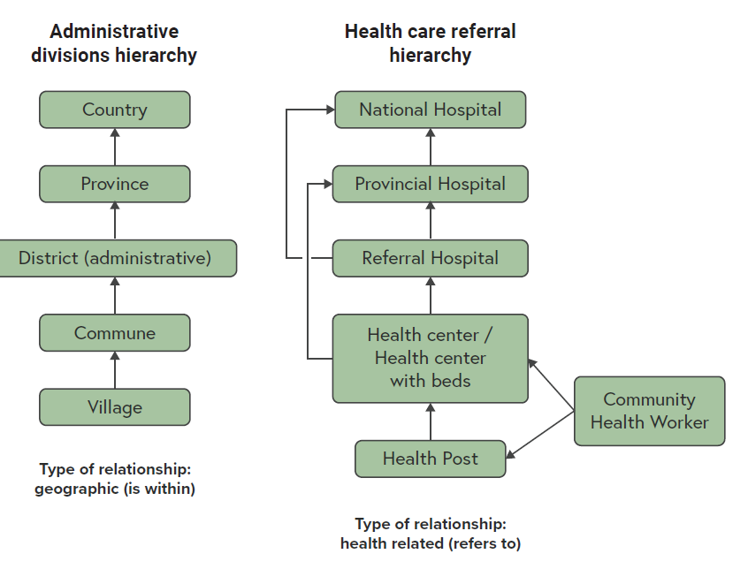
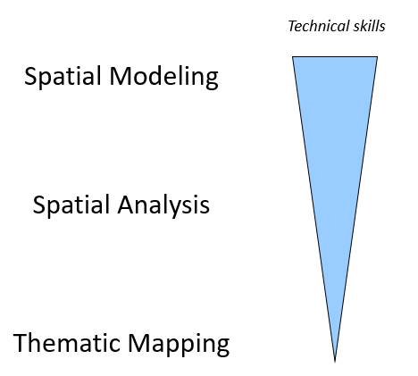
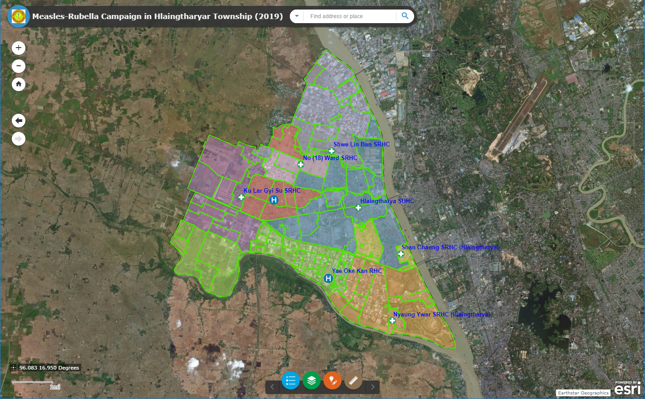
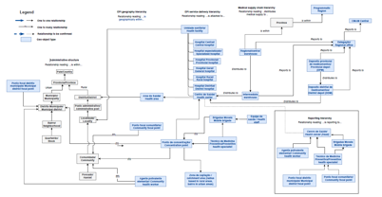
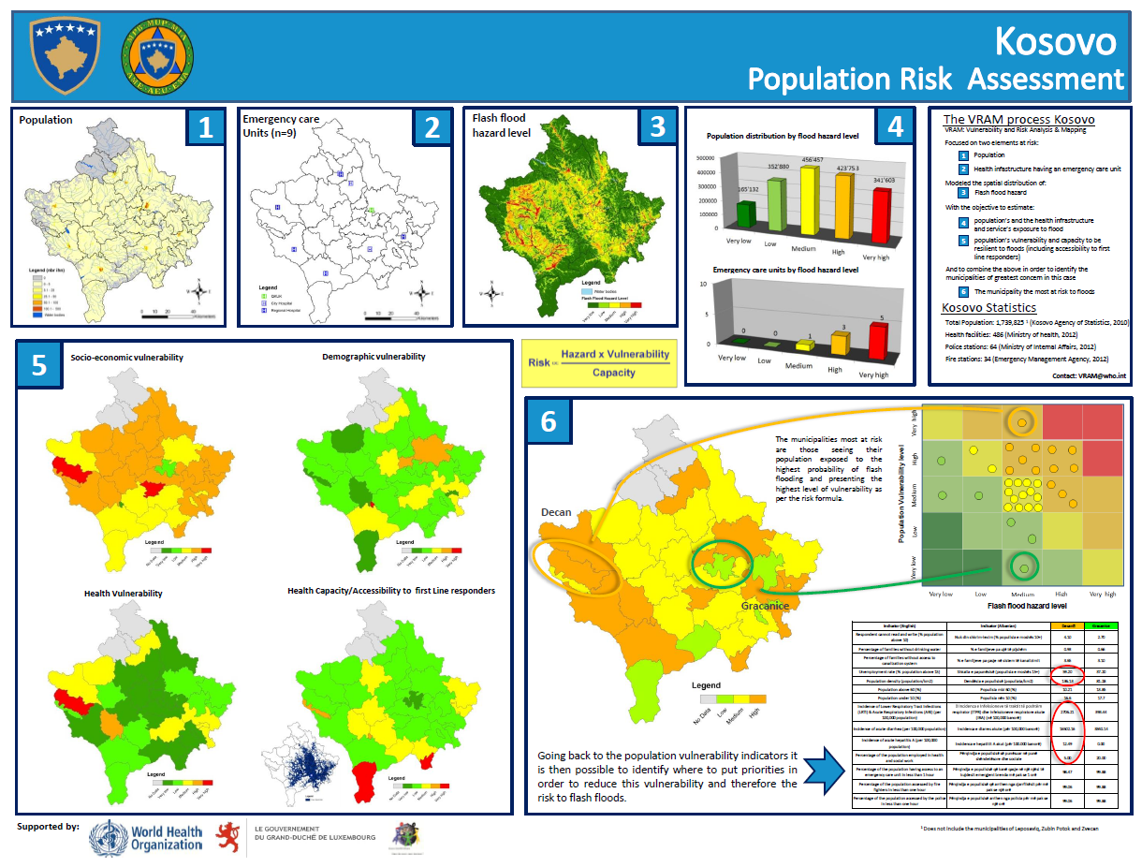
HIS Geo-enabling framework implementation process
Understand the geography
Define the “geo” products
Identify the needs in terms of hardware, software and technical expertise
Allow to define the data needs
3

Slide 4
Understanding the geography
This understanding is achieved by identifying and documenting:
The program or intervention strategy (e.g., home vaccination)
The geographic features that are central to the implementation of the program or intervention (list of these features with their definition)
The relationships that exist between these geographic features
Context
Eco-system
Data model
Hierarchies
Important to include all stakeholders involved in the planning and implementation of the program or intervention being geo-enabled
This will directly influence the data needed to generate products
4

Slide 5
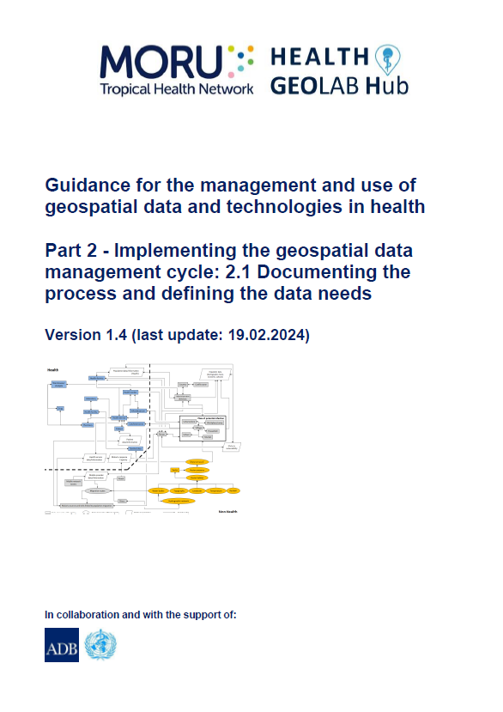
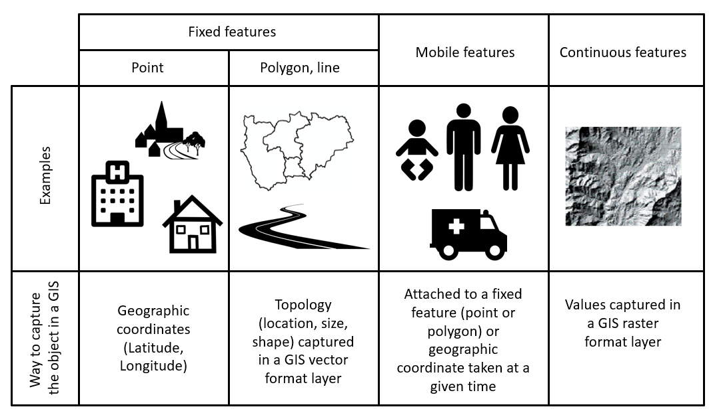
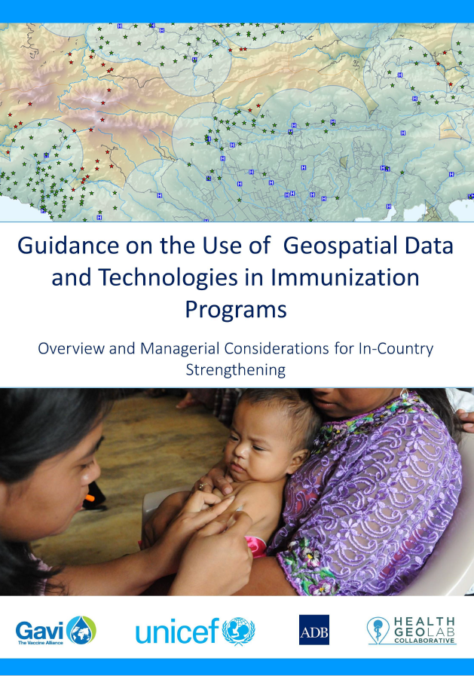
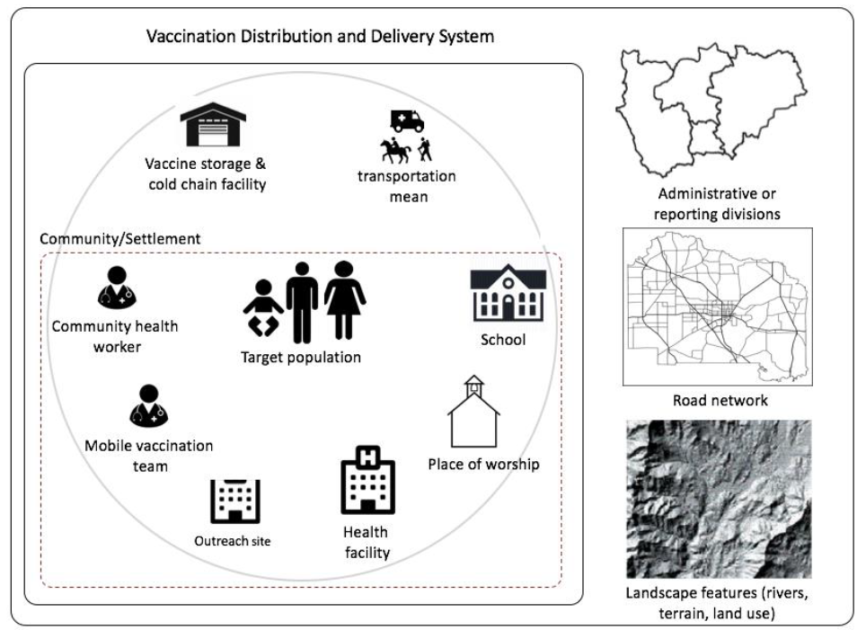

Understanding the geography – Geographic features and objects
1
2
Geographic feature = Naturally and artificially-created features on the earth (e.g. house, road, health facility, river, etc.)
Geographic object = Also called a geo-object, computer representation of a geographic feature (e.g. point, line, polygon)
http://www.healthgeolab.net/DOCUMENTS/Guide_HGLC_Part2_1.pdf
https://www.unicef.org/media/58181/file
5

Slide 6
Understanding the geography – Define each geographic feature
Example: What is a health facility?
Medline Plus: Places that provide health care. They include hospitals, clinics, outpatient care centers, and specialized care centers, such as birthing centers and psychiatric care centers.
Health authority Abu Dhabi: Standalone building with inpatient services for 24 hours use or longer by patients in the treatment of diseases, injuries, deformities, abnormal physical or mental status, maternity cases, nurseries and dispensaries.
Free dictionary: Building where medicine is practiced.
DOH Philippines: A building or physical structure that has amenities, equipment and staffing for the
delivery of health care services.
Wikipedia: in general, any location at which medicine is practiced regularly.
A building or a place/location are different concepts
Might need to define additional concepts (health care, medicine, service)
The final definition will impact the next steps of the geo-enablement process
6

Slide 7
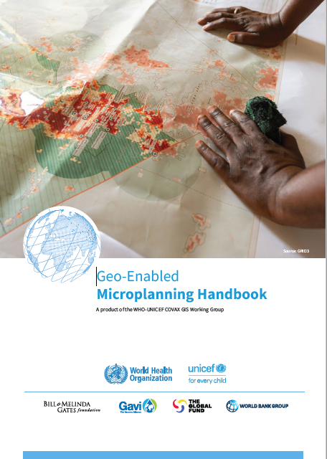

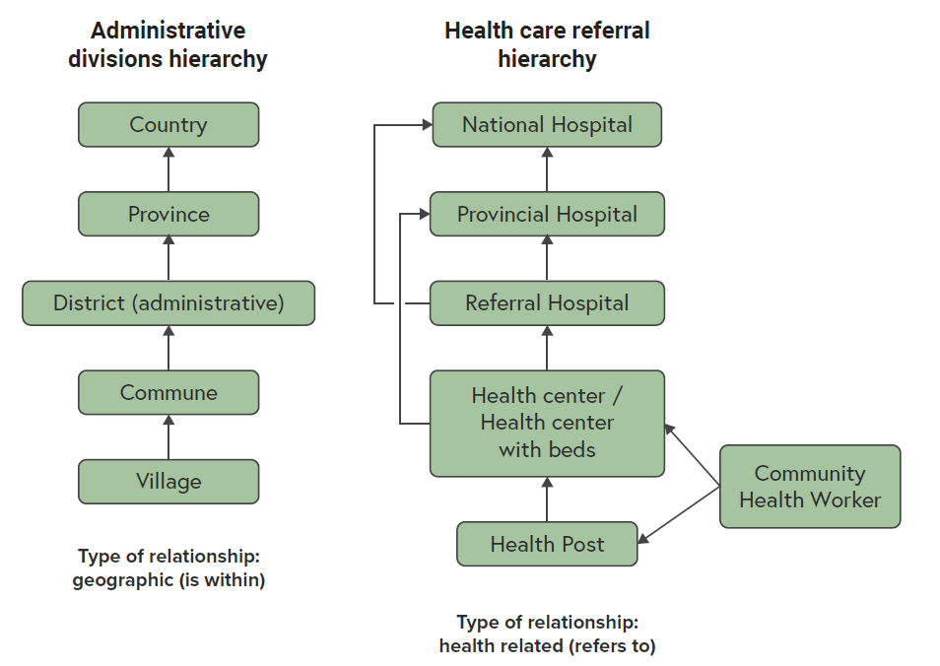
Understanding the geography – Hierarchies
1
The relationship between geographic features can be of different types. For example:
Geographic (…is geographically located within..)
Health (…refers patients to…)
Administrative (…is administered by…,…is reporting to…)
Associative (…is part of…)
2
Identifying and capturing these relationships in the form of hierarchies will influence the information that must be attached to each geographic feature to be in the position to recreate these hierarchies
1. https://drive.google.com/file/d/1jj779zww4herWOESAd9mXqVE1YfQehtH/view?usp=sharing
2. https://healthgeolab.net/DOCUMENTS/Guidance_Common_Geo-registry_Ve2.pdf
7

Slide 8
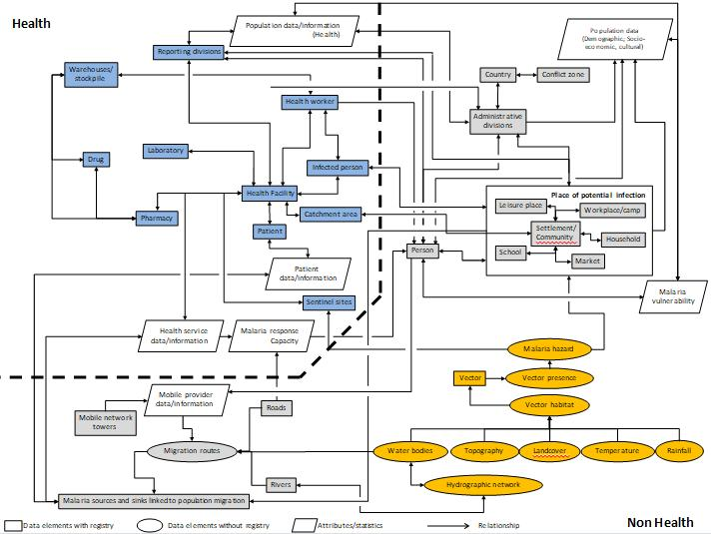
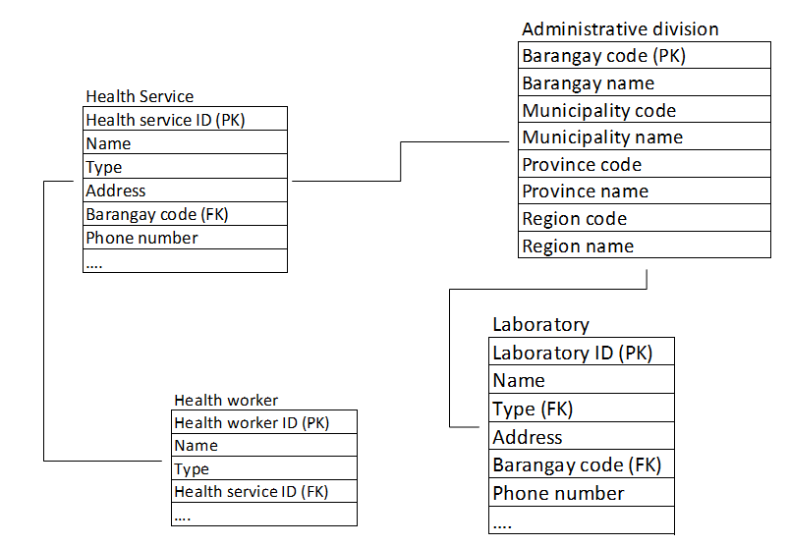
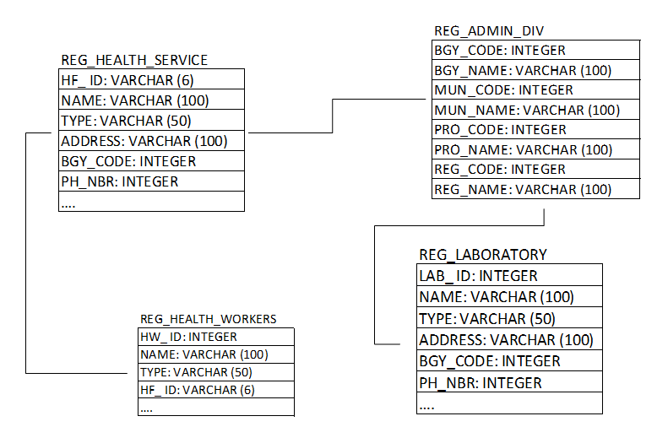
Understanding the geography – Data model
1
A data model is an abstract model that organizes and document the relationships that exists between geographic features and the data elements attached to each of them
Three (3) main levels of data model can be differentiated:
Conceptual data model which captures all the identified geographic features and the relationships between all of them
Logical data model which also captures the data elements associated to each geographic feature, without regard to how they will be physically implemented in the database
Physical data model which captures how the model is being implemented in the information system
Conceptual data model
Logical data model
Physical data model
1 http://www.healthgeolab.net/DOCUMENTS/Guide_HGLC_Part2_1.pdf
8

Slide 9
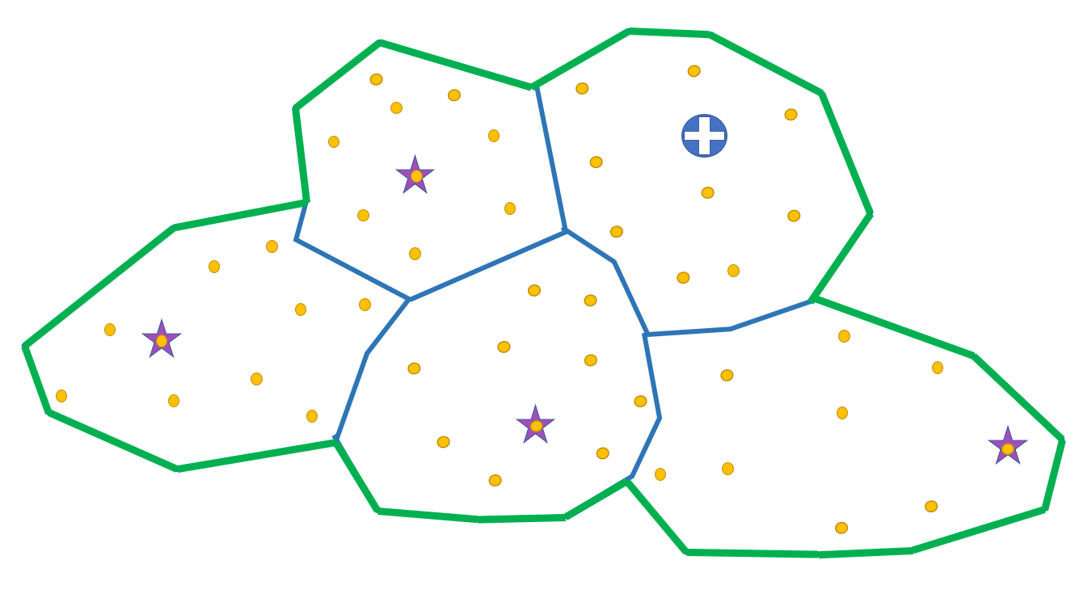
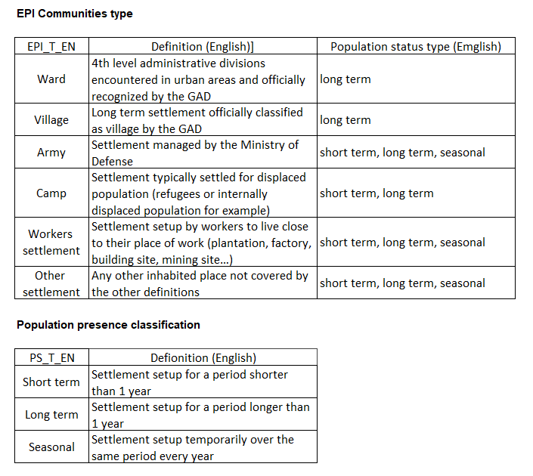
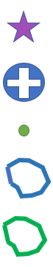
Understanding the geography – Example (Myanmar)
Challenge: Microplanning not covering the whole target population
Immunization ecosystem
EPI community?
Definition: Place where people live in community
Required to define different types of EPI communities and population presence
Legend
Vaccination post
Health center
Village
EPI community
Health area
Helped identify communities that were not yet covered by vaccination campaigns
9

Slide 10
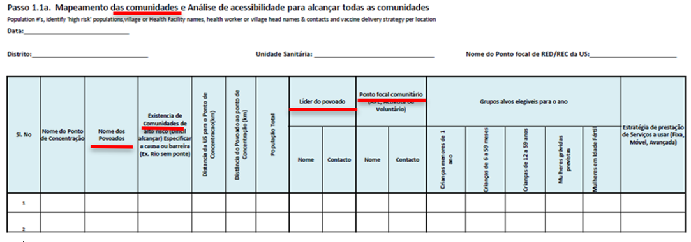
Understanding the geography – Example (Mozambique)
Challenge: Microplanning form combining different types of geographic features that were not clearly defined (povoados, community)
Needed to get a clear definition for both of them and understand how they related to each other
10

Slide 11
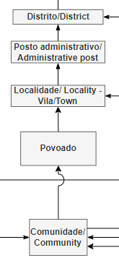
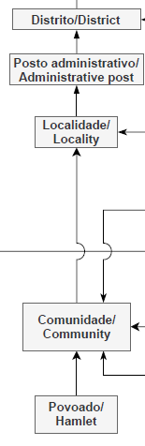
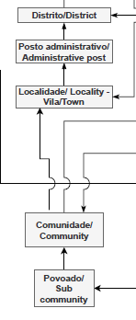
Understanding the geography – Example (Mozambique)
Challenge: Microplanning form combining different types of geographic features that were not clearly defined (povoados, community)
Aug 24, 2021 Sep 21, 2021 Oct 14, 2021
Conclusion:
Geographic feature without administrative role (only for statistical purpose)
Unofficial geographic feature (no regulation in place)
Recommendation made to the Ministry of Health to define and manage the micro-plan at the concentration point (vaccination post) level
11

Slide 12
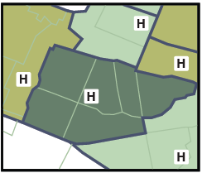
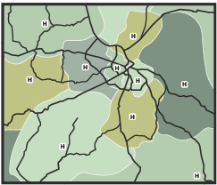
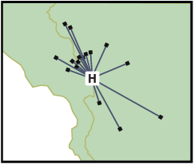
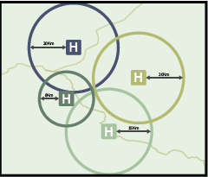
Understanding the geography – Example (zone types)
Challenge: Different understanding and use of the concept of catchment area
Needed to come up with a common terminology
Health areas
Type | Definition
Health area | Area around a health facility defined for purposes of cataloging, budgeting and health resource management
Proximity basin | An area around a service delivery point defined such that any location within this area is closer to that service delivery point than to any other service delivery point.
Catchment area | A geographical area delineated around an institution or business, such as a health facility, from where the population utilizes its services
Actual catchment area | Area around a service delivery point based on the location of the patient who received care at that service delivery point
Modeled catchment area | Catchment area modeled based on distance (buffer), travel time, population or a combination of these factors
Proximity basin (travel time)
Actual catchment area
Modeled catchment area (distance)
12

Slide 13
Understanding the geography – Process
1
Three (3) exercises:
Identify the geographic features specific to the program or intervention
Agree upon a definition for each of the geographic features identified during exercise 1
Capture the relationships between the geographic features identified during exercise 1 and defined during exercise 2
Exercises ideally conducted (at least started) during a workshop attended by key representative from:
The program or intervention being geo-enabled
The main producers/consumers of geospatial data (HIS unit, communicable diseases, planning, immunization and emergency management) if the geo-enablement of the HIS is being performed
1 http://www.healthgeolab.net/DOCUMENTS/Guide_HGLC_Part2_1.pdf
13

Slide 14
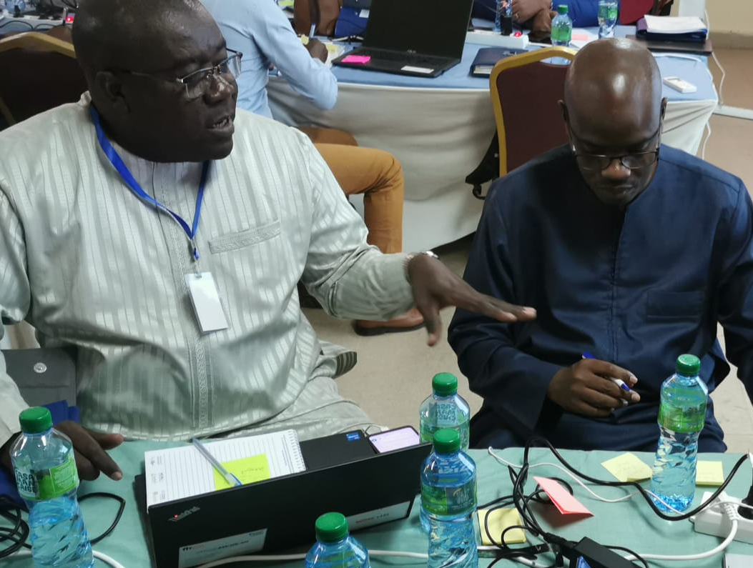
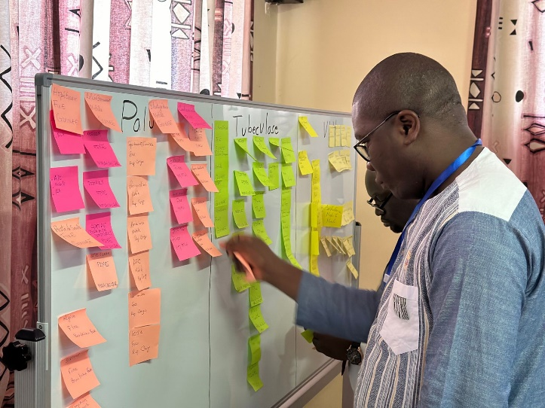
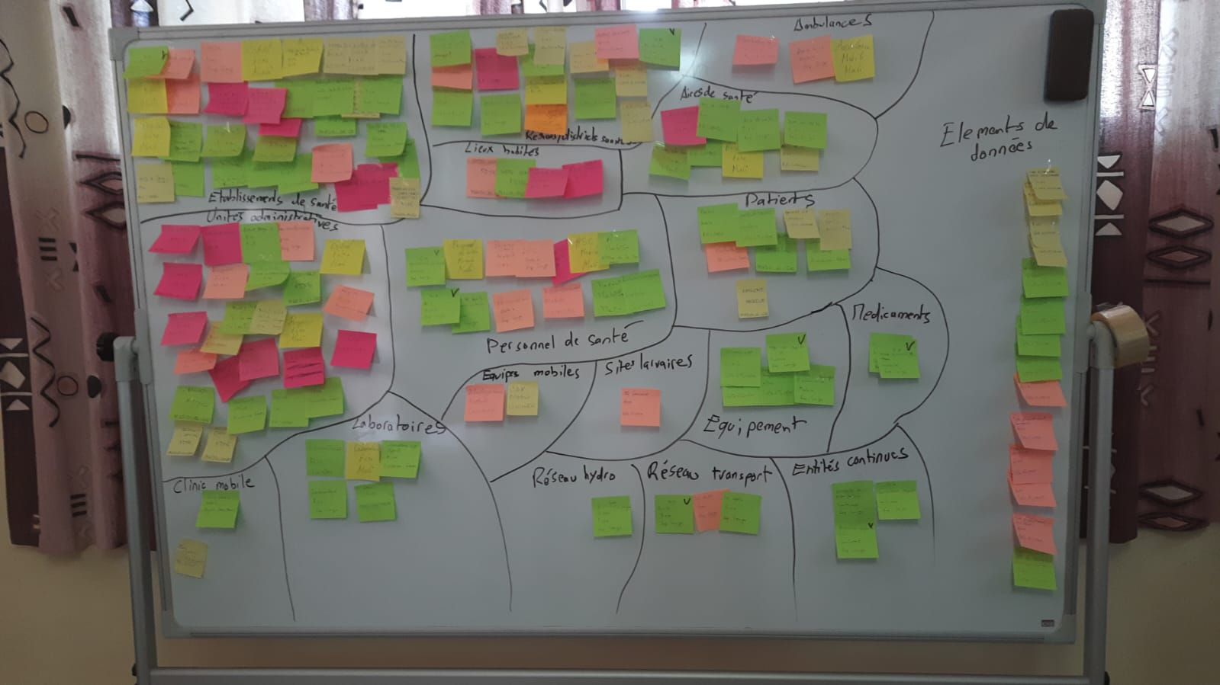
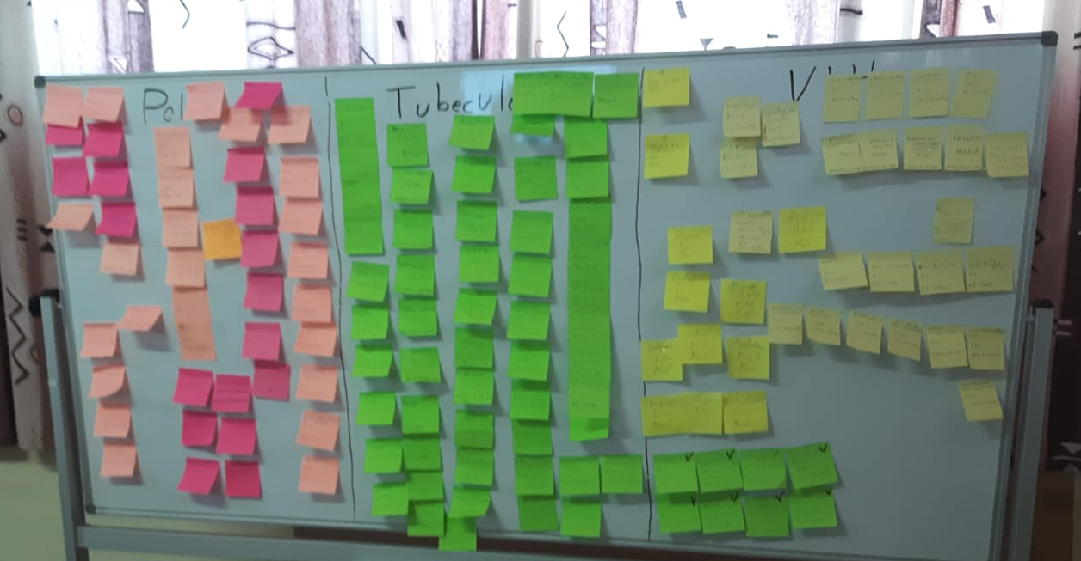
Understanding the geography – Exercise 1 (cross-program)
1. Participants identifying geographic features (1 feature per post it, one color per program)
2. Participants placing the post its on a board (one color per program)
4. Post it re-arranged by type of geographic feature
3. All the post it submitted by the participants
Defines the ecosystem and demonstrates that most geographic features are in common to all programs
14

Slide 15
Understanding the geography – Exercise 1 (cross-program)
Health facilities
Laboratories
Settlements
Administrative units
Health districts
Health areas
Hydrographic network
Transportation network
Patients
Health personnel
Mobile clinics
Ambulances
Equipment
Medicines
Altitude
Land cover
Often also provide the opportunity to clarify certain concepts or misunderstanding (e.g. data elements versus geographic features)
15

Slide 16
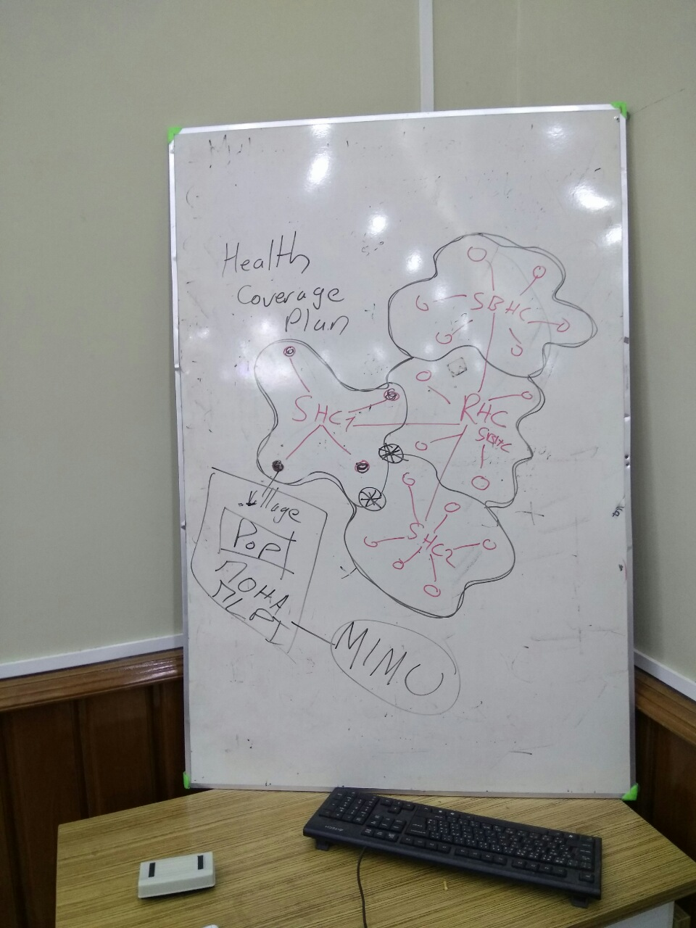


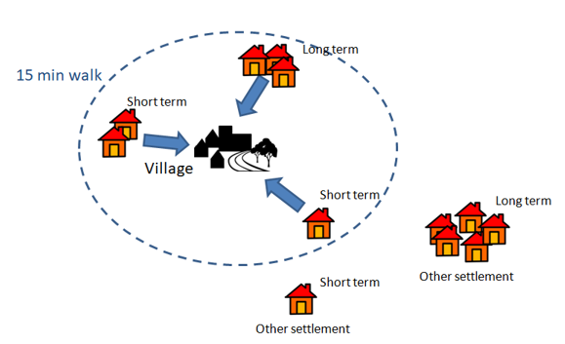




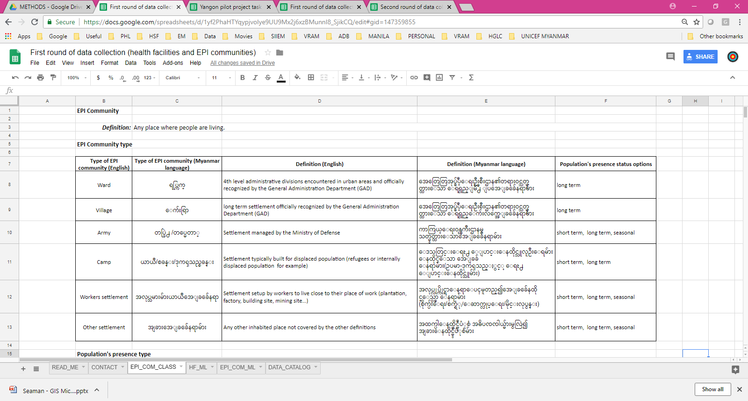


Understanding the geography – Exercise 2 (cross-program)
Term | Definition | Consensus
First set of definitions
First round during which each participant provide their own definition for the types of geographic features that are not already officially defined
Additional rounds to address the geographic features for which there is no consensus
Full consensus
Final agreed upon definitions
16

Slide 17
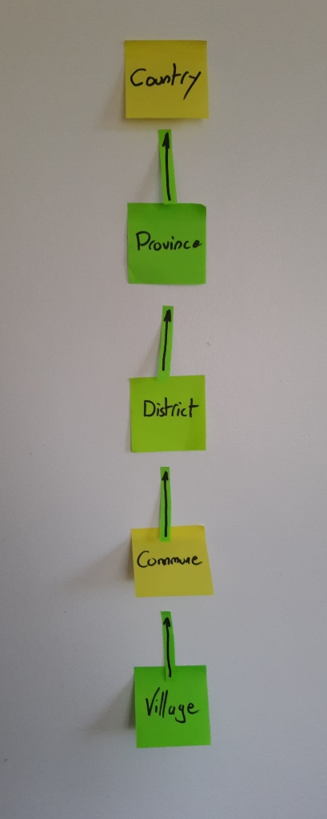
Understanding the geography – Exercise 3 (cross-program)
Use the post its from exercise 1 to get the participants to organize them under the form of hierarchies
Capture the agreed upon hierarchies in an electronic format
17

Slide 18
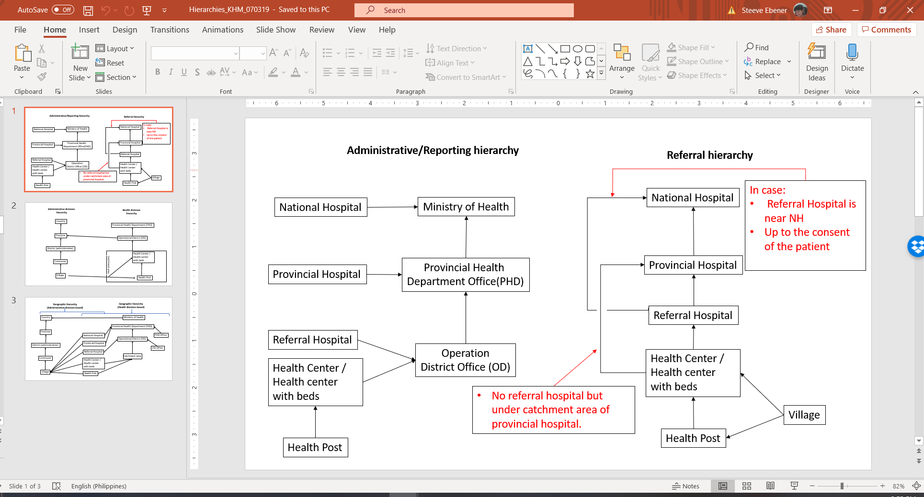
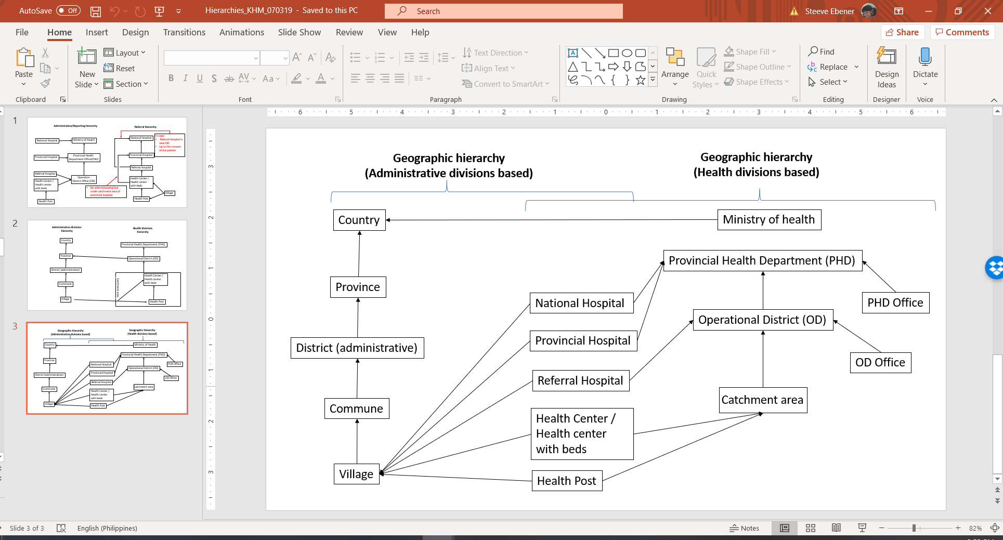
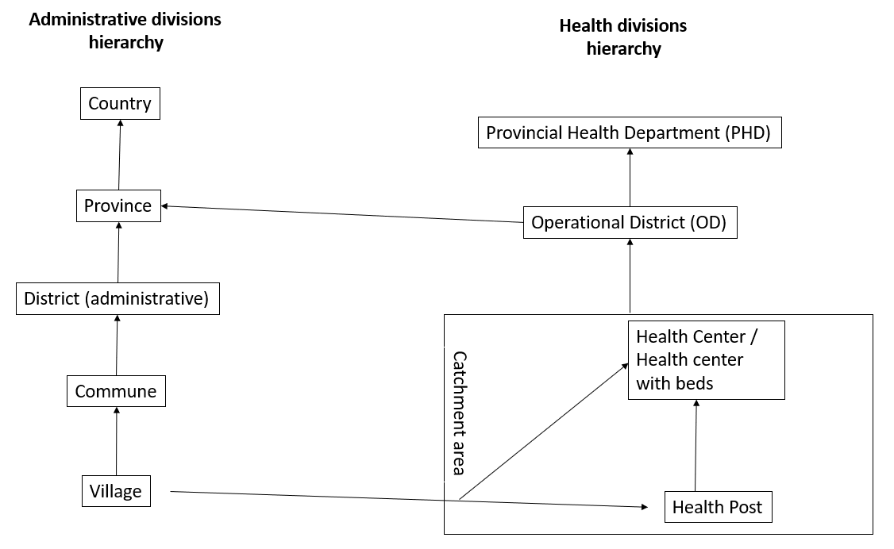
Understanding the geography – Exercise 3 (cross-program)
Several hierarchies can contain the same geographic feature
Example: Cambodia
18

