Slide 1

Introduction to geospatial data management
and technologies for Health Programs training workshop - Timor Leste
Session 5: Introduction to the geospatial data management cycle

Slide 2
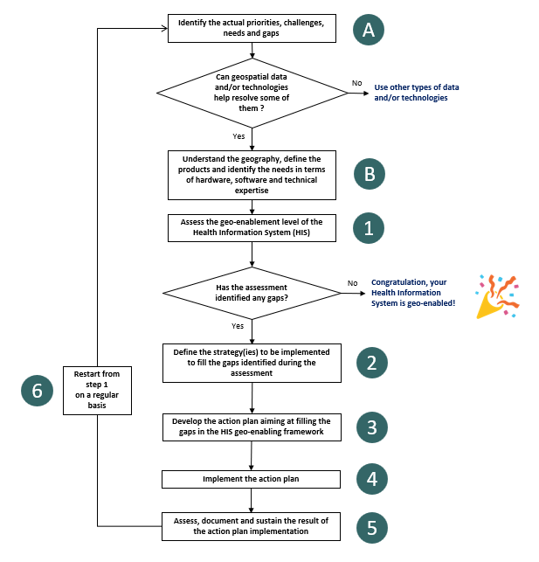
HIS Geo-enabling framework implementation process
Step 1 : Assess the availability, accessibility and quality of data and information
When geo-enabling the HIS, this activity only look at where the master list for a set of geographic features core to public health find themselves along a predefined continuum
Geo-enabling a program or intervention requires for a more in-depth assessment of the availability, accessibility and quality of the data needed to generate the information products defined during step B
Such an assessment is to take place during Step 1 and meant to identify currently existing gaps and how to fill them
Entry point for the geospatial data management cycle
2

Slide 3


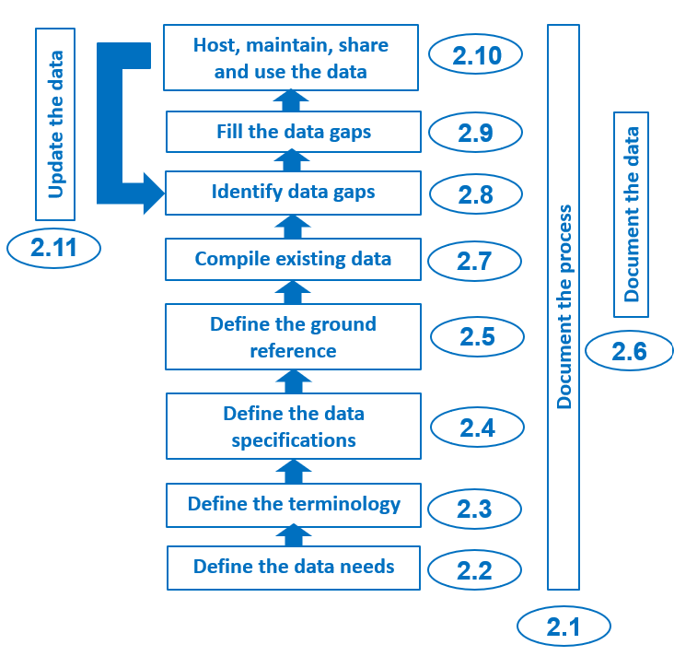
The geospatial data management cycle
1
Generating and maintaining good quality data (geospatial, statistical) and products require proper data management standards, processes, and protocols to be defined and implemented.
The geospatial data management cycle covers the steps to follow to define and implement proper data standards, processes, and protocols
Ensures data quality and therefore the quality of the information and information product to be generated out of it
Applicable to georeferenced master lists as well as geospatial and statistical data
1. http://www.healthgeolab.net/DOCUMENTS/Guide_HGLC_Part1.pdf
3

Slide 4
The geospatial data management cycle
2.9
2.10
2.11
4

Slide 5
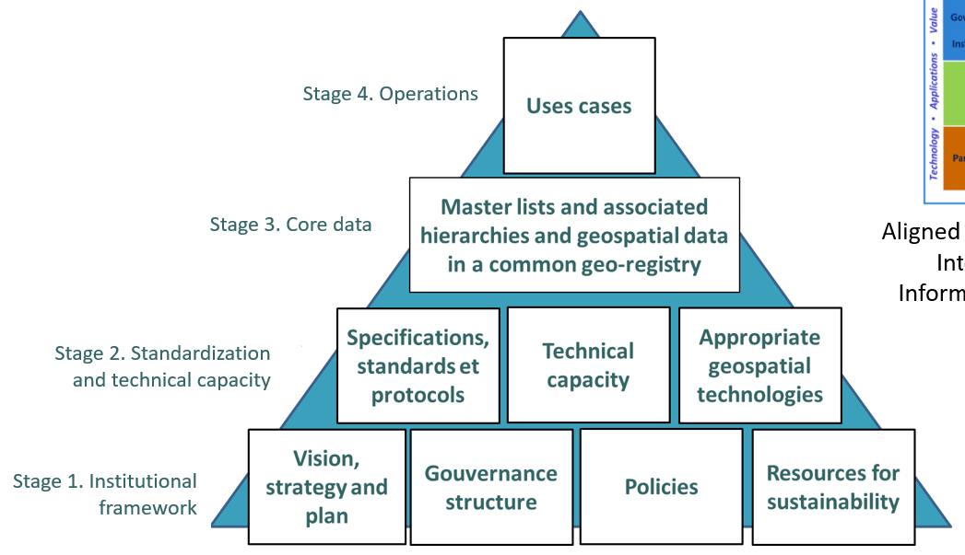
The geospatial data management cycle
The technical process behind the HIS geo-enabling framework
Strategic framework Technical process
5

Slide 6

Document the process
Documenting each step from the beginning as precisely as possible ensures that the process can be replicated
Applies to the entire geospatial data management cycle
A critical activity often forgotten or considered as not being necessary
1
Good example of project implementation documentation
  1 https://healthgeolab.net/KNOW_REP/Acc_Analysis_VUT_050224_FINAL.pdf
6

Slide 7
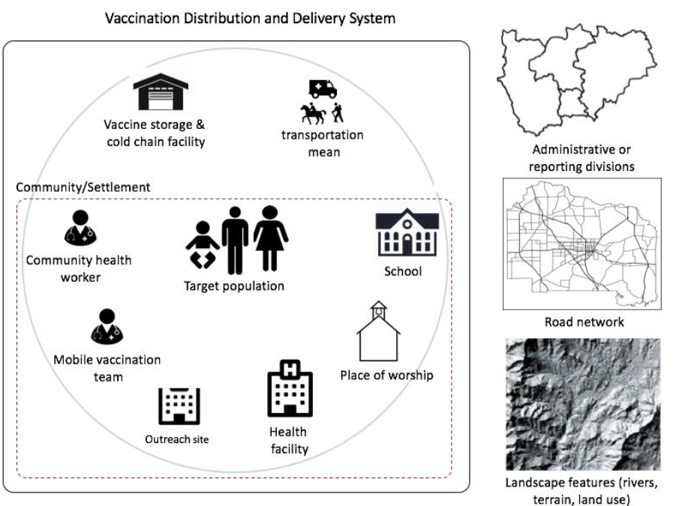
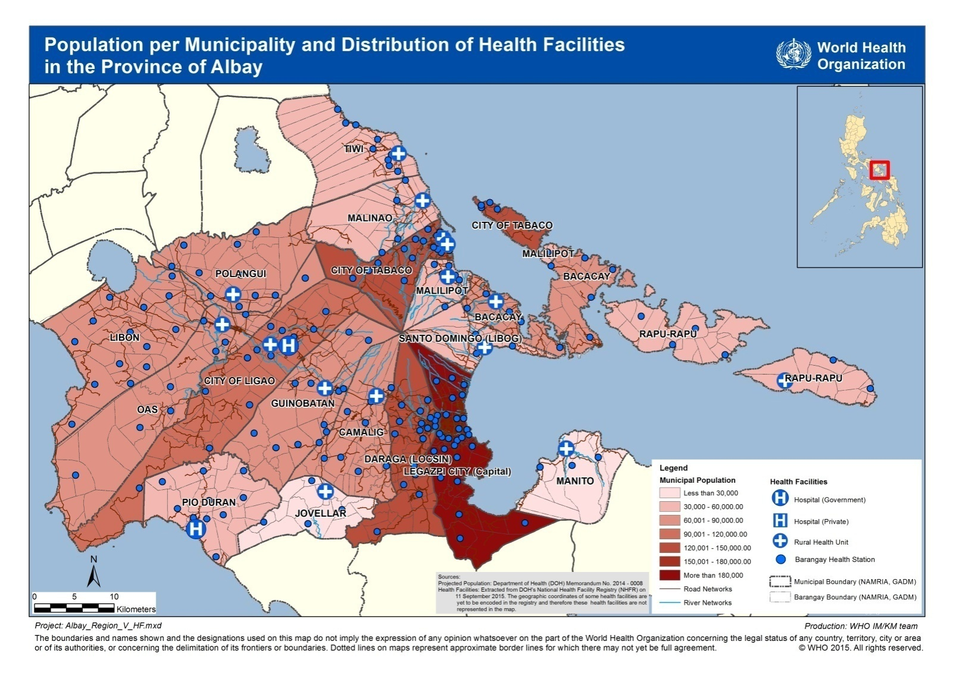
Define the data needs
This step builds on two activities completed during step B of the HIS geo-enabling framework implementation process:
Understand and document the geographic context (Session 4)
Define the purpose, audience, content and format of the GIS-based products to be generated to support the program or intervention (Session 12)
Used to identify the data needed to generate the defined GIS-based products
7

Slide 8
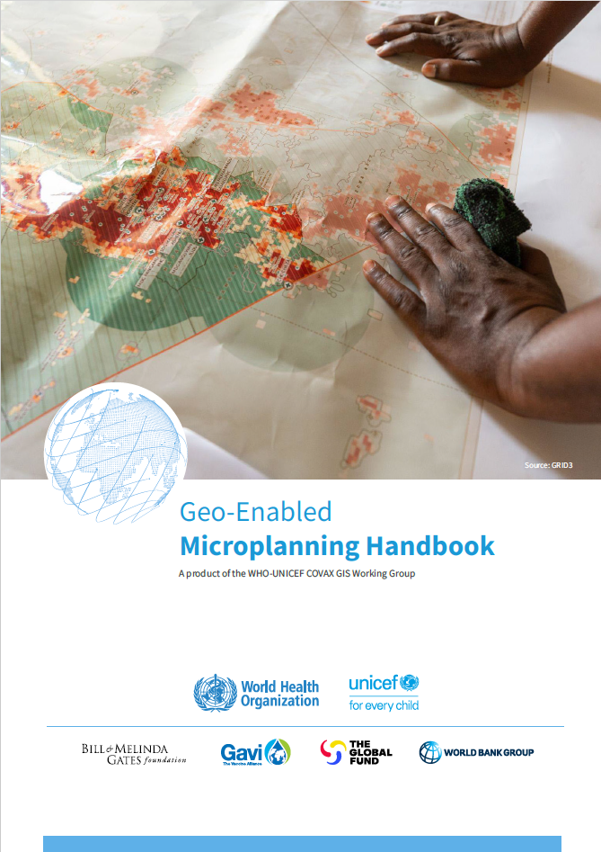
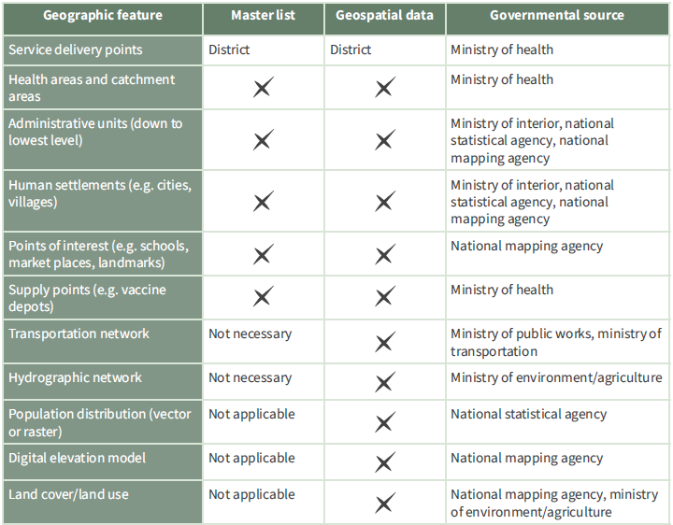
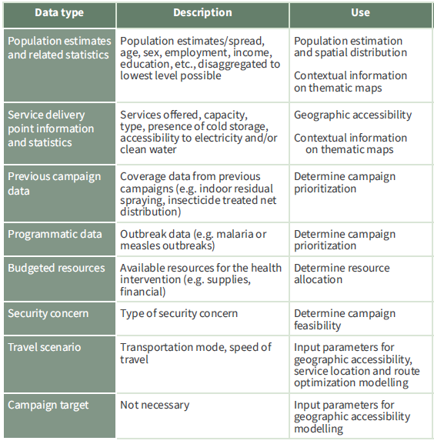
Define the data needs
The content of the products identified during step B of the HIS geo-enabling process define the data that are needed
Example for microplanning
Master lists
Geospatial data
Statistical data
Input parameters
Will depend on the application of geospatial data and technologies
Examples on the right for microplanning
8

Slide 9
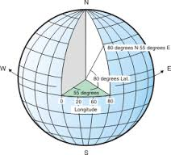
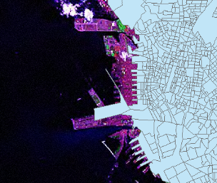
Define terminology, data specifications, and ground references
Defining the terminology ensures that all the actors involved speak the same language.
Data specifications and ground references (satellite imaging, master lists) provide the measurable criteria to assess and improve the quality of geospatial data across the 6 dimensions of data quality (completeness, uniqueness, timeliness, accuracy, validity and consistency).
We will come back to this in Session 13
890 m
9

Slide 10
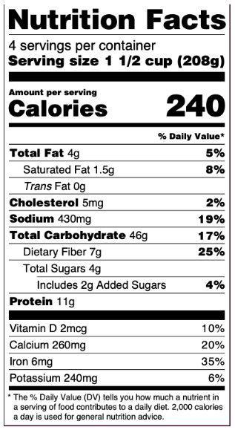
Document the data (metadata)
All geospatial and statistical data used or generated as part of the implementation of the cycle must be properly documented.
This documentation provides the information needed to guarantee the quality of the data and should be started as soon as possible throughout the cycle.
The information is entered in a metadata record based on a standardized metadata profile.
We will come back to this in Session 14
10

Slide 11
Compile existing data and identify gaps
The compilation and organization of existing data make it possible to reduce the duplication of efforts, and therefore save time and money.
The quality of the available and accessible data that has been compiled must then be assessed against the data specifications and ground reference to identify the potential gaps that will have to be filled.
Restrictions in the use and/or sharing of the compiled data can also result in the need to collect new or additional data.
We will come back to this in Session 15
11

Slide 12
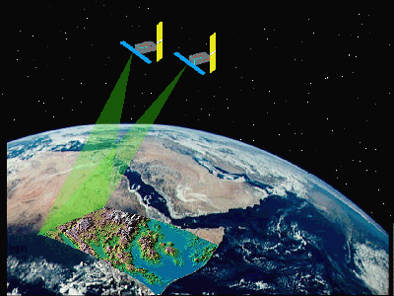
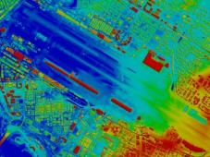


Fill the gaps in the data
Gaps in the data identified during the previous step should ideally be filled.
Different approaches can be used, including the improvement of existing data, the extraction of new data using different methods such as digitization or the collection of geographic coordinates in the field.
The data in question must also be validated before being used.
We will also cover this during Session 15
12

Slide 13
Host, manage, share, and use data
Once the data has reached the appropriate quality level, it can be used to generate the GIS-based products defined at the beginning of the process.
The data in question should ideally be properly hosted and maintained to allow for any other use.
Depending on the restrictions attached to it, the data can be distributed to the targeted and/or interested parties. The same goes for the information and/or information products which are then generated based on this data.
13

Slide 14
Update data
Like any other type of data, geospatial data must be updated regularly to reflect the changes that occur over time
Such an update must be done by following an established update mechanism
This may require the collection or extraction of additional data as well as updating the GIS-based products generated with it
Generates a loop
Note: The need to generate new GIS-based products might require for the process to restart from step 2.1
14

Slide 15
The geospatial data management cycle
The remaining session for today will focus in more details on specific steps of the geospatial data management cycle (in red)
For the other steps please refer to:
The Health GeoLab guidance to improve the management and use of geospatial data and technologies in health (https://healthgeolab.net/resources/reference-materials/)
The HIS geo-enabling training course (https://healthgeolab.net/resources/his-geo-enabling-course/)
Free online resources
15

Slide 16
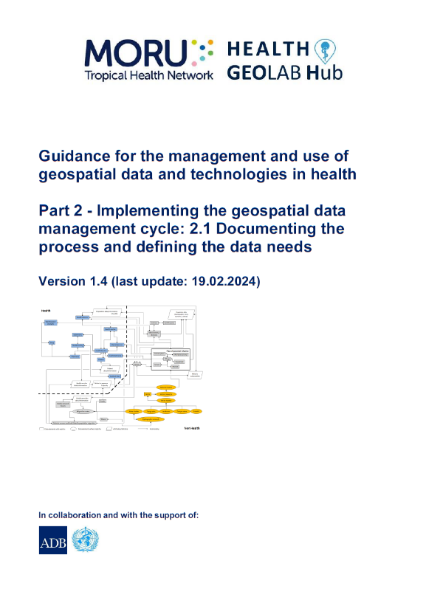


Health GeoLab guidance
The Health Geolab has created a series of guidances that describe the geospatial data management cycle and provide advice on how to implement each of the step in the cycle.
While developed to be used by the health sector they are applicable to any sectors including emergency management
Used as a reference in the context of the present training
Freely accessible:
https://healthgeolab.net/resources/reference-materials/
16

