Slide 1

Introduction to geospatial data management
and technologies for Health Programs training workshop - Timor Leste
Session 6: Key elements of the geospatial data management cycle

Slide 2
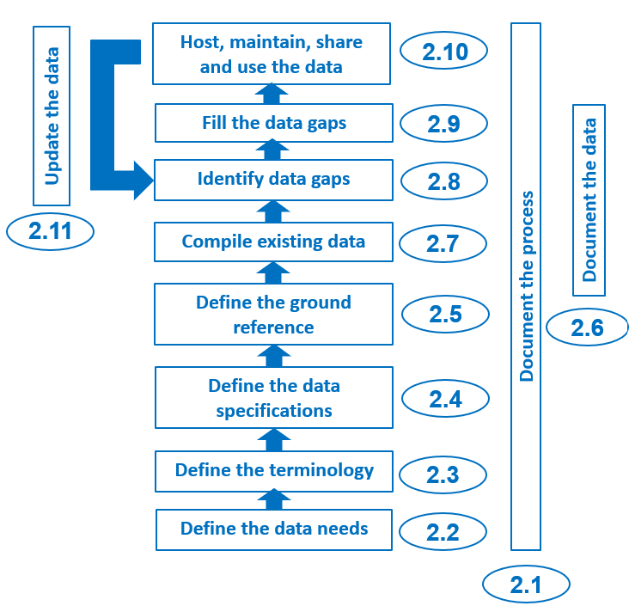
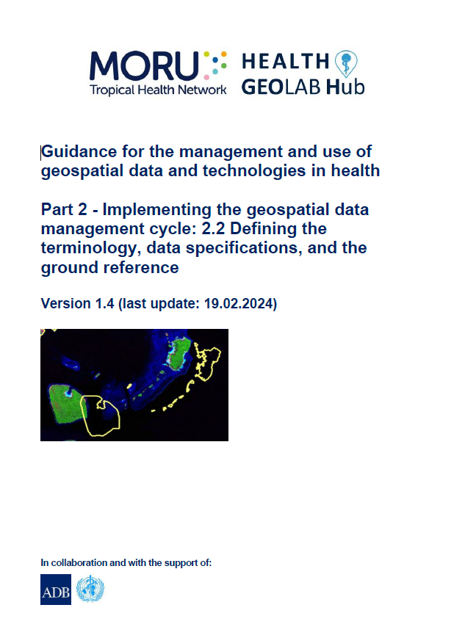

Define the terminology, data specifications and the ground reference
Once the data needs have been defined, the next three steps in the geospatial data management cycle (define the terminology, the data specifications and the ground reference) provide the foundation that will ensure the quality of the data being collected, generated, extracted and used during the rest of the cycle
Topics of one of the HGL’s guidance document (2.2)
http://www.healthgeolab.net/DOCUMENTS/Guide_HGLC_Part2_2.pdf
2

Slide 3
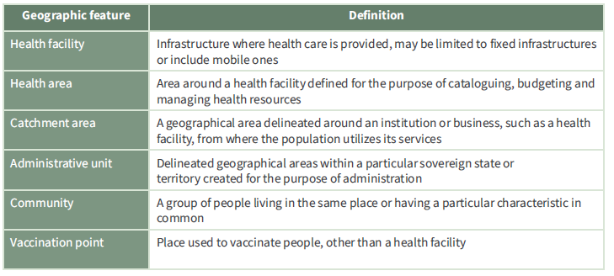
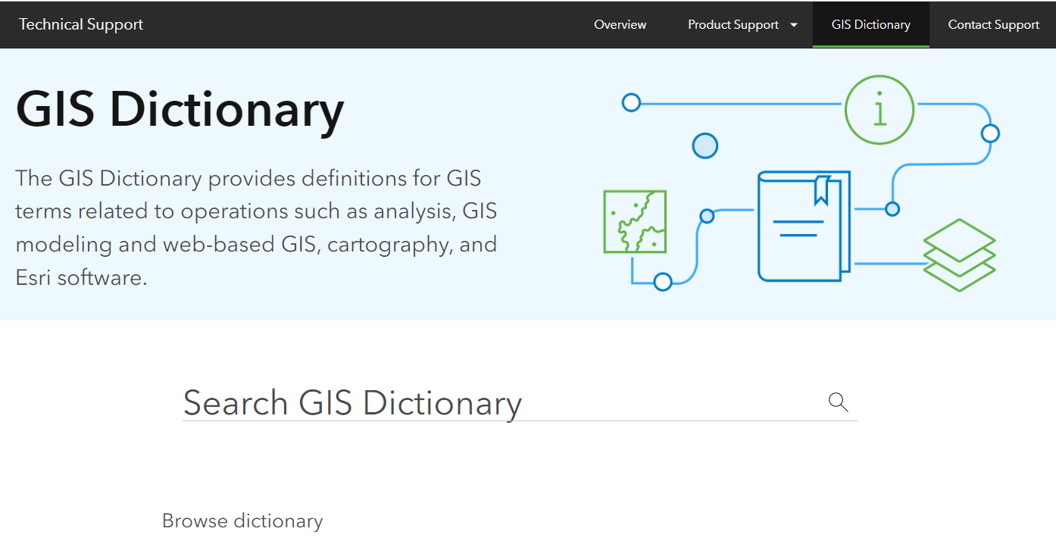
Define the terminology
Agreeing on and using a common terminology ensures that all actors involve understand each other by speaking the same language!
2 main glossaries to have:
Definition for each geographic feature (Session 6, Module 2)
Geospatial data and technologies terminology. Examples:
Esri GIS Dictionary: https://support.esri.com/en-us/gis-dictionary
It is also important to have a dictionary/glossary specific to the HIS, program or intervention being geo-enabled
https://drive.google.com/file/d/1jj779zww4herWOESAd9mXqVE1YfQehtH/view?usp=sharing; https://healthgeolab.net/DOCUMENTS/Guidance_Common_Geo-registry_Ve2.pdf
3

Slide 4
Define the data specifications and ground reference
Addressing public health issues requires data to be of quality and this across the six (6) dimensions of data quality:
Completeness: No data gap
Uniqueness: No duplicates
Timeliness: Reality from the required point in time
Accuracy: Correctness
Validity: Conform to the defined format, type, range,...
Consistency: Absence of apparent contradictions
Data quality is being assessed and improved based on measurable criteria captured in the data specifications (geospatial and statistical data, georeferenced master lists) and using remote sensing images and the master lists as ground reference when it comes to geospatial data
Applying these criteria and ground reference ensure the same minimum level of quality for the data used by an organization.
4

Slide 5
Define the data specifications – Geospatial data
When it comes to geospatial data, these criteria should at least cover:
Validity:
  V.1 Geographic coordinate system and map projection
  V.2 Geographic extent of the area being covered
  V.3 Language(s) included in the data
  V.4 File format(s) for sharing data
  V.5 Metadata profile
Accuracy:
  A.1 Scale (vector/raster layers)
  A.2 Spatial resolution (raster layers)
  A.3 Positional accuracy (vector/raster layers)
  A.4 Positional accuracy (GNSS reading)
  A.5 Positional precision (GNSS reading)
Timeliness:
  T.1 Period for which the data is being considered as relevant
5

Slide 6
Define the data specifications – Geospatial data
When it comes to completeness and uniqueness :
For vector format geospatial data associated to a master list:
Completeness:
  a. Records: When applicable, the data contains all the active records included in the corresponding master list
  b. Data elements: When applicable, a value is available for all the data elements included in the corresponding master list
Uniqueness:
a. No duplicate geographic objects based on the master list as ground reference
2. For other geospatial data:
Completeness: All the features existing in the reality are included in the dataset (e.g. road network) or area completely covered (e.g. DEM)
Uniqueness: No duplicated geographic objects
Consistency is achieved by reaching the criteria for all the other data quality dimensions
6

Slide 7

Define the data specifications – Geospatial data
V.1 Geographic Coordinate System
System in which geospatial data is defined by a 3-D surface and measured in latitude and longitude.
Different models exists, each of them trying to reproduce the earth’s shape based on:
Angular units: The unit of measurement on a sphere or a spheroid, usually degrees.
Prime meridian: The zero meridian (0°) used as the reference from which longitude east and west is measured.
Datum: Defines the position of the spheroid relative to the center of the earth.
Spheroid: The reference spheroid for the coordinate transformation.
Earth’s shape is not a perfect sphere (21,385 m difference between the two semi-axis)
7

Slide 8
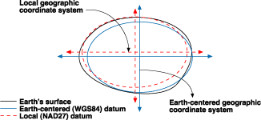
Define the data specifications – Geospatial data
V.1 Geographic Coordinate System
IMPORTANT: All the datasets combined on a map must present the same Geographic Coordinate System
Impact of using different datum
Correct Datum
More than 36 metres difference
8

Slide 9
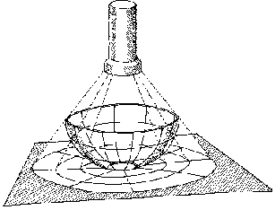
Define the data specifications – Geospatial data
V.1 Projected Coordinate System
System in which geospatial data is defined by a flat 2-D surface and can be measured in units of meters and feet.
Geographic Coordinate System + Map projection
Map projection
A method by which the curved surface of the earth is portrayed on a flat surface
The systematic transformation of points on the Earth’s surface to corresponding points on a plane (flat) surface
The earth is 3D but maps need to be flat!
This requires distortion of some parts of the map.
Note: When you don’t use a map projection, the data is unprojected. In this case, the GIS software treats the coordinate values as if they are linear values to display the data (Like the X and Y values on a graph).
9

Slide 10
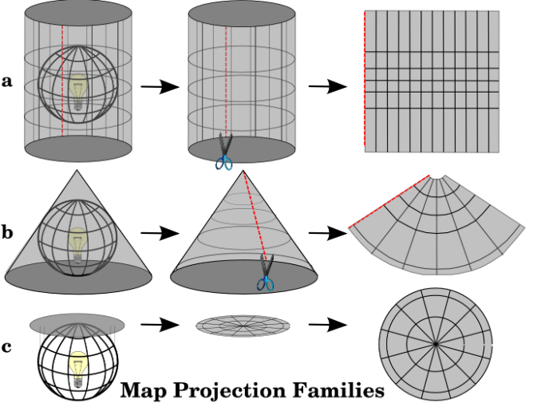
Define the data specifications – Geospatial data
V.1 Map Projection – Basic projection techniques
Cylindrical
Conical
Azimuthal
http://www.icsm.gov.au/mapping/about_projections.html#types
10

Slide 11
Define the data specifications – Geospatial data
V.1 Map Projection – Basic Projection Types
Each projection type preserves a particular relationship or characteristic​:
Equal-Area — correctly shows the size of features
Conformal — correctly shows the shape of features
Equidistant — correctly shows the distance between two features
True Direction — correctly shows the compass direction between two features
A printed map cannot be at the same time equal-area or conformal – it can only be one or the other, or neither.
A map projection is to be chosen based on the needs before being printed
Note: GIS software perform corrections on the fly which allows for these different types of measurements to correspond to the reality
11

Slide 12
Define the data specifications – Geospatial data
V.1 Map Projection – Examples
Projection | Technique | Type | Comment
Equirectangular | Cylindrical | Equidistant | Simplest geometry; distances along meridians are conserved. Plate carrée: special case having the equator as the standard parallel.
Lambert cylindrical equal-area | Cylindrical | Equal-area
Universal Transverse Mercator (UTM) | Cylindrical | Conformal | Divides the Earth into sixty zones, each being a six-degree band of longitude
Robinson | Pseudocylindrical | Compromise (neither equal-area nor conformal) | Used to create global maps
https://en.wikipedia.org/wiki/List_of_map_projections
12

Slide 13
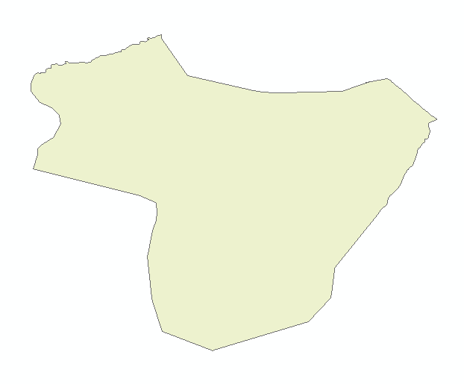


Define the data specifications – Geospatial data
V.2 Geographic extent of the area being covered
Layer 1
Layer 2
Once all the layers presenting the same geographic coordinate system and map projection you want to make sure that they are also covering the full extent of the area of interest
Layer 1
Layer 2
13

Slide 14
Define the data specifications – Geospatial data
V.3 Language
National and international language (e.g. English) using the Unicode text encoding standard
V.4 Geospatial and attribute data format (most used)
Vector
  Shapefile (actually composed of 3 to 8 files)
  GeoJSON (QGIS)
Raster
  Georeferenced: Geotiff or GRID
  Not georeferenced: .jpeg, .png, etc.
Tabular
  Spreadsheets: .xls, .dbf
Combined vector/raster/tabular
  Geodatabases
Recommended
14

Slide 15
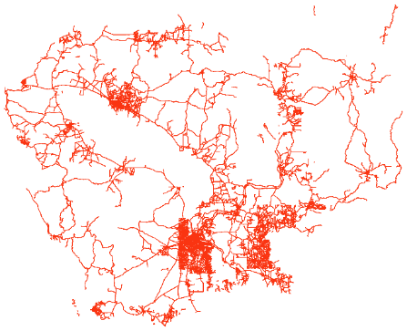
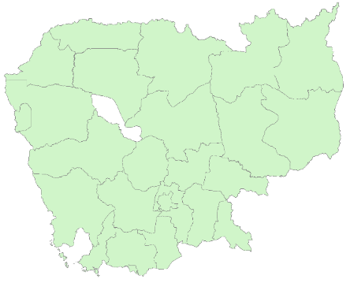
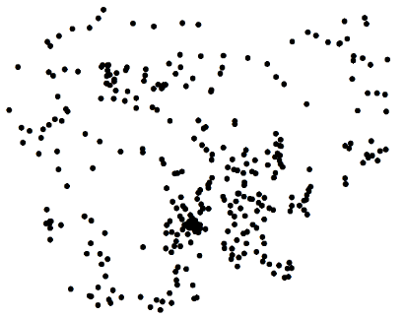
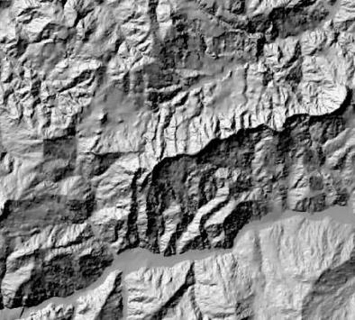
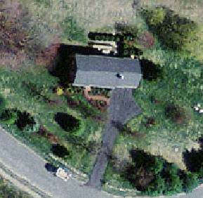

Geospatial data formats
V.4 Geospatial and attribute data format (most used)
Vector format
Point Line Polygon
Raster format
Grid
15

Slide 16
Define the data specifications – Geospatial data
V.5 Metadata
Information that describes the content, quality, condition, origin, and other characteristics of data or other pieces of information.
Data about the data
Allows user to find out if the data is appropriate for its intended purpose
Applies to master lists, geospatial and statistical data
Different metadata standards exists (FGDC, ISO) and a metadata profile needs to be generated out of one of these standards
Will be covered in more details during Session 14
16

Slide 17
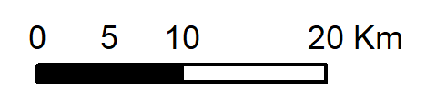
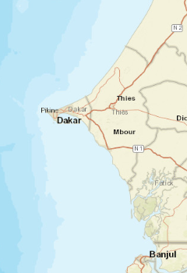
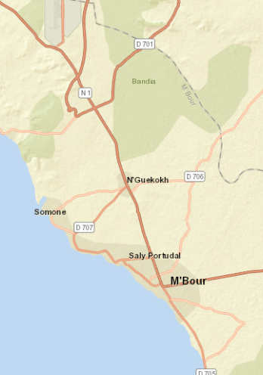
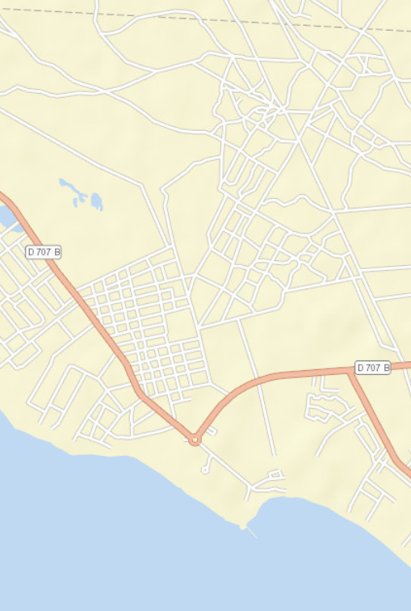
Define the data specifications – Geospatial data
A.1 Scale
The ratio or relationship between a distance or area on a map and the corresponding distance or area on the ground, commonly expressed as a fraction or ratio
A map scale of 1/100,000 or 1:100,000 means that one unit of measure on the map equals 100,000 of the same unit on the earth surface.
Large scale map versus small scale map
A large-scale map has a smaller ratio (1:10,000 or 1:25,000) and would contain more details such as streets and building footprints.
Small scale Medium scale Large scale
17

Slide 18
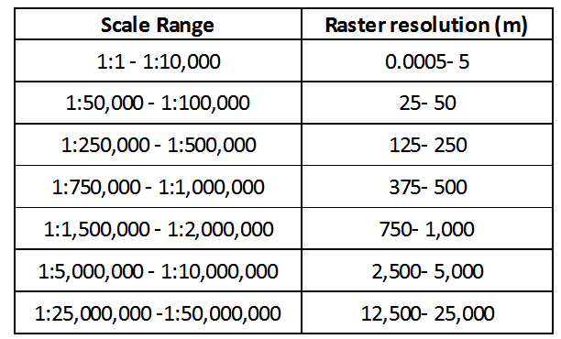
Define the data specifications – Geospatial data
A.2 Resolution
The dimensions represented by each cell or pixel in a raster format geospatial dataset.
100 m
100 m
Relation between scale and resolution
Tobler W. (1987): Measuring Spatial Resolution, Proceedings, Land Resources Information Systems Conference, Beijing, pp. 12-16
18

Slide 19
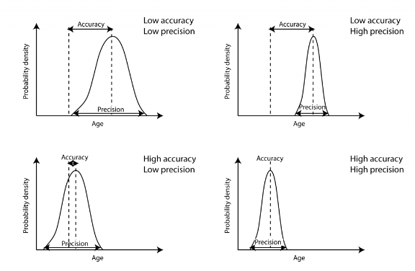
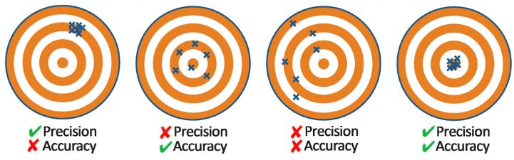
Define the data specifications – Geospatial data
A.3 & A.4 Positional accuracy, and A.5 Precision
Positional accuracy: Quantifiable value that represents the positional difference between a geospatial layer and reality (proximity of measurements to the real value)
Precision: The number of significant digits used to store numbers, particularly coordinate values (measurement of dispersion)
= real value, reality
Indicator Geographic coordinates
19

Slide 20
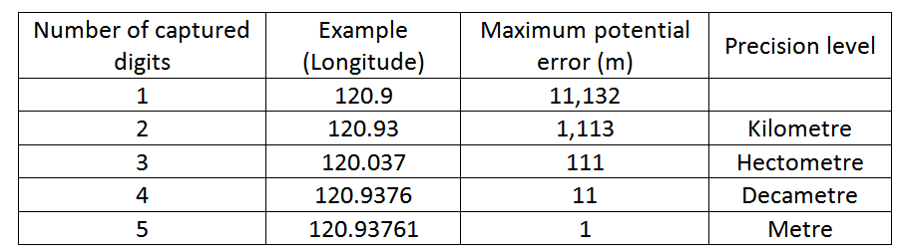
Define the data specifications – Geospatial data
Precision (A.5)
At the equator: 360 º
40,075 km
1 º
͌
111,320 m
Recommended
During data collection in the field (GNSS enabled devices)
When generating or extracting vector format geospatial data (precision level of vertices)
20

Slide 21
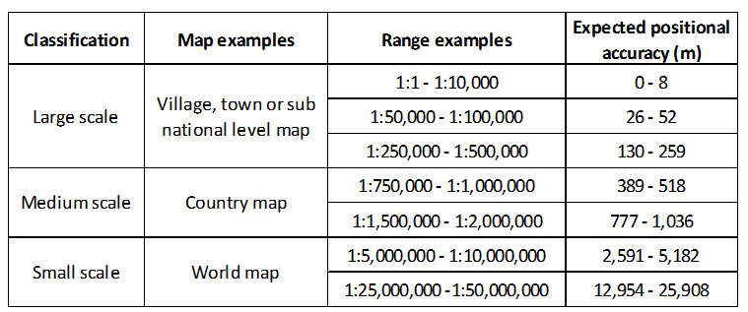
Define the data specifications – Geospatial data
Scale and positioning accuracy (A.1, A.3 et A.4)
United States Geological Survey mapping standards: "requirements for meeting horizontal accuracy as 90 per cent of all measurable points must be within 1/30th of an inch for maps at a scale of 1:20,000 or larger, and 1/50th of an inch for maps at scales smaller than 1:20,000."
Similar relationship than between scale and resolution
http://www.colorado.edu/geography/gcraft/notes/error/error_f.html
21
Notes:
.)

Slide 22
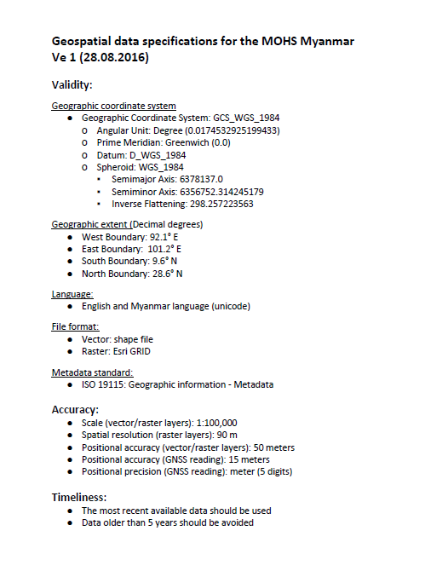
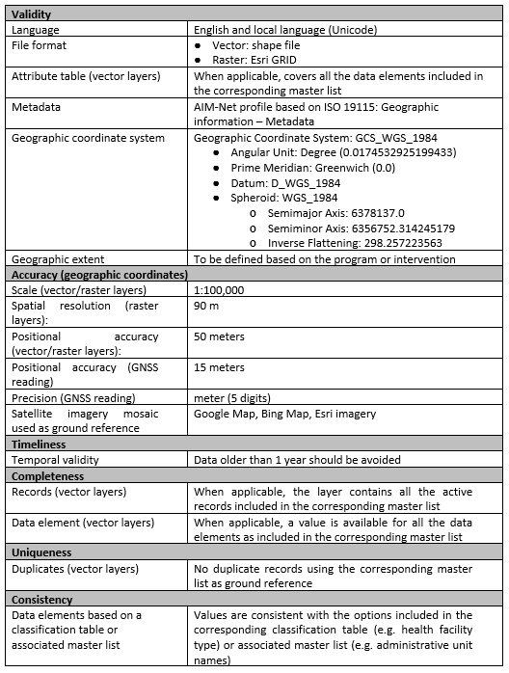
Define the data specifications – Geospatial data
Summary
Geospatial data set specifications for Myanmar
• The purpose behind the use of geospatial data will guide the choice of a specific scale of work.
• This scale will directly influence the positional accuracy and spatial resolution that should be used when compiling, collecting, extracting or using geospatial data.
• The highest positional accuracy and precision possible should be sought, including when using GNSS-enabled devices, to allow for the largest use possible of the resulting data.
• A precision level down to the meter (5 digits in decimal degrees) is recommended
22

Slide 23
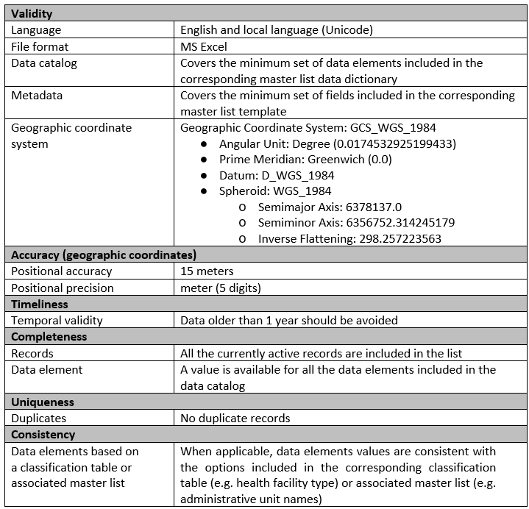
Define the data specifications – Georeferenced Master list
Data dictionary
Master list template
Same criteria as for the geospatial data
Classification tables
Other master lists
Fake example
23
Notes:
.)

Slide 24
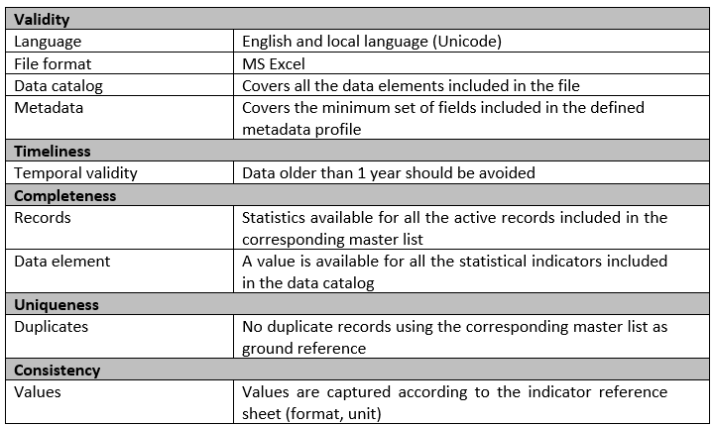
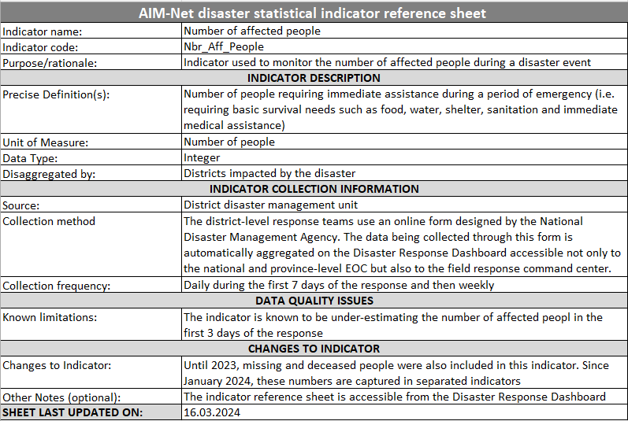
Define the data specifications – Statistical data
Metadata profile
Indicator reference sheet
Fake example
24
Notes:
.)

Slide 25
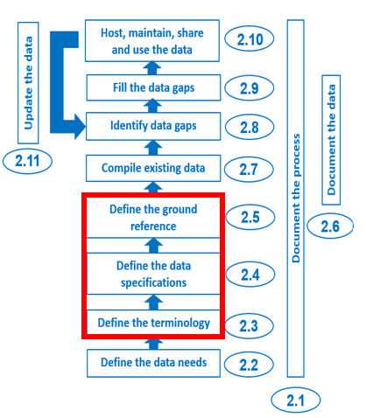
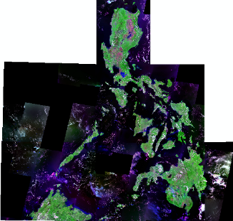


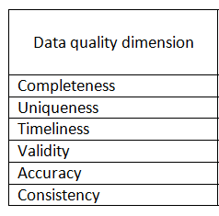
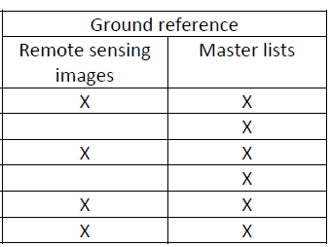
Define the ground reference
The closest reference to the reality against which data quality can be measured
In the context of the HGL guidance, the ground reference is provided by the following :
High resolution orthorectified remote sensing imagery (applies to geospatial data)
Georeferenced master lists (applies to geospatial and statistical data)
The imagery has its own accuracy
890 m
Emphasizes once again the key role that master lists are playing
25

Slide 26
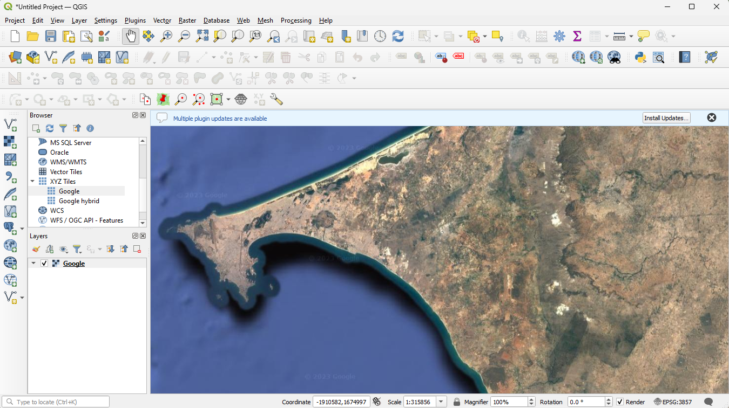
Define the ground reference – Remote sensing imagery
Imagery collected by a satellite, an aircraft, or a drone
Medium to high resolution satellite imagery are now available for free through online applications such as Google Map or Bing Map or directly in GIS software through what we call a web mapping service.
We will come back to this when talking about data quality assessment in Session 15
26

Slide 27
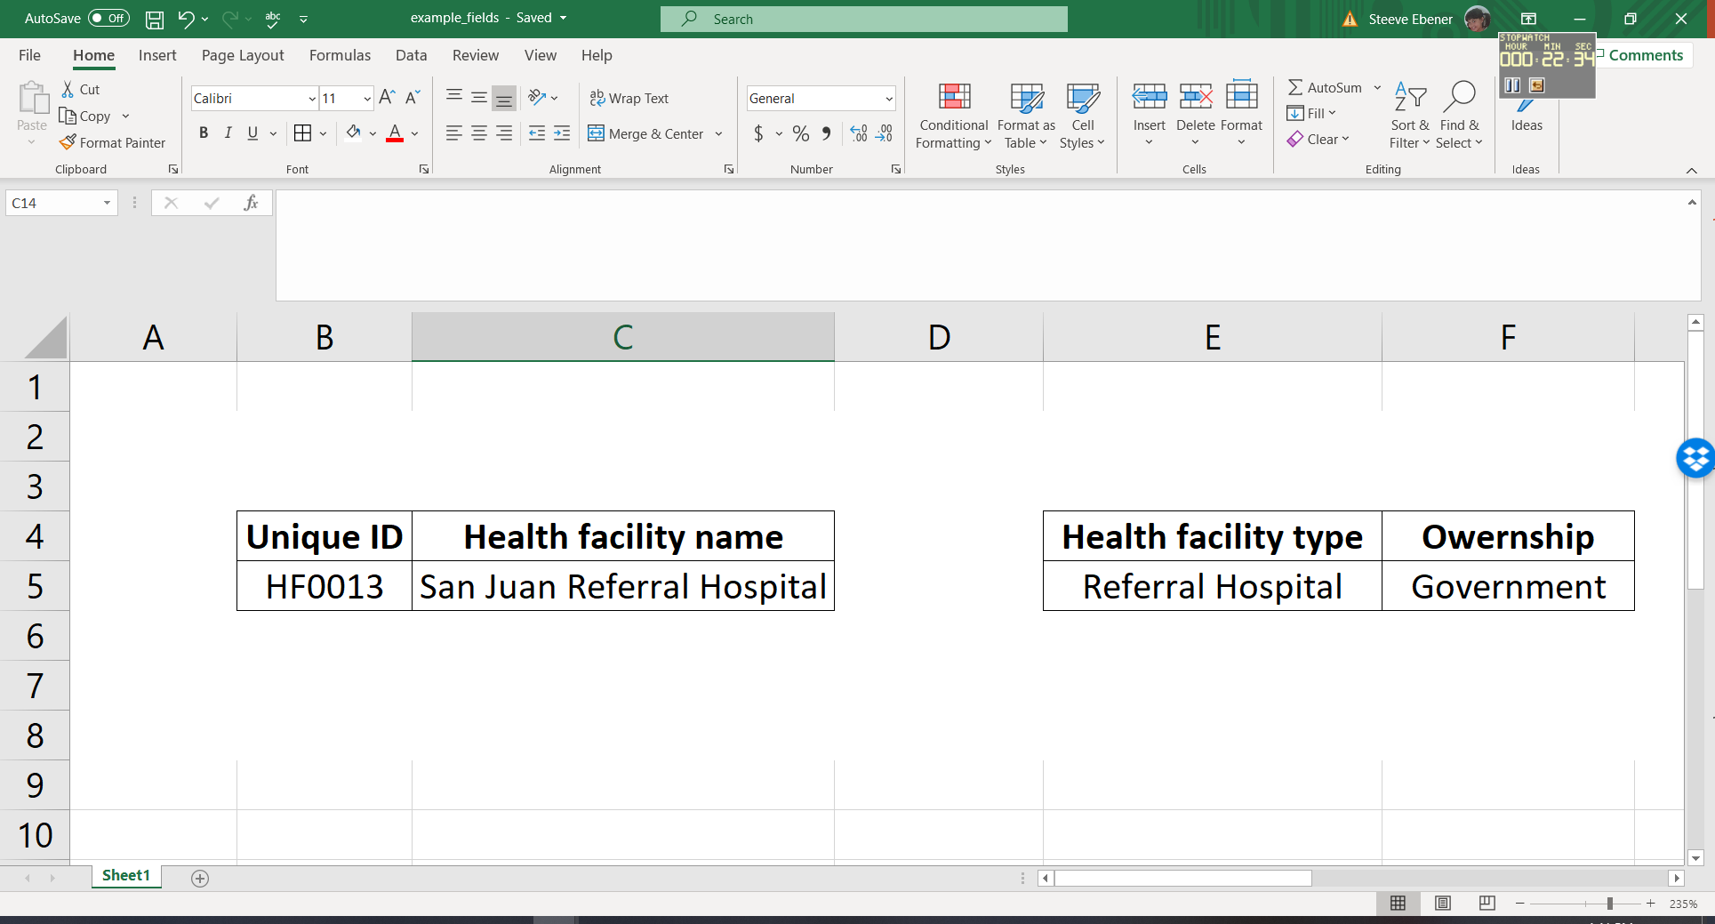
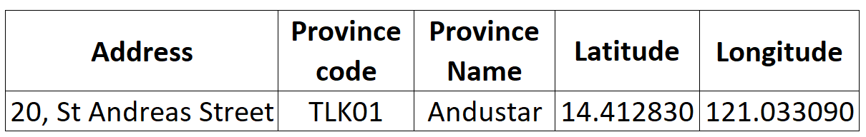
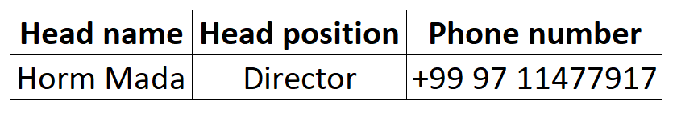
Define ground references – Georeferenced master Lists
Unique, authoritative, officially curated by the mandated agency, complete, up-to-date and uniquely coded list of all the active (and past active) records for a given type of geographic feature/object (e.g. health facilities, administrative units, villages)
The information that allows to do the following for each of the records in the master list:
Uniquely identify (unique identifier, name)
Classify (type, ownership,…)
Locate (address, administrative division, geographic coordinates)
When it applies, contact (head name, phone number, email address,…)
Example for health facilities
Any other data element is to be considered programmatic attributes and managed outside the master list
27

Slide 28



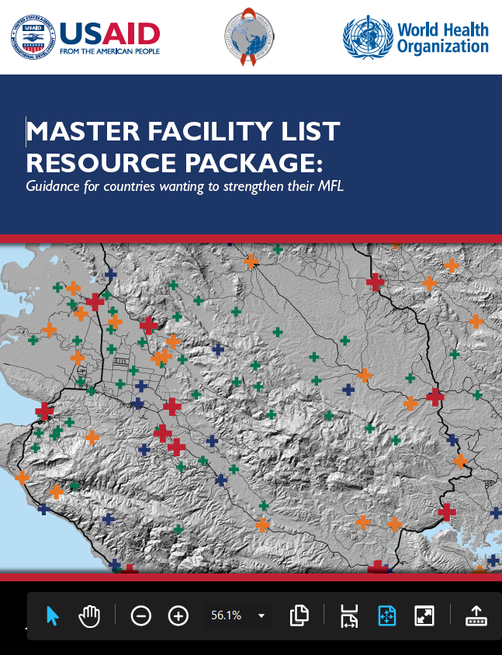

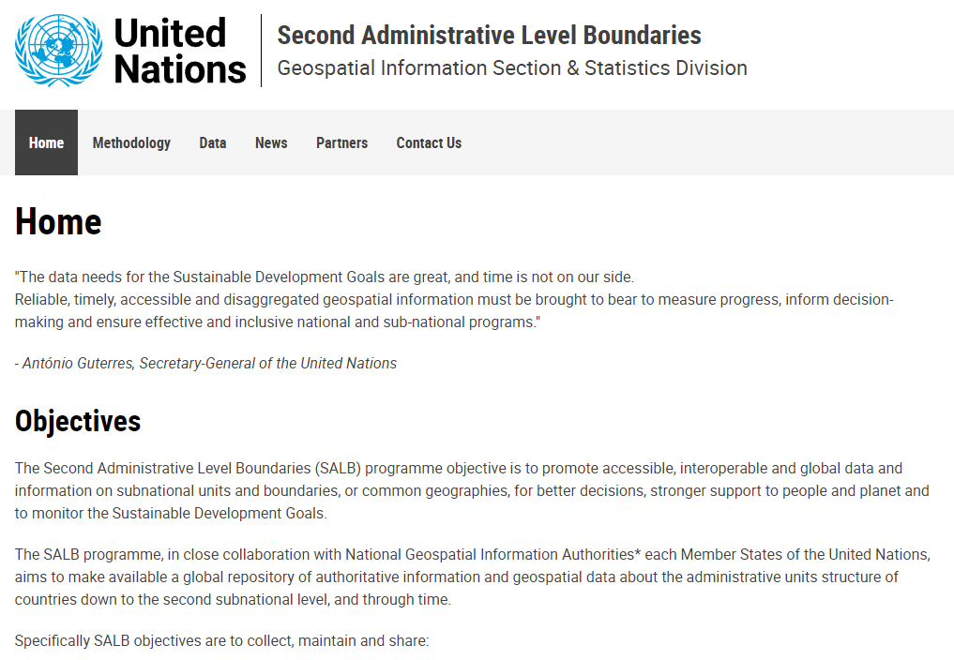

Define ground references – Georeferenced master Lists
Key elements mentioned in several health program guidelines
…the main subject of a growing number of master list-specific documents
Administrative units
Health facilities
…and at the origin of global level initiatives
https://salb.un.org/en
https://www.who.int/data/GIS/GHFD
28

Slide 29
Define ground references – Georeferenced master Lists
Key elements of a master list
Definition
Content
  Data elements and dictionary
  Coding scheme
  Naming convention
  Classification tables (types, Owner)
  Locations (addresses, administrative divisions, geographic coordinates)
  Contact information (establishment manager, phone number, etc.)
Registry or Common Geo-Registry (CGR)
Process
29

Slide 30

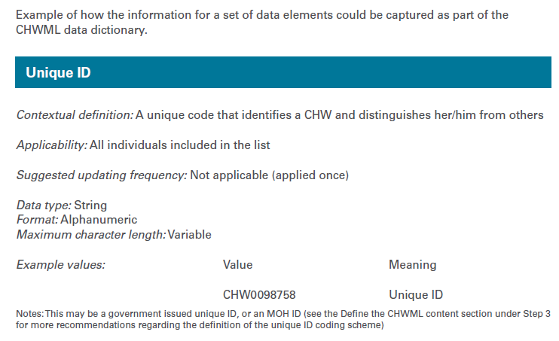
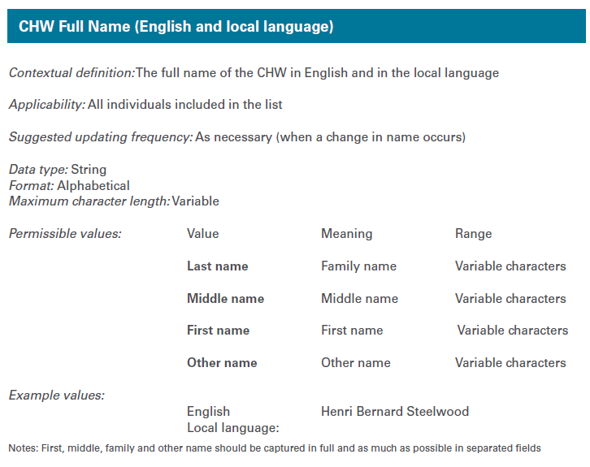
Georeferenced master Lists – Data dictionary
A collection of names, description, and attributes about the data elements that are being used or captured in a database or information system
Such a dictionary should contain the following for each data element:
A clear contextual definition
Its applicability (applied to all records in the list or only some of them)
Its format (alphanumeric, numeric, date, other)
Its maximum character length
The values that the data element can take, especially when these are bound to a limited number of options (classification tables)
Whether the data element should be considered as mandatory when a new record is being added to the master list (all the core data elements should be considered as mandatory by default).
Needs to be developed for each master list and must contain the information for all the data elements to be included in each of them
The list of data elements to be included is developed through a consultative and collaborative involving the concerned stakeholders
30

Slide 31
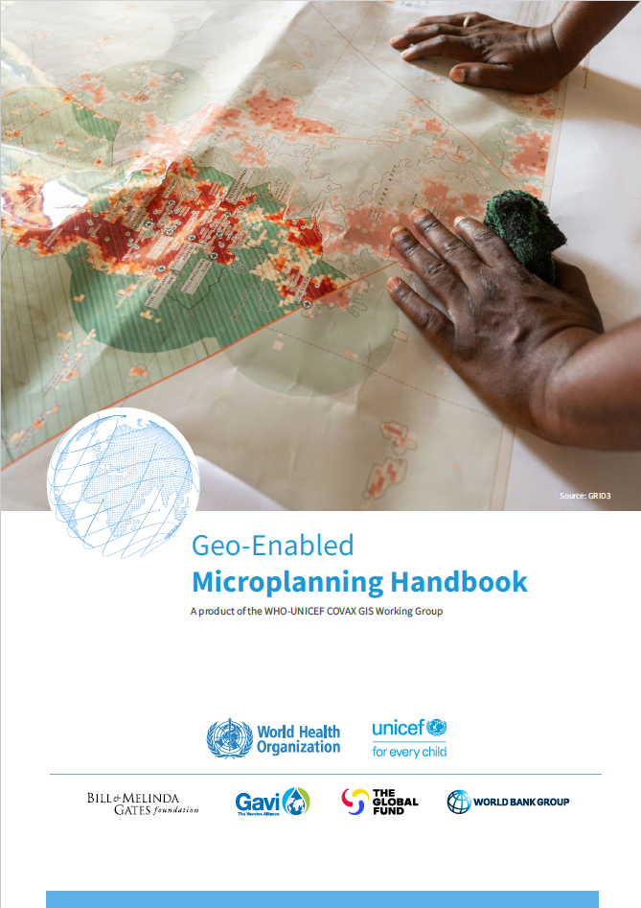
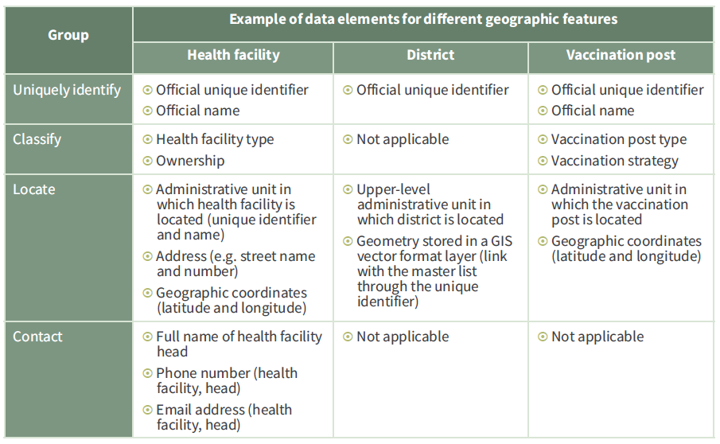
Georeferenced master lists – Data elements
Examples of core data elements for different types of geographic features
Depends on how the concept of vaccination post is defined
31

Slide 32
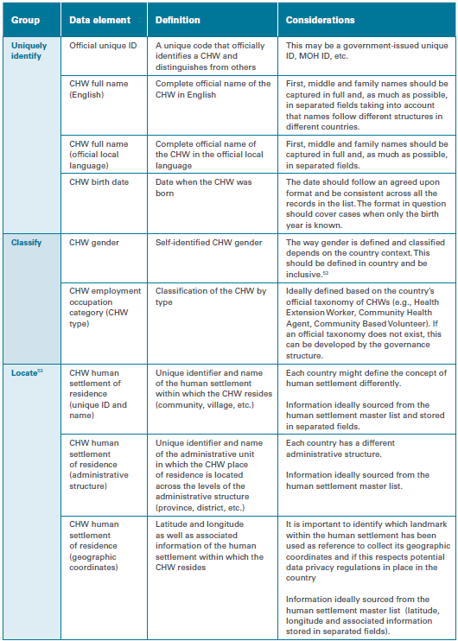
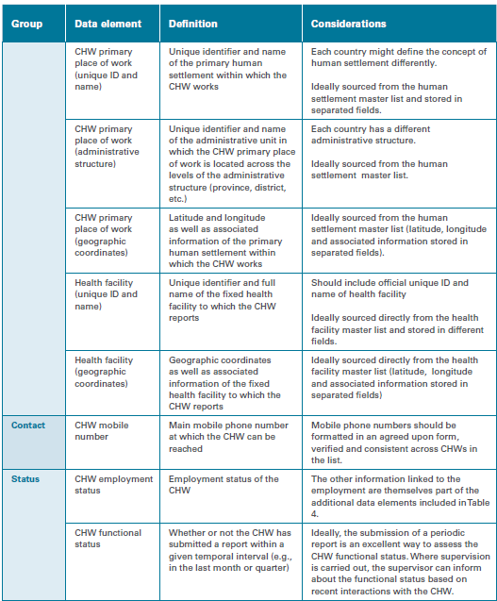
Georeferenced master lists – Data elements
Core data elements for establishing a community health worker master list
Core data elements necessary to uniquely identify, classify, locate and contact each Community Health Worker in the country as well as know their current contractual and reporting status.
32

Slide 33
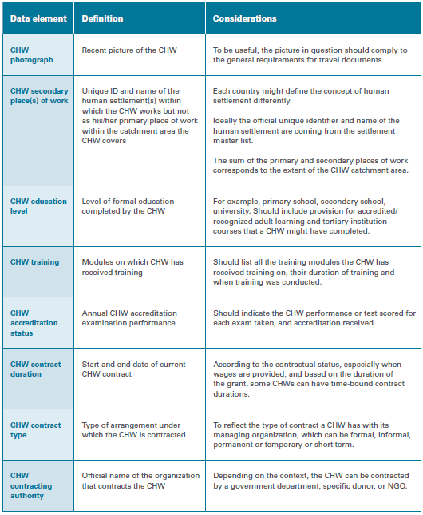
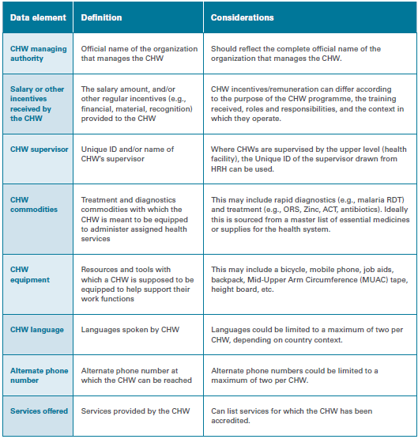
Georeferenced master lists – Data elements
Additional data elements for establishing a community health worker master list
Example of additional data elements to be prioritized in order to define which ones to be included in the minimum set for the master list
Note: the more data elements you include the more difficult it is to maintain the quality of the master list
33

Slide 34
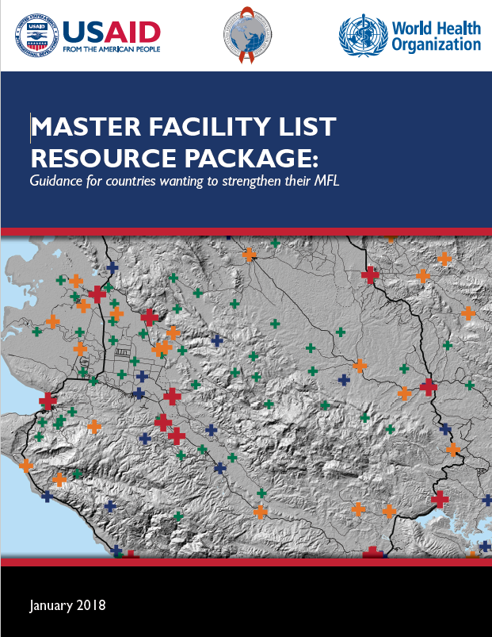
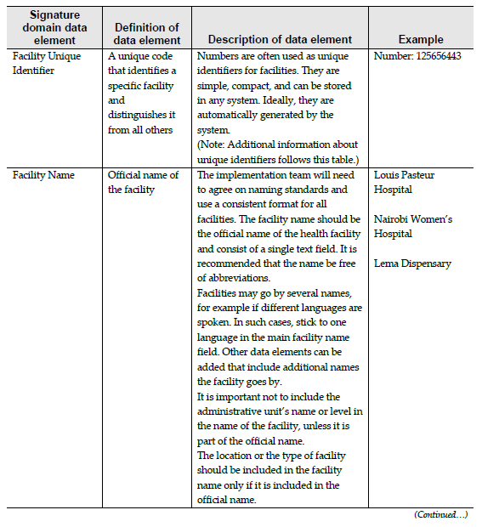
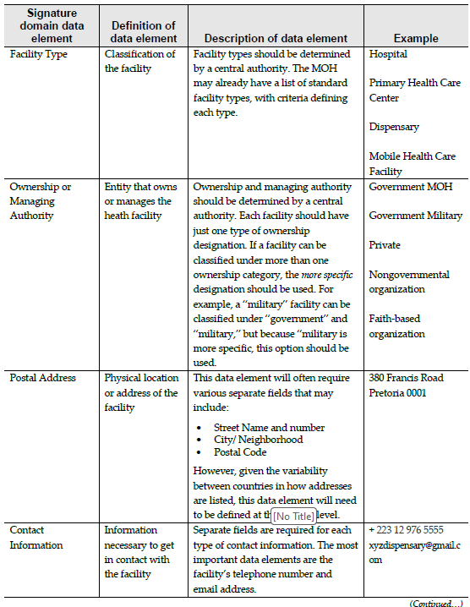
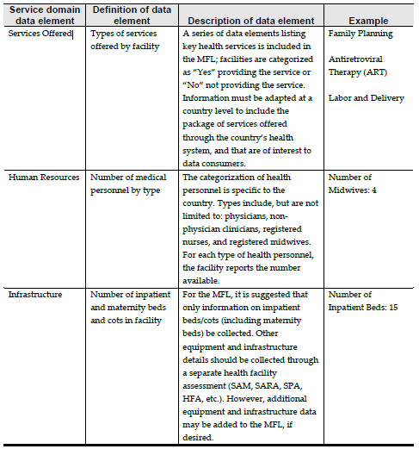
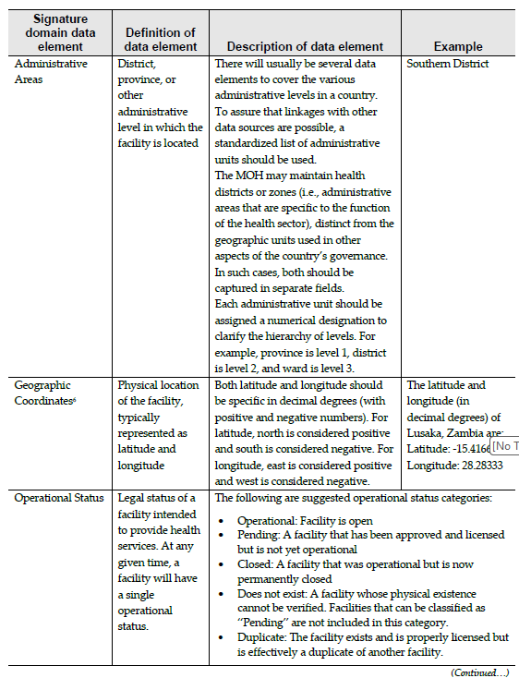


Georeferenced master lists – Data elements
Health facility master list (HFML) vs Master Facility List (MFL)
Service domain data elements
Included in the Master Facility List concept
Signature domain data elements
https://www.who.int/publications/i/item/-9789241513302
34

Slide 35
Georeferenced master lists – Data elements
Health facility master list (HFML) vs Master Facility List (MFL)
Including service domain data elements in the HFML should be carefully considered because:
Covering the 4 groups of data elements considered as being core to master lists (uniquely identify, classify, locate and contact) can already result in a long list of data elements to include in the data dictionary and therefore the master list
Service domain data elements can be under the curation mandate of different entities and have their proper life cycle
Service domain data elements can be more sensitive than the signature domain one
Example: Master list of health facilities – Mongolia (33 proposed signature domain data elements)
Synchronization of the information system containing the service domain data elements with the HFML through the integration of the health facility unique identifier
35

Slide 36


Georeferenced master lists – Classification tables
Table organizing and categorizing the values for a data element according to predefined criteria
To be defined for each of the data elements where the values are limited to a set of options (example: type, ownership, accuracy, etc.)
Ensures consistency across records
36

Slide 37
Georeferenced master lists – Coding scheme
Core rules to choose an appropriate coding scheme to uniquely identify each record in the master list:
Province | District | Health facility
Ensure for the code schemes to be meaningless when applied to an infrastructure => never include information that could change through time in an identifier (e.g., admin division code, health facility type, etc)
2. Use a sequence as short as possible but considering the number of changes that could take place over the coming decades (function of the current number of health facilities observed in the country for example) to avoid having to modify the structure of the coding scheme at some point
3. Use a specific set of characters at the beginning of the sequence (e.g. “HF”) to avoid the problems linked to having a “0” in front of it (disappears or format not considered in the same way (e.g., text vs integer) in some application/software
09 | 01 | 10
148337353801198976
08365222
37

Slide 38


Georeferenced master lists – Coding scheme
Ensure for the unique identifier to remains the same from the start until the end of existence of each geographic feature (example: from the opening until the closing of a health facility and this even if its name, type (upgrade) or location changes (because of a flood for example))
2017
2010
2010
Example for Cambodia
2005
2005
All the other information are stored in the master list and past values are kept in the IT solution serving as health facility registry
Allows following the changes occurring through time for any data element of a given record
38

Slide 39
Georeferenced master lists – Coding scheme
“Geo-tag”
If users want to be able to quickly identify which administrative unit a health facility is located in, they can always use what we call a “geo-tag”.
Concatenate the unique identifier of the administrative unit with that of the health facility on the fly based on the contents of the health facility master list
1020113 + HF000005
Geo-tag: 1020113HF000005
Not to be used as a unique identifier as this “tag” has meaning and it will change over time!
39
39

Slide 40


Georeferenced master lists – Naming convention
Good practice:
    In local language and English
    Include the name in full (avoid acronyms)
    When applicable, avoid name duplicates by including:
      the infrastructure type
      The name of the administrative unit in which the feature is located
A unique name for each feature
Examples for
Myanmar
40

Slide 41


Georeferenced master lists – Location
Address
Street number and name (if applicable)
Possibly the postal code if useful
Location in the administrative structure
Official code and name of the administrative unit of 1st, 2nd, 3rd,… level in which the geographic feature is located
The administrative structure of the country also evolves over time
Requires a regularly updated master list of administrative units and settlements
Such master list should come from the governmental entity having the curation mandate over this information
41

Slide 42







Georeferenced master lists – Location
Geographic coordinates
Latitude and longitude of each geographic feature expressed in decimal degrees as well as the indication of the source, method and level of accuracy attached to the coordinates (a separate data element for each information)
Example:
COOR_SO: Source
COOR_MU: Method used
COOR_AC: Qualitative assessment of accuracy
Thematic mapping
Examples for Cambodia
Spatial analysis
Spatial modeling
42

Slide 43




Georeferenced master lists – Contact information
Information needed to contact the healthcare facility through various media, including:
The full name and position of the head of the infrastructure
Telephone numbers (mobile, landline)
E-mail address
Not applicable to all the geographic features
43

Slide 44
Georeferenced master lists – Process
Assess the current state
Establish the governance structure
Define the target state
Generate the first version of master list
Establish the registry (or common geo-registry) to host, manage and regularly update the master list
Share and use the master list
Maintain the master list and registry
44
44

Slide 45



Compile existing data, identify and fill data gaps
The next steps consist in compiling existing data and identifying potential gaps against the needs that have been defined at the beginning of the process
Topics of one of the HGL’s guidance document (2.3)
1
The identified gaps is then to be filled as much as possible using different methods depending on the type of data and the resources at this disposal
Topics of two other HGL guidance document (2.4.1 and 2.4.2)
2
3
1 https://www.healthgeolab.net/DOCUMENTS/Guide_HGLC_Part2_3.pdf
2 https://healthgeolab.net/DOCUMENTS/Guide_HGLC_Part2_4_1.pdf
3 https://healthgeolab.net/DOCUMENTS/Guide_HGLC_Part2_4_2.pdf
45

Slide 46
Compile existing data
What to compile?
All data identified during the step which defined the data needs
Depending on the applications of geospatial data and technologies considered, and therefore the GIS-products to be generate, this may include:
  All data and information that could be used to establish one or more master lists
  If they already exist, the master list for all the geographic features included in the data model that has been documented
  The geospatial data containing the location (point) or extension (polygons, lines) of these same geographic entities
  Statistical data that will either be represented on thematic maps or used during geospatial analyses or modeling
  The parameters that will be used during certain analyses (example: travel scenario)
It is critical to obtain, and to keep, the metadata for this data and information
46

Slide 47

Compile existing data
Source of the data to be compiled – Master lists and geospatial data
Master lists should only come from the government entities having the official curation mandate over each considered geographic feature.
This table provides the list of the governmental entities generally in charge of the master list and associated geospatial data for the geographic features core to public health.
A master list is not required for certain geographic features
47

Slide 48
Compile existing data
Other potential sources of data to compile
Non -governmental sources of geospatial data can also be considered according to the availability, accessibility and quality of the governmental data
For example:
NGOs (UN, etc.) and voluntary groups (e.g. OSM): administrative boundaries, road network, hydrographic network, populated places, etc.
Research groups/universities: Population distribution grids (e.g. WorldPop), land cover, DEM
The quality and usability (e.g. use and/or redistribution rights) of this data must first be identified
48

Slide 49
Compile existing data
Other potential sources of data to compile – Example of global data
Geographic feature | Database name | Temporal validity/ last update | Format | Website | Access rights | Use restrictions | Redistribution restrictions
Digital elevation model | SRTM90 | 2000 | Raster | https://cmr.earthdata.nasa.gov/search/concepts/C1214622194-SCIOPS | Open access | Commercial use | Commercial use
Land cover | Copernicus Global Land Cover Layers | 2015 - 2019 | Raster | https://land.copernicus.eu/global/products/lc | Open access | None | None
Distribution of the population | WorldPop | 2020 | Raster | https://hub.worldpop.org/geodata/summary?id=50236 | Open access | None | None
Hydrographic network | OpenStreetMap (OSM) | 2024 | Vector | http://download.geofabrik.de/ | Open access | None | None
Transport network | OpenStreetMap (OSM)
Building footprint | Google Open building | 2021 | Vector | https://sites.research.google/open-buildings/ | Open access | None | None
49

Slide 50

Compile existing data
Organization of the compiled data
It is important to organize the data compiled so that it can be easily found, including by other users in the event of sharing it within a group.
Example using 3 levels of folders:
Data category corresponding to geographic characteristics (for example administrative divisions)
Data type
Four types to consider:
Documents: reports, publication and other narrative documents
GIS: For geospatial data
Maps: for maps saved in PDF, MS Word, or other formats
Tables: data recorded in the form of a table (Excel, CSV, DBF, etc.)
3. Data source with a file by source, including metadata
The compiled data file is then placed in the corresponding subfolder
50

Slide 51





Clean and homogenize compiled data
Lists and geospatial data
Once organized the data will have to be cleaned and homogenized in terms of validity (format, structure) and uniqueness (duplicate)
Lists
Geospatial data
Data specifications
The lists (if more than one) can then be merged (rows) and/or combined (columns)
+ When applicable, align the geospatial data attribute table with the contents of the corresponding master list
First draft of master list for which gaps can be identified
Geospatial data for which gaps can be identified
51

Slide 52




Clean and homogenize compiled data
Using MS Excel
Step-by-step
An important part of the cleaning and standardizing work for the compiled lists will happen in MS Excel before the first version of the master list is managed in a registry or common geo-registry
It is important to know how to use a set of functions and tools available in MS Excel
Exercise file
Subject of one of the guides prepared by the Health GeoLab (2.5.2)
Result file
https://healthgeolab.net/DOCUMENTS/Guide_HGLC_Part2_5_2.pdf
52

Slide 53

Clean and homogenize compiled data
Identify temporal disparities
  Data collected at, or representative of, different points in time
  Roads (2023)
  Land cover (2000)
  Administrative boundaries (2015)
  Hydrographic network (2020)
  Population (2009)
  Satellite imagery (2022)
  The GIS software will not report this problem
  This should be identified as part of the cleaning and homogenization process
  Importance of metadata
53

Slide 54

Clean and homogenize compiled data
Identify data gaps
Data gaps can be of two types:
No source is available, accessible and/or usable (e.g. restriction of use)
  There are gaps across some or all the six dimensions of data quality.
  For example:
1st draft of the master list
Geospatial data
Lack of value/information for certain data elements
Uncertainty about values/information entered (e.g. accuracy of geographic coordinates)
Outdated information
Geographic features not captured or missing
Tracing of geographic features not aligned with satellite imagery (example: roads)
Inconsistencies between databases (administrative boundaries not aligned with the hydrographic network)
54

Slide 55


Assess the quality of compiled data
Lists and Master lists
Questions to assess the quality of the master list, or lists to be combined, across the 6 dimensions of data quality
Several cases may arise after answering these questions:
None of the lists contains information considered to be of sufficient quality (too old, too much gaps, many duplicates, etc.).
Create the master list from scratch
Only one of the lists contains information considered to be of sufficient quality.
Process based solely on this list (no fusion is necessary).
Several lists contain information considered to be sufficient quality.
Merge the different lists together
55

Slide 56

Assess the quality of compiled data
Geospatial data
Questions to assess the quality of compiled geospatial data
Consistency is itself reached once the reference criteria set for the other dimensions are reached
56

Slide 57
Assess the quality of compiled data
Statistical data
When it comes to statistic data, the questions to answer are mainly the following from the point of view of their use in an application of geospatial data and technologies:
Timeliness:
  What is the temporal validity of statistical data?
  Does it correspond to the temporal validity defined in the data specifications?
Completeness:
  Is a value available for each of the records in the corresponding master list?
Uniqueness:
  Does the data set contain duplicates?
Validity:
  Is the data set accompanied by a data catalogue and metadata containing all the information necessary to use it correctly?
  Is the data set available in a format that allows its use or could be converted to such a format?
57

Slide 58

Assess the quality of compiled data
Identified data gaps
All the gaps should be documented and ideally filled as part of the action plan implementation
  Before that, it is always worth to first make sure you have not missed any data sources during the data compilation exercise
  If this is not the case, the gaps need to be filled
58

Slide 59
Fill data gaps
Data gaps don’t need to be filled at this stage, but it is important to estimate if and how this can be done in preparation for the development of the action plan
Filling data gaps (georeferenced master lists, geospatial and statistical data) can be done in the following main ways:
By improving existing data (geospatial data)
By collecting or extracting additional data (lists, geospatial data, statistical data)
Modelling or projecting values (statistical data)
It is important to start by filling the gaps in the master lists because they serve as the ground reference for geospatial and statistical data
Independently from the method, the data in question should be validated to ensure the highest possible quality
59

Slide 60






Fill data gaps
Possible approaches to fill data or information gaps
HGL guides covering part of these methods (2.4.1 and 2.4.2)
60

Slide 61

Fill data gaps – Master list
Before collecting data to fill the gaps identified in the first draft of a master list, it is important to validate the list in question with the government entity in charge of curating this list to ensure that the list:
Contains all currently active geographic features – Record-level completeness
Contains the indication of the administrative unit (from the highest to the lowest level in the hierarchy) in which each geographic feature is currently located
Does not contain duplicates that might have been missed during the cleaning and homogenization step
It is important to identify at what level of disaggregation the validation should take place to involve people with situational awareness on the ground
Depending on the situation, and the type of geographical feature, validation can constitute the first step when collecting data in the field
61

Slide 62
Fill data gaps – Master list
Once the completeness of the records of the 1st draft of the master list validated by the curating government authority, and this applies to any geographic feature (infrastructure, health personnel, etc.), the collection of missing, uncertain or outdated data can take place
Two types of data can be distinguished at this level because they may require a different collection method:
Geographic coordinates
Other data elements contained in the list
In both cases, a Standard Operating Procedure (SOP), including the validation step, should be defined and documented and the data collectors trained accordingly to ensure the effectiveness of the exercise and the quality of the data collected
Important note: the official unique identifier of each geographic feature as captured in the master list must be included in the data collection instrument being used to make the link with the master list
62

Slide 63

Fill data gaps – Collecting geographic coordinates
Twelve (12) methods for collecting geographic coordinates have been identified and documented by the Health GeoLab (guidance 2.4.2):
This table can be used to determine the most appropriate method based on the need for scalability and main data use
63

Slide 64
Fill data gaps – Collecting geographic coordinates
When selecting a method from this table, it is important to remember that:
These methods consider that there is no pre-existing electronic field data collection system in place in the country. If a system is already in place, and it provides the necessary functionalities to collect quality data then using it should be considered
The use of an electronic form, with predefined content when applicable, can considerably reduce data collection time as well as data entry errors. The use of such form should therefore be preferred over paper ones
The higher the positional accuracy and precision of the collected coordinates, the greater the number of use cases. It is therefore recommended to always aim to achieve the highest possible level of positional accuracy and precision
Collecting geographic coordinates through the sole use of an offline map application (methods 1-3) requires that data collectors know how to navigate on a map or imagery and to recognize the terrain from an aerial view
64

Slide 65

Fill data gaps – Collecting geographic coordinates
The following items are required for each of these methods:
  Data collection form
  A standard operating procedure (SOP)
  The master list of the geographic features for which geographic coordinates are to be collected
Data collection form
A proper collection form should include fields allowing to capture:
The official name and unique identifier of the geographic feature taken from the master list
The address and location in the administrative structure (official name and unique identifier of the administrative unit in which the geographic feature is located) of the feature
The geographic coordinates of the geographic feature as well as the fields used to evaluate the quality of these coordinates (number of signals, instrumental accuracy).
65

Slide 66

Fill data gaps – Collecting geographic coordinates
Standard Operating Procedure (SOP)
A SOP is a document that:
Contains the details of the steps to follow to collect and verify the quality of geographic coordinates
Should be used during the training of data collectors and supervisors as well as during the data collection exercise.
Focuses on providing only essential information, being as clear and simple as possible, covering all the fields in the form, and including illustrations that will help the data collector complete each step
66

Slide 67
Fill data gaps – Collecting geographic coordinates
Master Lists
The data collection exercise is based on the use of the master list of:
  Geographic features that need to be located: typically, infrastructure (e.g., health facility, school, household) or place (e.g. village)
  Administrative units: For the area covered by data collection exercise (total or part of the country)
The following items are also required to implement some of the method being used:
Geospatial data containing the boundaries of the administrative units
A Geographic Information System (GIS) software
GNSS-enabled devices
An Offline map application
Anticipated minimum/maximum values for geographic coordinates
Purpose-designed data collection application
67

Slide 68



Fill data gaps – Collecting geographic coordinates
Several important steps must be implemented before, during and after data collection.
Before data collection:
Prepare the materials needed to implement the selected method and to train data collectors and supervisors.
Select the data collectors and their supervisor(s)
Train data collectors and supervisors so that they can be as independent as possible once in the field
A good training including practical exercises is key to a successful data collection exercise!
68

Slide 69


Fill data gaps – Collecting geographic coordinates
During data collection:
The most important is to ensure that the data collectors follow the standard operating procedure for which they have been trained.
It is also important to rapidly detect and resolve any unexpected issues while the data collectors are in the field.
The following measures can be implemented depending on available resources and the geographic extent of the area being covered:
On-site spot checks of data accuracy and completeness conducted by the data collection supervisor
Remote verification of the collected data submitted using a Google spreadsheet for example
69

Slide 70


Fill data gaps – Collecting geographic coordinates
After data collection:
If this has not already been done as part of the data verification process implemented during the data collection, it is important to ensure that the data collected is organized into a structured table that can be saved or exported under the form of a spreadsheet (for example, in Microsoft Excel).
If the data is collected in electronic form, it must be possible to export it in a similar structure. This dataset must contain all fields included in the data collection form.
It is important that the worksheet containing the data is accompanied by the following two additional worksheets:
The data catalogue
The metadata
70

Slide 71



Fill data gaps – Geospatial data
Filling gaps in geospatial data can be done in different ways depending on the expected format:
  Raster format:
    Use of remote sensors placed on a satellite, airplane or drone (remote sensing)
  Raster or vector format:
    Processing images from remote sensing (image processing)
  Vector format:
    Adjust, create or extract point, line, or polygon type geographic features from a basemap
The method you are most likely going to use
71

Slide 72








Fill data gaps - Adjust, create or extract point, line, or polygon type geographic features from a basemap
Adjust GIS data in vector format (editing)
Create/extract data in vector format (digitizing)
Data specifications
300 m!!
72

Slide 73





Fill data gaps - Adjust, create or extract point, line, or polygon type geographic features from a basemap
When editing and/or extracting vector data from a basemap, it is important to choose
  The appropriate basemap
  Respect the data specifications that have been defined:
    Imagery: temporal validity, resolution, positional accuracy
    Scanned map: temporal validity, scale, resolution
  Images should be free of clouds wherever possible to ensure completeness.
  The images must be well orthorectified to avoid "duplicates" at the border between two scenes.
73

Slide 74


Fill data gaps - Adjust, create or extract point, line, or polygon type geographic features from a basemap
When editing and/or extracting vector data from a basemap, it is important to choose
  2. The most appropriate method:
  Manual Extraction: human-guided digitizing of geographic features from a basemap (usually done on-screen these days)
  Interactive extraction: manual extraction of features assisted by the automatic snapping to raster cells functionalities provided by the GIS software or application being used
  Automatic Extraction: An automatic, computer-guided method that converts raster data into vector data using image processing software that uses pattern recognition technology
74

Slide 75

Fill data gaps – Population estimates and spatial distribution
Different types of gaps might have to be filled:
Need to expand the geographic extent of the available population estimates to obtain full coverage. The method being used will depend on the available data:
Bottom-up estimation to fill gaps
2. Need to increase the resolution of the population estimate (disaggregate)
Top-down estimation to fill gaps
3. Project the population estimates to be representative of the point in time for which it is needed
2015 2020 2024
75

Slide 76
Fill data gaps - …and in the end…
It may well be that some of the gaps could not be filled due to lack of time and/or resources
If this is the case, a decision will have to be taken regarding the creation of the GIS-based products:
Option 1: The quality of the data remains sufficient for generating good quality GIS-based products (! Be careful of the impact this could have on decision-making!). In this case, it is necessary to precisely document the limitations that this implies, including for the GIS-based products that will be created.
Option 2: The quality of the data is insufficient, and this is a major limitation. In this case, the creation of the GIS-based products may need to be postponed until the necessary time and/or resources are available.
Option 3: The quality is insufficient, but the gaps could be addressed as part of the action plan implementation or the operationalization of the updating mechanism
76

Slide 77

Document the data - Metadata
Documentation is a key activity in the geospatial data management cycle. It applies not only to processes (Step 2.1), but also to individual data that has been compiled and/or created.
Georeferenced master lists, geospatial and statistical data must be properly documented using what we call metadata.
Topics of one of the HGL’s guidance document (2.5.1)
https://www.healthgeolab.net/DOCUMENTS/Guide_HGLC_Part2_5_1.pdf
77

Slide 78

Document the data - Metadata
Information that describes the content, quality, condition, origin, and other characteristics of data or other pieces of information.
Data about the data
Allows user to find out if the data is appropriate for its intended purpose
Applies to georeferenced master lists, geospatial and statistical data
The information captured in the metadata profile should be captured as much as possible during data collection and completed before data dissemination
Begin as soon as the data specifications are defined.
78

Slide 79

Document the data - Metadata
Good metadata must at least make it possible to answer the following questions:
  What is the data about?
  Who created the data?
  When was the data created, collected, last updated or released?
  How was the data created?
  What are the data specifications associated with the data (geographic coordinate system/projection system, extent, scale, accuracy, precision, language, etc.)
  Is the data subject to any use or redistribution restrictions?
  Who can I contact if I have questions about the data?
79

Slide 80


Document the data - Metadata
Information is to be captured into a metadata record based on a metadata profile (contextualization of an existing metadata standard).
A metadata standard is a requirement to establish a common understanding of the meaning or semantics of data, and to ensure correct and adequate use and interpretation of data by its owners and users.¹
The most widely used metadata standards for geospatial data are those produced by:
  The International Organization for Standardization (ISO)
  The Federal Geographic Data Committee (FGDC)
The ISO standard is obtained by international consensus which promotes a wider use
The FGDC is even encouraging federal agencies to transition to the ISO metadata standard ²
¹ https://en.wikipedia.org/wiki/Metadata_standard ² https://www.fgdc.gov/metadata/selecting-a-geospatial-metadata-standard
80

Slide 81




Document the data – Metadata for geospatial data
The minimum metadata profile for geospatial data recommended by the HGL is based on the ISO 19115 metadata standard.
30 fields to fill in to cover the key questions mentioned earlier
81

Slide 82

Document the data – Metadata for georeferenced master list
There are no specific metadata standards for georeferenced master lists.
A simple and effective way is to add a “ data catalogue” and a "metadata“ worksheets into the Excel file containing the georeferenced master list when sharing it.
Data catalogue
Metadata
82

Slide 83


Document the data – Metadata for statistical data
There are different metadata standards for statistical data, including the EDSM (Exchange of Statistical Data and Metadata) initiative. However, these standards tend to be difficult for non-IT professionals to understand and focus more on how data and metadata are exchanged.
The same approach as the one used for georeferenced master lists can also be applied for files containing statistical data
Data catalogue
Metadata
“Data catalogue” and "metadata“ worksheets included into the Excel file containing the statistical data .
83

Slide 84

Document the data – Metadata for georeferenced
master list and statistical data
Microsoft Excel is the recommended file format for exchanging georeferenced master lists and statistical data because:
  It is widely used in countries
  It allows the storage of data and information in multiple worksheets within the same file, which is not the case with other file formats such as .csv files.
This allows the georeferenced master list or statistical dataset as well as the data catalogue and metadata to be stored in a single file, ensuring that none of this information is lost when shared.
84

