Slide 1

Introduction to geospatial data management
and technologies for Health Programs training workshop - Timor Leste
Session 7: Verification of the installation of the GNSS app and QGIS

Slide 2
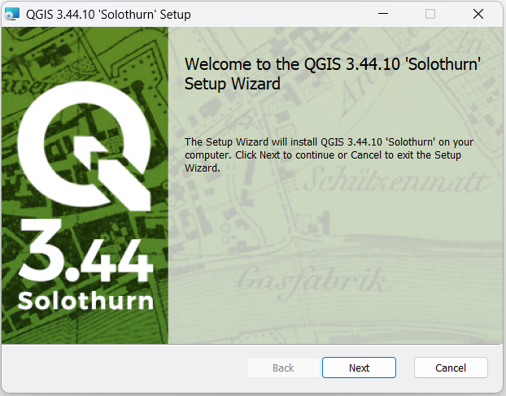
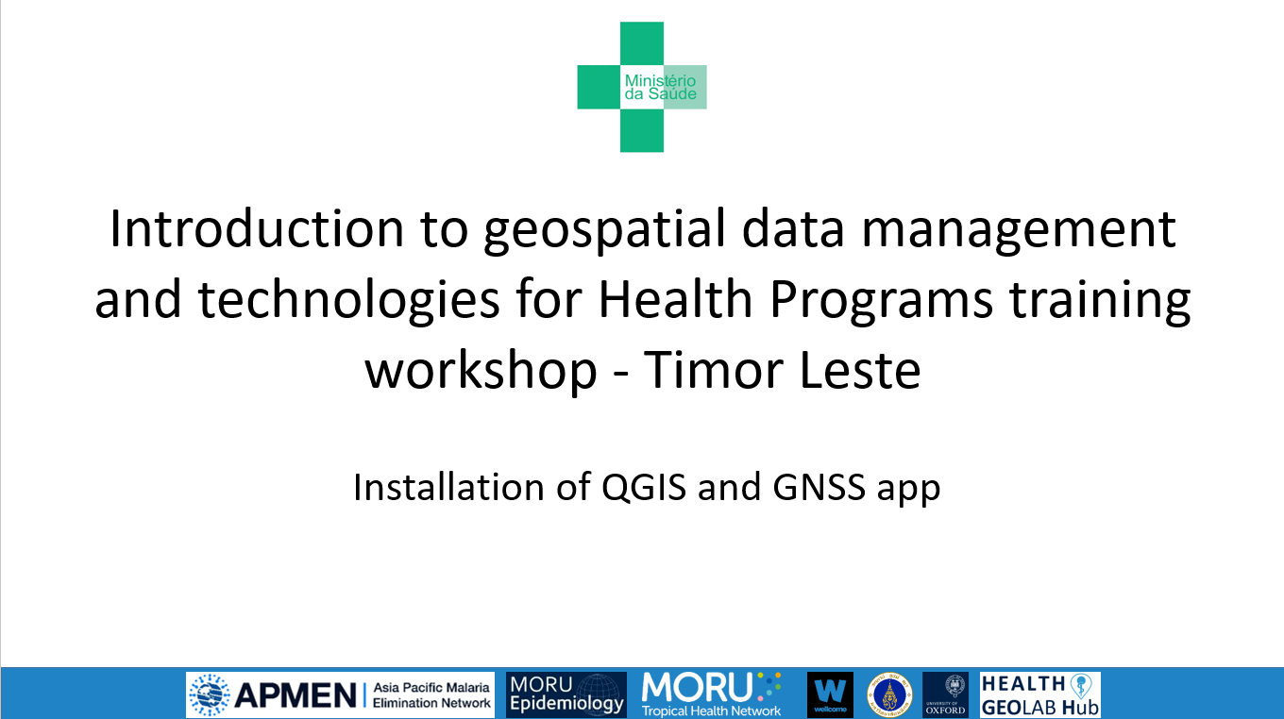
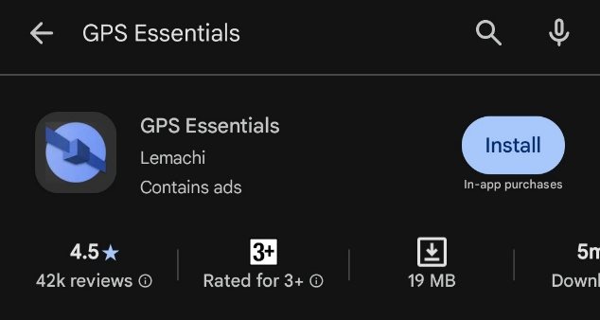
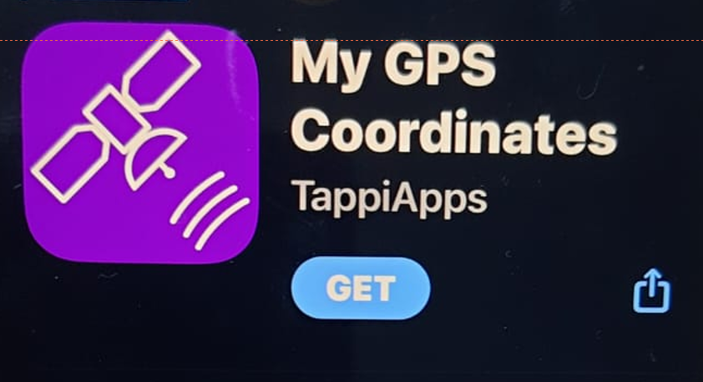
Installation steps sent prior to the training
Android
iOS
2

