Slide 1

Introduction to geospatial data management
and technologies for Health Programs training workshop - Timor Leste
Session 8: Introduction to geospatial technologies

Slide 2
Geospatial Technology – Definition
Set of technologies such as Geographic Information Systems (GIS), Global Navigation Satellite Systems (GNSS), photogrammetry, and remote sensing (RS), for acquiring and manipulating geographic data.¹
This also includes new technologies starting to be deployed (e.g., Common Geo-Registry (CGR))
¹ Modified from: https://support.esri.com/en-us/gis-dictionary/geospatial-technology
2

Slide 3
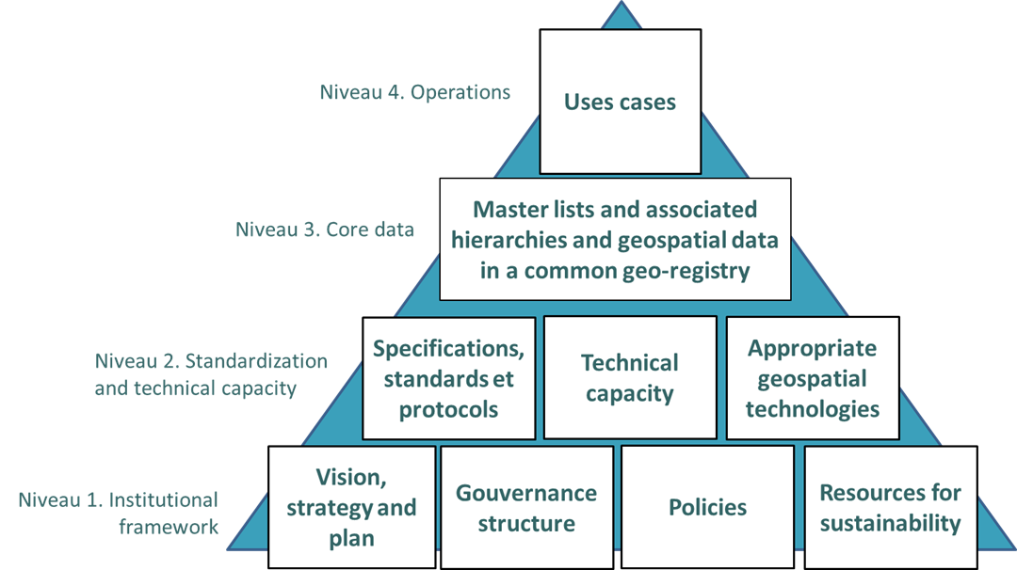
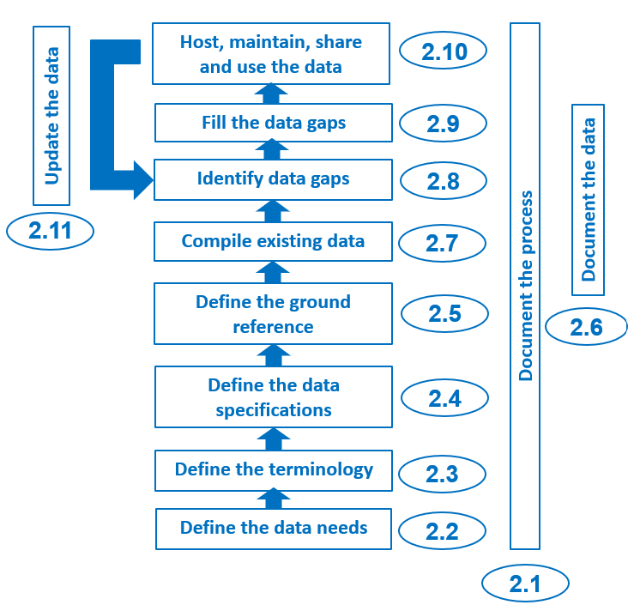
Place of Geospatial technologies in the HIS geo-enabling framework and geospatial data management cycle
Technology supporting content and use cases, not driving them!
3

Slide 4
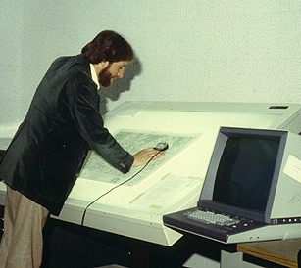
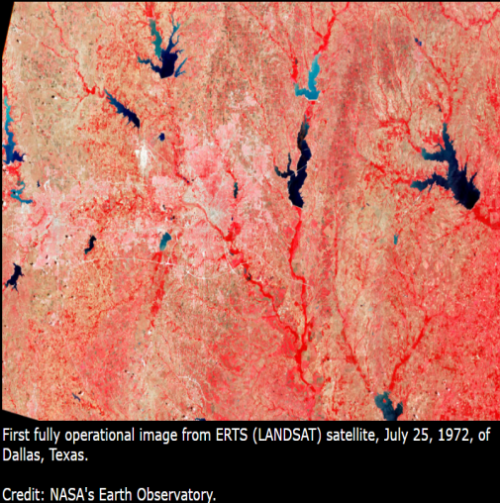

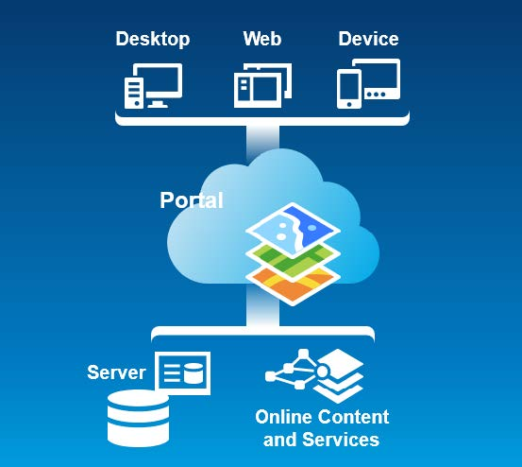
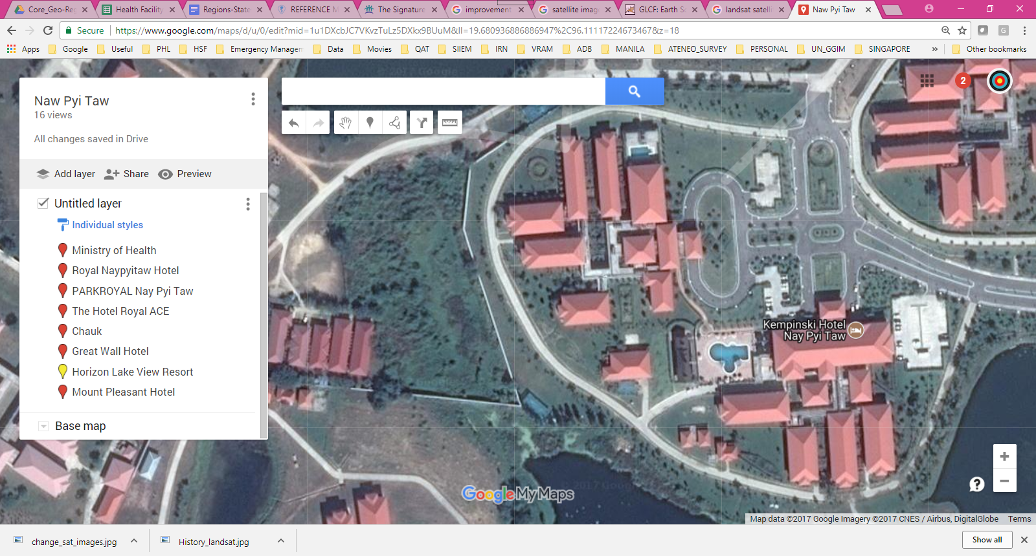


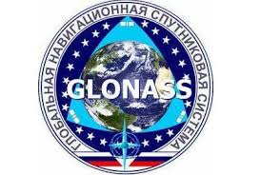
Evolution of geospatial technologies
These technologies have evolved enormously over the last 50 years
GIS
GNSS
Remote sensing
1970s
2026
4

Slide 5
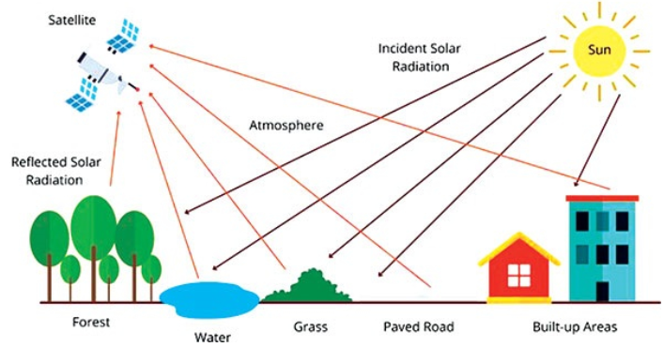
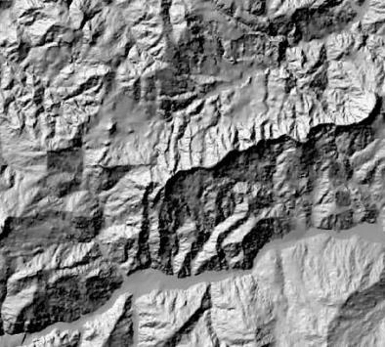
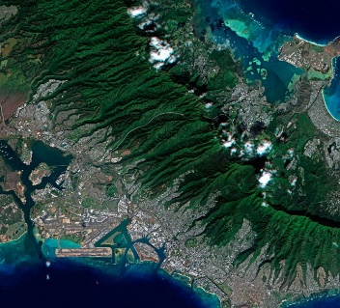
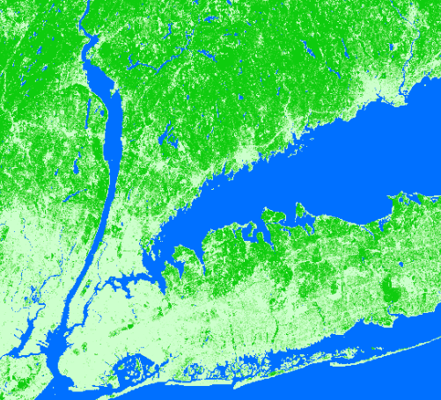
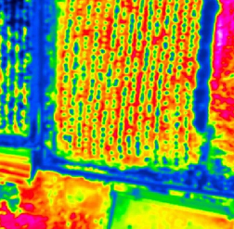
Geospatial Technologies – Remote Sensing (RS)
Remote sensing: Process of detecting and monitoring the physical characteristics of an area by measuring its reflected and emitted radiation at a distance (typically from satellite or aircraft)
A censor attached to a flying object (satellite, plane, drone) captures the radiation in question
Examples of derived data
Altitude Images Land cover Temperature
5

Slide 6
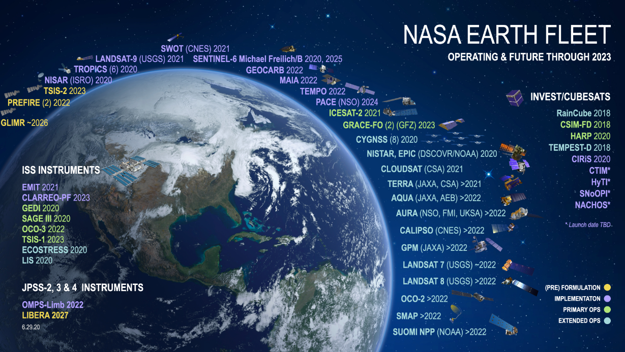
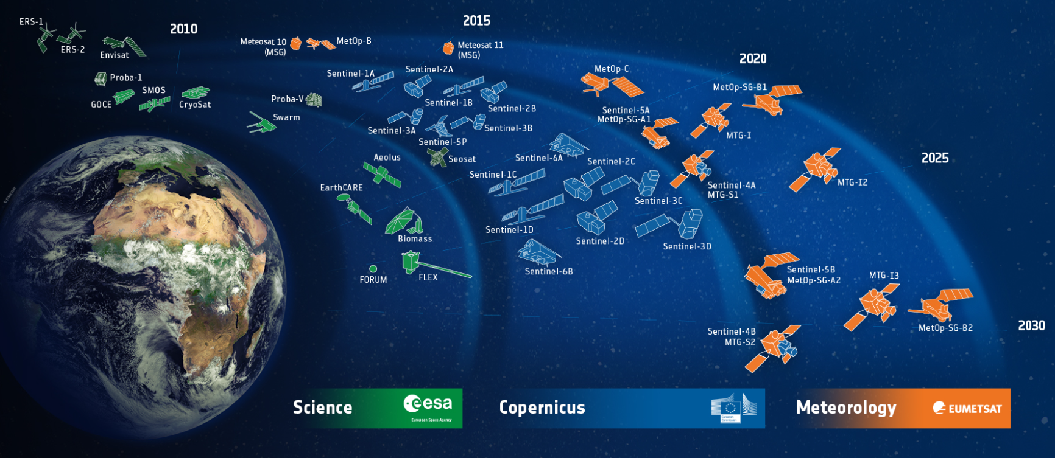

Geospatial Technologies – Remote Sensing (RS)
…. and there are plenty of satellites!
Only those from the National Aeronautics and Space Administration (NASA) and European Space Agency (ESA) shown here
6

Slide 7
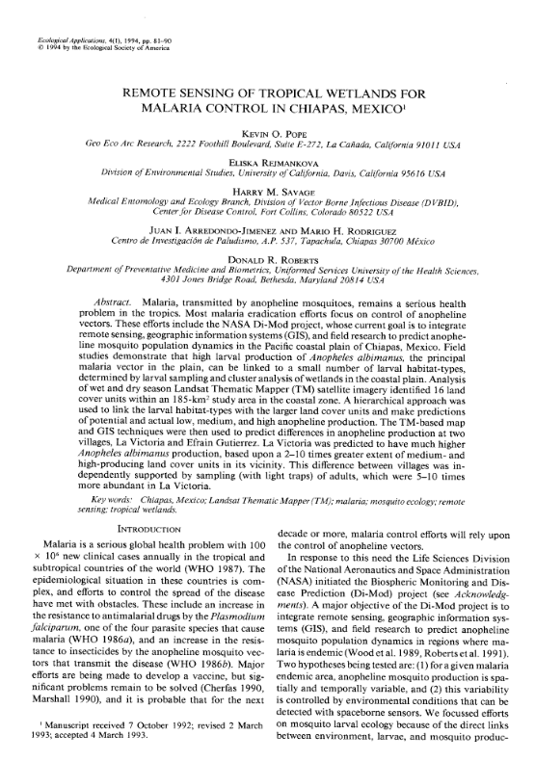
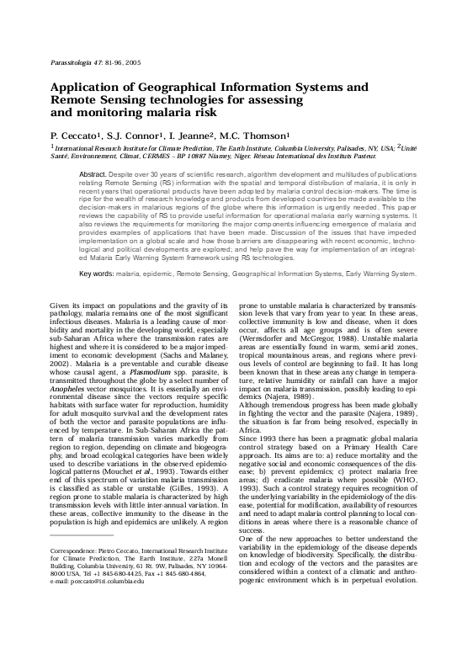
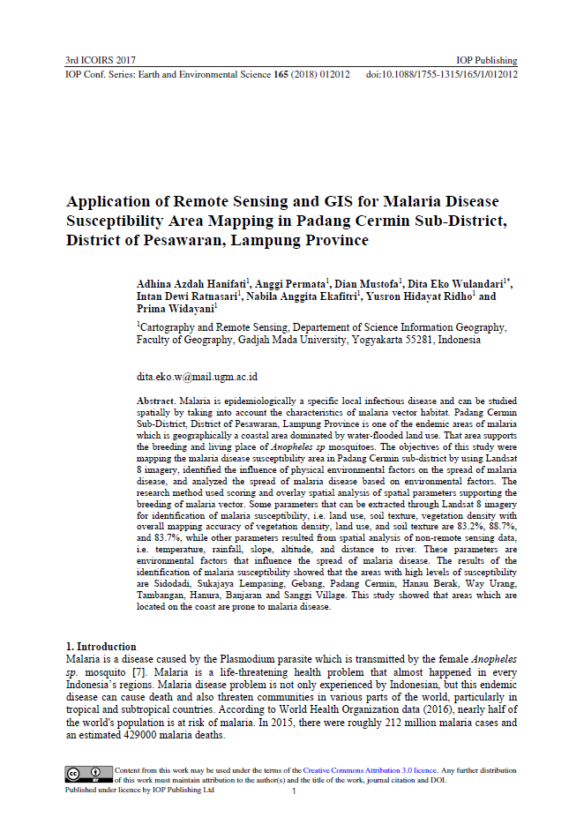

Geospatial Technologies – Remote sensing to combat malaria
A use which began a long time ago and which continues to support programs to combat vector-borne diseases in particular (example for Malaria presented here)
1994
2005
2017
2021
7

Slide 8
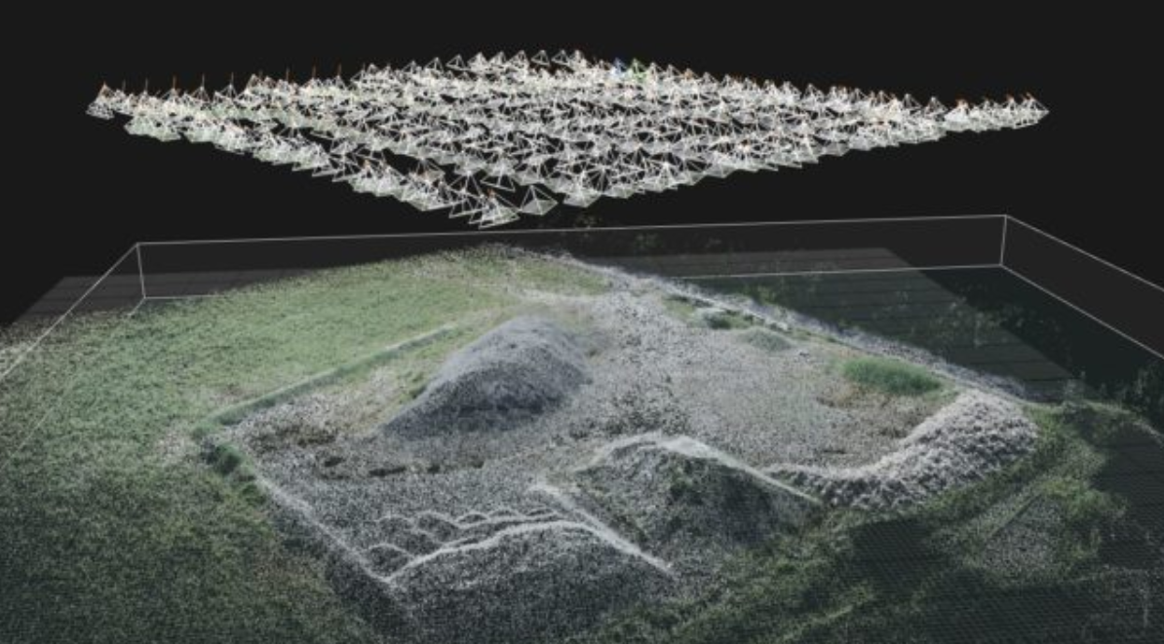
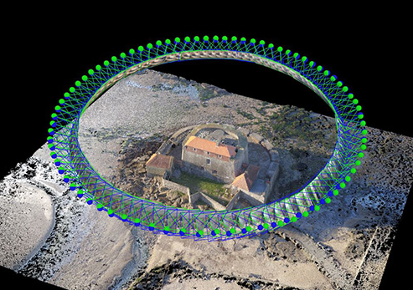
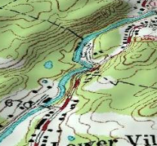
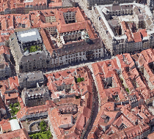
Geospatial Technologies – Photogrammetry
Photogrammetry: Determination of the dimension of objects, by means of measurements made on photographic perspectives of these objects.
A camera is attached to a flying object or to the ground
Examples of derived data
Topography 3D views
8

Slide 9
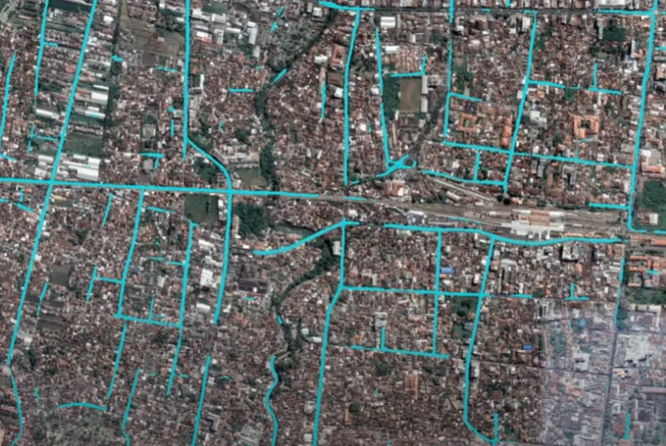
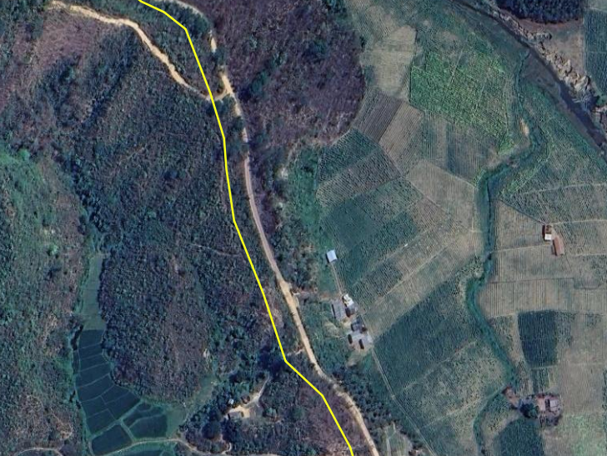
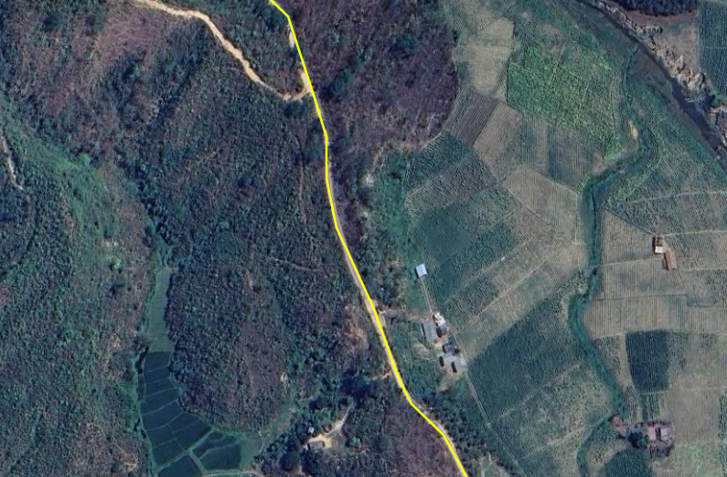


Use of remote sensing and photogrammetry for other applications
Automatic, or semi-automatic, extraction of geographic features visible on satellite (or other) imagery including building footprints which are core to population estimation and spatial distribution (Session 6)
Using satellite (or other) imagery as a ground reference to assess and improve the quality of geospatial data (Session 6)
Use of the digital elevation model and land cover to analyze accessibility to care
Remote sensing and photogrammetry generates key geospatial data needed to operationalize several of the applications of geospatial data and technologies
9

Slide 10
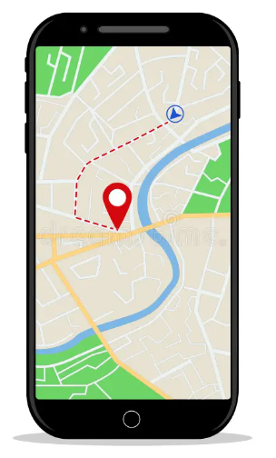
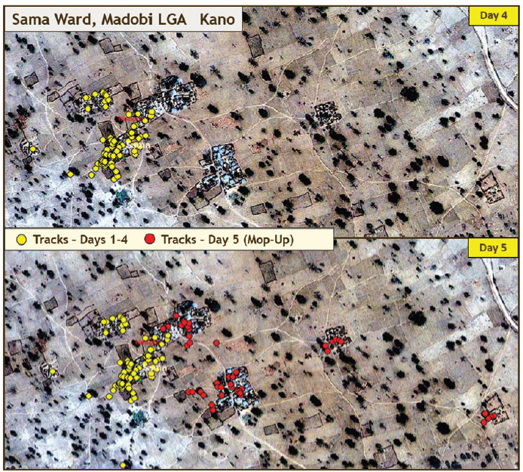
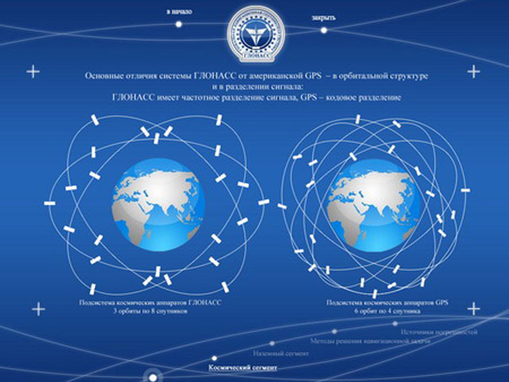
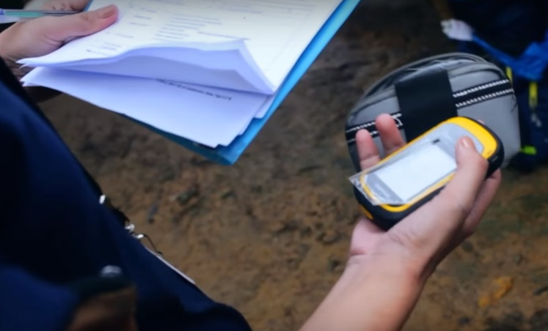
Geospatial Technologies – Global Navigation Satellite Systems (GNSS)
Use of a Global Navigation Satellite System (GNSS) enabled device to get to a particular location (navigate), track movements or collect geographic coordinates (latitude, longitudes) in the field
Tracking to support Polio eradication in Nigeria
Navigation
Collection of geographic coordinates in the field
Global Navigation Satellite System (GNSS)
Covered in more details in Session 9
10

Slide 11
Geospatial Technologies – Geographic Information Systems (GIS)
Two types of definitions
“A computer system that analyzes and displays geographically referenced information”
“Computer tool for representing and analyzing all the things that exist on earth as well as all the events that occur there“
GIS as a geospatial technology - software
“Information system designed to collect, store, process, analyze, manage, and present all types of spatial and geographic data”
“Information system set up by an organization to describe the spatial objects, phenomena, and processes that are necessary for its action “
GIS as an information system
Often a source of confusion
Both covered in more details in Session 10
11

Slide 12
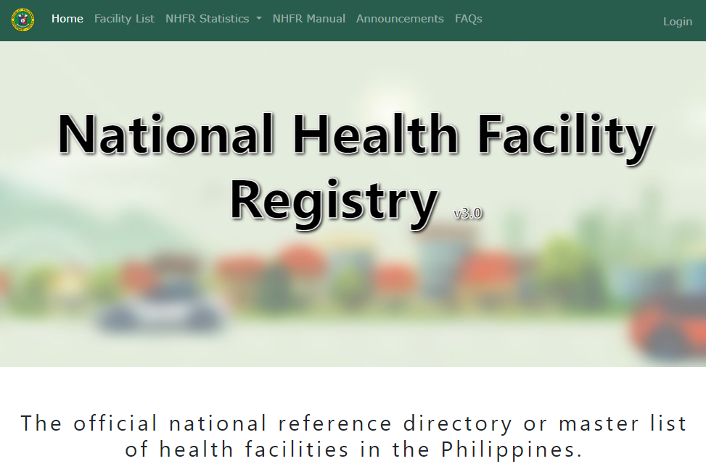
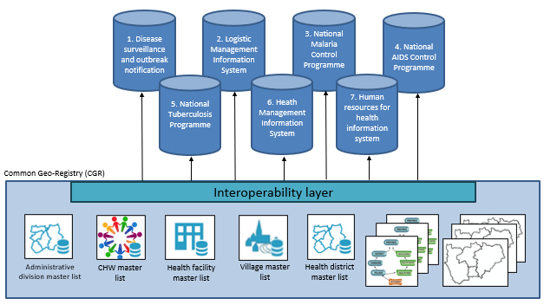
Geospatial Technologies – Registries and Common Geo-Registry (CGR)
Registry: IT solution to store, maintain, validate, update and share a master list.
Container that manages only one master lists and potentially its associated hierarchies and geospatial data
Common Geo-Registry: IT solution that allows the simultaneous hosting, management, regular update, and sharing of master lists as well as associated hierarchies and geospatial data for the geographical objects core to development in general and public health in particular.
Container that simultaneously manages multiple master lists and their associated hierarchies and geospatial data
Both covered in more detail in Session 11
12

Slide 13
…and in the end
Please remember that:
Technology is not supposed to guide the process but to support it
The choice of technology(ies) must be based on clearly defined needs
And above all,...Garbage in – Garbage out!
Choosing the technology(ies) is not the starting point of the process
13

