Slide 1

Introduction to geospatial data management
and technologies for Health Programs training workshop - Timor Leste
Session 10: Introduction to Geographic Information system (GIS)

Slide 2
Geographic Information Systems (GIS)
Two types of definitions
“A computer system that analyzes and displays geographically referenced information”
“Computer tool for representing and analyzing all the things that exist on earth as well as all the events that occur there“
GIS as a geospatial technology- software
“Information system designed to collect, store, process, analyze, manage, and present all types of spatial and geographic data”
“Information system set up by an organization to describe the spatial objects, phenomena, and processes that are necessary for its action “
GIS as an information system
Often a source of confusion
2

Slide 3
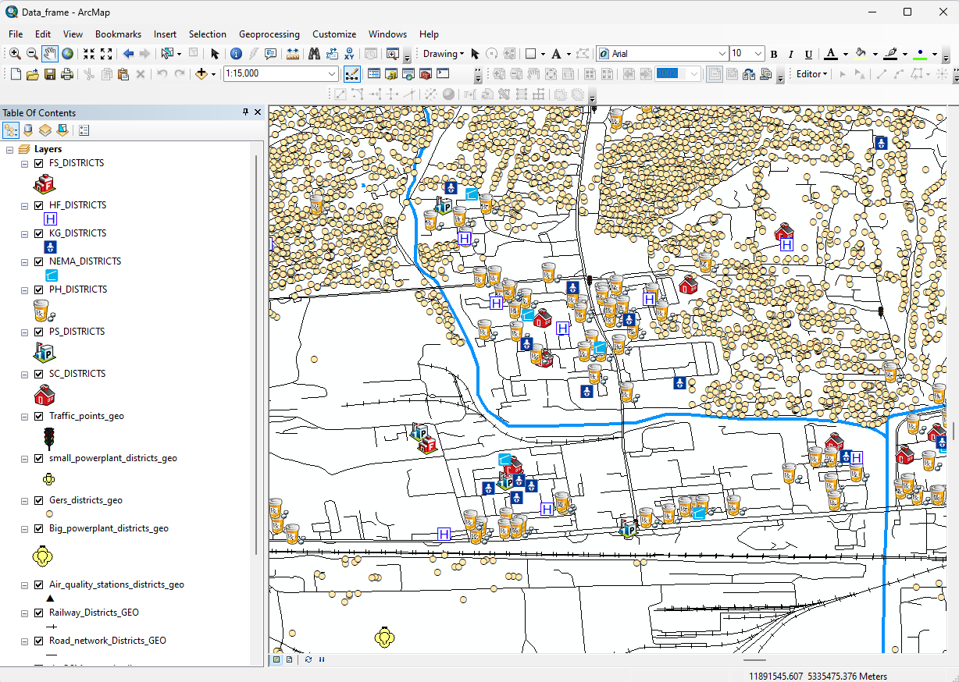
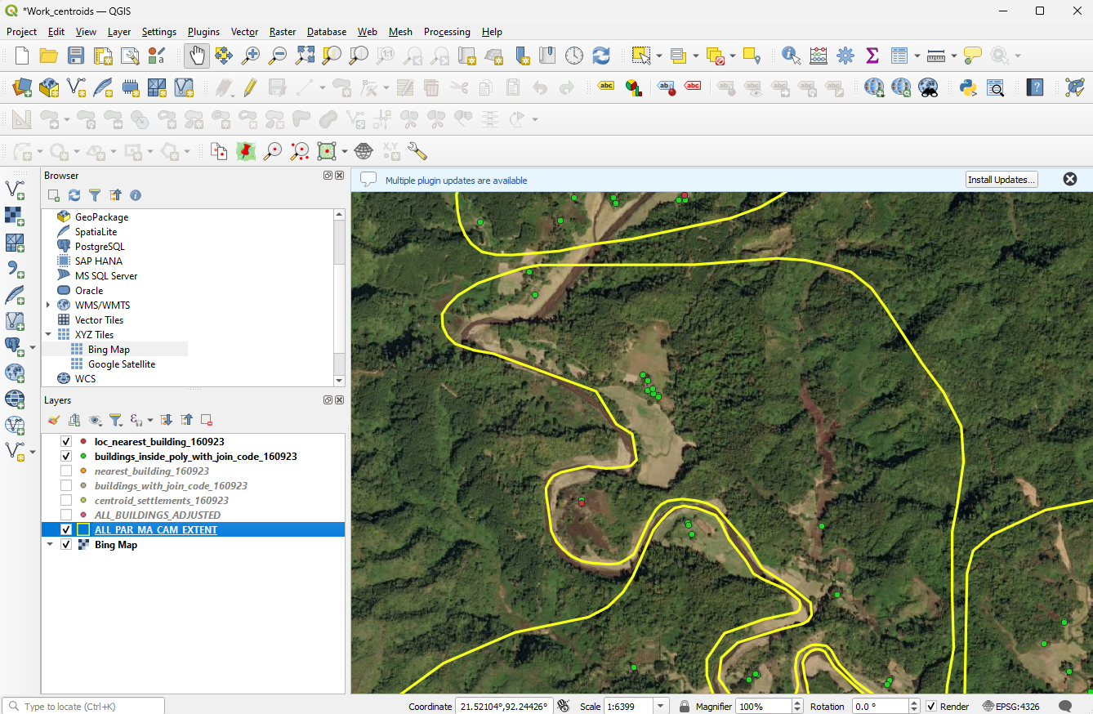
GIS as a software
Desktop GIS software:
Most used type of tool and providing the widest number of features. The most used being QGIS and ArcMap/ArcGIS Pro
Online GIS application:
Not as fast nor offering as many features as desktop GIS programs but still providing much of the same functionality (examples: ArcGIS Online (proprietary) or GeoNode (open source))
Can provide a convenient bridge between desktop work and a mobile work environment
Deployed either on the cloud or on a local server, each of which has a cost
GIS extensions:
Additional tools that are required to operationalize certain applications and/or not available by default in desktop or online GIS software
Available as extensions (example: ArcGIS Spatial Analyst Extension)
3

Slide 4
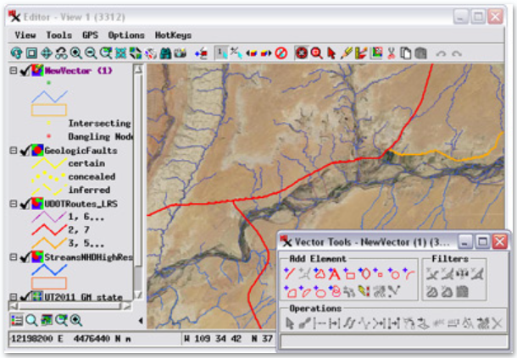
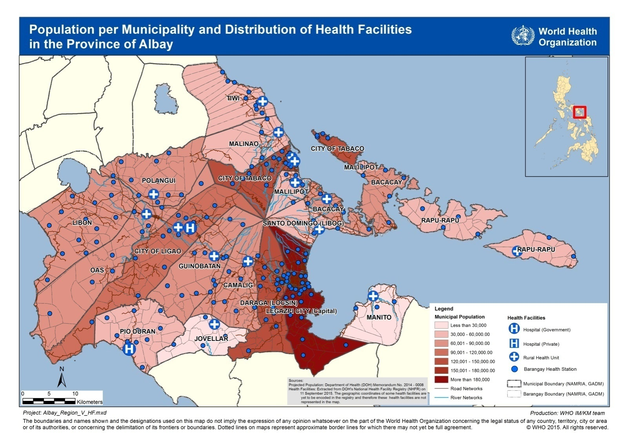
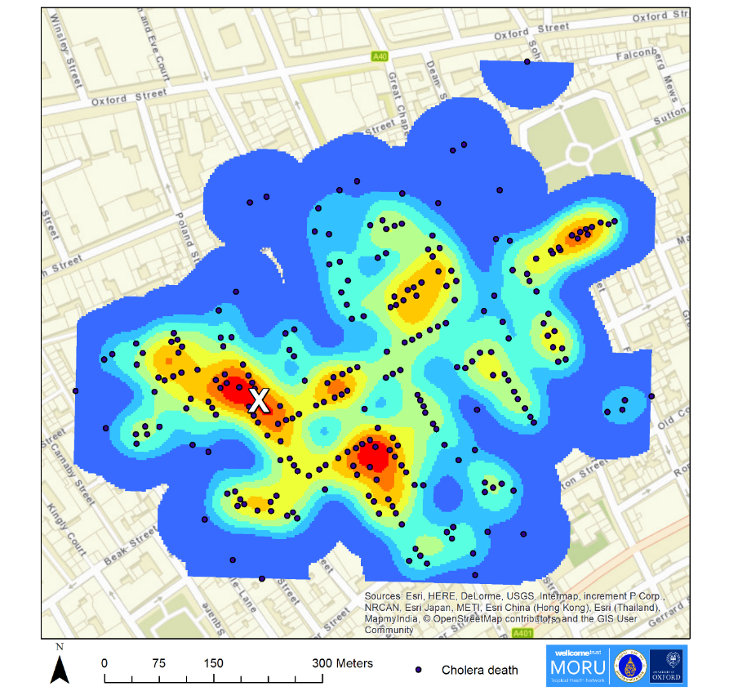
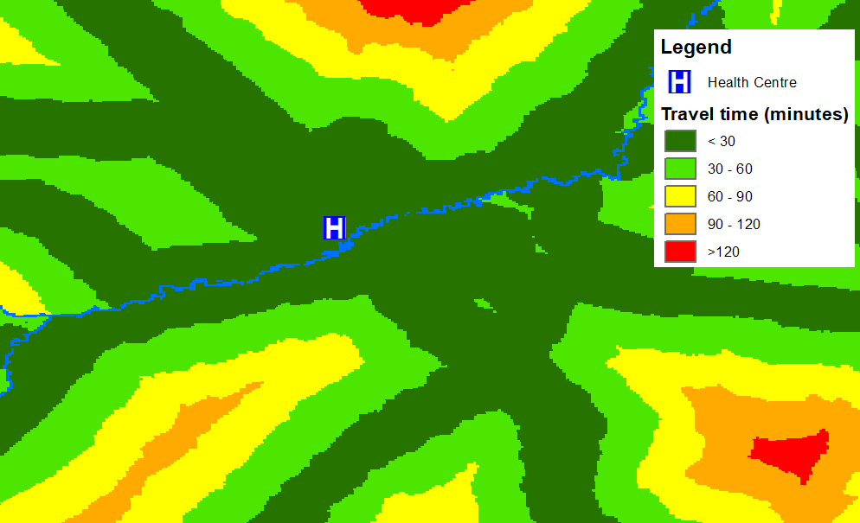
GIS as a software
A real GIS software allows you to perform:
Geospatial data management: All the disciplines related to managing geospatial data as a valuable resource (creating, editing,…)
Thematic mapping: the process of creating thematic maps to convey information about a single topic or theme, such as population density or health.
Spatial analysis: The process of examining the locations, attributes, patterns, and relationships of features in spatial data in order to address a question or gain useful knowledge
Spatial modeling: A methodology or set of analytical procedures used to derive information about spatial relationships between geographic phenomena
Software and applications not performing the above should not be considered a GIS software
4
Notes:
What can you do with GIS in public health?
With GIS in public health, you can do thematic mapping, spatial analyses, and spatial modelling.
Looking at the diagram, you will see that the complexity of the functionalities to be performed and quality of data needed is low for thematic mapping but these increase for spatial analyses and then spatial modelling.
The opposite happens with the number of users: there are more users who do thematic mapping than spatial analyses and fewer still for spatial modelling.
When it comes to the creation and/or management of geospatial data, it has mid-level complexity and number of users but produces high quality data.

Slide 5




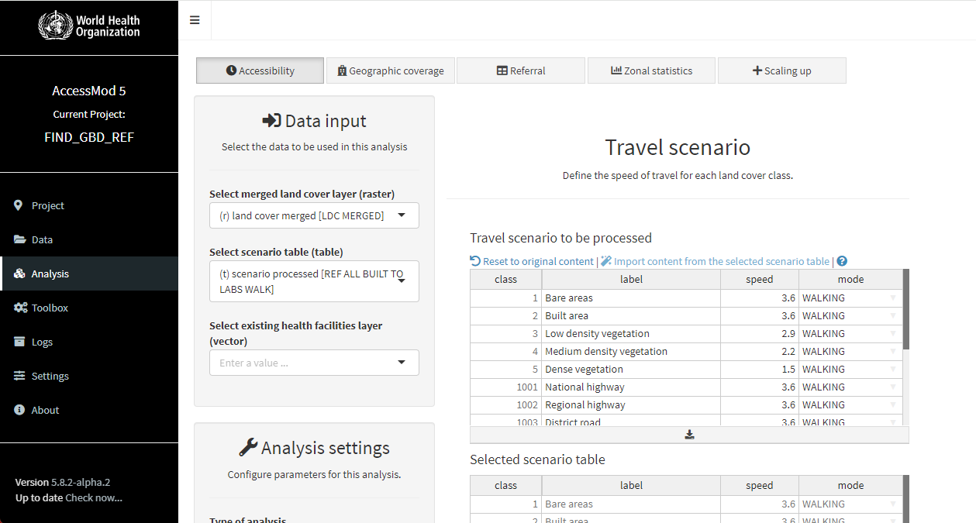
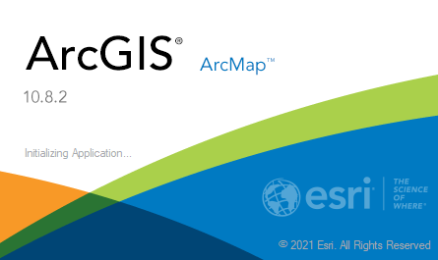



Not everything is a GIS software!
Database management systems with a thematic mapping interface
«Bridges» with GIS software that are existing or under development
Online mapping applications
GIS Based application
« Real » GIS software
ArcMap, ArcGIS, ArcGIS Pro www.esri.com
  The most complete and versatile
  Complete GIS ecosystem
  Technical support
  Proprietary (free/reduced cost licenses for the health sector)
QGIS (www.qgis.org)
  Very good for thematic mapping, sometimes limited for other functionalities but constantly improved
  Open Source, limited technical support
  Free
5
Notes:
Not everything is GIS software!
As mentioned in slide 5, GIS software should have spatially explicit commands and functionality around 4 components. With all the software and application out there, what most people think are GIS software just because they can do or handle maps are not really GIS software.
Some examples are:
DHIS2, Tableau, and DevInfo are database managers with a thematic mapping interface
R is a free software environment for statistical computing and graphics. It allows one to conduct geostatistical analysis.
Google Maps and Bing Maps are thematic mapping application.
On the other hand, the following are (non-exhaustive) examples of real GIS software:
ArcGIS
QGIS

Slide 6
GIS – Open Source vs. Proprietary
The choice between the two must be based on the context, needs, and resources available.
Some examples:
Use | Open source | Proprietary
Creation of thematic maps occasionally | X
Creation and management of quality geospatial data | X | X
Mapping support in an emergency operations center |  | X
Need to be able to move easily from field data collection to an online and desktop solution |  | X
Very often the solution is a combination of the two options
The most important thing is to have access to quality data and qualified personnel and to ensure that the work carried out is based on solid and documented processes.
6

Slide 7
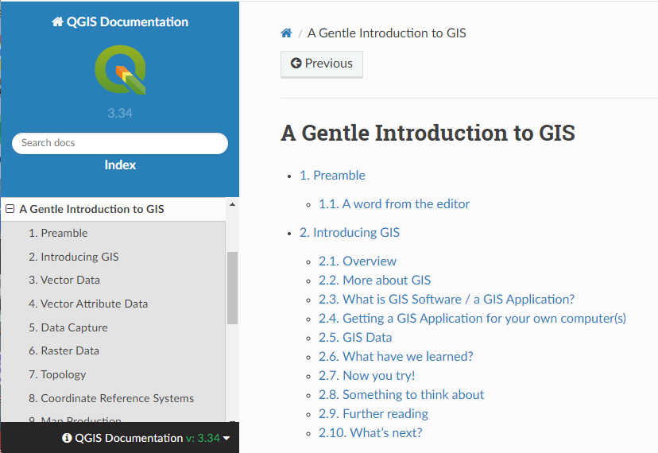
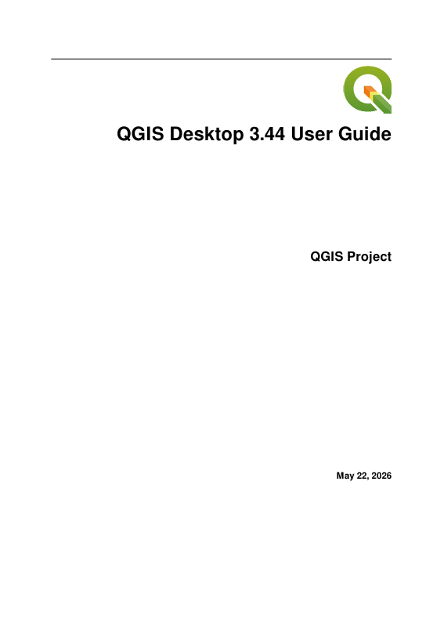


GIS Resources - QGIS
The QGIS website provides resources for their users:
A Gentle Introduction to GIS
https://docs.qgis.org/3.44/en/docs/gentle_gis_introduction/index.html
QGIS User Manual
Online: https://docs.qgis.org/3.44/en/docs/user_manual/index.html
PDF:
https://docs.qgis.org/3.44/pdf/en/QGIS-3.44-DesktopUserGuide-en.pdf
QGIS Training Manual
Online: https://docs.qgis.org/3.44/en/docs/training_manual/index.html
PDF:
https://docs.qgis.org/3.44/pdf/en/QGIS-3.44-TrainingManual-en.pdf
7

Slide 8



GIS Resources - QGIS
There are different QGIS courses you can find online such as:
YouTube offers many video tutorials on different QGIS topics: www.youtube.com
  Examples
    QGIS Training from Gaia Resources: https://www.youtube.com/playlist?list=PLfInsSYJw1lQ_vii1wxePr7aKqBOziKVQ
    Descomplica QGIS: https://www.youtube.com/@DescomplicaQGIS
    QGIS 3 em português: https://www.youtube.com/@qgis3emportugues
8
Notes:
QGIS Resources
QGIS Online Course

Slide 9
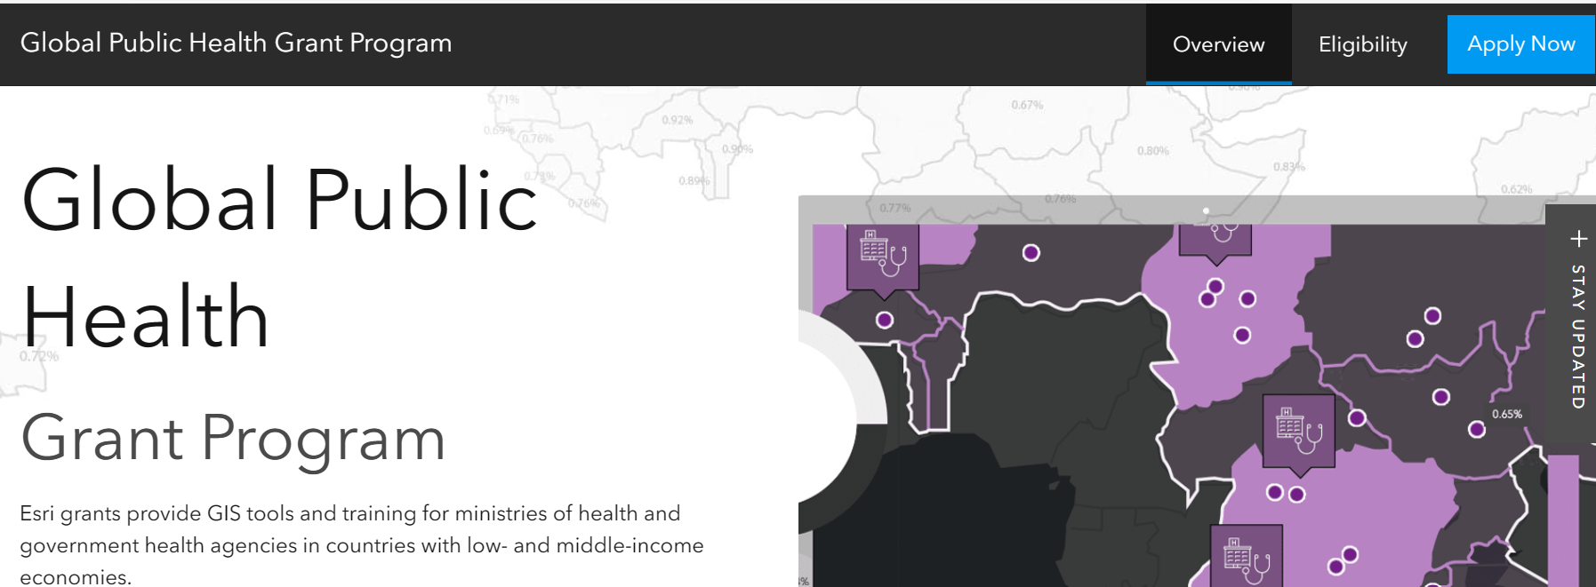
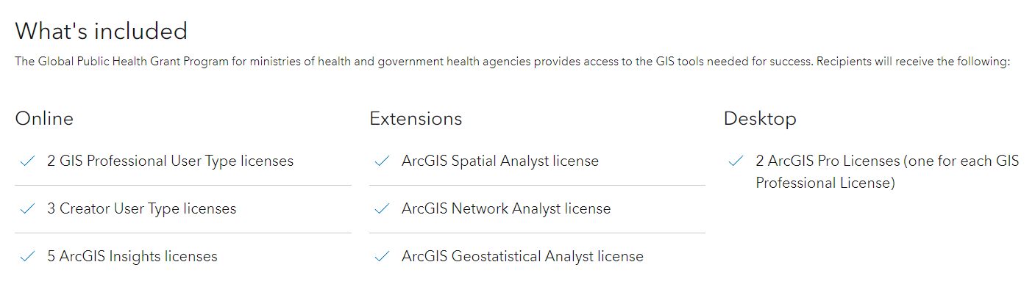
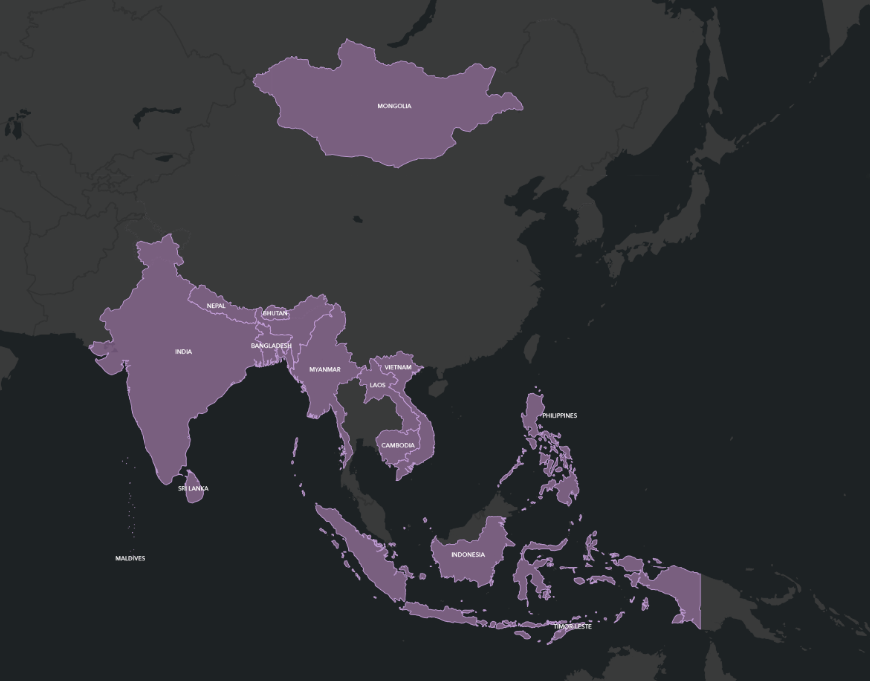
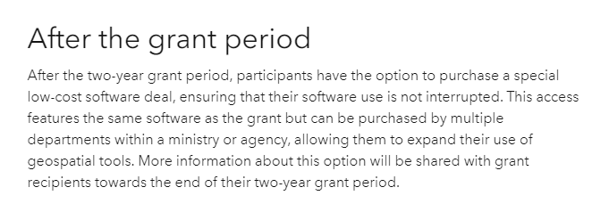
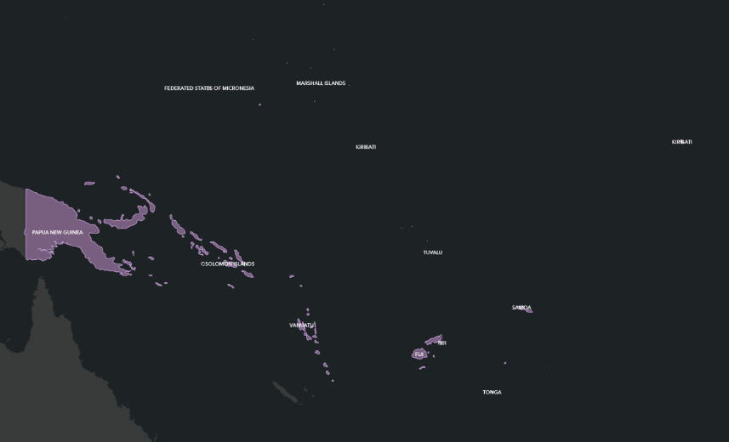
GIS Resources - Esri
Esri Global Public Health Grant Program: https://bit.ly/2PjysU1
Free for 2 years, very reduced cost after that
Timor-Leste is eligible for the grant
9

Slide 10
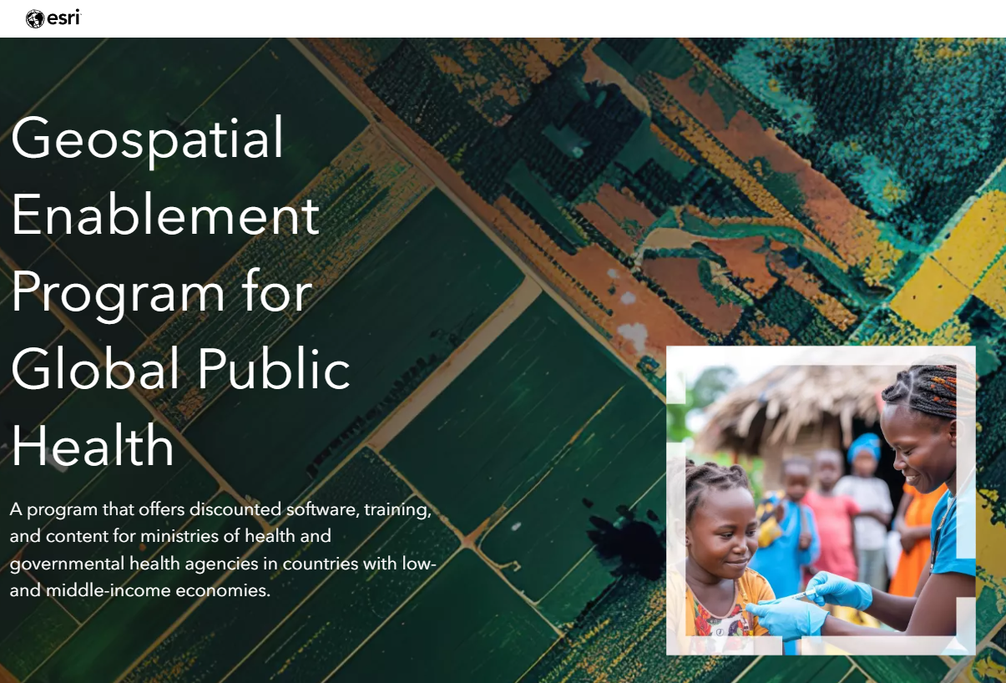
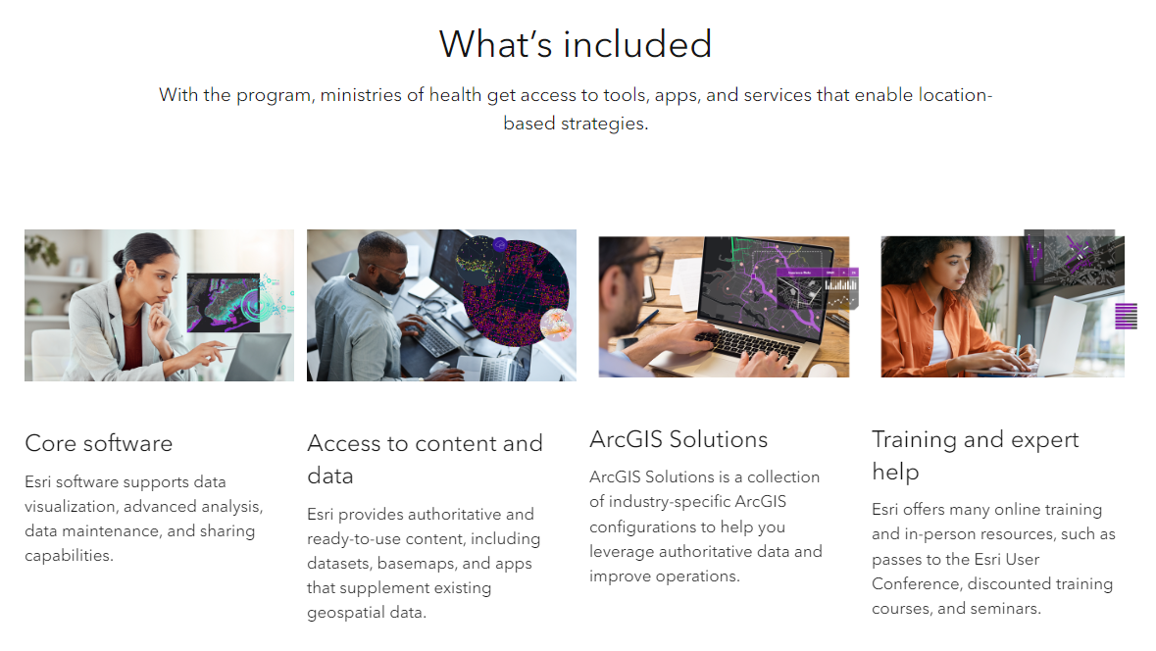
GIS Resources - Esri
Geospatial Enablement Program for Global Public Health: https://bit.ly/3AAVWBe
Offers more robust discounted software packages that include training and services
globalhealth@esri.com.
Visit the website to see if your country is eligible for the program
10

Slide 11
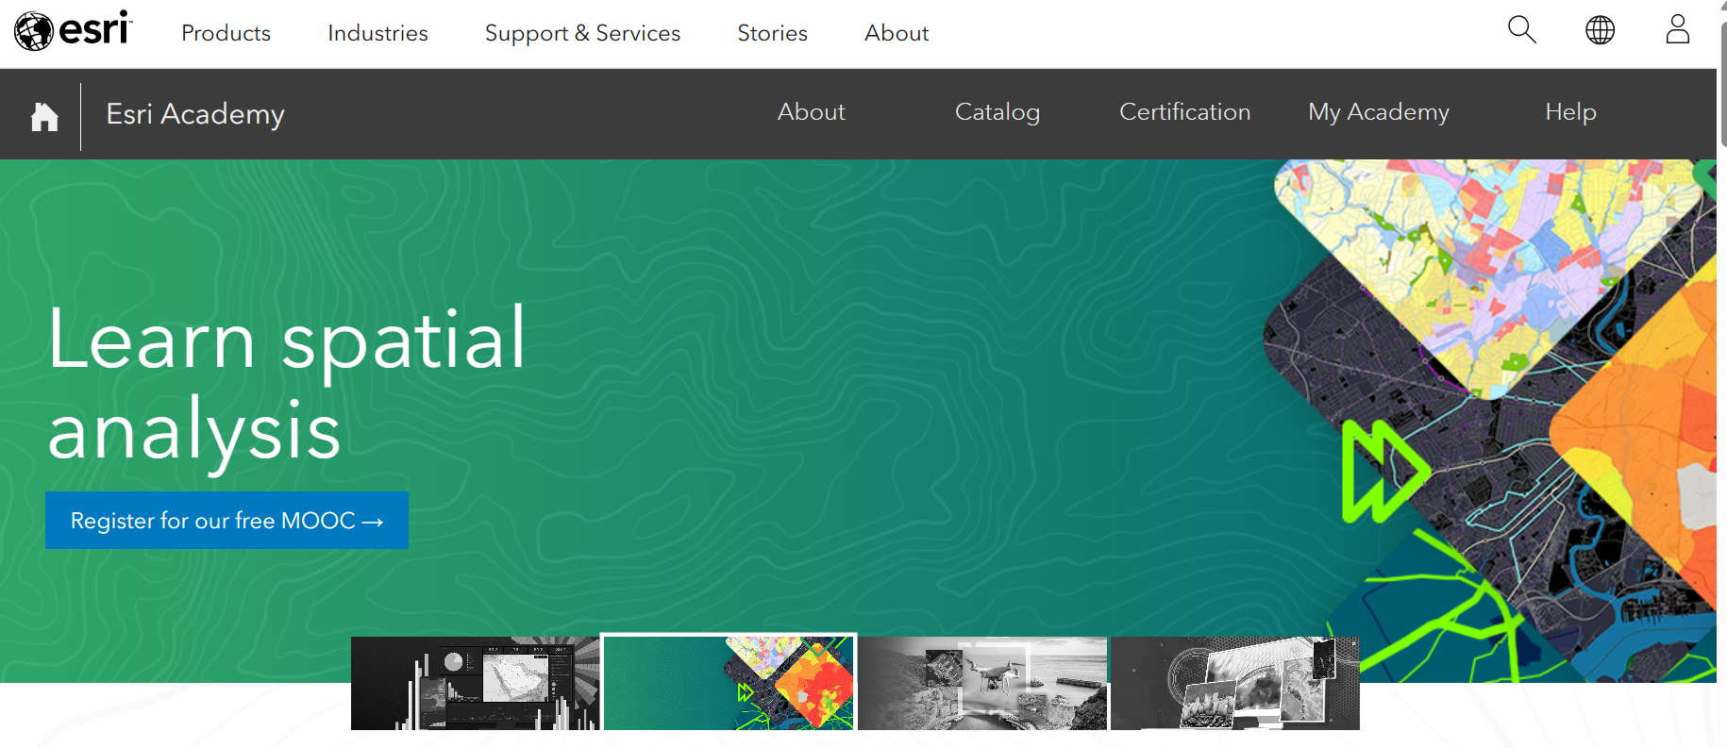
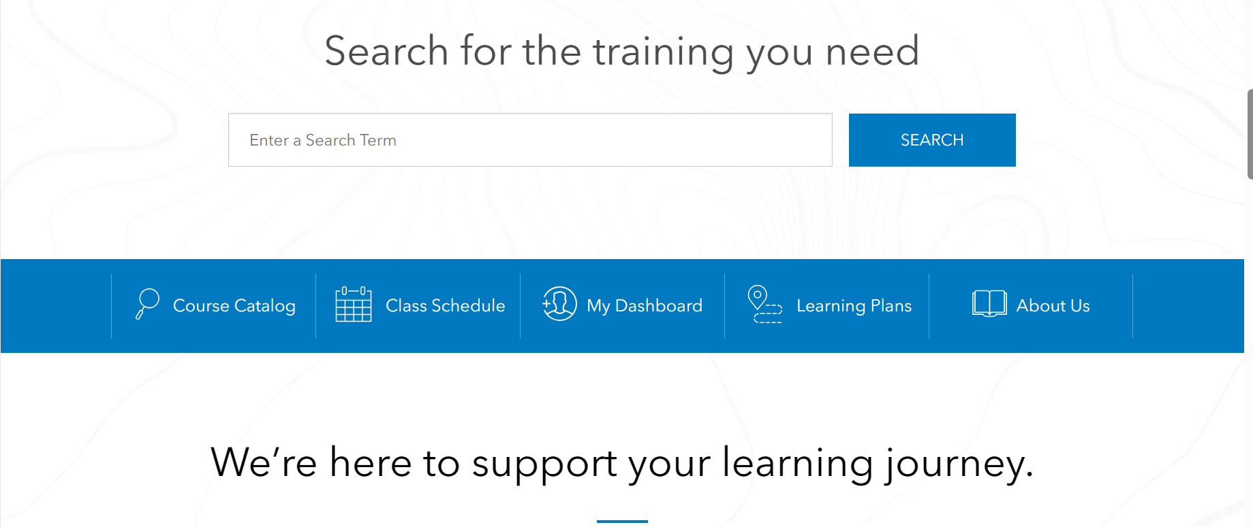
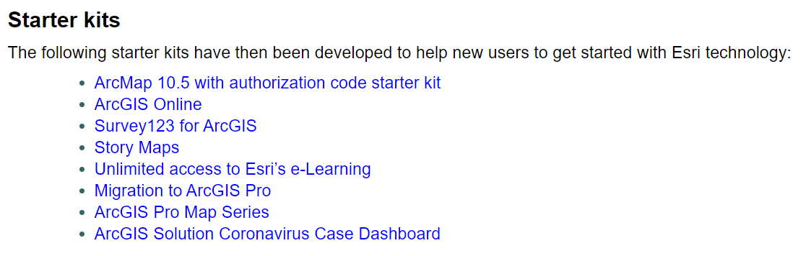
GIS Resources - Esri
https://www.esri.com/training/
https://healthgeolab.net/resources/reference-materials/
11

Slide 12
GIS as an information system
“Information system set up by an organization to describe the spatial objects, phenomena and processes that are necessary for its action“
Combines and articulates data, equipment, software, organizational structures (including personnel), and methods to represent and analyze geographic objects necessary for project implementation
GIS is not just about software!
12

Slide 13
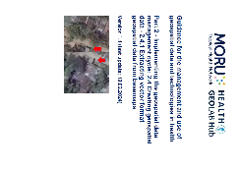
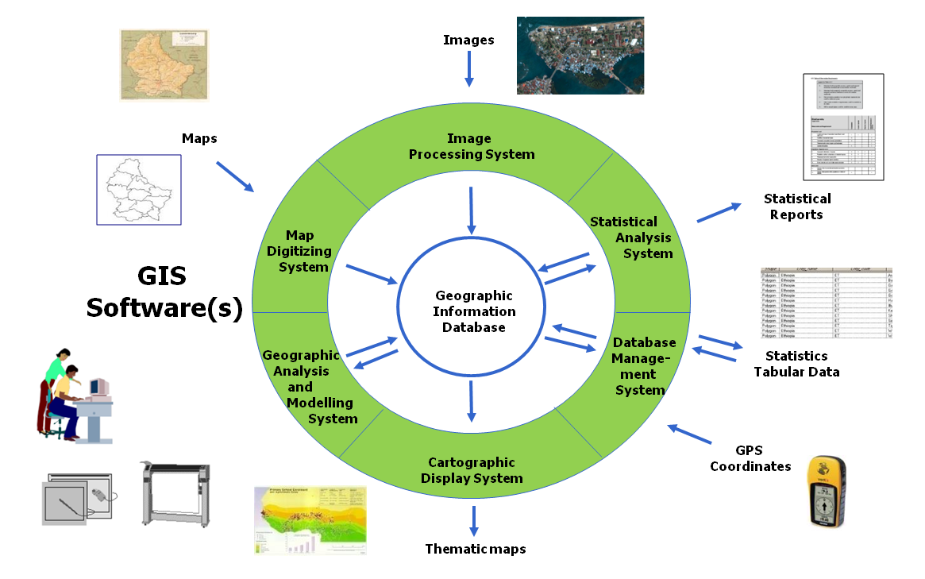
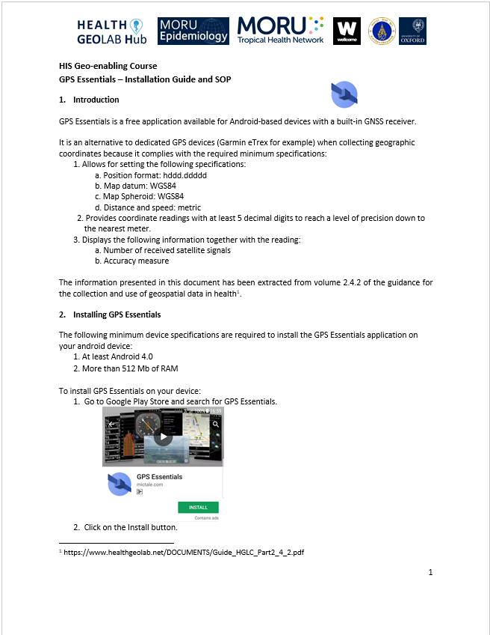
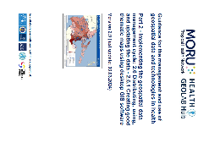
Essential elements of a GIS as an information system
5
Data
Software
Equipment
People
Methods
2
1
4
Data at the center of the system
5
3
Part of a geo-enabled information system
5
13
13
Notes:
Essential elements of GIS

