Slide 1

Introduction to geospatial data management
and technologies for Health Programs training workshop - Timor Leste
Session 11: Introduction to the concepts of registry and common geo-registry

Slide 2



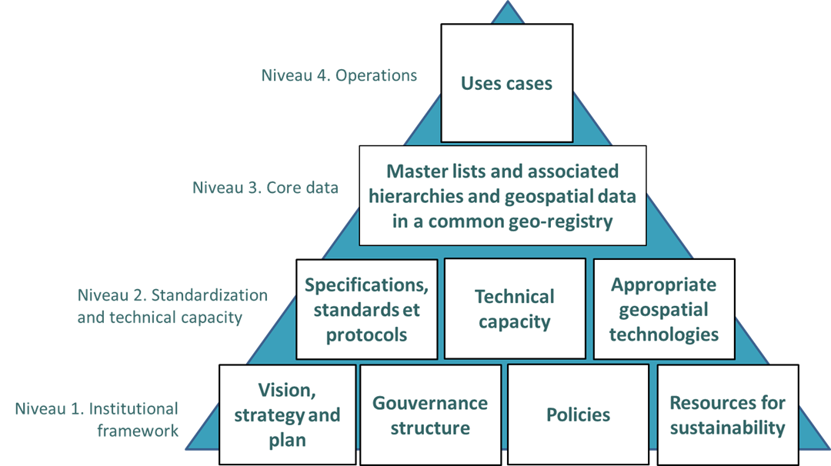
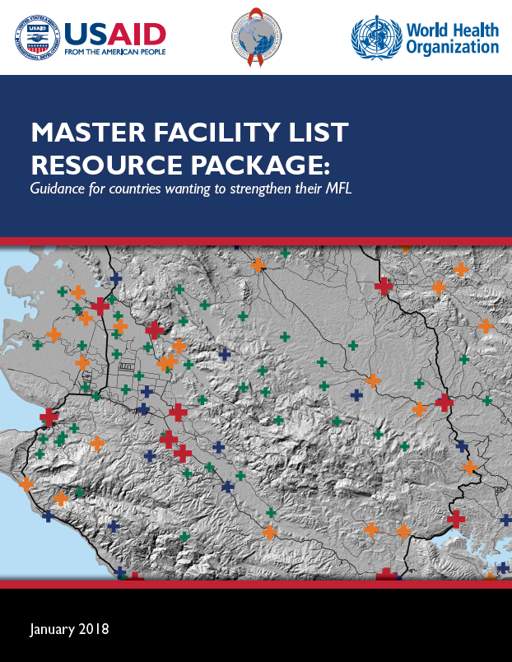



The importance of the registry concept in the HIS geo-enabling framework
Master lists are pivotal to the framework and the operationalization of strong use cases supporting planning and decision making
As the information contained in these master lists, as well as the associated geospatial data, evolves through time, there is a need for an IT solution that would store, manage, regularly update and share them
Registry or common geo-registry
Ideally deployed/developed and maintained as part of the geo-enablement of the HIS
2

Slide 3
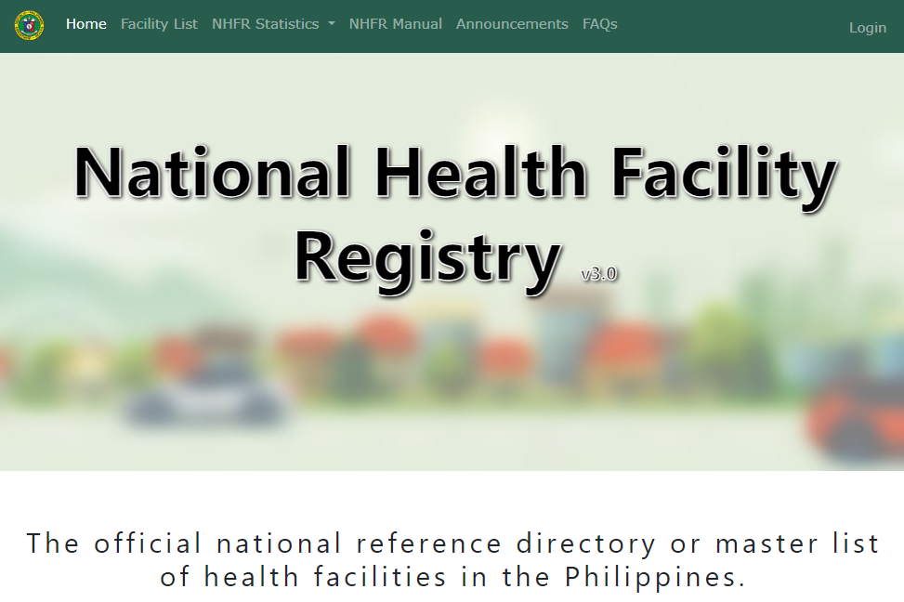
The concept of registry
An IT solution that allows storing, managing, validating, updating and sharing the master list for a specific geographic object. It is the “container” for the master list.
Example of the Health Facility Registry Service (HFRS) from the Department of Health of the Philippines: https://nhfr.doh.gov.ph/Home
Container that manages a single master list…
…but Public Health requires considering several types of geographic features/objects at the same time (health facilities, administrative units, villages, etc.) and these features/objects are connected to each other through different types of relationships (geographic, administrative, referral,…) and their proper geography. In addition, all this changes through time….
3

Slide 4
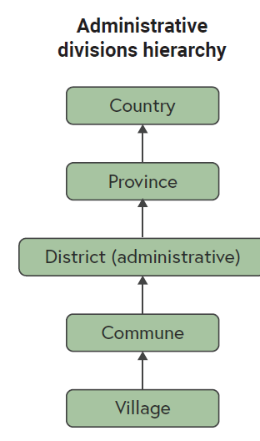
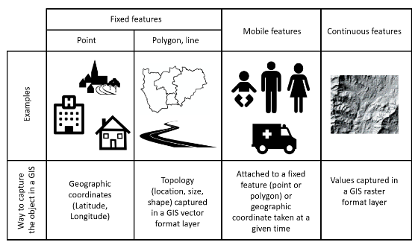
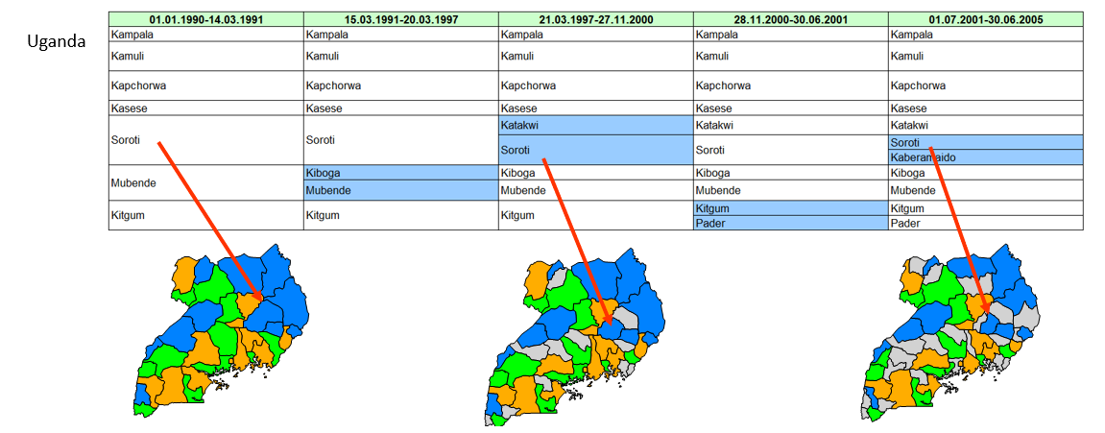
The concept of Common Geo-Registry (CGR)
1
IT solution that allows the simultaneous hosting, management, regular update and sharing of all the master lists as well as associated hierarchies and geospatial data for the geographic objects core to development in general and public health in particular.
Container that simultaneously manages, regularly update and multiple master lists and their associated hierarchies and geospatial data:
Unlimited number of geographic features (facilities, administrative divisions, reporting divisions, villages,…) geographies and hierarchies
Multiple organizations and different types of users
Handles changes over time down to the data element level
Accessible by any information system part of, or outside, the HIS
Supports the National Spatial Data Infrastructure (NSDI)
1. https://healthgeolab.net/DOCUMENTS/Guidance_Common_Geo-registry_Ve2.pdf
4

Slide 5



Define the functional requirements (how) of a registry
(example: registry for the master list of health facilities)
Common Geo-Registry (CGR) guidance
1
The concept of Common Geo-Registry is born during a workshop which took place in Phnom Penh in June 2017 ¹.
The structure of the first version of the CGR guidance document was defined during this workshop
The first version of the CGR guidance was released in August 2017 and discussed during a workshop with the University of Oslo in April 2018 to identify if DHIS2 could serve as a CGR ².
2
As neither DHIS2 nor other existing solution were complying with the requirements of a CGR, a new IT solution has been developed as part of the implementation of the Digital Solution for Malaria Elimination initiative (DSME)
GeoPrism Registry (https://geoprismregistry.com/)
The lessons learned during the development and deployment of this new IT solution led to the release of the 2nd version of the CGR guidance in 2022 ³.
https://www.healthgeolab.net/MEETINGS/CGR_2017/Geo-Registriy_Workshop_Final_Exec_Sum_010717.pdf
https://www.healthgeolab.net/MEETINGS/CGR_OSLO_2018/DHIS2_CGR-Exec_Sum_April18.pdf
https://healthgeolab.net/DOCUMENTS/Guidance_Common_Geo-registry_Ve2.pdf
3
5

Slide 6
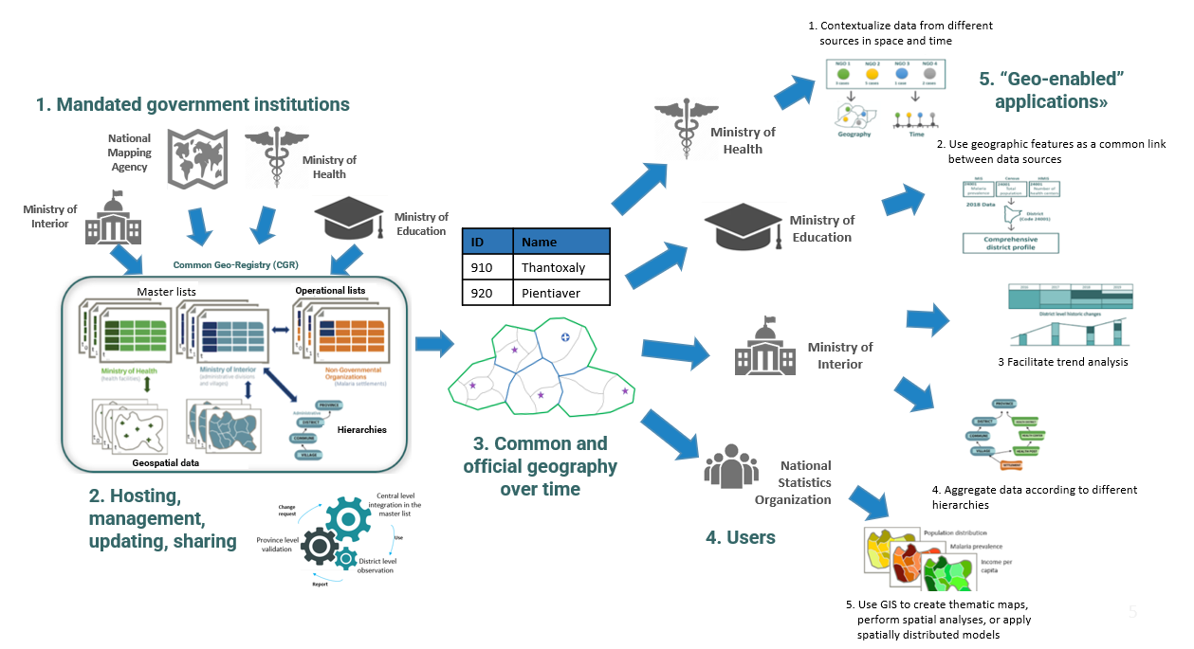
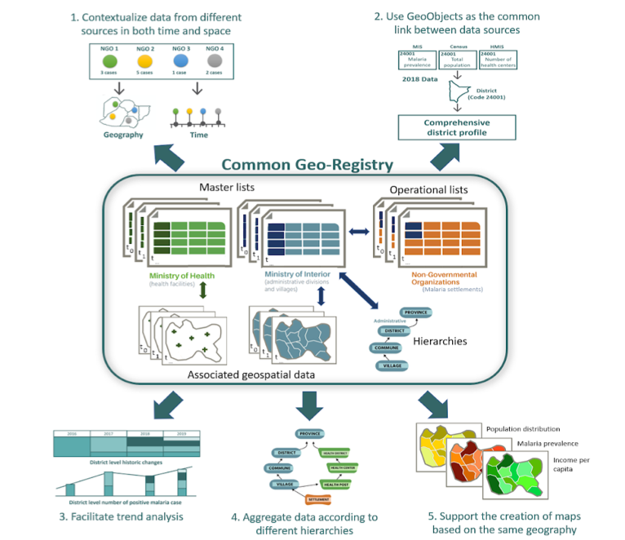

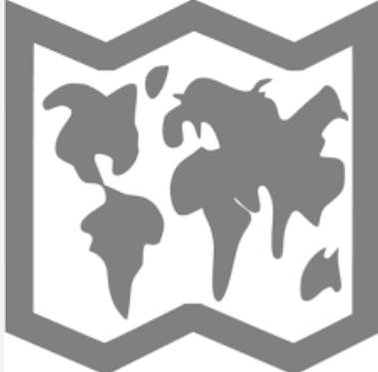

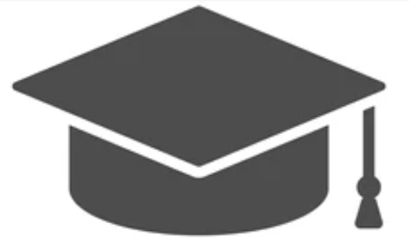
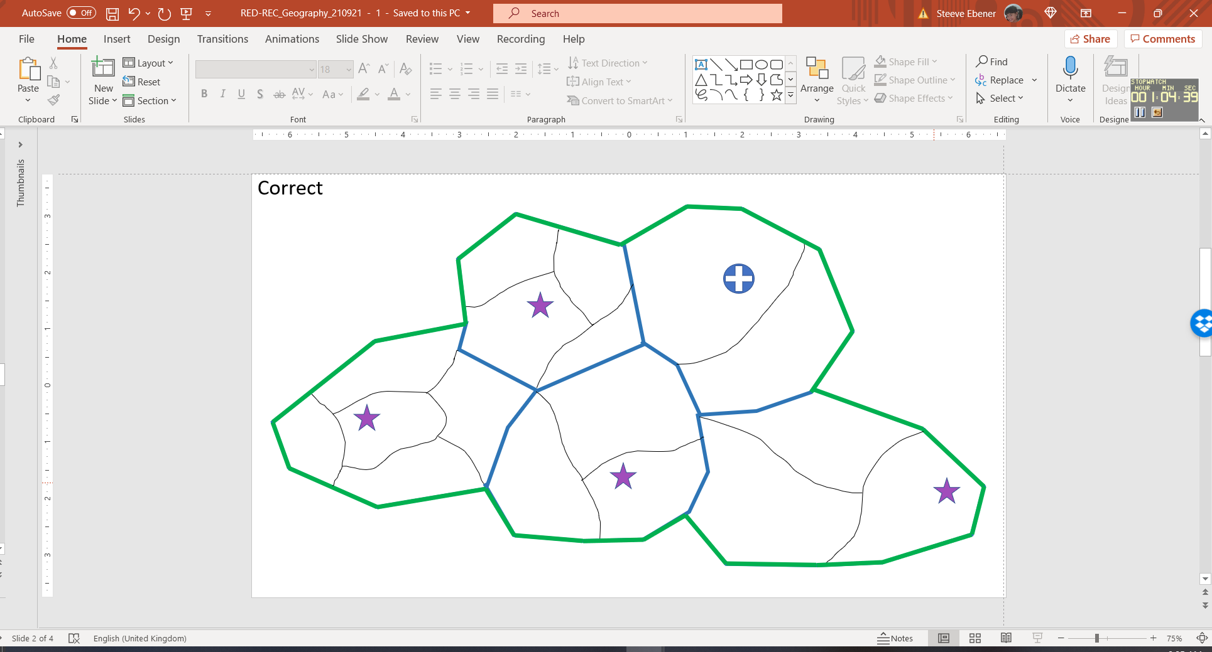


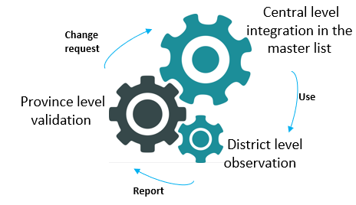
The Concept of Common Geo-Registry (CGR)
1. Contextualize data from different sources in space and time
5. “Geo-enabled” applications»
1. Mandated government institutions
National Mapping Agency
Ministry of Health
2. Use geographic features as a common link between data sources
Ministry of Health
Ministry of Interior
Ministry of Education
Ministry of Education
ID | Name
910 | Thantoxaly
920 | Pientiaver
Common Geo-Registry (CGR)
Master lists
Operational lists
Ministry of Interior
3 Facilitate trend analysis
Hierarchies
3. Common and official geography over time
Geospatial data
National Statistics
Organization
2. Hosting, management, updating, sharing
4. Aggregate data according to different hierarchies
4. Users
5. Use GIS to create thematic maps, perform spatial analyses, or apply spatially distributed models
6
6

Slide 7
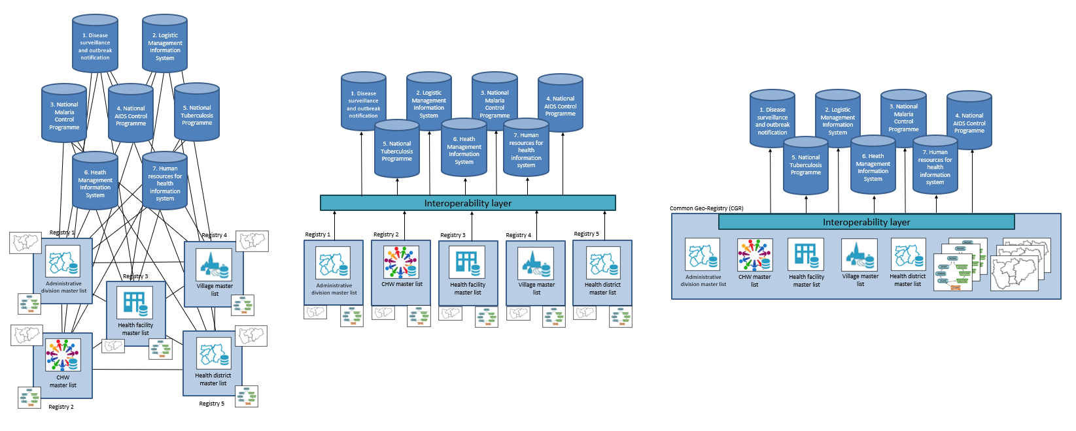
From separated registries to a Common Geo-Registry (CGR)
1. One registry per geographic features, no interoperability layer
2. One registry per geographic features with a separated interoperability layer
3. One common geo-registry with an integrated interoperability layer
Only one registry to maintain
Exchange only needed between the common geo-registry and each information system
Facilitates data quality including consistency
Easier to scale up
Large number of registries to maintain
Still a significant volume of exchange between registries to ensure data quality, including consistency between them
Difficult to scale up
Large number of registries to maintain
Important volume of exchange to ensure data quality between registries and information systems
Very difficult to scale up
Model promoted by the HIS geo-enabling framework
7

Slide 8
CGR or HFRS - Strategic outcomes
Strategic outcomes can be expressed in terms of the benefits that would be provided to the health sector once a HFRS or a CGR has been deployed and operationalized:
Data standardization and quality: A CGR or HFRS enforces data standardization and, as such, the quality of the information collected and stored in the master list
Interoperability: A CGR or HFRS enables data interoperability and sharing between information systems collecting, managing and or analyzing facility level data and information.
Online access: A standardized CGR or HFRS facilitates online use of information contained in the master list including, when appropriate, the creation of a public-facing portal for users to access basic information about nearby health facilities
Data-driven decision making: Well-maintained master list(s) accessible through a CGR or HFRS empowers policymakers, healthcare administrators, and stakeholders with accurate, ideally real-time data and reports. This facilitates evidence-based decision-making, allowing for informed policy formulation, strategic planning, and resource allocation
Efficient resource management: By centralizing information about geographic features core to public health, a CGR or HFRS first reduces duplication of efforts through the centralized management and regular update of the master list(s). It then enables efficient resource allocation for better health care access and delivery. It aids in identifying gaps in services, redistributing resources, and strategically planning infrastructure development
8

Slide 9
Define use cases for a registry
(example: registry for the master list of health facilities)
CGR or HFRS - Strategic outcomes
Optimized public health interventions: Timely access to master lists of quality through a registry enables authorities to design and implement targeted public health interventions efficiently
Enhanced coordination and collaboration: The sharing and accessibility of up-to-date information across various stakeholders within the healthcare system foster collaboration and coordination not only at the national but also regional and global level. This proves invaluable during emergencies, public health crises, and routine healthcare delivery
Transparency and accountability: The transparency offered by comprehensive master list(s) hosted in a registry fosters accountability among healthcare providers and institutions. It allows for monitoring quality standards, compliance with regulations, and assessing the performance of facilities
Innovation and research: Researchers and analysts benefit from the data contained in the registry to conduct studies, analyzing trends, and identifying areas for improvement. This aids in fostering innovation and driving advancements in healthcare practices
Programmatic benefits or use cases are not included here because a HFRS or a CGR are meant to support any program or intervention in view of the nature of their content
9

Slide 10



Define use cases for a registry
(example: registry for the master list of health facilities)
CGR or HFRS - Technical outcomes
HFRS: A platform for storing, managing, and sharing the health facility master list and associated data and information
CGR: IT solution that allows the simultaneous hosting, management, regular update and sharing of all the master lists as well as associated hierarchies and geospatial data for the geographic objects core to development in general and public health in particular.
The technical outcomes for both a CGR or HFRS are in their definition:
Store: Provide the necessary functionalities to ensure the storage, security and scalability of the registry’s content in a usable, reliable, cost-effective, and performing environment
Manage: Provide the necessary functionalities for the authorized users to effectively manage the content of the registry and ensure its quality and integrity
Share: Provide the necessary functionalities to ensure proper access to the registry’s content as well as its exchange with other systems and applications
as articulated by the national digital health enterprise architecture
Business requirements
10

Slide 11
Define use cases for a registry
(example: registry for the master list of health facilities)
CGR or HFRS – Strategic and technical outcomes
In conclusion the expected strategic and technical outcomes are the same for a HFRS or a CGR
The difference between the two reside in the number of geographic features being managed
Health Facility Registry Service (HFRS): once single geographic feature, health facilities in this case
Common Geo-registry (CGR): an indefinite number of geographic features, including health facilities
A CGR can be used as a HFRS but a HFRS can’t be used as a CGR
Strategic decision to be made considering the digital health infrastructure being implemented in the country
11

Slide 12
Define the functional requirements (how) of a registry
(example: registry for the master list of health facilities)
Common Geo-Registry (CGR) guidance
Table of content
Introduction (concept, use cases and benefits)
CGR content (geographic features and objects, data elements and classification tables, hierarchies and conceptual data model, lists, geospatial data, changes over time, content related considerations)
CGR functional requirements (data and information flow, organizations and users, required functionalities)
CGR supporting environment (HIS geo-enabling framework)
Conclusion
Content to guide countries in the choice of the appropriate IT solution to serve as a CGR
12

Slide 13
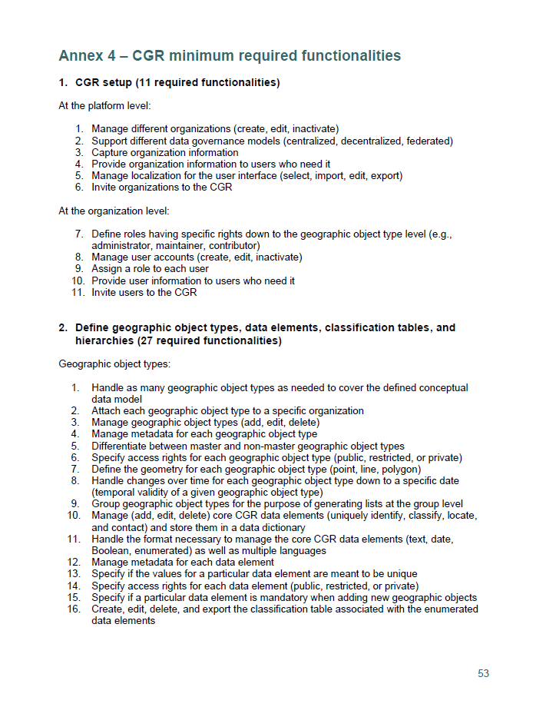
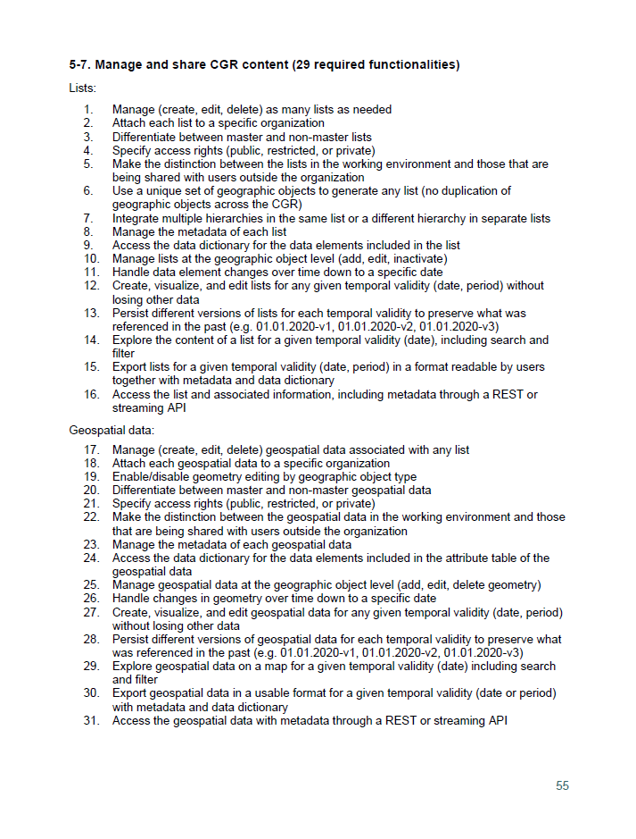
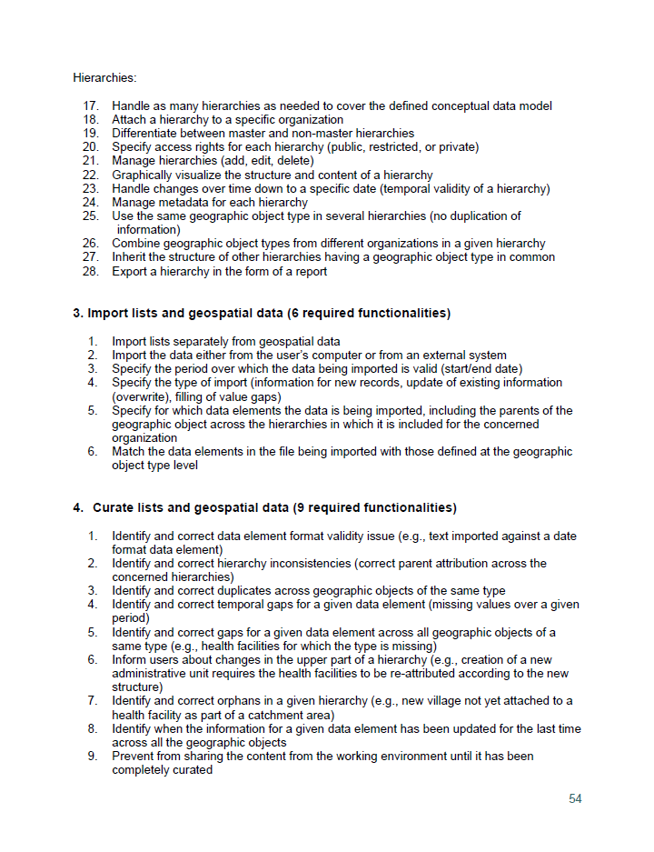
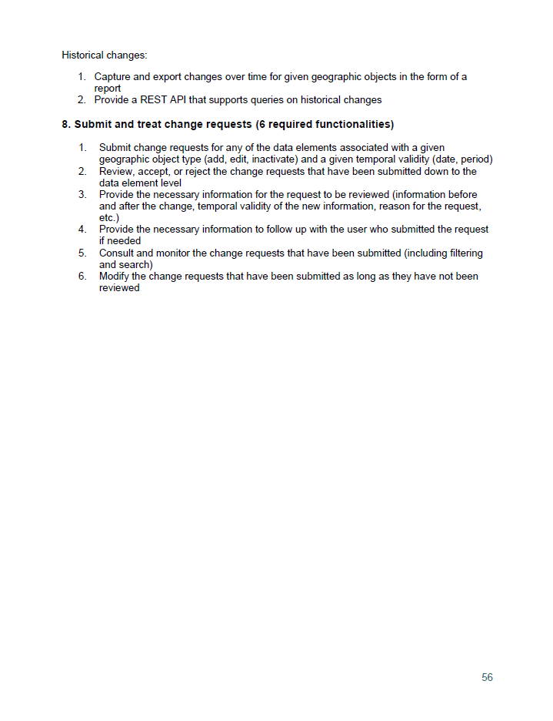
Functional requirements - CGR
93 functional requirements without criticality level
13

Slide 14
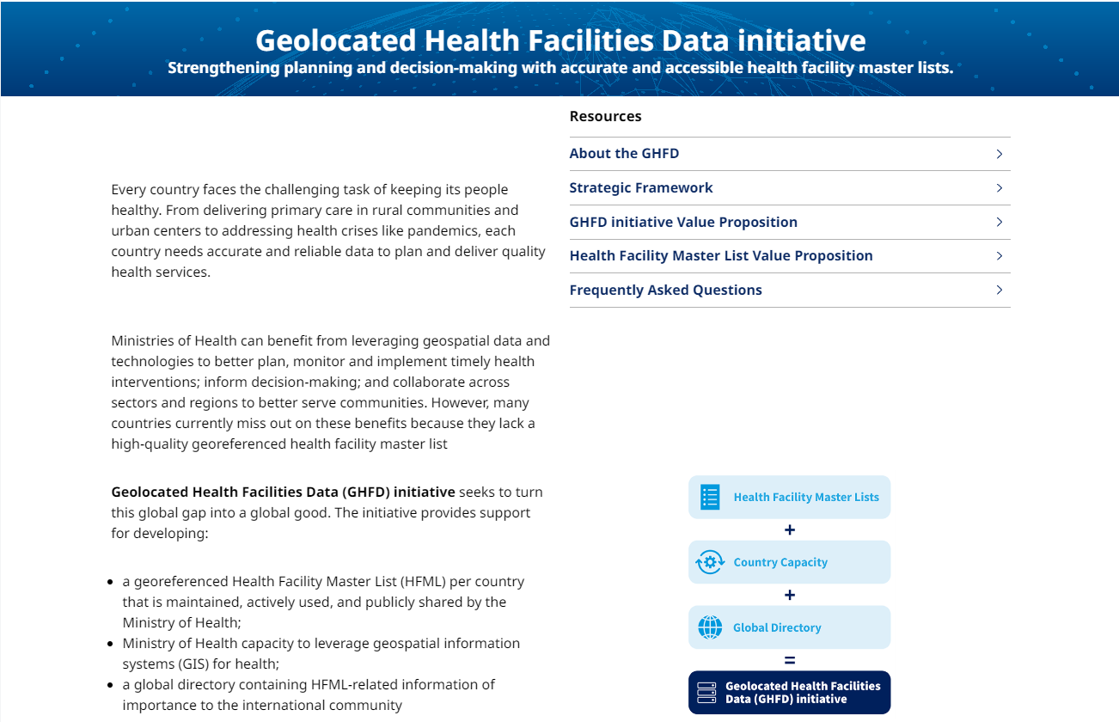
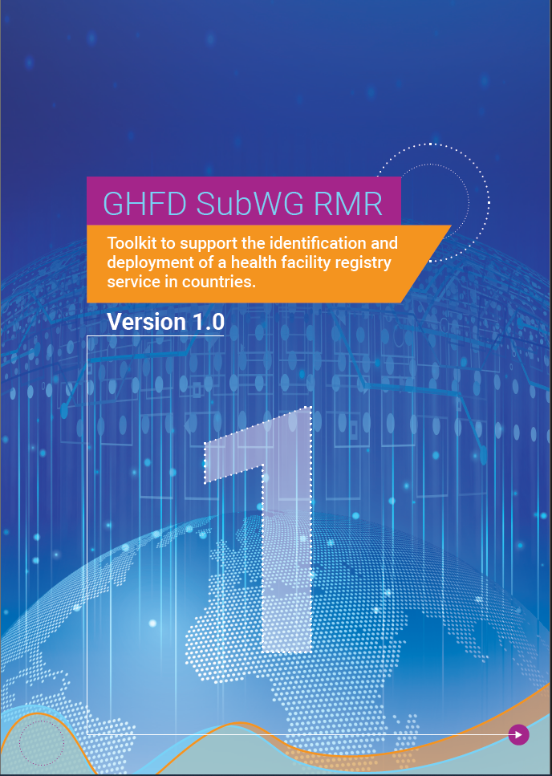
Health Facility Registry Service (HFRS) toolkit
The Master Facility List Resource package released by WHO in January 2017 launched the concept of a Facility Registry Service as a software solution that stores and shares the Master Facility List (MFL)
1
As part of its activities, the WHO Geolocated Health Facilities Data (GHFD) initiative established a Sub Working Group on Health Facility Registry Minimum Requirements (subWG RMR)
2
The toolkit to support the identification and deployment of a Health Facility registry Service (HFRS) in countries is born from the activities of this Sub Working Group
Published in 2024 and freely accessible from this link : https://www.unicef.org/digitalimpact/reports/health-facility-registry-toolkit
https://www.who.int/publications/i/item/-9789241513302
https://www.who.int/data/GIS/GHFD
14

Slide 15
Define the functional requirements (how) of a registry
(example: registry for the master list of health facilities)
Health Facility Registry Service (HFRS) toolkit
Table of content
Introduction (concept, use cases and benefits)
Step 1 – Establish a technical working group
Step 2 – Define the expected outcomes (strategic and technical)
Step 3 – Assess the current enabling environment (HIS geo-enabling framework)
Step 4 – Define what the HFRS needs to do (Data ecosystem, task flows, user roles, functional and non-functional requirements)
Step 5 – Find the appropriate IT solution
Step 6 – Develop the implementation, monitoring and evaluation and communication plans
Step 7 – Understand and manage risks
Organized as a process to guide countries to choose the appropriate IT solution to serve as a HFRS
15

Slide 16
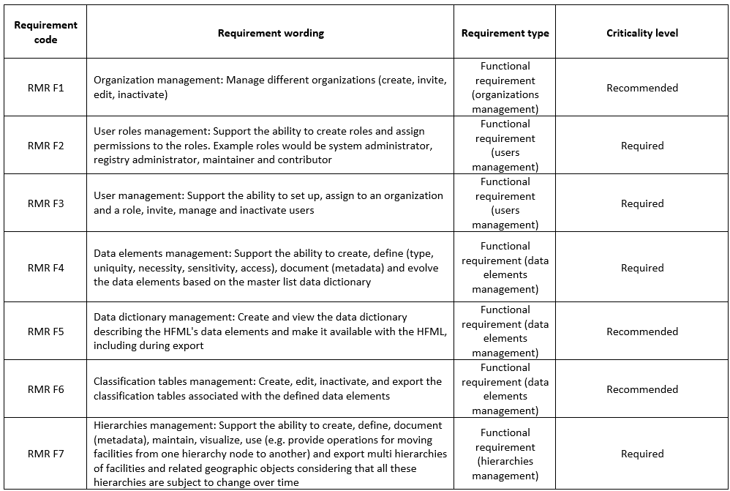
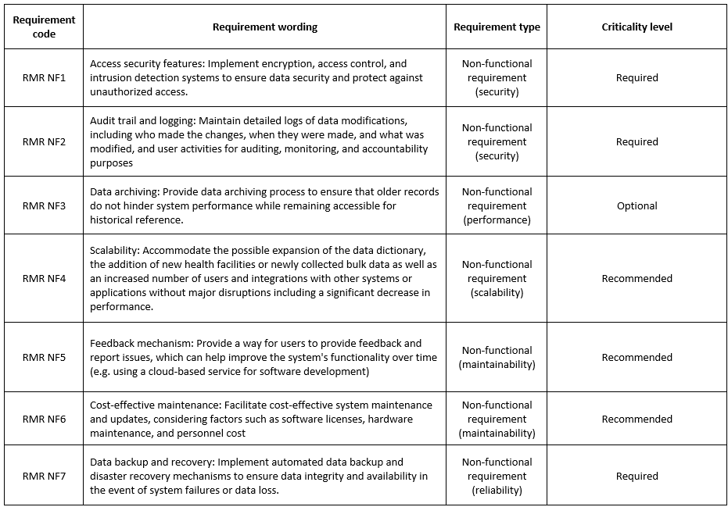
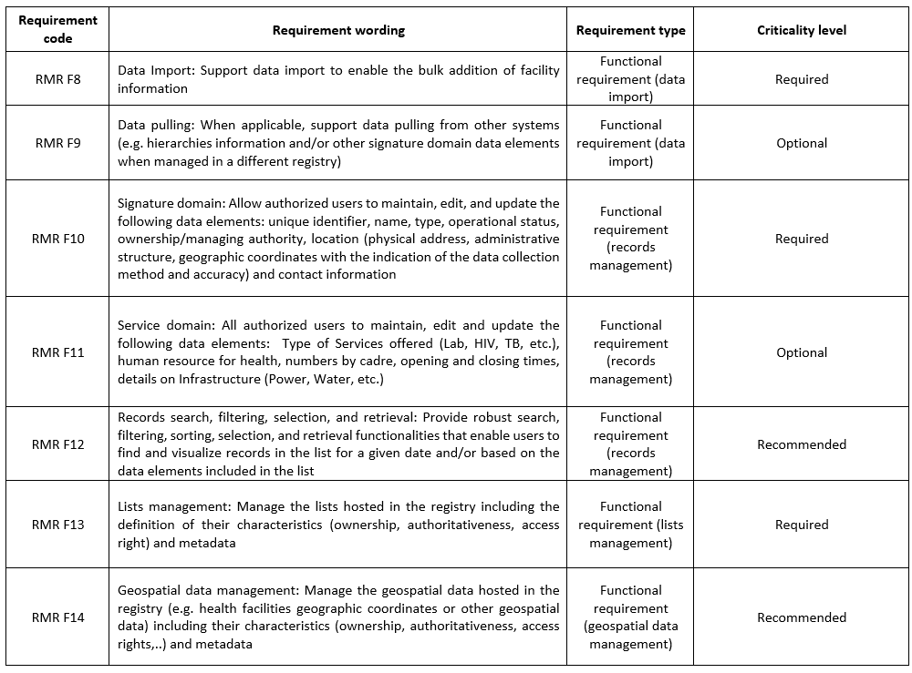
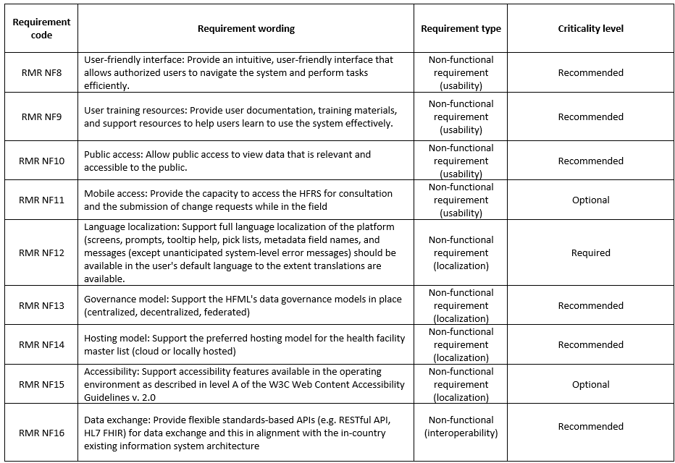
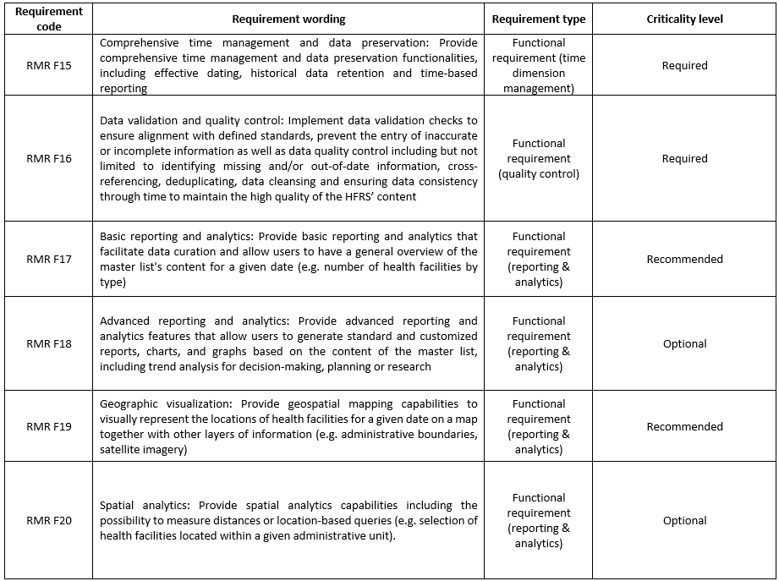
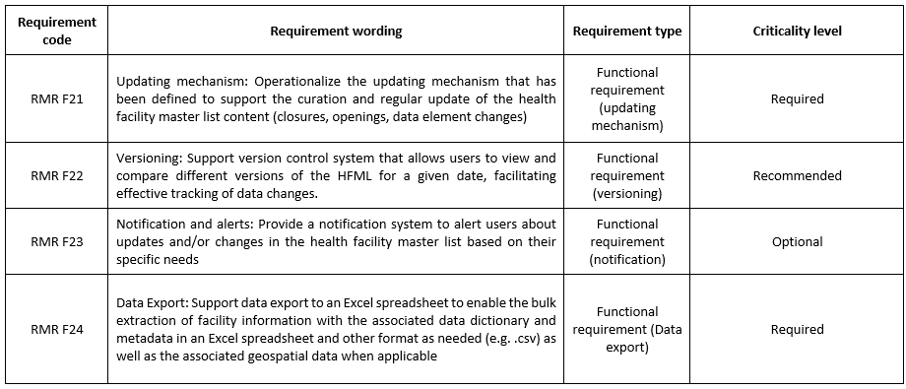
Define the functional requirements (how) of a registry
(example: registry for the master list of health facilities)
Functional and non-functional requirements - HFRS
Functional requirements: Product features or functions that developers must implement to enable users to accomplish their tasks
Non-functional requirements: Requirements describing how a system should perform
Also applicable to a CGR
24 functional and 16 non-functional requirements with recommended criticality level
16

