Slide 1
Exercise 1: Using an Android phone and GPS essentials to collect geographic coordinates in the field

Slide 2
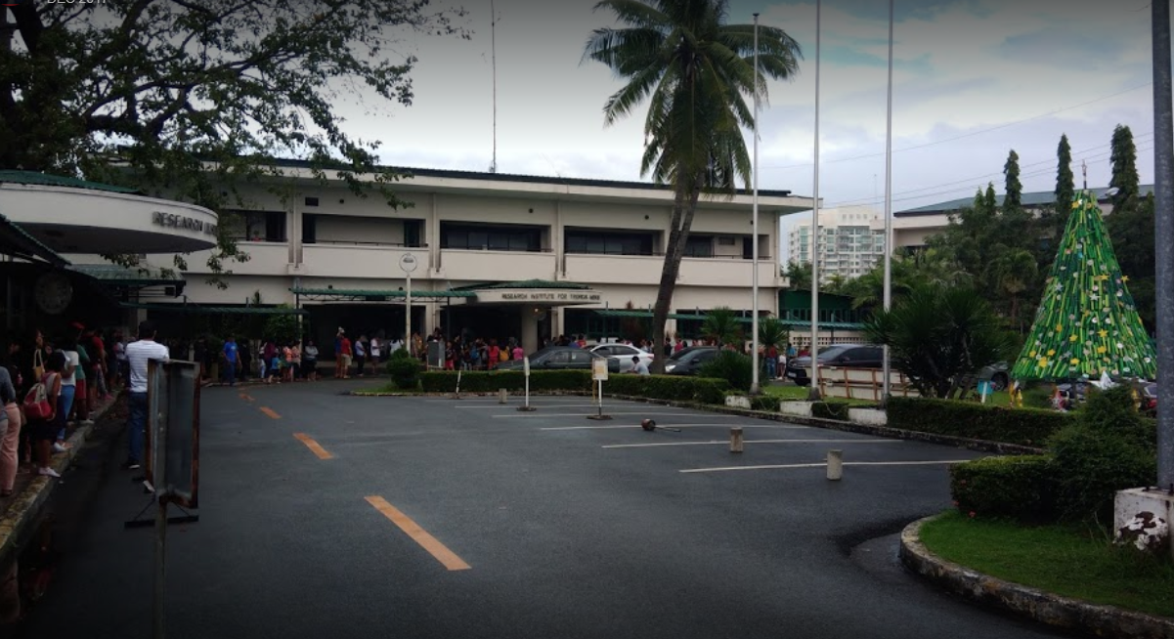
Health Facility geographic coordinates
Information from the health facility master list (fake):
Official DOH code: HF110192
Postal address: Filinvest, Alabang, Tolkien City 1781
Region: National Capital Region (NCR)
Province: Tolkien Province
Municipality/City: Tolkien City
Barangay: Centro
Barangay code: PH139916002
RITM Hospital
Let’s go collect some coordinates!

