Slide 1
Exercise 4: Preparing the geospatial data for its use in QGIS

Slide 2
Request received for a map
Map 1
Purpose: Assist on-going malaria control and elimination activities
Audience: Province level Malaria Surveillance Officer
Content:
  Updated number of malaria cases:
    By place of reporting at the health facility level
    By place of residence aggregated by Barangay
Medium: A4 size map stored in a pdf file
What geospatial data do we need?

Slide 3
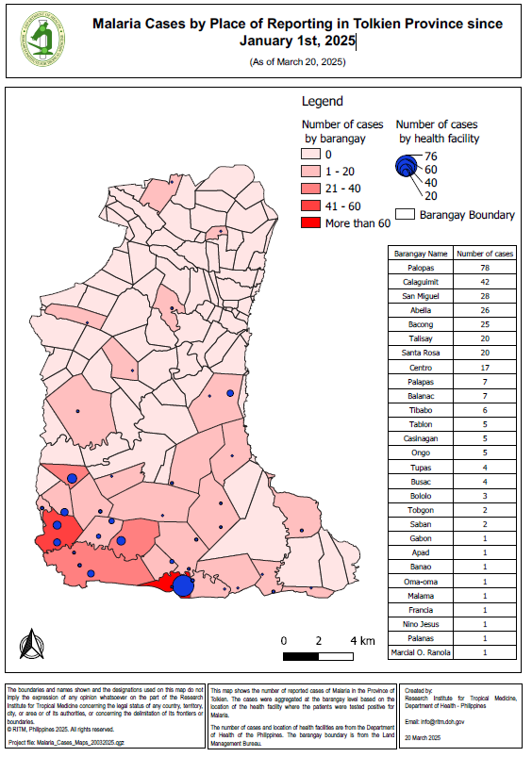
What geospatial data do we need?
Map 1
For the Province of Tolkien, we need shapefiles containing the:
Boundaries of the Barangay with the unique identifiers from the master list included in the attribute table
Location of the health facilities with the unique identifier from the master list included in the attribute table

Slide 4
Request received for a map
Map 2
Purpose: Identify geographic foci and guide foci investigations as needed
Audience: Commune level Malaria Surveillance Officer
Content:
  Location of place of residence and possible place of infection for the 315 positive cases reported since the beginning of the year including the new ones just reported by the RITM Hospital
  Hydrographic network (waterways and water bodies)
  Forests
  Barangay boundaries
Medium: A4 size map stored in a pdf file
What geospatial data do we need?

Slide 5
What geospatial data do we need?
Map 2
For the Province of Tolkien, we need:
  Shapefiles containing the:
    Boundaries of the Barangay with the unique identifier from the master list
    Geographic location of the place of residence for the cases observed since the beginning of the year
    Geographic location of the place of possible infection for the cases observed since the beginning of the year
    Hydrographic network and water bodies
  A shapefile, or a raster format grid containing the:
    Spatial distribution of forests

Slide 6
What geospatial data do we have?
Barangay boundaries shapefile (LMB)
Place of residence and possible place of infection for the 315 positive cases identified since the beginning of 2025 and the new ones reported by the RITM hospital (collected with ODK)
Hydrographic network (OSM)
Water bodies (HGLC)
Forest distribution (Modified from Hansen)
Data placed in the TRAINING_MATERIAL\EXERCISES\EXERCISE_4\DATA folder on your USB key + The results of the ODK-based questionnaire given to you on a separate USB key

Slide 7
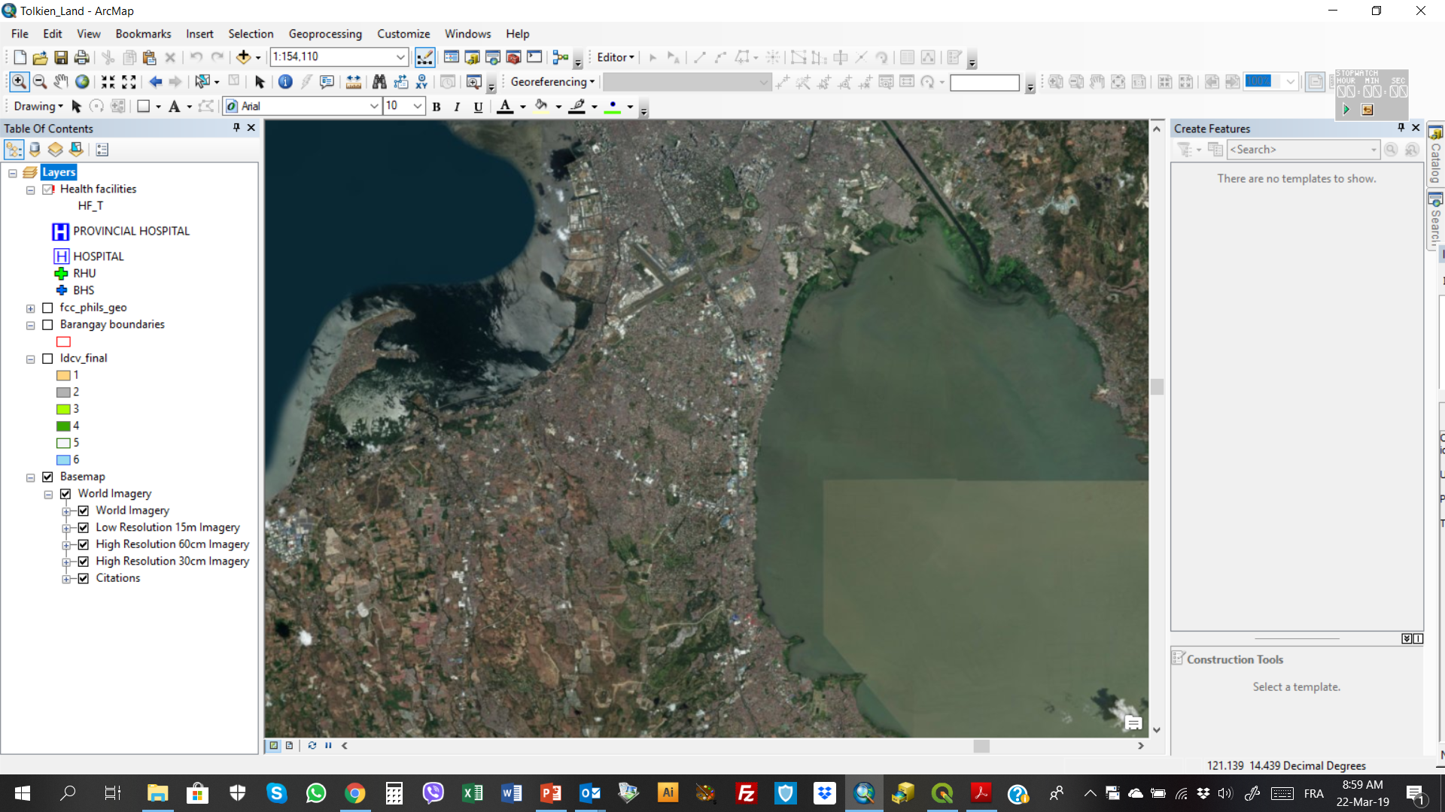
What geospatial data do we have?
Basemap
Satellite
images
Ground reference
Will be used to check the consistency, accuracy and completeness of the geospatial data that we will be using

Slide 8

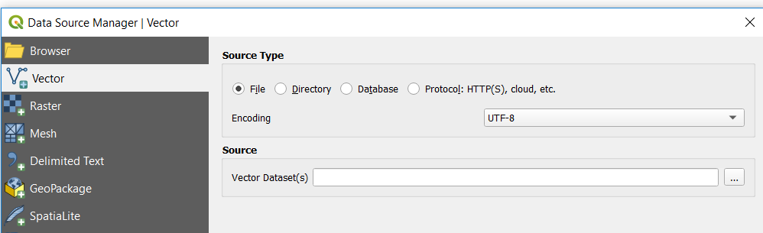
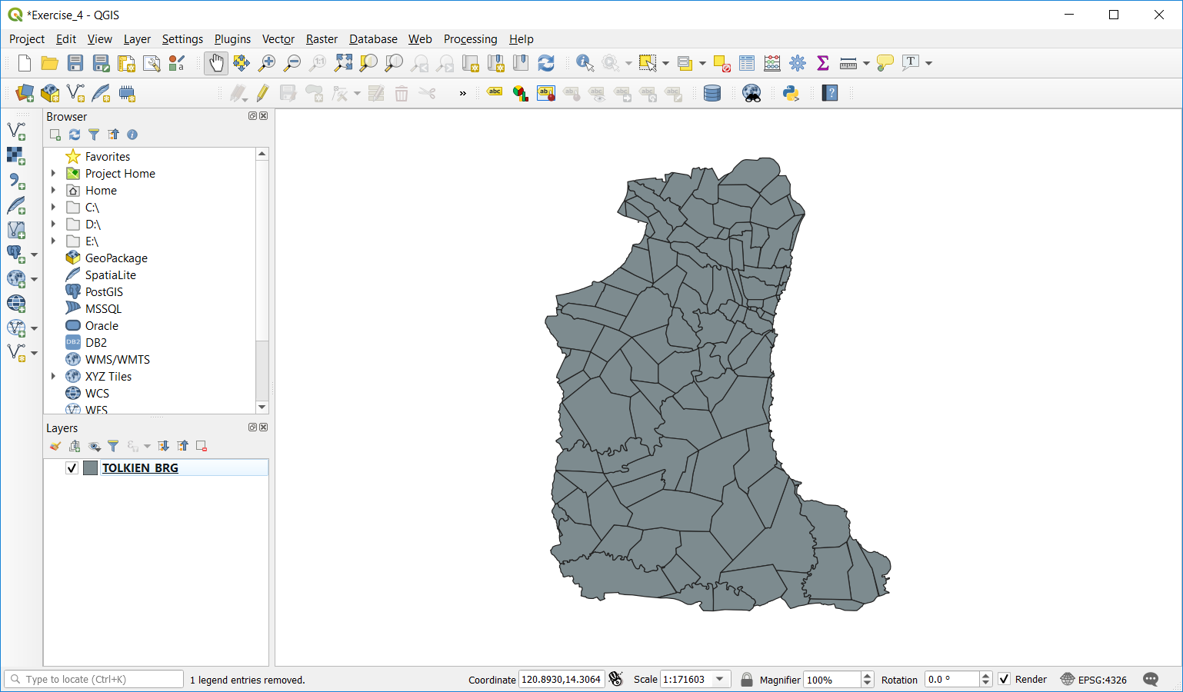
Exercise 4 – Part 1
Barangay boundaries shapefile
Launch QGIS
Click the Add Vector Layer button
Browse to the location of the TRAINING_MATERIAL\EXERCISES\EXERCISE_4\DATA\BARANGAY_BOUNDARIES\LMB folder on your computer
Select the TOLKIEN_BRG.shp file and click on the Add button
Close the Data Source Manager window
The Barangay boundaries for the Province of Tolkien should appear in the map canvas of QGIS

Slide 9
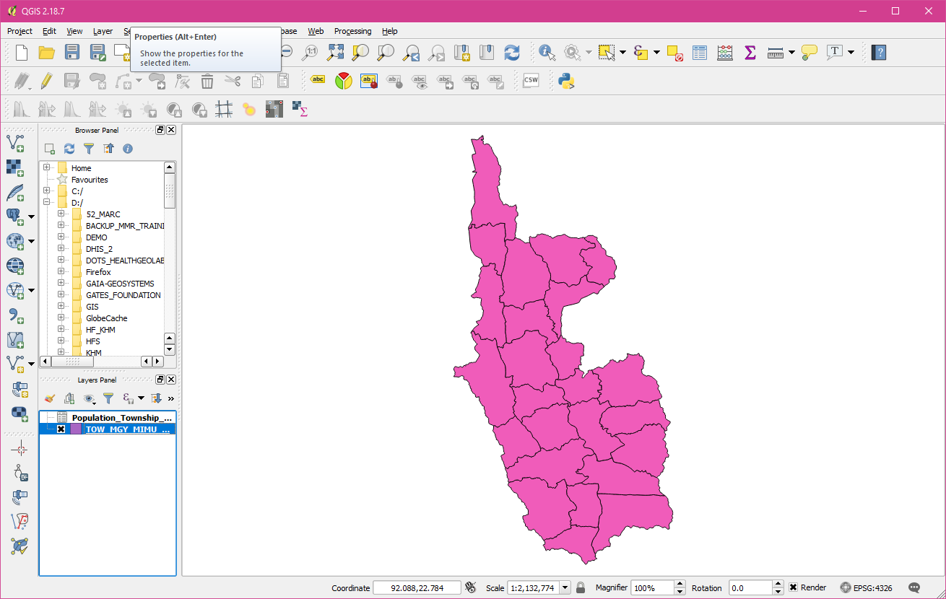
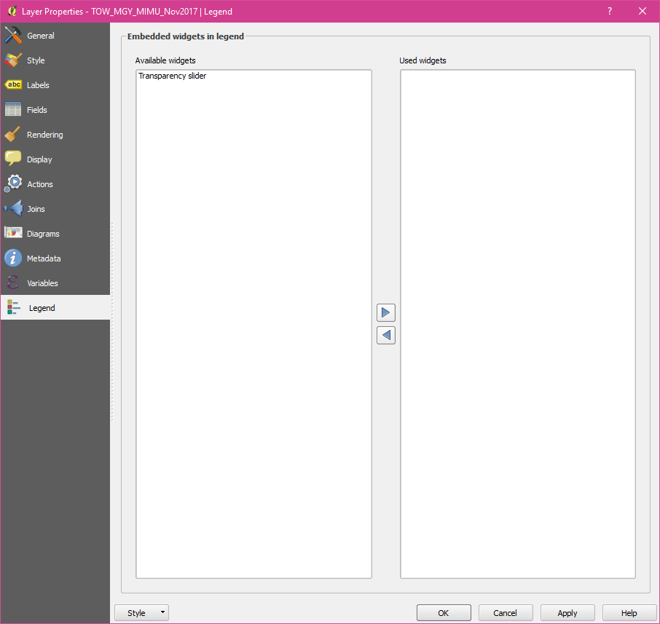
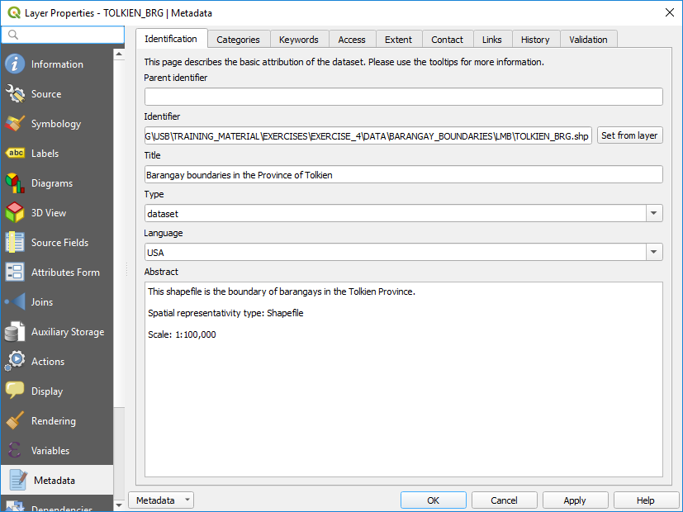
Exercise 4 – Part 1
Barangay boundaries shapefile
Click on the save icon
Browse to the folder where you want to save your QGIS project
Enter a file name and click Save
Barangay boundaries shapefile - Metadata
Right click on the barangay boundaries layer and select properties
Select Metadata in the list and have a look at information reported there
You can also have a look at the METADATA_LMB_BRG_BND.txt file stored in the TRAINING_MATERIAL\EXERCISES\EXERCISE_4\DATA\BARANGAY_BOUNDARIES \LMB folder to get information about this layer

Slide 10
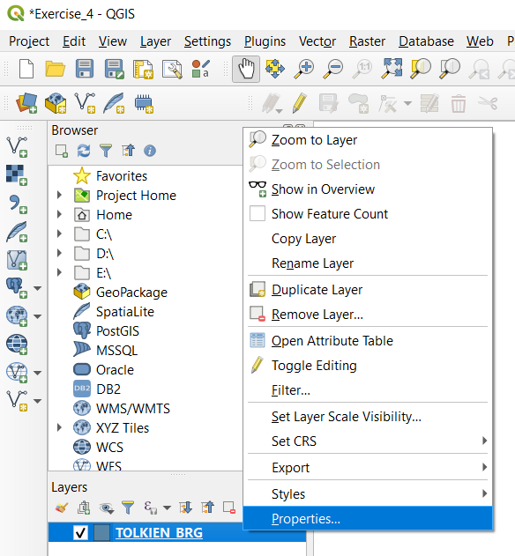
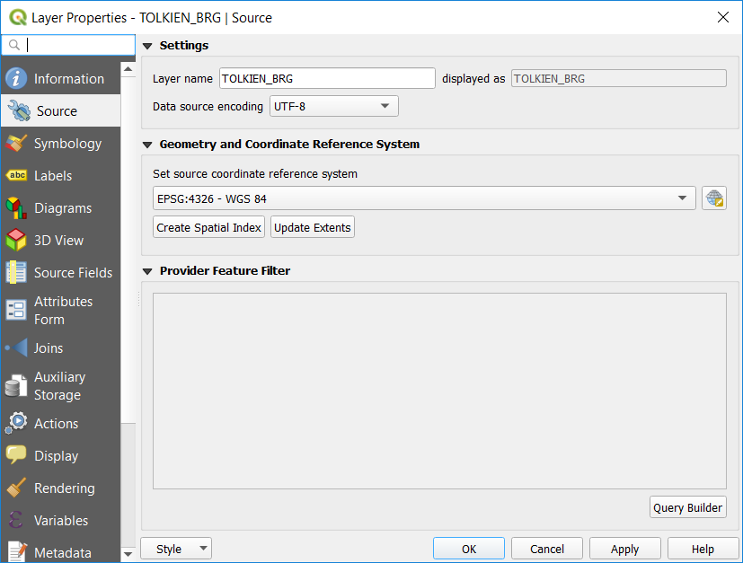
Exercise 4 – Part 1
Barangay boundaries shapefile - Projection
Right click on the layer
Select Properties in the menu
Click on Source
The information about the geographic coordinate and projection system is stored under “Geometry and Coordinate reference system”
Layer not projected, only using the a geographic coordinate system (WGS 84)

Slide 11
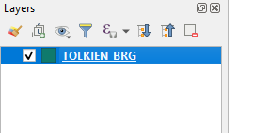
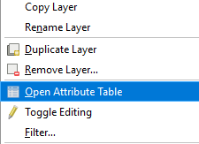
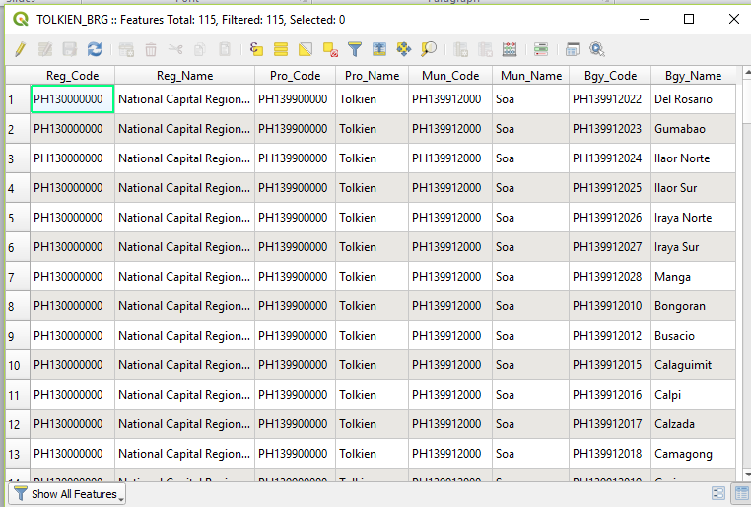
Exercise 4 – Part 1
Barangay boundaries shapefile – Attribute table
Right click on the layer
Select Open Attribute Table in the menu
Take some time to look at how the attribute table is structured (rows, columns)
Does this remind you of another table we saw in the previous exercise?
Does the content of the shapefile match the content of the master list?

Slide 12
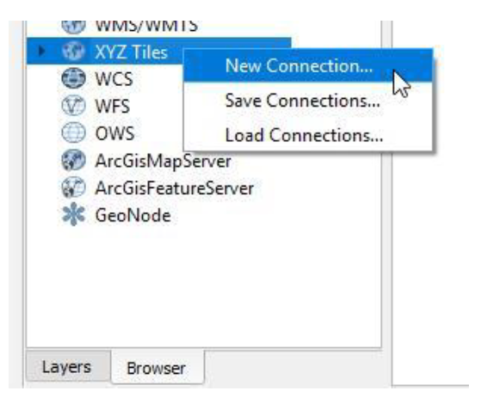
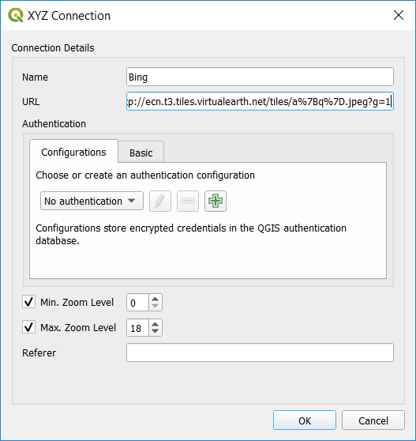
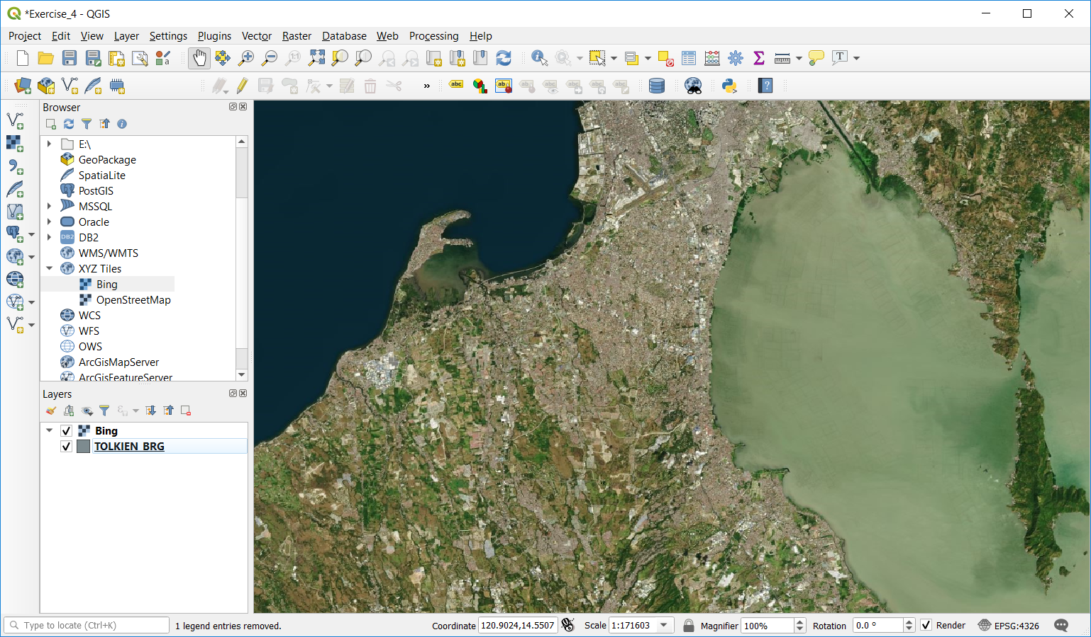
Exercise 4 – Part 1
Barangay boundaries shapefile – Consistency with the satellite image used as ground reference
In the Browser Panel, right click on XYZ Tiles then choose New Connection
In the window that opens:
  Indicate the name under which you want to see this layer appear in the list
  Enter the URL of the WMS you want to use (LINK_BING_SATELLITE.txt file)
  Do not change the other settings in the window. Click OK.
  Double click on the layer name under the XYZ Tiles
Save the project!
The satellite images should appear in the map canvas

Slide 13
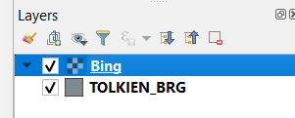
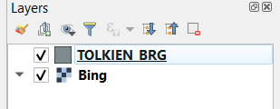

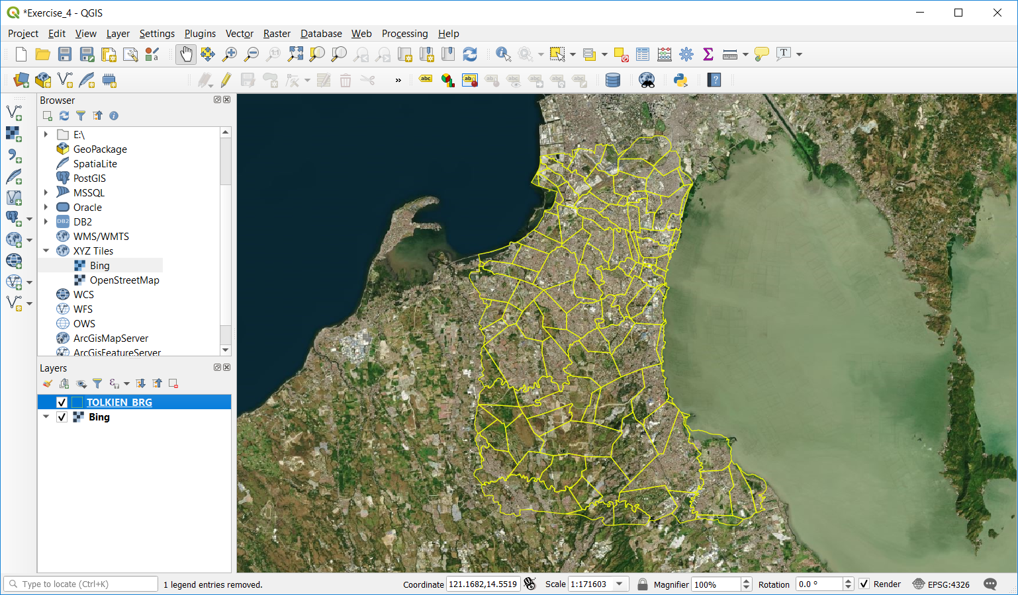
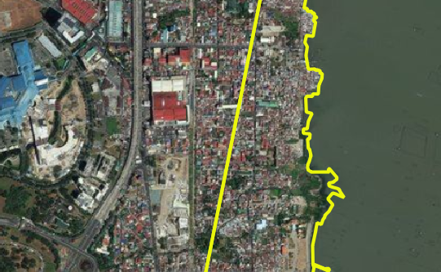
Exercise 4 – Part 1
Barangay boundaries shapefile – Consistency with the satellite image used as ground reference
Move the satellite image basemap in the back of the Barangay boundaries
Change the symbology of the Barangay boundaries layer so that we can see the satellite images through them
Zoom on some areas to visually judge the accuracy of the Barangay boundaries
Uncheck the basemap and Barangay boundaries layer before moving to the next step
Save the project!

Slide 14
Exercise 4 – Part 2
Health facilities location shapefile
Open the Health_Facilities_master_list_DOH_Jan2025.xlsx file in excel (located under TRAINING_MATERIAL\EXERCISES\EXERCISE_4\DATA)
Look at the fields containing the the information related to the geographic coordinates of the health facilities:
  How many fields do you see?
  What does these fields contain?
  What is the level of precision of the geographic coordinates?
  Do we have geographic coordinates for the RITM Hospital?
Lat: 14.40956 Long: 121.03732
Source (method): RITM (GPS) Accuracy: High

Slide 15
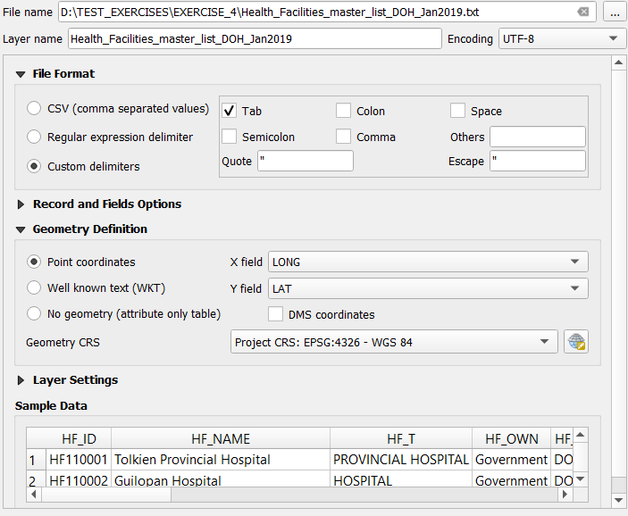

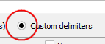
Exercise 4 – Part 2
Health facilities location shapefile
We have to convert the content of the health facility master list into a shapefile
Save the Health_Facilities_master_list_DOH_Jan2025.xlsx as tab delimited (.txt) file
Close Excel
In QGIS:
  Click on the Add Delimited Text Layer button
  In the window that opens:
    Browse to the .txt file
    Select Custom delimiters under file format and check Tab
    Indicate which fields contain the longitudes and latitudes and Project CRS; EPSG:4326 – WGS 84 under Geometry definition
Click Add

Slide 16
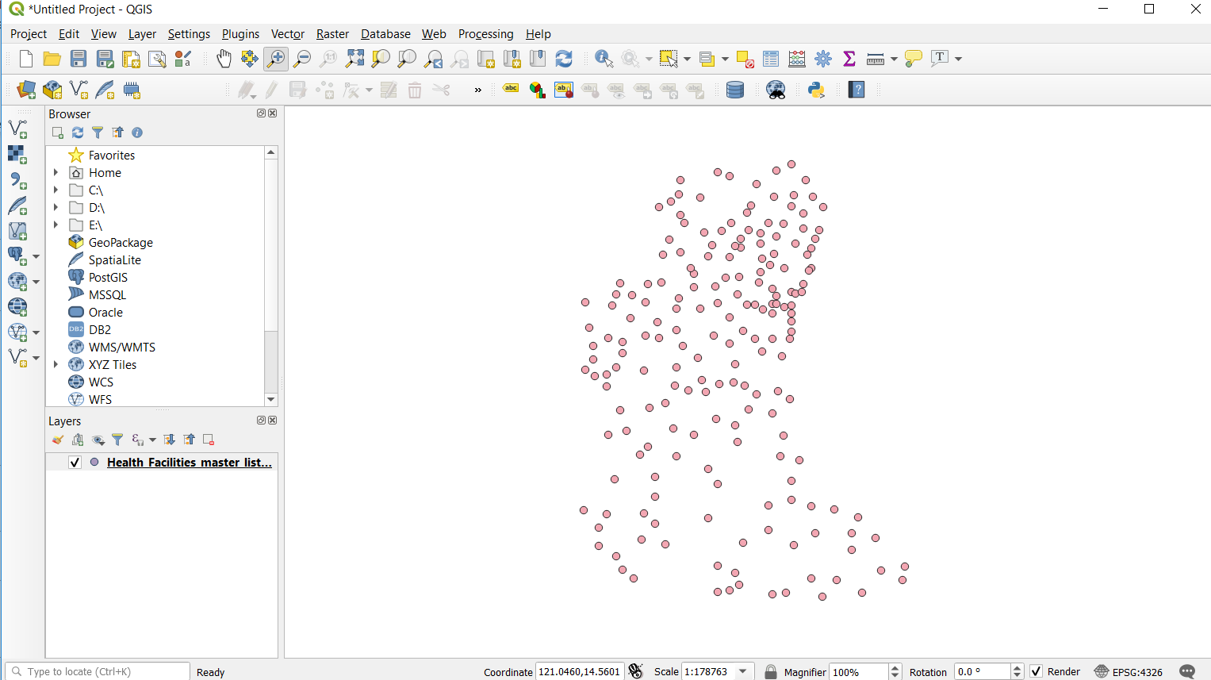
Exercise 4 – Part 2
Health facilities location shapefile
The locations of the health facilities included the master list should appear in the map canvas
Save the project!
!!!! The points are not yet saved in a shapefile!!!

Slide 17
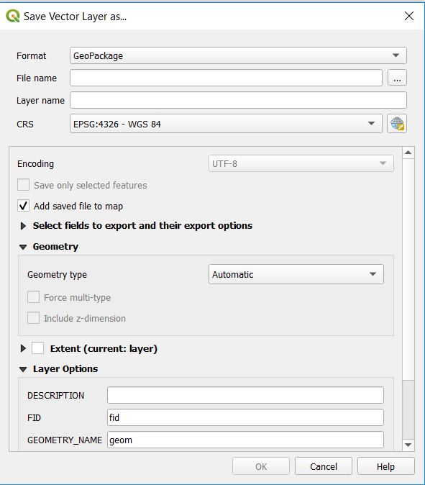
Exercise 4 – Part 2
Health facilities location shapefile
To do so:
Right click on the layer containing the points in the layer panel and click on Export > Save Features as
In the Window that opens:
  Select Esri Shapefile as the Format
  Browse to the folder where you want to save it and give it a name (HF_Locations.shp)
  Keep EPSG:4326 - WGS 84 as the CRS
Click OK

Slide 18
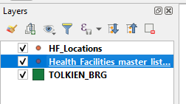
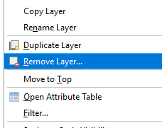
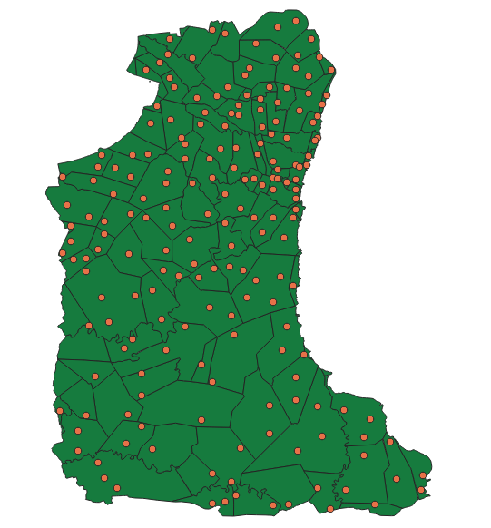
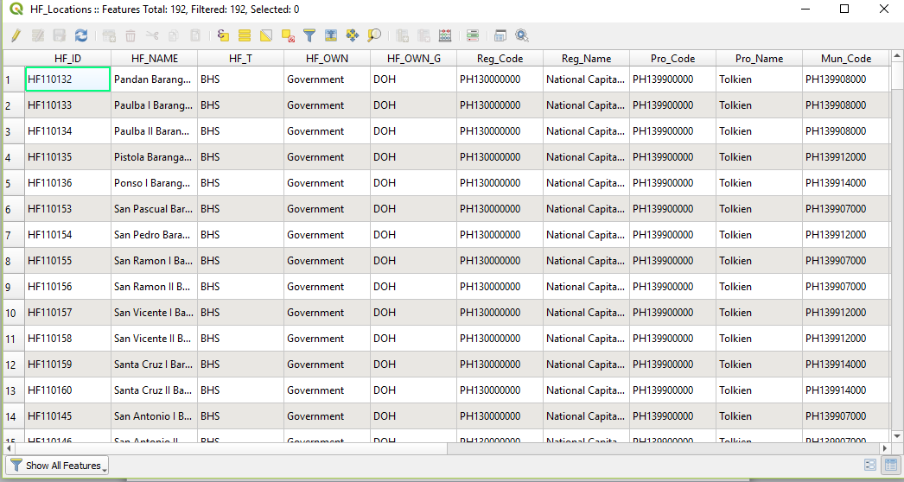
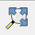
Exercise 4 – Part 2
Health facilities location shapefile
The new shapefile is now added to the layer panel
You can delete the temporary layer by right clicking on it and then click on Remove Layer
Once done, save the project and:
Make sure that all the points are falling within the Tolkien Province (click on the Zoom Full button for that )
Open the attribute table and check that all the content from the master list is there (192 health facilities)
Check that the health facilities are falling within the correct City and Barangay
Save the project!

Slide 19
Exercise 4 – Part 3
Place of residence and possible place of infection shapefile
Open the Place_res_inf_by_case_200325.xlsx file in excel (located under: TRAINING_MATERIAL\EXERCISES\EXERCISE_4\DATA)
Look at the content and structure of the file:
  What does this file contain?
  Anything you should be cautious about when using this kind of data?
  How many set of geographic coordinates do we have for each case?
  What is the level of precision of the geographic coordinates?
  Are the locations collected using ODK yesterday included in this file?

Slide 20
Exercise 4 – Part 3
Place of residence and possible place of infection shapefile - Include the new cases in the file
Open the Surveillance_results.csv file provided to you on a separated USB key
Look at the content and structure of the file:
  What are the differences compare to the previous tabular files you looked at until now?
  What does this file contain? What is missing?
  In which columns are stored the geographic coordinates for the place of residence and the places of possible infection?
  What other information are captured in relation to the geographic coordinates?

Slide 21
Exercise 4 – Part 3
Place of residence and possible place of infection shapefile - Include the new cases in the file
  How to integrate these new geographic coordinates into the Place_res_inf_by_case_200325.xlsx file?
In the Surveillance_results.csv file:
  Identify and highlight in yellow the columns that needs to be kept to match the structure of the Place_res_inf_by_case_200325.xlsx file
  Delete the other columns
Copy the new records from the file resulting from step 1 and paste them in Place_res_inf_by_case_200325.xlsx file
Verify that you have the correct final number of records
Save the places file under a new name (with today’s date…in 2025)

Slide 22
Exercise 4 – Part 3
Place of residence and possible place of infection shapefile - Include the new cases in the file
  List of fields that should be in your temporary file before copying the records to the Place_res_inf_by_case_200325.xlsx file
Place of residence – Barangay code: barangay_address:residence_brgy
Place of residence - Barangay name: Not captured
Place of residence - Latitude: RES:res:Latitude
Place of residence - longitude: RES:res:Longitude
First place of potential infection - type: INF1:TYPE
First place of potential infection - latitude: INF1:INF1:Latitude
First place of potential infection - longitude: INF1:INF1:Longitude
Second place of potential infection - type: INF2:TYPE
Second place of potential infection - latitude: INF2:INF2:Latitude
Second place of potential infection - longitude: INF2:INF2:Longitude
Third place of potential infection - type: INF3:TYPE
Third place of potential infection - latitude: INF3:INF3:Latitude
Third place of potential infection – longitude: INF3:INF3:Longitude

Slide 23
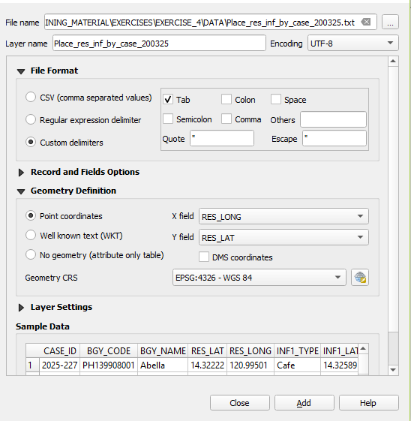
Exercise 4 – Part 3
Places of residence shapefile
We have to convert the places of residence in the Excel file into a shapefile
Save the Place_res_inf_by_case_270325.xlsx as tab delimited (.txt) file
Close Excel
In QGIS:
  Click on the Add Delimited Text Layer button
  In the window that opens:
    Browse to the .txt file
    Select Custom delimiters under file format and check Tab
    Indicate which fields contain the longitudes and latitudes of the place of residence and Project CRS; EPSG:4326 – WGS 84 under Geometry definition
Click Add

Slide 24
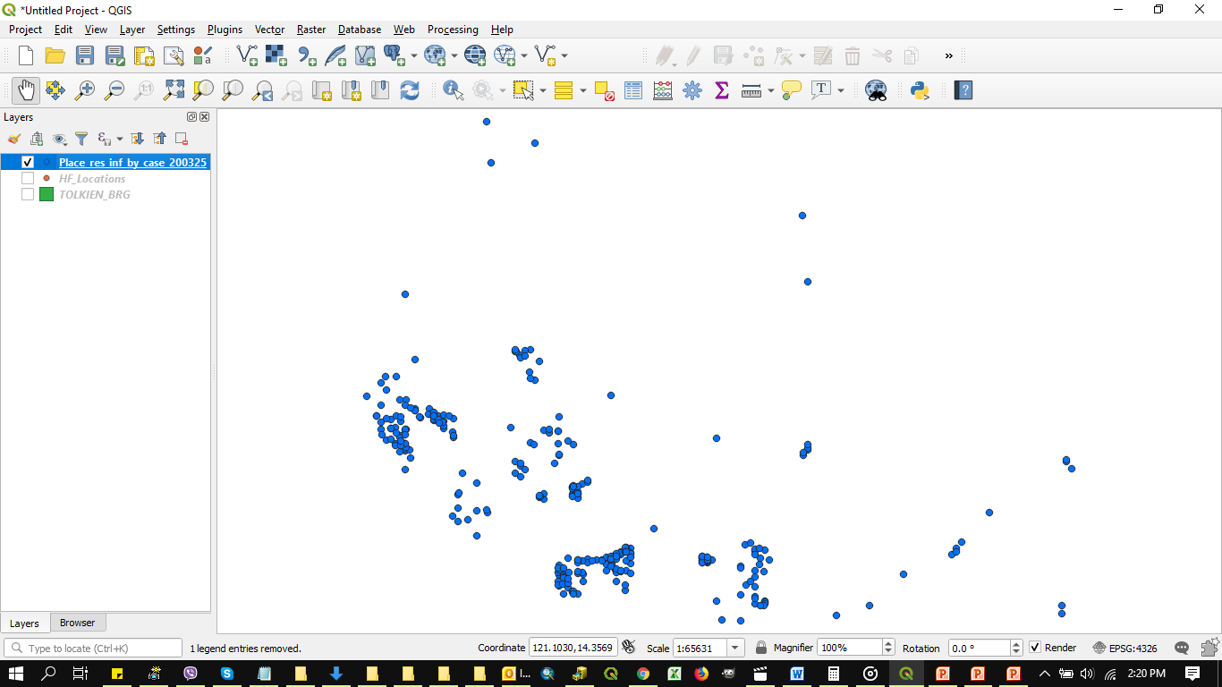
Exercise 4 – Part 3
Places of residence shapefile
The places of residence should now appear in the map canvas
Save the project!
!!!! The points are not yet saved in a shapefile!!!

Slide 25
Exercise 4 – Part 3
Places of residence shapefile
To do so:
Right click on the layer containing the points in the layer panel and click on Export > Save Features as
In the Window that opens:
  Select Esri Shapefile as the Format
  Browse to the folder where you want to save it and give it a name (Place_of_residence_270325.shp)
  Keep EPSG:4326 - WGS 84 as the CRS
Click OK

Slide 26
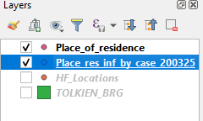
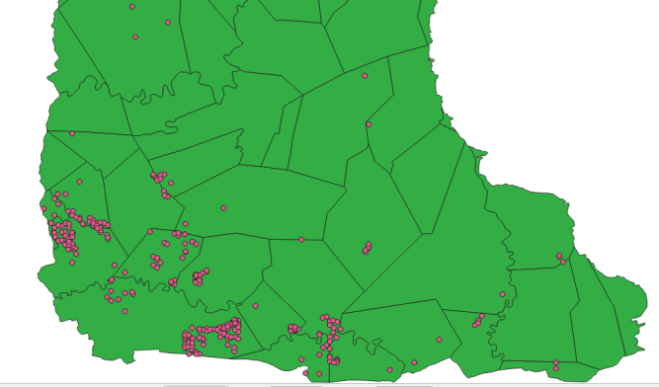
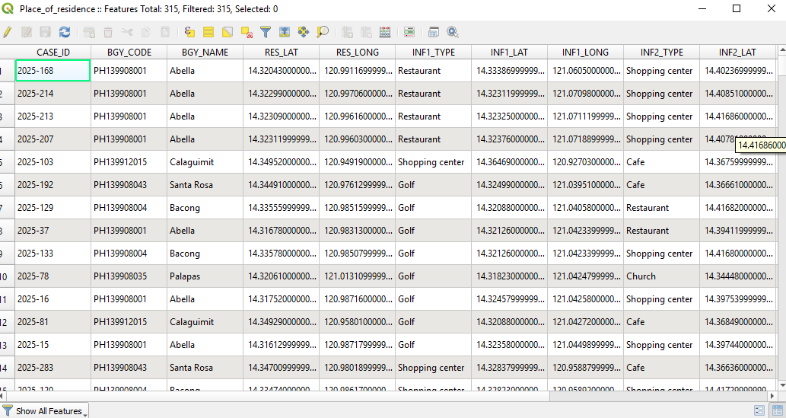
Exercise 4 – Part 3
Places of residence shapefile
The new shapefile is now added to the layer panel
You can delete the temporary layer by right clicking on it and then click on Remove Layer
Once done, save the project and:
Make sure that all the points are falling within the Tolkien Province (click on the Zoom Full button for that )
Open the attribute table and check that all the content from the master list is there
Save the project!

Slide 27

Exercise 4 – Part 4
Possible places of infection shapefile
We also have to convert the possible place of infection in the into a shapefile
Repeat the steps starting from adding the Place_res_inf_by_case_270325.txt file up to converting the temporary layer into a shapefile and checking that all the points are there for each of the 3 set of geographic coordinates
You will end up with 3 shapefiles (Place_infection_1.shp, Place_infection_2.shp, Place_infection_3.shp)
We need to merge these 3 shapefiles together
But, before that…
Save the project!

Slide 28
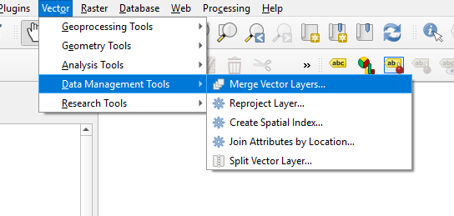
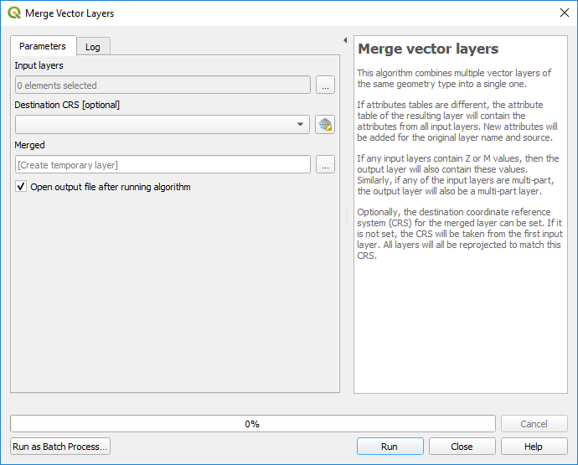
Exercise 4 – Part 4
Possible places of infection shapefile
To merge the 3 shapefiles together (Place_infection_1.shp, Place_infection_2.shp, Place_infection_3.shp):
Im QGIS, select the Vector> Data management tools > Merge Vector layers option
In the window that opens:
  Select the shapefiles you want to merge under Input layers
  Select the path and the name for the merged shapefile under Merged
  Click the Run button
The merged shapefile should appear in the map canvas
Check that you did not loose any points on the way and if the location of the points make sense on the satellite image

Slide 29
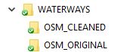
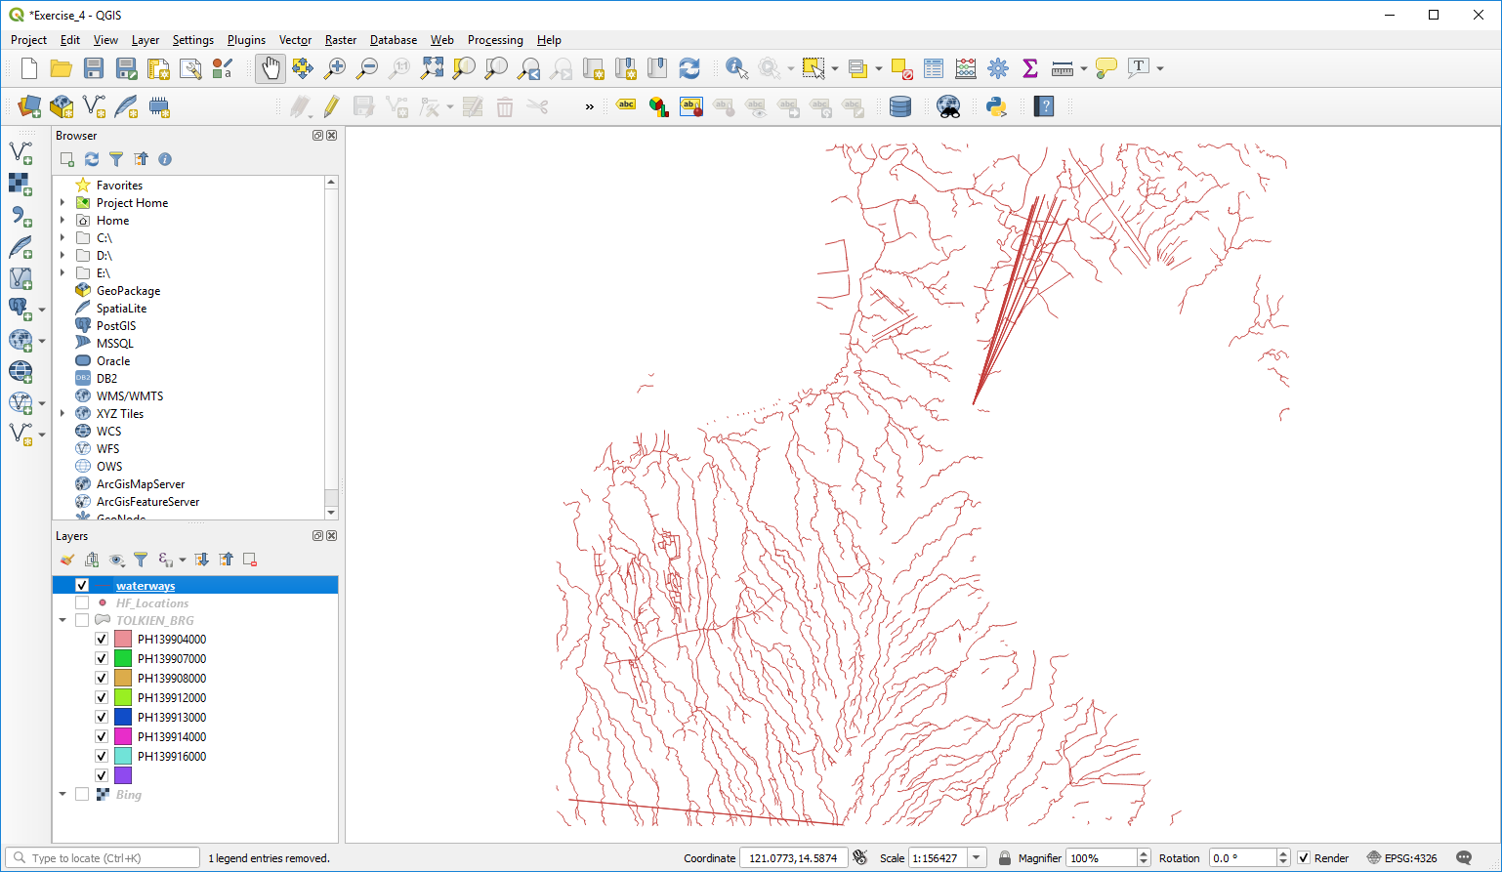
Save the project!
Exercise 4 – Part 5
Hydrographic network shapefile (waterways)
Click the Add Vector Layer button
Browse to the location of the EXERCISES\EXERCISE_4\DATA\ HYDROGRAPHIC_NETWORK\WATERWAYS
folder on the USB key
Notice that there are two folders there: OSM_ORIGINAL and OSM_CLEANED
Open the OSM_ORIGINAL folder and select the waterways.shp file and click on the Add button
Close the Data Source Manager window.
The waterways should appear in the map canvas of QGIS
29

Slide 30
Exercise 4 – Part 5
Hydrographic network shapefile (waterways)
Anything strange?
30

Slide 31
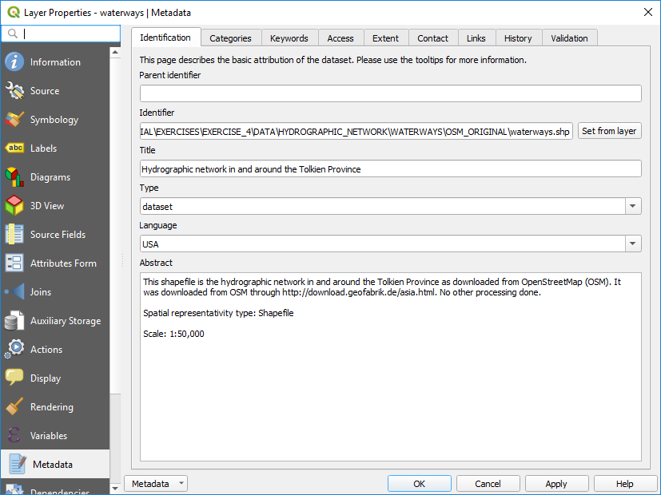
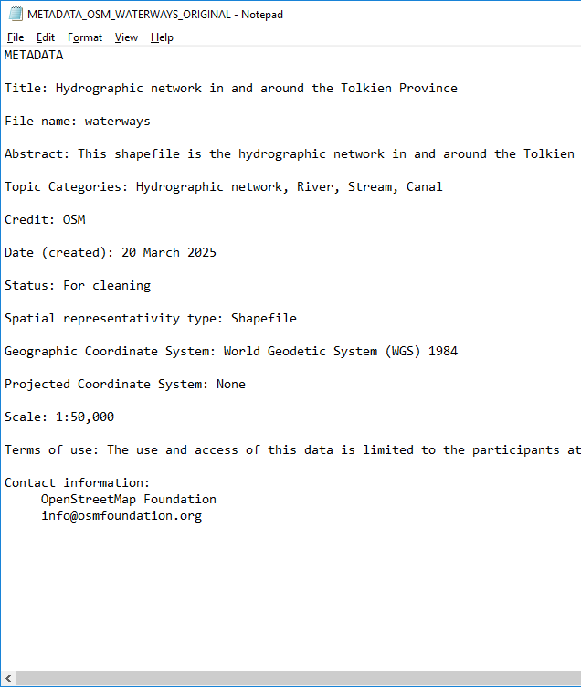
Exercise 4 – Part 5
Hydrographic network shapefile (waterways) - Metadata
Have a look at the Metadata profile stored in QGIS or at the METADATA_OSM_WATERWAYS_ORIGINAL .txt file stored in the folder to get information about this layer
What is this shapefile about?
What is its source and when is this data valid?
Who can use this shapefile?
Anything that could explain what we saw on the map?
Notice that this shapefile has not been processed and is as directly downloaded from OpenStreetMap.
31

Slide 32
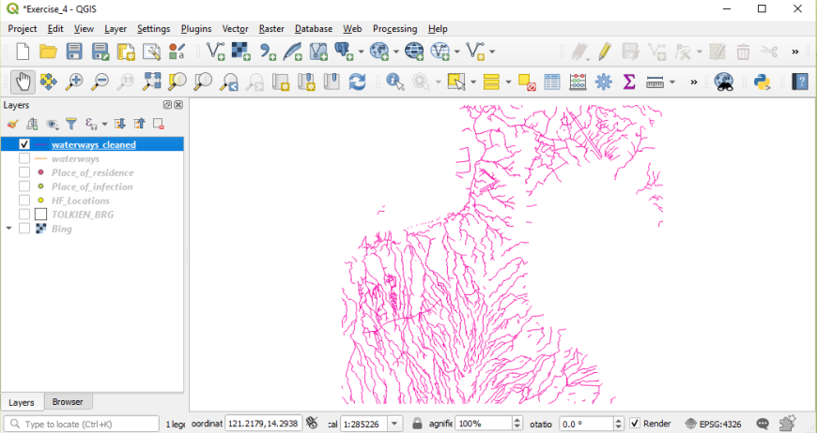
Exercise 4 – Part 5
Hydrographic network shapefile (waterways)
We have prepared a cleaned hydrographic network shapefile for this exercise
Click the Add Vector Layer button
Browse to the location of the TRAINING_MATERIAL\EXERCISES\EXERCISE_4\DATA\HYDROGRAPHIC_NETWORK\WATERWAYS\OSM_CLEANED on your USB
Select the waterways_cleaned.shp file and click on the Add button
Close the Data Source Manager window.
The cleaned hydrographic network for the Province of Tolkien should appear in the map canvas of QGIS
Do things look ok now?
32

Slide 33
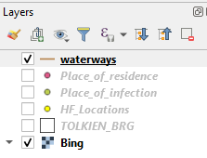
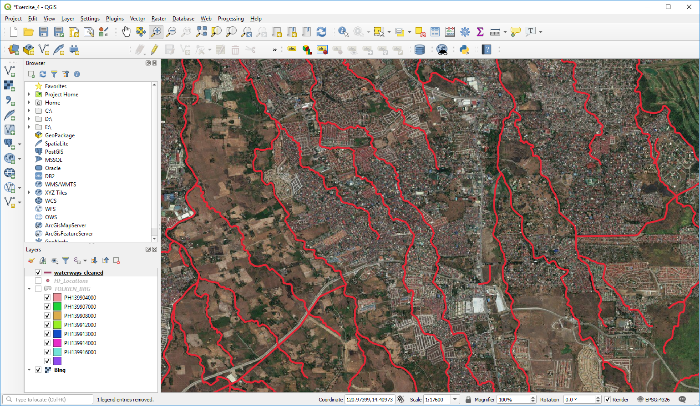
Exercise 4 – Part 5
Hydrographic network shapefile (waterways) – Check against the satellite images used as ground reference
Using the same satellite image you connected to earlier, check both the satellite image and the waterways layer to make them appear in the map canvas.
Zoom on some areas to visually judge the completeness and accuracy of the hydrographic network

Slide 34
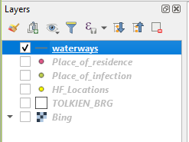
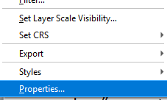
Exercise 4 – Part 5
Hydrographic network shapefile (waterways) - Projection
Right click on the layer
Select Properties in the menu
Click on Source
The information about the geographic coordinate and projection system is stored under “Geometry and Coordinate reference system”
Layer not projected, only using the a geographic coordinate system (WGS 84)

Slide 35
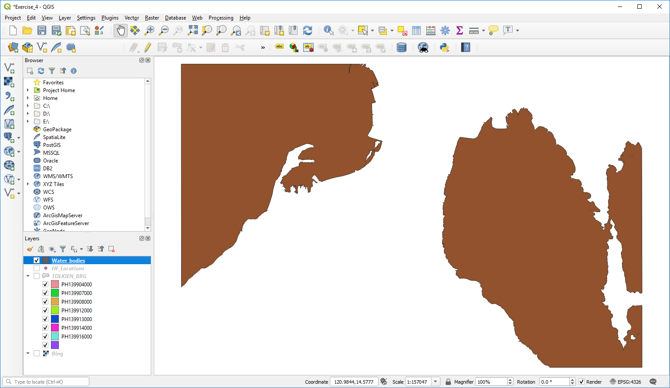
Save the project!
Exercise 4 – Part 5
Hydrographic network shapefile (water bodies)
Click the Add Vector Layer button
Browse to the location of the TRAINING_MATERIAL\EXERCISES\EXERCISE_4\DATA\ HYDROGRAPHIC_NETWORK \ WATER_BODIES \ HGLC folder on the USB key
Select the water_bodies.shp file and click on the Add button
Close the Data Source Manager window.
The water bodies should appear in the map canvas of QGIS
Take some time to look at the metadata, the projection, and how it fits with the satellite images
35

Slide 36
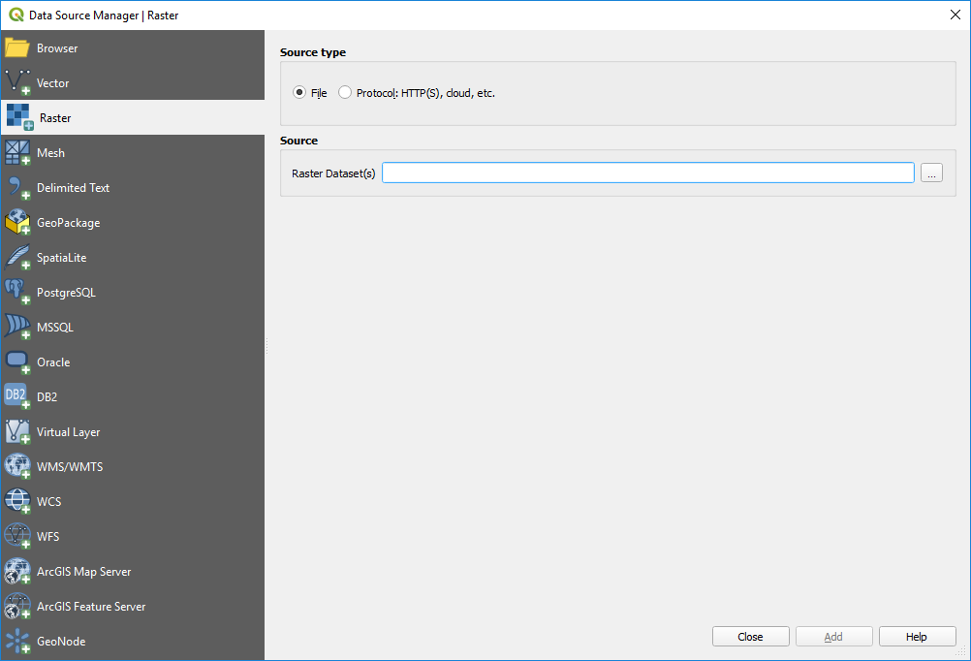
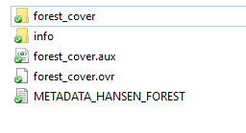
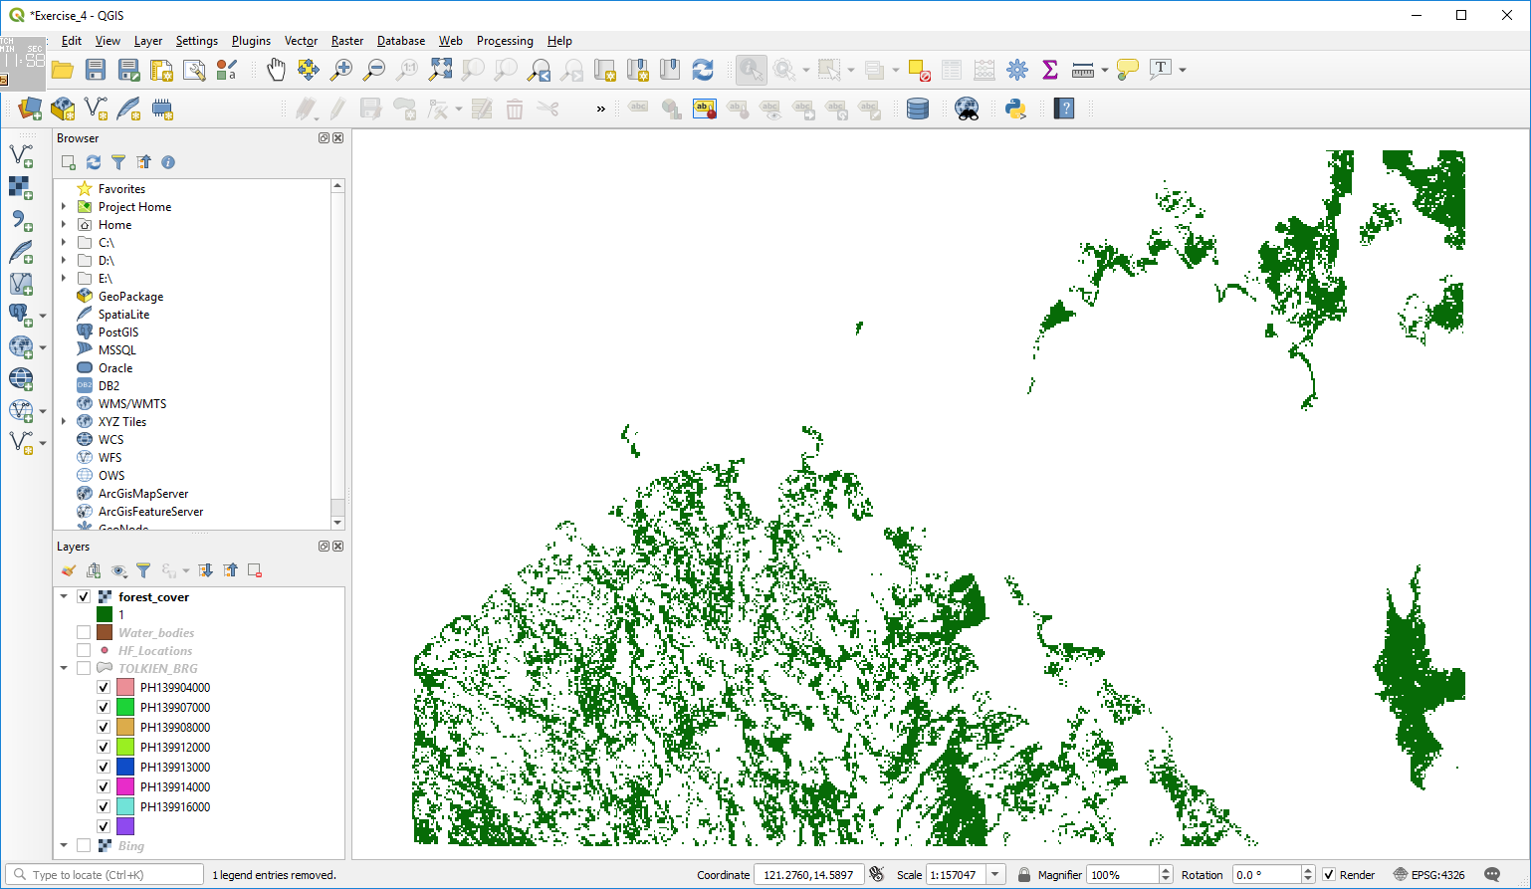
Exercise 4 – Part6
Forest cover distribution grid
Click the Add Raster Layer button
Browse to the location of the TRAINING_MATERIAL\EXERCISES\EXERCISE_4\DATA\FOREST folder on the USB key
Open the forest_cover sub folder and select any of the file see in there
Click on the Add button
Close the Data Source Manager window.
The forest distribution grid should appear in the map canvas of QGIS
36
Save the project!

Slide 37
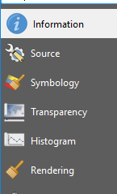
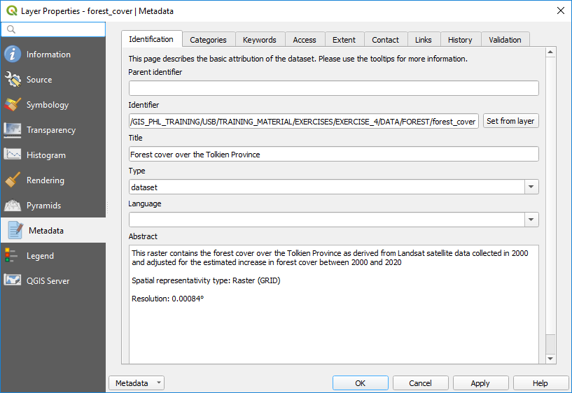

Exercise 4 – Part6
Forest cover distribution grid – Information and metadata
Right click on the layer
Select Properties in the menu
Click on Information
In the window that opens identify:
  The CRS
  The number of cells
  The resolution of the grid
Have a look at the metadata
37
Save the project!

Slide 38

Exercise 4 – Conclusion
We now have all the geospatial data needed to create the two maps
38

Slide 39
Exercise 4 – Conclusion
Geospatial data can be stored in different ways (geographic coordinates in an excel file, shapefile, raster grid,…)
It is very important to remain very critical about the data you are using to make sure that it is of quality and corresponds to your needs
  Metadata
  Ground reference
Always make sure that all the data you use present the same datum, even better the same geographic coordinate system and projection to have shifts between layers
39

Slide 40

Exercise 4 – Conclusion
Ready to make some maps!!
40

