Slide 1
Exercise 5: Creating individual thematic maps using QGIS

Slide 2
Recap
In Exercise 3, you prepared the statistical data
In Exercise 4, you prepared the geospatial data
In Exercise 5, you will join the statistical data with the geospatial data to create geographic data which you will represent in your maps.
Create thematic maps!

Slide 3
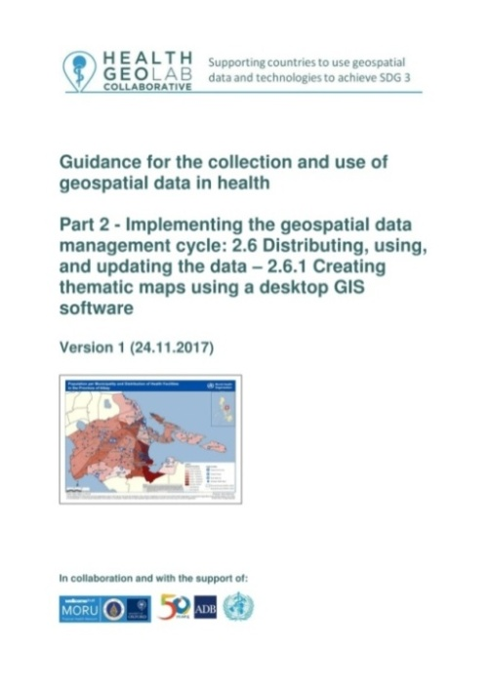

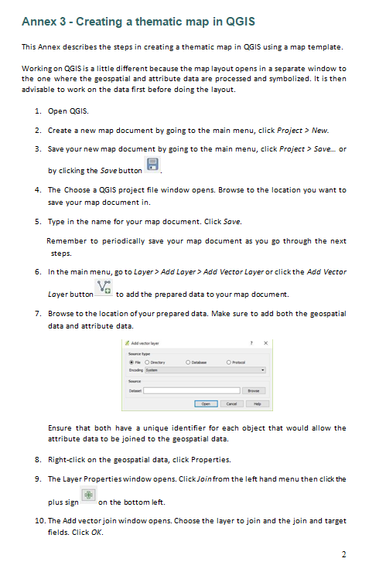
Quick reminder - The thematic mapping process
Creating the thematic map
Import the data in QGIS
Select the appropriate mode of representation
Fix the symbology
Add labels to the map
Choose the map template
Fix the other elements of the layout
Save the final map in the appropriate format
Printed
document

Slide 4

Map Competition!
Reminder: competition of the best thematic map(s) !!!
Judging criteria
Fit the purpose, audience, content, and medium
Inclusion of the key components that make a good map
Visually appealing and passing a strong message
Good luck !!!

Slide 5
Request received for the first map
Purpose: Assist on-going malaria control and elimination activities
Audience: Province level Malaria Surveillance Officer
Content:
  Updated number of malaria cases:
    By place of reporting at the health facility level
    By place of residence aggregated by Barangay
Medium: A4 size map stored in a pdf file
??
Need to find away to represent the information in a visually appealing way on top of each other

Slide 6
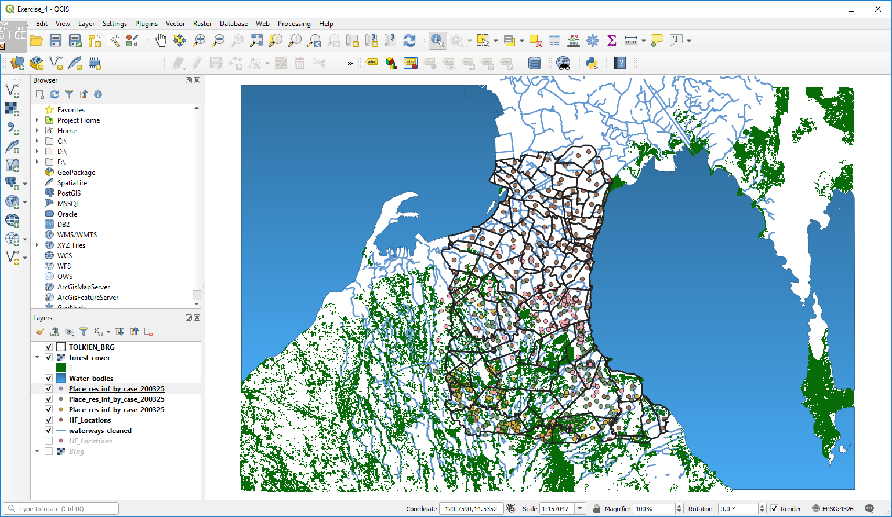
Map 1 - All the geospatial data already in QGIS from Exercise 4
Re-open your project created during Exercise 4
Remove all the layers except the Barangay boundaries and health facilities location shape files
Save the result in a new project named Map_1
We will now link the statistical data with the geospatial data to create geographic data

Slide 7

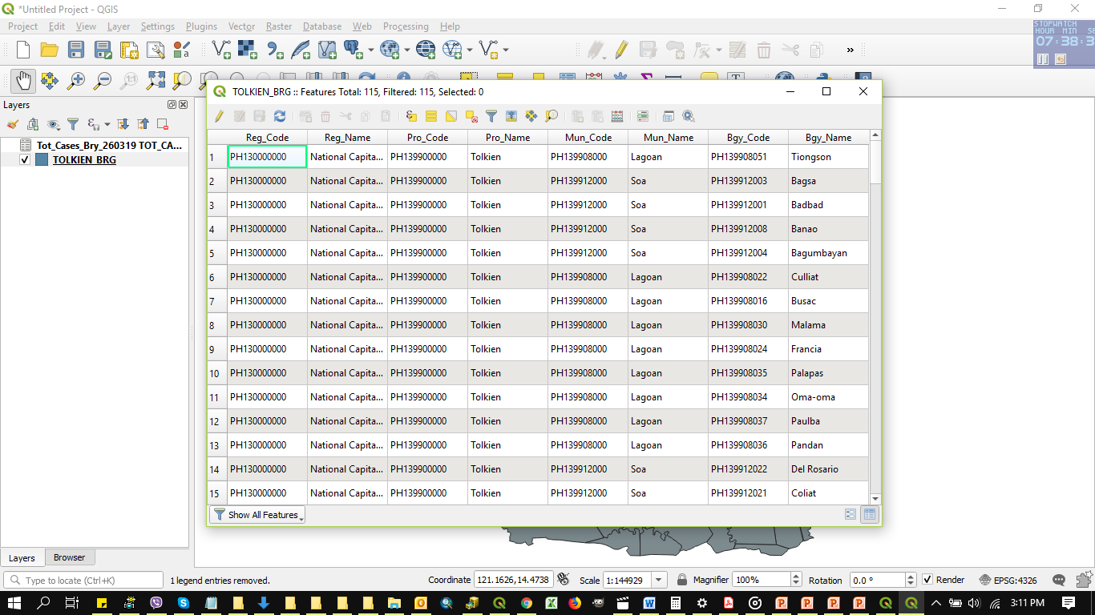
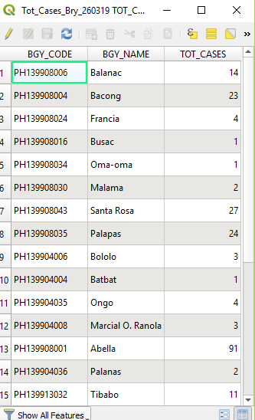
Creating Geographic Data for Map 1 – Part 1
Barangay – Link with the number of malaria cases aggregated at barangay level
Click the Add Vector Layer button
Browse to the location of the EXERCISE_3\Data
folder on your computer
Select the Tot_Cases_Bry_260325.xlsx file and click Add.
In the next dialogue box, choose the sheet you want to add then click OK. Close the Data Source Manager window.
Open the attribute table of the Excel file and Barangay boundary shapefile and compare the two tables.
Do they contain the same list of Barangays?
Is there a unique identifier in common to both tables that could be used to join them together?
Notes:
Note that the inclusion of the Administrative Division Master List in the population dataset and the shapefile make it easier to immediately link the two information. This saves time and effort .

Slide 8
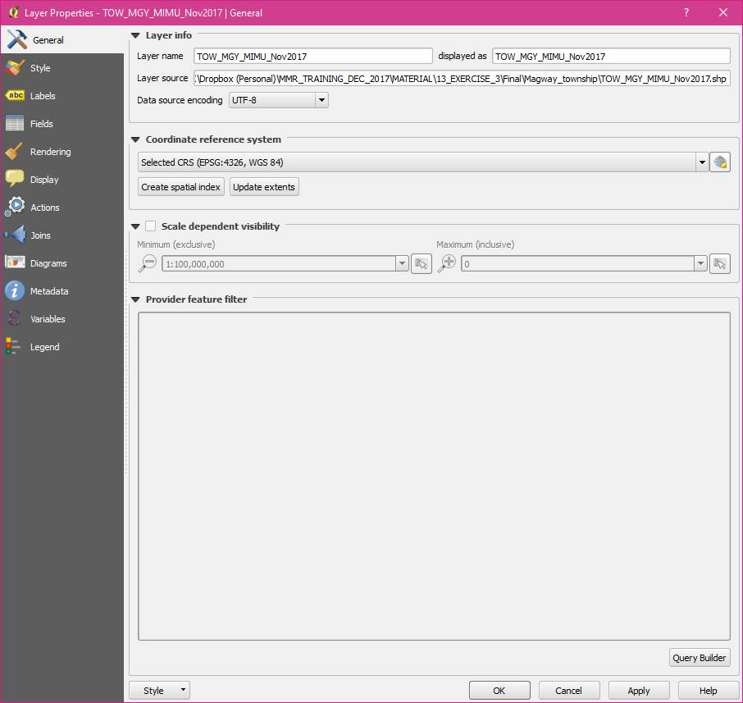

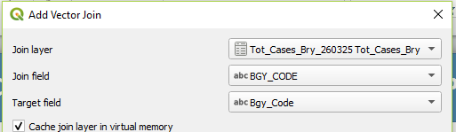
Creating Geographic Data for Map 1 – Part 1
Barangay – Link with the number of malaria cases aggregated at barangay level
This means that we can join the content of the malaria cases table (Excel) to the attribute table of the shapefile
Right click on the shapefile name in the menu and click on Properties
Click on Joins in the window that opens
Click on the « + » icon at the bottom of the window
In the window that opens select:
  Tot_Cases_Bry_260325 Tot_Cases_Bry as the Join layer
  BGY_CODE as the Join field
  Bgy_Code as the Target field in the shapefile
  Click OK Twice

Slide 9
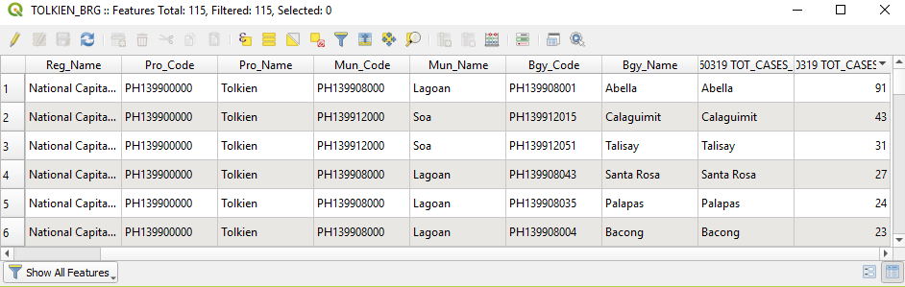
Creating Geographic Data for Map 1 – Part 1
Barangay – Link with the number of malaria cases aggregated at barangay level
Re-open the attribute table of the Barangay boundaries shapefile
  Notice that the content of the malaria cases table from the Excel file is now included in the shapefile attribute table
  Check that there that all the Barangays for which cases have been reported do present a value in the attribute table
Layer ready for thematic mapping!
Don’t forget to save your project!

Slide 10
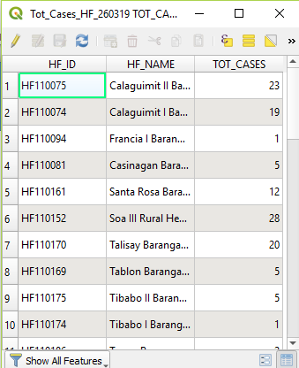
Creating Geographic Data for Map 1 – Part 2
Health facility location - Link with the number of malaria cases by health facility
Click once again the Add Vector Layer button
Browse to the location of the EXERCISE_3\Data
folder on your computer
Select the Tot_Cases_HF_260325.xlsx file and click Add.
In the next dialogue box, choose the sheet you want to add then click OK. Close the Data Source Manager window.
Open the attribute table of the Excel file and Health facility shapefile and compare the two tables.
Do we have the unique identifier?
Is there a value in the TOT_CASES column for each health facility in the Excel file?
Notes:
Note that the inclusion of the Administrative Division Master List in the population dataset and the shapefile make it easier to immediately link the two information. This saves time and effort .

Slide 11
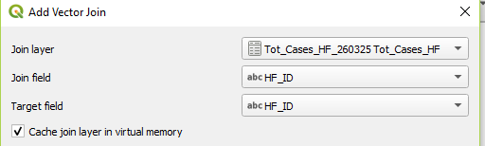
Creating Geographic Data for Map 1 – Part 2
Health facility location - Link with the number of malaria cases by health facility
We can join the content of the malaria cases table (Excel) to the attribute table of the shapefile
Right click on the health facility shapefile name in the menu and click on Properties
Click on Joins in the window that opens
Click on the « + » icon at the bottom of the window
In the window that opens select:
  Tot_Cases_HF_260325 Tot_Cases_HF as the Join layer
  HF_ID as the Join field
  HF_ID as the Target field in the shapefile
  Click OK twice
Save the project!

Slide 12
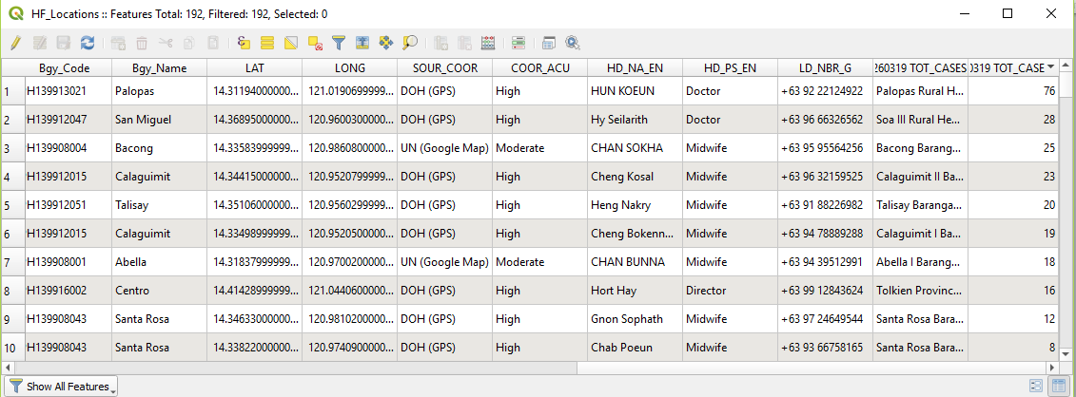
Creating Geographic Data for Map 1 – Part 2
Health facility location - Link with the number of malaria cases by health facility
Re-open the attribute table of the health facility shapefile
  Notice that the content of the malaria cases table from the Excel file is now included in the shapefile attribute table
  Notice that there not all the health facilities have TOT_CASES value because health facilities with no reported cases (0 cases) were not included in the Excel file
Click on the header of the “Tot_Cases_HF_260325 TOT_CASES_HF_TOT_CASES” column (last column) and scroll down to check that the join worked for all the 39 facilities
Does all the health facilities for which we have malaria cases have a Latitude/ Longitude?
Layer ready for thematic mapping

Slide 13
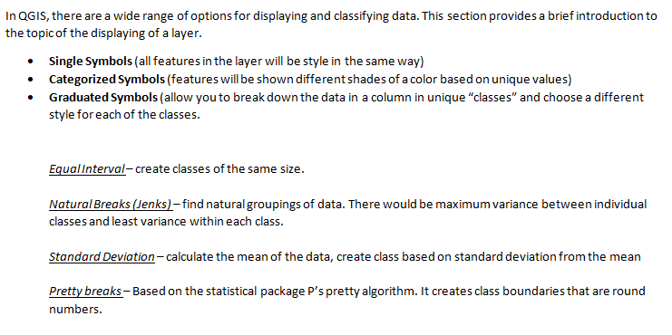
Creating thematic map – Mode of representation
Some complement to Annex 3

Slide 14
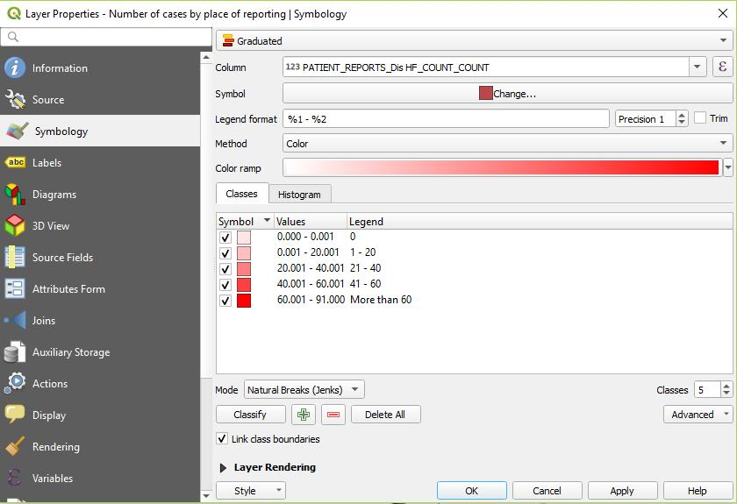
Creating thematic map – Mode of representation
Creating Graduated symbology

Slide 15
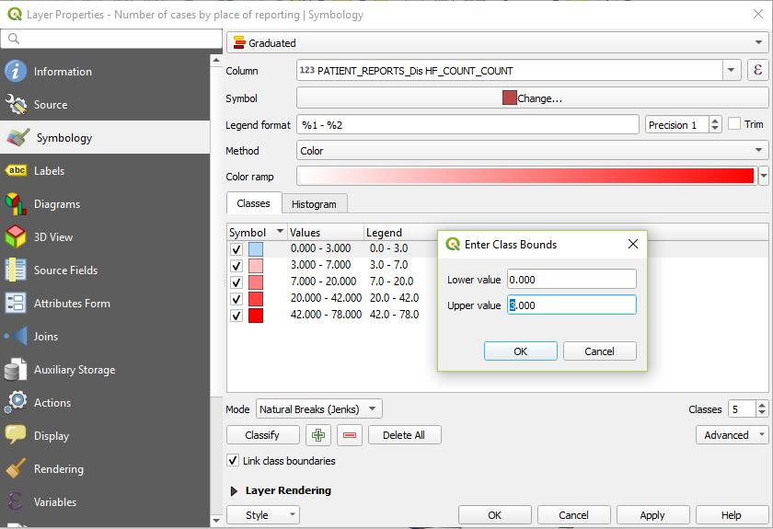
Creating thematic map – Mode of representation
Adding Zero class
In the Symbol section, double click on the lowest value in the in the Values column. Type “0.00” in the Upper value field.

Slide 16
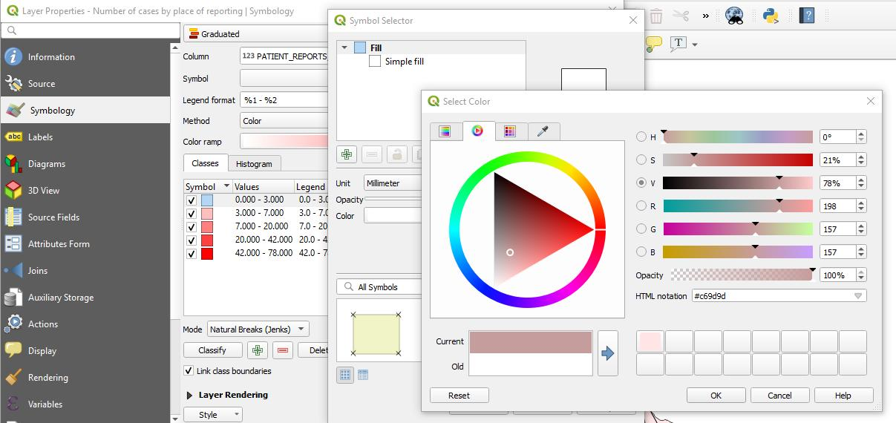
Creating thematic map – Mode of representation
Customize the fill color by double-clicking on the color rectangle then clicking the Color field.

Slide 17
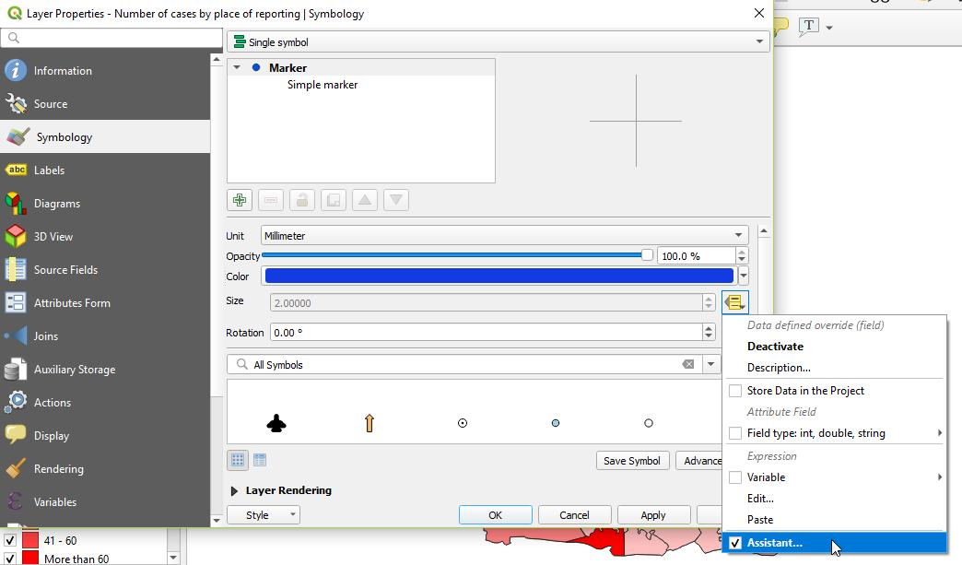
Creating thematic map – Mode of representation
To create proportional symbols:
1. Click the dropdown menu beside the Size field and choose Assistant…

Slide 18
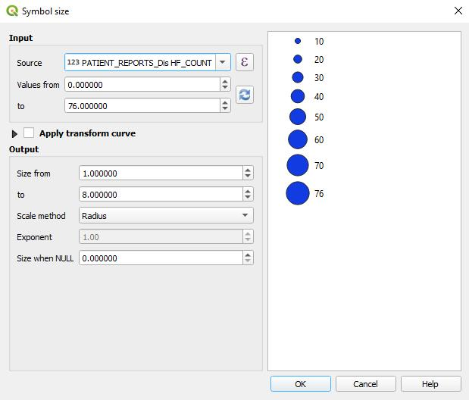

Creating thematic map – Mode of representation
In the Input section, choose the column you would like to symbolize in the Source field.
Click the Refresh button for the field values to appear.
In the Output section, put the minimum and maximum size you would like for your symbol.
In the Scale mathod field, choose Radius.
Click OK.
Click OK in the Properties window.
If your symbols turn out to be too big or too small, you may repeat these steps to change their size

Slide 19
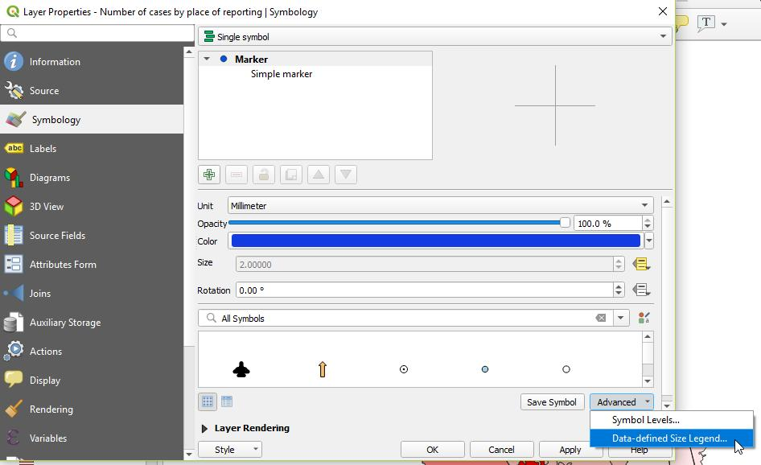
Creating thematic map – Mode of representation
To make sure that the proportional symbol appears in the map layout legend:
1. Click the Advanced dropdown menu and choose Data-defined Size Legend…

Slide 20
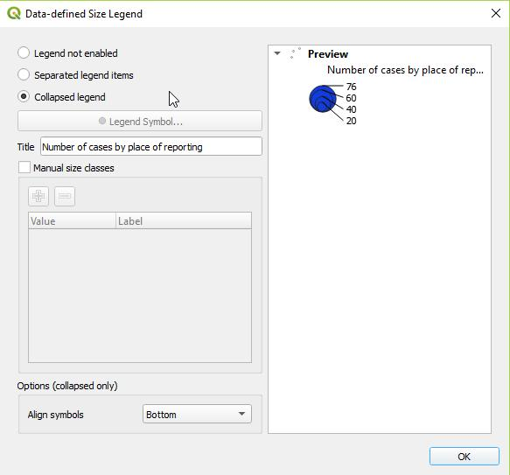
Creating thematic map – Mode of representation
Choose how you would like the symbol to appear in the legend (preferrably Collapsed legend).
Type in the title of your legend item.
Click OK.
Click OK in the Properties window.

Slide 21
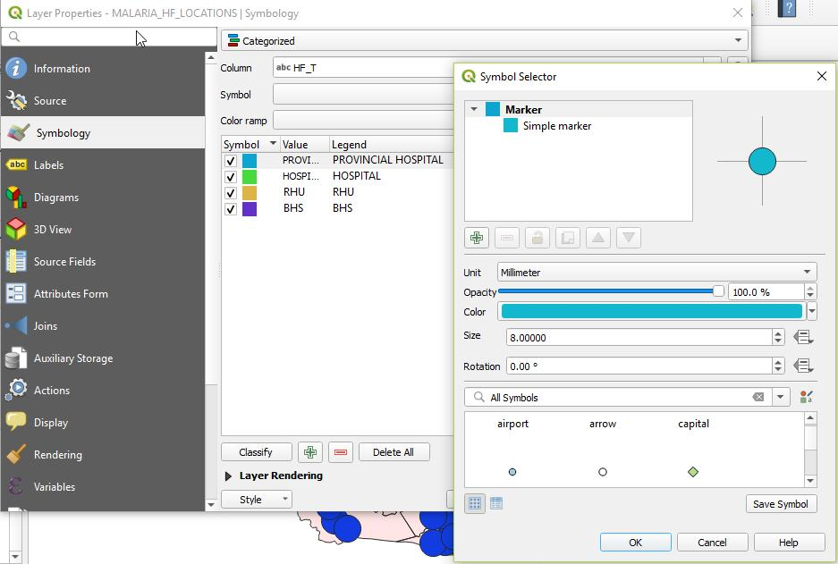
Creating thematic map – Mode of representation
To change the point symbols:
1. Double click on the color rectangle. Choose the appropriate symbol in the Symbol Selector window.
The symbols may be further customized by changing their colors and size in the same window

Slide 22
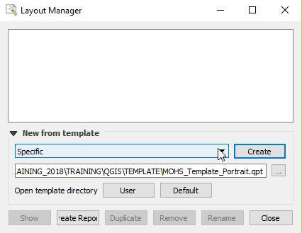
Creating thematic map – Using a map template
We have prepared an incomplete map template for you to use in this exercise. Skip steps 25-31 in Annex 3 and do the following steps instead.
To start creating the layout for your map, click Project > Layout Manager… in the main menu.
The Layout Manager window opens. To choose the template, in the New from template section dropdown list, choose Specific then click the Browse button.

Slide 23
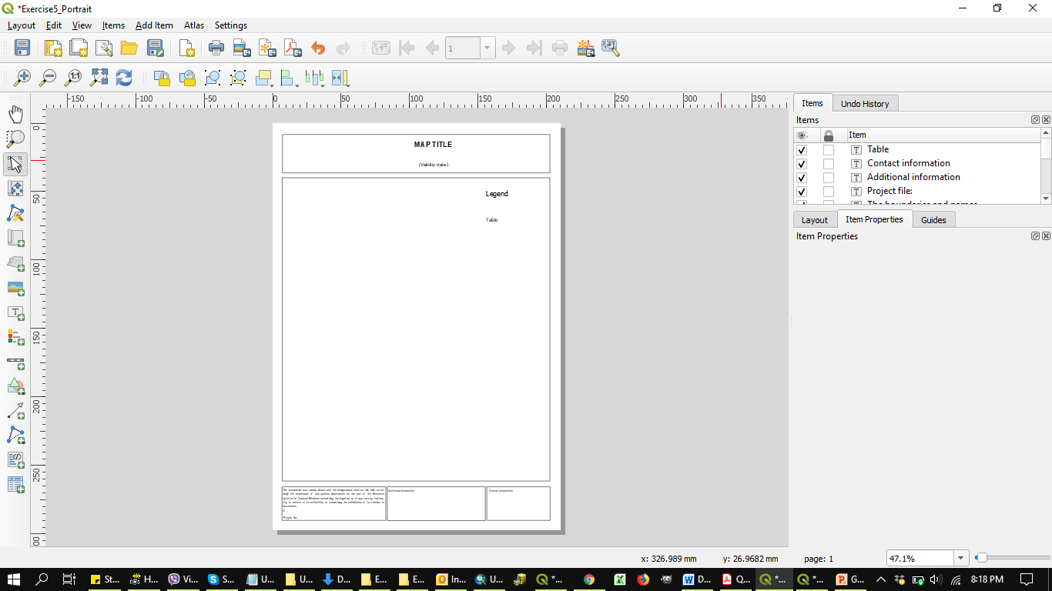
Creating thematic map – Using a map template
The Select a Template window opens. In your USB drive, go to TRAINING_MATERIAL\EXERCISES\EXERCISE_5\MAP_TEMPLATE.
Select the appropriate orientation for your map. Click Open.
Click Create then type in a unique print composer title in the field that appears. (Otherwise a title will be generated for you.) Click OK.
The map template will open in a new window.

Slide 24
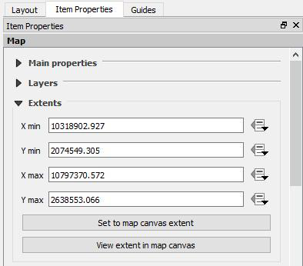
Creating thematic map – Using a map template
If you don’t see your symbolized data on the template, click the map area or click the corresponding item in the Items list on the right side. On the Item Properties tab, expand the Extents section then click Set to map canvas extent. You will now see your symbolized data on the map.
Proceed with steps 32 onward of Annex 3 to complete your map.
RITM logo in the TRAINING_MATERIALS\EXERCISES\EXERCISE_5\Data folder

Slide 25
Request received for the second map
Purpose: Identify geographic foci and guide foci investigations as needed
Audience: Commune-level Malaria Surveillance Officer
Content:
  Location of place of residence and possible place of infection for the 315 positive cases reported since the beginning of the year including the new ones just reported by the RITM Hospital
  Waterways and water body
  Forests
  Barangay boundaries
Medium: A4 size map stored in a pdf file
??
Need to find away to represent the information in a visually appealing way on top of each other

Slide 26

Map 2 - All the geospatial data already in QGIS from Exercise 4
Re-open your project created during Exercise 4
Remove all the layers except the Barangay boundaries, the waterways, water bodies, places of residence and possible infection and forest cover
Save the result in a new project (Map_2)
No link to be done with Statistical data…just use your artistic skills!!!

Slide 27
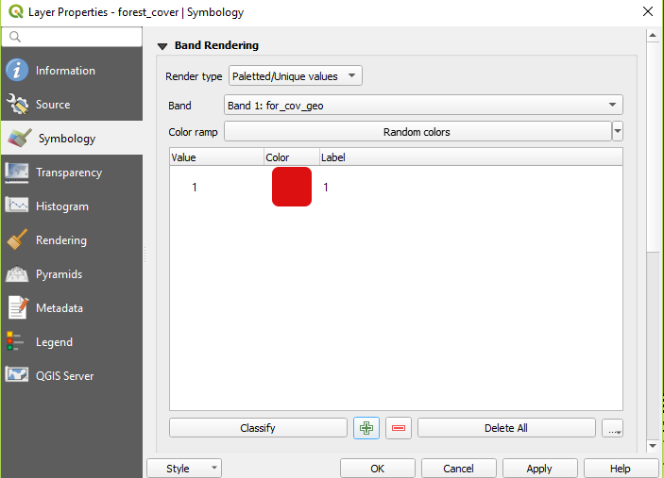
Creating thematic map – Mode of representation
To symbolize raster data:
1. In the Render type field, choose Palleted/Unique values.
2. Click the color box that appears and choose the appropriate color. Click OK.

Slide 28
Creating thematic map – Using a map template
Repeat the steps in used in Map 1 when using a map template.
Make sure to select the appropriate orientation for your 2nd map.

