Slide 1




Objectives of the training, round of introduction, expectations and agenda
INTRODUCTION TO GEOSPATIAL DATA MANAGEMENT AND TECHNOLOGIES
FOR MALARIA PROGRAMS
Manila, March 25-28, 2019

Slide 2
Objectives of the training
Strengthen Malaria programs’ technical skills and practices to manage and use geospatial data and technologies.
More specifically, the training will:
Clarify the concepts and the process behind the making of a good thematic map including use of data from other sources
Train participants on the use of open-source software (QGIS and GeoODK) to collect data and produce thematic maps
Guide NMCPs towards geo-enabling their information system to support Malaria elimination

Slide 3
Round of introduction and expectations
Name, position, location
Your experience with maps, GIS, GPS,..
Expectations for this training
Master list?
Thematic mapping?
GIS ???
Don’t hesitate to ask questions!

Slide 4
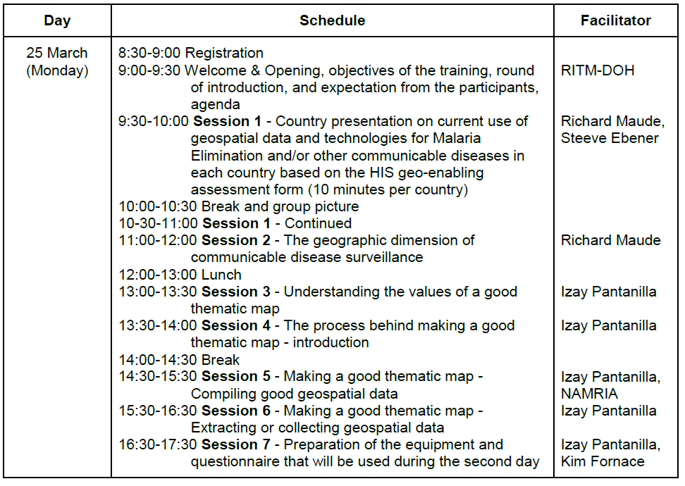
Agenda
Day 1
Concepts and processes

Slide 5
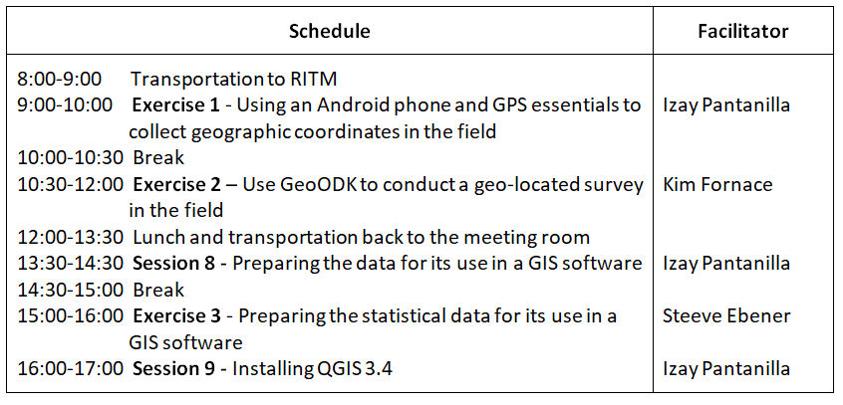
Agenda
Day 2
Field data collection and data preparation

Slide 6
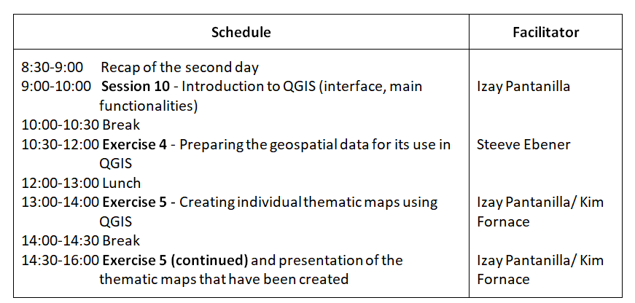
Agenda
Day 3
Data preparation (continued) and map creation

Slide 7
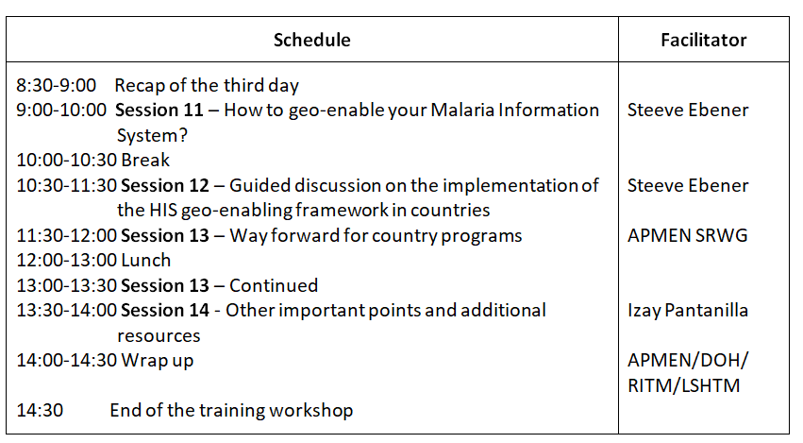
Agenda
Day 4
HIS geo-enabling and way forward

Slide 8
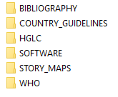
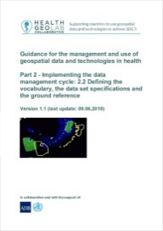

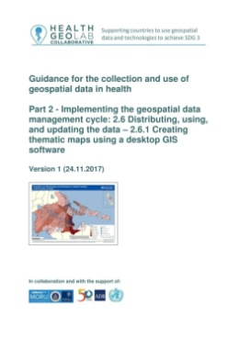
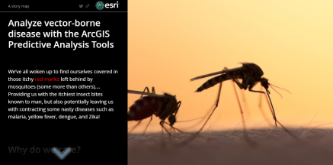
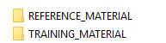
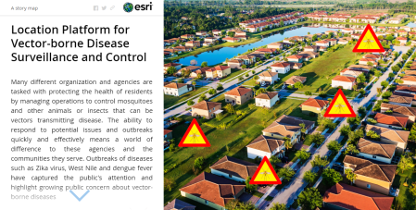
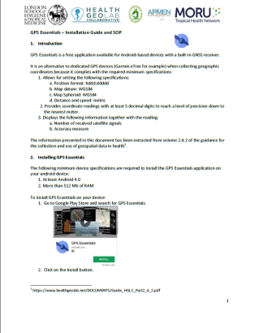
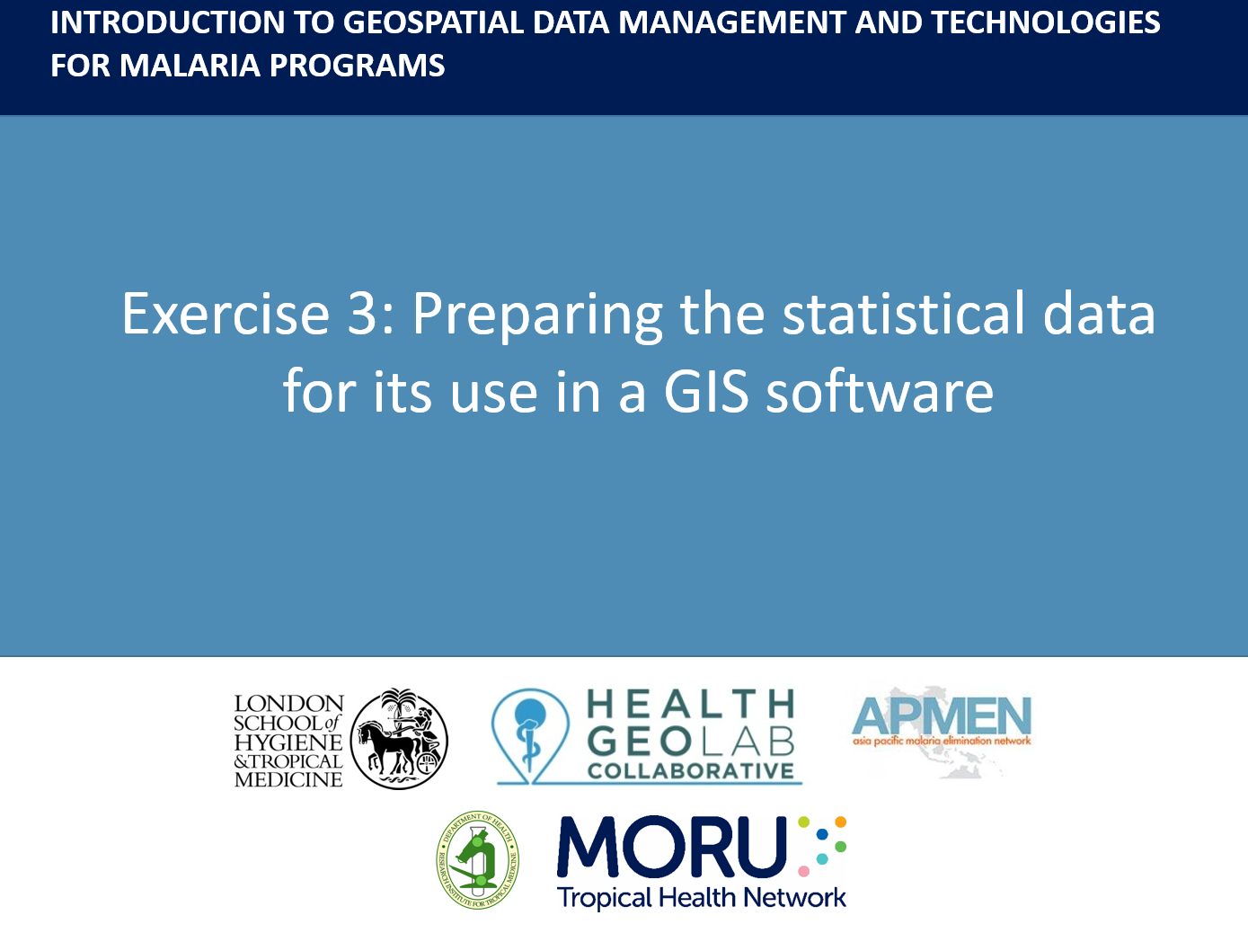
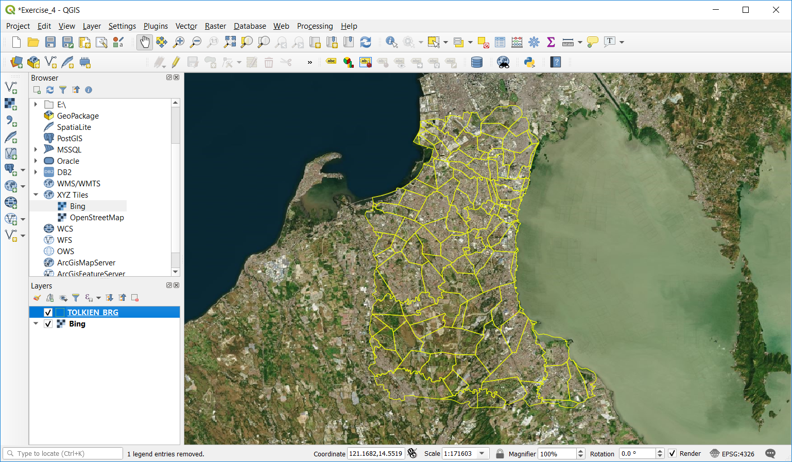
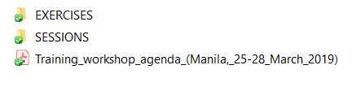
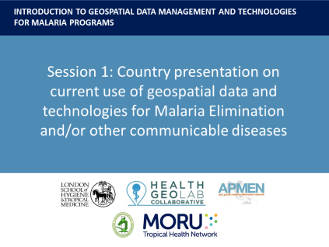

Content of the USB key
Guides
Story maps
Exercises with data
Separate USB
Slides
QGIS Installer

