Slide 1
The Geographic Dimension of Communicable Disease Surveillance
Richard J Maude
MBChB Hons BSc DTM&H DPhil MD FRGS
Head of Epidemiology Dept., MORU, Bangkok
richard@tropmedres.ac

Slide 2
Learning Goals
Know which data in Health Information Systems has a geographic dimension
Understand why mapping is essential to communicable disease surveillance
Know how geography is used in the different components of malaria surveillance
Know how malaria mapping needs change as country approach elimination
Understand the roles of GIS and data dashboards

Slide 3
Cholera: from paper maps to GIS

Slide 4

John Snow, Cholera 1854
https://www.youtube.com/watch?v=753XHXPLrn48

Slide 5
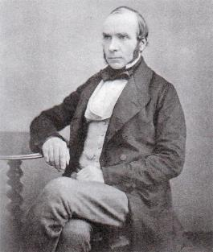
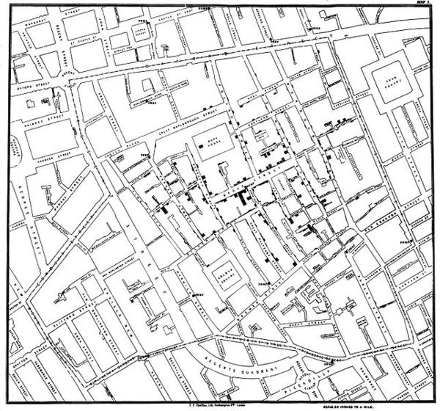
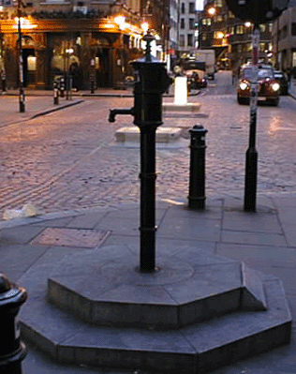
John Snow, Cholera 1854
Broad Street water pump

Slide 6
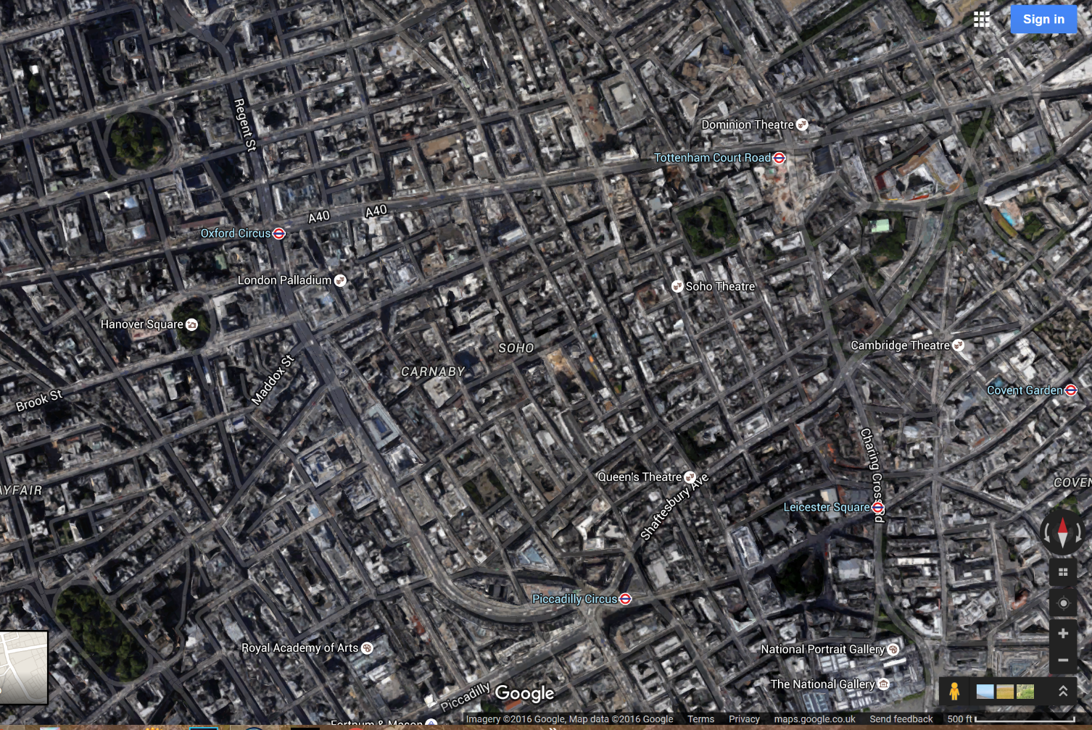
John Snow, Cholera 1854 & Google Maps
Broad Street water pump

Slide 7
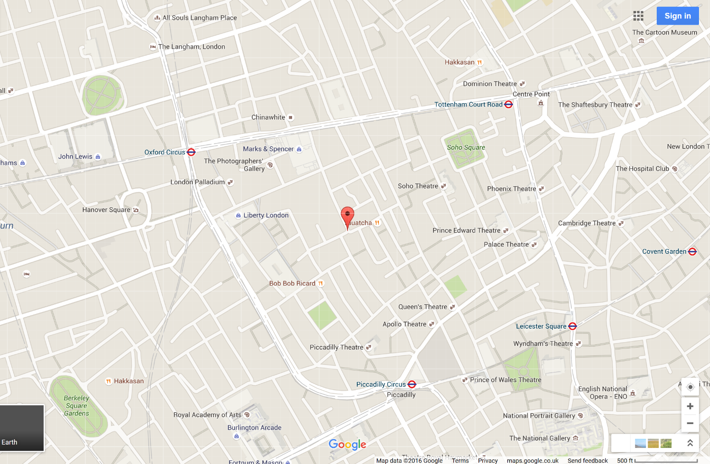
John Snow, Cholera 1854 & Google Maps
Broad Street water pump

Slide 8
John Snow, Cholera 1854 & Google Maps
Broad Street water pump

Slide 9
John Snow, Cholera 1854 & Google Maps
Broad Street water pump

Slide 10
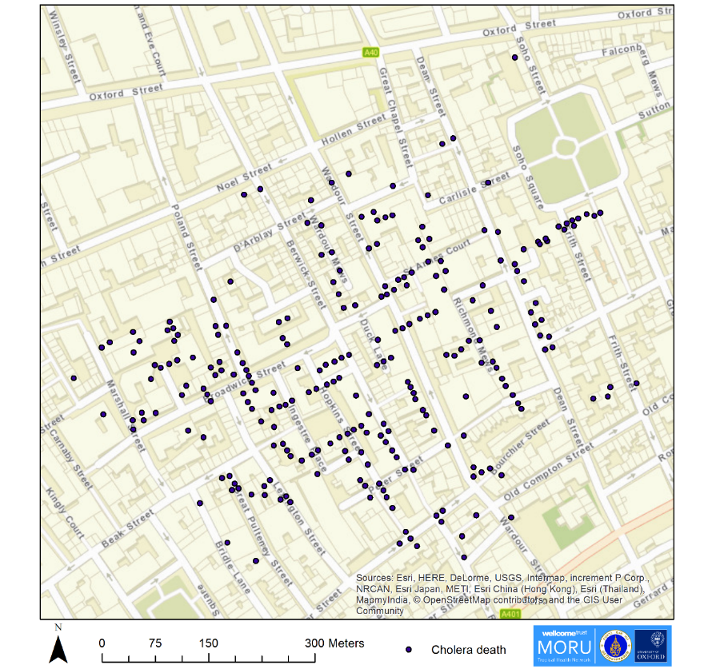
John Snow, Cholera 1854 & GIS

Slide 11
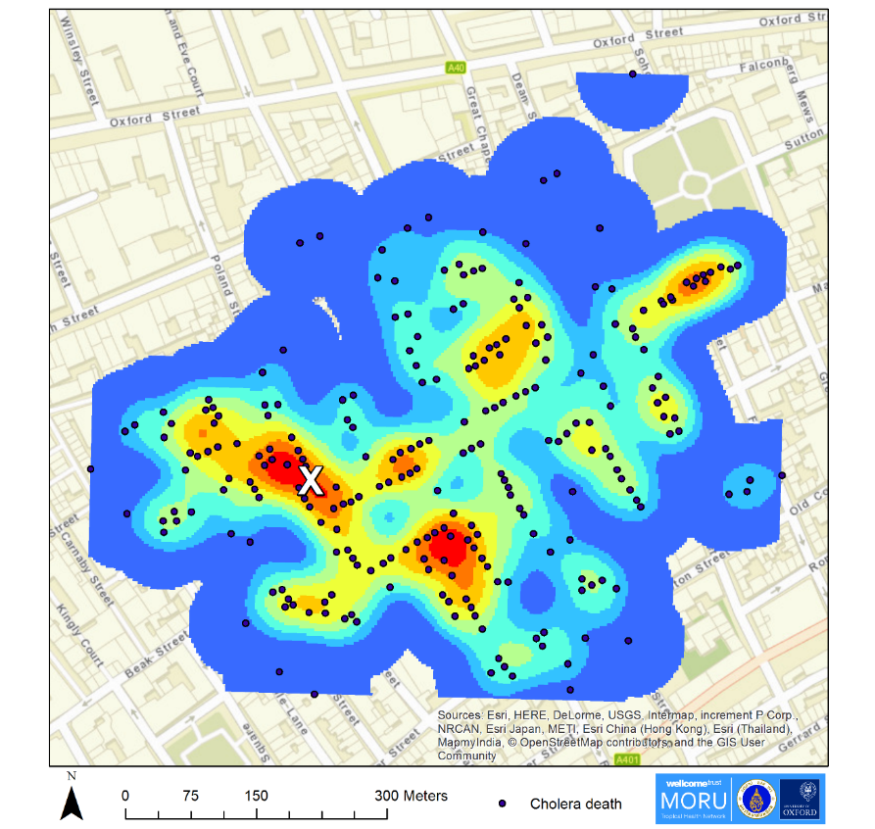
John Snow, Cholera 1854 & GIS
Kernel density plot

Slide 12
John Snow, Cholera 1854 & GIS
Broad Street water pump

Slide 13
Communicable Disease Surveillance & GIS

Slide 14
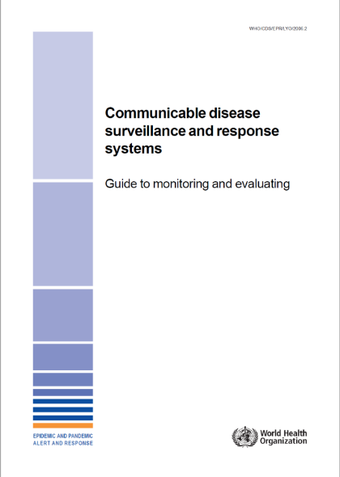
Communicable Disease Surveillance
World Health Organization
Ongoing systematic collection, analysis, and interpretation of outcome specific data for use in planning, implementing and evaluating public health policies and practices.

Slide 15
Communicable Disease Surveillance
World Health Organization
A communicable disease surveillance system serves two key functions:
1. early warning of potential threats to public health.
2. programme monitoring functions which may be disease specific or multi-disease in nature.

Slide 16
Health Information System (HIS)
“Provides the underpinnings for decision-making” (WHO)
4 key functions:
Generates health data e.g. from surveillance system
Compiles data from the health sector and other relevant sectors
Analyses the data and ensures their overall quality, relevance & timeliness
Converts data into information for health-related decision-making.
1. Data Generation
2. Compilation
3. Analysis and synthesis
4. Communication and use

Slide 17
Can you think about one piece of data or information within a Health Information System (HIS) that has neither a geographic nor a time dimension ?
"everything happens somewhere”*
…“at a given time"
Geography and time should be routinely captured in a Health Information System (HIS)
BUT they among the most poorly captured dimensions
Taken for granted
Geospatial data management is not very attractive
*Tosta 2001

Slide 18
Health Information Cycle, Geography & GIS
Resource allocation
Lat/long, address
Targeting interventions
GIS
Geoenabled database
GIS
Report
GIS
Maps, tables
Dashboard
WHO 2018

Slide 19
Dengue in Singapore

Slide 20
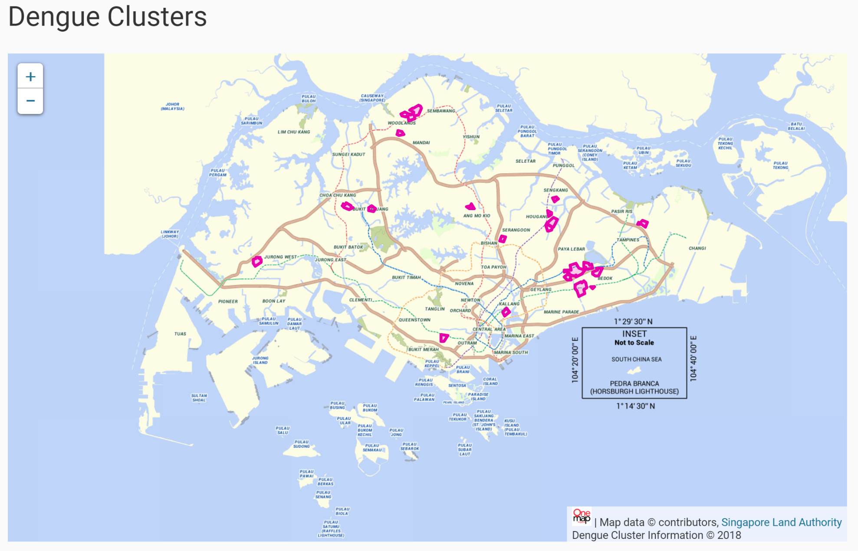
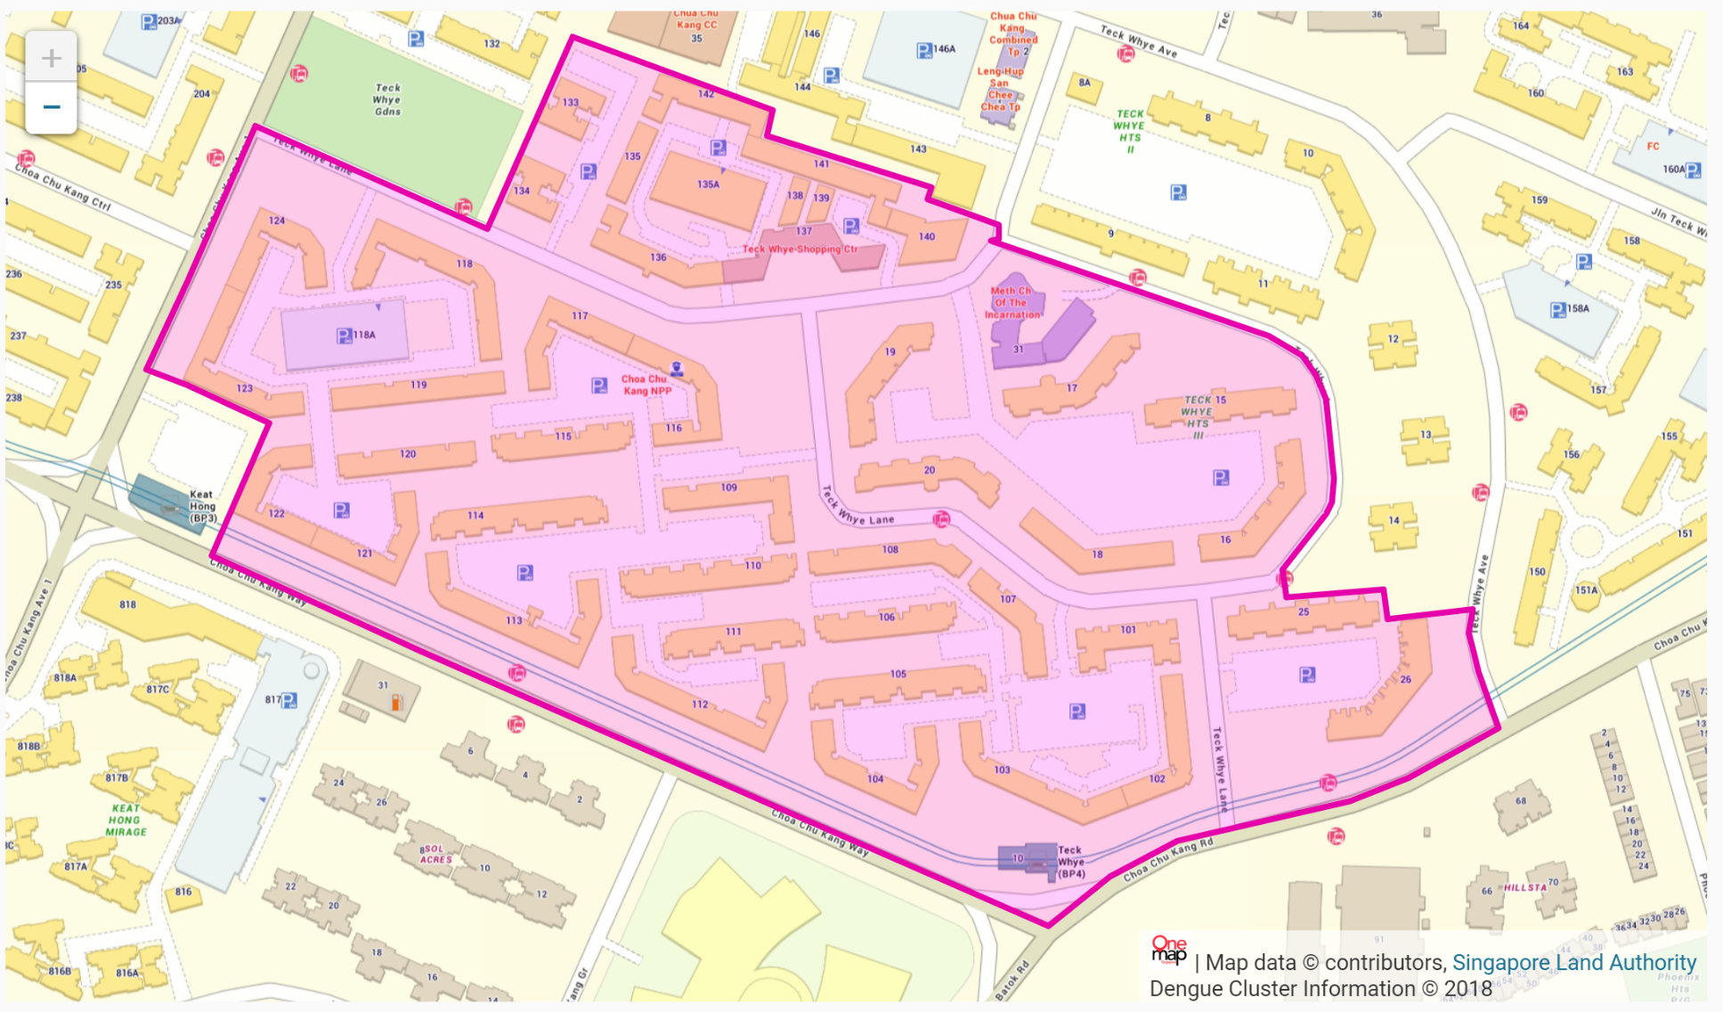
Dengue Dashboard, Singapore
https://www.nea.gov.sg/dengue-zika/dengue/dengue-clusters

Slide 21
Malaria Surveillance & Geography

Slide 22
2018

Slide 23
Closer to elimination -> higher resolution reporting
Notes:
Malaria heterogeneity across the transmission continuum
As transmission decreases, malaria becomes focal, and the intensity and frequency of reporting increase. Surveillance systems evolve from reporting aggregate case data by month over large geographical areas (e.g. district) to reporting near-real-time individual case data in small areas (foci).

Slide 24
Data flow and analysis for malaria

Slide 25
Sources of malaria surveillance data
Government hospitals
Government health centres
Village health workers
Non-governmental organisations
Private healthcare providers
Shops
Pharmacies
Military
Etc.
Level of geographic detail and accuracy can vary widely
Mercado et al. Malar J. 2017.

Slide 26
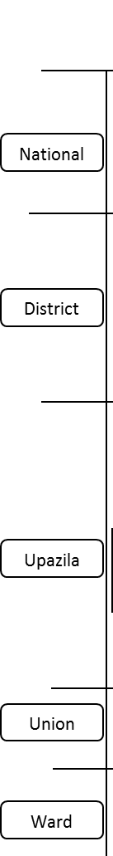
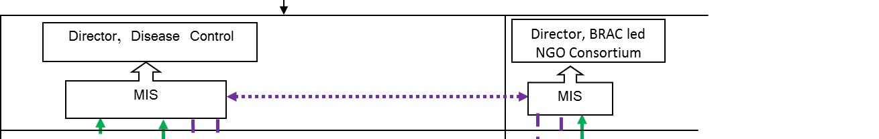
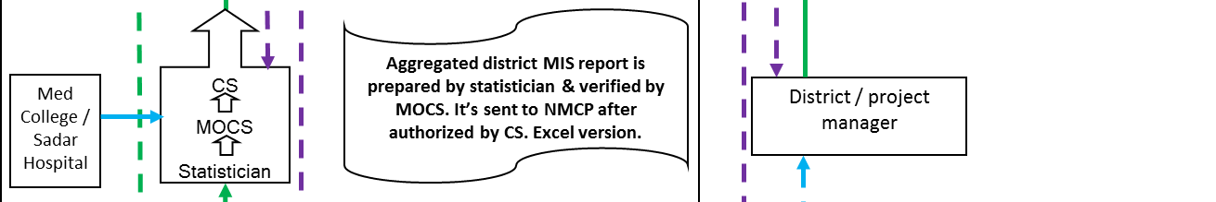
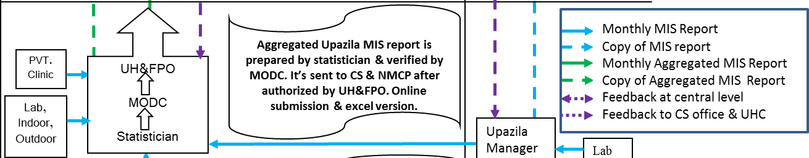

Hierarchical Reporting System
GOB
NGO
Anjan Saha, NMEP, Bangladesh.

Slide 27
Data collation: ideal vs reality
Data from multiple sources need to be combined
Ideal:
  Data available from all sources
  Standardized format/layout
  Same level of spatial aggregation using same geography
  Defined data fields common all sources
Reality:
  Data from only some sources
  Variety of formats from different organisations need to be combined manually
  Different levels of spatial aggregation using different geography
  Subset of data fields match e.g. gender, age

Slide 28
Malaria elimination surveillance and geography
ACTIVITY GEOGRAPHY
CASES
Case detection
  Passive case detection (PCD): people seeking care
  Active case detection (ACD): screening in those at higher risk
    Proactive case detection (PACD)
    Reactive case detection (RACD) e.g. outbreaks
Case investigation -> classification
Focus investigation -> classification
Drug efficacy and resistance
VECTORS
Baseline survey
Routine sentinel survey
Spot checks
Focus investigation
INTERVENTIONS AND LOGISTICS
  Antimalarial stocks
  RDTs
  Diagnostic labs
  LLIN coverage
  Staff and services e.g. VHVs, clinics
  Location of cases:
    Residence
    Health facility
    Area e.g. district, province
  Location of possible transmission site
  Location of survey site
    Vector species distribution
    Insecticide resistance
  Location of health facility
  Location of supply chain

Slide 29
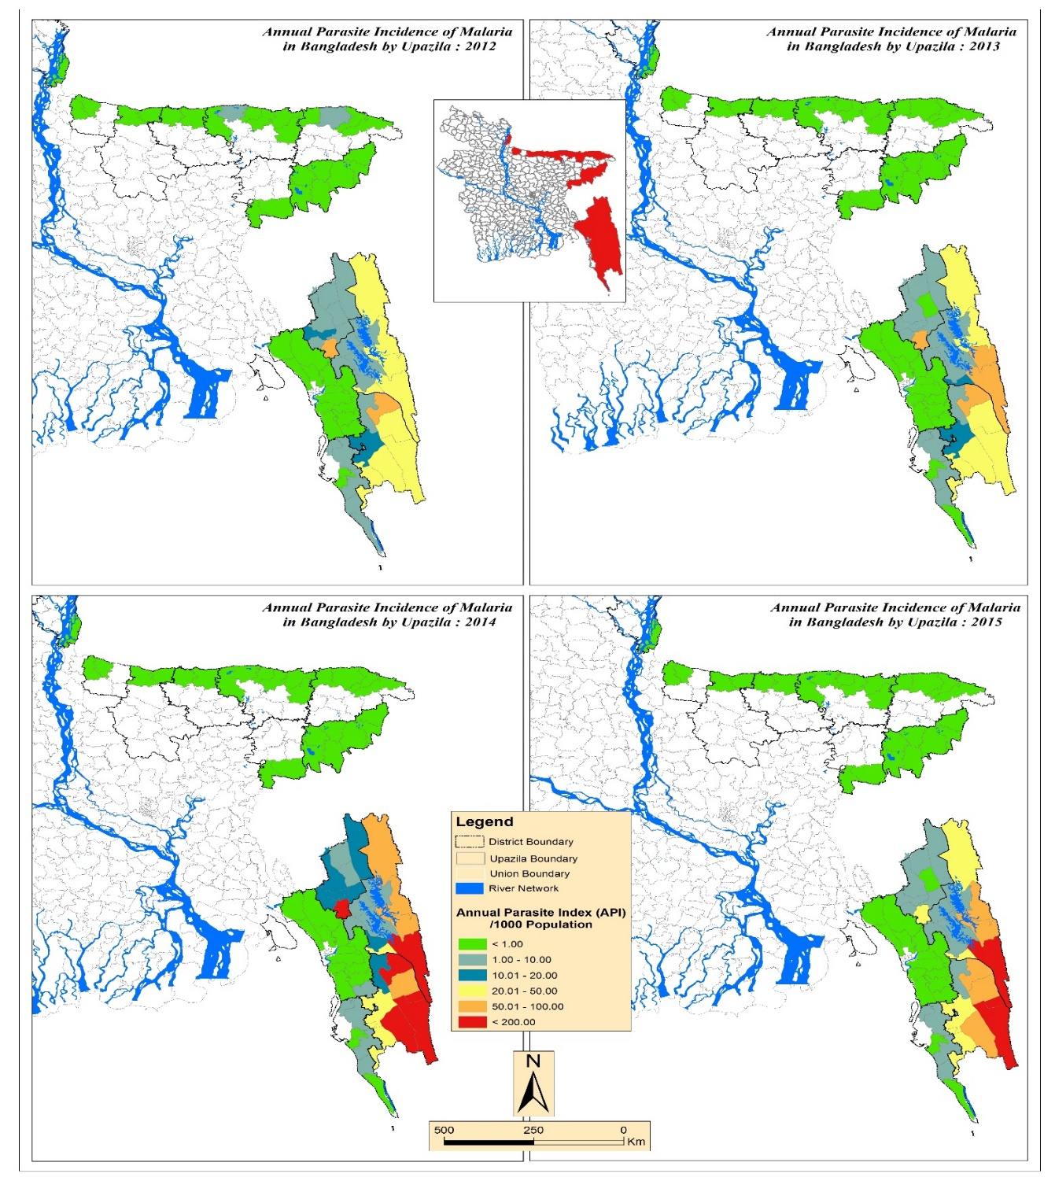
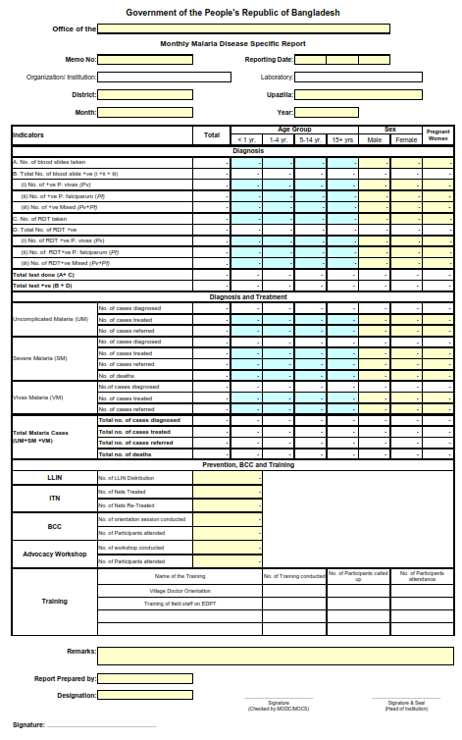
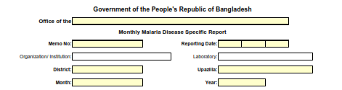
Passive Case Detection
Karim et al. ASTMH 2016.

Slide 30

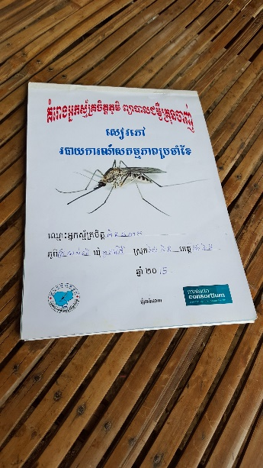
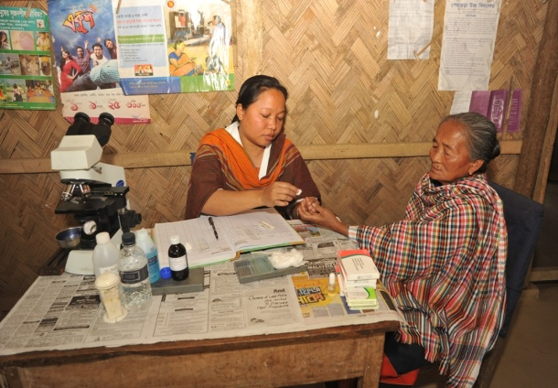
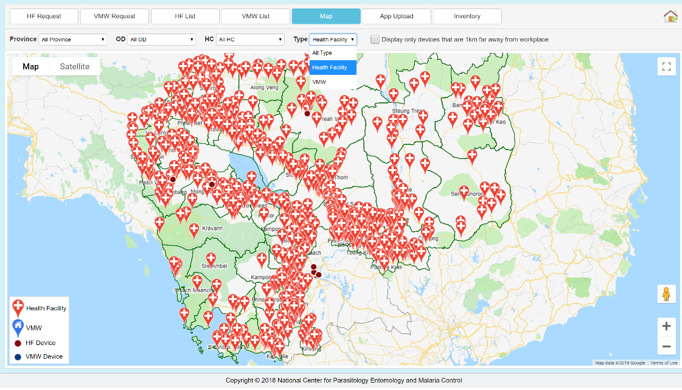
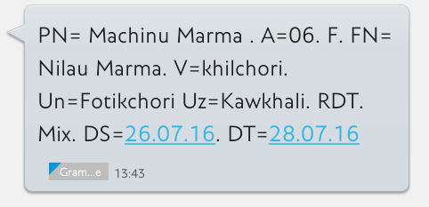
Passive Case Detection
Cambodia
Bangladesh

Slide 31
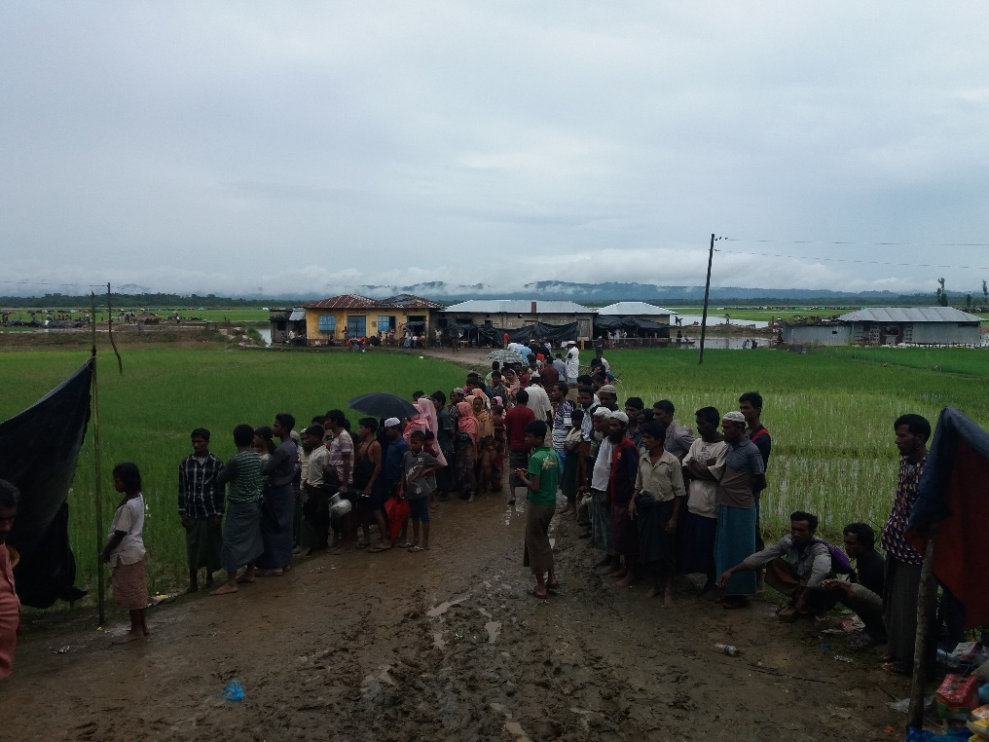
Case investigation -> classification
Where was the infection acquired?
Mosquito transmission
Acquired locally
  Indigenous (no link to imported case)
  Introduced (linked to proven imported case)
Acquired abroad or outside area
  Imported
Not Mosquito transmission
Induced
  Blood transfusion
  Congenital
Notes:
The collection of a detailed history of an index case at a fixed point of care (health facility or CHW) is the basis of initial case investigation. Recording of a detailed patient history is an integral part of surveillance for elimination and should be implemented at the fixed points of care even when a case will not be followed up in the community.

Slide 32

Case Investigation

Slide 33
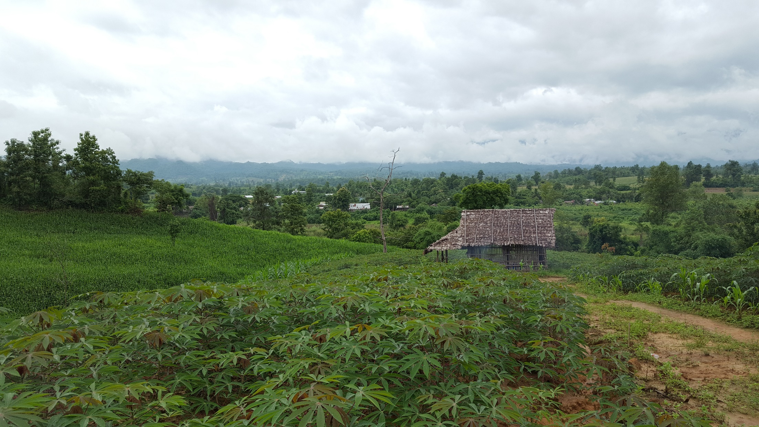

Mapping cases
Place of diagnosis vs place of residence vs place of infection
Health facility
Home Address
Travel Patterns

Slide 34
Focus investigation -> classification
Focus = defined, circumscribed area in a currently or formerly malarious area that contains epidemiological and ecological factors necessary for malaria transmission
>3 years
≤3 years

Slide 35
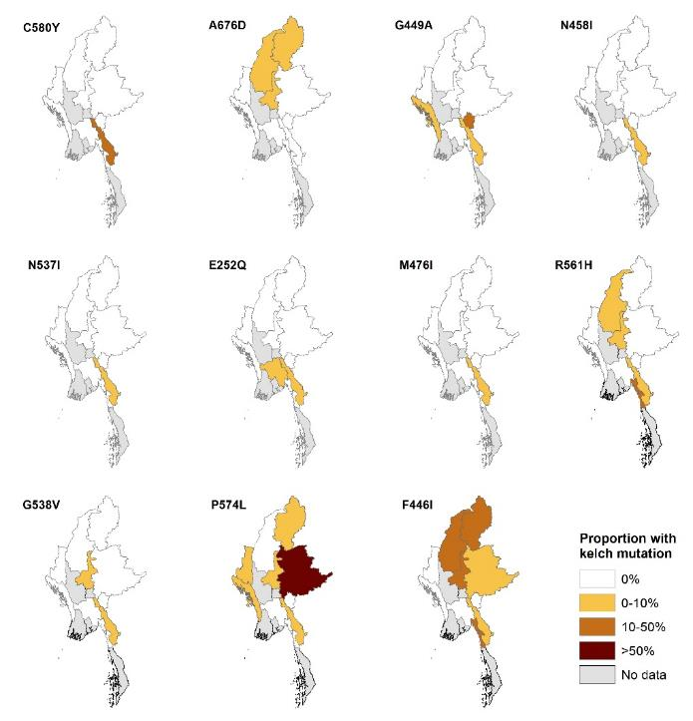
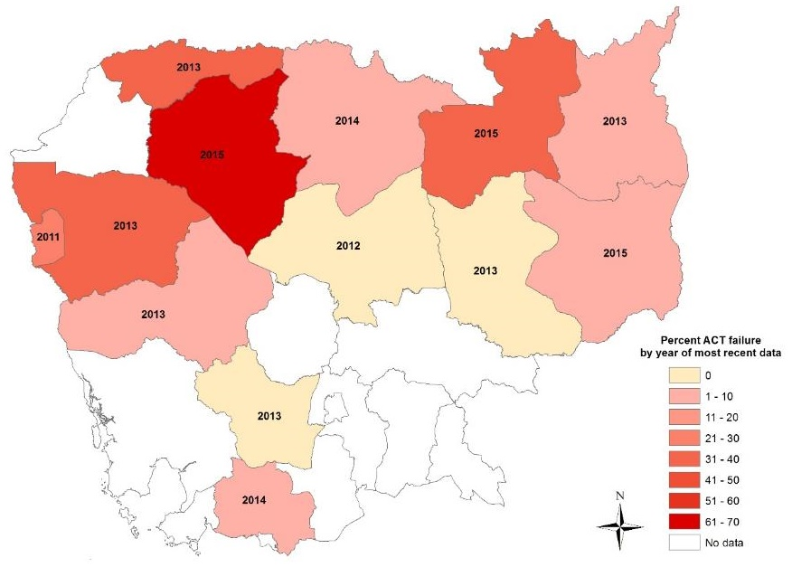
Drug efficacy and resistance
ACT treatment failure in Cambodia
Molecular markers in Myanmar

Slide 36
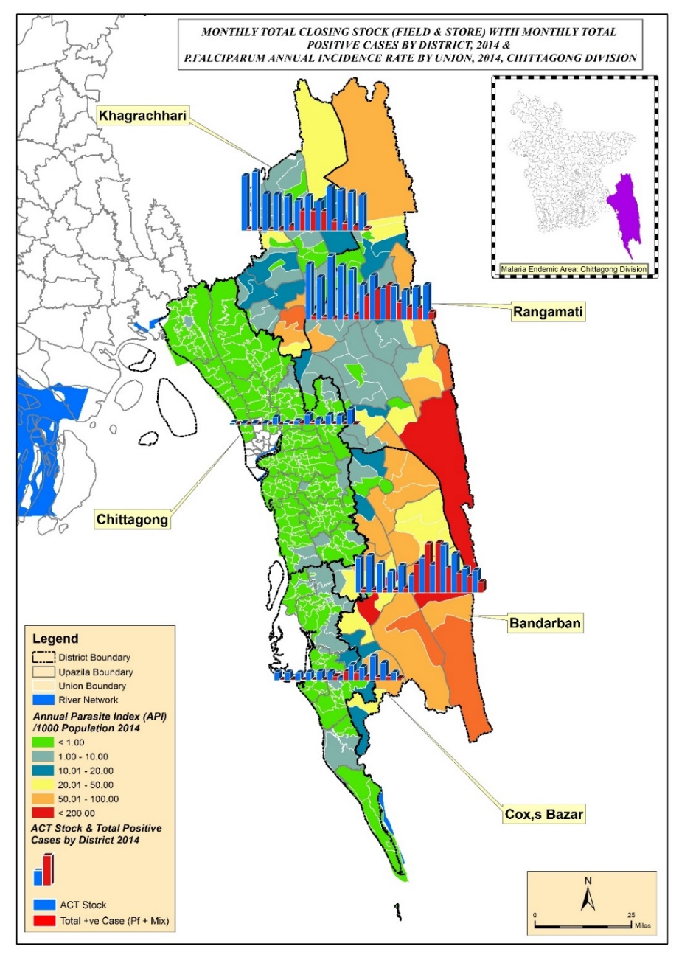
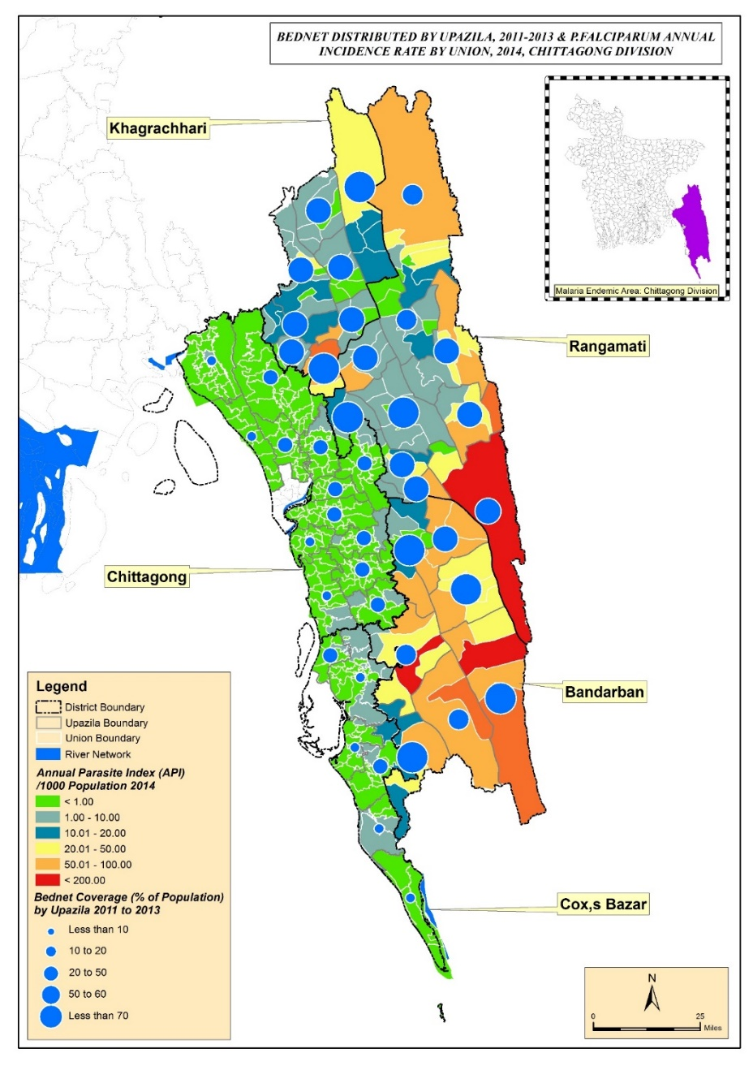
Logistics
ACT stock
LLIN distribution
Karim et al. ASTMH 2016.

Slide 37
Uses of surveillance data by an NMCP:
where maps might be needed
Internal use of NMCP – monthly/near real-time situation analysis and planning activities
Annual bulletin/report for MOH
Progress update to Global Fund
WHO World Malaria Report
NMCP/MOH Dashboard
Publications (internal/external)
Presentations
Special requests from MoH
Information sharing with collaborating organizations

Slide 38
Malaria dashboards vs GIS
Dashboard e.g. DHIS2 | GIS e.g. QGIS, ArcGIS
User-friendly, easy to learn | More difficult to learn
Online, may be near-real-time | Online or offline, harder to update
Limited range of fixed map outputs | Potentially unlimited range of map outputs
Little or no spatial analysis | Broad range of spatial analyses
Relatively inflexible once set up | Very flexible – content, formats…
Mostly require pre-prepared geographic data | Can manage and edit geographic data
NMCPs need both!

Slide 39
Summary
All data in Health Information Systems has a geographic dimension
Mapping is essential to communicable disease surveillance for monitoring and planning service delivery
For malaria, the closer a location is to elimination, the more geographical and temporal detail is needed
GIS is an essential partner to dashboards e.g. DHIS2

Slide 40
Resources
https://www.who.int/csr/resources/publications/surveillance/WHO_CDS_EPR_LYO_2006_2/en/
https://www.who.int/malaria/publications/atoz/9789241503334/en/
https://www.dhis2.org/
https://www.arcgis.com/index.html
https://www.qgis.org/en/site/
https://www.nea.gov.sg/dengue-zika/dengue/dengue-clusters

Slide 41



Acknowledgements
Cambodia NMCP (CNM): Siv Sovannaroth
Bangladesh NMEP: Anjan Saha, MM Aktaruzzaman
MORU: Pengby Ngor, Jahirul Karim, Chris Mercado

Slide 42
Thank you and good luck!
richard@tropmedres.ac
www.tropmedres.ac/epidemiology

