Slide 1
Session 3: Understanding the value of a good thematic map

Slide 2
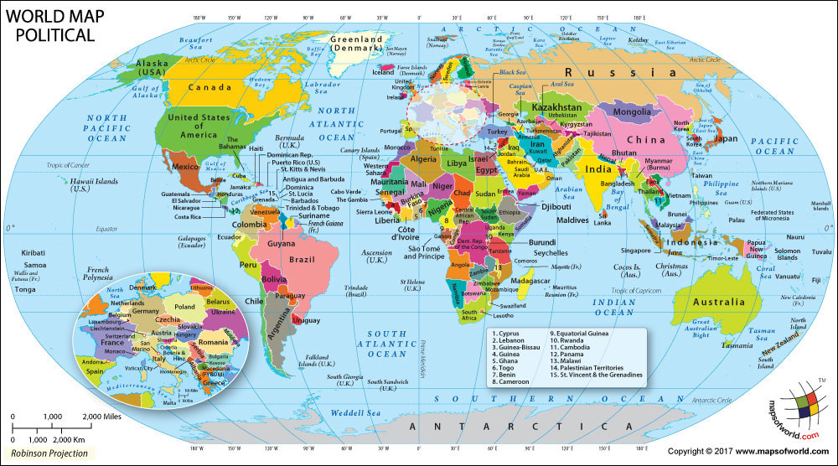
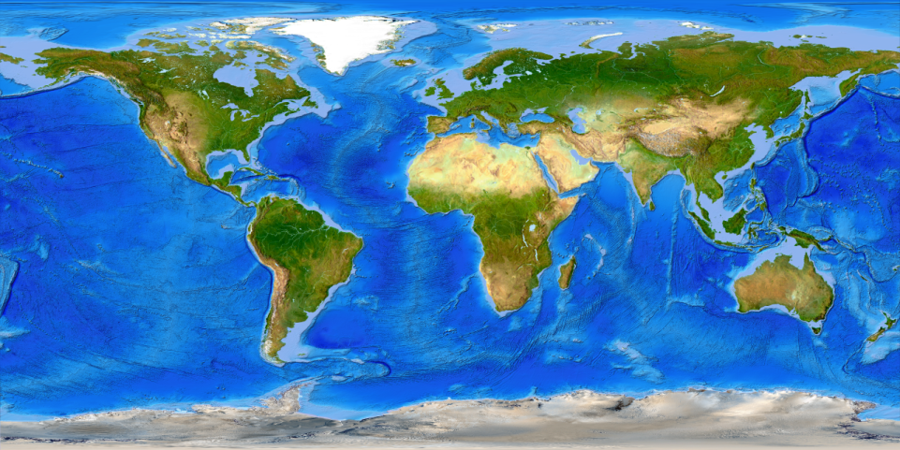
What is a map?
A drawing of the Earth's surface, or part of that surface, showing the shape and position of different countries, political borders, natural features such as rivers and mountains, and artificial features such as roads and buildings
Notes:
What is a map?

Slide 3
Types of map
Political maps
Physical maps
Topographic maps
Climate maps
Street maps
Geological maps
Navigational maps
Thematic maps
Topic of the present session
Guide_HGLC_Part2_6_1.pdf
https://www.healthgeolab.net/DOCUMENTS/Guide_HGLC_Part2_6_1.pdf
Notes:
There are different types of map such as the ones mentioned here.
However, this session focuses on thematic maps. The topics presented here are taken from the HGLC guidance document volume 2.6.1: Creating good thematic maps using desktop GIS software

Slide 4
Thematic Map
What is a thematic map?
A map designed to convey information about a single topic or theme, such as population density, geology, or health
What is a good thematic map?
A good thematic map easily and effectively conveys the information it contains to the reader without having to contact the person who created the map.
Easy to understand
Contains just the right amount of information to support decision making
Useful!
Notes:
What is a thematic map?
What is a GOOD thematic map?
Not all thematic maps can be considered good thematic maps. There are certain criteria that a map need to meet such as:
The map should be easy to understand particularly by the intended audience
It should contains just the right amount of information to support decision making
It should be useful

Slide 5
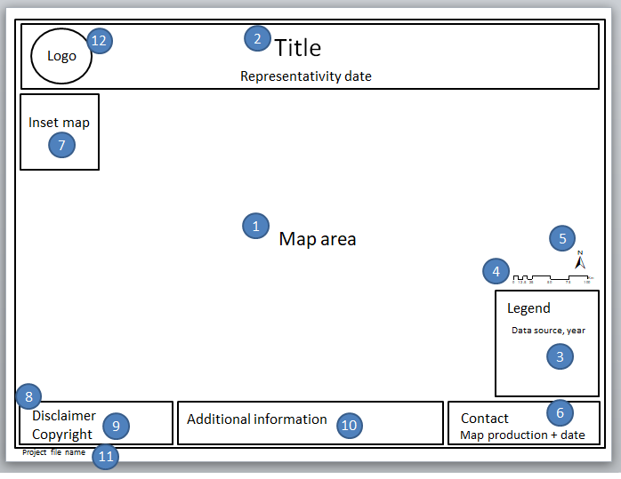
Components of a good thematic map
A good thematic map should at least always have the following components:
Map area
Title
Legend
Scale bar
North arrow
Map production information
Guide_HGLC_Part2_6_1.pdf
Notes:
Components of a good thematic map
As mentioned in the previous slide, a good thematic map easily and effectively conveys the information it contains to the reader.
To help reach such a result, a thematic map should always contain:
Map area
Title
Legend
Scale bar
North arrow
Map production information

Slide 6
Components of a good thematic map
The following components, while not mandatory, are adding value to the map:
Inset map
Disclaimer
Copyright
Additional information
Project file name
Logo
It is good to create one template in portrait and one in landscape orientation that can be used each time you create a thematic map
Notes:
Components of a good thematic map
While not mandatory, the following elements could be useful to the reader:
Inset map
Disclaimer
Copyright
Additional information
Project file name
Logo
All these elements together constitute a map layout.
You can create a layout wherein the position of the map elements is predefined as specified by you or organization. This is called a map template.
In a map template, the text for map elements that changes from one map to another such as the title, legend, and map production date are left blank although their positions are already fixed in the layout. The text for map elements that remains the same for all maps such as map production (author) information, disclaimer, and copyright are already supplied.
It is beneficial to create a map template as it makes the creation of thematic maps faster by eliminating the need to arrange the map elements every time a map is made. It can also serve as the corporate image of the organization. It is good to have one in prepared in landscape and another in portrait orientation.

Slide 7
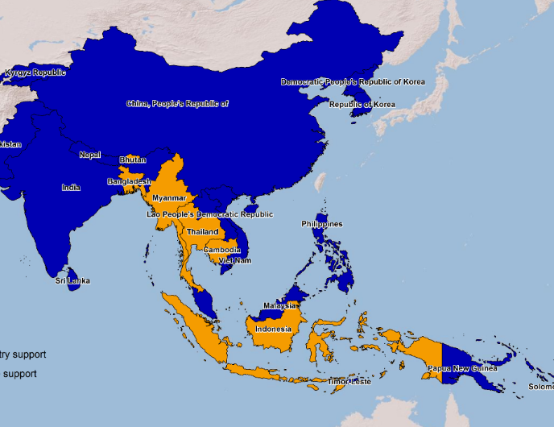
Components of a good thematic map
Mandatory components
Map area – where the symbolized and labelled data is located
Title – Description of the content of the map
A good practice, when it applies, is to also indicate in the title the validity date of the information represented on the map
Notes:
Mandatory components
Map area - where the symbolized and labelled data is located. This is usually placed in the center of the map layout.
Title – the title must be descriptive of the content of the map but not too long. It is a good practice, when it applies, to already include the validity data of the information represented on the map

Slide 8
Components of a good thematic map
Mandatory components
Legend - indicating what the different symbols used in the map represent on the ground. The legend should also contain the source of the data and the year when it was collected if not in the title.
The source and year associated to the data may sometime be placed separately from the legend if the texts are too long (in the additional information)
Notes:
Mandatory components
Legend – all the symbols used in the map shouldbe included in the legend

Slide 9
Components of a good thematic map
Mandatory components
Scale – A map element used to graphically represent the scale of a map
North arrow - A map symbol that shows the direction of north on the map, thereby showing how the map is oriented
Map production information - stating the person and/or organization who created the map and their contact information and the date when the map was created.
Notes:
Mandatory components
Scale – It can be a scale bar, representative fraction, or a verbal scale.
North arrow - Although it is rare for maps not to have the “north up” orientation, it is good practice to always include a north arrow in the map layout.
Map production information – This can help particularly if the readers have questions about the map

Slide 10
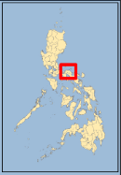
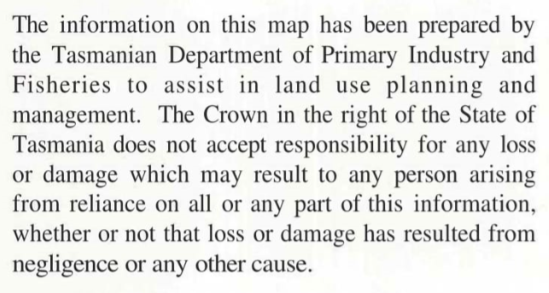
Components of a good thematic map
Optional components
Inset map - showing a detailed part of the map at a larger scale, the location of the main map in the context of a larger area, or information for a related location that cannot easily fit into the same map
Disclaimer - delimiting the scope of rights and responsibility of the author regarding the content of the map.
Copyright - detailing use and distribution information of the map.
Notes:
Optional components
Inset map
Disclaimer
Copyright

Slide 11
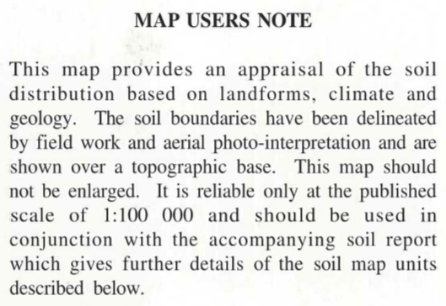
Components of a good thematic map
Optional components
Additional information - that would provide further context to the map
Project file name - and its complete path to allow the GIS technician to easily find such project in case changes needs to be made
Logo - A personal or organization logo that will help make the map more recognizable as a property of and contribute to the image of the owner or organization.
Notes:
Optional components
Additional information
Project file name
Logo

Slide 12
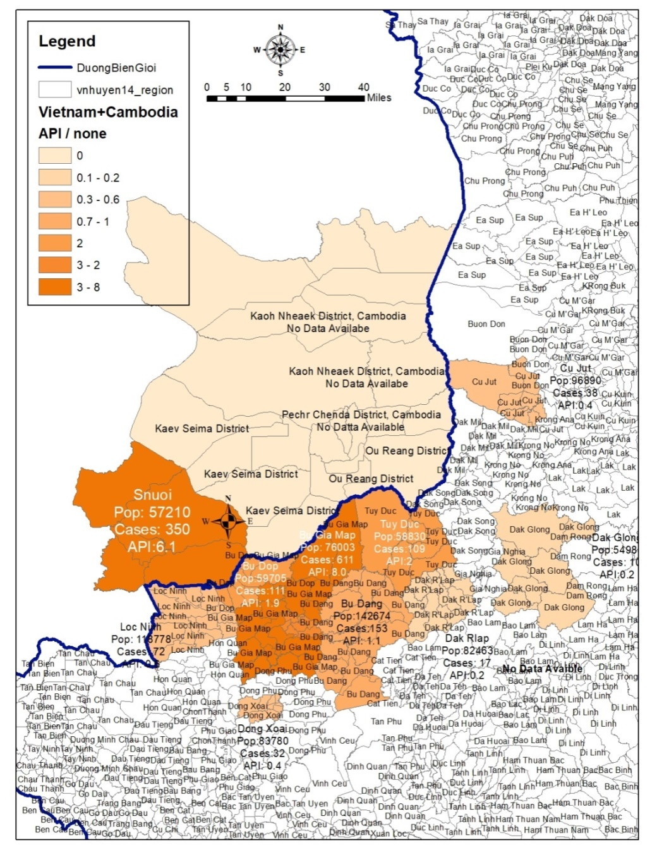
Is this a good thematic map?
Is this a good thematic map?
What is missing?
What should/could be improved?
Does it contain the right amount of information?
Is this map useful?
Notes:
Is this a good thematic map?
Based on what you have learned from this session, can you say if this is a good thematic map or not?
Does it have all the mandatory component? Does the placement of the different components make the map easy to understand?

Slide 13
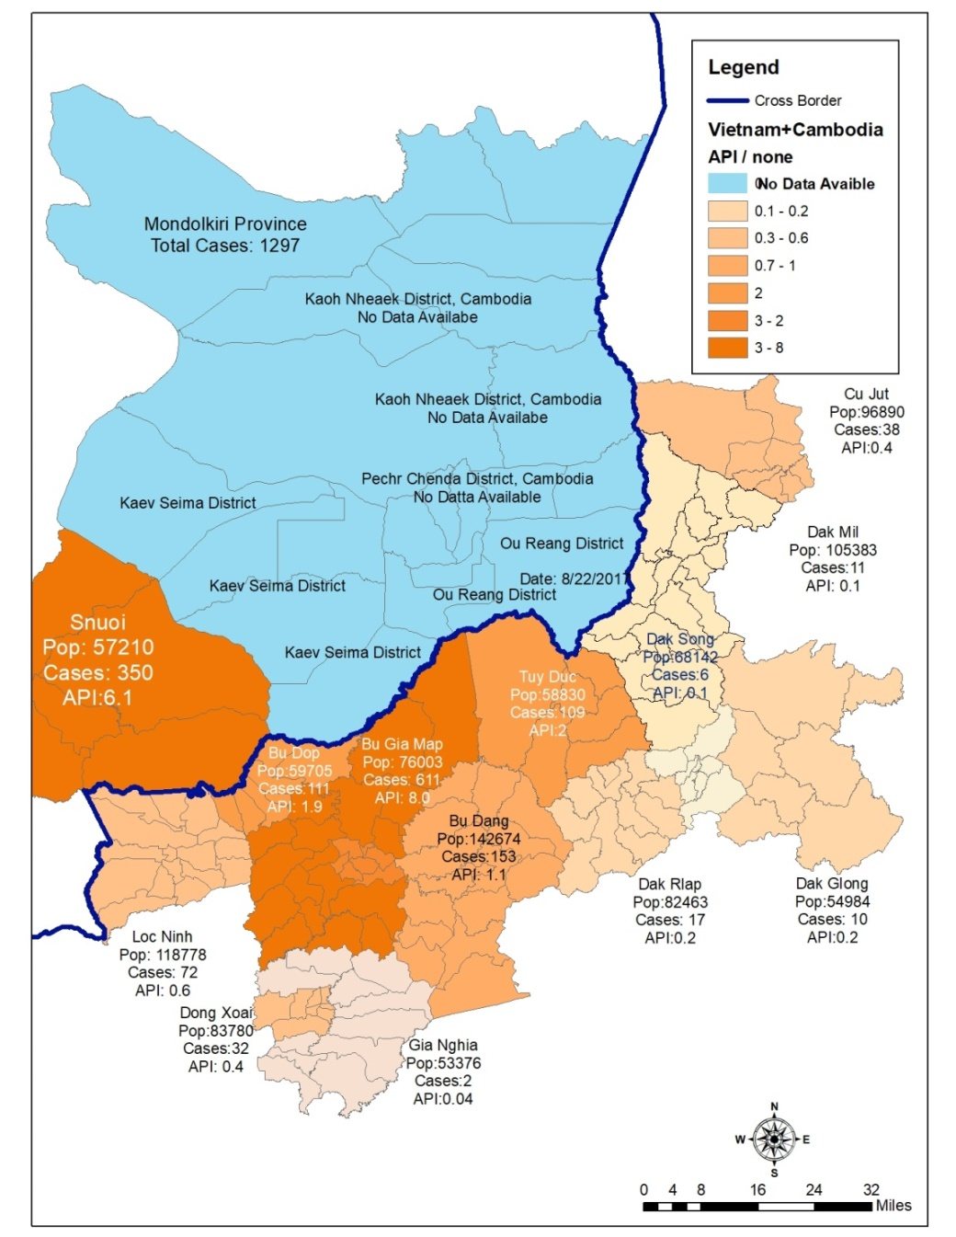
Is this a good thematic map?
Is this a good thematic map?
What is missing?
What should/could be improved?
Does it contain the right amount of information?
Is this map useful?
Notes:
Is this a good thematic map?
Is this an imporvement from the previous thematic map or not?

Slide 14
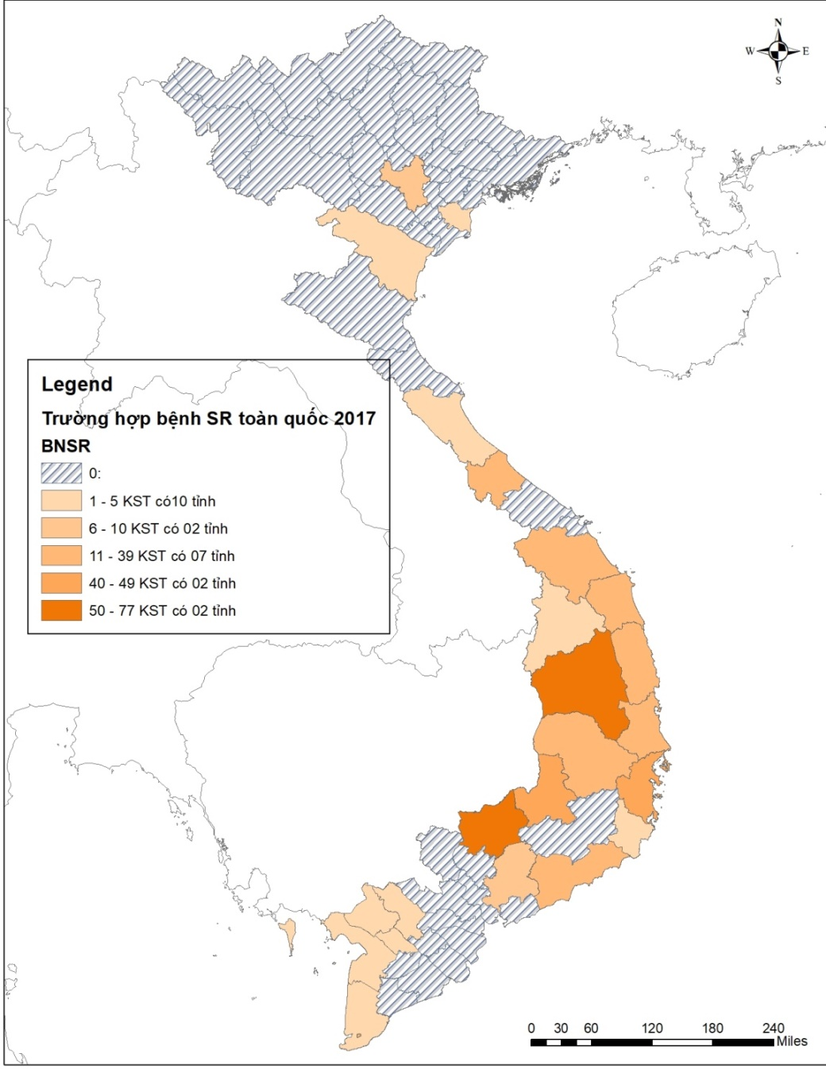
Is this a good thematic map?
Is this a good thematic map?
What is missing?
What should/could be improved?
Does it contain the right amount of information?
Is this map useful?
Notes:
Is this a good thematic map?
How about this one?

Slide 15
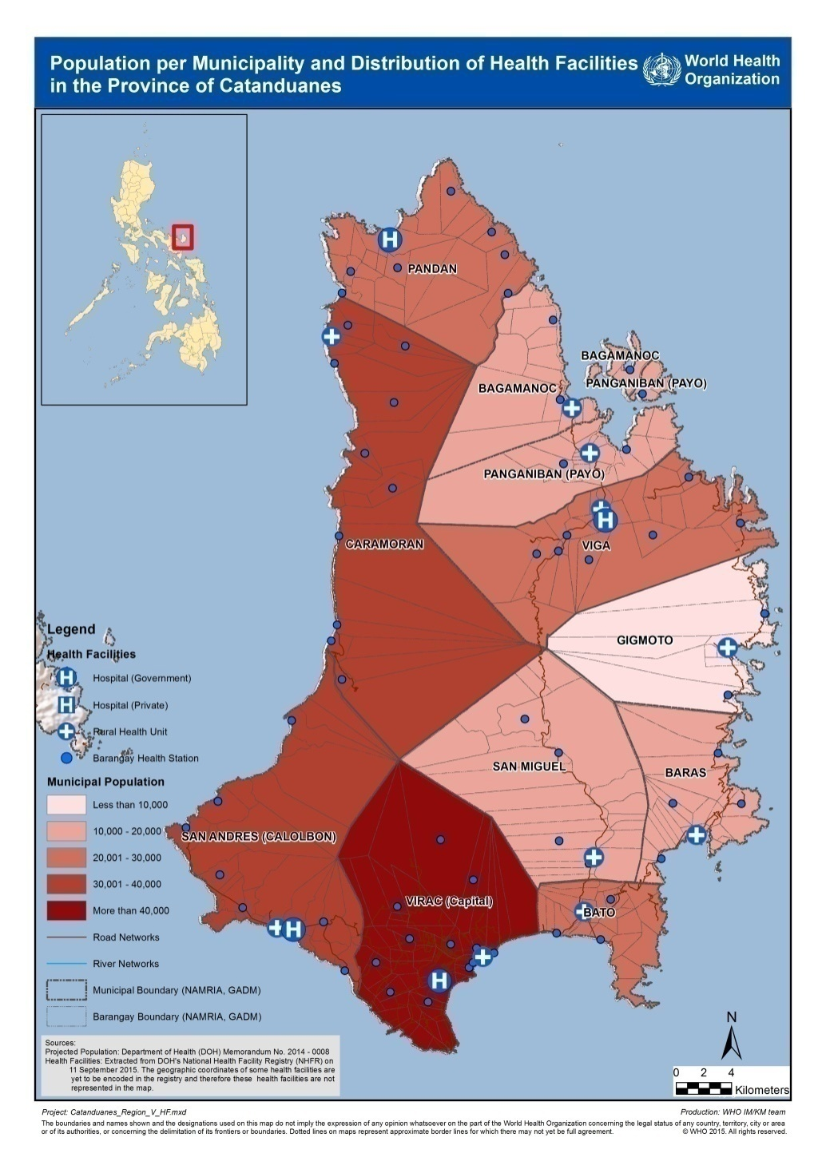
Is this a good thematic map?
Is this a good thematic map?
What is missing?
What should/could be improved?
Does it contain the right amount of information?
Is this map useful?
Notes:
Is this a good thematic map?
And this one?

Slide 16
Example of good thematic map
Notes:
Is this a good thematic map?
And this one?

