Slide 1
Session 4: The process behind making a good thematic map
–
Introduction

Slide 2
Key terms used in this session
Attribute data: Also statistical data. Nonspatial information about a geographic feature, usually stored in a table that can be attached to a geographic object through the use of unique identifier or ID
Geospatial data: Also referred to as spatial data, information about the locations and shapes of geographic features and the relationships between them, usually stored as coordinates and topology.
Map: Any graphical representation of geographic or spatial information.
Thematic map: A map designed to convey information about a single topic or theme, such as population density, geology or health
Notes:
Key terms used in this session

Slide 3
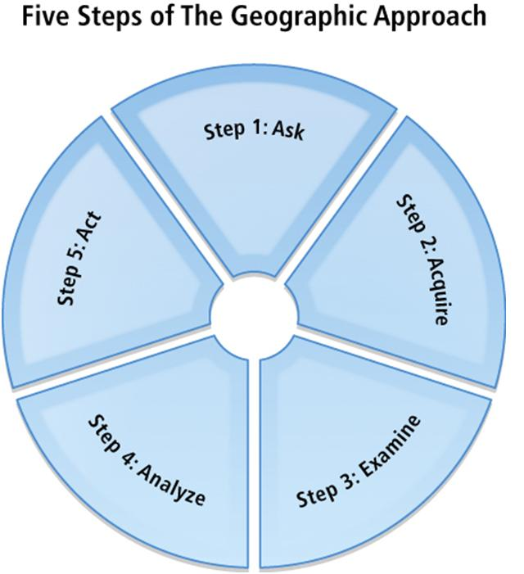
The geographic approach
Step 1: Ask
What is the problem to solve or analyze, where is it located?
Step 2: Acquire
What data are needed to complete the analysis, where can it be found or generated?
Step 3: Examine
Visual inspection of data, how is it organized (schema), how does it correspond to other data and physical world (topology), where is it from (metadata).
Step 4: Analyze
Way data processed and analysed depends on results wanted.
Step 5: Act
Presentation of results part of the decision making process. Via reports, maps, tables, and charts; printed/digitally – network/web.
Thematic mapping follows these steps
Notes:
The geographic approach
The geographic approach has five steps:
Ask
Acquire
Examine
Analyze
Act
Thematic mapping follows these steps.

Slide 4
The thematic mapping process
Three main parts of the process:
Understanding the context of the map to be created
Collecting and preparing the necessary data and information
Creating the thematic map itself
Ask
Acquire
Examine
Analyse
Guide_HGLC_Part2_6_1.pdf
https://www.healthgeolab.net/DOCUMENTS/Guide_HGLC_Part2_6_1.pdf
Notes:
The thematic mapping process
The thematic mapping process has three main parts:
Understanding the context of the map to be created
Collecting and preparing the necessary data and information
Creating the thematic map itself

Slide 5
The thematic mapping process
Understanding the context of the map to be created
1. Understanding the purpose
What is the map going to be used for? Is this for general information, decision making?
What is the message(s) that the map is meant to convey?
When and where will this map be used?
Who will present the map?
Notes:
Understanding the context of the map to be created
Understanding the purpose
To be able to create a thematic map that is easy to understand and effectively conveys the information it contains, the author of the map should first identify the purpose of the map he/she wants to create. He/She must set the objectives and expected outcomes for creating the map.
There are numerous uses for a thematic map including disseminating information to a community or aiding in decision making. Identifying the purpose for which the map is going to be used helps in identifying the scale of the map and the information it needs to contain.

Slide 6
The thematic mapping process
Understanding the context of the map to be created
2. Understanding the audience
Who will be using the map?
Is this map meant for the MOHS only or for the public?
Can we use technical terms/jargons or should we only use simple terms?
Is the audience familiar with the topic covered by the map?
Do your map readers know the area well?
Notes:
Understanding the context of the map to be created
Understanding the audience
Knowing who will use the map has a significant impact on the content and design of the map. The author of the map should at least have an idea of the knowledge level of the audience on the topic to be presented on the map. This would help decide on the amount and technical complexity of the data to be presented.
For example, if the audience has limited knowledge of the area being mapped, it would be necessary to have more location reference information/landmarks to help orient them on the map. Another example is if a thematic map is for a group of doctors, then it may be acceptable to contain technical medical terminology as opposed to if the same map is presented to non-medical practitioners.

Slide 7
The thematic mapping process
Understanding the context of the map to be created
3. Defining the content
What information needs to appear on the map to fulfil the expected purpose and reach the target audience?
Is there any particular way in which the information should be represented on the map?
What data and information needs to be collected in order to create the map
Avoid including too much information in just one map!
Notes:
Understanding the context of the map to be created
Defining the content
Once the purpose and the audience of the map are known, the information the map needs to contain has to be identified. The information must be enough to achieve the identified objectives and expected outcomes. The way the information is to be represented on the map must also be defined.
It is important to keep in mind that there should not be too much information presented in one map. Too much information can make the map appear too crowded and can confuse the reader.

Slide 8
The thematic mapping process
Understanding the context of the map to be created
4. Identifying the medium
Medium = support on which the map will be stored (printed on paper, saved in a pdf or ppt file, shared online,...)
How will the map reach the audience?
What is the appropriate size for the map?
Does the audience need to zoom on the map?
Notes:
Understanding the context of the map to be created
Identifying the medium
Identifying the medium on which the map will be presented is important. It is how the map will reach its audience.
Most commonly, maps are printed for inclusion in reports and for hanging on walls, or viewed electronically such as in slide presentations.
When creating maps for printing, the size of the printing material should be determined. This size should be defined when setting up the “paper” size. This would ensure a crisp and clear printed map as the resolution would be appropriate for the size.

Slide 9
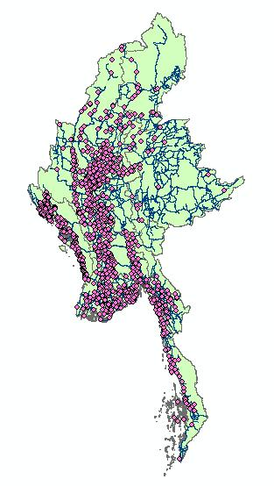
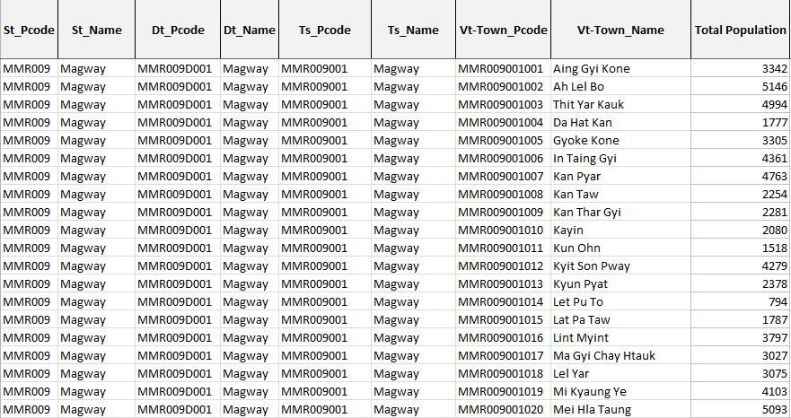
The thematic mapping process
Collecting and preparing the necessary data
Two main data types needed to create a thematic map:
Geospatial/spatial data
Attribute data
Additional data:
Other information to appear on the map
Basemap
Notes:
Collecting and preparing the necessary data
There are two main types of data that are needed to create a thematic map:
Geospatial/spatial data
Attribute data
Other data may be collected to provide more context to the map such as basemaps.

Slide 10
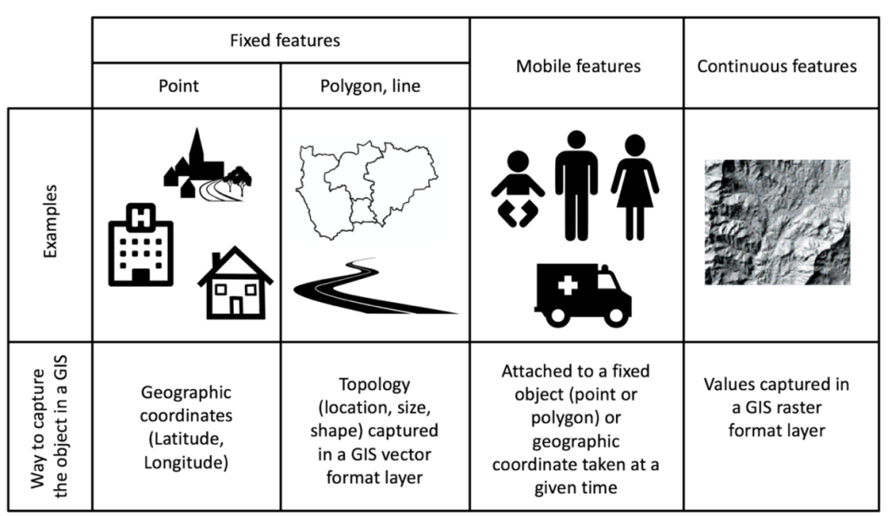
The thematic mapping process
Collecting and preparing the necessary data
Geospatial/spatial data
Information about the locations and shapes of geographic features (object) and the relationships between them, usually stored as coordinates and topology (how point, line, and polygon features share geometry).
Guide_HGLC_Part2_1.pdf
https://www.healthgeolab.net/DOCUMENTS/Guide_HGLC_Part2_1.pdf
Notes:
Collecting and preparing the necessary data
Geospatial/spatial data

Slide 11
The thematic mapping process
Collecting and preparing the necessary data
Attribute data
Statistical data and/or information that can be attached to a specific geographic objects (geospatial data)
Generally stored in a table (Excel file for example)
A unique identifier allow the link (join) with the corresponding object
Unique identifier
Notes:
Collecting and preparing the necessary data
Attribute data

Slide 12
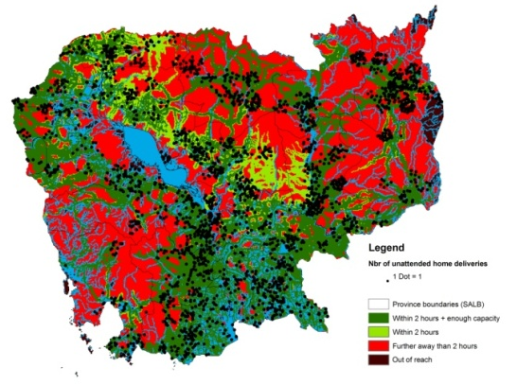
The thematic mapping process
Collecting and preparing the necessary data
Geographic
objects
Unique identifier
Programmatic
attributes
Map
Region/
State
Stats/Info
District
Stats/Info
Township
Stats/Info
Village track
Stats/Info
Table/graph
Ward
Health facility
Information
EPI community
Information
Patient
Stats/Info
Health
program
specific
Master lists
Notes:
Collecting and preparing the necessary data
Attribute data are linked to their corresponding geospatial data through the use of unique identifiers which comes from the master lists of the objects. This linking/joining allows the creation of data products which in this case are the thematic maps.

Slide 13
The thematic mapping process
The concept of master list
An authoritative, officially curated by the mandated agency, complete, up-to-date and uniquely coded list of all the active (and past active) records for a given geographic object (e.g. health facilities, administrative divisions, villages)
Key characteristics
1. Cover the core set of fields that would allow to uniquely identify, classify, geographicaly locate and, when appropriate, contact each active record in the master list;
2. Originate from the governmental entity officially mandated to develop and maintain such master list (unique);
3. Be complete and up-to-date (updating mechanism in place, validity time stamp);
4. Contain an official and unique Identifier (ID) for each record;
5. Make the link with other master lists in order to describe the geographical and hierarchical relationships between the objects (e.g. by including the name and unique code of administrative divisions in the health facility master list)
Notes:
The concept of master list

Slide 14
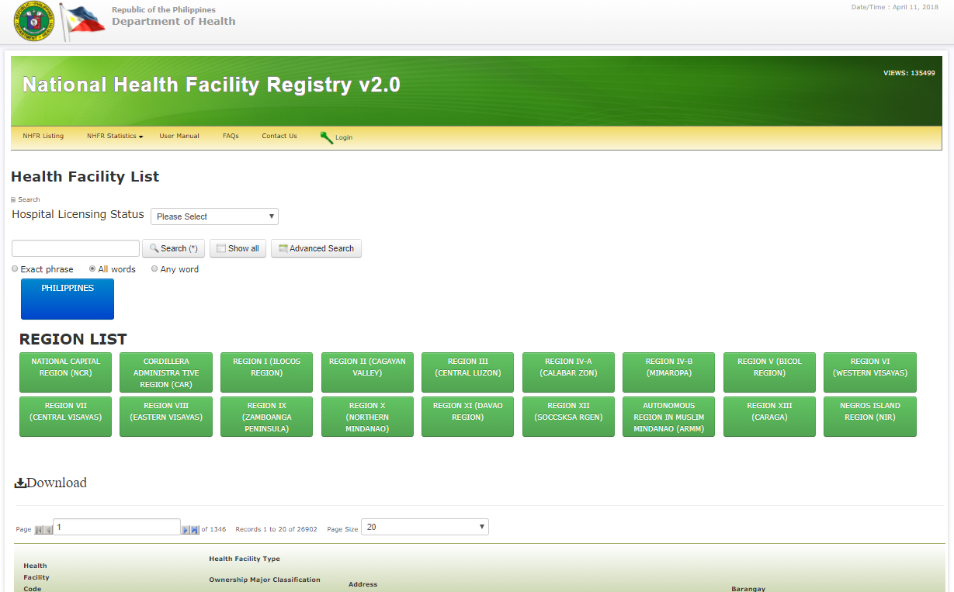
The thematic mapping process
The concept of registry
Central authority to collect, store and distribute an up to date and standardized master list
In other words, a registry can be understood as the IT solution while the master list is itself the standardized data stored in that solution.
Example of the health facility registry of the Department of Health of the Philippines: https://nhfr.doh.gov.ph/rfacilities2list.php
Notes:
The concept of registry

Slide 15
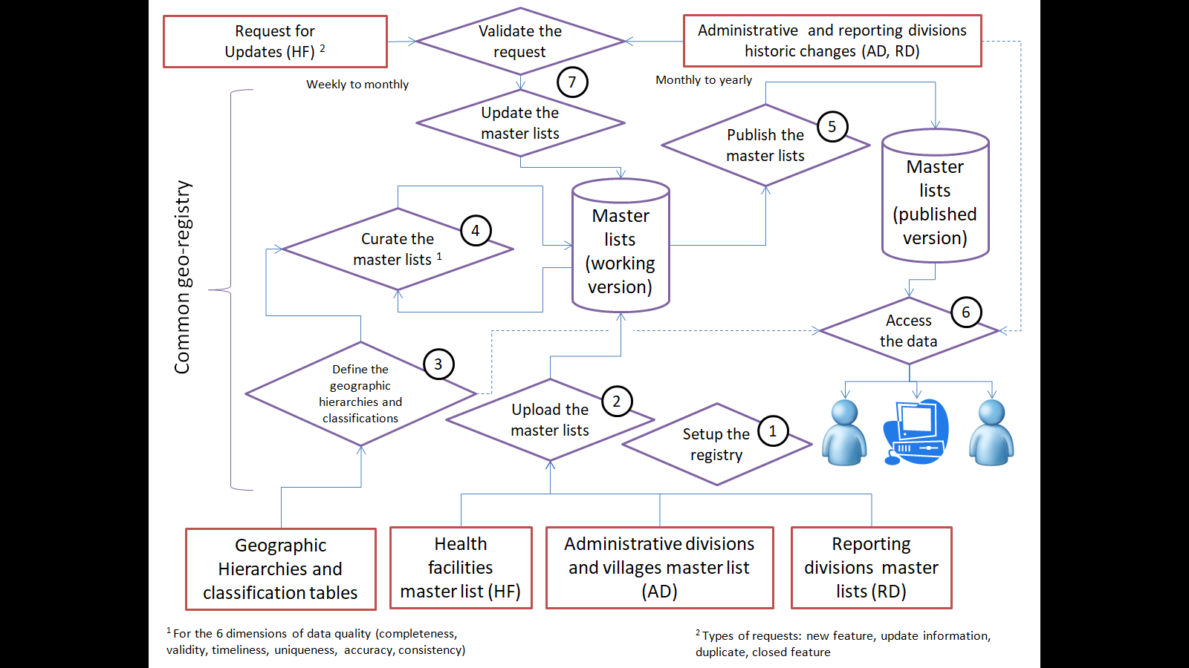
The thematic mapping process
The concept of Common Geo-Registry
IT solution that allows to store, manage, validate, update and share multiple master lists in parallel
We will talk more about this during the last day of the training workshop
http://bit.ly/2My58s6
Notes:
The concept of Common Geo-Registry

Slide 16
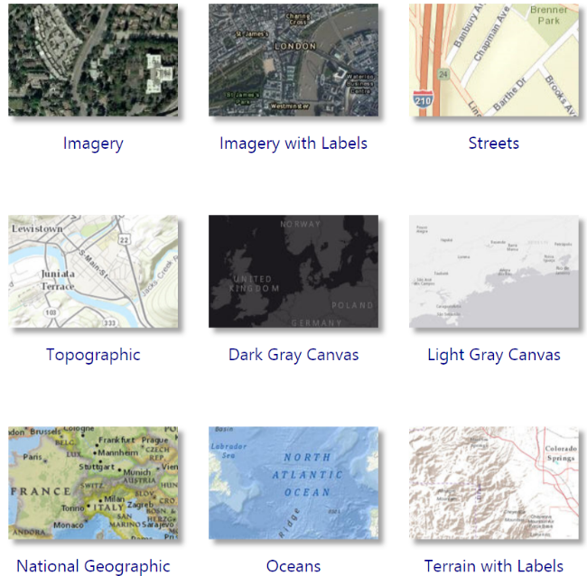
The thematic mapping process
Collecting and preparing the necessary data
Basemaps
Raster file with selection of layers combined into single raster or vector file
Used as bottom layer/background for a map
E.g.
Google Maps
ESRI via ArcGIS online
Open Street Map
Only for visualization purpose
Notes:
Collecting and preparing the necessary data
Basemap
Basemaps are used only for visualization purpose and cannot be interacted with.

Slide 17
The thematic mapping process
Creating the thematic map
Steps in creating a thematic map
Import the data into the GIS software
Select the appropriate mode of representation
Fix the symbology
Add labels to the map
Choose the map orientation (or map template)
Fix the other elements of the layout
Save the final map in the appropriate format
+
Fix map elements outside the GIS software (with Adobe illustrator for example after export)
Notes:
Creating the thematic map
Once all the needed data are collected and prepared, the actual process of creating a thematic map can begin.
There are 7 main steps in this process that will be discussed in detail in the succeeding slides.

Slide 18
The thematic mapping process
Creating the thematic map
1. Import the data in the GIS software
Geospatial data
Attribute data
Basemap
Join the attribute data with the geospatial data using the unique identifier
Notes:
Creating the thematic map
1. Import the data in the GIS software
To start creating the thematic map, all the data must be imported into the GIS software. It is important that both the geospatial and attribute data are added.
If the steps in the previous volumes of guidance documents are correctly implemented and also as emphasized in previous slides, both geospatial and attribute data should have a unique identifier for each object that would allow the attribute data to be joined to the geospatial data and consequently be symbolized on the map.
The basemap to be used must also be added to the GIS software.
Each of the data imported into the GIS software is referred to as a layer of the map.

Slide 19
The thematic mapping process
Creating the thematic map
2. Select the appropriate mode of representation for the content of the map
Choropleth
Proportional symbol
Isarithmic or isopleth
Chorochromatic
Dot density
Dasymetric or cartogram
Most used
Guide_HGLC_Part2_6_1.pdf
Section 4.3.3
Notes:
Creating the thematic map
2. Select the appropriate mode of representation for the content of the map
The most appropriate way to represent the data on a thematic map depends on the data.
The most common thematic mapping methods are choropleth, proportional symbol, isarithmic or isopleth, chorochromatic, dot density, and dasymetric or cartogram.
A short description for each is included in the guidance document.

Slide 20
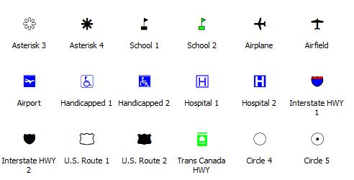
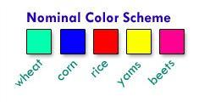
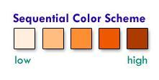
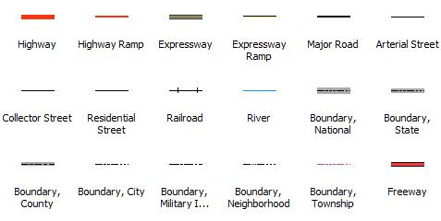
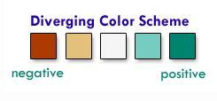
The thematic mapping process
Creating the thematic map
3. Fix the symbology
Choose the appropriate symbols and/or colors
Notes:
Creating the thematic map
3. Fix the symbology
Choosing the appropriate symbol to represent the data is critical in communicating the message of the map. It is advisable to use well-known symbols and symbologies including national/international standards and conventions as applicable to the theme of the map. This would eliminate the need to devise new symbols for already established objects and prevent confusion among readers.
The size of the different symbols used in the map should be carefully calibrated. The symbols should be proportionate to their importance in the map and the actual size of the map layout. Great care should be taken to prevent multiple symbols from overlapping and covering each other.
The visual hierarchy of how different types of symbols are shown on the map is usually point symbols on top, then lines, and lastly, polygons on the bottom.
Furthermore, the use of colors and patterns can enhance or ruin the map. A colorful map may be visually enticing but it may not be communicating the information accurately. It is important to understand the data and how it is to be presented to be able to choose the appropriate color scheme.

Slide 21
The thematic mapping process
Creating the thematic map
4. Add labels to the map
In cartography, a label is a text placed on or near a map feature that describes or identifies it.
Identify the intellectual hierarchy
The ranking of importance of the different map features
Determine the visual hierarchy of map labels based on the intellectual hierarchy
The way the map labels are designed to help map readers organize geographical information
Notes:
Creating the thematic map
4. Add labels to the map
Labels on a map do not only name geographic features, they help map readers understand the information being presented.
Two important things to consider when labeling map features are intellectual hierarchy and visual hierarchy.
There are some basic conventions that can help in proper labeling of a map (included in the guidance document) such as determining font size and type. You may follow these conventions when appropriate.

Slide 22
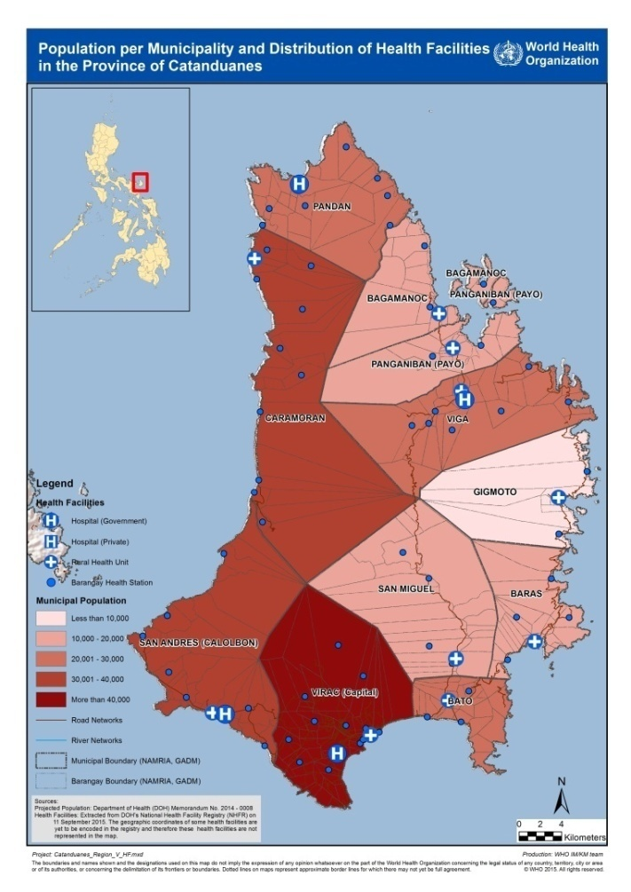
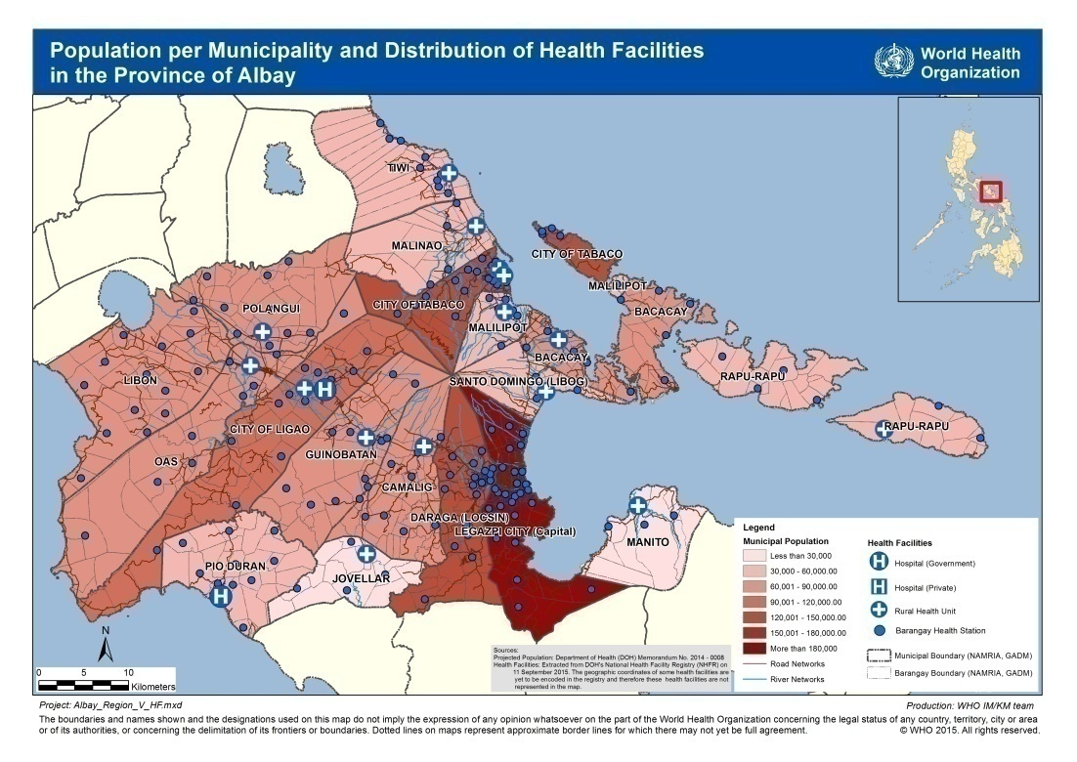
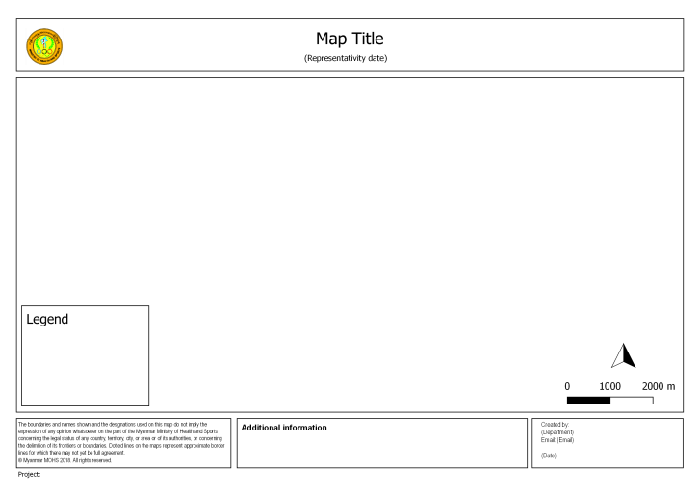
The thematic mapping process
Creating the thematic map
5. Choose the map orientation (or map template)
Portrait
Landscape
Depends mainly on the shape of the geographic area being covered
Notes:
Creating the thematic map
5. Choose the map orientation (or map template)
Once the preceding steps are done, the next step would be to work on the map layout. Working with the data doing the previous steps should give a good idea on the best map orientation (landscape or portrait) to be selected in order to make the best use of the space possible.
Carefully assess how the data is best visualized including whether a portrait (vertical) or landscape (horizontal) orientation of the map and of the page makes the best use of available space. This is particularly helpful when choosing the most appropriate map template if already available for either orientation.
A map template is a map layout with the position of the map elements predefined as specified by the author or organization.
However, if no map template is available, the placement of other map elements such as title, legend, scale, etc. have to be taken into account when choosing the orientation.

Slide 23
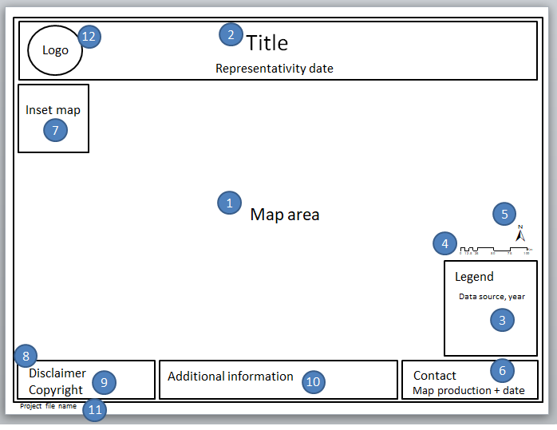
The thematic mapping process
Creating the thematic map
6. Fix the other elements of the layout
If no map template is available, make sure that all map elements are present.
If using a map template:
Supply the text for the title, production date, project file name, etc.
Check that the legend and scale represent the current map
Check the overall look of your map. Ensure that it looks clean and balanced.
Notes:
Creating the thematic map
6. Fix the other elements of the layout
Once the orientation is chosen, fix the location of the map elements around the map area.
The components of a good thematic map is discussed in detail in Session 5.3.
Ensure that the placement of the map elements do not cover the main feature(s) of the map area. Arrange the elements in such a way that they are distributed across the whole page and not crowded in one area.
Similar to map labels, all the text of the map elements should be big enough to be readable. Avoid stylized fonts, if possible, especially for maps for professional use.

Slide 24
The thematic mapping process
Creating the thematic map
7. Save the final map in the appropriate format
Save the map in a file format that would best suit the end use
For use in electronic viewing wherein the map readers do not need to zoom in, the map can be saved in JPEG, BMP, or PNG file format.
Otherwise, it is best to save in PDF format.
It is advisable to save the map with at least 300 dots per inch (dpi) resolution.
Notes:
Creating the thematic map
7. Save the final map in the appropriate format
Once the map layout has been finalized, the map should be saved in a file format that would best suit the end use. The common file formats for saving are JPEG, BMP, PNG, and PDF.
For use in electronic viewing wherein the map readers do not need to zoom in, the map can be saved in JPEG, BMP, or PNG file format. Otherwise, it is best to save in PDF format.
It is critical to save the map layout in a sufficiently high resolution so the map is clear in the form it will be viewed. For printing maps, it is advisable to save at at least 300 dots per inch (dpi).

Slide 25
The thematic mapping process
Creating the thematic map
Fix map elements outside the GIS software (after export)
There is sometimes the need to do minor editing after creating the final map:
Repositioning or adding labels
Adding text information
Removing unnecessary data and/or text
JPEG, BMP, and PNG MS Paint or Adobe Photoshop
PDF Adobe Photoshop or Adobe Illustrator
Notes:
Creating the thematic map
Fix map elements outside the GIS software (after export)
This is an additional step that can be doe once the map has been exported to the required format.
Sometimes, the final map layout needs minor editing. If the source map document or GIS software is not available, the modifications can sometimes be done using graphics or image editing software. These changes would mostly be repositioning or adding labels, correcting colors or adding text information. Image editing software is also sometimes used to improve the aesthetic elements in a map where this is not possible, or more difficult, using GIS software e.g. adding drop shadows or creating infographics.

