Slide 1
Session 5: Making a good thematic map
–
Compiling good geospatial data

Slide 2
Key terms used in this session
Attribute data: Also statistical data. Nonspatial information about a geographic feature, usually stored in a table that can be attached to a geographic object through the use of unique identifier or ID
Geospatial data: Also referred to as spatial data, information about the locations and shapes of geographic features and the relationships between them, usually stored as coordinates and topology.
Data: Facts and statistics collected for reference or analysis
Map: Any graphical representation of geographic or spatial information.
Notes:
Key terms used in this session

Slide 3
Key terms used in this session
Basemap: Collection of GIS data and/or orthorectified imagery that form the background setting for a map. The function of the basemap is to provide background detail necessary to orient the location of the map.
Master list: An authoritative, officially curated by the mandated agency, complete, up-to-date and uniquely coded list of all the active (and past active) records for a given geographic object (e.g. health facilities, administrative divisions, villages)
Metadata: Information that describes the content, quality, condition, origin, and other characteristics of data or other pieces of data
Thematic layer: A spatial representation of analyzed geospatial data of elements of the same type (health facilities, roads, districts, etc.)
3
Notes:
Here are the key terms that will be used in this session.

Slide 4
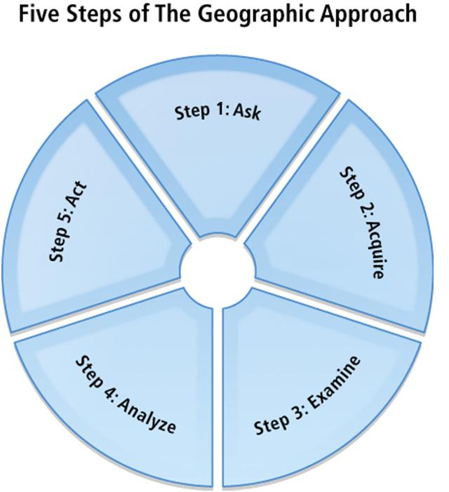
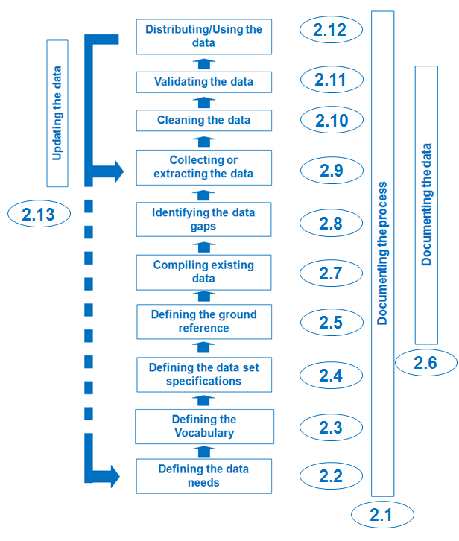
The geospatial data cycle
Geospatial data life cycle
Critical steps to create good maps !
4
Notes:
Defining the vocabulary, data set specifcation, and ground reference
These steps of the geographic approach which are crticital in creating good maps correspond to different steps in the geospatial data life cycle.

Slide 5
Defining the vocabulary, data set specifcation, and ground reference
As mentioned earlier, identifying and understanding the purpose of the map helps identify the data needs and identifying the audience helps in defining the vocabulary to be used. Before compiling the needed data, the data specification and ground reference have to be defined to ensure the quality of the data to be used.
  Defining the vocabulary
  Defining the data set specification
  Defining the ground reference
5
http://www.healthgeolab.net/DOCUMENTS/Guide_HGLC_Part2_2.pdf
Notes:
Defining the vocabulary, data set specifcation, and ground reference
(Refer to slide)

Slide 6
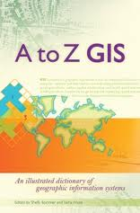
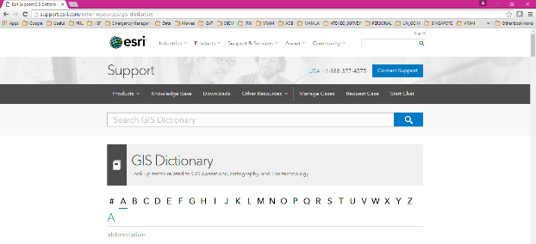
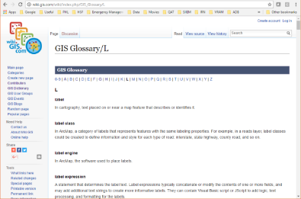
Defining the vocabulary
Defining the vocabulary ensures that all actors involve speak the same language
GIS: Esri online GIS dictionary: http://support.esri.com/other-resources/gis-dictionary
GIS: wiki.GIS.com: http://wiki.gis.com/wiki/index.php/GIS_Glossary
Also important to have a dictionary covering the concerned thematic area (Malaria, MNH,…)
6
Notes:
Defining the vocabulary
This step ensures that all actors involved speak the same language.
For GIS-related terms, you may consult Esri online GIS dictionary or wiki.GIS.com.
Wiki.GIS.com is by far the most comprehensive online resource and therefore being recommended by HGLC.
It is also important to have a dictionary covering the thematic terms. By thematic terms, we mean all the terms related to the public health issues being addressed through the use of geospatial data and GIS.
If you use definitions you find from sources outside your organization or location, the definitions contained in these dictionaries often have to be contextualized locally in order to account for strategies, plans, practices,... enforce in countries.
If there are different intepretations of a word or phrase being used, it is best to decide on what it should mean for your particular project.

Slide 7


Defining the data set specification and ground reference
Addressing public health issues requires good quality data and good geospatial data must cover the six (6) dimensions of data quality:
Completeness: No data gap
Uniqueness: No duplicates
Timeliness: Up-to-date
Validity: Conform to the defined format, type, range,...
Accuracy: Correctness
Consistency: No difference across sources
The data set specifications and the ground reference capture the standards against which geospatial data is assessed to measure these dimensions.
7
http://www.healthgeolab.net/DOCUMENTS/Guide_HGLC_Part2_2.pdf
Notes:
Defining the data set specification and ground reference
Addressing public health issues requires any data to be of good quality and covering the following dimensions as defined by the Data Management Association International (DAMA):
1. Completeness means that all records are in and there are no gaps in the data.
2. Uniqueness means that each record is logged only once and there are no duplicates.
3. Timeliness means that the data is up-to-date or fits within the time range being considered.
4. Validity means that the data conforms to the defined/prescribed type, range, format, etc.
5. Accuracy means that the data is correct.
6. Consistency means that there is no difference across sources.

Slide 8
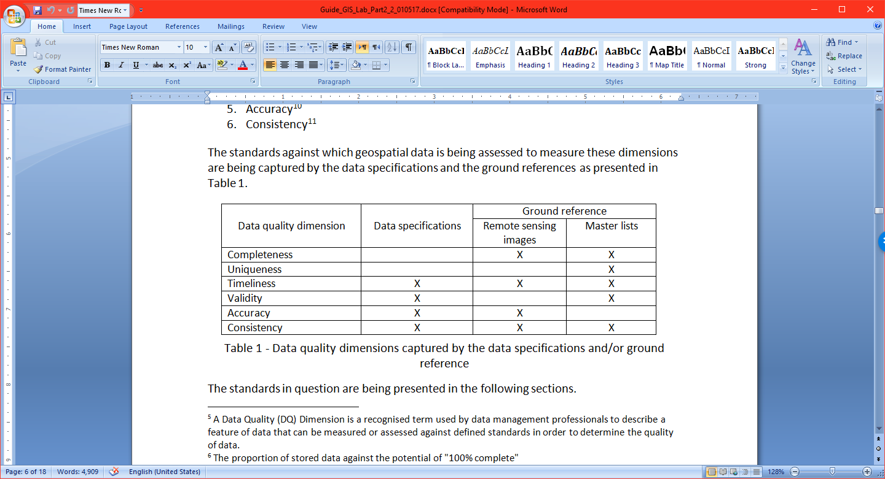
Defining the data set specifications
A geospatial data specification document contains all features a geospatial dataset should comply with in order to be considered of good quality and fulfill the original purpose and expected outcomes of the project.
The data quality dimensions¹ covered by the data set specifications are presented below:
¹ A Data Quality (DQ) Dimension is a recognised term used by data management professionals to describe a feature of data that can be measured or assessed against defined standards in order to determine the quality of data.
8
Notes:
Defining the data set specifications
The data set specifications cover timeliness, validity, accuracy, and consistency.
The defined specifications should be put in a document and should contain the information to be discussed in the next slides.

Slide 9
Defining the data set specifications
Such document should contain at least the following information:
Validity:
  V.1 Geographic coordinate system and map projection
  V.2 Geographic extent of the area being covered
  V.3 Language(s) included in the data
  V.4 File format(s) for sharing data
  V.5 Metadata standard used to document the data
Accuracy:
  A.1 Scale (vector layers)
  A.2 Spatial resolution (raster layers)
  A.3 Positional accuracy (vector layers)
  A.4 Positional accuracy (GNSS reading)
  A.5 Positional precision (GNSS reading)
Timeliness:
  T.1 Period for which the data is being considered as relevant
Consistency
9
Notes:
Defining the data set specifications
As mentioned in the previous slide, the data set specifications covers timeliness, validity, accuracy, and consistency.
There are different items/information that need to be defined for the validity, accuracy, and timeliness data quality dimensions in order to ensure that the dimension is fully covered and that by complying with these defined standards, the data is deemed of good quality.
Having all the standards for these three (3) dimensions defined and followed ensures consistency in all the data being compiled or collected in the field.
Each of the items here are explained further in the succeeding slides.

Slide 10
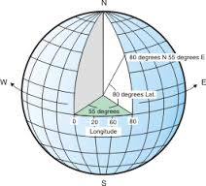
Defining the data set specifications
V.1 Geographic Coordinate System
System in which geospatial data is defined by a 3-D surface and measured in latitude and longitude.
Angular units: The unit of measure on the spherical reference system.
Prime meridian: The longitude origin of the spherical reference system.
Datum: Defines the relationship of the reference spheroid to the Earth's surface.
Spheroid: The reference spheroid for the coordinate transformation.
https://www.healthgeolab.net/DOCUMENTS/Guide_HGLC_Part2_2.pdf
10
http://help.arcgis.com/en/arcgisdesktop/10.0/help/index.html#/What_are_geographic_coordinate_systems/003r00000006000000/
Notes:
Defining the data set specifications
V.1 Geographic Coordinate System
The geographic coordinate system is a system in which geospatial data is defined by a 3-D surface and measured in latitude and longitude. In other words, such system is a model which tries to be as close as possible to the shape of the earth. This model is principally defined by two elements, namely:
1. The spheroid: A three-dimensional shape obtained by rotating an ellipse about its minor axis, with dimensions that either approximate the earth as a whole, or with a part that approximates the corresponding portion of the geoid
2. The datum: The reference specifications of a measurement system, usually a system of coordinate positions on a surface (a horizontal datum) or heights above or below a surface (a vertical datum). In other words, the datum defines the position of the spheroid relative to the center of the earth.
The most widely used geographic coordinate system nowadays is the World Geodetic System 1984 (WGS 84).

Slide 11
Defining the data set specifications
V.1 Geographic Coordinate System
IMPORTANT: Must use the same Geographic Coordinate System on each dataset being combined on a map
11
Notes:
Defining the data set specifications
V.1 Geographic Coordinate System
A pair of geographic coordinates (latitude and longitude) if taken using different Geographic Coordinate System will appear on different locations when plotted together on a map. (See example in the slide)
It is therefore important to use the same Geographic Coordinate System on each dataset being combined on a map.

Slide 12
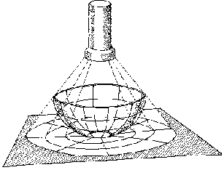
Defining the data set specifications
V.2 Projected Coordinate System
System in which geospatial data is defined by a flat 2-D surface and can be measured in units of meters and feet.
Map projection
A method by which the curved surface of the earth is portrayed on a flat surface
The systematic transformation of points on the Earth’s surface to corresponding points on a plane (flat) surface
The earth is 3D but maps need to be flat!
This requires distortion of some parts of the map.
Note: When displaying data that's using a geographic coordinate system, GIS uses a projected coordinate system. Basically, we just treat the coordinate values as if they are linear and just display the data.
12
Notes:
Defining the data set specifications
V.2 Projected Coordinate System
The Projected Coordiate System is a system in which geospatial data is defined by a flat 2-D surface and can be measured in units of meters and feet.
Map projection is the method by which this is done.

Slide 13
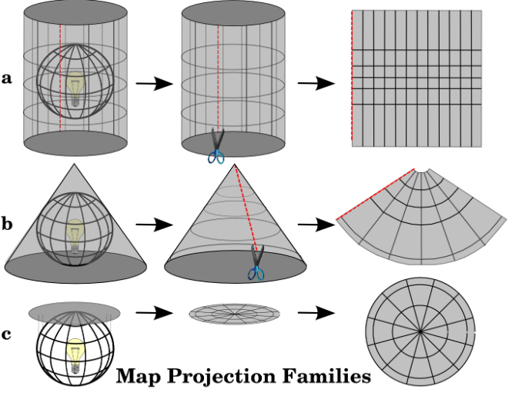
Defining the data set specifications
V.2 Map Projection – Basic projection techniques
Cylindrical
Conical
Azimuthal
https://www.healthgeolab.net/DOCUMENTS/Guide_HGLC_Part2_2.pdf
13
http://www.icsm.gov.au/mapping/about_projections.html#types
Notes:
Defining the data set specifications
V.2 Projected Coordinate System
A map can be projected in different ways using different techniques.
The projection technique describes how an imaginary piece of paper (which will become the map) is laid on the Earth to obtain locations. These techniques are:
• Cylindrical: the imaginary ‘piece of paper’ is rolled into a cylinder, this is usually used over Equatorial areas or for World Maps;
• Conical: the imaginary ‘piece of paper’ is rolled into a cone, this is usually used in mid-latitude areas (approximately 20° – 60° North and South); and
• Azimuthal: the imaginary ‘piece of paper’ is flat, this is usually used over Polar areas.

Slide 14
Defining the data set specifications
V.2 Map Projection – Basic projection types
Each projection preserves a particular relationship or characteristic:
Equal-Area — correctly shows the size of a feature
Conformal — correctly shows the shape of features
Equidistant — correctly shows the distance between two features
True Direction — correctly shows the compass direction between two features
A map cannot be at the same time equal-area or conformal – it can only be one or the other, or neither.
A map projection is to be chosen based on the needs
https://www.healthgeolab.net/DOCUMENTS/Guide_HGLC_Part2_2.pdf
14
Notes:
Defining the data set specifications
V.2 Projected Coordinate System
There are also different projection types. Four main types of projection exist, each of them having a particular purpose as it preserves a particular relationship or characteristic. These types are as follows:
• Equal-Area: Conserves the size of a feature,
• Conformal: Conserves the shape of features,
• Equidistant: Conserves the distance between two features, and
• True Direction: Conserves the direction between two features.
It is important to note that a map cannot be both equal-area or conformal – it can only be one or the other, or neither.

Slide 15
Defining the data set specifications
V.2 Map Projection – Examples
Projection | Technique | Type
Equirectangular | Cylindrical | Equidistant | Simplest geometry; distances along meridians are conserved. Plate carrée: special case having the equator as the standard parallel.
Lambert cylindrical equal-area | Cylindrical | Equal-area
Universal Transverse Mercator (UTM) | Cylindrical | Conformal | Divides the Earth into sixty zones, each being a six-degree band of longitude
Robinson | Pseudocylindrical | Compromise (neither equal-area nor conformal) | Used to create global maps
https://en.wikipedia.org/wiki/List_of_map_projections
15
Notes:
Defining the data set specifications
V.2 Projected Coordinate System
Having known the different map projection types and techniques, each map projection can then be described as a combination of these two classifications.
The map projection recommended by HGLC is the Universal Transverse Mercator (UTM).

Slide 16
Defining the data set specifications
V.3 Language
National versus international capacity to understand the data
V.4 Geospatial and attribute data format (most used)
Vector
  Shapefiles (actually composed of the 3 to 8 files)
  GeoJSON (QGIS)
Raster
  Georeferenced: Geotiff
  Not georeferenced: .jpeg, .png, etc.
  GRID
Tabular (attributes):
  Spreadsheets: .xls, .dbf (for point type data and when they contain the latitude and longitude)
Combined vector/raster/tabular
  Geodatabases
Recommended
16
Notes:
Defining the data set specifications
V.3 Language
The language or languages to be used for the project must be defined. It usually must include a local/national language and an international one to facilitate understanding with the international community if necessary.
V.4 Geospatial and attribute data format
There are different formats available for geospatial and attribute data and what will be used for your project must be defined.
For geospatial data, the formats for both vector and raster data must be defined.
HGLC recommends shapefiles for vector files as it is the most universally known format and can be used on most GIS software; Geotiff and GRID for raster files, and Microsoft Excel for tabular files.

Slide 17
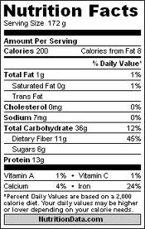
Defining the data set specifications
V.5 Metadata – Data about the data
For users to ensure that the data is appropriate for their own purpose
Should be captured as much as possible during data collection and completed before data dissemination
Applies to both geospatial and statistical data
Different standards exists (FGDC, ISO) but they first need to be converted into a metadata profile (selection of fields) before being used.
17
Notes:
Defining the data set specifications
V.5 Metadata
The metadata is the data about the data.
There are different metadata standards to help capture the important information about the data such as Federal Geographic Data Committee (FGDC) and International Organization for Standardization (ISO) but they first need to be converted into a metadata profile (selection of fields) before being used.
This topic is further discussed in Session 14.
This being said, it is crucial to decide on the metadata standard as well as develop the metadata profile that will be used as part of defining the data specifications. This is crucial in order to collect the necessary information to fill the profile during the implementation of the next steps in the geospatial data management cycle.

Slide 18

Defining the data set specifications
V.5 Metadata – Data about the data
A minimum metadata should cover:
  Where is the data coming from?
  When was it created/last updated?
  What is the method behind the data (scale, accuracy,..)?
  Which geographic coordinate/projection system is being used?
  Are there any use or redistribution restrictions attached to the data?
  Who can I contact if I have questions?
https://www.healthgeolab.net/DOCUMENTS/Guide_HGLC_Part2_5_1.pdf
18
Notes:
Defining the data set specifications
V.5 Metadata
A minimum metadata should cover:
Where is the data coming from?
When was it created/last updated?
What is the method behind the data (scale, accuracy,..)?
Which geographic coordinate/projection system is being used?
Are there any use or redistribution restrictions attached to the data?
Who can I contact if I have questions?

Slide 19
Defining the data set specifications
A.1 Scale, A.2 Resolution, A.3 & A.4 Accuracy, and A.5 Precision
Scale: The ratio or relationship between a distance or area on a map and the corresponding distance or area on the ground, commonly expressed as a fraction or ratio. A map scale of 1/100,000 or 1:100,000 means that one unit of measure on the map equals 100,000 of the same unit on the earth.
Resolution (raster format): The dimensions represented by each cell or pixel in a raster.
Accuracy: The degree to which a measured value conforms to true or accepted values. Accuracy is a measure of correctness.
Precision: The number of significant digits used to store numbers, particularly coordinate values. Precision measures exactness.
http://support.esri.com/other-resources/gis-dictionary/
19
Notes:
Defining the data set specifications
A.1 Scale, A.2 Resolution, A.3 & A.4 Accuracy, and A.5 Precision
(Refer to slide for the definitions)

Slide 20
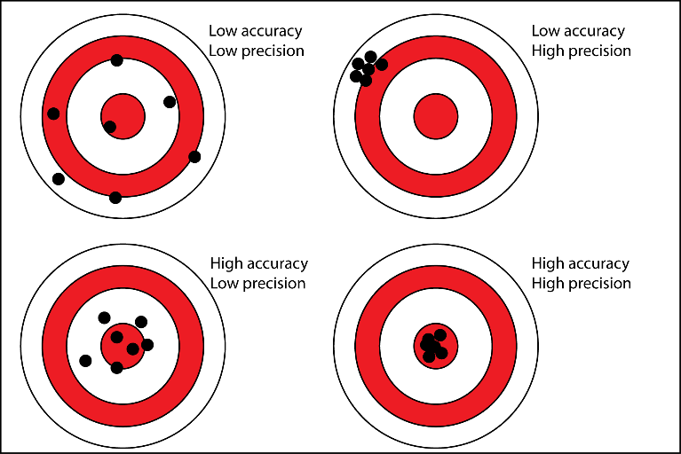
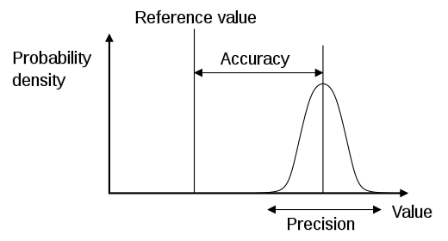
Defining the data set specifications
Accuracy and Precision (A.4 and A.5)
20
Notes:
Defining the data set specifications
Accuracy and Precision (A.4 and A.5)
Accuracy is the shift between real location and geographic coordinates recorded. Precision is the dispersion around the location that is measured.
In simpler terms and relating to the image shown, accuracy is the ability to shoot in the right direction; the precision is how much your hand is shaking at the time of shooting.

Slide 21
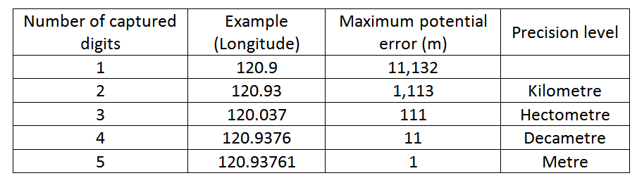
Defining the data set specifications
Precision (A.5)
At the equator: 360 º
40’075 km
1 º
͌
111’320 m
Recommended
During data collection in the field (GNSS enabled devices)
When generating or extracting vector format geospatial data (precision level of vertices)
21
Notes:
Defining the data set specifications
Precision (A.5)
Precision, as defined here, directly depends on the number of digits being captured by geographic coordinates. This relation is illustrated in table shown when considering a geographic coordinate taken at the level of the equator using the WGS 84 Geographic coordinate system. At that level, the circumference of the Earth is equal to about 40,075 km. Each degree along the equator is then equivalent to 11,320 meters (40,075 km / 360°).
As you increase the number of decimal places when capturing the longitude or latitude, you decrease the maximum potential error. It is therefore recommended to capture five (5) decimal places in order to have a maximum potential error in meters.

Slide 22
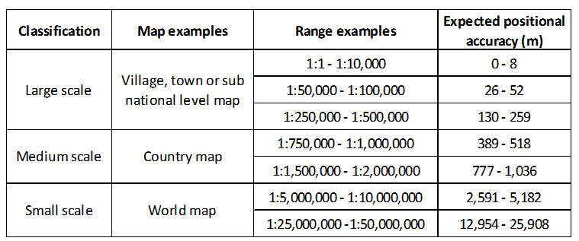
Defining the data set specifications
Scale, Accuracy, and Precision (A.1, A.3, and A.5)
United States Geological Survey mapping standards: "requirements for meeting horizontal accuracy as 90 per cent of all measurable points must be within 1/30th of an inch for maps at a scale of 1:20,000 or larger, and 1/50th of an inch for maps at scales smaller than 1:20,000."
http://www.colorado.edu/geography/gcraft/notes/error/error_f.html
22
Notes:
Defining the data set specifications
Scale, Accuracy, and Precision (A.1, A.3, and A.5)
Maps scales are generally classified as small, medium, or large scale, with the corresponding scale ranges for each scale.
For most public health related maps, the recommended scale is 1:50,000 – 1:100,000 which should be based on geospatial data with a positional accuracy, or a maximum positional error, of 52 meters.
While it can be costly to generate polygon or line type data for large scale maps, today’s Global Navigation Satellite Systems (GNSS) have high accuracy that enables the collection of geographic coordinates with positional accuracy close to the meter and therefore generate point type geospatial data that can be used across the whole range of scales presented in the table.

Slide 23
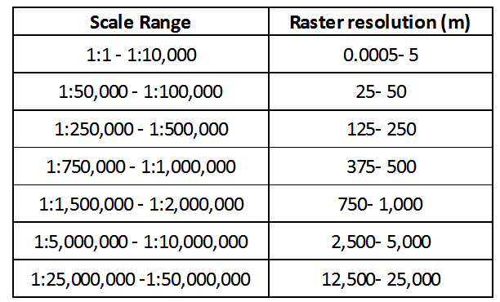
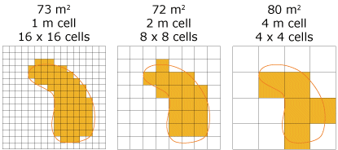
Defining the data set specifications
Scale and Resolution (A.1 and A.2)
Values are very close to those for accuracy
23
Tobler W. (1987): Measuring Spatial Resolution, Proceedings, Land Resources Information Systems Conference, Beijing, pp. 12-16
Notes:
Defining the data set specifications
Scale and Resolution (A.1 and A.2)
The relation between scale and the expected resolution of a raster layer has been defined by Waldo Tobler in 1987 through the following rule: divide the denominator of the map scale by 1,000 to get the detectable size in meters. The resolution is one half of this amount. Table 4 presents the application of this rule for the ranges of scales reported in the table in the previous slide.
The values reported in this table can also be used to define the minimum resolution for the imagery to be used as ground reference or to generate geospatial data for a particular scale of work.
The recommended raster resolution is 25-50 meters which is very close to the accuracy of the recommended map scale (in previous slide).

Slide 24
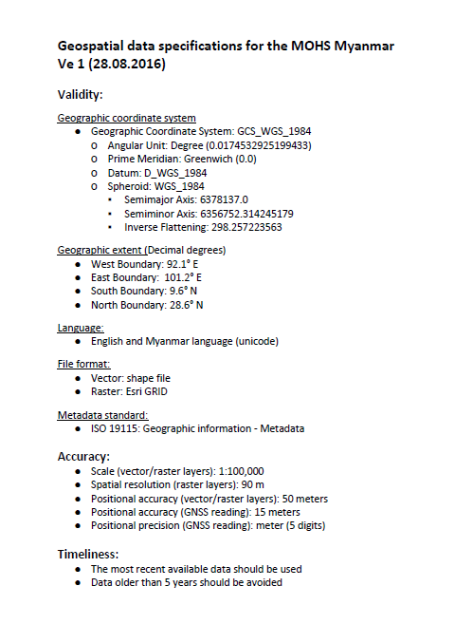
Defining the data set specifications
To summarize
• The purpose behind the use of geospatial data will guide the choice of a specific scale of work.
• This scale will directly influence the positional accuracy and spatial resolution that should be used when compiling, collecting, or extracting geospatial data.
• The highest accuracy possible should be sought when using GNSS-enabled devices to allow for the largest use possible of the resulting data; and
• A precision level down to the meter (5 digits in decimal degrees) is being recommended.
Geospatial data set specifications for Myanmar
24
Notes:
Defining the data set specifications
Summary for defining the data set specifications
(Refer to slide)

Slide 25
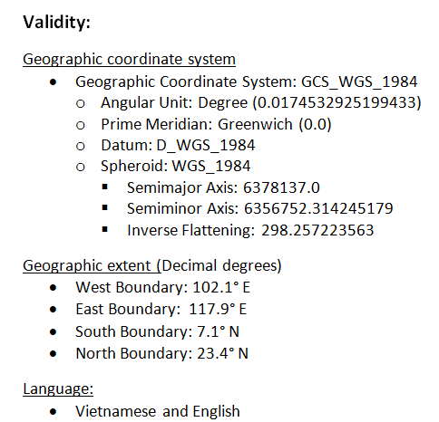
Defining the data set specifications
Example - Data specifications for MOH of Vietnam (HIS geo-enabling process)
25
Notes:
Defining the data set specifications
Here is an example of a data set specification document. This is defined for the Ministry of Health of Vietnam.

Slide 26
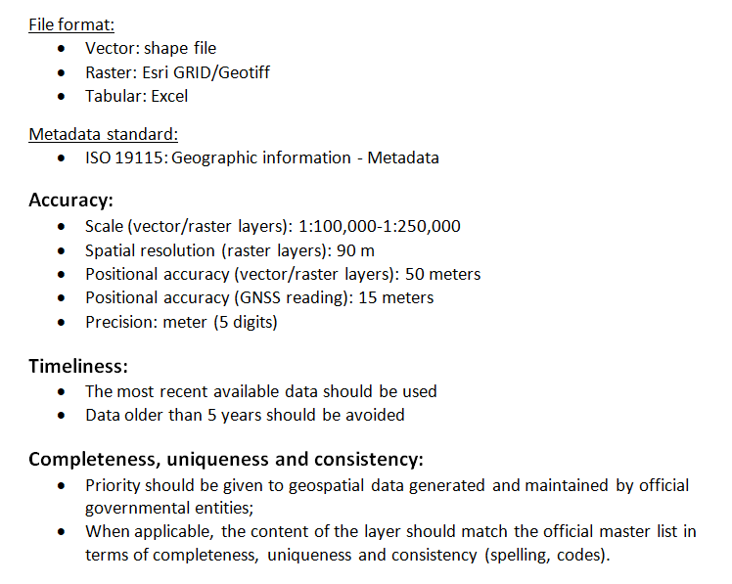
Defining the data set specifications
Example - Data specifications for MOH of Vietnam (HIS geo-enabling process)
26
Notes:
Defining the data set specifications
Here is an example of a data set specification document. This is defined for the Ministry of Health of Vietnam.

Slide 27
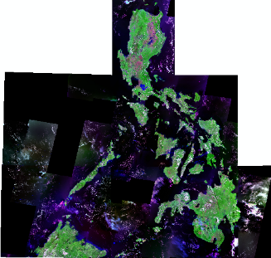
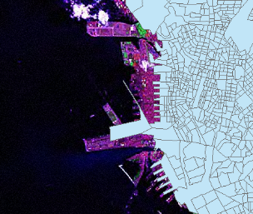

Defining the ground reference
There are two types of ground references or ground truths:
Remote sensing imagery (geospatial)
The image also has its own accuracy
Master lists (geospatial and attribute data)
890 m
27
Notes:
Defining the ground reference
There are two types of ground references or ground truths in this session: Remote sensing imagery and master lists.
These concepts refer to:
1. Remote sensing imagery: The actual location of a given feature on the surface of the Earth. As it is not possible to check all the available geospatial data directly in the field, high resolution satellite or orthophoto images represent the best option.
2. Master list which can be defined as the authoritative, standardized, complete, up-to-date, and uniquely coded list of all active records for a given object.
Both of these elements are necessary to evaluate the completeness, uniqueness, timeliness, accuracy, and consistency of geospatial data.

Slide 28
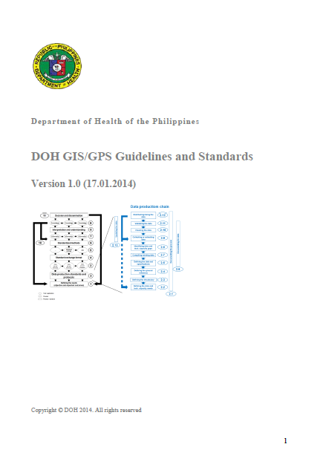



Geospatial data management guideline
It is good to capture all we have covered in this session into a Geospatial data management guideline document
Philippines (2014): https://healthgeolab.net/KNOW_REP/DOH_GIS-GPS_Guidelines_Standards_011714.pdf
Cambodia (2018): https://www.healthgeolab.net/KNOW_REP/KHM_MOH_Guidelines_2018.pdf
Myanmar (2018): https://www.healthgeolab.net/KNOW_REP/MMR_MOHS_Geo-Guidelines.pdf
28
Notes:
Geospatial data management guideline

Slide 29
Compiling existing data
Once the data needs have been identified and before collecting data in the field, existing data must first be compiled. The defined data specifications and ground reference will then be used as references to assess the compiled data.
Compiling existing data first prevents duplication of efforts, saves time and money, and allows identification of potential gaps.
29
http://www.healthgeolab.net/DOCUMENTS/Guide_HGLC_Part2_3.pdf
Notes:
Compiling existing data
(Refer to slide)

Slide 30
What is needed?
The following must be compiled in order to have a quality dataset:
  The master list for the geographic features considered in the data model
  The thematic layers containing the geospatial representation (geographic objects) for the considered geographic features
  The statistical data to be attached to these features
  Basemaps to serve as ground reference when checking the geospatial data that has been collected
  Metadata
30
Notes:
What is needed?
What must be compiled in order to have a quality dataset?
(Refer to slide)
This is explained further for each object in the next slides.

Slide 31
Sources of data
Master lists should only come from government entities which have the official mandate over the considered geographic feature(s).
This table provides the list of the governmental entities generally in charge of the master list and associated thematic layer for the geographic features most often used in public health.
Geographic feature | Master list | Thematic layer | Governmental entity
Health facilities | ✔ | ✔ | Ministry of Health, NGO (WHO)
Health districts or other reporting divisions | ✔ | ✔ | Ministry of Health, NGO (WHO)
Administrative divisions and villages | ✔ | ✔ | Ministry of Interior, National Statistical Agency, National Mapping Agency
Transportation network | Not necessary | ✔ | Ministry of Public Works, Ministry of Transportation
Hydrographic network | Not necessary | ✔ | Ministry of Environment/Agriculture
Climate data (temperature, precipitation, etc.) | Not applicable | ✔ | Ministry of Meteorology, Meteorological agency
Digital Elevation Model (DEM) | Not applicable | ✔ | National Mapping Agency
Land cover | Not applicable | ✔ | National Mapping Agency, Ministry of Environment/Agriculture
31
Notes:
Sources of data
Where should you look for the needed master list of objects?

Slide 32
Sources of data
However, other sources can be considered for geospatial and statistical data and basemaps depending on the needs identified at the beginning of the process and their availability.
It is important to consider all of these sources as they might be complementary and under different use and redistribution rights constraints.
32
Notes:
Sources of data
How about for other data – geospatial and statistical data and basemaps?

Slide 33
Potential sources of data
Aside from governmental entities, other potential sources of local, regional or global geospatial and statistical data are:
NGOs (UN,…) and volunteer groups (i.e. OSM): administrative boundaries, road network, hydrographic network, populated places,…
Research groups/universities: Population distribution grids, land cover
Other type of institutions: satellite images
Private sector including GIS software companies (e.g. Esri): basemap layers
33
Notes:
Potential sources of data
What are these other sources for geospatial and statistical data and basemaps?

Slide 34
Potential sources of data
Online free shapefiles (for download)
There are hundreds of websites for online free shapefiles.
Here are some examples:
DIVA GIS: www.diva-gis.org
United Nations: www.fao.org/geonetwork
    Wide range of spatial data (not all freely accessible)
    Global Administrative Unit Layers (need to apply for access)
Open Street Map: openstreetmap.org, http://download.geofabrik.de/, openstreetmapdata.com , http://extract.bbbike.org/
  ISCGM: http://globalmaps.github.io/
    Government data
34
Notes:
Potential sources of data
There are hundreds of websites for online free shapefiles if one tries to search the internet. Here are just some examples.

Slide 35
Potential sources of data
Online free population data (for download)
Worldpop: www.worldpop.org.uk
GEOHIVE: http://www.geohive.ie/catalogue.html
Gridded Population of the World http://sedac.ciesin.columbia.edu/data/collection/gpw-v4
Free raster layers (for download)
Global Land Cover 30: http://www.globallandcover.com
Forest cover: https://earthenginepartners.appspot.com/science-2013-global-forest/download_v1.6.html
DEM (CGIAR): http://srtm.csi.cgiar.org/
35
Notes:
Potential sources of data
Here are examples of potential sources of data for population data, satellite images, and other raster data.

