Slide 1
Session 7: Preparation of the equipment and questionnaire that will be used during the second day

Slide 2
What’s the story?
We are in March 2025
The President elected in 2022 has decided to expand the National Capital Region due to the urbanization and has created a new Province, the Tolkien Province. (He is a big fan of The Lord of the Rings movie.)
The President has also re-organized the health service delivery network over this Province.
The bad news is that Malaria has resurfaced in this Province since 2013 and 315 positive cases have already been identified since January 1st, 2025.
There are new cases that have recently been identified at the RITM Hospital.

Slide 3
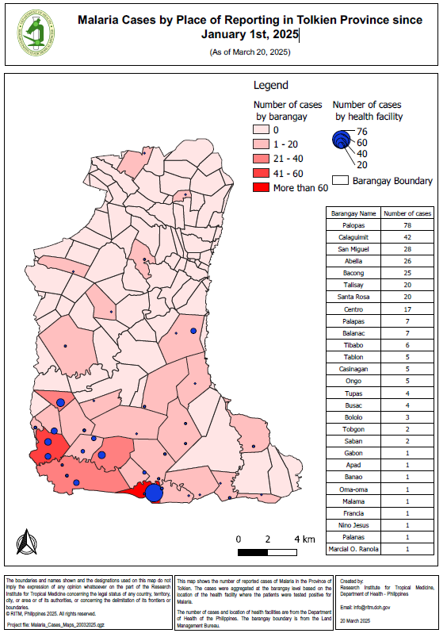
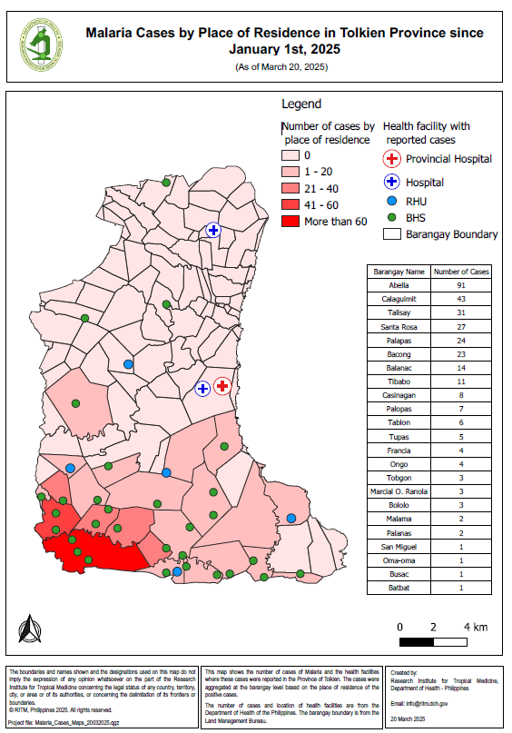
Malaria Cases by Place of Reporting or Place of Residence

Slide 4
What’s the story?
You received a request to create new maps.
These new maps will be:
  An updated version of the Province-level map to include these new cases
  A detailed map showing the location of the place of residence and possible place of infection of all the previous cases including the new cases currently under observation in the RITM Hospital
The purpose of these maps are:
  Assist on-going malaria control and elimination activities
  Identify geographic foci and guide foci investigations as needed

Slide 5
What’s the story?
These maps will be used by Province-level and Barangay-level malaria surveillance officer, respectively.
Before being able to create the maps, you will need to get the geographic coordinates of the health facility in which these patients are currently under observation and information on their place of residence and possible place of infection.
Summaries of the purpose, audience, content, and medium for the two maps are provided in the next slides

Slide 6
Request received for a map
Map 1
Purpose: Assist on-going malaria control and elimination activities
Audience: Province-level Malaria Surveillance Officer
Content:
  Updated number of malaria cases:
    By place of reporting at the health facility level
    By place of residence aggregated by Barangay
Medium: A4 size map stored in a pdf file

Slide 7
Request received for a map
Map 2
Purpose: Identify geographic foci and guide foci investigations as needed
Audience: Commune-level Malaria Surveillance Officer
Content:
  Location of place of residence and possible place of infection for the 315 positive cases reported since the beginning of the year including the new ones just reported by the RITM Hospital
  Waterways and water body
  Forests
Medium: A4 size map stored in a pdf file
Competition of the best thematic map(s) !!!

Slide 8
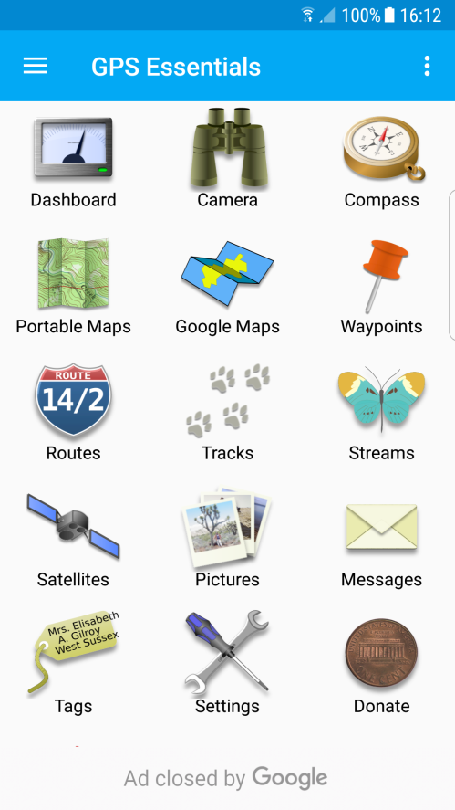
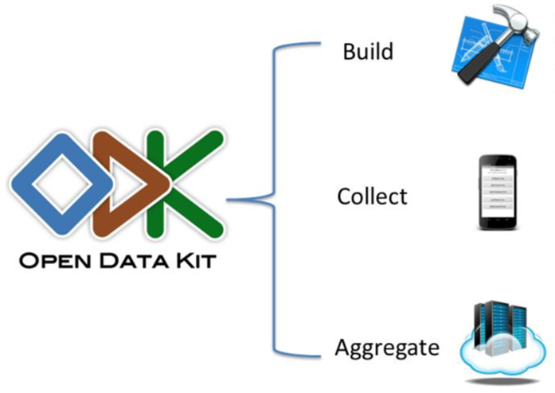
Getting ready for data collection
We will use two software tomorrow

Slide 9
Android devices and GPS Essentials
GPS Essentials is a free application available for Android-based devices with a built-in GNSS receiver.
It can be used as an alternative to dedicated GPS devices when collecting geographic coordinates as it complies with the specifications discussed in the previous slides.
Notes:
Android devices and GPS Essentials
There are smart phones, particularly Android-based devices, that have built-in GNSS receiver.
One mobile app that can be used on these Android-based devices is the GPS Essentials.
You will be using GPS Essentials to complete Exercise 1.

Slide 10
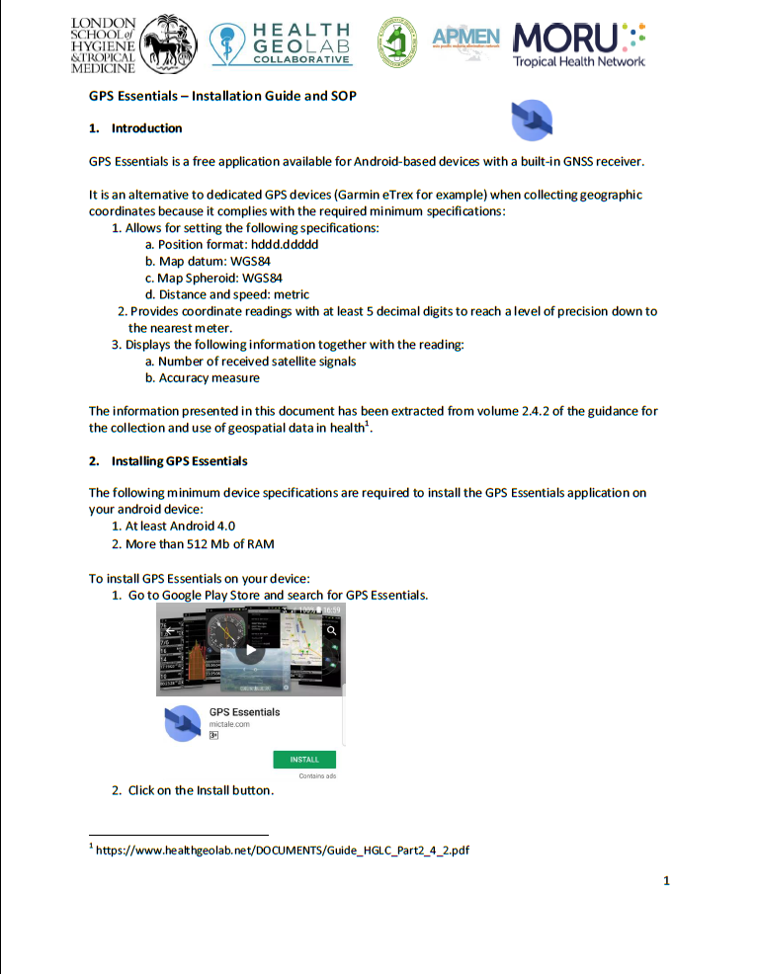

Preparation for Exercise 1
  Separate document
  Installation guide for GPS Essentials
  SOP to follow and data collection form to use when collecting geographic coordinates using an android phone and GPS Essentials
Exercise 1
Notes:
Preparation for Exercise 1
One of the documents provided to you contains the installation guide for GPS Essentials and the SOP to follow and data collection form to use when collecting geographic coordinates using an android phone and GPS Essentials
You will be using this for Exercise 1.

Slide 11
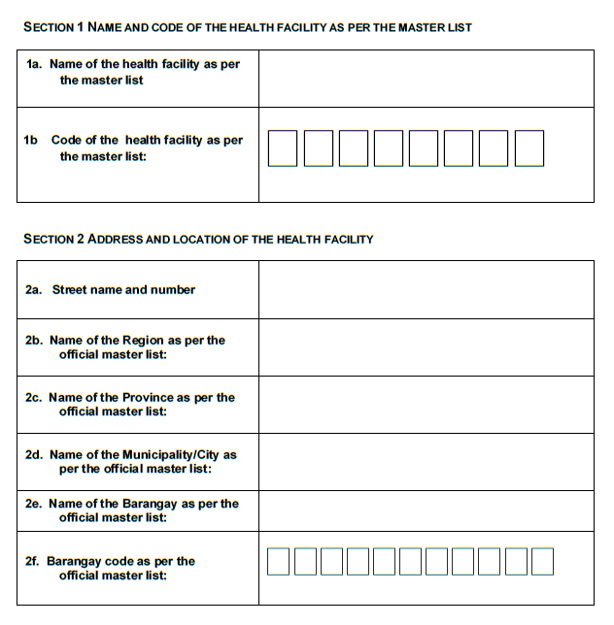
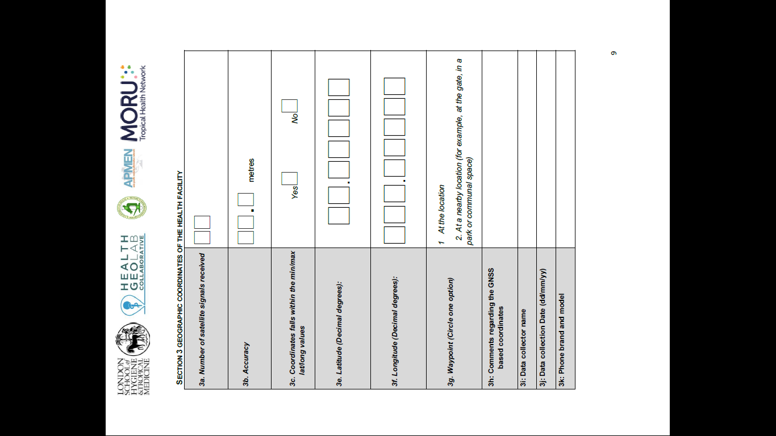
Data collection form when using GPS Essentials
Notes:
Data collection form when using GPS Essentials

Slide 12
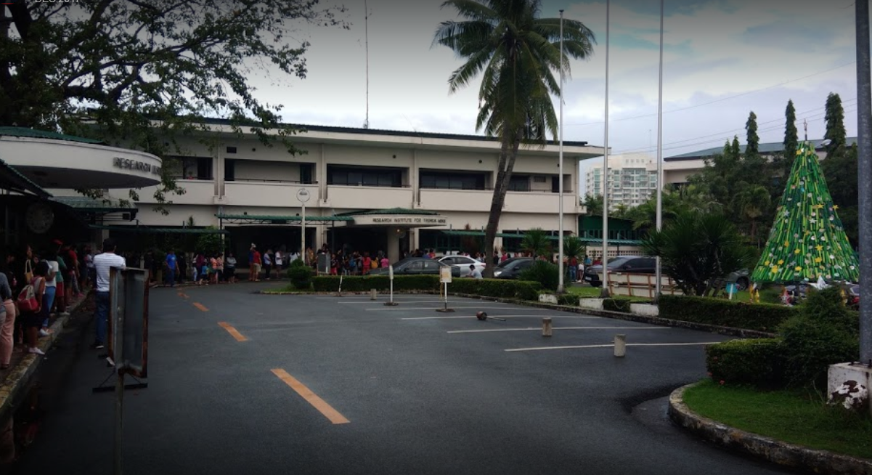
Pre-fill the form for tomorrow
Information from the health facility master list (fake):
Official DOH code: HF110192
Postal address: Filinvest, Alabang, Tolkien City 1781
Region: National Capital Region (NCR)
Province: Tolkien Province
Municipality/City: Tolkien City
Barangay: Centro
Barangay code: PH139916002
RITM Hospital
Let’s go collect some coordinates!

Slide 13
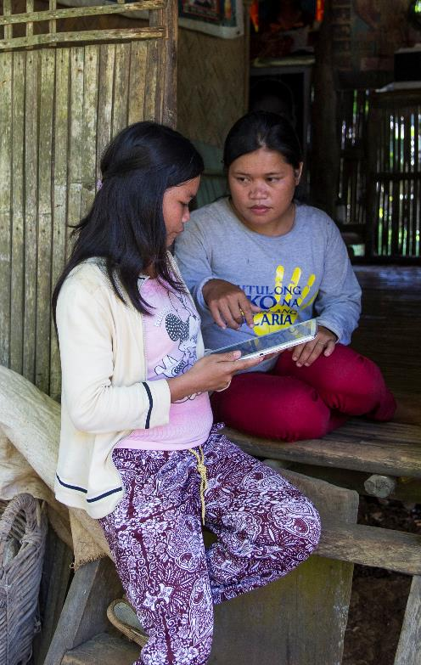
Other Data Collection Platforms
GPS data may need to be collected with other data types
  Questionnaire data
  Images
  Barcodes of samples
Many tablet-based programs allow you to collect GPS data with these other data types, e.g.
  DHIS2
  REDCap
  ArcGIS Collector/ Survey123
  ODK/ GeoODK

Slide 14
What is ODK?
  ODK is an open-source data platform allowing you to design forms, collect data and aggregate the results on an online database.
  https://opendatakit.org/

Slide 15
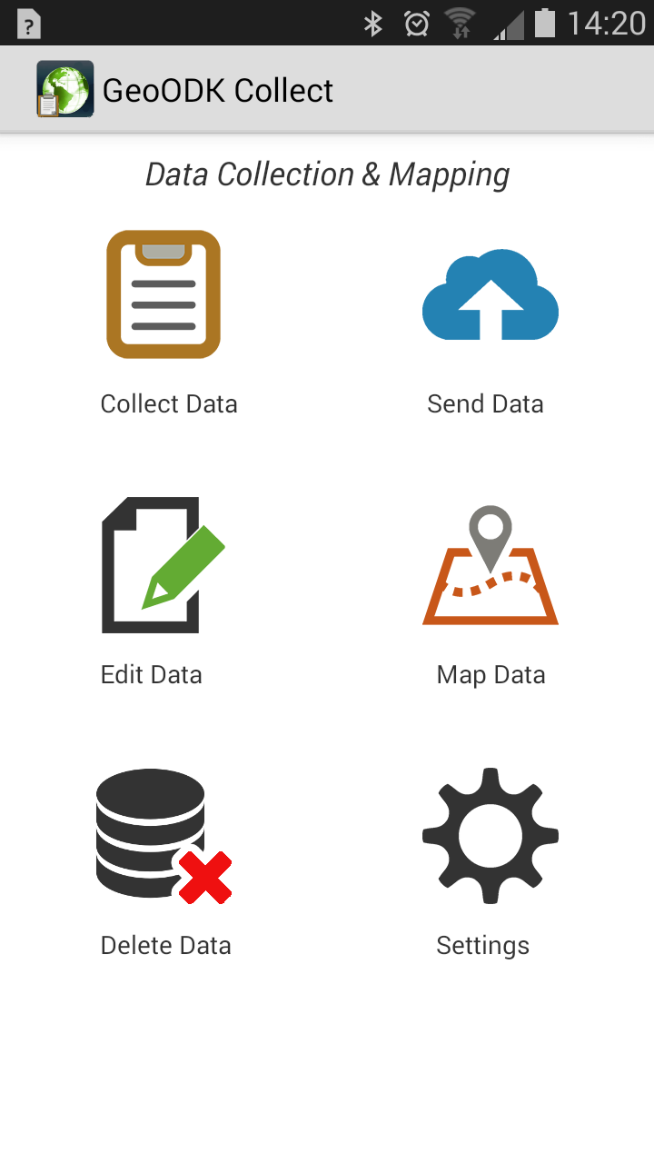
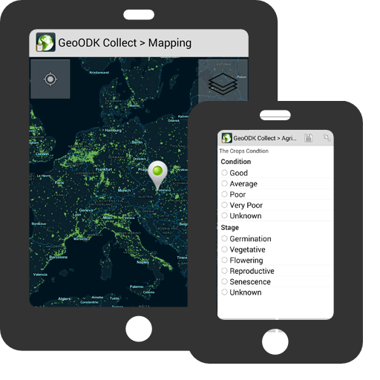
What is GeoODK?
  GeoODK extends the capabilities of ODK to collect spatial data
    Collect GPS point, line or polygon data
    Use offline maps or custom maps
    Display online maps of spatial data collected
Free at: http://geoodk.com/

Slide 16
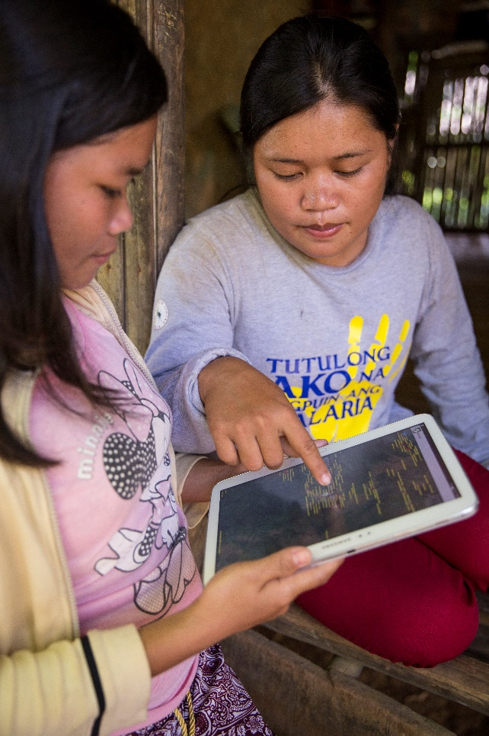
Using GeoODK for Malaria Studies
Offline maps including satellite data and landmarks can be used to geolocate health facility attendee households and visited locations

Slide 17
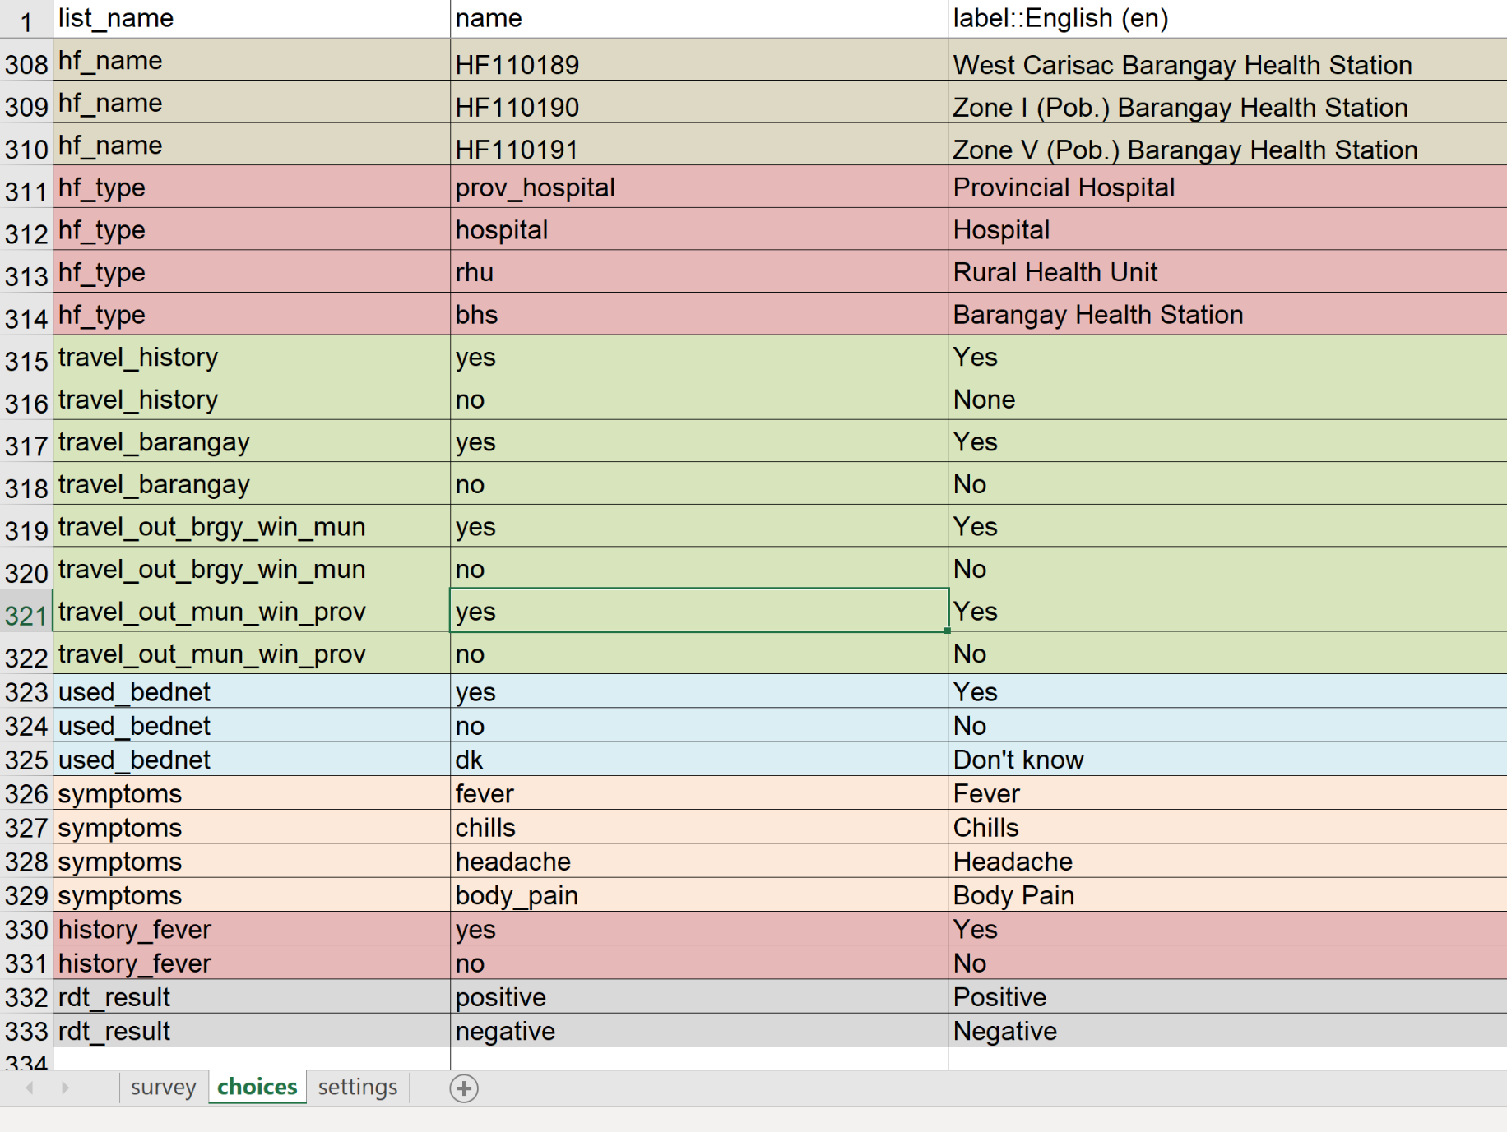
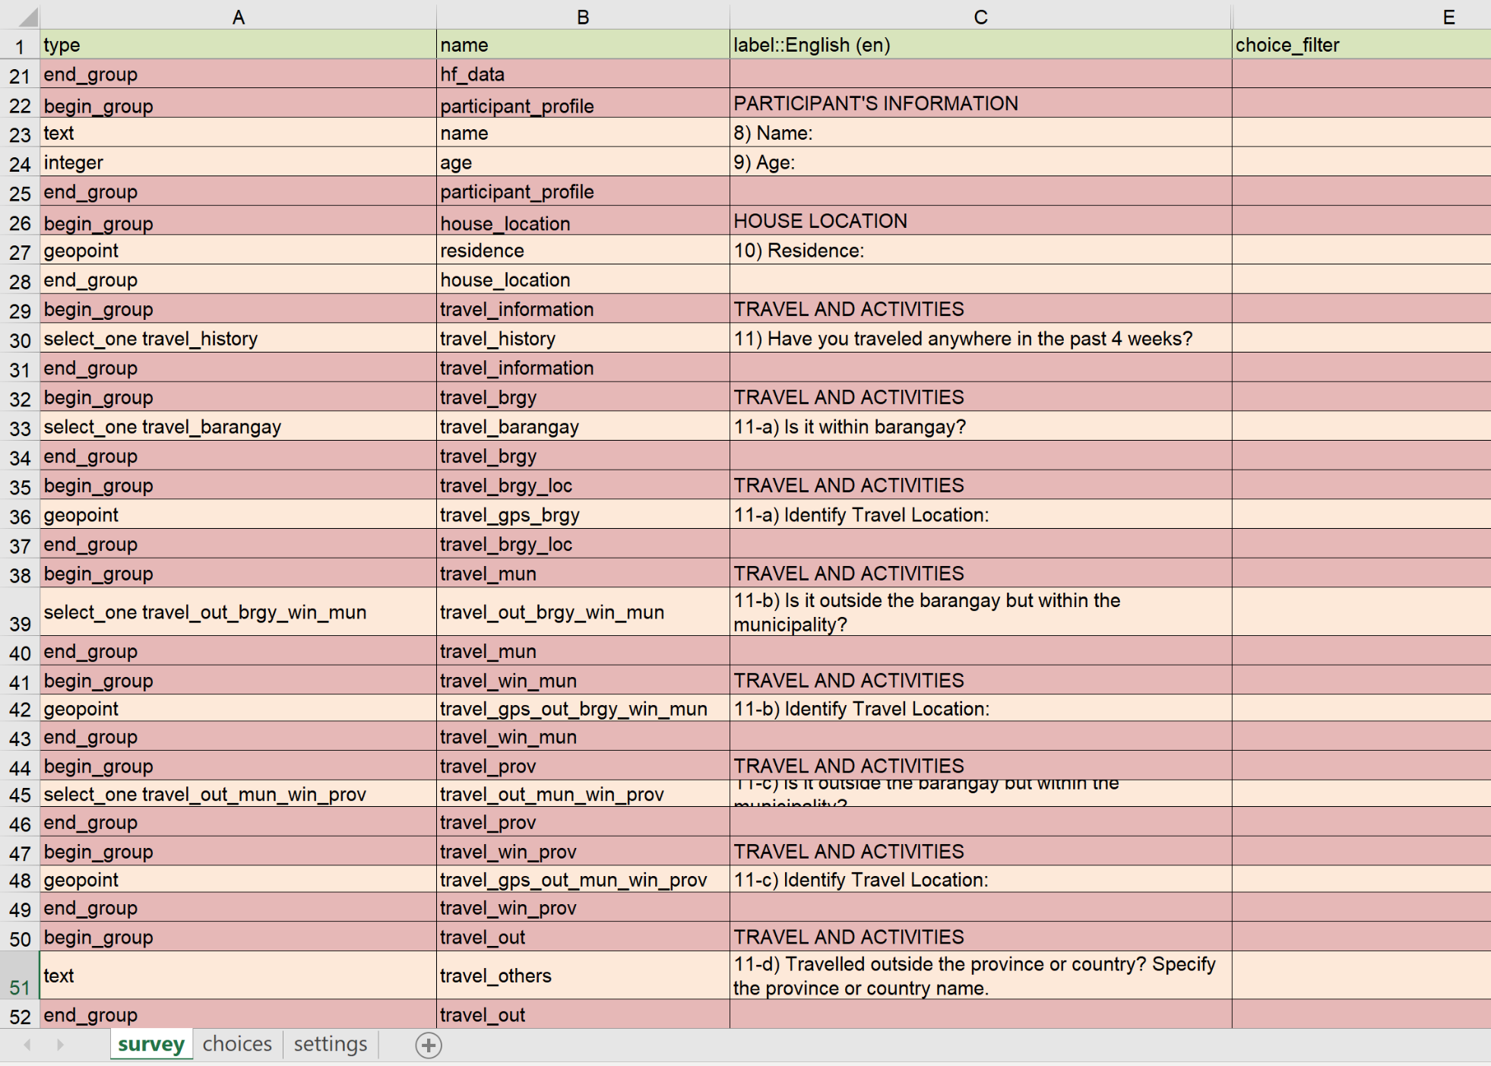
Step 1: Designing a form
Forms are designed in Excel and then converted to XLS format
  Examples included in the USB drive

Slide 18
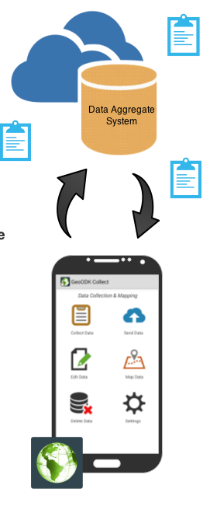
Step 2: Uploading to an online server
Download ODK Aggregate and connect to an online server
  This can be through your institution or create a free server through Google App Engine
This system will be used to send the forms and collect data responses
Full instructions included in the USB

Slide 19
Step 3: Downloading the questionnaire
Connect to the server using the GeoODK Collect application
  Add the website in the Server information in the General Settings in the app
Select get blank form in the main menu to download the forms from the server
The questionnaire will appear. Practice filling out the form.

Slide 20
Step 4: Upload completed forms
All completed questionnaire data will be stored in the tablet
Depending on internet access, you can choose to:
  Upload to the online server
  Copy offline to a computer
Data uploaded online can be viewed on the ODK interface

Slide 21

…and by the way…
… did you try installing QGIS 3.4 on your computer?

