Slide 1
Session 9: Installing QGIS 3.4

Slide 2
Installing QGIS
Go to the location where you have saved the
QGIS installer files
Double click on:
64-bit computer: QGIS-OSGeo4W-3.4.5-1-Setup-x86_64.exe
32-bit computer: QGIS-OSGeo4W-3.4.5-1-Setup-x86.exe
When asked if you want to allow the app to make changes to your device, click Yes.
This will launch the Setup Wizard.

Slide 3
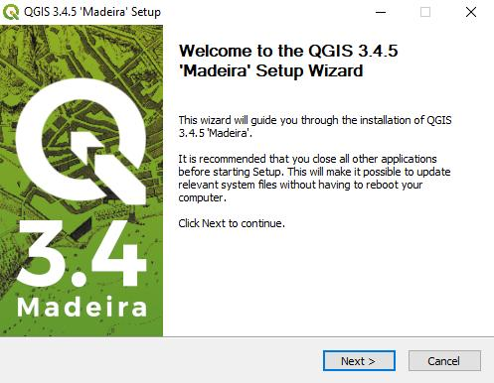
Installing QGIS
The Setup Wizard will guide you through the installation process
Click Next.

Slide 4
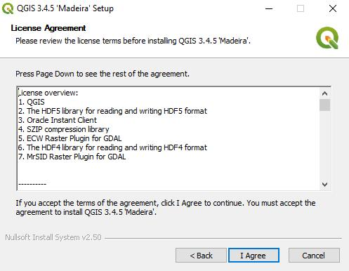
Installing QGIS
Read the license agreement and click I Agree.

Slide 5
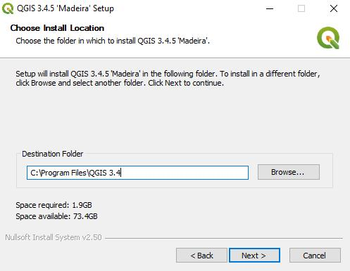
Installing QGIS
Choose the folder in which to install QGIS or accept the default folder (recommended).
Click Next.

Slide 6
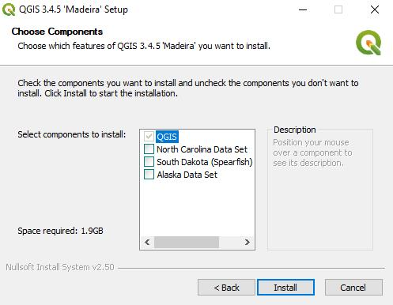
Installing QGIS
In this window, you can choose which other components to install. (QGIS is checked by default and greyed out.)
Click Install.

Slide 7
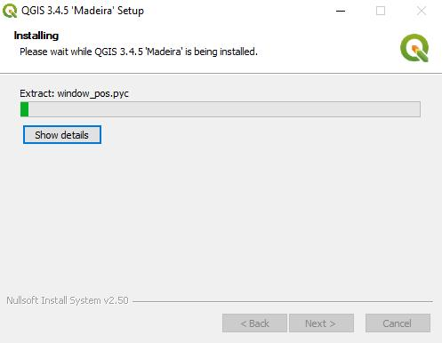
Installing QGIS
QGIS will start the installation.
This may take some time depending on your computer.

Slide 8
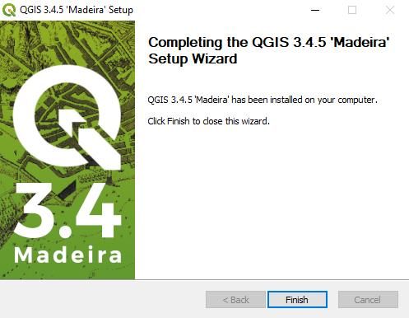
Installing QGIS
Once the installation is done, click Finish.

Slide 9
Using QGIS
To use QGIS, click on the Windows Start menu and look for the QGIS 3.4 folder.
Click QGIS Desktop 3.4.5

