Slide 1
RECAP Day 2

Slide 2
Summary of 2nd day
What did we do yesterday?
We learned how to properly collect information and geographic coordinates using GPS Essentials
We learned how to use GeoODK to conduct a geolocated survey in the field
We learned how to prepare data for use in GIS software
We practiced what we have learned in cleaning statistical data
??
Any questions?

Slide 3
Session 10: Introduction to QGIS

Slide 4
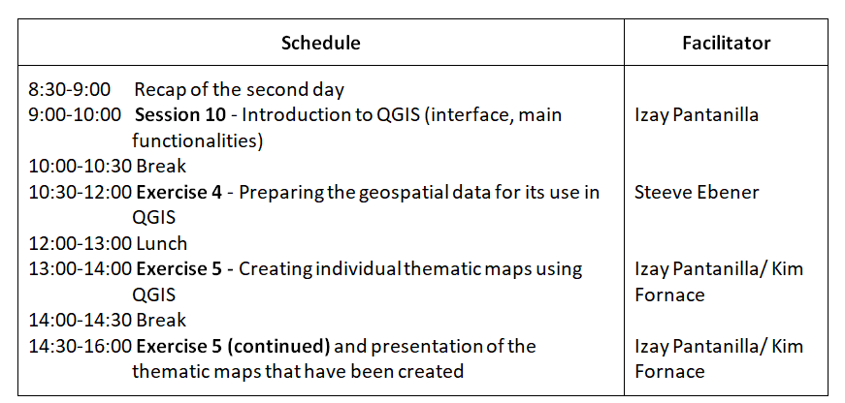
Agenda for Day 3
Introduce QGIS and learn how to prepare simple thematic maps with it

Slide 5
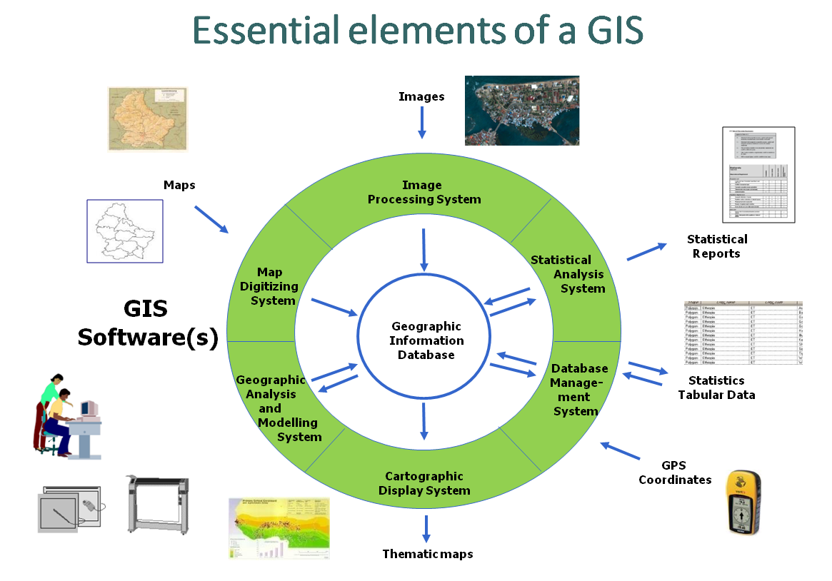
GIS - Definition
“An integrated collection of computer software and data used to view and manage information about geographic places, analyze spatial relationships, and model spatial processes.”
It is not only about software!
Data
Software
Hardware
People
Methods
5
Notes:
GIS - Definition

Slide 6
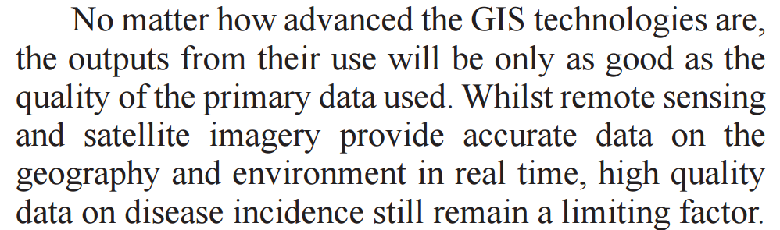

Data - The content at the center!
Essential elements of GIS
Garbage in –
Garbage out !
Need for good data management practices
6
Mendis K. (2009) Spatial technology & malaria control. Indian J Med Res 130, November 2009, pp 498-500
Notes:
Essential elements of GIS

Slide 7
What can you do with GIS in public health?
Complexity
Data Quality
Nbr of users
Spatial Modeling
Spatial Analysis
Thematic Mapping
+
Creation/Management of Geospatial data
7
Notes:
What can you do with GIS in public health?

Slide 8
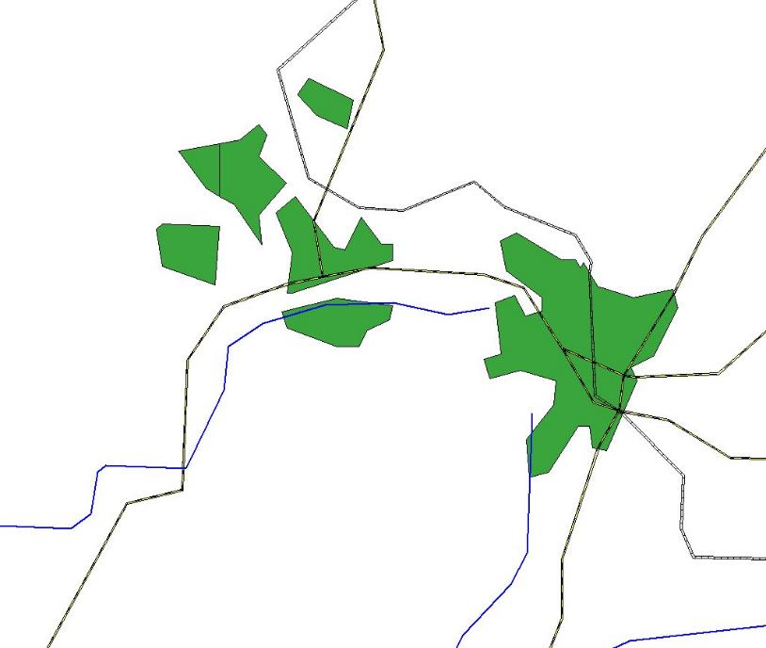

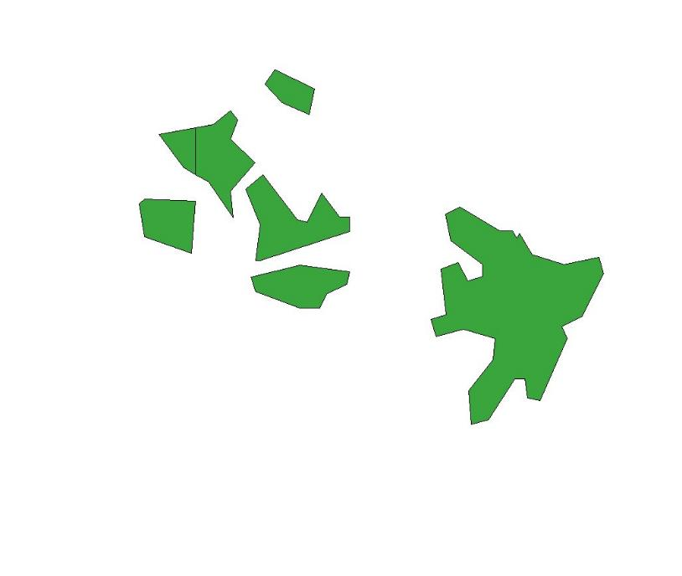

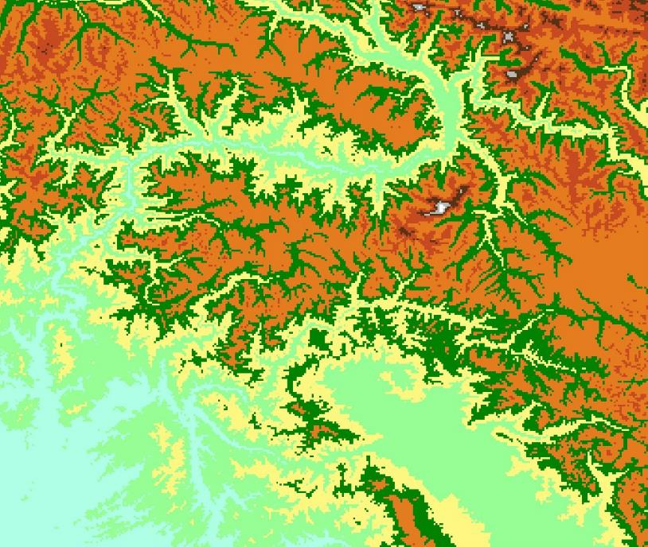

What can you do with GIS in public health?
Spatial Modeling
Spatial Analysis
1 hour
Thematic Mapping
Context/relationship
Distance
Travel time
8
Notes:
What can you do with GIS in public health?

Slide 9
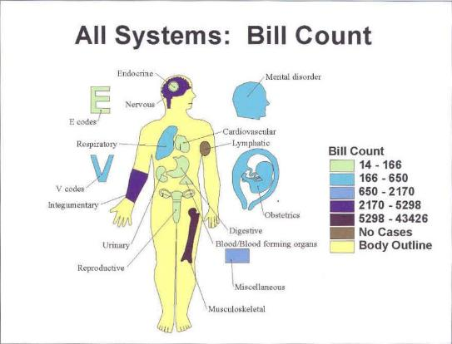
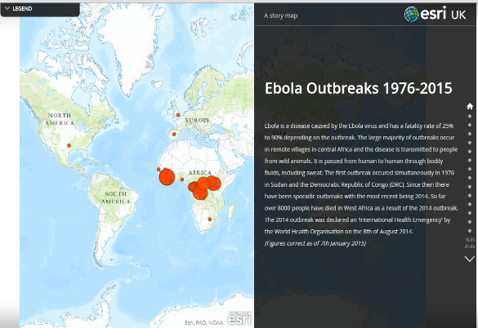
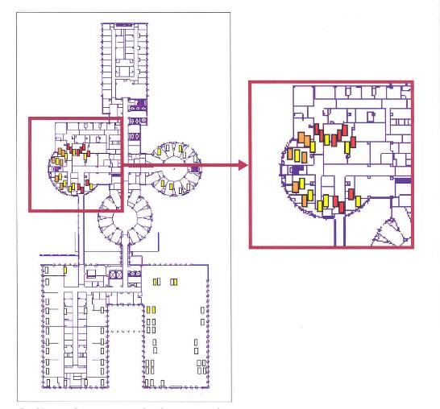
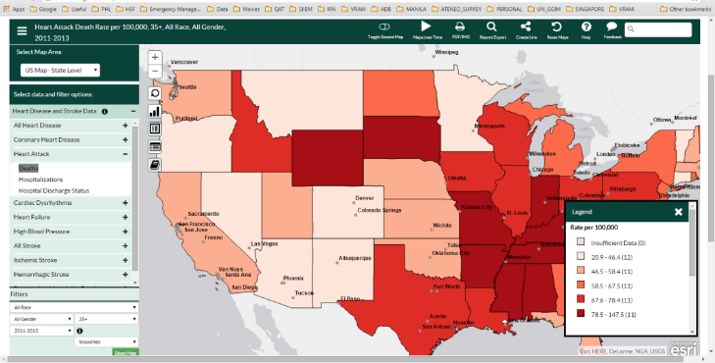
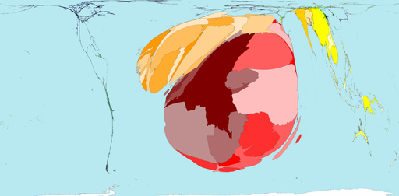
Example of application in Public Health
Thematic mapping
Story
Map
Web mapping
Hospital management
Cartogram
9
Notes:
Example of application in Public Health

Slide 10
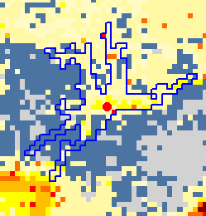
Example of application in Public Health
Spatial analysis
Location (e.g. altitude)
Distance
Travelling Time
10
Notes:
Example of application in Public Health

Slide 11
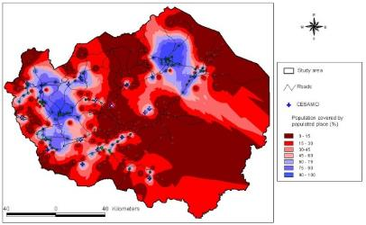
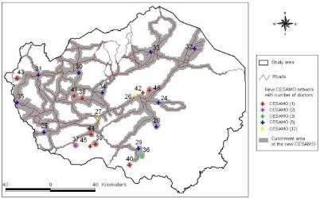
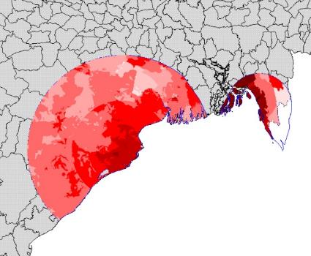
Example of application in Public Health
Spatial modeling
Physical Accessibility
Distribution of health inequalities
Poverty Mapping
Vulnerability Mapping
Link between Natural disaster (floods and hurricanes) and epidemics
11
Notes:
Example of application in Public Health

Slide 12

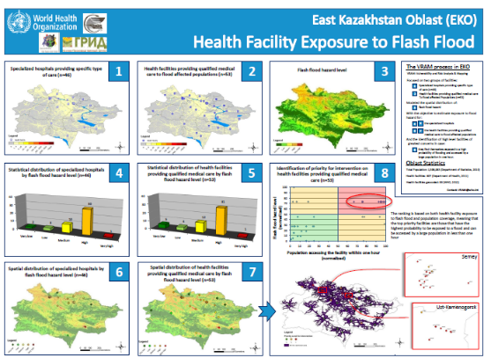

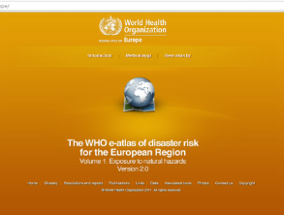
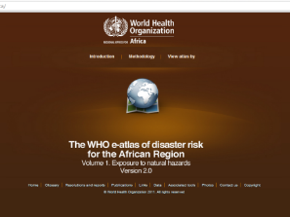
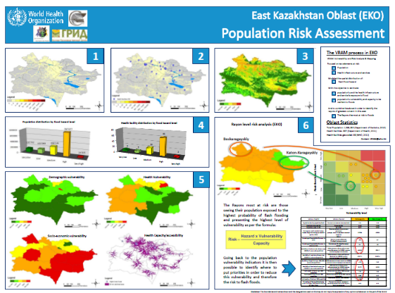
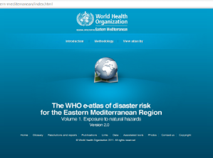
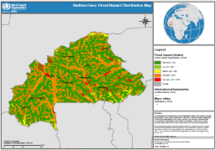
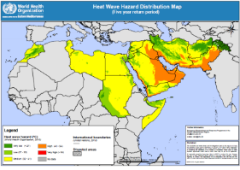
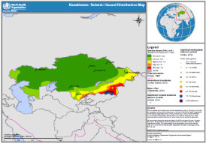
Example of application in Public Health
Spatial modeling
Hazard modeling and geographicaly based risk assesment
VRAM
WHO eAtlas for Europe: http://data.euro.who.int/e-atlas/europe/
VRAM KAZ: http://www.gaia-geosystems.org/PROJECTS/VRAM/KAZ/vram_kaz_home.htm
12
Notes:
Example of application in Public Health

Slide 13






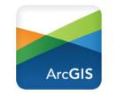
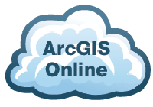

Not everything is a GIS
Database managers with a thematic mapping interface
Statistical packages allowing to conduct geostatistical analysis
Navigation and thematic mapping applications
These are real GIS software
ArcGIS www.arcgis.com
  Most comprehensive and versatile
  Complete GIS ecosystem: maps, analyses, web apps, servers, mobile, coding in Python, integration with R…
  Proprietary and comes with a price but grant and highly discounted for the MOHs
QGIS www.qgis.org
  Good for thematic maps, limited for analyses
  Open Source
  Free
Notes:
Not everything is a GIS

Slide 14
What is QGIS?
QGIS (formerly known as Quantum GIS) is a free and open-source cross platform desktop geographic information system (GIS) application that supports viewing, editing, and analysis of geospatial data.
Version 3.4
Why are we using QGIS version 3.4?
Version 3.4 is the most stable version of QGIS at the moment which means that it has fewer bugs and less likely to crash.
Notes:
What is QGIS?

Slide 15
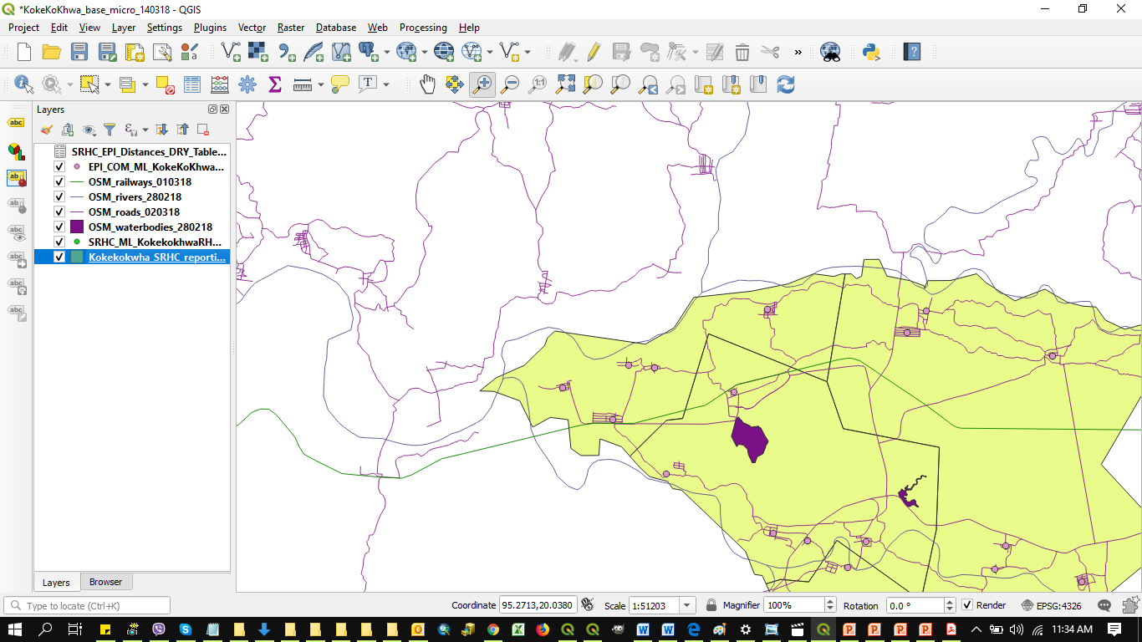
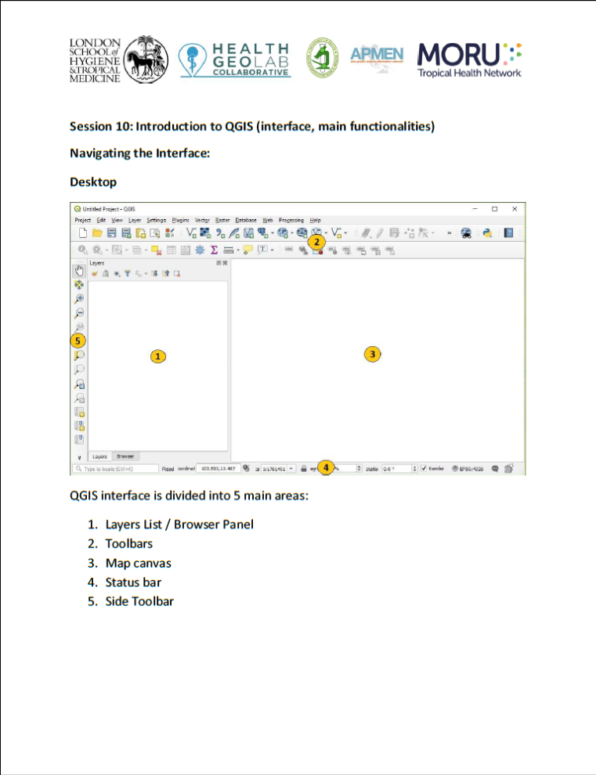

QGIS (Interface, main functionalities)
Let’s have a look together!

