Slide 1
Session 11: How to geo-enable your Malaria Information System?

Slide 2
Geography central to malaria surveillance and elimination
The geographic mapping of identified positive cases down to their place of residence and work is critical to effectively support case and foci investigation as well as monitor interventions
Knowing where Malaria services are located help planning interventions and filling potential gaps
Integrating geography and time across the Health information System (HIS) allows linking vertical disease programs together and supports a more systemic approach to solving public health issues

Slide 3
Geography central to malaria surveillance and elimination
Geo-related terms (105 pages):
Mapping/map: 43 times
Global Positioning System (GPS): 12
Geographic Information System (GIS): 9
Mapping of foci has been added compare to the 2012 version
Maps used across surveillance, monitoring and evaluation
Annex 5 on geographical reconnaissance during focus investigation
Certification of elimination requires supporting maps
“Clear illustrative mapping, electronically or on paper, should be a routine”
Important to strengthen in country technical capacity when it comes to the management and use of geospatial data, technologies and services

Slide 4
Geo-enabled HIS – The definition
An Information System that fully benefits from the power of geography, geospatial data and technologies through the proper integration of geography and time across its business processes
Geography: The study of the natural features of the Earth, such as mountains and rivers – The Science
Geospatial data: Also referred to as spatial data, information about the locations and shapes of geographic features and the relationships between them, usually stored as coordinates and topology – The Content
Geospatial technologies: Refers to equipment used in visualization, measurement, and analysis of earth's features, typically involving such systems as Global Navigation Satellite System (GNSS), Geographical Information Systems (GIS), and remote sensing (RS) – The Tools

Slide 5
Geo-enabled HIS – The reason
Can you think about one piece of data or information within an HIS that has neither a spatial nor a time dimension ?
"everything happens somewhere
at a given time"
Key across all the public health functions (assessment, service delivery, policy formulation,…
At the origin of modern epidemiology

Slide 6
Geo-enabled HIS – The benefits
Extracted from: https://www.adb.org/publications/building-capacity-geo-enabling-health-information-systems

Slide 7
Geo-enabled HIS – The benefits
Extracted from: https://www.adb.org/publications/building-capacity-geo-enabling-health-information-systems

Slide 8
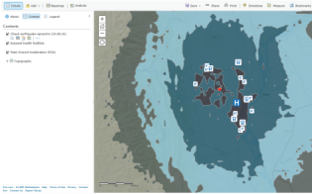
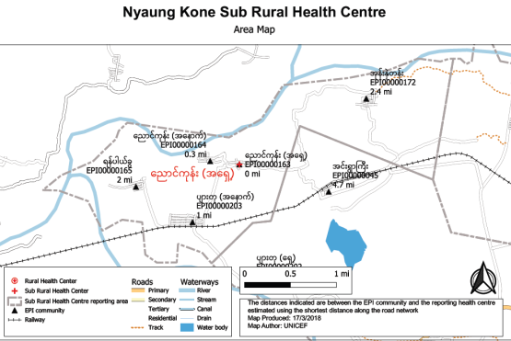
Geo-enabled HIS – The main users in Public Health
Health services planning by improving physical accessibility
Communicable disease surveillance, monitoring and elimination
Emergency management (risk identification, rapid impact assessment, response and recovery)
Improving immunization coverage (microplanning, monitoring and evaluation)
All share the same geography!

Slide 9
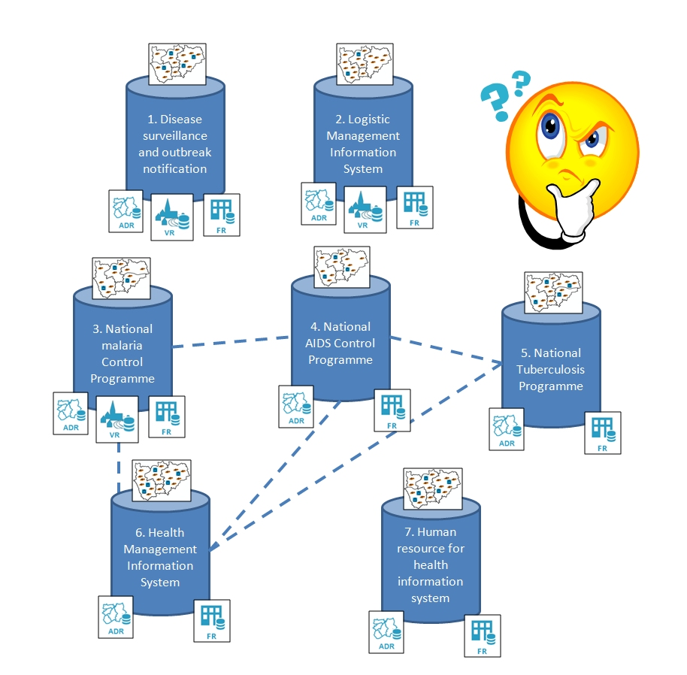
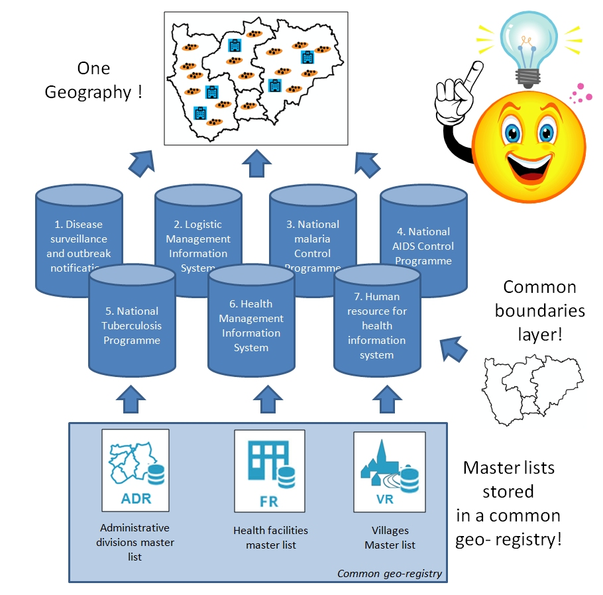
Geo-enabled HIS – The vision
Passing from this…
…to this
Each information system is using a different geography and not being able benefiting from the power of geospatial data and technologies
All the information systems use the same geography which does not only reduce duplication of efforts but also allow using geography as a common neutral integrating platform across programs

Slide 10
Geo-enabled HIS – The framework
Documented
use cases
Stage 4. Operations
Master lists and common
geo-registry
Stage 3. Core data
Stage2. Standardization
And technical capacity
Specifications, standards and protocols
Technical capacity
Appropriate geospatial technologies
Stage 1. Institutional framework
Vision, strategy and plan
Governance structure
Policies
Resources for sustainability
9 core common assets for an HIS to be considered as geo-enabled
Examples for each in the HGLC knowledge repository

Slide 11
Geo-enabled HIS – The toolkit
Designed as the instrument to help countries assess their level of HIS geo-enablement and fill the identified gaps.
https://www.healthgeolab.net/DOCUMENTS/HIS_geo-enabling_toolkit.pdf

Slide 12
Geo-enabled HIS – The toolkit
Adaptation of the toolkit for immunization
Provide a non-technical introduction to the role of geospatial data and technologies in immunization programs; and
Propose a process-based framework to guide decision-makers and planners in strengthening the management and use of geospatial data and geospatial technologies in immunization program in countries.
12
https://www.unicef.org/health/files/Gavi_UNICEF_HGLC_GIS_Immunization_guidance_Oct2018.pdf

Slide 13
Geo-enabled HIS – The implementation
So far….
Documented
use cases
Master lists and common
geo-registry
…implementing a pilot project to strengthen this and demonstrate the benefits of the geo-enablement….
Specifications, standards and protocols
Technical capacity
Appropriate geospatial technologies
…and support the establishment of this
Vision, strategy and plan
Governance structure
Policies
Resources for sustainability

Slide 14
Geo-enabled HIS – Example of implementation
Myanmar (http://arcg.is/neSvX)
Cambodia (https://arcg.is/C4fjD)
Vietnam (https://bit.ly/2HfVvjH)

Slide 15
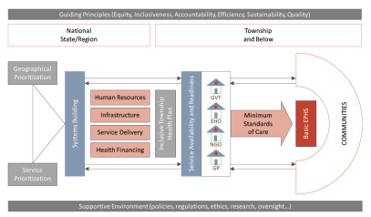
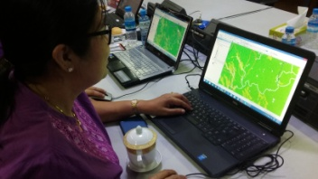
Implementation in Myanmar
National health Plan 2017-2021
HIS Geo-enabling
National roll out
Vision and needs
Regional level
pilot project
Data model and data specifications
Capacity building
Guidelines and master lists
Township level
pilot project
http://arcg.is/2lzRrL4
Needs &
Gaps
Training &
Equipment
Workplan & methods
Pilot
project
Geo-enabling of the Immunization program

Slide 16
“Resilient health systems are aware. Resilient health systems have an up-to-date map of human, physical, and information assets that highlight areas of strength and vulnerability”
(Margaret E Kruk et al, 2015)
https://www.thelancet.com/action/showPdf?pii=S0140-6736%2815%2960755-3
16
Notes:
Robust, responsive and resilient health systems are “aware”. One essential component of health system “awareness” is having and using up-to-date information on the location and functionality of health system assets, including community health workers. This information is critical to health services planning, human resource management, supply chain management, emergency preparedness and response, monitoring, and evaluation – indeed spatial information and data on the functionality of health assets are critical to all aspects of health systems strengthening.

