Slide 1
Way Forward
Introduction to geospatial data management and technologies for Malaria Programs training workshop
Manila, Philippines
28 March 2019

Slide 2
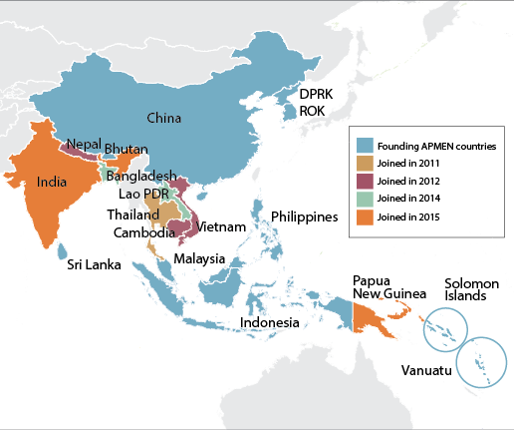
APMEN highlights
Collaborative platform for malaria elimination through exchange of information, experience, and tools
Programmatic capacity and evidence-based practice
  1-3-7 surveillance strategy
  G6PD deficiency and implications for radical treatment of P. vivax malaria
  Outdoor malaria transmission
Brought global attention to the achievements and diverse challenges faced by Asia Pacific countries
Afghanistan
Pakistan
18 country partners and 47 partner institutions to date

Slide 3
Objectives
Guiding principles
Strategies
Country Ownership
South-South collaboration and peer-to-peer support
Foundation for regional health security against vector-borne diseases
Collaborative networking
Information and knowledge management
Capacity building
Targeted research to test new tools and solutions in key areas
Integrated activities with the Asia Pacific Leaders’ Malaria Alliance (APLMA)
Contribute to improved evidence, facilitate and support work and action in areas that impact on malaria elimination in the Asia Pacific region
Target human resource capacity development

Slide 5
Country GeoHIS framework Components | Malaysia | Papua New Guinea | Philippines | Solomon Islands | Vanuatu | Vietnam
Vision and strategic plans |  |  |  | No mapping agenda | ?? | Circular 54
Governance structure (IRRs, MOP) |  | ?? |  |  |  | ??
Technical capacity | Skills for new systems Trouble shooting System integration | Inadequate technical training on GIS | Skills | No team for communicable diseases | Scale-up from Efate and Torba | Proficiency with use of geospatial data Skills in new software
Specifications, standards and protocols (data quality) | Data quality |  |  | Data quality
Accessible and common geo-registry |  | ?? | ?? | ?? | ??
Geospatial technologies |  | Inadequate GPS devices ?? |  | ?? | ??
Use cases |  |  | Project-based |  |  | Pilot project
Policies | ?? | ?? | ?? | No policy | ?? | ??
Resources for sustainability | Data transfer | Poor internet connection | Infrastructure Cost of surveys |  | Costs | ??

Slide 6

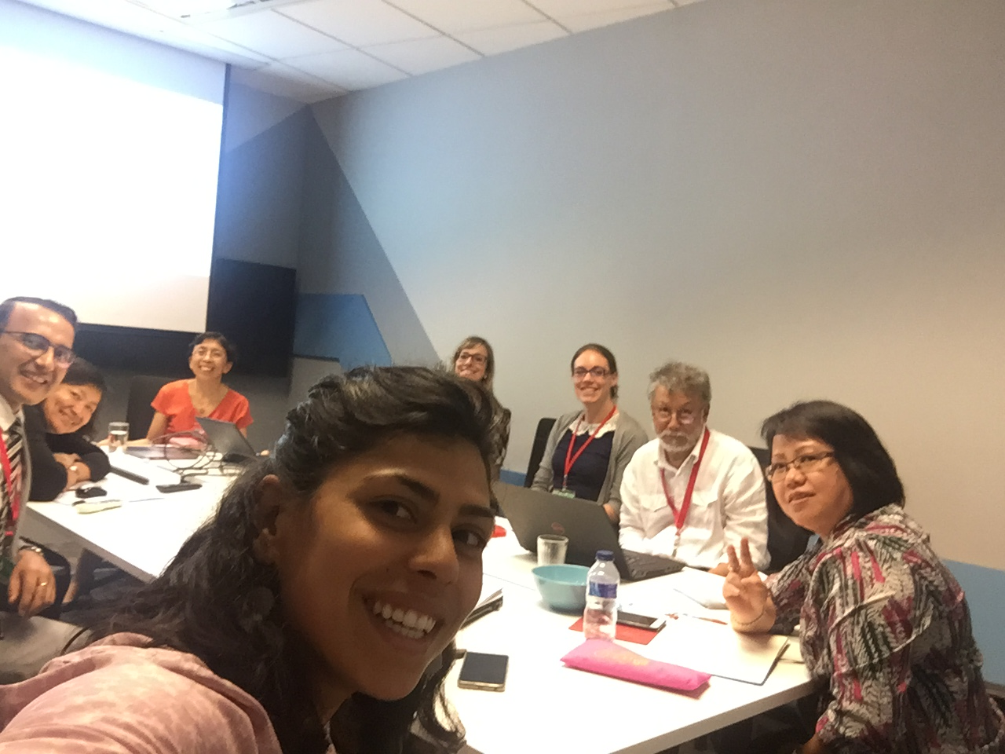
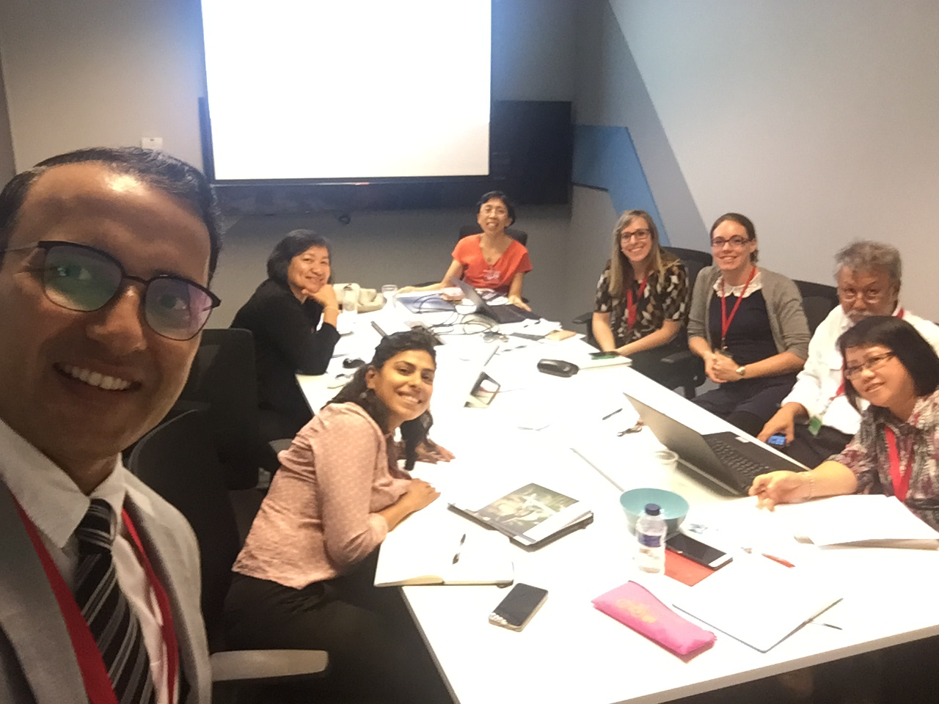

APMEN
APLMA
Translate strong political
commitment into action
Integrate and complement
regional elimination efforts

Slide 7
Way Forward
Country assessment of specific training needs to enhance technical capacity in managing geospatial data
  Collection, processing, analysis, and reporting
Development and sharing of use cases that demonstrate the utility of public health maps for decision-making

Slide 8
’No country left behind.’
www.apmen.org

