Slide 1
Session 14: Other important points and additional resources

Slide 2
Definition for some terms we used these past days
Map: A drawing of the Earth's surface, or part of that surface, showing the shape and position of different countries, political borders, natural features such as rivers and mountains, and artificial features such as roads and buildings
Geospatial/Spatial data: information about the locations and shapes of geographic features and the relationships between them, usually stored as coordinates and topology
Geographic data: Information describing the location and attributes of things, including their shapes and representation. Geographic data is the composite of spatial data and attribute data.
Geographic Information: Spatial and/or geographic data organized and presented to create some value and to answer questions
Geographic Information System (GIS): An integrated collection of computer software and data used to view and manage information about geographic places, analyze spatial relationships, and model spatial processes

Slide 3
Documenting the process
The geospatial data management cycle comprises several steps and implementing these steps takes a long time and may involve different individuals.
Documenting each step from the beginning as precisely as possible ensures that the process can be replicated
3
Notes:
Documenting the process

Slide 4
Documenting the process
Some steps may require simple documentation such as just describing the choices made and why
Other steps may require a more lengthy description of the processes and other elements involved:
Compiling existing data
Collecting or extracting data
Cleaning and validating data
Using the data
4
Notes:
How are the steps documented?
Some steps in the geospatial data management cycle may require simple documentation such as just describing the choices made (and why) such as the step in defining the vocabulary and defining the data set specification and ground reference.
However, other steps require a more lengthy description of the processes and other elements involved. For example, when documenting the collection of data, this will include the method and technology of data collection, the preparation made to implement the process, the data collection team, etc.

Slide 5
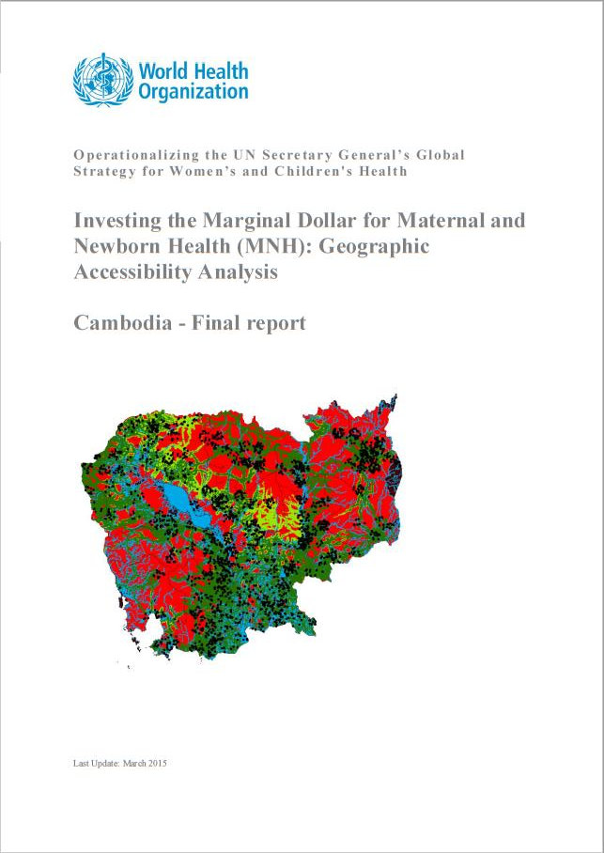
Documenting the process
The document on the geographic accessibility analysis done by the World Health Organization (WHO) to support maternal and newborn health in Cambodia is an example (below).
All the elements and processes involved (indicators, targets, assumptions, tools, analyses, data, and norms) are fully documented in the report.
A good document such as this will allow someone else to obtain the same results
5
http://www.healthgeolab.net/KNOW_REP/WHO-HIS-HGF-GIS-2016.2-eng.pdf
Notes:
Example of a report documenting the process.
All the elements and processes involved (indicators, targets, assumptions, tools, analyses, data, and norms) are fully documented in the report.

Slide 6
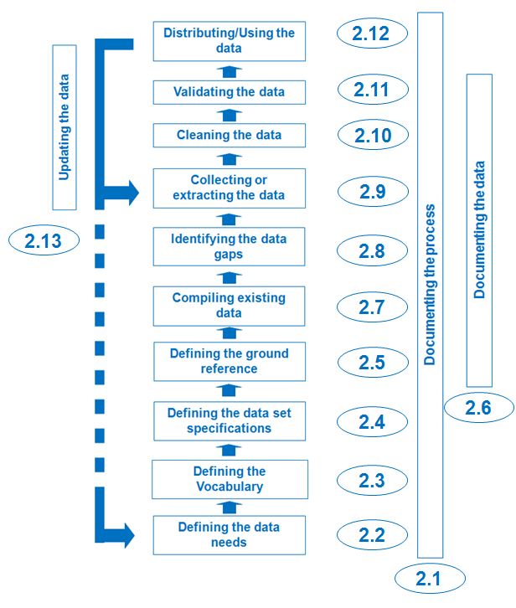
Documenting the data
Documentation is an integral step in the geospatial data management cycle. This applies not only to the processes involved but also to the individual data compiled and created.
All data – geospatial and statistical – must be properly documented.
6
http://www.healthgeolab.net/DOCUMENTS/Guide_HGLC_Part2_5.1.pdf
Notes:
Documenting the data
Apart from documenting the whole data management process, it is integral to properly document the data.

Slide 7
Documenting the data
The minimum metadata should cover:
What is the data about?
Who created the data?
When was the data created/collected/last updated?
How was the data created?
What are the data specifications (geographic coordinate system/projection system, scale, accuracy, language, etc.)?
Are there any use or redistribution restrictions attached to the data?
Who can I contact if I have questions about the data?
Guide_HGLC_Part2_5.1.pdf
The topic of metadata is explained further in HGLC guidance document Part 2.5.1: Documenting the data using a metadata profile
7
Notes:
Documenting the data
The minimum metadata should cover:
What is the data about?
Who created the data?
When was the data created/collected/last updated?
How was the data created?
What are the data specifications (geographic coordinate system/projection system, scale, accuracy, language, etc.)?
Are there any use or redistribution restrictions attached to the data?
Who can I contact if I have questions about the data?

Slide 8
Documenting the data
The information is captured in a metadata record which is based on a metadata profile (modification of an existing metadata standard to adapt to data issues, cultural issues, or both)¹.
A metadata standard is a requirement which is intended to establish a common understanding of the meaning or semantics of the data, and ensure correct and proper use and interpretation of the data by its owners and users.²
A metadata record should accompany any geospatial or statistical dataset being shared to ensure it is used appropriately.
¹ http://wiki.gis.com/wiki/index.php/GIS_Glossary/M (Metadata profile)
² https://en.wikipedia.org/wiki/Metadata_standard
8
Notes:
Documenting the data
It is crucial to decide on the metadata standard as well as develop the metadata profile that will be used as part of defining the data specifications. This is important in order to collect the necessary information to fill the profile during the implementation of the next steps in the geospatial data management cycle.
The process of filling the metadata information is a continuous process and should commence at the start of the data extraction or collection process. All information should be recorded as soon as they are known. Waiting until a later stage may result to information being lost and not being recorded in the metadata profile.

Slide 9
Documenting the data
Similar with documenting the process, for the creation of the metadata record, it is recommended to capture the necessary information included in the metadata profile from the beginning of the data production/collection process and to address issues pertaining to use and redistribution rights long before its dissemination.
9
Notes:
Documenting the data
It is crucial to decide on the metadata standard as well as develop the metadata profile that will be used as part of defining the data specifications. This is important in order to collect the necessary information to fill the profile during the implementation of the next steps in the geospatial data management cycle.
The process of filling the metadata information is a continuous process and should commence at the start of the data extraction or collection process. All information should be recorded as soon as they are known. Waiting until a later stage may result to information being lost and not being recorded in the metadata profile.

Slide 10
Metadata standard for geospatial data
There are different metadata standard for geospatial data but the four main groups are:
International Organization for Standardization (ISO)
Federal Geographic Data Committee (FGDC)
Dublin Core Metadata Initiative (DCMI)
Infrastructure for Spatial Information in Europe (INSPIRE)
The first two are the most widely used but with ISO created through international consensus, it supports better data sharing across national and cultural boundaries.
10
Notes:
Documenting the data
Metadata standards

Slide 11
Metadata standard for statistical data
There are also different metadata standards for statistical data, among these is the Statistical Data and Metadata Exchange (SDMX) initiative. These standards tend to nevertheless be difficult to digest by non-IT professionals and focus more on how the data and metadata are being exchanged.
An easy and effective way to document statistical data is to add ‘data catalog’ and ‘metadata’ tabs/worksheets in an Excel spreadsheet.
11
Notes:
Documenting the data
Metadata standard for statistical data

Slide 12
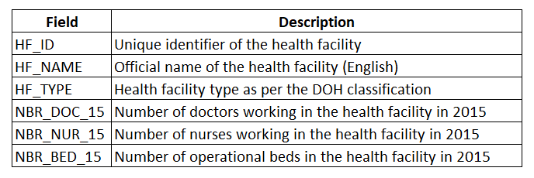
Documenting the data
A data catalog describes the content of each of the fields contained in the statistical dataset.
12
Notes:
Documenting the data
Metadata for statistical data – Use of Microsoft Excel
As mentioned in previous sessions, it is advisable to keep field headers/names short as GIS software typically do not allow long headers/field names. However, it sometimes becomes hard to understand this shortened names. By having a data catalog tab, it will allow you to describe what each shortened name means and consequently what data each column contains.

Slide 13
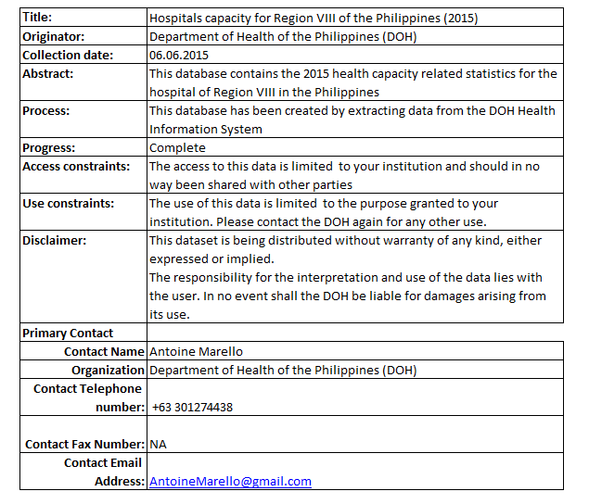
Documenting the data
A metadata record provides the essential information allowing the user to answer the questions a minimum metadata should cover.
13
Notes:
Documenting the data
Metadata for statistical data – Use of Microsoft Excel
Similar to having the data catalog tab, the metadata tab allows you to provides the essential information about your statistical data within the same Excel file.

Slide 14
Documenting the data
The metadata record should contain the following fields:
Title: the name by which the statistical dataset is known
Originator: complete name of the institution which generated the statistical dataset
Creation date: date on which the data was collected
Abstract: short description of the content of the statistical dataset
Process: general description of the steps that were followed to create the statistical dataset
Progress: development status of the statistical dataset
Access constraints: access constraints attached to the statistical dataset
Use constraints: use constraints attached to the statistical dataset
Disclaimer: liability statement for the statistical dataset
Primary contact: full name, organization, position and role, phone number, and email address of the person to contact regarding the statistical dataset
14
Notes:
Documenting the data
Metadata for statistical data – Use of Microsoft Excel

Slide 15
Documenting the data
Microsoft Excel is the recommended format for statistical data because:
It is widely used in countries
It allows the storage of data and information in multiple spreadsheets/”Sheets” in the same file which is not the case with other file formats such as .csv files.
This allows the dataset, the data catalog, and the metadata record to be saved together in a single file therefore ensuring that none of this information is lost when shared.
15
Notes:
Documenting the data
Metadata for statistical data – Use of Microsoft Excel

Slide 16
Updating the data
Another important step in the geospatial data management cycle is updating the data.
16
Notes:
Updating the data
The next step in the geospatial data management cycle is updating the data.
This step has been mostly overlooked particularly once the data has been used and/or distributed. This is can be due lack of data management skill of the people responsible for the data or the lack of resources to update the data.

Slide 17
Updating the data
We live in a constantly changing world
Geospatial data is like a picture
By the time you “develop” the picture the view has already changed
Needs to be regularly updated in order to be representative of the evolution of the situation and take informed decision
Updating mechanisms will need to be put in place for both the master list and the attributes
17
Notes:
Updating the data
It is integral to regularly update the data being used to produce data/information products. Otherwise, these data/information products won’t be useful in making timely informed decisions.

Slide 18
Updating the data
The common geo-registry is a technological solution that can simultaneously host, maintain, update, and openly share master lists of geographic objects core to public health and relationships, together with their associated data, including geography stored in a GIS readable format.
Pending the realization of a fully working common geo-registry, other mechanism can be used such as Google Sheets.
18
Notes:
Updating the data
The concept of common geo-registry is already being incorporated into a number of different software/tools but pending the realization of a fully working common geo-registry, other mechanism can be used such as Google Sheets.

Slide 19
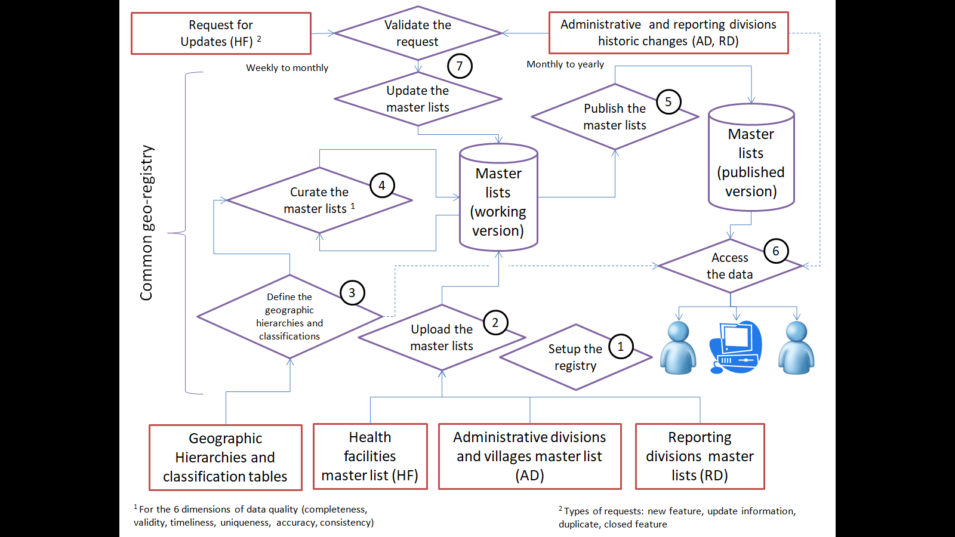
Updating the data
19
Notes:
Updating the data
Diagram presenting the generic data flow for the common geo-registry

Slide 20
Updating the data
For statistical data:
Data that are collected regularly like routine health data are easier to update
Data that are collected through field survey or census takes longer time and uses more resources are usually updated only every few years (5 to 10 years)
20
Notes:
Updating the data
Statistical data:
Data that are collected regularly like routine health data are easier to update
Data that are collected through field survey or census takes longer time and uses more resources are usually updated only every few years (5 to 10 years)

Slide 21
Additional resources

Slide 22
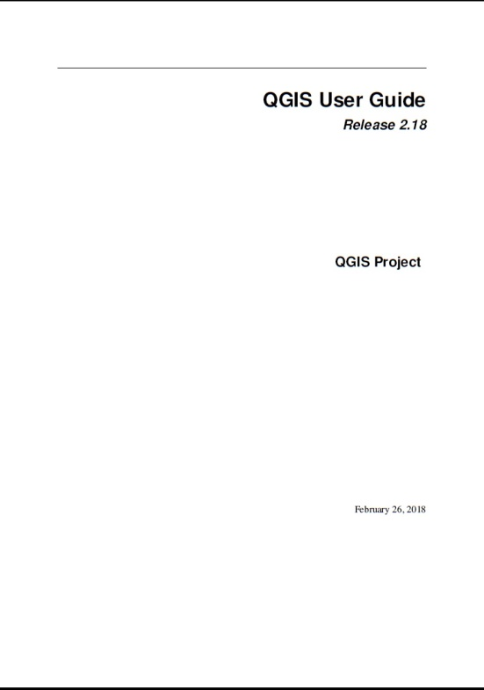
QGIS website
The QGIS website provides learning resources for their users.
A Gentle Introduction to GIS
2.18 https://docs.qgis.org/2.18/en/docs/gentle_gis_introduction/
3.x (Testing)
https://docs.qgis.org/testing/en/docs/gentle_gis_introduction/index.html#
QGIS User Guide
PDF and online:
https://docs.qgis.org/2.18/en/docs/user_manual/index.html
https://docs.qgis.org/testing/en/docs/user_manual/index.html
QGIS Training Manual
PDF and online: https://docs.qgis.org/2.18/en/docs/training_manual/index.html
https://docs.qgis.org/testing/en/docs/training_manual/index.html

Slide 23
Other QGIS Reference Materials
If using an older version of QGIS (older than 3.x):
An Introduction to QGIS from North River Geographic Systems

Slide 24
Other QGIS Reference Materials
Aside from their own materials, QGIS also lists other FREE training material:
https://www.qgis.org/en/site/forusers/trainingmaterial/index.html
NOTE: If you have free QGIS training material/s, you can have it listed in the QGIS website.
QGIS Tutorials and Tips website: http://www.qgistutorials.com/en/
QGIS Video Tutorials: http://qgis-tutorials.mangomap.com/
YouTube has a lot of video tutorials for different QGIS topics:
www.youtube.com

Slide 25
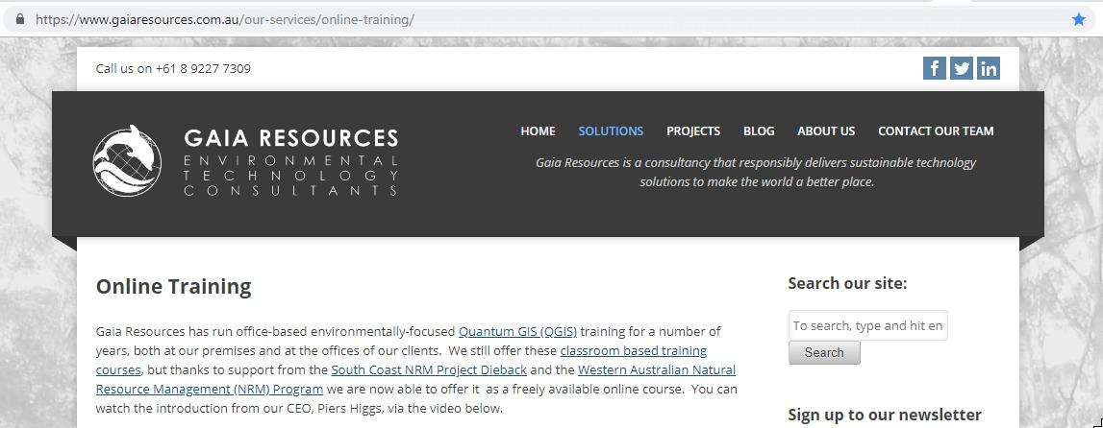
Online Course
There are different QGIS courses you can find online such as:
Environmental QGIS Training from Gaia Resources:
https://www.gaiaresources.com.au/our-services/online-training/
It is a self-paced course you can follow on YouTube:
https://www.youtube.com/playlist?list=PLfInsSYJw1lQ_vii1wxePr7aKqBOziKVQ

Slide 26
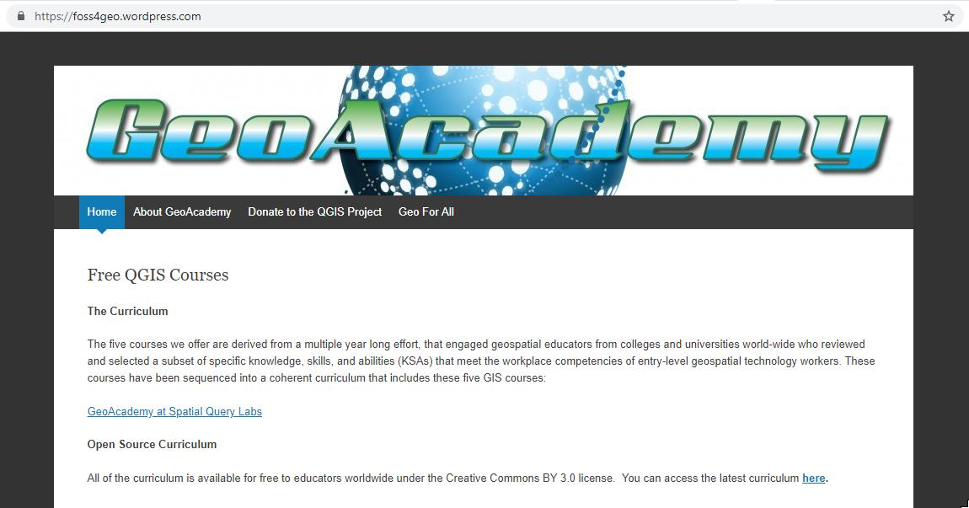
Online Course
Free QGIS courses from GeoAcademy:
https://foss4geo.wordpress.com/

Slide 27
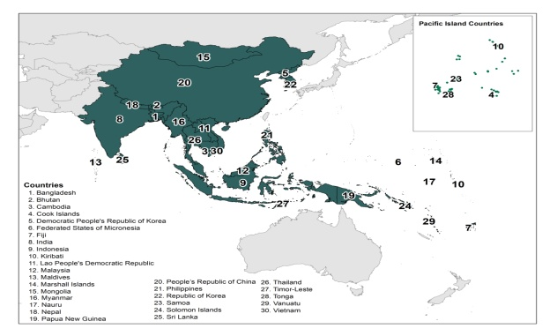
Health GeoLab Collaborative
The Health GeoLab Collaborative is a collective of institutions and individuals sharing the same vision and willing to engage their respective skills, experience, network and/or resources to achieve it.
Vision:
For the 30 low and middle income countries in Asia and the Pacific to fully benefit from the power of geography, geospatial data, and technologies to reach the health related Sustainable Development Goal of healthy lives and well-being for all (SDG 3).
Mission:
Facilitate the implementation of the HIS geo-enabling framework across low and middle income countries in Asia and the Pacific.

Slide 28
Health GeoLab Collaborative
Members
The Collaborative strives to have members representing the full range of stakeholders involved in activities promoting and/or strengthening the use of geospatial data and technologies in the health sector in countries across Asia and the Pacific (government, development partners, private sector, academic institutions and open community).
Membership is free and any institution or individual based in/having activities in Asia and the Pacific who shares the HGLC's vision and ready to contribute to its mission can be a
Member of the HGLC

Slide 29
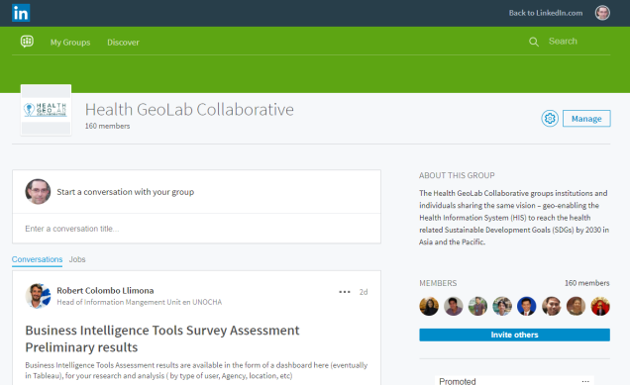
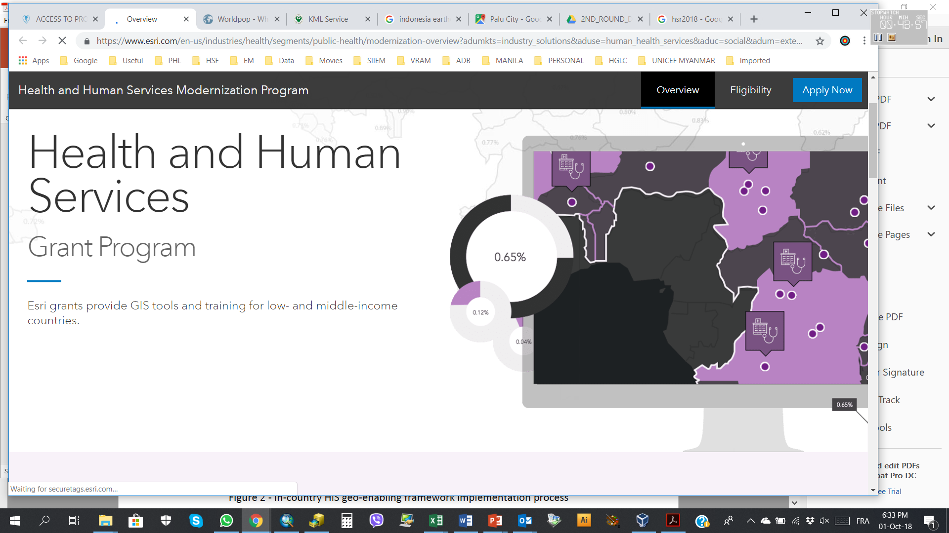
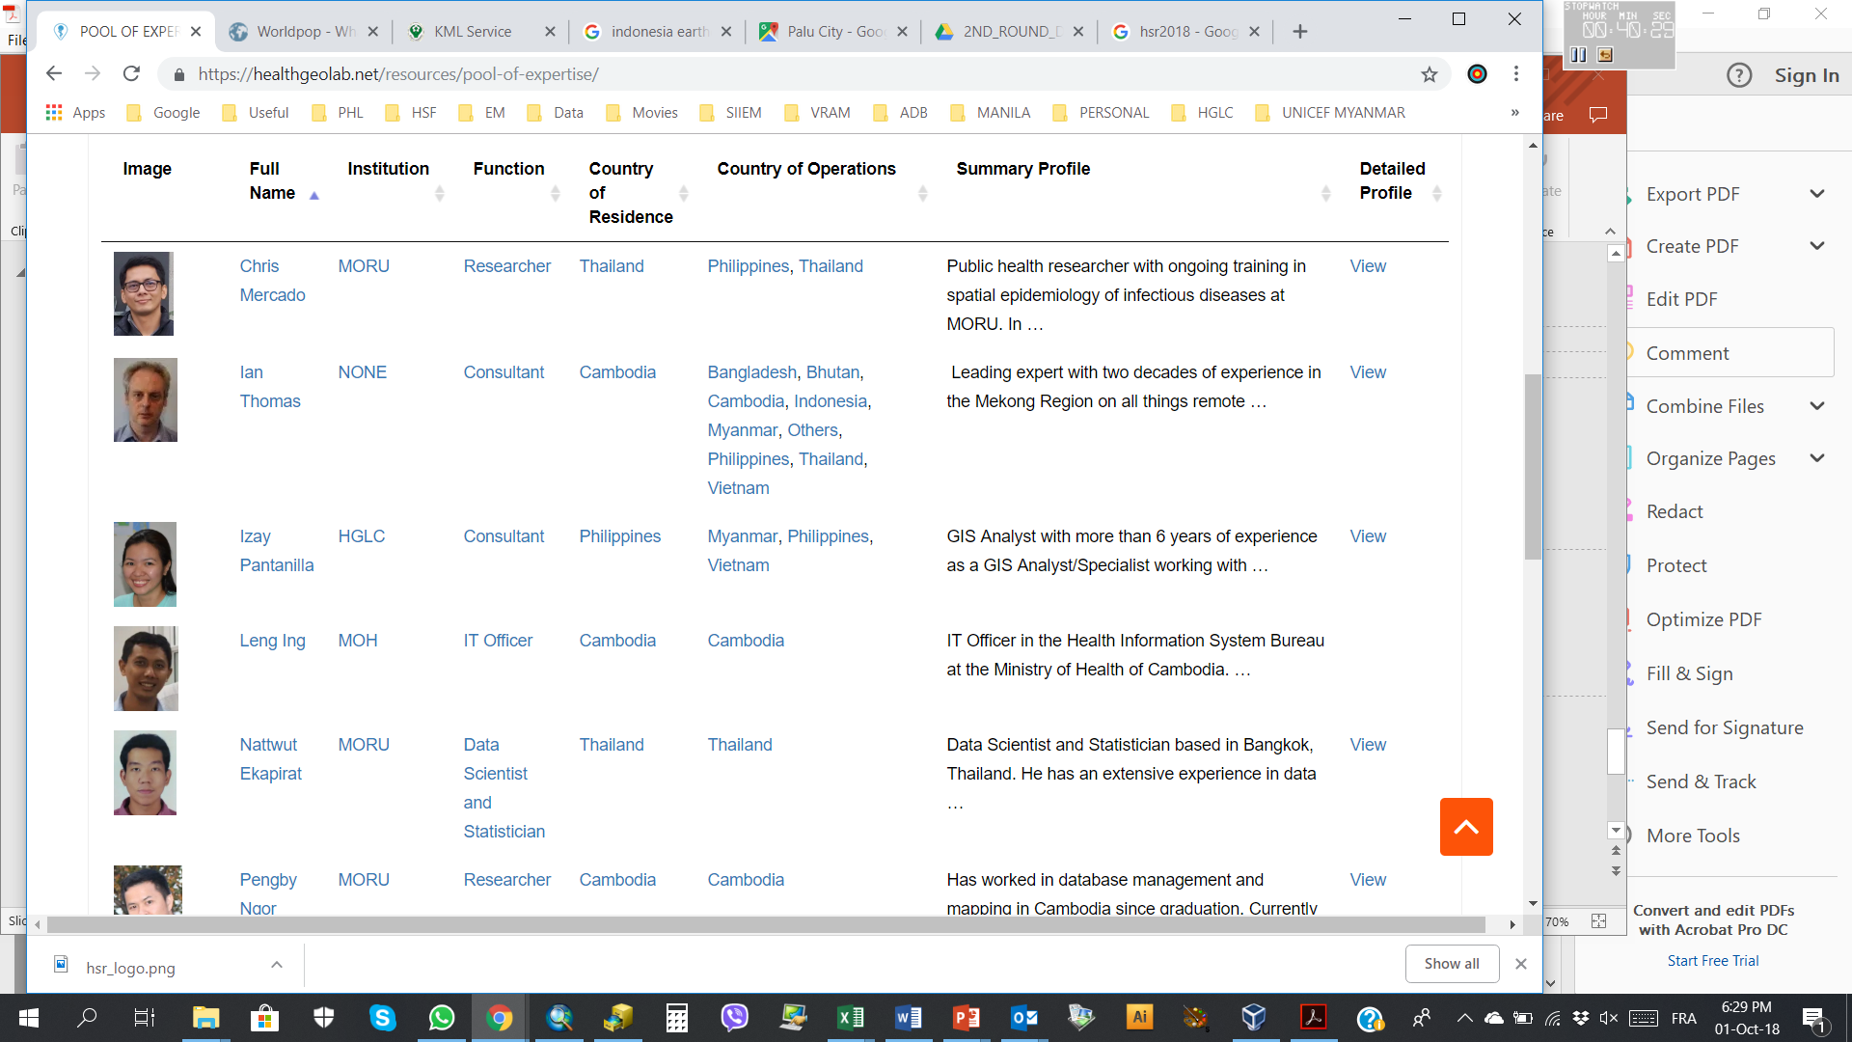
Health GeoLab Collaborative
Resources
Guidance
Reference material (guidelines, starter kits, toolkits)
Knowledge repository (79 resources pertaining to the 9 elements of the HIS geo-enabling framework
Network (LinkedIn, 205 members)
Training material (all the material from 3 training, this one to be added, HIS geo-enabling curriculum being created)
Access to GIS technology (Esri grants and bundles for low and middle income countries)
Pool of expertise (HIS “geo-enablers” based or working in Asia and Pacific)
Starter kit
Knowledge repository
Network
Technology
Pool of expertise

Slide 30
Health GeoLab Collaborative
Join us (membership is free)…
https://healthgeolab.net/join-us/
…contact us…
info@healthgeolab.net
…or visit us
Internet: healthgeolab.net
https://www.linkedin.com/groups/10311235

Slide 31
Esri Health and Human Services Grant Program and Discounted Bundles
This grant allows Ministries of Health of eligible countries to freely use the following Esri’s technology for a period of two years:
5 ArcGIS Pro Basic licenses (term, single use)
3 extensions (spatial analyst, network analyst, geostatistical analyst) single use per core desktop license
ArcGIS Online via the typical desktop entitlement
Visit this link for more information about this grant, find out if your country is eligible, and to apply: https://bit.ly/2PjysU1
Esri also offers discounted bundles with which you will get:
1 perpetual ArcGIS desktop license with 3 extensions
ArcGIS Online subscription for 1 year
Please contact us at info@healthgeolab.net for more information.

Slide 32
Thank you!
Thank you to everyone.
We hope that you have learned a lot from this training workshop and will continue to practice and apply what you have learned with your respective programs.

